Slide 1
What is Java:
Java is a programming language and a platform. Java is a high level, robust, object-oriented and secure programming language.
Java was developed by Sun Microsystems (which is now the subsidiary of Oracle) in the year 1995. James Gosling is known as the father of Java. Before Java, its name was Oak. Since Oak was already a registered company, so James Gosling and his team changed the name from Oak to Java.
Platform: Any hardware or software environment in which a program runs, is known as a platform. Since Java has a runtime environment (JRE) and API, it is called a platform.

Slide 2




Slide 3
Editions of Java:
Java Standard Editions (JSE): It is used to create programs for a desktop computer.
Java Enterprise Edition (JEE): It is used to create large programs that run on the server and manages heavy traffic and complex transactions.
Java Micro Edition (JME): It is used to develop applications for small devices such as set-top boxes, phone, and appliances.

Slide 4
Types of Java Applications:
Standalone Applications: Java standalone applications uses GUI components such as AWT, Swing, and JavaFX. These components contain buttons, list, menu, scroll panel, etc. It is also known as desktop alienations.
Enterprise Applications: An application which is distributed in nature is called enterprise applications.
Web Applications: An applications that run on the server is called web applications. We use JSP, Servlet, Spring, and Hibernate technologies for creating web applications.
Mobile Applications: Java ME is a cross-platform to develop mobile applications which run across smartphones. Java is a platform for App Development in Android.

Slide 5
Features of Java:
Simple: Java is a simple language because its syntax is simple, clean, and easy to understand. Complex and ambiguous concepts of C++ are either eliminated or re-implemented in Java. For example, pointer and operator overloading are not used in Java.
Object-Oriented: In Java, everything is in the form of the object. It means it has some data and behavior. A program must have at least one class and object.
Robust: Java makes an effort to check error at run time and compile time. It uses a strong memory management system called garbage collector. Exception handling and garbage collection features make it strong.
Secure: Java is a secure programming language because it has no explicit pointer and programs runs in the virtual machine. Java contains a security manager that defines the access of Java classes.

Slide 6
Contd..
Platform-Independent: Java provides a guarantee that code writes once and run anywhere. This byte code is platform-independent and can be run on any machine.
Portable: Java Byte code can be carried to any platform. No implementation-dependent features. Everything related to storage is predefined, for example, the size of primitive data types.
High Performance: Java is an interpreted language. Java enables high performance with the use of the Just-In-Time compiler.
Distributed: Java also has networking facilities. It is designed for the distributed environment of the internet because it supports TCP/IP protocol. It can run over the internet. EJB and RMI are used to create a distributed system.
Multi-threaded: Java also supports multi-threading. It means to handle more than one job a time.

Slide 7
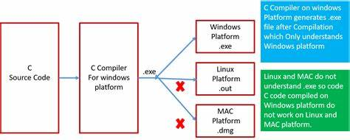

Slide 8
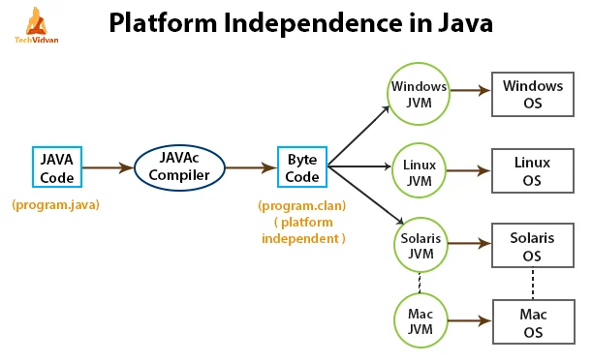

Slide 9
Comparison Index | C++ | Java
Platform-independent | C++ is platform-dependent. | Java is platform-independent.
Mainly used for | C++ is mainly used for system programming. | Java is mainly used for application programming. It is widely used in Windows-based, web-based, enterprise, and mobile applications.
Design Goal | C++ was designed for systems and applications programming. It was an extension of the C programming language. | Java was designed and created as an interpreter for printing systems but later extended as a support network computing. It was designed to be easy to use and accessible to a broader audience.
Multiple inheritance | C++ supports multiple inheritance. | Java doesn't support multiple inheritance through class. It can be achieved by using interfaces in java.
Pointers | C++ supports pointers. You can write a pointer program in C++. | Java supports pointer internally. However, you can't write the pointer program in java. It means java has restricted pointer support in java.
Compiler and Interpreter | C++ uses compiler only. C++ is compiled and run using the compiler which converts source code into machine code so, C++ is platform dependent. | Java uses both compiler and interpreter. Java source code is converted into bytecode at compilation time. The interpreter executes this bytecode at runtime and produces output. Java is interpreted that is why it is platform-independent.
Call by Value and Call by reference | C++ supports both call by value and call by reference. | Java supports call by value only. There is no call by reference in java.

Slide 10
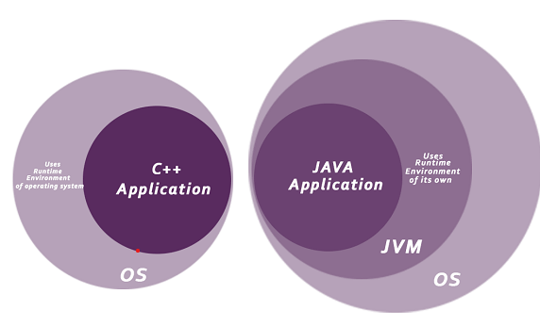
C++ Program:
#include <iostream>
using namespace std;
int main() {
cout << "Hello C++ Programming";
return 0;
}
JAVA Program:
class Simple{
public static void main(String args[]){
System.out.println("Hello Java");
}
}

Slide 11
First Java Program:
For executing any Java program, the following software or application must be properly installed.
Install the JDK if you don't have installed it, download the JDK and install it.
Set path of the jdk/bin directory.
Create the Java program
Compile and run the Java program

Slide 12
Creating the program :
class Simple{
public static void main(String args[]){
System.out.println("Hello Java");
}
}
CMD Commands:
To compile: | javac Simple.java
To execute: | java Simple
Output :
Hello Java

Slide 13
Parameters used in First Java Program:
class keyword is used to declare a class in Java.
public keyword is an access modifier that represents visibility. It means it is visible to all.
static is a keyword. If we declare any method as static, it is known as the static method. The core advantage of the static method is that there is no need to create an object to invoke the static method. The main() method is executed by the JVM, so it doesn't require creating an object to invoke the main() method. So, it saves memory.
void is the return type of the method. It means it doesn't return any value.
main represents the starting point of the program.
String[] args or String args[] is used for command line argument.
System.out.println() is used to print statement. Here, System is a class, out is an object of the PrintStream class, println() is a method of the PrintStream class.

Slide 14
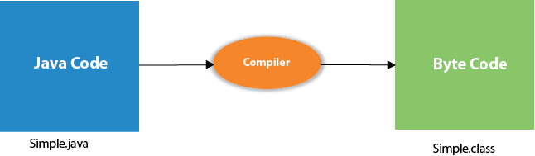
Program Internal :
At compile time, the Java file is compiled by Java Compiler (It does not interact with OS) and converts the Java code into bytecode.

Slide 15
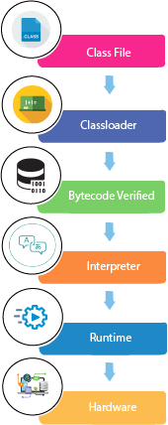
At runtime, the following steps are performed:
Classloader: It is the subsystem of JVM that is used to load class files.
Bytecode Verifier: Checks the code fragments for illegal code that can violate access rights to objects.
Interpreter: Read bytecode stream then execute the instructions.

Slide 16
Can you save a Java source file by
another name than the class name ?

Slide 17

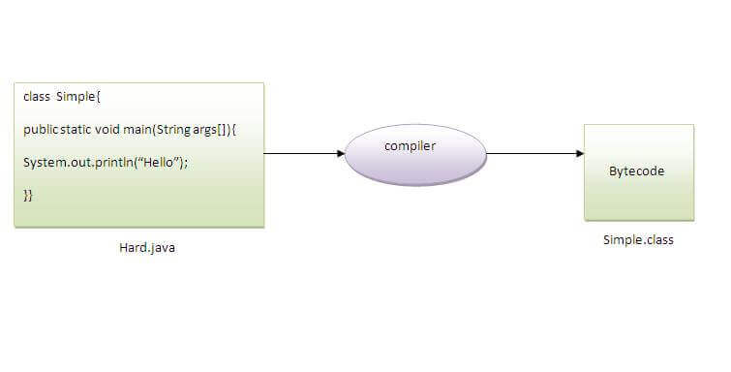
Yes, if the class is not public.
To compile: | javac Hard.java
To execute: | java Simple

Slide 18
Can you have multiple
classes in a java source file ?

Slide 19
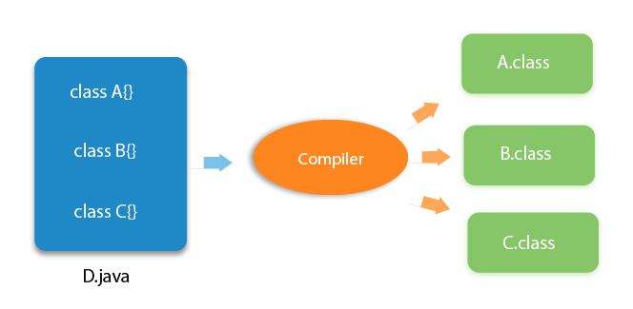

Slide 20
JDK, JRE, and JVM
JDK (Java Development Kit): A software package that provides tools for developing, compiling,
and running Java applications. It includes the Java compiler, debugger, and other development
utilities.
JVM (Java Virtual Machine): A virtual machine that executes Java bytecode, allowing Java
applications to run on different platforms without modification. It provides runtime environment for Java applications.
JRE (Java Runtime Environment): A subset of the JDK, the JRE includes the JVM and essential
libraries required to run Java applications. It's used for executing Java programs without the
need for development tools.

Slide 21
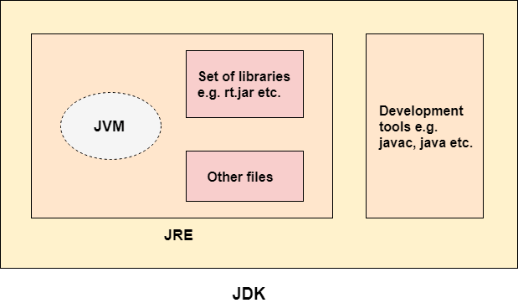

Slide 22
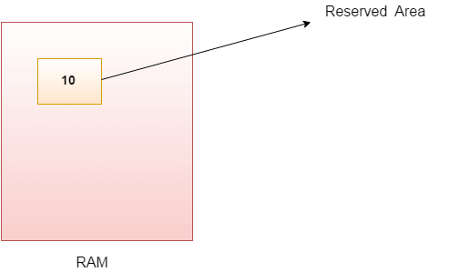
Java Variables :
A variable is the name of a reserved area allocated in memory. In other words, it is a name of the memory location. It is a combination of "vary + able" which means its value can be changed.

Slide 23
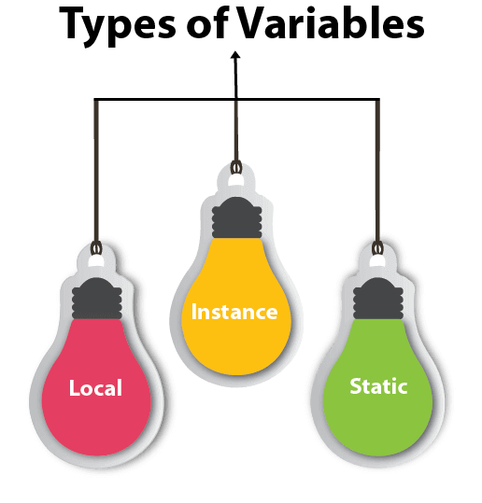
int data = 50; //Here data is variable

Slide 24
Local Variable: A local variable is declared within a method, constructor, or a block of code. It exists only within the scope of that method, meaning it can be accessed and used only within that method. Once the method execution is complete, the local variable's memory is reclaimed. Local variables must be initialized before they are used.
Instance Variable: Also known as non-static or member variables, instance variables are declared within a class but outside any method. They hold data that is unique to each instance (object) of the class. These variables have a separate memory location for each object created from the class. Instance variables are accessible through object references and can have different values for different objects.
Static Variable: Also called a class variable, a static variable is associated with the class rather than with any particular instance of the class. It is declared using the static keyword. Static variables are shared among all instances of the class. They are stored in a single memory location throughout the program's execution.

Slide 25
Understand the types of variables in java
public class A
{
static int m=100; //static variable
void method()
{
int n=90; //local variable
}
public static void main(String args[])
{
int data=50; //instance variable
}
} //end of class

Slide 26
Add Two Numbers :
public class Simple{
public static void main(String[] args){
int a=10;
int b=10;
int c = a+b;
System.out.println(c);
}
}

Slide 27
Data Types in Java :
Java is a statically-typed programming language. It means, all variables must be declared before its use. That is why we need to declare variable's type and name.
Data types specify the different sizes and values that can be stored in the variable. There are two types of data types in Java:
Primitive data types: The primitive data types include boolean, char, byte, short, int, long, float and double.
Non-primitive data types: The non-primitive data types include Classes, Interfaces, and Arrays.

Slide 28
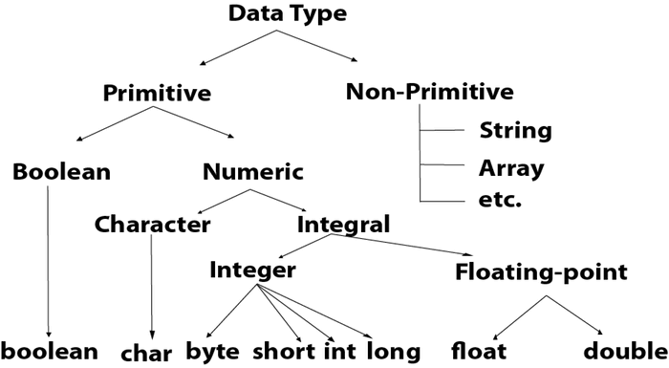

Slide 29
Default Value and Size :
Data Type | Default Value | Default size
boolean | false | 1 bit
char | '\u0000' | 2 byte
byte | 0 | 1 byte
short | 0 | 2 byte
int | 0 | 4 byte
long | 0L | 8 byte
float | 0.0f | 4 byte
double | 0.0d | 8 byte

Slide 30
Boolean one = false //The Boolean data type is used to store only two possible values: true and false. This data type is used for simple flags that track true/false conditions.
byte a = 10, byte b = -20 //4 times smaller than an integer
3. short s = 10000, short r = -5000 //2 times smaller than an integer.
int a = 100000, int b = -200000 //The int data type is generally used as a default data type for integral values unless if there is no problem about memory.
long a = 100000L, long b = -200000L //The long data type is used when you need a range of values more than those provided by int.
float f1 = 234.5f //The float data type is a single-precision 32-bit floating point. The float data type should never be used for precise values, such as currency. Its default value is 0.0F.
double d1 = 12.3 //The double data type is a double-precision 64-bit floating point.
char letterA = 'A’ //The char data type is a single 16-bit Unicode character.

Slide 31
Operator Type | Category | Precedence
Unary | postfix | expr++ expr--
 | prefix | ++expr --expr +expr -expr ~ !
Arithmetic | multiplicative | * / %
 | additive | + -
Shift | shift | << >> >>>
Relational | comparison | < > <= >= instanceof
 | equality | == !=
Bitwise | bitwise AND | &
 | bitwise exclusive OR | ^
 | bitwise inclusive OR | |
Logical | logical AND | &&
 | logical OR | ||
Ternary | ternary | ? :
Assignment | assignment | = += -= *= /= %= &= ^= |= <<= >>= >>>=

Slide 32
Bitwise v/s Logical Operators :
logical operators work on boolean expressions and return boolean values (either true or false), whereas bitwise operators work on binary digits of integer values (long, int, short, char, and byte) and return an integer.

Slide 33
Unary Operator Examples :
public class OperatorExample{
public static void main(String args[]){
int x=10;
System.out.println(x++);//10 (11)
System.out.println(++x);//12
System.out.println(x--);//12 (11)
System.out.println(--x);//10
}}
public class OperatorExample{
public static void main(String args[]){
int a=10;
int b=10;
System.out.println(a++ + ++a);//10+12=22
System.out.println(b++ + b++);//10+11=21
}}

Slide 34
Arithmetic Operations :
public class OperatorExample{
public static void main(String args[]){
int a=10;
int b=5;
System.out.println(a+b);//15
System.out.println(a-b);//5
System.out.println(a*b);//50
System.out.println(a/b);//2
System.out.println(a%b);//0
}}
public class OperatorExample{
public static void main(String args[]){
System.out.println(10*10/5+3-1*4/2);
}}

Slide 35
Logical && vs Bitwise & :
public class OperatorExample{
public static void main(String args[]){
int a=10;
int b=5;
int c=20;
System.out.println(a<b&&a++<c);//false && true = false
System.out.println(a);//10 because second condition is not checked
System.out.println(a<b&a++<c);//false && true = false
System.out.println(a);//11 because second condition is checked
}}

Slide 36
Ternary Operator :
public class OperatorExample{
public static void main(String args[]){
int a=2;
int b=5;
int min=(a<b)?a:b;
System.out.println(min);
}}

Slide 37
Assignment Operator :
public class OperatorExample{
public static void main(String[] args){
int a=10;
a+=3;//10+3
System.out.println(a);
a-=4;//13-4
System.out.println(a);
a*=2;//9*2
System.out.println(a);
a/=2;//18/2
System.out.println(a);
}}

Slide 38
Adding Short :
public class OperatorExample{
public static void main(String args[]){
short a=10;
short b=10;
a=a+b;
System.out.println(a);
}}

Slide 39
Previous code has a compilation error because when you add two short values (a and b), the result is promoted to an int by default. To fix this, we can explicitly cast the result back to a short like this: a = (short)(a + b);.
After type cast:
public class OperatorExample{
public static void main(String args[]){
short a=10;
short b=10;
a=(short)(a+b);//20 which is int now converted to short
System.out.println(a);
System.out.println(((Object) (a+b)).getClass().getName());
}}

Slide 40
Control Statements
Java provides three types of control flow statements.
Decision Making statements
if statements
switch statement
Loop statements
do while loop
while loop
for loop
for-each loop
Jump statements
break statement
continue statement

Slide 41
if statements
The control of the program is diverted depending upon the specific condition. The condition of the If statement gives a Boolean value, either true or false. In Java, there are four types of if-statements given below.
Simple if statement
if-else statement
if-else-if ladder
Nested if-statement

Slide 42
if-else statement
public class Student {
public static void main(String[] args) {
int x = 10;
int y = 12;
if(x+y < 10) {
System.out.println("x + y is less than 10");
} else {
System.out.println("x + y is greater than 20");
}
}
}

Slide 43
if-else-if ladder
public class Student {
public static void main(String[] args) {
String city = "Delhi";
if(city == "Meerut") {
System.out.println("city is meerut");
}else if (city == "Noida") {
System.out.println("city is noida");
}else if(city == "Agra") {
System.out.println("city is agra");
}else {
System.out.println(city);
}
}
}

Slide 44
Nested if-statement
public class NestedIfElseExample { public static void main(String[] args) { int num = 10; if (num > 0) { if (num % 2 == 0) { System.out.println("The number is positive and even."); } else { System.out.println("The number is positive and odd."); } } else if (num < 0) { System.out.println("The number is negative."); } else { System.out.println("The number is zero."); } } }
public class Student {
public static void main(String[] args) {
String address = "Delhi, India";
if(address.endsWith("India")) {
if(address.contains("Meerut")) {
System.out.println("Your city is Meerut");
}else if(address.contains("Noida")) {
System.out.println("Your city is Noida");
}else {
System.out.println(address.split(",")[0]);
}
}else {
System.out.println("You are not living in India");
}
}
}

Slide 45
Switch Statement :
In Java, Switch statements are similar to if-else-if statements. The switch statement contains multiple blocks of code called cases and a single case is executed based on the variable which is being switched. The switch statement is easier to use instead of if-else-if statements. It also enhances the readability of the program.
Points to be noted about switch statement:
The case variables can be int, short, byte, char, or enumeration. String type is also supported since version 7 of Java
Cases cannot be duplicate
Default statement is executed when any of the case doesn't match the value of expression. It is optional.
Break statement terminates the switch block when the condition is satisfied. It is optional, if not used, next case is executed.
While using switch statements, we must notice that the case expression will be of the same type as the variable. However, it will also be a constant value.

Slide 46
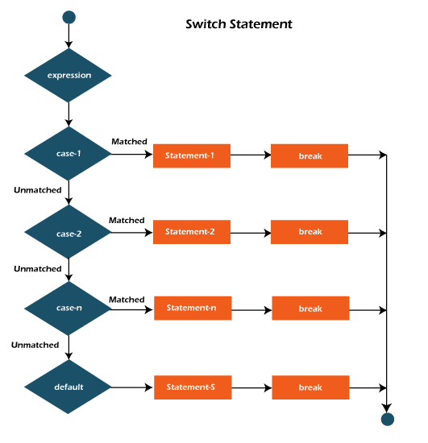

Slide 47
public class Student implements Cloneable {
public static void main(String[] args) {
int num = 2;
switch (num){
case 0:
System.out.println("number is 0");
break;
case 1:
System.out.println("number is 1");
break;
default:
System.out.println(num);
}
}
}

Slide 48
public class SwitchExample { public static void main(String[] args) { int day = 3; String dayName; switch (day) { case 1: dayName = "Monday"; break; case 2: dayName = "Tuesday"; break; case 3: dayName = "Wednesday"; break; case 4: dayName = "Thursday"; break;
case 5: dayName = "Friday"; break; case 6: dayName = "Saturday"; break; case 7: dayName = "Sunday"; break; default: dayName = "Invalid day"; break; } System.out.println("Day " + day + " is " + dayName); } }

Slide 49
Loops in Java :
1. Java Simple for Loop
A simple for loop is the same as C/C++. We can initialize the variable, check condition and increment/decrement value. It consists of four parts:
Initialization: It is the initial condition which is executed once when the loop starts. Here, we can initialize the variable, or we can use an already initialized variable. It is an optional condition.
Condition: It is the second condition which is executed each time to test the condition of the loop. It continues execution until the condition is false. It must return boolean value either true or false. It is an optional condition.
Increment/Decrement: It increments or decrements the variable value. It is an optional condition.
Statement: The statement of the loop is executed each time until the second condition is false.

Slide 50
Syntax:
for(initialization; condition; increment/decrement){
//statement or code to be executed
}
Java Program to demonstrate the example of for loop
which prints table of 1
public class ForExample {
public static void main(String[] args) {
//Code of Java for loop
for(int i=1;i<=10;i++){
System.out.println(i);
}
}
}

Slide 51
Java Nested for Loop:
If we have a for loop inside the another loop, it is known as nested for loop. The inner loop executes completely whenever outer loop executes.
public class NestedForExample {
public static void main(String[] args) {
//loop of i
for(int i=1;i<=3;i++){
//loop of j
for(int j=1;j<=3;j++){
System.out.println(i+" "+j);
}//end of i
}//end of j
}
}

Slide 52
Java for-each Loop:
The for-each loop is used to traverse array or collection in Java. It is easier to use than simple for loop because we don't need to increment value and use subscript notation.
It works on the basis of elements and not the index. It returns element one by one in the defined variable.
Syntax:
for(data_type variable : array_name){
//code to be executed
}

Slide 53
Java For-each loop example which prints the elements of the array
public class ForEachExample {
public static void main(String[] args) {
//Declaring an array
int arr[]={12,23,44,56,78};
//Printing array using for-each loop
for(int i:arr){
System.out.println(i);
}
}
}

Slide 54
Java Labeled For Loop:
We can have a name of each Java for loop. To do so, we use label before the for loop. It is useful while using the nested for loop as we can break/continue specific for loop.
The break and continue keywords breaks or continues the innermost for loop respectively.
Syntax:
labelname:
for(initialization; condition; increment/decrement){
//code to be executed
}

Slide 55
public class LabeledForExample {
public static void main(String[] args) {
//Using Label for outer and for loop
aa:
for(int i=1;i<=3;i++){
bb:
for(int j=1;j<=3;j++){
if(i==2&&j==2){
break aa;
}
System.out.println(i+" "+j);
}
}
}
}

Slide 56
Java Infinitive for Loop:
If you use two semicolons ;; in the for loop, it will be infinitive for loop.
Syntax:
public class ForExample {
public static void main(String[] args) {
//Using no condition in for loop
for(;;){
System.out.println("infinitive loop");
}
}
}
for(;;){
//code to be executed
}

Slide 57
Java While Loop:
The Java while loop is used to iterate a part of the program repeatedly until the specified Boolean condition is true. As soon as the Boolean condition becomes false, the loop automatically stops.
The while loop is considered as a repeating if statement. If the number of iteration is not fixed, it is recommended to use the while loop.
Syntax:
while (condition){
//code to be executed
I ncrement / decrement statement
}

Slide 58
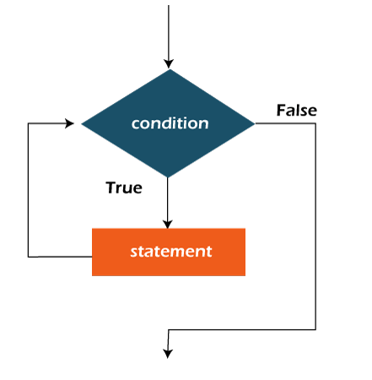
public class WhileExample {
public static void main(String[] args) {
int i=1;
while(i<=10){
System.out.println(i);
i++;
}
}
}

Slide 59
Java Infinitive While Loop:
If you pass true in the while loop, it will be infinitive while loop.
public class WhileExample2 {
public static void main(String[] args) {
while(true){
System.out.println("infinitive while loop");
}
}
}
Syntax:
while(true){
//code to be executed
}

Slide 60
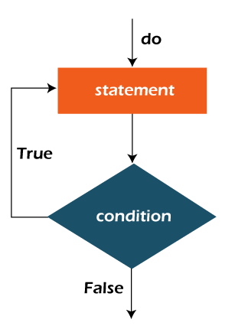
Java do-while Loop:
The Java do-while loop is used to iterate a part of the program repeatedly, until the specified condition is true. If the number of iteration is not fixed and you must have to execute the loop at least once, it is recommended to use a do-while loop.
Syntax:
do{
//code to be executed / loop body
//update statement
}while (condition);

Slide 61
Java Infinitive do-while Loop:
If you pass true in the do-while loop, it will be infinitive do-while loop.
public class DoWhileExample {
public static void main(String[] args) {
int i=1;
do{
System.out.println(i);
i++;
}while(i<=10);
}
public class DoWhileExample2 {
public static void main(String[] args) {
do{
System.out.println("infinitive do while loop");
}while(true);
}
}

Slide 62
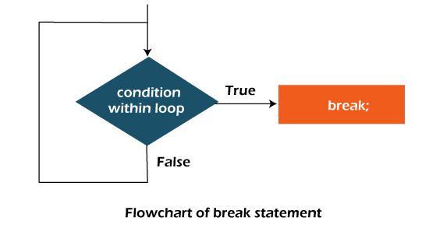
Java Break Statement:
When a break statement is encountered inside a loop, the loop is immediately terminated and the program control resumes at the next statement following the loop.
The Java break statement is used to break loop or switch statement. It breaks the current flow of the program at specified condition. In case of inner loop, it breaks only inner loop.
We can use Java break statement in all types of loops such as for loop, while loop and do-while loop.

Slide 63
Java Break Statement with Loop:
public class BreakExample {
public static void main(String[] args) {
//using for loop
for(int i=1;i<=10;i++){
if(i==5){
//breaking the loop
break;
}
System.out.println(i);
}
}
}

Slide 64
Java Break Statement with Inner Loop
public class BreakExample2 {
public static void main(String[] args) {
//outer loop
for(int i=1;i<=3;i++){
//inner loop
for(int j=1;j<=3;j++){
if(i==2&&j==2){
//using break statement inside the inner loop
break;
}
System.out.println(i+" "+j);
}
}
}
}

Slide 65
Java Break Statement in while loop
public class BreakWhileExample {
public static void main(String[] args) {
//while loop
int i=1;
while(i<=10){
if(i==5){
//using break statement
i++;
break;//it will break the loop
}
System.out.println(i);
i++;
}
}
}

Slide 66
Java Break Statement in do-while loop
public class BreakDoWhileExample {
public static void main(String[] args) {
//declaring variable
int i=1;
//do-while loop
do{
if(i==5){
//using break statement
i++;
break;//it will break the loop
}
System.out.println(i);
i++;
}while(i<=10);
}
}

Slide 67
Java Continue Statement:
The continue statement is used in loop control structure when you need to jump to the next iteration of the loop immediately. It can be used with for loop or while loop.
The Java continue statement is used to continue the loop. It continues the current flow of the program and skips the remaining code at the specified condition. In case of an inner loop, it continues the inner loop only.
We can use Java continue statement in all types of loops such as for loop, while loop and do-while loop.

Slide 68
Java Program to demonstrate the use of continue statement inside the for loop:
public class ContinueExample {
public static void main(String[] args) {
//for loop
for(int i=1;i<=10;i++){
if(i==5){
//using continue statement
continue;//it will skip the rest statement
}
System.out.println(i);
}
}
}

Slide 69
Java Continue Statement with Labelled For Loop
We can use continue statement with a label. This feature is introduced since JDK 1.5. So, we can continue any loop in Java now whether it is outer loop or inner.
public class ContinueExample3 {
public static void main(String[] args) {
aa:
for(int i=1;i<=3;i++){
bb:
for(int j=1;j<=3;j++){
if(i==2&&j==2){
//using continue statement with label
continue aa;
}
System.out.println(i+" "+j);
}
}
}
}

Slide 70
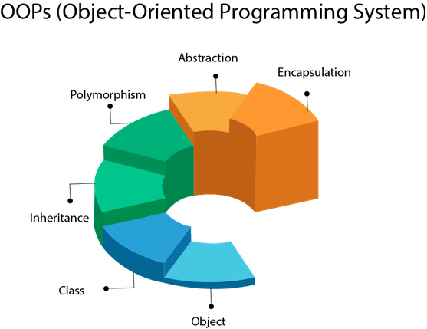
OOPs (Object-Oriented Programming
System)
Object means a real-world entity such as a pen, chair, table, computer, watch, etc. Object-Oriented Programming is a methodology or paradigm to design a program using classes and objects. It simplifies software development and maintenance by providing some concepts:

Slide 71
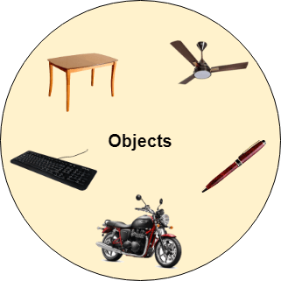
Object:
Any entity that has state and behavior is known as an object. For example, a chair, pen, table, keyboard, bike, etc. It can be physical or logical.
An Object can be defined as an instance of a class. An object contains an address and takes up some space in memory. Objects can communicate without knowing the details of each other's data or code. The only necessary thing is the type of message accepted and the type of response returned by the objects.
Example: A dog is an object because it has states like color, name, breed, etc. as well as behaviors like wagging the tail, barking, eating, etc.

Slide 72
Class | Collection of objects is called class. It is a logical entity. A class can also be defined as a blueprint from which you can create an individual object. Class doesn't consume any space.
Inheritance | When one object acquires all the properties and behaviors of a parent object, it is known as inheritance. It provides code reusability. It is used to achieve runtime polymorphism.
Polymorphism | If one task is performed in different ways, it is known as polymorphism. For example: to convince the customer differently, to draw something, for example, shape, triangle, rectangle, etc. In Java, we use method overloading and method overriding to achieve polymorphism. Another example can be to speak something; for example, a cat speaks meow, dog barks woof, etc.
Abstraction | Hiding internal details and showing functionality is known as abstraction. For example phone call, we don't know the internal processing. In Java, we use abstract class and interface to achieve abstraction.

Slide 73
Encapsulation | Binding (or wrapping) code and data together into a single unit are known as encapsulation. For example, a capsule, it is wrapped with different medicines. A java class is the example of encapsulation. Java bean is the fully encapsulated class because all the data members are private here.
Coupling | Coupling refers to the knowledge or information or dependency of another class. It arises when classes are aware of each other. If a class has the details information of another class, there is strong coupling. In Java, we use private, protected, and public modifiers to display the visibility level of a class, method, and field. You can use interfaces for the weaker coupling because there is no concrete implementation.
Cohesion | Cohesion refers to the level of a component which performs a single well-defined task. A single well-defined task is done by a highly cohesive method. The weakly cohesive method will split the task into separate parts. The java.io package is a highly cohesive package because it has I/O related classes and interface. However, the java.util package is a weakly cohesive package because it has unrelated classes and interfaces.

Slide 74
Association | Association represents the relationship between the objects. Here, one object can be associated with one object or many objects. There can be four types of association between the objects: One to One One to Many Many to One, and Many to Many
Aggregation | Aggregation is a way to achieve Association. Aggregation represents the relationship where one object contains other objects as a part of its state. It represents the weak relationship between objects. It is also termed as a has-a relationship in Java. Like, inheritance represents the is-a relationship. It is another way to reuse objects.
Composition | The composition is also a way to achieve Association. The composition represents the relationship where one object contains other objects as a part of its state. There is a strong relationship between the containing object and the dependent object. It is the state where containing objects do not have an independent existence. If you delete the parent object, all the child objects will be deleted automatically.

Slide 75
Advantage of OOPs over Procedure-oriented programming language
OOPs makes development and maintenance easier, whereas, in a procedure-oriented programming language, it is not easy to manage if code grows as project size increases.
OOPs provides data hiding, whereas, in a procedure-oriented programming language, global data can be accessed from anywhere.
OOPs provides the ability to simulate real-world event much more effectively. We can provide the solution of real word problem if we are using the Object-Oriented Programming language.

Slide 76
Naming Conventions of the Different Identifiers
Identifiers Type | Naming Conventions | Examples
Class | It should start with the uppercase letter. It should be a noun such as Color, Button, System, Thread, etc. Use appropriate words, instead of acronyms. | public class Employee { //code snippet }
Interface | It should start with the uppercase letter. It should be an adjective such as Runnable, Remote, ActionListener. Use appropriate words, instead of acronyms. | interface Printable { //code snippet }
Method | It should start with lowercase letter. It should be a verb such as main(), print(), println(). If the name contains multiple words, start it with a lowercase letter followed by an uppercase letter such as actionPerformed(). | class Employee { // method void draw() { //code snippet } }

Slide 77
Variable | It should start with a lowercase letter such as id, name. It should not start with the special characters like & (ampersand), $ (dollar), _ (underscore). If the name contains multiple words, start it with the lowercase letter followed by an uppercase letter such as firstName, lastName. Avoid using one-character variables such as x, y, z. | class Employee { // variable int id; //code snippet }
Package | It should be a lowercase letter such as java, lang. If the name contains multiple words, it should be separated by dots (.) such as java.util, java.lang. | //package package com.javatpoint; class Employee { //code snippet }
Constant | It should be in uppercase letters such as RED, YELLOW. If the name contains multiple words, it should be separated by an underscore(_) such as MAX_PRIORITY. It may contain digits but not as the first letter. | class Employee { //constant static final int MIN_AGE = 18; //code snippet }

Slide 78
CamelCase in Java naming conventions:
Java follows camel-case syntax for naming the class, interface, method, and variable.
If the name is combined with two words, the second word will start with uppercase letter always such as actionPerformed(), firstName, ActionEvent, ActionListener, etc.

Slide 79
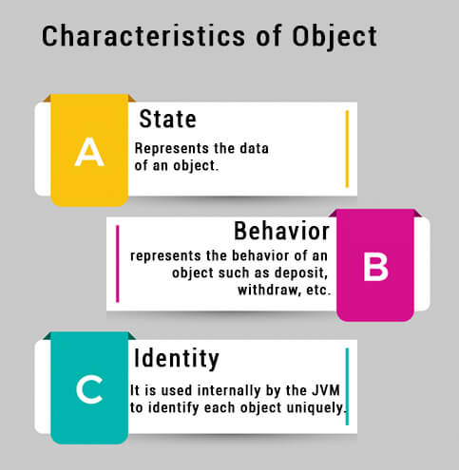
Objects and Classes in Java
Object Definitions:
An object is a real-world entity.
An object is a runtime entity.
The object is an entity which has state and behavior.
The object is an instance of a class.

Slide 80
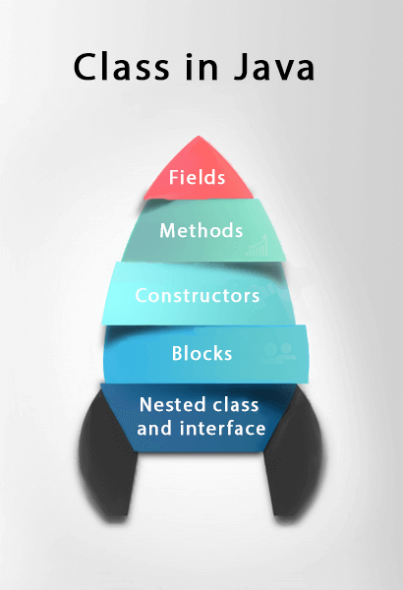
What is a class in Java
A class is a group of objects which have common properties. It is a template or blueprint from which objects are created. It is a logical entity. It can't be physical.
A class in Java can contain:
Fields
Methods
Constructors
Blocks
Nested class and interface
Syntax to declare a class:
class <class_name>{
field;
method;
}

Slide 81
Instance variable in Java :
A variable which is created inside the class but outside the method is known as an instance variable. Instance variable doesn't get memory at compile time. It gets memory at runtime when an object or instance is created. That is why it is known as an instance variable.
Method in Java :
In Java, a method is like a function which is used to expose the behavior of an object.
Advantage of Method
Code Reusability
Code Optimization
new keyword in Java :
The new keyword is used to allocate memory at runtime. All objects get memory in Heap memory area.

Slide 82
Object and Class Example: main within the class
class Student{
//defining fields
int id;//field or data member or instance variable
String name;
//creating main method inside the Student class
public static void main(String args[]){
//Creating an object or instance
Student s1=new Student();//creating an object of Student
//Printing values of the object
System.out.println(s1.id);//accessing member through reference variable
System.out.println(s1.name);
}
}

Slide 83
Object and Class Example: main outside the class
There are 3 ways to initialize object in Java.
By reference variable
By method
By constructor
class Student{
int id;
String name;
}
//Creating another class TestStudent1 which contains the main method
class TestStudent1{
public static void main(String args[]){
Student s1=new Student();
System.out.println(s1.id);
System.out.println(s1.name);
}
}

Slide 84
Object and Class Example: Initialization through reference
class Student{
int id;
String name;
}
class TestStudent3{
public static void main(String args[]){
//Creating objects
Student s1=new Student();
Student s2=new Student();
//Initializing objects
s1.id=101;
s1.name="Sonoo";
s2.id=102;
s2.name="Amit";
//Printing data
System.out.println(s1.id+" "+s1.name);
System.out.println(s2.id+" "+s2.name);
}
}

Slide 85
Object and Class Example: Initialization through method
class Student{
int rollno;
String name;
void insertRecord(int r, String n){
rollno=r;
name=n;
}
void displayInformation(){
System.out.println(rollno+" "+name);
}
}
class TestStudent4{
13. public static void main(String args[]){
14. Student s1=new Student();
15.Student s2=new Student();
16. s1.insertRecord(111,"Karan");
17. s2.insertRecord(222,"Aryan");
18. s1.displayInformation();
19. s2.displayInformation();
20. }
21. }

Slide 86
Object and Class Example: Initialization through a constructor
class Employee{
int id;
String name;
float salary;
void insert(int i, String n, float s) {
id=i;
name=n;
salary=s;
}
void display(){
System.out.println(id+" "+name+" "+
salary);
}
}
public class TestEmployee {
public static void main(String[] args) {
Employee e1=new Employee();
Employee e2=new Employee();
Employee e3=new Employee();
e1.insert(101,"ajeet",45000);
e2.insert(102,"irfan",25000);
e3.insert(103,"nakul",55000);
e1.display();
e2.display();
e3.display();
}
}

Slide 87
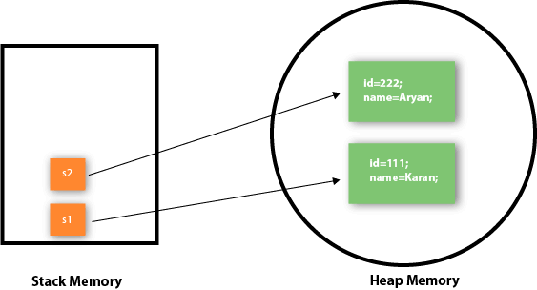
Object gets the memory in heap memory area. The reference variable refers to the object allocated in the heap memory area. Here, s1 and s2 both are reference variables that refer to the objects allocated in memory.

Slide 88
Object and Class Example: Rectangle
class Rectangle{
int length;
int width;
void insert(int l, int w){
length=l;
width=w;
}
void calculateArea(){System.out.println(length*width);}
}
class TestRectangle1{
public static void main(String args[]){
Rectangle r1=new Rectangle();
Rectangle r2=new Rectangle();
r1.insert(11,5);
r2.insert(3,15);
r1.calculateArea();
r2.calculateArea();
}
}

Slide 89
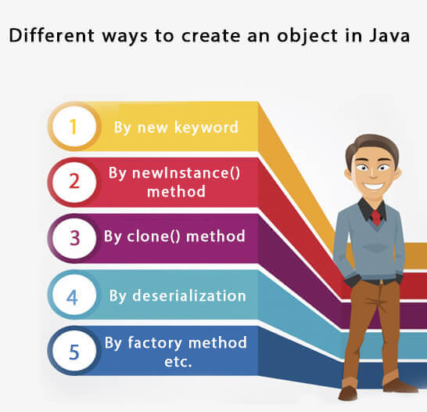

Slide 90
Anonymous object :
Anonymous simply means nameless. An object which has no reference is known as an anonymous object. It can be used at the time of object creation only.
If you have to use an object only once, an anonymous object is a good approach. For example:
new Calculation();//anonymous object
class Calculation{
void fact(int n){
int fact=1;
for(int i=1;i<=n;i++){
fact=fact*i;
}
System.out.println("factorial is "+fact);
}
public static void main(String args[]){
new Calculation().fact(5);//calling method with anonymous object
}
}

Slide 91
Creating multiple objects by one type only
class Rectangle{
int length;
int width;
void insert(int l,int w){
length=l;
width=w;
}
void calculateArea(){System.out.println(length*width);}
}
class TestRectangle2{
public static void main(String args[]){
Rectangle r1=new Rectangle(),r2=new Rectangle();//creating two objects
r1.insert(11,5);
r2.insert(3,15);
r1.calculateArea();
r2.calculateArea();
}
}

Slide 92
Real World Example: Account
//deposit method
void deposit(float amt){
amount=amount+amt;
System.out.println(amt+" deposited");
}
//withdraw method
void withdraw(float amt){
if(amount<amt){
System.out.println("Insufficient Balance");
}else{
amount=amount-amt;
System.out.println(amt+" withdrawn");
}
}
Java Program to demonstrate the working of a
banking-system
class Account{
int acc_no;
String name;
float amount;
//Method to initialize object
void insert(int a,String n,float amt){
acc_no=a;
name=n;
amount=amt;
}

Slide 93
//method to check the balance of the account
void checkBalance(){System.out.println("Balance is: "+amount);}
//method to display the values of an object
void display(){System.out.println(acc_no+" "+name+" "+amount);}
}
//Creating a test class to deposit and withdraw amount
class TestAccount{
public static void main(String[] args){
Account a1=new Account();
a1.insert(832345,"Ankit",1000);
a1.display();
a1.checkBalance();
a1.deposit(40000);
a1.checkBalance();
a1.withdraw(15000);
a1.checkBalance();
}}

Slide 94
Constructors in Java
In Java, a constructor is a block of codes similar to the method. It is called when an instance of the class is created. At the time of calling constructor, memory for the object is allocated in the memory.
It is a special type of method which is used to initialize the object.
Every time an object is created using the new() keyword, at least one constructor is called.
It calls a default constructor if there is no constructor available in the class. In such case, Java compiler provides a default constructor by default.

Slide 95
Rules for creating Java constructor
There are two rules defined for the constructor.
Constructor name must be the same as its class name
A Constructor must have no explicit return type
A Java constructor cannot be abstract, static, final, and synchronized
Note: We can use access modifiers while declaring a constructor. It controls the object creation. In other words, we can have private, protected, public or default constructor in Java.

Slide 96
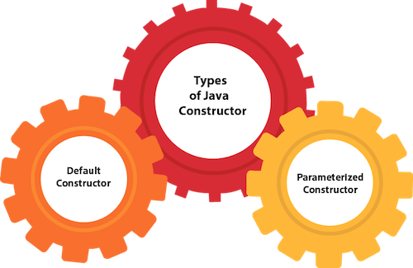

Slide 97
Java Default Constructor
A constructor is called "Default Constructor" when it doesn't have any parameter.
The default constructor is used to provide the default values to the object like 0, null, etc., depending on the type.
If there is no constructor in a class, compiler automatically creates a default constructor.
Syntax of default constructor:
<class_name>(){}
Example of default constructor
class Bike1{
//creating a default constructor
Bike1(){System.out.println("Bike is created");}
//main method
public static void main(String args[]){
//calling a default constructor
Bike1 b=new Bike1();
}
}

Slide 98
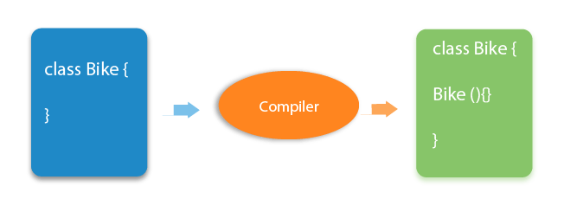

Slide 99
class Student3{
int id;
String name;
//method to display the value of id and name
void display(){System.out.println(id+" "+name);}
public static void main(String args[]){
//creating objects
Student3 s1=new Student3();
Student3 s2=new Student3();
//displaying values of the object
s1.display();
s2.display();
}
}

Slide 100
Java Parameterized Constructor
A constructor which has a specific number of parameters is called a parameterized constructor.
The parameterized constructor is used to provide different values to distinct objects. However, you can provide the same values also.
class Student4{
int id;
String name;
//creating a parameterized constructor
Student4(int i,String n){
id = i;
name = n;
}
//method to display the values
void display(){
System.out.println(id+" "+name);
}
public static void main(String args[]){
//creating objects and passing values
Student4 s1 = new Student4(111,"Karan");
Student4 s2 = new Student4(222,"Aryan");
//calling method to display the values of object
s1.display();
s2.display();
}
}

Slide 101
Java Constructor | Java Method
A constructor is used to initialize the state of an object. | A method is used to expose the behavior of an object.
A constructor must not have a return type. | A method must have a return type.
The constructor is invoked implicitly. | The method is invoked explicitly.
The Java compiler provides a default constructor if you don't have any constructor in a class. | The method is not provided by the compiler in any case.
The constructor name must be same as the class name. | The method name may or may not be same as the class name.

Slide 102
Java Copy Constructor
There is no copy constructor in Java. However, we can copy the values from one object to another like copy constructor in C++.
There are many ways to copy the values of one object into another in Java. They are:
By constructor
By assigning the values of one object into another
By clone() method of Object class

Slide 103
class Student6{
int id;
String name;
//constructor to initialize integer and string
Student6(int i,String n){
id = i;
name = n;
}
//constructor to initialize another object
Student6(Student6 s){
id = s.id;
name =s.name;
}
void display(){System.out.println(id+" "+name);}
public static void main(String args[]){
Student6 s1 = new Student6(111,"Karan");
Student6 s2 = new Student6(s1);
s1.display();
s2.display();
}
}

Slide 104
Copying values without constructor
class Student7{
int id;
String name;
Student7(int i,String n){
id = i;
name = n;
}
Student7(){}
void display(){System.out.println(id+" "+name);}
public static void main(String args[]){
Student7 s1 = new Student7(111,"Karan");
Student7 s2 = new Student7();
s2.id=s1.id;
s2.name=s1.name;
s1.display();
s2.display();
}
}

Slide 105
Does constructor return any value?
Can constructor perform other tasks instead of initialization?

Slide 106
Does constructor return any value?
Yes, it is the current class instance (You cannot use return type yet it returns a value).
Can constructor perform other tasks instead of initialization?
Yes, like object creation, starting a thread, calling a method, etc. You can perform any operation in the constructor as you perform in the method.

Slide 107
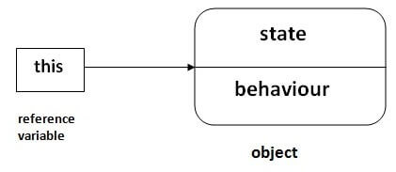
this keyword in Java
This is a reference variable that refers to the current object.
Usage of Java this keyword
6 usage of java this keyword -
this can be used to refer current class instance variable.
this can be used to invoke current class method (implicitly)
this() can be used to invoke current class constructor.
this can be passed as an argument in the method call.
this can be passed as argument in the constructor call.
this can be used to return the current class instance from the method.

Slide 108
1) this: to refer current class instance variable
The this keyword can be used to refer current class instance variable. If there is ambiguity between the instance variables and parameters, this keyword resolves the problem of ambiguity.
class TestThis2{
public static void main(String args[]){
Student s1=new Student(111,"ankit",5000f);
Student s2=new Student(112,"sumit",6000f);
s1.display();
s2.display();
}}
class Student{
int rollno;
String name;
float fee;
Student(int rollno,String name,float fee){
this.rollno=rollno;
this.name=name;
this.fee=fee;
}
void display(){System.out.println(rollno+" "+name+" "+fee);}
}

Slide 109
2) this: to invoke current class method
You may invoke the method of the current class by using the this keyword. If you don't use the this keyword, compiler automatically adds this keyword while invoking the method.
class A{
void m(){System.out.println("hello m");}
void n(){
System.out.println("hello n");
//m();//same as this.m()
this.m();
}
}
class TestThis4{
public static void main(String args[]){
A a=new A();
a.n();
}}

Slide 110
3) this() : to invoke current class constructor
The this() constructor call can be used to invoke the current class constructor. It is used to reuse the constructor. In other words, it is used for constructor chaining.
Rule: Call to this() must be the first statement in constructor.
class A{
A(){System.out.println("hello a");}
A(int x){
this();
System.out.println(x);
}
}
class TestThis5{
public static void main(String args[]){
A a=new A(10);
}}
class A{
A(){
this(5);
System.out.println("hello a");
}
A(int x){
System.out.println(x);
}
}
class TestThis6{
public static void main(String args[]){
A a=new A();
}}

Slide 111
4) this: to pass as an argument in the method
The this keyword can also be passed as an argument in the method. It is mainly used in the event handling.
class S2{
void m(S2 obj){
System.out.println("method is invoked");
}
void p(){
m(this);
}
public static void main(String args[]){
S2 s1 = new S2();
s1.p();
}
}

Slide 112
5) this: to pass as argument in the constructor call
We can pass the this keyword in the constructor also. It is useful if we have to use one object in multiple classes.
class B{
A4 obj;
B(A4 obj){
this.obj=obj;
}
void display(){
System.out.println(obj.data);
//using data member of A4 class
}
}
class A4{
int data=10;
A4(){
B b=new B(this);
b.display();
}
public static void main(String args[]){
A4 a=new A4();
}
}

Slide 113
6) this keyword can be used to return current class instance
We can return this keyword as an statement from the method. In such case, return type of the method must be the class type (non-primitive).
class A{
A getA(){
return this;
}
void msg(){System.out.println("Hello java");}
}
class Test1{
public static void main(String args[]){
new A().getA().msg();
}
}
Syntax of this that can be returned as a statement
return_type method_name(){
return this;
}

Slide 114
Inheritance in Java
Inheritance in Java is a mechanism in which one object acquires all the properties and behaviors of a parent object. It is an important part of OOPs (Object Oriented programming system).
Why use inheritance in java
For Method Overriding (so runtime polymorphism can be achieved).
For Code Reusability.
Terms used in Inheritance
Class: A class is a group of objects which have common properties. It is a template or blueprint from which objects are created.
Sub Class/Child Class: Subclass is a class which inherits the other class. It is also called a derived class, extended class, or child class.
Super Class/Parent Class: Superclass is the class from where a subclass inherits the features. It is also called a base class or a parent class.
Reusability: As the name specifies, reusability is a mechanism which facilitates you to reuse the fields and methods of the existing class when you create a new class. You can use the same fields and methods already defined in the previous class.

Slide 115
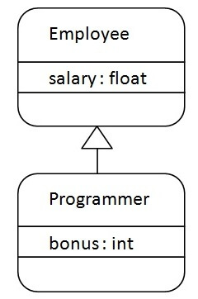
syntax of Java Inheritance
The extends keyword indicates that you are making a new class that derives from an existing class.
class Subclass-name extends Superclass-name
{
//methods and fields
}
Programmer is the subclass and Employee is the superclass. The relationship between the two classes is Programmer IS-A Employee. It means that Programmer is a type of Employee.

Slide 116
class Employee{
float salary=40000;
}
class Programmer extends Employee{
int bonus=10000;
public static void main(String args[]){
Programmer p=new Programmer();
System.out.println("Programmer salary is:"+p.salary);
System.out.println("Bonus of Programmer is:"+p.bonus);
}
}
Output :
Programmer salary is:40000.0
Bonus of programmer is:10000

Slide 117
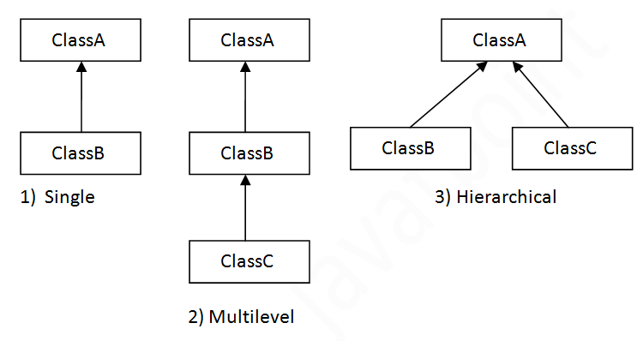
Types of inheritance in java
In java programming, multiple and hybrid inheritance is supported through interface only.

Slide 118
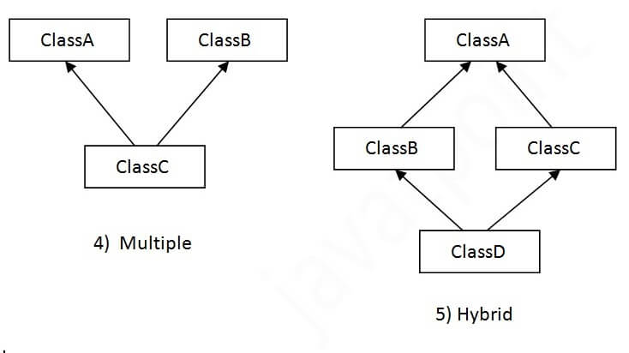

Slide 119
Single Inheritance Example
When a class inherits another class, it is known as a single inheritance. In the example given below, Dog class inherits the Animal class, so there is the single inheritance.
class Animal{
void eat(){System.out.println("eating...");}
}
class Dog extends Animal{
void bark(){System.out.println("barking...");}
}
class TestInheritance{
public static void main(String args[]){
Dog d=new Dog();
d.bark();
d.eat();
}}

Slide 120
Multilevel Inheritance Example
When there is a chain of inheritance, it is known as multilevel inheritance.
class Animal{
void eat(){System.out.println("eating...");}
}
class Dog extends Animal{
void bark(){System.out.println("barking...");}
}
class BabyDog extends Dog{
void weep(){System.out.println("weeping...");}
}
class TestInheritance2{
public static void main(String args[]){
BabyDog d=new BabyDog();
d.weep();
d.bark();
d.eat();
}}

Slide 121
Hierarchical Inheritance Example
When two or more classes inherits a single class, it is known as hierarchical inheritance.
class Animal{
void eat(){System.out.println("eating...");}
}
class Dog extends Animal{
void bark(){System.out.println("barking...");}
}
class Cat extends Animal{
void meow(){System.out.println("meowing...");}
}
class TestInheritance3{
public static void main(String args[]){
Cat c=new Cat();
c.meow();
c.eat();
//c.bark();//C.T.Error
}}

Slide 122
Q) Why multiple inheritance is not
supported in java?

Slide 123
Q) Why multiple inheritance is not supported in java?
To reduce the complexity and simplify the language, multiple inheritance is not supported in java.
Consider a scenario where A, B, and C are three classes. The C class inherits A and B classes. If A and B classes have the same method and you call it from child class object, there will be ambiguity to call the method of A or B class.
Since compile-time errors are better than runtime errors, Java renders compile-time error if you inherit 2 classes. So whether you have same method or different, there will be compile time error.

Slide 124
Aggregation in Java
If a class have an entity reference, it is known as Aggregation. Aggregation represents HAS-A relationship.
class Employee{
int id;
String name;
Address address;//Address is a class
...
}
Employee has an entity reference address, so relationship is Employee HAS-A address.
When use Aggregation?
Code reuse is also best achieved by aggregation when there is no is-a relationship.
Inheritance should be used only if the relationship is-a is maintained throughout the lifetime of the objects involved; otherwise, aggregation is the best choice.

Slide 125
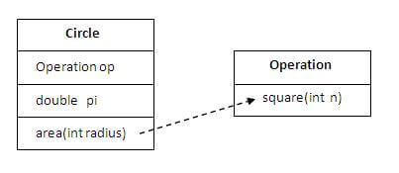
class Operation{
int square(int n){
return n*n;
}
}
class Circle{
Operation op;//aggregation
double pi=3.14;
double area(int radius){
op=new Operation();
int rsquare=op.square(radius);//code reusability (i.e. delegates the method call).
return pi*rsquare;
}
public static void main(String args[]){
Circle c=new Circle();
double result=c.area(5);
System.out.println(result);
}
}

Slide 126
Java Polymorphism
Method Overloading in Java
If a class has multiple methods having same name but different in parameters, it is known as Method Overloading.
There are two ways to overload the method in java
By changing number of arguments
By changing the data type
Advantage : Method overloading increases the readability of the program.
In Java, Method Overloading is not possible by changing the return type of the method only.

Slide 127
1) Method Overloading: changing no. of arguments
class Adder{
static int add(int a,int b){return a+b;}
static int add(int a,int b,int c){return a+b+c;}
}
class TestOverloading1{
public static void main(String[] args){
System.out.println(Adder.add(11,11));
System.out.println(Adder.add(11,11,11));
}}

Slide 128
2) Method Overloading: changing data type of arguments
class Adder{
static int add(int a, int b){return a+b;}
static double add(double a, double b){return a+b;}
}
class TestOverloading2{
public static void main(String[] args){
System.out.println(Adder.add(11,11));
System.out.println(Adder.add(12.3,12.6));
}}

Slide 129
Q) Why Method Overloading is not possible by changing the return type of method only?
In java, method overloading is not possible by changing the return type of the method only because of ambiguity. Let's see how ambiguity may occur:
class Adder{
static int add(int a,int b){return a+b;}
static double add(int a,int b){return a+b;}
}
class TestOverloading3{
public static void main(String[] args){
System.out.println(Adder.add(11,11));//ambiguity
}}

Slide 130
Can we overload java main() method?

Slide 131
Can we overload java main() method?
Yes, by method overloading. You can have any number of main methods in a class by method overloading. But JVM calls main() method which receives string array as arguments only.

Slide 132
Method Overriding in Java
If subclass (child class) has the same method as declared in the parent class, it is known as method overriding in Java.
In other words, If a subclass provides the specific implementation of the method that has been declared by one of its parent class, it is known as method overriding.
Usage of Java Method Overriding
Method overriding is used to provide the specific implementation of a method which is already provided by its superclass.
Method overriding is used for runtime polymorphism
Rules for Java Method Overriding
The method must have the same name as in the parent class
The method must have the same parameter as in the parent class.
There must be an IS-A relationship (inheritance).

Slide 133
class Vehicle{
//defining a method
void run(){System.out.println("Vehicle is running");}
}
//Creating a child class
class Bike2 extends Vehicle{
//defining the same method as in the parent class
void run(){System.out.println("Bike is running safely");}
public static void main(String args[]){
Bike2 obj = new Bike2();//creating object
obj.run();//calling method
}
}
we have defined the run method in the subclass as defined in the parent class but it has some specific implementation. The name and parameter of the method are the same, and there is IS-A relationship between the classes, so there is method overriding.

Slide 134
class Bank{
int getRateOfInterest(){return 0;}
}
//Creating child classes.
class SBI extends Bank{
int getRateOfInterest(){return 8;}
}
class ICICI extends Bank{
int getRateOfInterest(){return 7;}
}
class AXIS extends Bank{
int getRateOfInterest(){return 9;}
}
//Test class to create objects and call the methods
class Test2{
public static void main(String args[]){
SBI s=new SBI();
ICICI i=new ICICI();
AXIS a=new AXIS();
System.out.println("SBI Rate of Interest: "+s.getRateOfInterest());
System.out.println("ICICI Rate of Interest: "+i.getRateOfInterest());
System.out.println("AXIS Rate of Interest: "+a.getRateOfInterest());
}
}

Slide 135
Why can we not override static method?
Can we override java main method?

Slide 136
Super Keyword in Java
The super keyword in Java is a reference variable which is used to refer immediate parent class object.
Whenever you create the instance of subclass, an instance of parent class is created implicitly which is referred by super reference variable.
Usage of Java super Keyword
super can be used to refer immediate parent class instance variable.
super can be used to invoke immediate parent class method.
super() can be used to invoke immediate parent class constructor.

Slide 137
Abstraction in Java
Abstraction is a process of hiding the implementation details and showing only functionality to the user. Abstraction lets you focus on what the object does instead of how it does it.
There are two ways to achieve abstraction in java
Abstract class (0 to 100%)
Interface (100%)

Slide 138
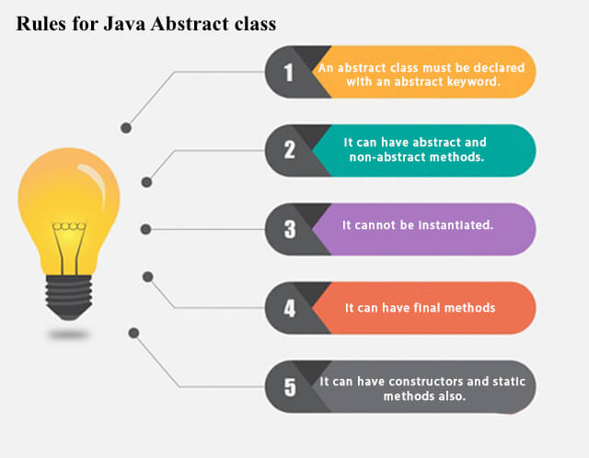
Abstract class in Java
A class which is declared as abstract is known as an abstract class. It can have abstract and non-abstract methods. It needs to be extended and its method implemented. It cannot be instantiated.

Slide 139
abstract class Bank{
abstract int getRateOfInterest();
}
class SBI extends Bank{
int getRateOfInterest(){return 7;}
}
class PNB extends Bank{
int getRateOfInterest(){return 8;}
}
class TestBank{
public static void main(String args[]){
Bank b;
b=new SBI();
System.out.println("Rate of Interest is: "+b.getRateOfInterest()+" %");
b=new PNB();
System.out.println("Rate of Interest is: "+b.getRateOfInterest()+" %");
}}

Slide 140
Interface in Java
The interface in Java is a mechanism to achieve abstraction. There can be only abstract methods in the Java interface, not method body. It is used to achieve abstraction and multiple inheritance in Java.
Java Interface also represents the IS-A relationship.
It cannot be instantiated just like the abstract class.
Since Java 8, we can have default and static methods in an interface.
Since Java 9, we can have private methods in an interface.
The Java compiler adds public and abstract keywords before the interface method. Moreover, it adds public, static and final keywords before data members.

Slide 141
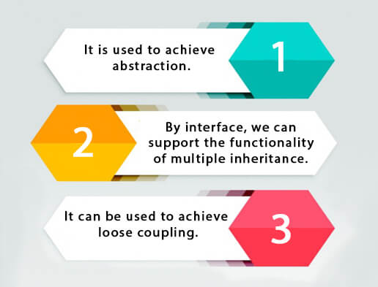
Why use Java interface?

Slide 142
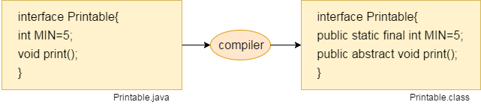
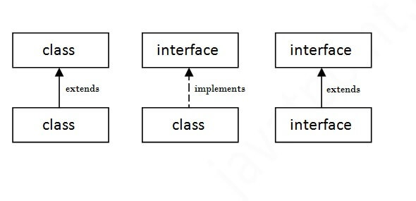
The relationship between classes and interfaces

Slide 143
Java Interface Example
interface Bank{
float rateOfInterest();
}
class SBI implements Bank{
public float rateOfInterest(){return 9.15f;}
}
class PNB implements Bank{
public float rateOfInterest(){return 9.7f;}
}
class TestInterface2{
public static void main(String[] args){
Bank b=new SBI();
System.out.println("ROI: "+b.rateOfInterest());
}}
interface Drawable{
void draw();
}
class Rectangle implements Drawable{
public void draw(){System.out.println("drawing rectangle");}
}
class Circle implements Drawable{
public void draw(){System.out.println("drawing circle");}
}
class TestInterface1{
public static void main(String args[]){
Drawable d=new Circle();
d.draw();
}}

Slide 144
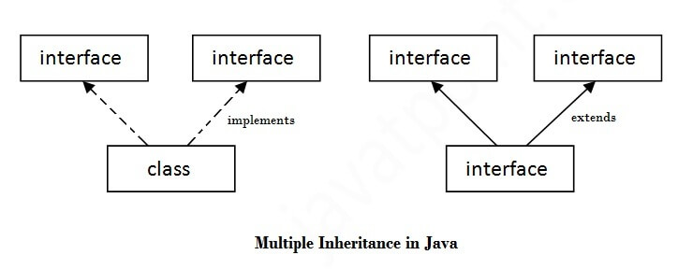
Multiple inheritance in Java by interface
If a class implements multiple interfaces, or an interface extends multiple interfaces, it is known as multiple inheritance.

Slide 145
interface Printable{
void print();
}
interface Showable{
void show();
}
class A7 implements Printable,Showable{
public void print(){System.out.println("Hello");}
public void show(){System.out.println("Welcome");}
public static void main(String args[]){
A7 obj = new A7();
obj.print();
obj.show();
}
}
In case of an interface because there is no ambiguity. It is because its implementation is provided by the implementation class. For example:
interface Printable{
void print();
}
interface Showable{
void print();
}
class TestInterface3 implements Printable, Showable{
public void print(){System.out.println("Hello");}
public static void main(String args[]){
TestInterface3 obj = new TestInterface3();
obj.print();
}
}

Slide 146
Interface inheritance
A class implements an interface, but one interface extends another interface.
interface Printable{
void print();
}
interface Showable extends Printable{
void show();
}
class TestInterface4 implements Showable{
public void print(){System.out.println("Hello");}
public void show(){System.out.println("Welcome");}
public static void main(String args[]){
TestInterface4 obj = new TestInterface4();
obj.print();
obj.show();
}
}

Slide 147
Java 8 Default Method in Interface
Since Java 8, we can have method body in interface. But we need to make it default method. Let's see an example:
interface Drawable{
void draw();
default void msg(){System.out.println("default method");}
}
class Rectangle implements Drawable{
public void draw(){System.out.println("drawing rectangle");}
}
class TestInterfaceDefault{
public static void main(String args[]){
Drawable d=new Rectangle();
d.draw();
d.msg();
}}

Slide 148
Java 8 Static Method in Interface
Since Java 8, we can have static method in interface. Let's see an example:
interface Drawable{
void draw();
static int cube(int x){return x*x*x;}
}
class Rectangle implements Drawable{
public void draw(){System.out.println("drawing rectangle");}
}
class TestInterfaceStatic{
public static void main(String args[]){
Drawable d=new Rectangle();
d.draw();
System.out.println(Drawable.cube(3));
}}

Slide 149
Do it Yourself -
Q) What is marker or tagged interface?
Q) What is Nested Interface in Java ?
How to handle them ?

Slide 150
Abstract class | Interface
1) Abstract class can have abstract and non-abstract methods. | Interface can have only abstract methods. Since Java 8, it can have default and static methods also.
2) Abstract class doesn't support multiple inheritance. | Interface supports multiple inheritance.
3) Abstract class can have final, non-final, static and non-static variables. | Interface has only static and final variables.
4) Abstract class can provide the implementation of interface. | Interface can't provide the implementation of abstract class.
5) The abstract keyword is used to declare abstract class. | The interface keyword is used to declare interface.
6) An abstract class can extend another Java class and implement multiple Java interfaces. | An interface can extend another Java interface only.
7) An abstract class can be extended using keyword "extends". | An interface can be implemented using keyword "implements".
8) A Java abstract class can have class members like private, protected, etc. | Members of a Java interface are public by default.
9)Example: public abstract class Shape{ public abstract void draw(); } | Example: public interface Drawable{ void draw(); }

Slide 151
Access Modifiers in Java
There are two types of modifiers in Java: access modifiers and non-access modifiers.
The access modifiers in Java specifies the accessibility or scope of a field, method, constructor, or class.
There are four types of Java access modifiers:
Private: The access level of a private modifier is only within the class. It cannot be accessed from outside the class.
Default: The access level of a default modifier is only within the package. It cannot be accessed from outside the package. If you do not specify any access level, it will be the default.
Protected: The access level of a protected modifier is within the package and outside the package through child class. If you do not make the child class, it cannot be accessed from outside the package.
Public: The access level of a public modifier is everywhere. It can be accessed from within the class, outside the class, within the package and outside the package.

Slide 152
Access Modifier | within class | within package | outside package by subclass only | outside package
Private | Y | N | N | N
Default | Y | Y | N | N
Protected | Y | Y | Y | N
Public | Y | Y | Y | Y

Slide 153
Simple example of private access modifier
class A{
private int data=40;
private void msg(){System.out.println("Hello java");}
}
public class Simple{
public static void main(String args[]){
A obj=new A();
System.out.println(obj.data);//Compile Time Error
obj.msg();//Compile Time Error
}
}

Slide 154
Role of Private Constructor
If you make any class constructor private, you cannot create the instance of that class from outside the class.
class A{
private A(){}//private constructor
void msg(){System.out.println("Hello java");}
}
public class Simple{
public static void main(String args[]){
A obj=new A();//Compile Time Error
}
}

Slide 155
Example of default access modifier
If you don't use any modifier, it is treated as default by default. The default modifier is accessible only within package. It cannot be accessed from outside the package.
//save by A.java
package pack;
class A{
void msg(){System.out.println("Hello");}
}
//save by B.java
package mypack;
import pack.*;
class B{
public static void main(String args[]){
A obj = new A();//Compile Time Error
obj.msg();//Compile Time Error
}
}
we have created two packages pack and mypack. We are accessing the A class from outside its package, since A class is not public, so it cannot be accessed from outside the package.

Slide 156
Example of protected access modifier
The protected access modifier is accessible within package and outside the package but through inheritance only.
The protected access modifier can be applied on the data member, method and constructor. It can't be applied on the class.
//save by A.java
package pack;
public class A{
protected void msg(){System.out.println("Hello");}
}
//save by B.java
package mypack;
import pack.*;
class B extends A{
public static void main(String args[]){
B obj = new B();
obj.msg();
}
}
The A class of pack package is public, so can be accessed from outside the package. But msg method of this package is declared as protected, so it can be accessed from outside the class only through inheritance.

Slide 157
Example of public access modifier
The public access modifier is accessible everywhere. It has the widest scope among all other modifiers.
//save by A.java
package pack;
public class A{
public void msg(){System.out.println("Hello");}
}
//save by B.java
package mypack;
import pack.*;
class B{
public static void main(String args[]){
A obj = new A();
obj.msg();
}
}

Slide 158
Java Access Modifiers with Method Overriding
If you are overriding any method, overridden method (i.e. declared in subclass) must not be more restrictive.
class A{
protected void msg(){System.out.println("Hello java");}
}
public class Simple extends A{
void msg(){System.out.println("Hello java");}//C.T.Error
public static void main(String args[]){
Simple obj=new Simple();
obj.msg();
}
}
The default modifier is more restrictive than protected. That is why, there is a compile-time error.

Slide 159
Encapsulation in Java
Encapsulation in Java is a process of wrapping code and data together into a single unit, for example, a capsule which is mixed of several medicines.
We can create a fully encapsulated class in Java by making all the data members of the class private. Now we can use setter and getter methods to set and get the data in it.
The Java Bean class is the example of a fully encapsulated class.
Advantage of Encapsulation in Java
control over the data
data hiding
easy to test
The standard IDE's are providing the facility to generate the getters and setters. So, it is easy and fast to create an encapsulated class in Java.

Slide 160
Simple Example of Encapsulation in Java
//A Java class which is a fully encapsulated class.
//It has a private data member and getter and setter methods.
package com.javatpoint;
public class Student{
//private data member
private String name;
//getter method for name
public String getName(){
return name;
}
//setter method for name
public void setName(String name){
this.name=name
}
}
//A Java class to test the encapsulated class.
package com.javatpoint;
class Test{
public static void main(String[] args){
//creating instance of the encapsulated class
Student s=new Student();
//setting value in the name member
s.setName("vijay");
//getting value of the name member
System.out.println(s.getName());
}
}

Slide 161
Read-Only class
//A Java class which has only getter methods.
public class Student{
//private data member
private String college="AKG";
//getter method for college
public String getCollege(){
return college;
}
}
Now, you can't change the value of the college data member which is "AKG".
s.setCollege("KITE");//will render compile time error

Slide 162
Write-Only class
//A Java class which has only setter methods.
public class Student{
//private data member
private String college;
//getter method for college
public void setCollege(String college){
this.college=college;
}
}
System.out.println(s.getCollege());
//Compile Time Error, because there is no such
Method.
System.out.println(s.college);
//Compile Time Error, because the college data
member is private. So, it can't be accessed from
outside the class.
Now, you can't get the value of the college, you can only change the value of college data member.

Slide 163
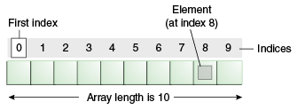
Java Arrays
An array is a collection of similar type of elements which has contiguous memory location.
We can store only a fixed set of elements in a Java array.
Array in Java is index-based, the first element of the array is stored at the 0th index, 2nd element is stored on 1st index and so on.
We can get the length of the array using the length member.

Slide 164
Advantages
Code Optimization: It makes the code optimized, we can retrieve or sort the data efficiently.
Random access: We can get any data located at an index position.
Disadvantages
Size Limit: We can store only the fixed size of elements in the array. It doesn't grow its size at runtime. To solve this problem, collection framework is used in Java which grows automatically.
There are two types of array -
Single Dimensional Array
Multidimensional Array

Slide 165
Single Dimensional Array in Java
class Testarray{
public static void main(String args[]){
int a[]=new int[5];//declaration and instantiation
a[0]=10;//initialization
a[1]=20;
a[2]=70;
a[3]=40;
a[4]=50;
//traversing array
for(int i=0;i<a.length;i++)
//length is the property of array
System.out.println(a[i]);
}}
Syntax to Declare an Array in Java
dataType[] arr; (or)
dataType []arr; (or)
dataType arr[]; // example : int num[5];
Instantiation of an Array in Java
DataType[] arrayName = new DataType[arraySize];
Example : int[] numbers = new int[5];

Slide 166
Declaration, Instantiation and Initialization
We can declare, instantiate and initialize the java array together by:
int a[]={33,3,4,5}; //declaration, instantiation and initialization
class Testarray1{
public static void main(String args[]){
int a[]={33,3,4,5};//declaration, instantiation and initialization
//printing array
for(int i=0;i<a.length;i++)//length is the property of array
System.out.println(a[i]);
}}

Slide 167
For-each Loop for Java Array
We can also print the Java array using for-each loop. The Java for-each loop prints the array elements one by one. It holds an array element in a variable, then executes the body of the loop.
syntax of the for-each loop :
for(data_type variable:array){
//body of the loop
}
class Testarray1{
public static void main(String args[]){
int arr[]={33,3,4,5};
//printing array using for-each loop
for(int i:arr)
System.out.println(i);
}}

Slide 168
Passing Array to a Method in Java
We can pass the java array to method so that we can reuse the same logic on any array.
class Testarray2{
//creating a method which receives an array as a parameter
static void min(int arr[]){
int min=arr[0];
for(int i=1;i<arr.length;i++)
if(min>arr[i])
min=arr[i];
System.out.println(min);
}
public static void main(String args[]){
int a[]={33,3,4,5};//declaring and initializing an array
min(a);//passing array to method
}}

Slide 169
Anonymous Array in Java
Java supports the feature of an anonymous array, so you don't need to declare the array while passing an array to the method.
public class TestAnonymousArray{
//creating a method which receives an array as a parameter
static void printArray(int arr[]){
for(int i=0;i<arr.length;i++)
System.out.println(arr[i]);
}
public static void main(String args[]){
printArray(new int[]{10,22,44,66});//passing anonymous array to method
}}

Slide 170
Returning Array from the Method
class TestReturnArray{
//creating method which returns an array
static int[] get(){
return new int[]{10,30,50,90,60};
}
public static void main(String args[]){
//calling method which returns an array
int arr[]=get();
//printing the values of an array
for(int i=0;i<arr.length;i++)
System.out.println(arr[i]);
}}

Slide 171
ArrayIndexOutOfBoundsException
The Java Virtual Machine (JVM) throws an ArrayIndexOutOfBoundsException if length of the array in negative, equal to the array size or greater than the array size while traversing the array.
public class TestArrayException{
public static void main(String args[]){
int arr[]={50,60,70,80};
for(int i=0;i<=arr.length;i++){
System.out.println(arr[i]);
}
}}
Output :
Exception in thread "main" java.lang.ArrayIndexOutOfBoundsException: 4
at TestArrayException.main(TestArrayException.java:5)

Slide 172
Multidimensional Array in Java
In such case, data is stored in row and column based index (also known as matrix form).
Syntax to Declare Multidimensional Array
dataType[][] arrayRefVar; (or)
dataType [][]arrayRefVar; (or)
dataType arrayRefVar[][]; (or)
dataType []arrayRefVar[]
Example to instantiate Multidimensional Array
int[][] arr=new int[3][3]; //3 row and 3 column

Slide 173
public class TwoDArray {
public static void main(String[] args) {
int rows = 4;
int columns = 4;
int[][] array = new int[rows][columns];
int value = 1;
for (int i = 0; i < rows; i++) {
for (int j = 0; j < columns; j++) {
array[i][j] = value;
value++;
}
}
System.out.println("The 2D array is: ");
for (int i = 0; i < rows; i++) {
for (int j = 0; j < columns; j++) {
System.out.print(array[i][j] + " ");
}
System.out.println();
}
}
}
class Testarray3{
public static void main(String args[]){
//declaring and initializing 2D array
int arr[][]={{1,2,3},{2,4,5},{4,4,5}};
//printing 2D array
for(int i=0;i<3;i++){
for(int j=0;j<3;j++){
System.out.print(arr[i][j]+" ");
}
System.out.println();
}
}}

Slide 174
Jagged Array in Java
If we are creating odd number of columns in a 2D array, it is known as a jagged array. In other words, it is an array of arrays with different number of columns.
class TestJaggedArray{
public static void main(String[] args){
//declaring a 2D array with odd columns
int arr[][] = new int[3][];
arr[0] = new int[3];
arr[1] = new int[4];
arr[2] = new int[2];
//initializing a jagged array
int count = 0;
for (int i=0; i<arr.length; i++)
for(int j=0; j<arr[i].length; j++)
arr[i][j] = count++;
//printing the data of a jagged array
for (int i=0; i<arr.length; i++){
for (int j=0; j<arr[i].length; j++){
System.out.print(arr[i][j]+" ");
}
System.out.println();//new line
}
}
}

Slide 175
Copying a Java Array
We can copy an array to another by the arraycopy() method of System class.
Syntax of arraycopy method:
public static void arraycopy(
Object src, int srcPos,Object dest, int destPos, int length
)
class TestArrayCopyDemo {
public static void main(String[] args) {
//declaring a source array
char[] copyFrom = { 'd', 'e', 'c', 'a', 'f', 'f', 'e', 'i', 'n', 'a', 't', 'e', 'd' };
//declaring a destination array
char[] copyTo = new char[7];
//copying array using System.arraycopy() method
System.arraycopy(copyFrom, 2, copyTo, 0, 7);
//printing the destination array
System.out.println(String.valueOf(copyTo));
}
}

Slide 176
Cloning an Array in Java
Since, Java array implements the Cloneable interface, we can create the clone of the Java array. If we create the clone of a single-dimensional array, it creates the deep copy of the Java array. It means, it will copy the actual value. But, if we create the clone of a multidimensional array, it creates the shallow copy of the Java array which means it copies the references.
class Testarray1{
public static void main(String args[]){
int arr[]={33,3,4,5};
System.out.println("Printing original array:");
for(int i:arr)
System.out.println(i);
System.out.println("Printing clone of the array:");
int carr[]=arr.clone();
for(int i:carr)
System.out.println(i);
System.out.println("Are both equal?");
System.out.println(arr==carr);
}}

Slide 177
Addition of 2 Matrices in Java
class Testarray5{
public static void main(String args[]){
//creating two matrices
int a[][]={{1,3,4},{3,4,5}};
int b[][]={{1,3,4},{3,4,5}};
//creating another matrix to store the sum of two matrices
int c[][]=new int[2][3];
//adding and printing addition of 2 matrices
for(int i=0;i<2;i++){
for(int j=0;j<3;j++){
c[i][j]=a[i][j]+b[i][j];
System.out.print(c[i][j]+" ");
}
System.out.println();//new line
}
}}

Slide 178
Object class in Java
The Object class is the parent class of all the classes in java by default. In other words, it is the topmost class of java.
The Object class is beneficial if you want to refer any object whose type you don't know. Notice that parent class reference variable can refer the child class object, know as upcasting.
Let's take an example, there is getObject() method that returns an object but it can be of any type like Employee,Student etc, we can use Object class reference to refer that object. For example:
Object obj=getObject();//we don't know what object will be returned from this method
The Object class provides some common behaviors to all the objects such as object can be compared, object can be cloned, object can be notified etc.

Slide 179
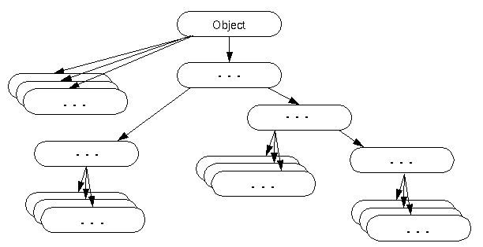

Slide 180
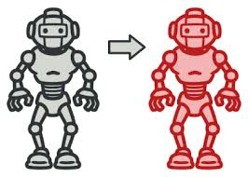
Object Cloning in Java
The object cloning is a way to create exact copy of an object. The clone() method of Object class is used to clone an object.
The java.lang.Cloneable interface must be implemented by the class whose object clone we want to create. If we don't implement Cloneable interface, clone() method generates CloneNotSupportedException.
The clone() method is defined in the Object class. Syntax of the clone() method is as follows:
protected Object clone() throws CloneNotSupportedException

Slide 181
Why use clone() method ?
The clone() method saves the extra processing task for creating the exact copy of an object. If we perform it by using the new keyword, it will take a lot of processing time to be performed that is why we use object cloning.
public static void main(String args[]){
try{
Student18 s1=new Student18(101,"amit");
Student18 s2=(Student18)s1.clone();
System.out.println(s1.rollno+" "+s1.name);
System.out.println(s2.rollno+" "+s2.name);
}catch(CloneNotSupportedException c){}
}
}
class Student18 implements Cloneable{
int rollno;
String name;
Student18(int rollno,String name){
this.rollno=rollno;
this.name=name;
}
public Object clone()throws CloneNotSupportedException{
return super.clone();
}

Slide 182
Wrapper classes in Java
The wrapper class in Java provides the mechanism to convert primitive into object and object into primitive.
Since J2SE 5.0, autoboxing and unboxing feature convert primitives into objects and objects into primitives automatically. The automatic conversion of primitive into an object is known as autoboxing and vice-versa unboxing.
Use of Wrapper classes in Java
Change the value in Method
Serialization
Synchronization
Collection Framework

Slide 183
Primitive Type | Wrapper class
boolean | Boolean
char | Character
byte | Byte
short | Short
int | Integer
long | Long
float | Float
double | Double

Slide 184
Autoboxing
The automatic conversion of primitive data type into its corresponding wrapper class is known as autoboxing, for example, byte to Byte, char to Character, int to Integer, long to Long, float to Float, boolean to Boolean, double to Double, and short to Short.
public class WrapperExample1{
public static void main(String args[]){
//Converting int into Integer
int a=20;
Integer i=Integer.valueOf(a);//converting int into Integer explicitly
Integer j=a;//autoboxing, now compiler will write Integer.valueOf(a) internally
System.out.println(a+" "+i+" "+j);
}}

Slide 185
Unboxing
The automatic conversion of wrapper type into its corresponding primitive type is known as unboxing. It is the reverse process of autoboxing.
public class WrapperExample2{
public static void main(String args[]){
//Converting Integer to int
Integer a=new Integer(3);
int i=a.intValue();//converting Integer to int explicitly
int j=a;//unboxing, now compiler will write a.intValue() internally
System.out.println(a+" "+i+" "+j);
}}

Slide 186
Java Wrapper classes Example
public class WrapperExample3{
public static void main(String args[]){
byte b=10;
short s=20;
int i=30;
long l=40;
float f=50.0F;
double d=60.0D;
char c='a';
boolean b2=true;
//Autoboxing: Converting primitives into objects
Byte byteobj=b;
Short shortobj=s;
Integer intobj=i;
Long longobj=l;
Float floatobj=f;
Double doubleobj=d;
Character charobj=c;
Boolean boolobj=b2;
//Unboxing: Converting Objects to Primitives
byte bytevalue=byteobj;
short shortvalue=shortobj;
int intvalue=intobj;
long longvalue=longobj;
float floatvalue=floatobj;
double doublevalue=doubleobj;
char charvalue=charobj;
boolean boolvalue=boolobj;

