Slide 1
Merchant Fraud Detection
By:
Sahishnuta Tosh

Slide 2

Problem Statement:
A Classification problem which predicts if the Merchant is Fraudster or not for an e-commerce client by analyzing merchant and order data.

Slide 3
Insight:
With all the hype about identity theft and other consumer-side digital crimes, it’s easy to overlook the fact that merchant fraud is still one of the most common and costly causes of financial loss for acquirers. Merchant fraud can be very hard to detect – especially given the complexity of the digital payments ecosystem.
Bust Out Fraud -The aim of this type of fraud is simple: process as many fraudulent transactions as possible within a short amount of time, and before being caught, simply abandon the account
Identity Swap - Certain individuals, for example individuals on the AML/ATF watch lists, merchants from countries on which economic sanctions are imposed or those belonging to certain extremist groups are prohibited from opening merchant accounts with major acquirers. To circumvent these prohibitions, merchants often use a fake or stolen identity or set up a bogus online storefront in order to secure a merchant account.
Transaction Laundering (a.k.a. Factoring) - An urgent and growing problem in the payments industry, transaction laundering occurs when an unknown business uses an approved merchant’s payment credentials to process payments for products and services that the acquirer is not aware of.

Slide 4
Multiple Approach for Problem Statement:
Based on available data, we have the information regarding the Merchant and the details of the Orders by Customers.
We have information on lower and upper bound of IP Address for different countries. Hence, in the Merchant data, we can get the location of the merchant.
One way to preprocess IPAddress is by getting the range and assigning it the Country name accordingly.
Another way to preprocess is by using Python library – geoip to get the country name.

Slide 5
Understanding Data:
Start by running Descriptive Statistics and understanding the data briefly.
Merchant data file contains details of the merchant like ‘Ecommerce Provider ID’, ‘Merchant ID’, ‘Merchant Registration Date’, ‘Registered Device ID’, ‘Gender’, ‘Age’, ‘IP Address’ etc.
Order data file contains details of the orders placed by customer or purchase history like ‘Order ID’, ‘Date of Order’, ‘Order Value USD’, ‘Order Source’, ‘Order Payment Method’ etc.
Main train data file contains the unique ‘Merchant_ID’ & ‘Fraudster’ as Target attribute.
Here the task to predict whether the merchant is fraudster or not based on his/her details and order data.

Slide 6
Understanding Data Cont.:
Descriptive Stats:
We have 54213 no. of unique merchant ids and their respective values in train data set.
Merchant file contains 54213 no. of records regarding merchant and 7 features
Order data file contains 54213 no. records and 7 features having customerID and details regarding order transactions.
No missing values in any data files.
Following features are excluded from analysis based on initial observation.
i. Merchant_Registration_Date
ii. Registered_Device_ID
iii. Order_ID
iv. Date_of_Order
We performed various classification algorithms like Decision Tree, Random Forest, KNN, XGBoost on data set in order to understand model performance and we found following :
Decision Tree has given highest accuracy on unseen data.

Slide 7
Preprocessing:
So we have converted following object type attribute to categorical.
Gender
Order Source
Order Payment
Dummify the categorical attribute.
Drop the original & unnecessary categorical attribute that has generated after dummification.
Converted the IP Address to the location of the merchant i.e. country

Slide 8
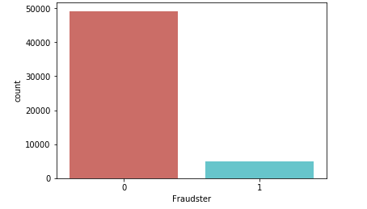
Preprocessing:
Checked the count of the Merchant being fraudster and count of the Merchant not being fraudster.

Slide 9
Preprocessing:
Since the count of the Merchant being fraudster and count of the Merchant not being fraudster is imbalanced i.e. having huge difference.
We can handle the imbalanced data by following ways:
One popular way to deal with imbalanced data is by Oversampling i.e. SMOTE — Synthetic Minority Over-sampling Technique. i.e. artificially create observations in our data set belonging to the class that is under represented in our data.
Another simple way to deal is undersampling is randomly selecting a handful of samples from the class that is overrepresented.
Another way to deal is by Combined Class Methods. In this regard, we will use SMOTE together with edited nearest-neighbours(ENN). Here, ENN is used as the cleaning method after SMOTE over-sampling to obtain a cleaner space.

Slide 10
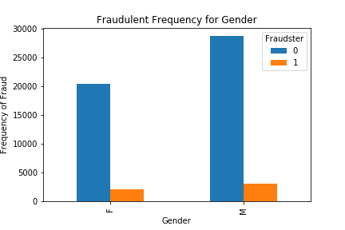
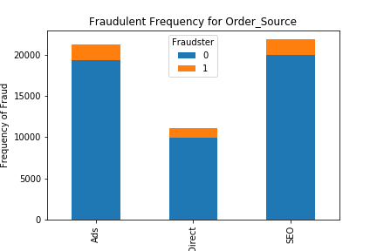
Exploratory Data Analysis:

Slide 11
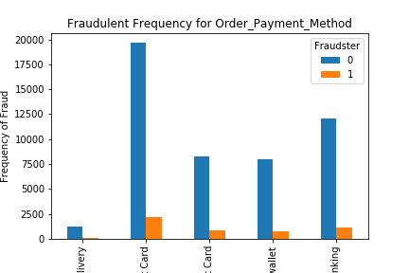
Exploratory Data Analysis:

Slide 12
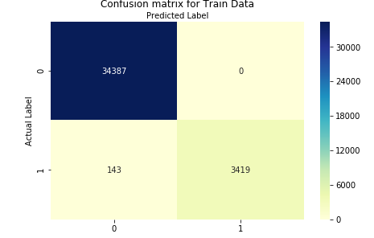
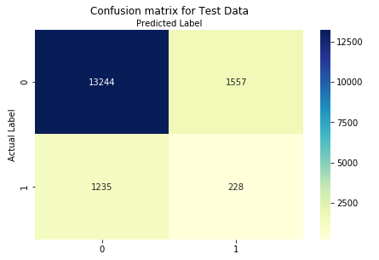
Error Metrics:
Random Forest:
Train Data
Test Data

Slide 13
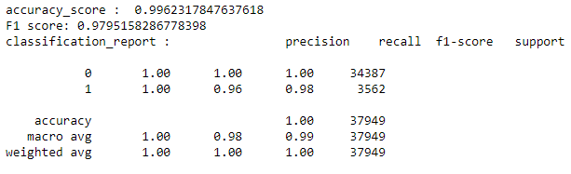
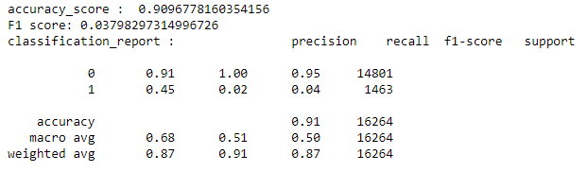
Summary Details of Random Forest Model:
Random Forest:
Train Data
Test Data

Slide 14
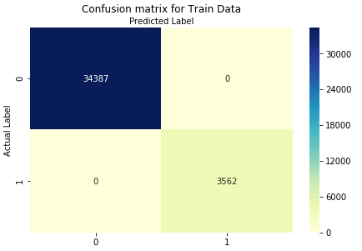

Error Metrics:
Decision Tree:
Train Data
Test Data

Slide 15
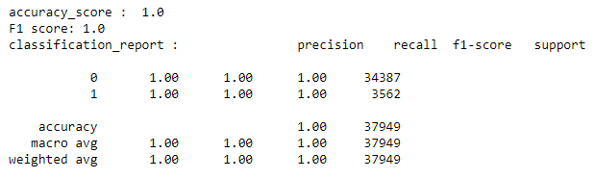
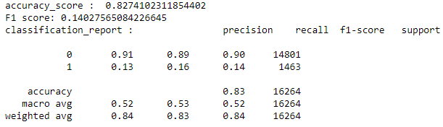
Summary Details of Decision Tree Model:
Decision Tree:
Train Data
Test Data

Slide 16
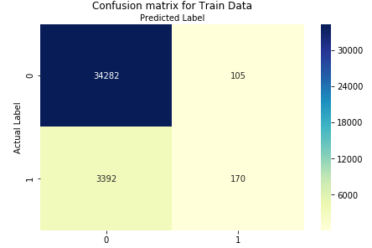
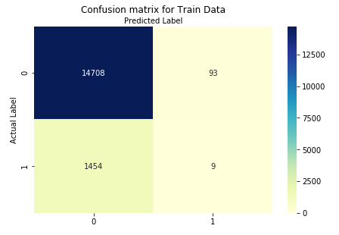
Error Metrics:
KNN:
Train Data
Test Data

Slide 17
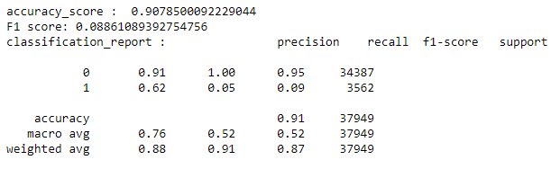
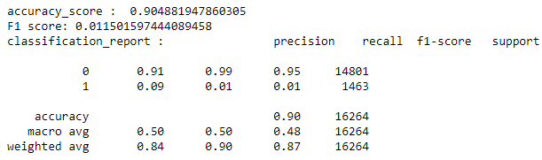
Summary Details of KNN Model:
KNN:
Train Data
Test Data

Slide 18
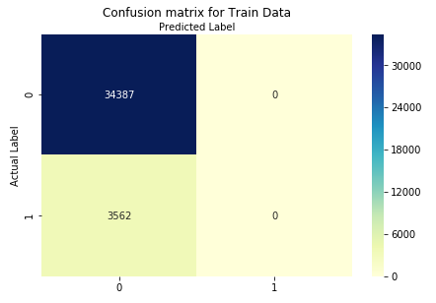
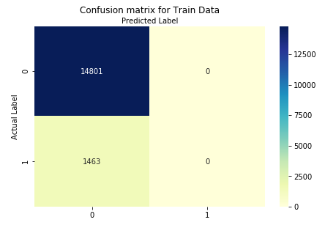
Error Metrics:
XGBoost:
Train Data
Test Data

Slide 19
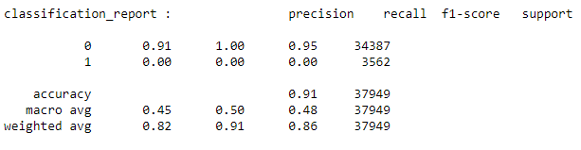
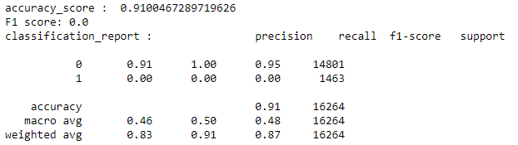
Summary Details of XGBoost Model:
XGBoost:
Train Data
Test Data

Slide 20
Conclusion:
There are several different models and all tend to share a similar modelling framework.
For Merchant Fraud detection, F1 score is the evaluation metric.
Higher F1 score of the model should be considered for choosing the best model.

Slide 21
Reference Links:
https://towardsdatascience.com/detecting-financial-fraud-using-machine-learning-three-ways-of-winning-the-war-against-imbalanced-a03f8815cce9
https://www.finextra.com/blogposting/14769/three-types-of-merchant-fraud-a-guide-for-merchant-acquirers

Slide 22
Thank you

