Slide 1
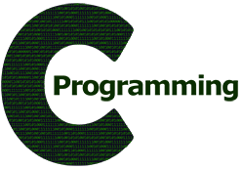
CSE101
Computer Programming
Lecture #0

Slide 2
Course Details
Exam Category
Mid Term Exam: All MCQ
End Term Exam: MCQ + Subjective
L | T | P Credit
2 | 0 | 2 3

Slide 3
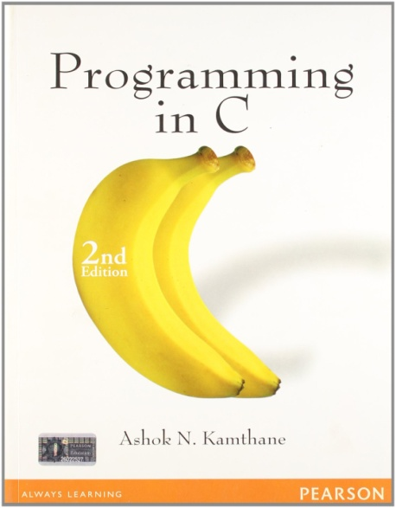
Reference Books
  “PROGRAMMING IN C”
  by
  ASHOK N. KAMTHANE
  PEARSON, 2nd Edition

Slide 4
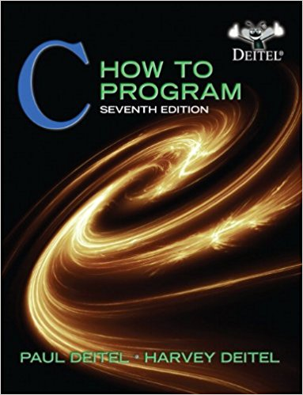
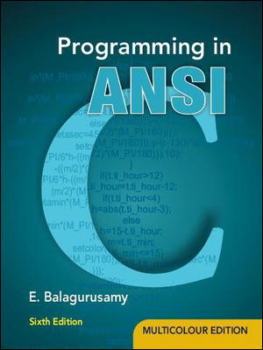
Reference Books
  “C HOW TO PROGRAM” by
  PAUL DEITEL AND
  HARVEY DEITEL
  PHI(Prentice Hall India) 7TH Edition
  “PROGRAMMING IN ANSI C”
  By E. BALAGURUSAMY
  McGraw Hill Education
  6th Edition

Slide 5
Course Assessment Model
Marks break up
Attendance 05
Academic Task(CA) 25
MTE 20
ETE 50
Total 100

Slide 6
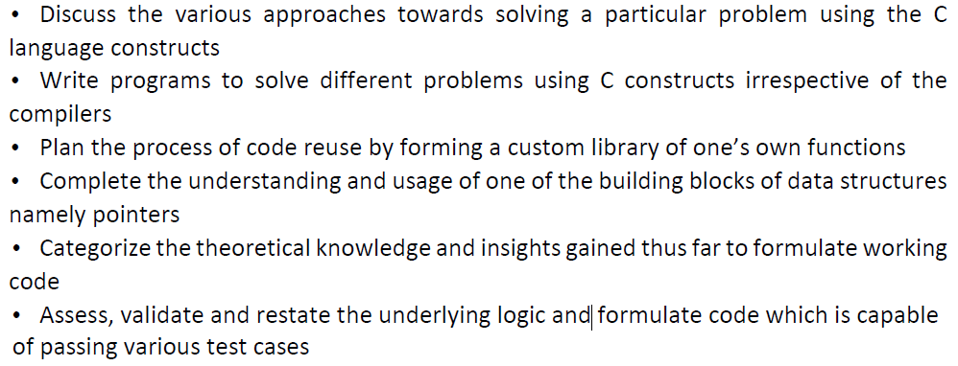
Course Outcomes
Through this course students should be able to:

Slide 7



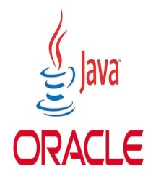
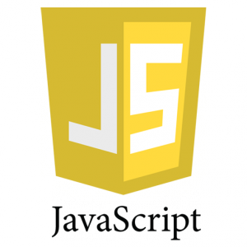
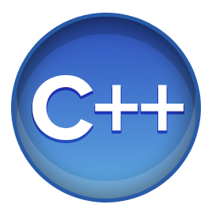

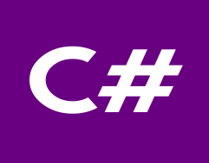
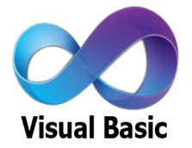
WHY C???????????????
If we have number of powerful programming languages available with us then why c??????

Slide 8
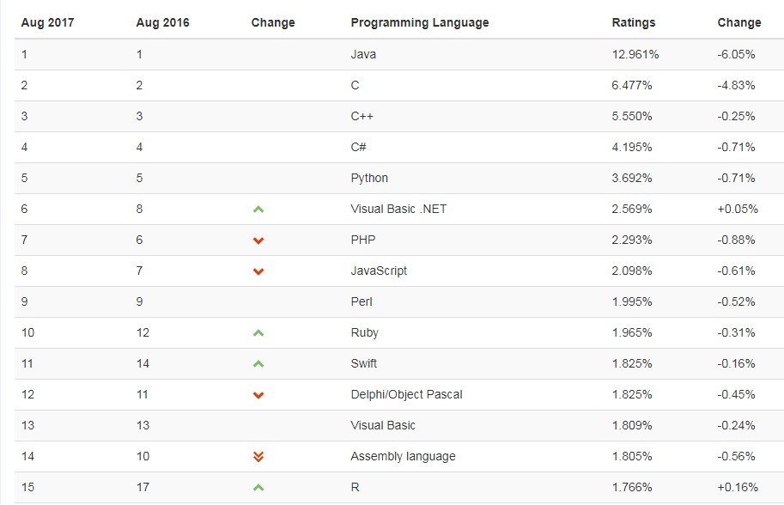
Popular Programming Ratings

Slide 9


The hitch...............
Some burning questions in mind......
C is a very old language. Why are we still studying this language??????
Now, we have very powerful languages with us then, why c??
There is no scope of this language in industry

Slide 10





Lets take you close to the reality
All of us use Computers or Laptops for different purposes.
Could you tell me which system software is most required to get our system in working mode??????

Slide 11
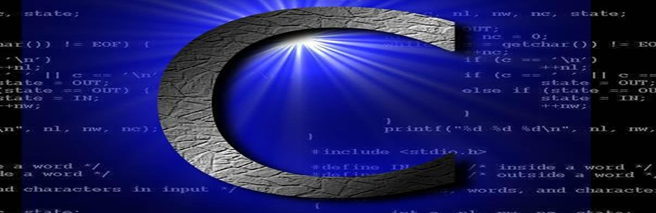
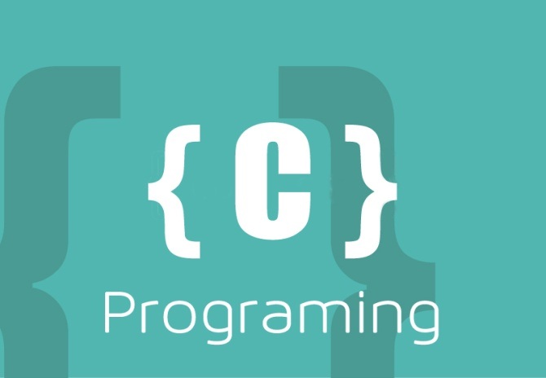
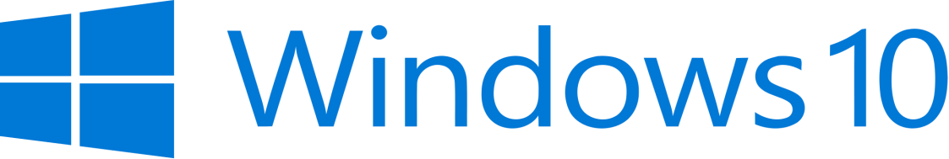
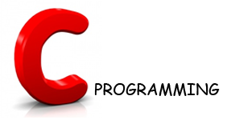
Let’s Explore more
Could you tell me which programming language is used in writing all these operating system??????
Latest version of Microsoft Windows i.e. Windows10 is still being written in C Language

Slide 12
Contd.....
Device drivers are also written in C language.
All these modern programming languages are influenced by C language
Compilers for Python and PHP language are also written in C language

Slide 13
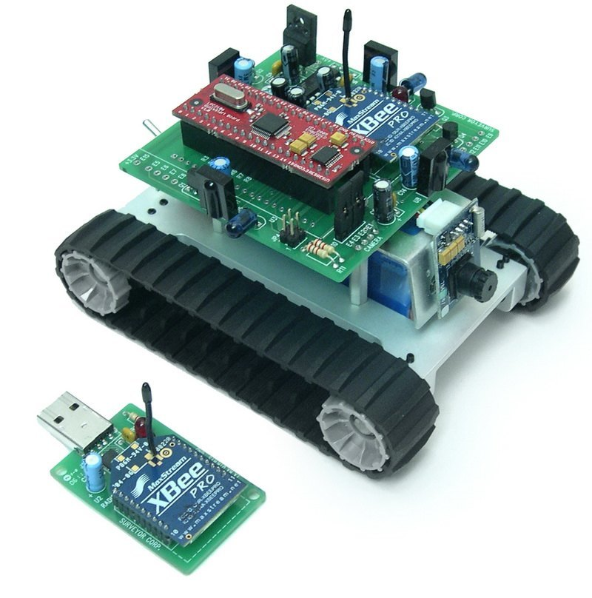
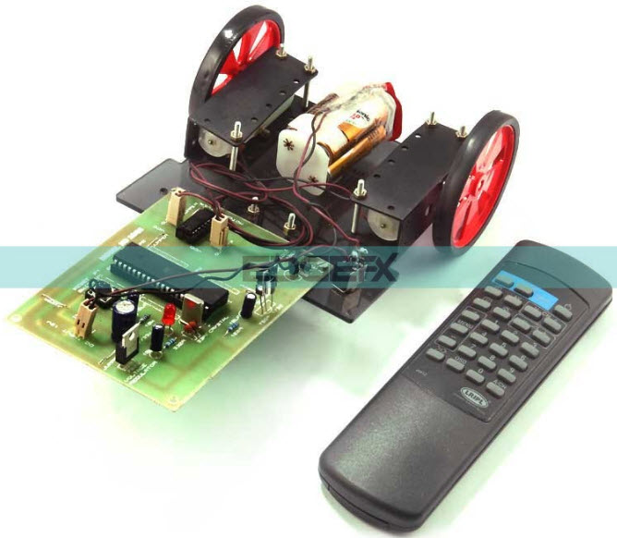
Contd.....
Embedded systems are also developed with the help of C language

Slide 14

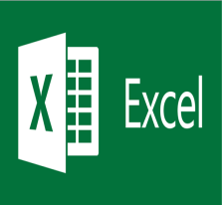




Contd.....
Git
 | Microsoft Excel
Oracle Database
 | MySql
Linux
 | Unix
Android
 | Google

Slide 15





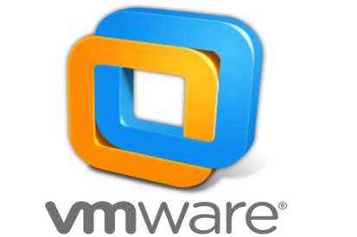
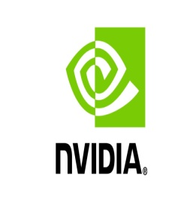




MNCs
Top rated Companies which has a dearth of C programmers

Slide 16


Here are the Answers of Questions
C is very a old language still, why do we study C language??
Now, we have very powerful languages
with us then why c??
There is no scope of this language in industry
Basic Pillar
Scope for Experts always Exists

Slide 17

Conclusion: Today C language is not used in Electronics. Today C language is Electronics. So C language knowledge and C programming skill are must for every ECE student. Since C programming is skill, every ECE students should start practicing C programming from 1st semester onwards and continue to practice C programming during the entire 4 years.
Balajee Seshadri
Embedded Systems Professional
30 Years Experience in Embedded Systems Field.
Source: https://www.quora.com/What-is-the-use-of-c-language-in-electronics

Slide 18
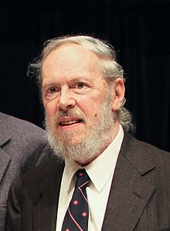
History of C
Guys Can you make a sentence with the word ‘Necessity’
“Necessity is the mother of invention”
Dennis Ritchie and Ken Thompson were working on developing a new operating system i.e UNIX
But the programming language they
were using was not providing them
the portability feature
So Dennis Ritchie developed new
language i.e C

Slide 19
Where is C used? Key Applications
'C' language is widely used in Embedded Systems.
For developing System Applications & Desktop Applications.
Most of the applications by Adobe are developed using 'C' programming language.
For developing browsers and their extensions. Google's Chromium is built using it.
To develop databases. MySQL is the most popular database software which is built using 'C’.
To develop an operating system. Operating systems such as Apple's OS X, Microsoft's Windows, and Symbian are developed using 'C' language. It is used for developing desktop as well as mobile phone's operating system.
It is used for compiler production.

Slide 20
Some facts
In 1988, the American National Standards Institute (ANSI) had formalized the C language.
C was invented to write UNIX operating system.
C is a successor of 'Basic Combined Programming Language' (BCPL) called B language.
Linux OS, PHP, and MySQL are written in C.
C has been written in assembly language.

Slide 21
Features of C
C is a robust language with a rich set of built-in functions and operators.
Programs written in C are Efficient And Fast.
C is highly Portable, programs once written in C can be run on other machines with minor or no modification.
C is a collection of C library functions; we can also create our function and add it to the C library.
C is easily Extensible.

Slide 22
Course Contents
Before MTE | After MTE
Data Types & Operators | Arrays and Strings
Control Structures | Dynamic Memory Allocation
User Defined Functions | Derived Data Types – Structures & Unions
Storage Classes | Pointers

Slide 23


Program Development in C
Program Development in C

