Slide 1

Real Estate Price Prediction
UMBC Data Science Master's Capstone, Spring 2024
Shiva Sahith Gaddam

Slide 2
Introduction:
Project Overview: Predicting real estate prices using advanced machine learning.
Scope: Analyzing factors driving housing prices for valuable insights.
Value Proposition: Enhancing transparency and efficiency in real estate transactions.

Slide 3
Objectives:
Develop a machine learning model for accurate price prediction.
Identify key factors influencing housing prices.
Provide stakeholders with reliable insights for informed decision-making.

Slide 4
Data Overview:
Dataset Description:
Includes housing unit details like transaction dates, house ages, distances to MRT, convenience store counts, and prices.
Size:
Real estate.csv: 21 kB
Shape:
414 rows by 8 columns

Slide 5
Methodology:
Data Preprocessing:
Handle missing values, duplicate rows, and convert date columns.
Exploratory Data Analysis (EDA):
Understand data distributions, correlations, and patterns.
Feature Engineering:
Extract relevant features and ensure data adherence to tidy format.
Model Selection:
Choose appropriate machine learning algorithms for price prediction.
Model Training:
Train the selected model using preprocessed data.
Model Evaluation:
Assess model performance using metrics like MAE, MSE, and RMSE.

Slide 6
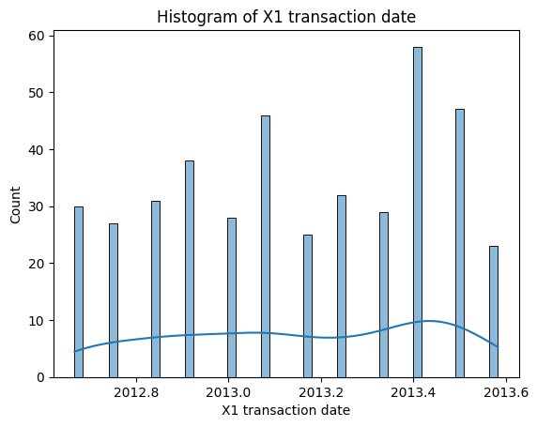
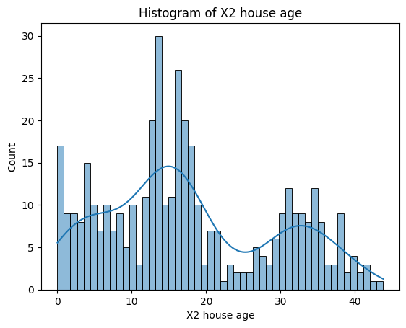
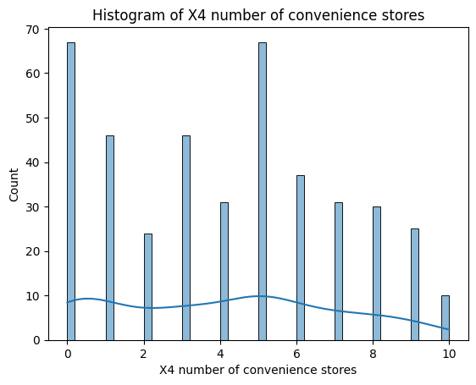
Visualizations:

Slide 7
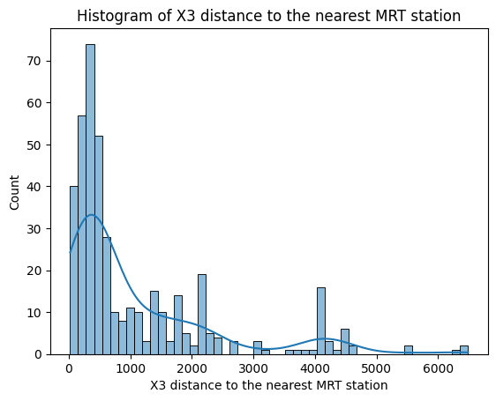

Slide 8
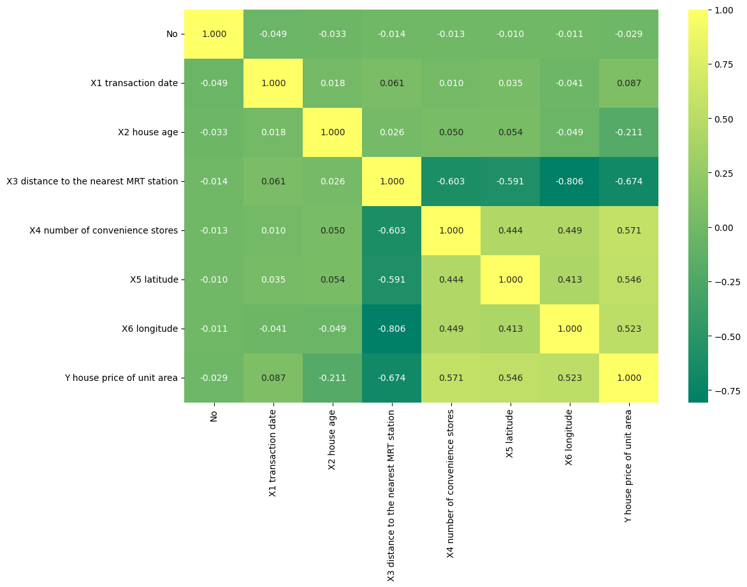

Slide 9
Model Training:
Data Splitting:
Split dataset into training and testing sets (70-30).
Model Selection:
Choose Linear Regression for simplicity.
Model Training:
Train Linear Regression on training data.
Performance Evaluation:
Assess with metrics like MAE, MSE, RMSE.

Slide 10
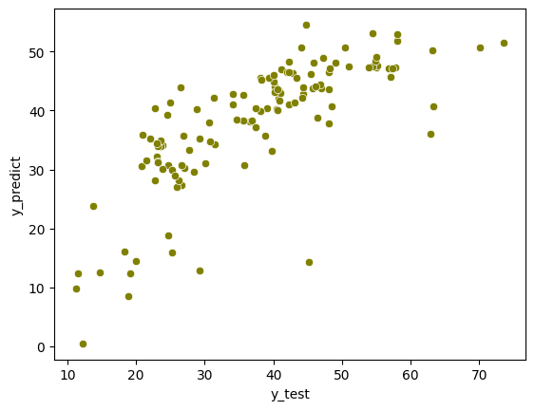
Results:
Model Performance Metrics:
Mean Absolute Error (MAE): 6.49
Mean Squared Error (MSE): 72.91
Root Mean Squared Error (RMSE): 8.54

Slide 11
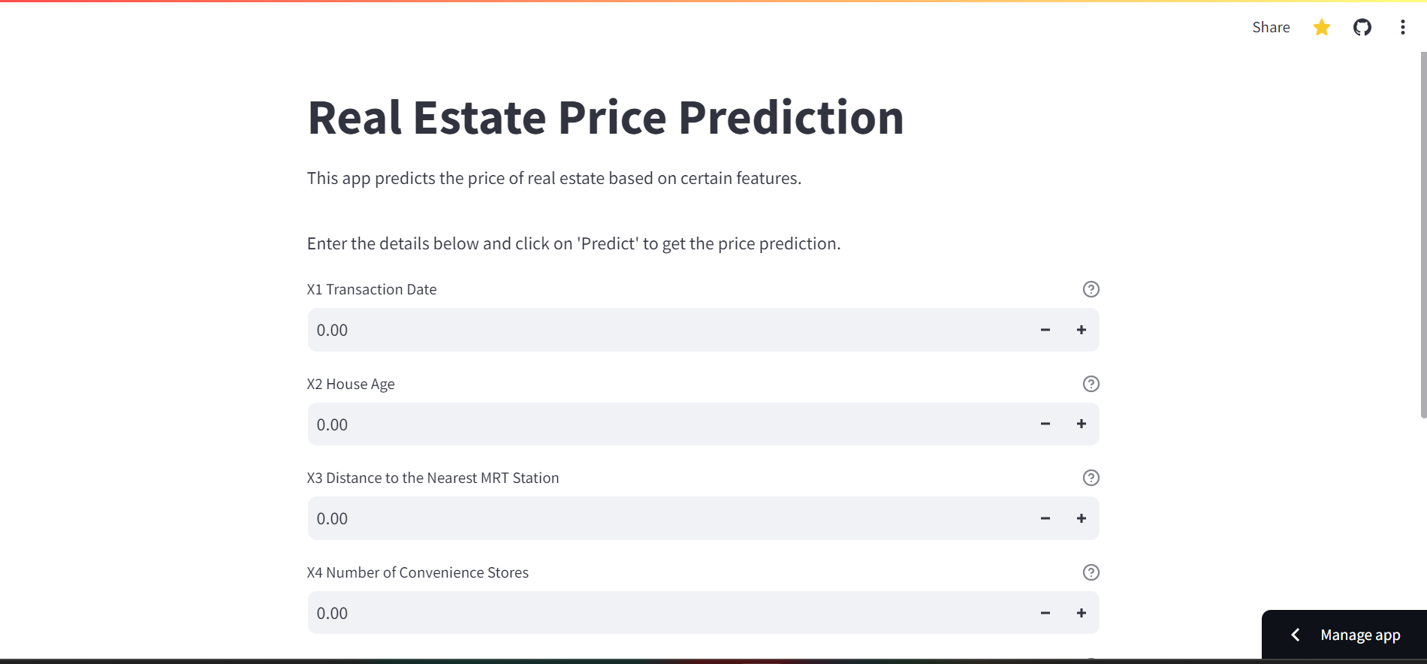
Streamlit Application:
Purpose:
Interactive web app for instant property price estimation.
Features:
User-friendly interface for inputting property details.
Immediate prediction of property prices.
Benefits:
Quick and accurate property valuation.
Supports informed real estate decisions.
Future:
Add more features for enhanced predictions.
Implement dynamic pricing for adaptability.

Slide 12
Conclusion:
Achievements:
Developed predictive model & Streamlit app for real estate price estimation.
Key Findings:
Model shows reasonable accuracy.
Streamlit app enables quick property valuation.
Implications:
Informs decision-making in real estate.
Enhances transaction transparency and efficiency.
Future Directions:
Explore advanced modeling.
Expand app features for broader usability.

Slide 13
Future Scope:
Advanced Modeling:
Explore advanced ML for better accuracy.
Feature Engineering:
Refine features for stronger predictions.
Spatial Analysis:
Dive deeper into geographical insights.
Temporal Analysis:
Forecast future price trends.
Ensemble Methods:
Enhance model robustness.
Data Integration:
Include more data for comprehensive analysis.
Dynamic Pricing Models:
Adapt to real-time market conditions.
Geospatial Visualization:
Visualize data for deeper exploration.

Slide 14

References:
https://www.geeksforgeeks.org/ml-linear-regression/
https://towardsdatascience.com/exploratory-data-analysis-8fc1cb20fd15
https://baotramduong.medium.com/regression-rivalry-mse-vs-mae-vs-rmse-which-is-the-best-metric-9f898167e773#:~:text=to%20use%20each.-,Mean%20Squared%20Error%20(MSE)%2C%20Mean%20Absolute%20Error%20(MAE,between%20predicted%20and%20actual%20values.

Slide 15

Thank you

