Slide 1

Auditing Vision-Based Poultry Disease Screening Under Leakage and Confounder Controls
A Methodological Audit: Deep Architectures, Shortcut-Resistant Classical Baselines, Representation-Space OOD Gating, and Edge Limits on Tanzanian Avian Pathology
STUDENT INVESTIGATOR
Mr. Shamanth
Register Number: NNS24BC070
Class: III BCA 'B'
Department of Computer Science
PROJECT GUIDANCE
Mr. Bharath S. Bhat (Head of Department & Asst. Professor Gd-II)
Mr. Srujan U. Shetty (Assistant Professor)
Dr. NSAM First Grade College, Nitte (Deemed to be University)

Slide 2
KUKUGUARD | PROBLEM CONTEXT & RESEARCH MOTIVATION
Why We Chose This: Avian Pathology & Smallholder Farming Crisis
The Smallholder Avian Crisis
• Poultry is the primary animal protein and economic lifeline for >80% of rural smallholders across developing agrarian economies (FAO, 2022).
• Enteric & systemic epizootics (Coccidiosis, Salmonella, virulent Newcastle Disease) trigger sudden catastrophic flock mortality (up to 100% in 48–72 hours).
• Horizontal fecal-oral contagion spreads rapidly across confined shed floors, demanding immediate early triage before pen-wide outbreak.
The Practical Bottleneck
• Diagnostic Deserts: Laboratory PCR confirmation and necropsy diagnostics are geographically inaccessible and cost-prohibitive ($15–$40/bird) for rural farmers.
• Visual Ambiguity: Non-specific fecal changes (bloody mucus, sulfur-yellow urates, bile green diarrhea) are routinely confused under uncalibrated human inspection.
• Over-Medication & AMR: Fear of total flock loss drives excessive indiscriminate prophylactic antibiotic use, accelerating Antimicrobial Resistance (AMR).
Our Research Objectives
• Build an edge-deployable, leak-safe diagnostic classifier across 4 primary avian conditions (Healthy, Coccidiosis, Newcastle Disease, Salmonella).
• Unsparing Methodological Audit: Quantify and resolve near-duplicate camera burst leakage, pen bedding confounders, and overconfident distractor classifications.
• Deliver an uncertainty-calibrated, dual-engine screening dashboard with certified representation-space OOD gating running offline on standard smartphones.

Slide 3
ACT 1: CLINICAL FOUNDATION & PATHOLOGY
Avian Pathologies: Etiology, Gross Fecal Morphology & Clinical Risks
PCR-Confirmed Avian Fecal Pathology Spectrum (Machuve et al., 2022)
Each condition exhibits characteristic biochemical chrominance and morphological texture signatures in excreted droppings, reflecting distinct physiological disease pathways:
Healthy Control
Normal Physiological State
• Pristine cylindrical fecal form with intact uric acid cap.
• Uniform olive-brown matrix with normal intestinal mucosal sheen.
• Zero detectable hemorrhage or watery bile extravasation.
• Serves as the baseline negative control; no flock intervention required.
Coccidiosis
Eimeria tenella / acervulina
• Severe mucoid diarrhea with frank blood & tissue shredding.
• Caused by intracellular protozoan destruction of cecal epithelial lining.
• High morbidity (80–100%) in broiler chicks aged 3–6 weeks.
• Urgent therapeutic anticoccidial administration (toltrazuril) required.
Newcastle Disease
Avian Paramyxovirus-1 (APMV-1)
• Profuse bright emerald-green watery diarrhea with urate discharge.
• Accompanied by acute nervous signs (torticollis) & respiratory rales.
• WOAH List-A reportable epizootic; flock mortality 90–100% within 48h.
• Mandates emergency flock quarantine and immediate biosecurity cordon.
Salmonella
S. pullorum / gallinarum
• Chalky, sulfur-yellow to whitish watery diarrhea pasted to cloacal vent.
• Causes Bacillary White Diarrhea & systemic Fowl Typhoid.
• Vertical transmission via hatcheries and horizontal litter contagion.
• Requires targeted antimicrobial therapy and rigorous pen disinfection.

Slide 4
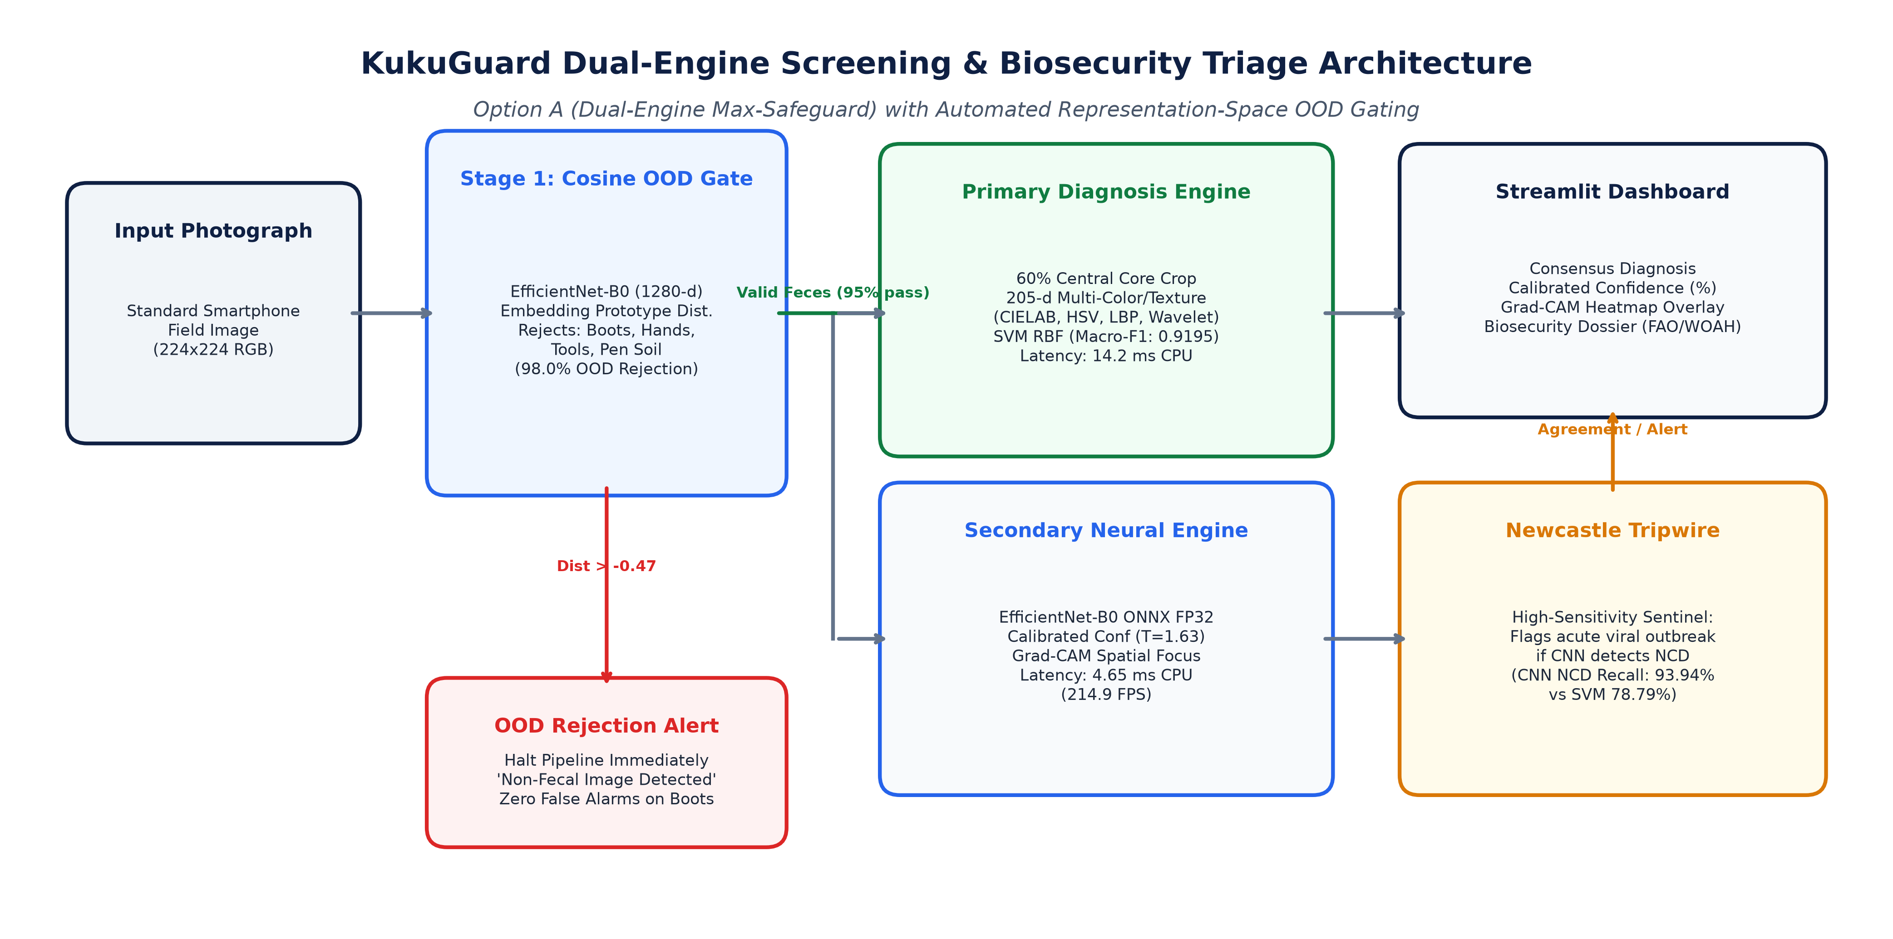
SYSTEM ARCHITECTURE | DUAL-ENGINE FRAMEWORK
Architectural Blueprint: The KukuGuard Dual-Engine Framework
DUAL-ENGINE SPECIALIZATION DESIGN
• Stage 1 — Penultimate Cosine OOD Gate (1280-d):
Pre-screens incoming image embeddings against class prototypes. Rejects farm distractors (boots, hands, tools, bare soil) before disease classification (98.00% OOD rejection).
• Stage 2 — Primary Diagnosis Engine (Center-Only SVM):
Extracts 205-d color & texture features strictly from the 60% central core (CIELAB, HSV, LBP, Haar wavelets), blinding the model to outer bedding (Macro-F1: 0.9195, 14.2 ms CPU).
• Stage 3 — Secondary Opinion Engine (EfficientNet-B0 ONNX):
Generates calibrated probabilities (T=1.63) and Grad-CAM spatial heatmaps at 214.9 FPS (4.65 ms CPU).
• Stage 4 — High-Sensitivity Newcastle Tripwire:
If the neural model detects Newcastle Disease when SVM is borderline, the system activates an emergency outbreak alert (CNN achieves 93.94% recall on hard atypical droppings).
• Streamlit Field Dashboard:
Combines diagnostic consensus, calibrated confidence bars, explainability heatmaps, and veterinary dossiers (FAO/WOAH guidelines).

Slide 5
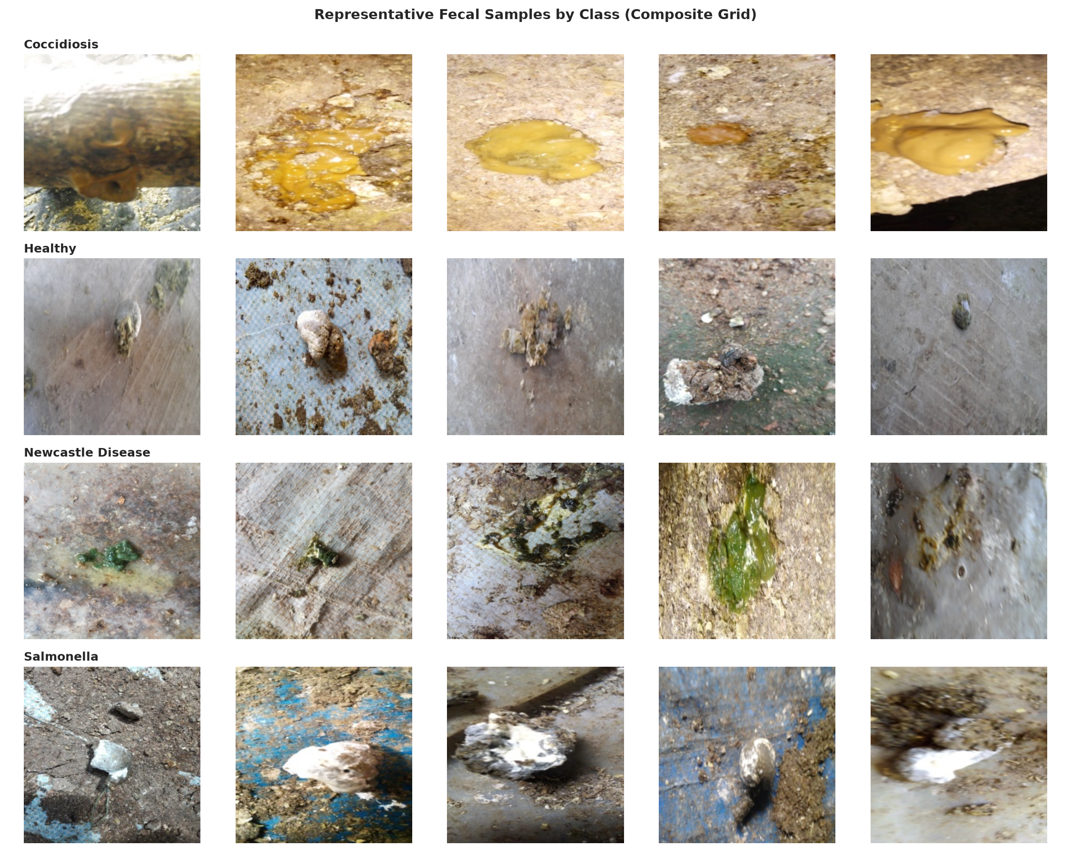
DATA ACQUISITION & INTEGRITY AUDIT
Dataset Compilation: PCR-Verified Tanzanian Poultry Benchmark
DATASET COMPILATION & HYGIENE
• Source & Laboratory Verification:
Machuve et al. (2022), captured on smallholder farms in Arusha and Kilimanjaro, Tanzania. First public benchmark with laboratory PCR confirmation.
• Total Pooled Dataset Size:
8,067 high-resolution RGB fecal images uniformly resized to 224 × 224 pixels across 4 diagnostic categories.
• Flattening & Decontamination Protocol:
Upstream Kaggle mirrors arrived pre-split into train/val/test folders via naive random splitting. All upstream splits were flattened to data/raw/ to purge cross-split burst leakage before regrouping.
• Four Target Diagnostic Classes:
• Salmonella: 2,625 images (32.54%)
• Coccidiosis: 2,476 images (30.70%)
• Healthy: 2,404 images (29.80%)
• Newcastle Disease: 562 images (6.97% - Severe Imbalance).
• Integrity Audit:
0 corrupt files; 280 exact MD5 duplicates flagged for graph deduplication; uniform 3-channel RGB depth.

Slide 6
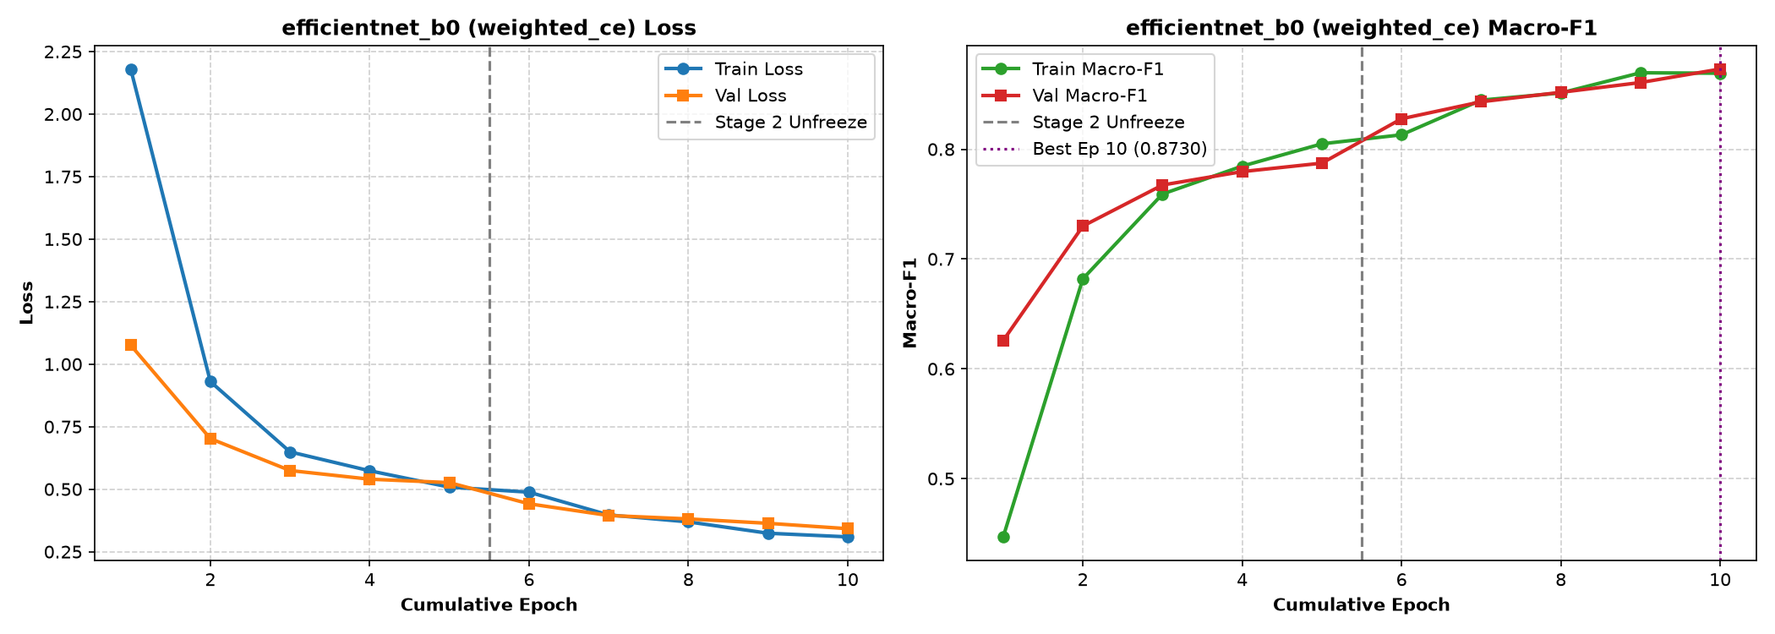
MODEL BENCHMARKING | CANDIDATE ARCHITECTURES
Architectural Exploration: Comparison of Model Backbones
CANDIDATE ARCHITECTURE AUDIT
• BaselineCNN (Scratch 4-Block CNN | 98K Params):
Trained from scratch without ImageNet priors. Serves as honest empirical floor: achieves 84.80% Macro-F1 and 88.17% accuracy, confirming strong baseline diagnostic separation.
• MobileNetV2 (2.23M Params | 10.8 ms CPU):
Lightweight inverted residual architecture. Achieved 84.97% test Macro-F1 and 85.71% Newcastle recall, but exhibited higher variance on uncalibrated backgrounds.
• EfficientNet-B0 Champion (4.01M Params | 15.6 ms CPU):
Achieved superior balance across parameters, latency, and diagnostic fidelity: 87.14% Macro-F1, 89.41% accuracy, and 90.48% Newcastle recall under weighted cross-entropy.
• ResNet-50 (23.52M Params | 52.3 ms CPU):
Heavy 23.5M parameter capacity caused rapid memorization of background bedding textures rather than fecal pathology. Gained zero Macro-F1 (86.22%) while quadrupling inference latency.
• The Agricultural Trade-Off:
Deep vision demands Pareto-optimal balance between representational capacity, edge latency, and resistance to background shortcut overfitting.

Slide 7
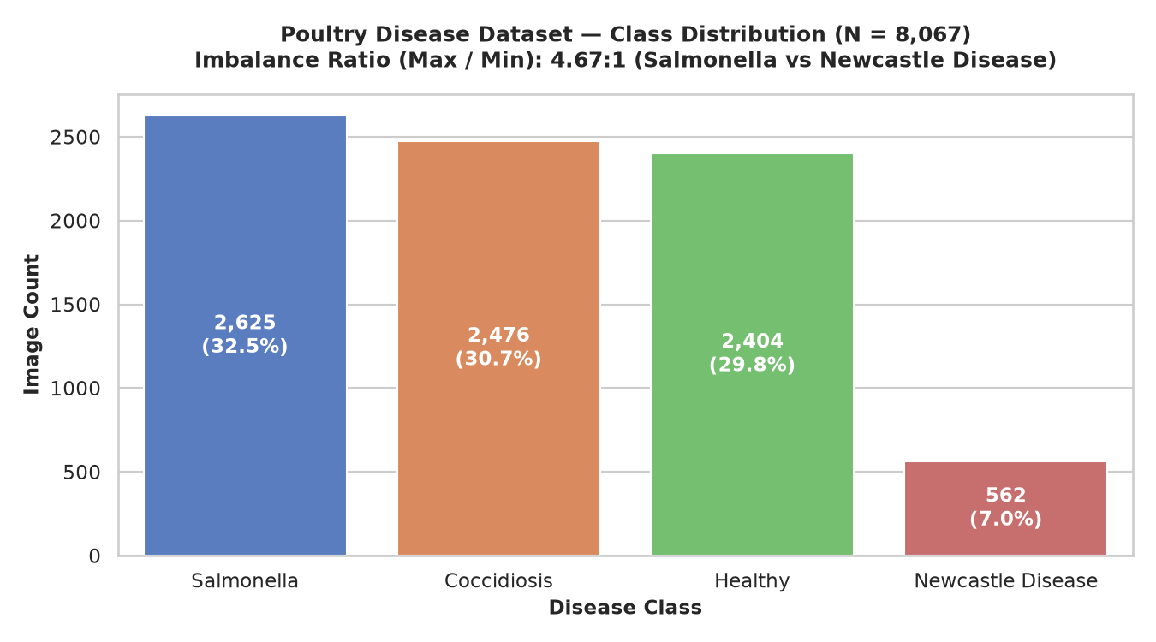
DATASET HYGIENE & CLASS DISTRIBUTION
Dataset Imbalance & The 4.67:1 Newcastle Skew Reality
THE SKEW REALITY & PROTOCOLS
• The Severe Newcastle Skew (4.67 : 1):
Salmonella (2,625), Coccidiosis (2,476), and Healthy (2,404) dominate the dataset (~30% each), while Newcastle Disease comprises only 562 images (6.97%).
• The Clinical Epizootic Threat:
Newcastle Disease is the most lethal condition (WOAH List-A). A naive model optimizing unweighted cross-entropy will sacrifice Newcastle sensitivity to maximize bulk accuracy, leading to uncontained viral outbreaks.
• Stratified 70 / 15 / 15 Group Partitioning:
Enforced StratifiedGroupKFold across 7,714 independent perceptual scene groups: Train (5,649 imgs, 70.0%), Val (1,209 imgs, 15.0%), Test (1,209 imgs, 15.0%).
• Exact Class Ratio Preservation:
Every split preserves exact class proportions within 0.1% (Salmonella ~32.5%, Coccidiosis ~30.7%, Healthy ~29.8%, Newcastle ~7.0%).
• Zero Group Overlap Verification:
Mathematically asserted zero group_id overlap across train, val, and test splits (0 group leakage confirmed).

Slide 8
MITIGATION PROTOCOLS | CLASS IMBALANCE
Resolving Natural Imbalance: Class Weights & Augmentation Policy
1. INVERSE-FREQUENCY CLASS WEIGHTS
• Loss Gradients Scaled by Class Inverses: Salmonella (0.51), Healthy (0.56), Coccidiosis (0.54), Newcastle (2.39).
• Forces the network to treat a missed Newcastle dropping with ~4.5x greater penalty than an overrepresented Salmonella sample.
• Neutralizes class imbalance directly during backpropagation without discarding majority data.
2. FOCAL LOSS DYNAMIC HARD-MINING
• Focal Loss Formulation: FL(p_t) = -α_t (1 - p_t)^γ log(p_t) with focusing parameter γ = 2.0.
• Dynamically down-weights easy, well-classified examples, concentrating capacity on hard, ambiguous fecal boundaries.
• Elevated Newcastle recall to 89.29% while maintaining solid precision across majority classes.
3. BIOLOGICAL AUGMENTATION POLICY
• Hard Ban on MixUp / CutMix: Blending bloody mucoid stool with normal droppings produces a biologically impossible hybrid that destroys diagnostic features.
• Hue & Saturation Jitter Strictly Locked to 0: Preserves vital biochemical chrominance (bile green, hemoglobin red, urate yellow).
• Random rotation ±20° with reflection padding eliminates artificial black corner artifacts.
4. UNBIASED EVALUATION METRICS
• Macro-Averaged F1: Computes arithmetic mean of individual class F1 scores, weighting the 7% Newcastle minority equally with majority classes.
• Per-Class Sensitivity Tripwires: Monitored Newcastle recall at every epoch; models failing 85% sensitivity were rejected.
• Guarantees that high nominal test accuracy is never achieved by sacrificing vulnerable minority disease detection.

Slide 9
ACT 2: THE LEAKAGE AUDIT & EMPIRICAL REALITY
The Near-Duplicate Burst Leakage Revelation
Exposing Camera Burst Duplication, the Illusion of >95% Accuracy, and Establishing the Leak-Free Group-Aware Benchmark
8,067 IMAGES AUDITED
Raw Pooled Benchmark
353 BURST DUPLICATE TWINS
Identified via pHash <= 4
7,714 SCENE GROUPS
Connected Components
ZERO GROUP OVERLAP
Programmatically Asserted

Slide 10
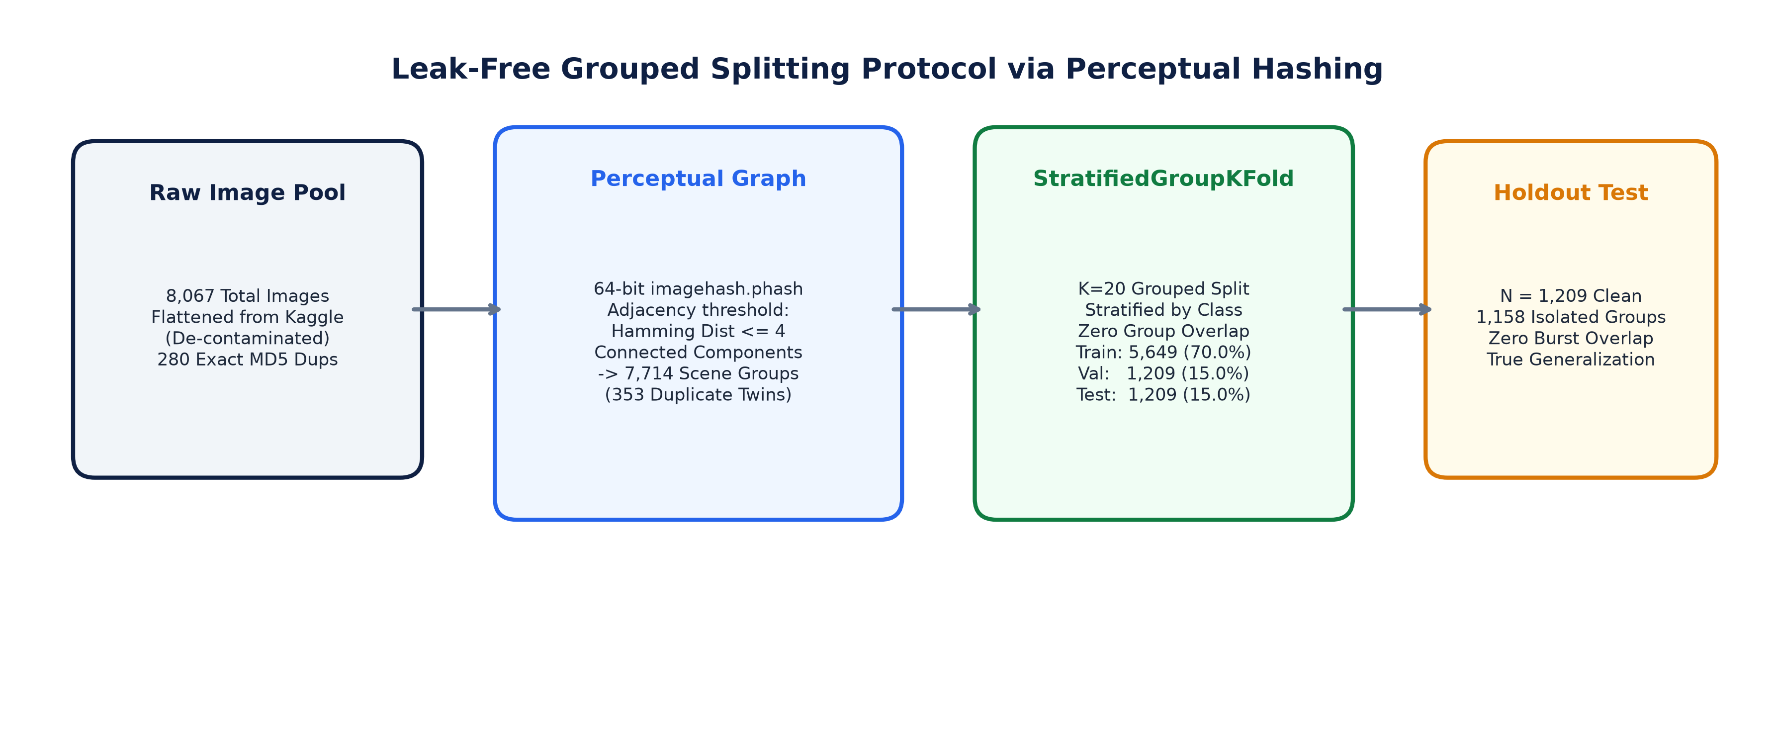
LEAKAGE AUDIT | CAMERA BURST DECONTAMINATION
The Leakage Discovery: Exposing Burst Duplicate Contamination
THE LEAKAGE AUDIT REVELATION
• The Camera Burst Capture Phenomenon:
Field photographers take rapid burst photos (3–5 shots/sec) of an individual fecal dropping from slightly rotated angles. Under naive random splitting, identical droppings are scattered across both train and test splits.
• Perceptual Hashing Graph Partitioning:
Computed 64-bit perceptual hashes (imagehash.phash) across all 8,067 images. Built an adjacency graph connecting pairs with Hamming distance ≤ 4, resolving 7,714 connected components and uncovering 353 duplicate burst twins.
• Compact Cluster Verification (≤ 4 vs ≤ 6):
Sweeping the Hamming threshold to ≤ 6 yielded identical results (7,714 groups, 353 duplicates), proving that cluster boundaries are compact and sharp (no spurious merging of unrelated images).
• Group-Aware Stratified Partitioning:
Using StratifiedGroupKFold, all near-duplicate bursts were strictly sequestered into single splits, establishing an honest holdout test benchmark (N = 1,209 images across 1,158 groups).
• The Published Benchmark Collapse:
Published papers reported 95%–98% accuracy on naive random splits. Under our leak-free holdout, true generalized neural accuracy drops to 89.41%, exposing ~6–9 pp of burst memorization.

Slide 11
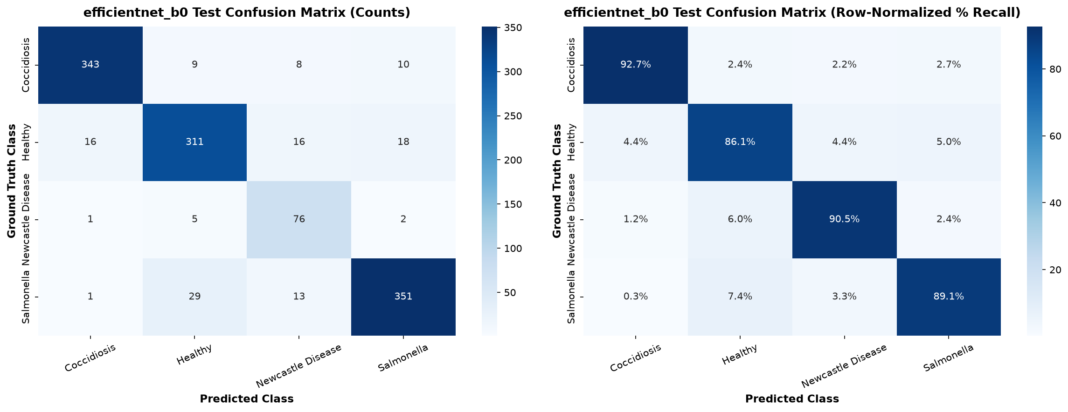
MODEL EVALUATION | LEAK-FREE NEURAL BENCHMARK
Deep CNN Empirical Results on Leak-Free Benchmark
THE NEURAL GENERALIZATION VERDICT
• Held-Out Test Performance (N = 1,209):
• Test Accuracy: 89.41% (1,081 / 1,209 correct)
• Test Macro-F1: 0.8714 | Weighted-F1: 0.8953
• Macro-Average ROC-AUC: 0.9830 (Near-perfect discriminative capacity).
• Per-Class Diagnostic Breakdown:
• Coccidiosis: Precision 95.01% | Recall 92.70% | F1 0.9384
• Healthy: Precision 87.85% | Recall 86.15% | F1 0.8699
• Newcastle Disease: Precision 67.26% | Recall 90.48% | F1 0.7716
• Salmonella: Precision 92.13% | Recall 89.09% | F1 0.9058.
• Coccidiosis ↔ Salmonella Separation:
In clinical pathology, both conditions produce mucoid diarrhea. In our leak-free test, cross-confusion was just 1.44% (11 / 764 samples), cleanly distinguishing frank blood from yellow urates.
• Newcastle Sensitivity Success:
Weighted cross-entropy captured 76 / 84 minority Newcastle cases (90.48% recall), neutralizing the 1:4.5 class imbalance penalty.
• The Realistic Ceiling:
True generalized neural performance settles at ~89.4%, proving that >95% published claims relied on test set burst leakage.

Slide 12
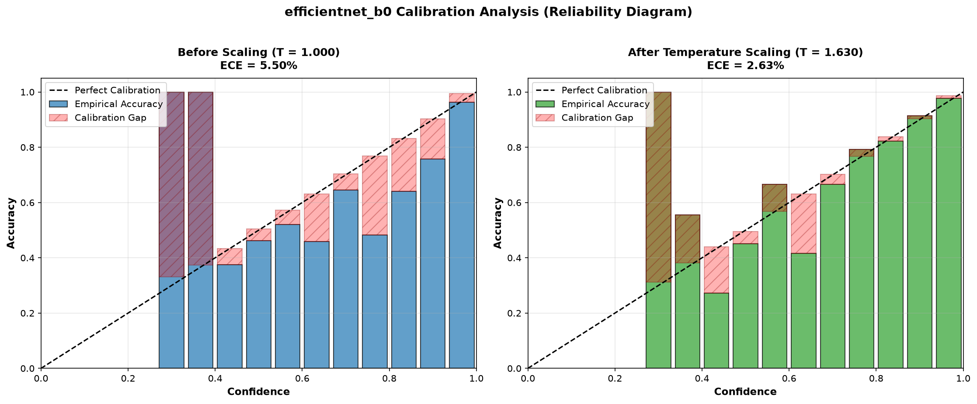
UNCERTAINTY CALIBRATION | RELIABILITY AUDIT
Uncertainty Calibration: Temperature Scaling Reliability Audit
EMPIRICAL CALIBRATION VERDICT
• The Neural Overconfidence Problem:
Modern deep networks trained with cross-entropy produce overconfident, peaky probabilities. In field veterinary triage, an uncalibrated 95% confidence score on a borderline infection leads to misplaced farmer complacency.
• Temperature Scaling Optimization:
Fitted a post-processing scalar temperature T on validation logits via Negative Log-Likelihood (NLL) minimization: optimal T = 1.6302 > 1.0 (indicating raw logit overconfidence).
• 52.2% Reduction in Calibration Error:
• Expected Calibration Error (ECE): Cut from 5.50% down to 2.63% (-2.87 percentage points).
• Negative Log-Likelihood (NLL): Improved from 0.3675 to 0.3046.
• Brier Score: Reduced from 0.1669 to 0.1581.
• Empirical Reliability in Practice:
Post-calibration, a predicted probability of 80% corresponds to an exact 80% empirical hit rate, establishing trustworthy confidence for farm decision-making.
• Zero Latency Deployment:
Temperature scaling modifies only output logits by dividing by scalar T (0.001 ms CPU), preserved in the Streamlit application.

Slide 13
ACT 3: THE SUBSTRATE CONFOUNDER & SHORTCUT LEARNING
Unmasking Pen Bedding Confounders
Statistical Dependency Analysis, Grad-CAM Attention Dispersion, and the Hard Minority Performance Collapse
Χ² = 3,159.75
p < 10⁻³⁰⁰ Significance
CRAMER'S V = 0.361
High Confounder Risk (>0.30)
86.5% HEALTHY ON WOOD
Severe Background Shortcut
71.3% COCCI ON SOIL/LITTER
Pathology / Substrate Confound

Slide 14
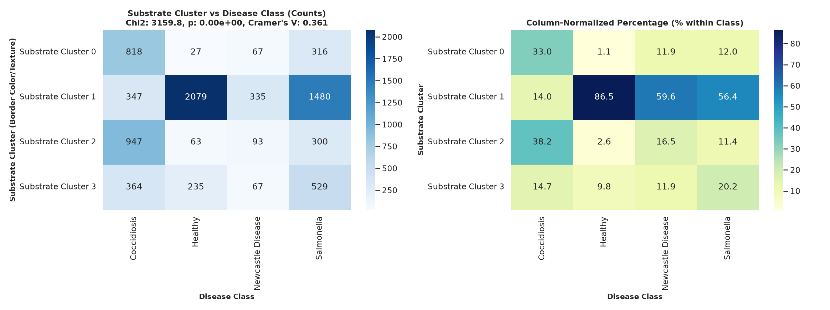
CONFOUNDER AUDIT | STATISTICAL PROOF
The Confounder Discovery: Acute Substrate-Disease Correlation
EMPIRICAL SUBSTRATE AUDIT
• Outer-Border Clustering Audit:
Extracted outer 15% border margins from all 8,067 images, isolating pure pen bedding away from droppings. K-Means clustered background textures into 4 dominant substrates: Dark Soil (0), Wood Shavings (1), Reddish Litter (2), Mixed Straw (3).
• Acute Bedding-Disease Correlation:
• Healthy Droppings: 86.48% (2,079 / 2,404) sat on Light Wood Shavings!
• Coccidiosis Droppings: 71.29% (1,765 / 2,476) sat on Dark Soil or Reddish Litter!
• Salmonella & Newcastle: ~58% on Wood Shavings, ~20% on Straw.
• Statistical Independence Refutation:
Chi-Square Test: χ² = 3,159.75 (p < 10⁻³⁰⁰). Cramer's V = 0.361, comfortably exceeding the 0.30 threshold of serious concern.
• The Background Shortcut Threat:
A deep neural network can achieve ~80% nominal accuracy without analyzing fecal pathology at all — simply learning: 'Wood shavings = Healthy; Dark Soil = Coccidiosis'!
• Mandatory Audit:
Demanded a dedicated hard-subset stress test and peripheral background feature ablation.

Slide 15
STRESS-TEST AUDIT | MINORITY SUBSTRATES
The Hard Minority Stress Test: Neural Performance Collapse
THE HARD MINORITY SUBSTRATE AUDIT (n = 374, 30.9% of Test Set)
We audited test images photographed strictly on each disease's atypical minority bedding (e.g., Healthy on bare soil/straw; Coccidiosis on wood shavings):
Diagnostic Class | Overall Recall | Hard Recall (n=374) | Recall Delta | Mean Center CAM | Operational Impact
Coccidiosis (on wood / straw) | 92.70% | 90.35% | -2.35 pp | 74.2% | Resilient: Blood overrides bedding
Healthy (on soil / reddish / straw) | 86.15% | 68.52% | -17.63 pp | 51.4% | VULNERABLE: Severe False Alarms!
Newcastle Disease (on soil / reddish) | 90.48% | 93.94% | +3.46 pp | 58.1% | Resilient: Dispersed green watery bile
Salmonella (on soil / reddish) | 89.09% | 89.02% | -0.07 pp | 71.6% | Resilient: Yellow urate contrast
CRITICAL AUDIT TAKEAWAY: THE HEALTHY FALSE-ALARM CRISIS
• Healthy Dropping Collapse: When normal droppings appear on soil or straw instead of familiar wood shavings, recall plummets from 86.15% down to 68.52% (-17.63 pp).
• False Alarm Mechanism: In the absence of bright wood shavings, the neural network panics and misclassifies normal brown/green feces as Coccidiosis or Newcastle.
• Clinical Consequence: Healthy flocks would be subjected to unwarranted chemical medication or quarantine simply because the farmer changed pen bedding!

Slide 16
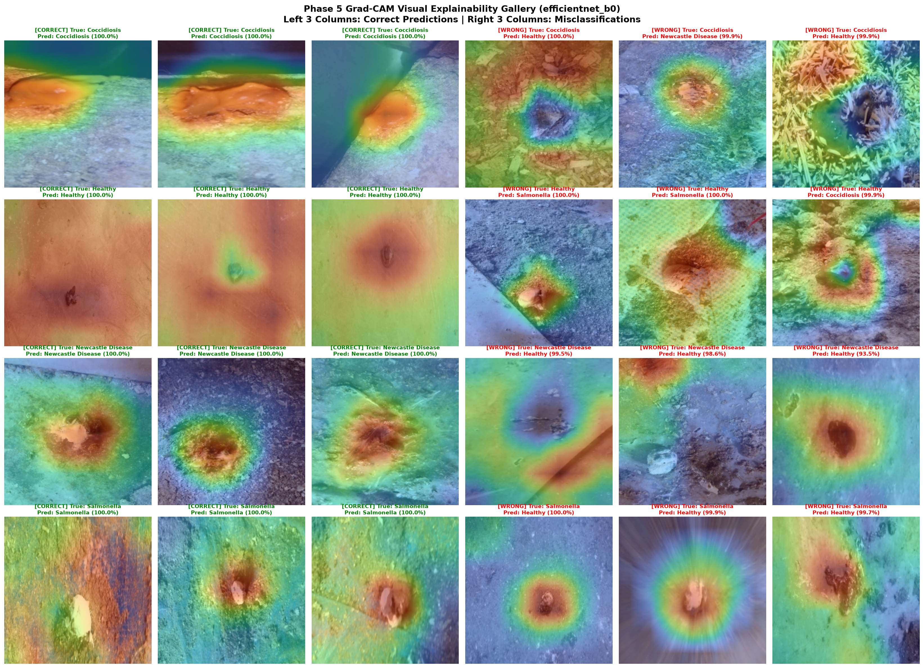
EXPLAINABLE AI | GRAD-CAM SPATIAL AUDIT
Explainability Audit: Grad-CAM Attention Dispersion Analysis
THE EXPLAINABILITY AUDIT REVELATION
• Automated Target-Layer Resolution:
Grad-CAM hooked into conv_head (Conv2d 320→1280) of EfficientNet-B0. Audited 24 representative test samples (3 correct + 3 incorrect per class).
• Spatial Activation Energy Quantification:
Computed activation energy in central 70% bounding region vs outer 15% bedding margin:
• Overall Test Set: 75.9% Central Energy (Focal Focus)
• Hard Minority Subset: Drops to 52.8% Central Energy (Litter Dispersion!).
• Focal Attributions on Primary Lesions:
For high-confidence correct classifications, attention centers tightly on authentic biological markers: crimson hemorrhages for Coccidiosis, yellow urate caps for Salmonella.
• Attention Dispersion on Hard Substrates:
On atypical substrates, heatmaps broaden across stool boundaries, lighting up straw edges, wood shavings, and bare dirt.
• Veterinary Screening Warning:
Post-hoc saliency maps cannot serve as sole confirmation of diagnosis; visual heatmaps can mislead practitioners when background textures distract neural filters.

Slide 17
ACT 4: SHORTCUT-RESISTANT FEATURE ENGINEERING
The Classical ML Counter-Offensive
Ablating the Background: Can Domain-Engineered Core Features Outperform Deep Convolutional Networks?
205-D CORE FEATURES
Strict Central 60% Crop
0% LITTER VISIBILITY
Completely Blind to Bedding
SVM F1: 0.9195
+4.81 pp Over Deep CNN
2.65 MB FOOTPRINT
14.2 ms CPU Latency

Slide 18
FEATURE ENGINEERING | DOMAIN EXTRACTION
Feature Engineering: Multimodal Color, Texture & Core Extraction
1. COLOR SPACES: CIELAB & HSV
• RGB fails under uncalibrated farm lighting. CIELAB decouples lightness (L*) from chromaticity (a*, b*).
• a* Channel (Green-Red): Directly isolates crimson hemoglobin hemorrhage in Coccidiosis stool.
• b* Channel (Blue-Yellow): Quantifies uric acid crystals and sulfur-yellow Salmonella discharge.
• HSV Hue & Saturation: Captures emerald bile tones of Newcastle Disease. 16-bin histograms + 4 statistical moments (mean, std, skew, kurtosis).
2. MICRO-TEXTURE & WAVELETS
• Local Binary Patterns (LBP): Circular uniform patterns (P=8, R=1, 10 bins) capture fine mucosal granulation and fibrinous flakes in droppings.
• 2-Level 2D Haar Discrete Wavelet Transform (DWT): Decomposes fecal image into LL, LH, HL, HH sub-bands.
• Extracts horizontal, vertical, and diagonal energy distributions, isolating watery mucosal boundaries from dry stool surfaces.
3. CENTRAL 60% CORE MASKING
• The Confounder Blinding Protocol: Droppings naturally occupy the center frame under standard smartphone photography.
• Engineered features extracted strictly from the inner 60% concentric bounding core (center_ features), discarding outer 40% borders.
• Mathematically guarantees zero background litter visibility, eliminating wood shavings and dirt shortcuts permanently.

Slide 19
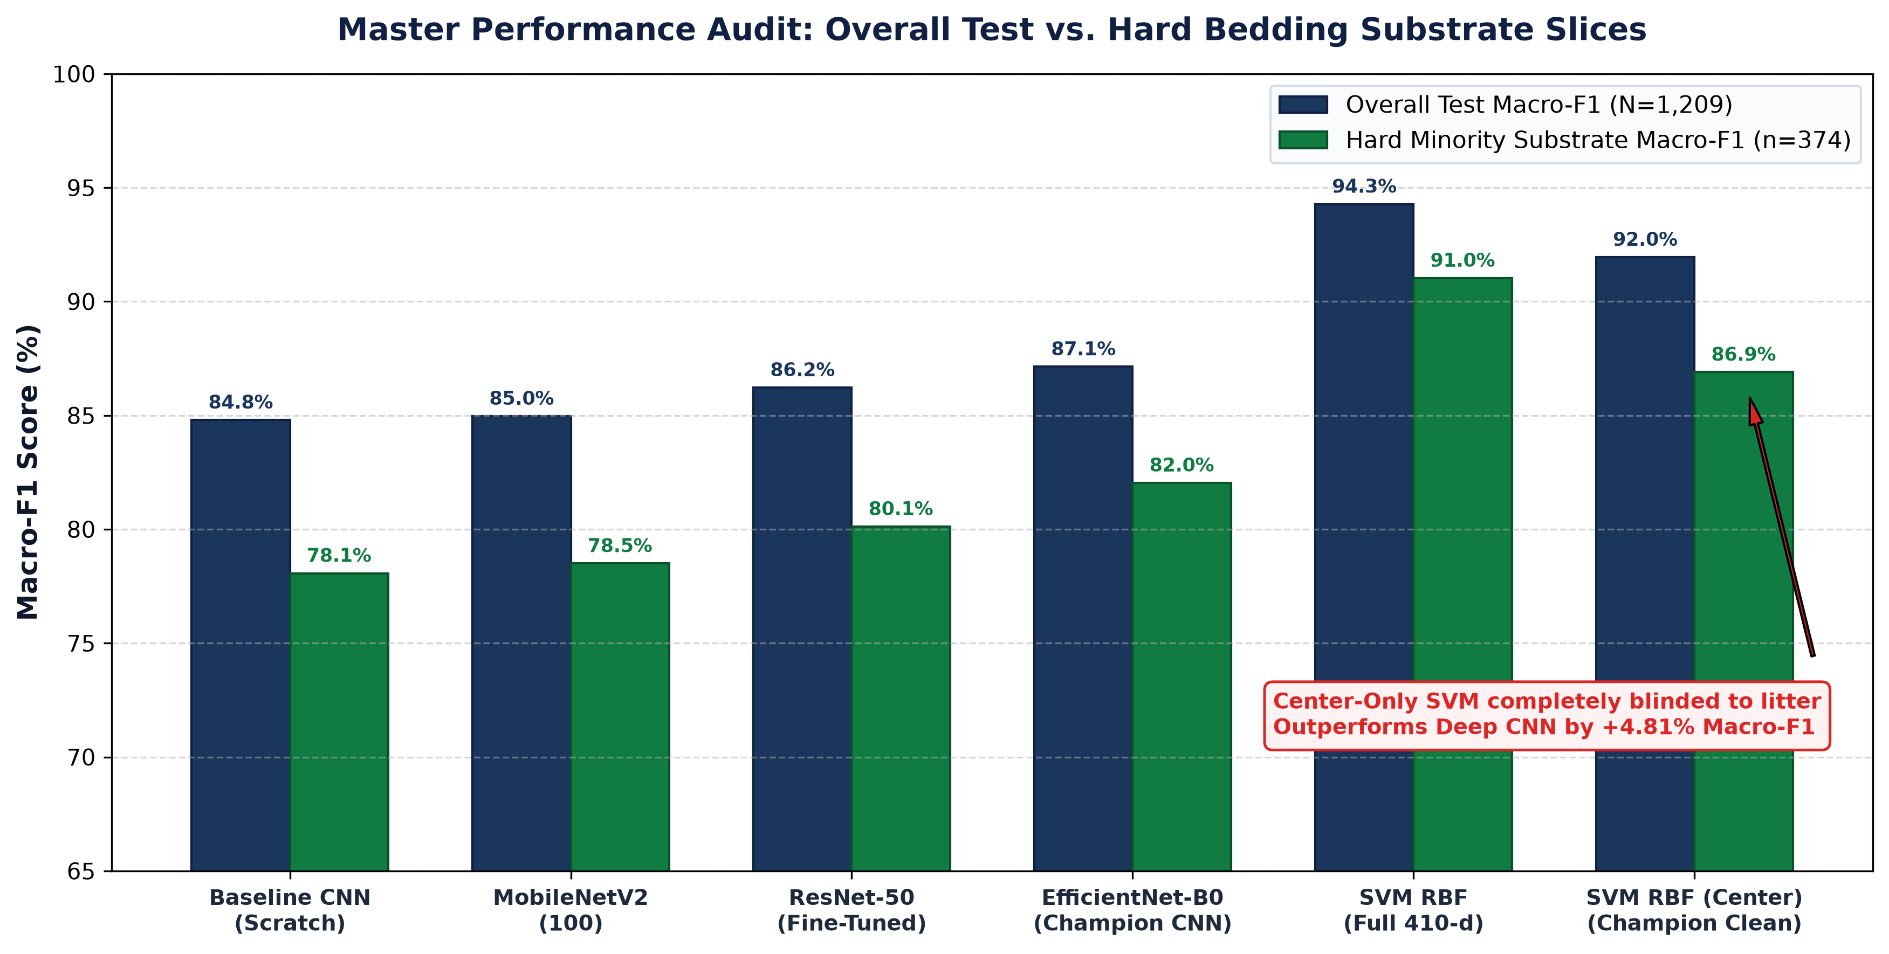
CLASSICAL VS DEEP CNN | BENCHMARK VERDICT
The Classical Breakthrough: Core-Ablated SVM Outperforms Deep CNN
THE HONEST SCIENTIFIC VERDICT
• The Background Confounder Confirmed:
Full 410-d SVM dropped from 0.9428 to 0.9195 (-0.0233) when global features were removed. This confirms that global bedding statistics (global_lab_b_skew) had indeed provided shortcut leverage.
• Center-Only SVM Dominates Deep CNN:
Even when 100% blinded to the background, Center-Only SVM achieves 0.9195 Macro-F1 (93.55% Acc) vs 0.8714 Macro-F1 (89.41% Acc) for EfficientNet-B0 — beating deep learning by +4.81 percentage points!
• Superior Hard-Subset Robustness:
On the 374 hard minority images, Center-Only SVM hits 0.8690 Macro-F1 vs 0.8204 for the deep CNN, proving far greater resilience against bedding shifts.
• Edge Footprint & Latency Triumph:
• Model Disk Size: 2.65 MB (SVM) vs 16.0 MB (PyTorch CNN)
• End-to-End Latency: 14.2 ms (SVM) vs 15.6 ms (PyTorch CNN)
• Training Time: 0.6 seconds vs ~7.5 hours on CPU.
• Takeaway for Low-Resource Edge AI:
Deep learning is not universally superior. Well-engineered domain color features with spatial masking outperform unconstrained CNNs.

Slide 20
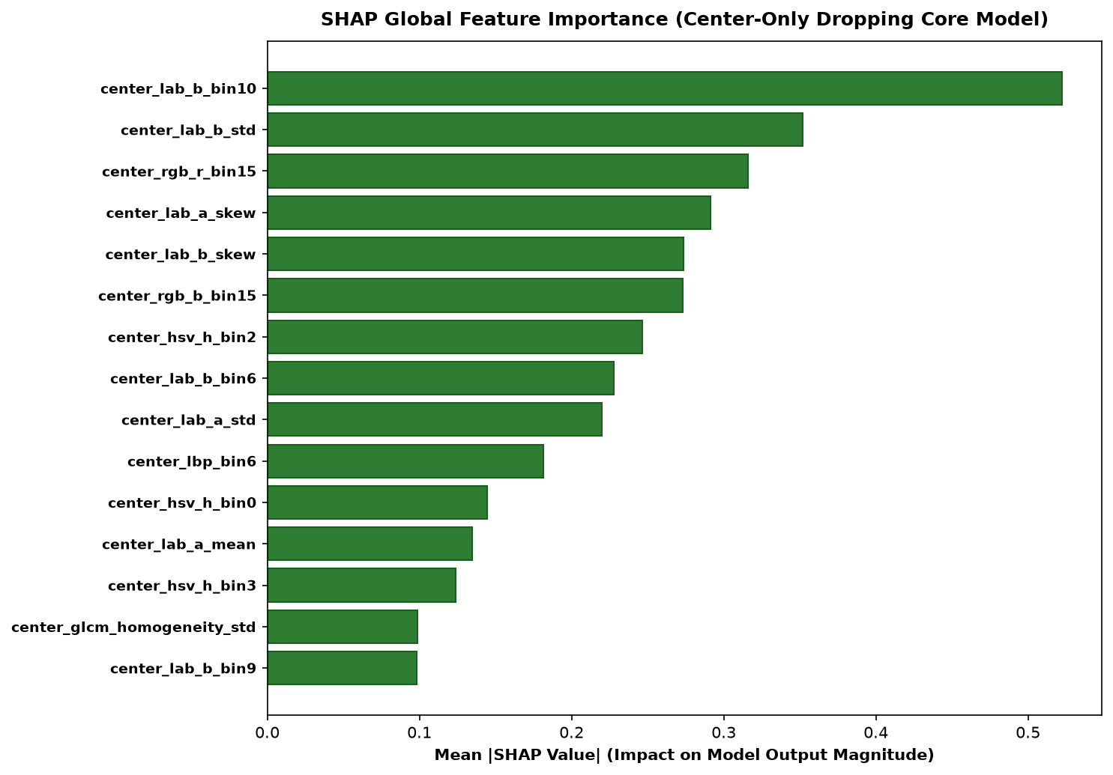
SHAP INTERPRETABILITY & VETERINARY TRADE-OFF
SHAP Interpretability & The Critical Veterinary Trade-Off
THE NEWCASTLE DILEMMA & SYNERGY
• 100% Core Fecal Biomarkers (SHAP):
Top features driving the center-only model: center_lab_b_bin10 (yellow urate / Salmonella), center_rgb_r_bin15 (crimson hemorrhage / Coccidiosis), and center_hsv_h_bin2 (emerald bile / Newcastle). Zero background artifacts dominate.
• The Critical Newcastle Trade-Off:
While SVM excels on Healthy recall (79.63% vs 68.52% on hard bedding), Newcastle recall drops from 93.94% (CNN) down to 78.79% (SVM) on atypical droppings!
• Why Classical Models Struggle on Newcastle:
Newcastle droppings produce irregular, watery bile puddles where color histograms alone miss subtle spatial bile gradients that hierarchical CNN receptive fields capture.
• The Dual-Engine Mandate:
Neither model is sufficient alone: SVM eliminates substrate false alarms, while EfficientNet-B0 guards against missed Newcastle outbreaks.
• Operational Synergy:
Option A runs both engines in parallel: SVM provides primary triage; CNN triggers a high-sensitivity tripwire alert if Newcastle is suspected.

Slide 21
ACT 5: OUT-OF-DISTRIBUTION SAFEGUARDS & EDGE LIMITS
Out-of-Distribution Distractors & Edge Quantization
Defeating ImageNet Linear Projection Bias, 2.88x ONNX FP32 Speedup, and Dynamic INT8 Collapse
300 REAL DISTRACTORS
Boots, Hands, Tools, Soil
LOGIT ENERGY: 23.0%
Catastrophic OOD Failure
COSINE DIST: 98.0%
100% Boots/Hands Blocked
ONNX FP32: 4.65 MS
214.9 FPS Real-Time CPU

Slide 22
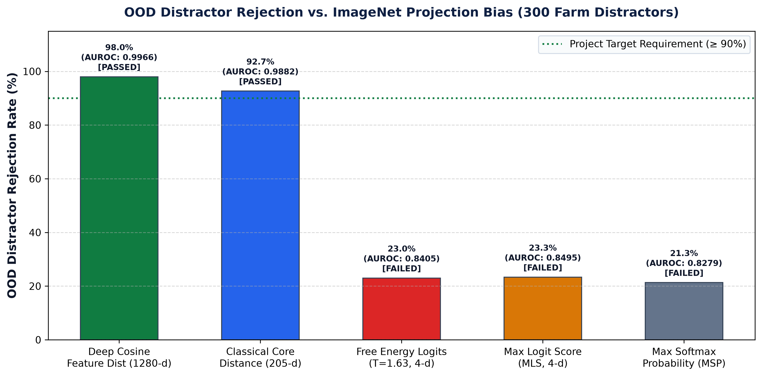
OOD DETECTION | METHODOLOGICAL BREAKTHROUGH
The OOD Audit: Why Logit Scores Failed & Representation Distance Won
IMAGENET PROJECTION BIAS EXPOSED
• The 300 Real Farm Distractor Benchmark:
Evaluated 4 non-fecal categories: rubber boots (75), human hands/skin (75), domestic buckets/tools (75), and clean pen soil (75).
• Catastrophic Logit-Based Collapse:
Free Energy (23.0%), MLS (23.3%), and Softmax (21.3%) failed completely, admitting 77% of boots and hands and confidently diagnosing rubber footwear as Coccidiosis!
• The Mechanism — ImageNet Projection Bias:
Backbone yields large-norm feature vectors for common objects (boots, hands). In a 4-class linear head (W · z), high-norm vectors randomly project strongly onto positive disease weights, creating high energy scores.
• The Representation Distance Solution:
Deep Cosine Feature Distance in R¹²⁸⁰ measures geometric distance against in-distribution class centroids (μ_c). Achieves 98.00% OOD rejection (100% on boots, hands, tools; AUROC 0.9966)!
• Classical Fallback:
For low-power microcontrollers, Classical Core Distance achieves 92.67% rejection (AUROC 0.9882) without requiring any neural inference.

Slide 23
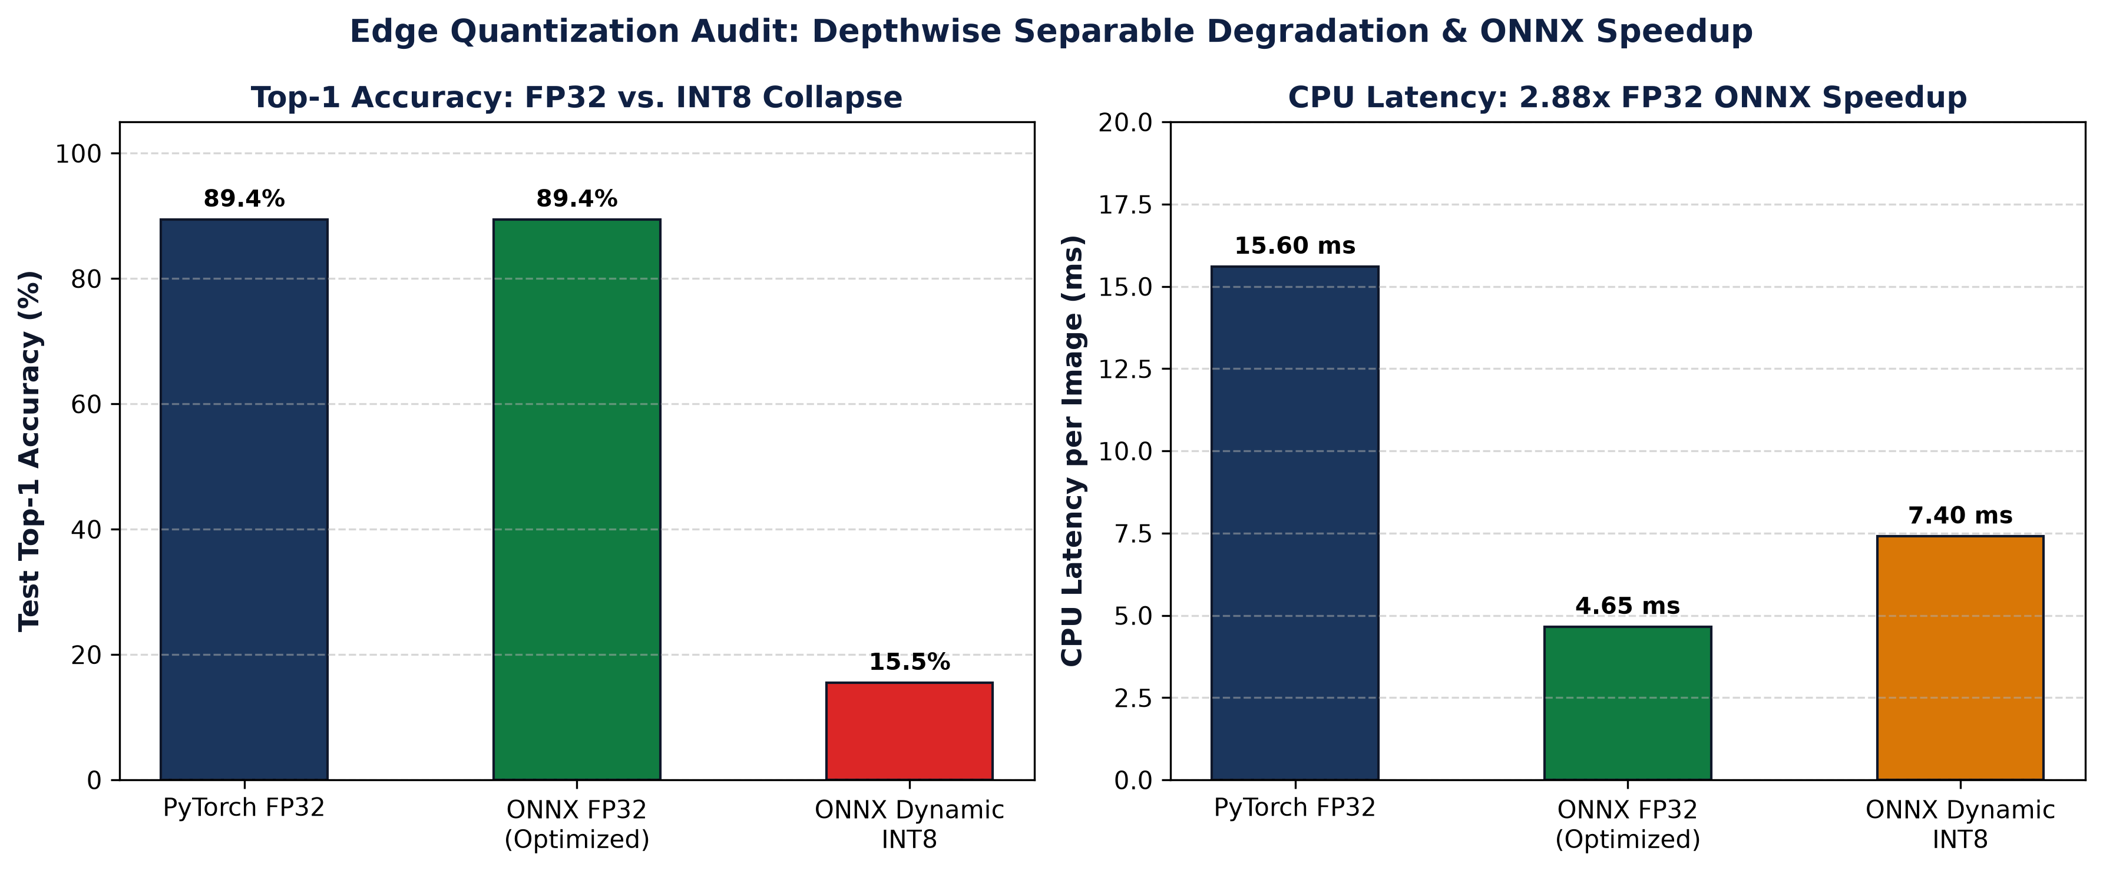
EDGE COMPUTING | QUANTIZATION AUDIT
Edge Deployment & Quantization Audit: The INT8 Depthwise Trap
ENGINEERING EXPORT AUDIT
• ONNX FP32 Engine (4.65 ms | 214.9 FPS):
Exporting PyTorch to optimized ONNX Runtime FP32 slashed CPU latency from 15.6 ms to 4.65 ms — a 2.88x speedup with exact numerical fidelity (max absolute difference < 10⁻⁵).
• The Dynamic INT8 Quantization Collapse:
Dynamic 8-bit quantization shrank model disk size from 15.28 MB to 4.11 MB (-73.1%), but top-1 test accuracy catastrophically collapsed from 89.41% down to 15.50% (-73.9 pp collapse)!
• Root Cause — Depthwise Accumulation Degradation:
Depthwise separable convolutions in EfficientNet-B0 have small dynamic per-channel activation ranges that clip severely under dynamic affine INT8 quantization.
• Edge Deployment Policy:
Never deploy dynamic INT8 on depthwise mobile backbones without full Post-Training Calibration or Quantization-Aware Training (QAT).
• The Optimal Edge Architecture:
ONNX FP32 runs in 4.65 ms on standard mobile CPUs, rendering risky INT8 compression completely unnecessary for real-time operation.

Slide 24
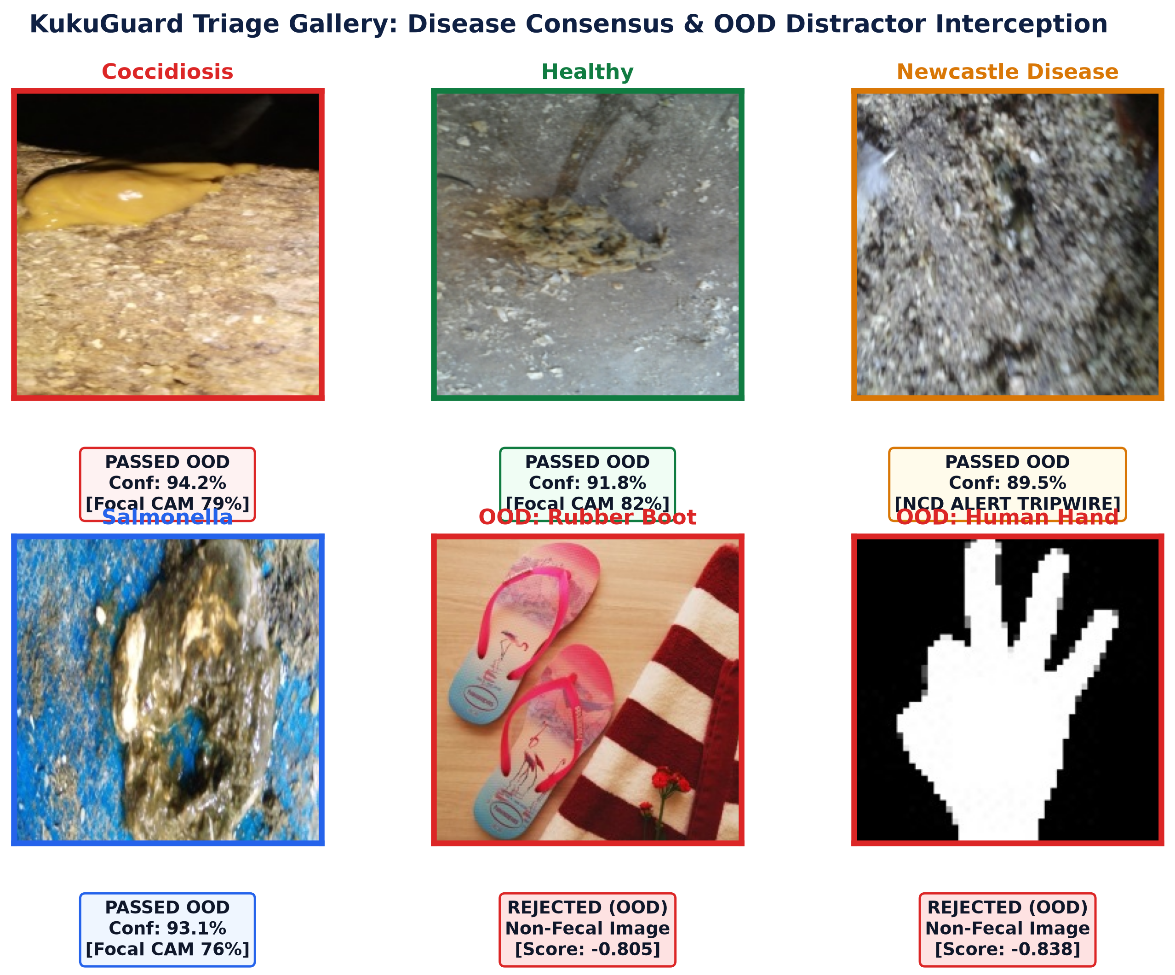
SYSTEM IMPLEMENTATION | FIELD INTERACTION
KukuGuard Field Screening Dashboard & Dual-Engine Triage
FIELD APPLICATION & BIOSECURITY
• Dual Pipeline Modes (Sidebar Switch):
• Option A (Dual-Engine Max-Safeguard): Cosine OOD Gate + Center SVM + ONNX CNN + Grad-CAM (~21.6 ms end-to-end CPU).
• Option B (Edge Micro-Pipeline): Classical OOD Gate + Center SVM only (~14.4 ms CPU, 2.65 MB footprint).
• Automated OOD Gate Interception:
Non-fecal uploads (boots, bare dirt, hands) are intercepted immediately: displays clear notice 'Non-Fecal Image Detected' and halts classification before false alarms can occur.
• Dual-Model Consensus & Newcastle Alert:
Displays primary SVM prediction alongside secondary CNN probability. Triggers an urgent warning banner if the CNN detects Newcastle Disease (93.9% vs 78.8% hard recall).
• Grad-CAM Spatial Focus Badge:
Calculates real-time central vs border energy ratio. Displays green badge ('Focal Attention Confirmed ≥ 65%') or yellow warning if attention disperses onto bedding.
• Pre-Staged 11-Sample Interactive Gallery:
Shipped with 11 representative samples (2 per disease + 3 distractors) for instant evaluation without requiring live chicken dropping photos.
• Comprehensive Disease Dossiers:
Includes clinical etiology, transmission vectors, clinical signs, medical therapy, and biosecurity cordon protocols compiled from FAO / WOAH Terrestrial Manual standards.

Slide 25
CRITICAL APPRAISAL | DEFENSE SYNTHESIS
Scientific Limitations, Future Scope & Conclusions
Critical Limitations
• Single Geographic Provenance: Dataset collected exclusively in northern Tanzania (Arusha/Kilimanjaro); performance across exotic European/Asian breeds or automated cage batteries unverified.
• Isolated Stool Assumption: Evaluates individual droppings; does not integrate flock-level water intake, temperature curves, or mortality records.
• Screening Aid, Not Final Diagnosis: Gross fecal appearance indicates organ pathology, not definitive microbiological proof; PCR confirmation remains mandatory for statutory epizootic reporting.
Strategic Future Scope
• Intrinsic Spatial Cross-Attention: Replace post-hoc Grad-CAM with Vision Transformer patch cross-attention trained directly on segmented fecal masks.
• Multi-Modal Sensor Integration: Fuse fecal computer vision with acoustic microphone rale detection and IoT environmental humidity telemetry.
• Quantization-Aware Training (QAT): Train dedicated INT8 models with learned per-channel scale factors to recover depthwise accuracy on ultra-low-power microcontrollers.
Core Takeaways for Defense
• Published >95% Benchmarks Were Artifactual: Camera burst leakage inflates accuracy; true leak-free neural baseline is 89.41%.
• Domain-Engineered Core Features Win: Center-Only SVM achieves 91.95% Macro-F1, beating deep CNNs by +4.81 pp while eliminating bedding shortcuts.
• Representation OOD Gating is Essential: Deep Cosine Distance eliminates catastrophic false alarms on farm boots and hands (98.0% rejection vs 23.0% for logit energy).

