Slide 1
Mini project -SAREPAKA SURYA SAHITHI

Slide 2
TASK 1 — Understanding & Opening Raw Detector Image Data
Why Understand Raw Detector Image Files?
Detector hardware (FPGA + sensors) does not produce JPG/PNG
It produces raw numeric data
Engineers must understand exact memory layout before processing
Why this matters?
Wrong interpretation → wrong image → wrong conclusions
FPGA pipelines rely on precise data formats
This task builds the foundation for all further image processing

Slide 3
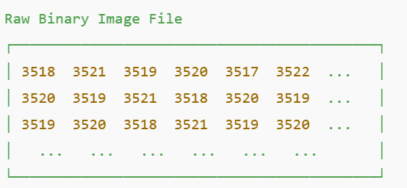
What is a Raw Binary Image?
A raw image is a binary file
Contains only numbers
No compression
No color format
No image headers like JPG/PNG
IN OUR CASE
Image type: 16-bit grayscale
Pixel range: 0 – 65535
Each pixel = one number

Slide 4
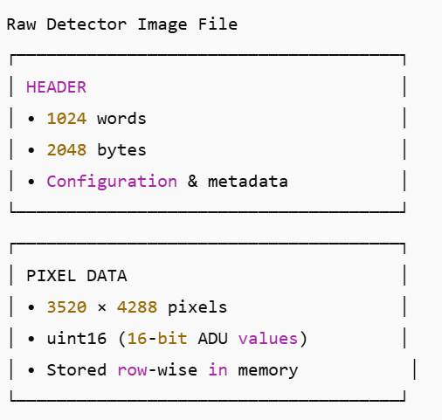
Raw File Structure
FILE LAYOUT
| Header | Pixel Data |
HEADER
Size: 1024 words
1 word = 16 bits = 2 bytes
Total header = 2048 bytes
Contains detector configuration & metadata
PIXEL DATA
Size: 3520 × 4288 pixels
Data type: uint16
Stored row-wise in memory

Slide 5
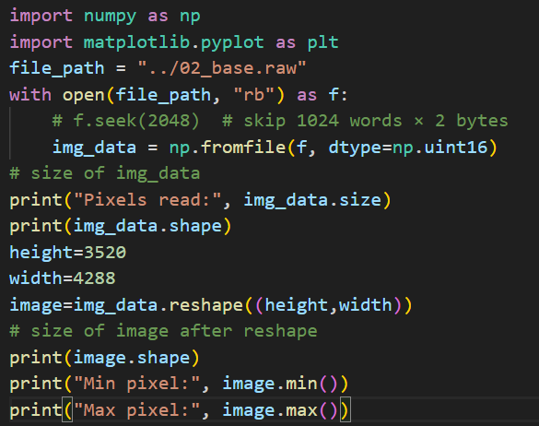
How Raw Data Was Read?
Binary file opened in read mode
Header skipped
Pixel data read as uint16
Reshaped into image

Slide 6
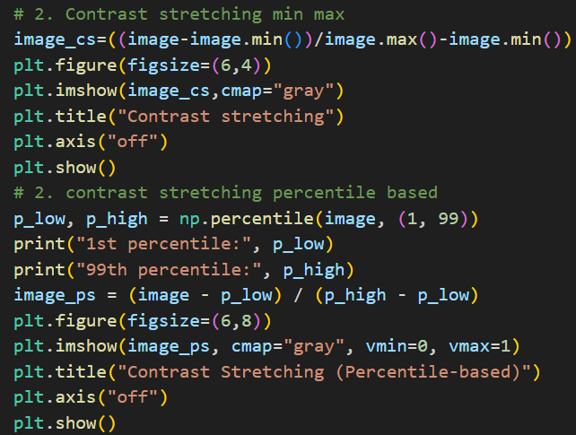
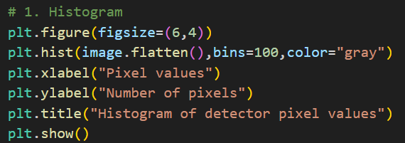
Image processing techniques implementation
1. Histogram
2.Contrast stretching
Histogram reveals narrow pixel distribution, indicating baseline offset and low contrast in raw detector output.
Contrast stretching reveals hidden row-wise detector structure

Slide 7
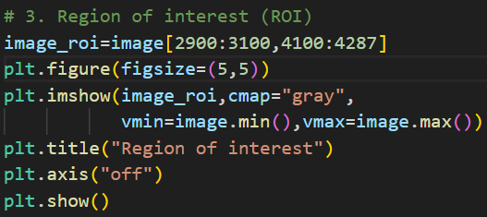
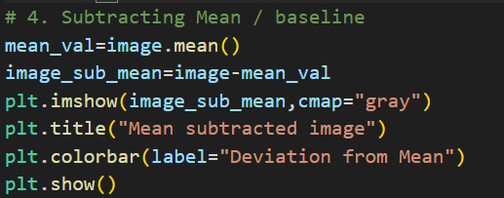
3.ROI (Region of interest)
4. Mean subtraction
Region of Interest (ROI) isolates a localized detector area to analyze spatial variations and noise characteristics.
Mean subtraction removes baseline offset and highlights pixel-level deviations.

Slide 8
Key learnings
Understood how raw detector images are stored as binary numeric data.
Learned the structure of detector files, including headers and pixel data.
Gained clarity on 16-bit grayscale images and the meaning of ADU values.
Learned how to correctly interpret raw memory into a 2D image.
Applied basic image processing techniques to analyze detector behavior.
CODE : Sahithi/Varex_mini_project_tasks/Code & Output_images

Slide 9
TASK 2 — Pixel-Level Access & Verification
What is the task?
Open the raw detector image file.
Skip the 1024-word image header.
Access the pixel value at a specified row and column.
Print the pixel’s ADU (Analog-to-Digital Unit) value.
Visually verify the selected pixel on the image.
Why is the task given?
Detector debugging requires checking individual pixel values.
Engineers must validate:
detector output
firmware behavior
calibration correctness

Slide 10
How are Pixel Values Retrieved?
Read raw image data into a 2D array
Accept row and column as user input
Access pixel using:
image[row, column]
Print the corresponding ADU value
Mark the pixel location on the image for visual confirmation

Slide 11
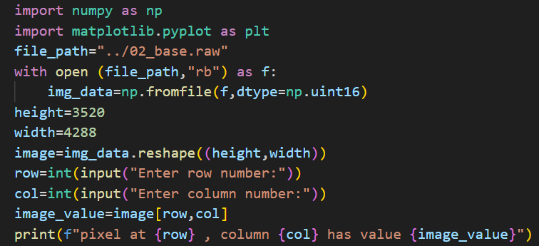
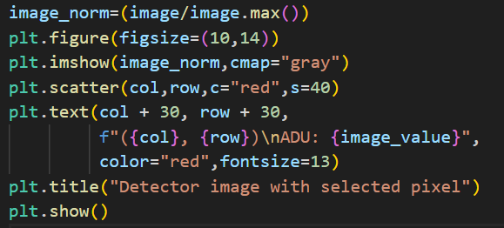
Code to display:

Slide 12
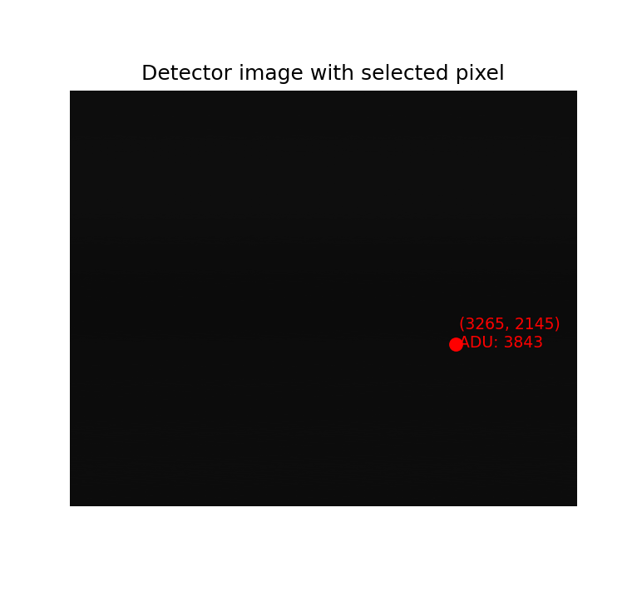
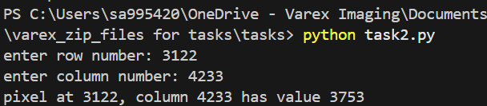
Outputs:

Slide 13
Key learnings
Understood how raw detector data maps directly to 2D image coordinates.
Learned how to access an exact pixel value using row–column indexing.
Gained clarity on the importance of correct memory layout interpretation.
Verified pixel values programmatically against visualization tools.
Learned how ADU values represent detector signal intensity.
CODE : Sahithi/Varex_mini_project_tasks/Code & Output_images

Slide 14
TASK 3 — Offset Characterization & Normalization Across Integration Time
Significance of Offset Characterization
Why this task?
Detector electronics introduce offset and noise even without X-ray signal
Offset varies with integration time due to electronic behavior
Accurate imaging requires understanding and correcting this offset
Why this matters?
Enables reliable detector calibration
Ensures consistent image quality across different integration times
Forms the basis for real-time offset correction in FPGA pipelines

Slide 15
WHAT IS REQUIRED?
Read detector images acquired at different integration times.
Calculate the average pixel value for each image.
Plot average pixel value vs integration time.
Fit a polynomial model to characterize offset behavior.
Scale all images using the 500 ms image as reference.
Subtract the reference image to remove offset.
Compute and plot noise (standard deviation) vs integration time.
Share processed images and analysis results.

Slide 16
Basic definitions
Detector: Hardware that converts X-rays into digital pixel values.
Integration Time: Duration for which the detector collects signal.
Offset: Unwanted background signal produced by detector electronics.
ADU: Digital value output by the ADC for each pixel.
Average Pixel Value: Mean of all pixel values in an image, used to estimate offset.
Noise: Random variation in pixel values around the offset.

Slide 17
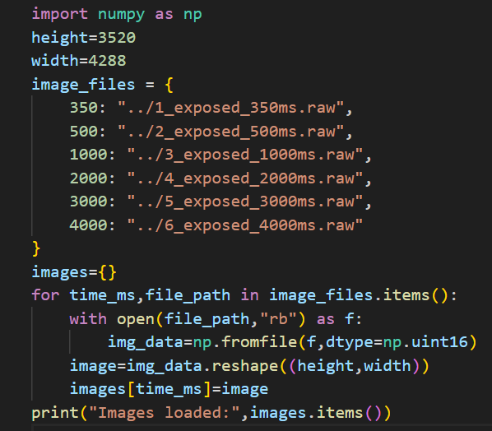
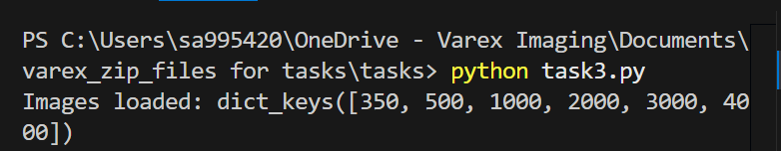
3.1 — Reading Multiple Detector Images
Read all detector image files taken at different integration times into Python.

Slide 18
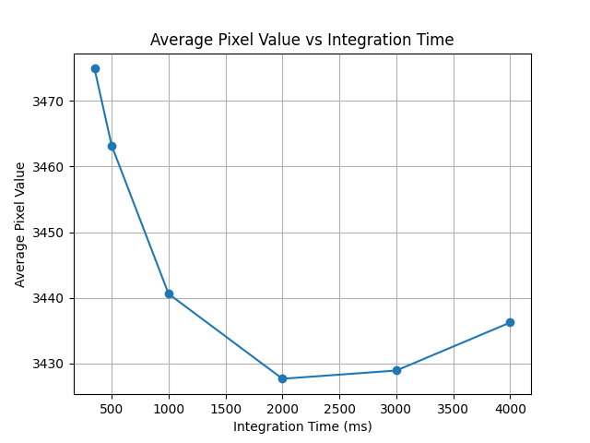
3.2,3.3 — Computing Average Pixel Value (Offset Estimation)
Why this step?
Detector introduces a baseline offset
Offset changes with integration time
Must be understood before calibration
What is done?
Offset = average pixel value of each image
Computed for multiple integration times(350 ms → 4000 ms)
How it works?
Read each raw image
Calculate mean of all pixels
Plot mean value vs integration time

Slide 19
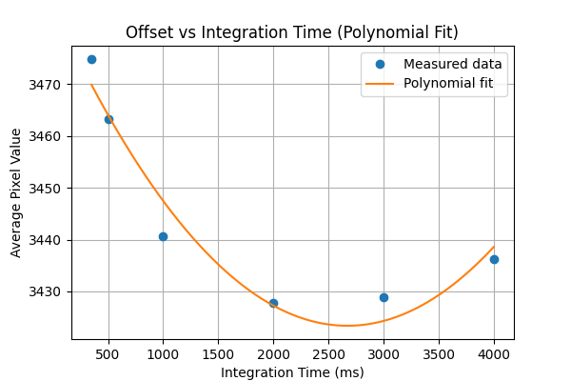
3.4 — Polynomial Modeling of Offset vs Integration Time
Why this step?
Offset varies with integration time
Enable offset predictions at any exposure time.
Required for scaling and correction.
What is done?
2nd-degree polynomial fitted to measured data
How this works?
Used NumPy polyfit to model offset behavior
Result
Smooth curve accurately represents offset trend

Slide 20
3.5 — Scaling Images Using 500 ms Reference
Why this step?
Images are captured at different integration times
Pixel values cannot be compared directly
Scaling removes integration-time dependency
What is done?
500 ms image chosen as reference
Polynomial model predicts average pixel value vs time
Each image is scaled to behave like a 500 ms image
How it works ?
Scaling factor = Predicted offset at 500 ms ÷ Predicted offset at current time
Every pixel in the image is multiplied by this factor
Outcome
All images normalized to the same baseline
Images are now directly comparable

Slide 21
3.6 — Subtracting 500 ms Reference Image
Why this step?
Even after scaling, images still contain fixed detector offset
Offset is common across all pixels
Must be removed to analyze true noise behavior
What is done?
500 ms image used as reference baseline
Each scaled image is compared against this reference
How it works (concept)
Pixel-by-pixel subtraction is performed
Formula: Subtracted Image = Scaled Image − 500 ms Image
Outcome
Baseline offset removed
Only noise and residual variations remain
Images are ready for statistical analysis

Slide 22
3.7 — Noise Analysis Using Standard Deviation
Why this step?
To quantify detector noise after offset correction.
To understand how noise varies with integration time.
What is done?
Reference image (500 ms) is subtracted from all scaled images.
Standard deviation is computed for each subtracted image.
How it works?
Standard deviation measures pixel-to-pixel variation.
Higher value → more noise.
Lower value → more stable detector response.
Result
Noise is plotted against integration time.
Reveals detector noise behavior across exposures.

Slide 23
Key learnings
Understood how raw detector data maps directly to 2D image coordinates.
Learned how to access an exact pixel value using row–column indexing.
Gained clarity on the importance of correct memory layout interpretation.
Verified pixel values programmatically against visualization tools.
Learned how ADU values represent detector signal intensity.
CODE : Sahithi/Varex_mini_project_tasks/Code & Output_images

Slide 24
TASK 4 — Row-wise Offset Characterization & Normalization
What is this task?
Instead of using one average per image, we now:
Divide the detector into three row regions.
Region 1: rows 0 – 1428
Region 2: rows 1429 – 2857
Region 3: rows 2858 – 4287
Treat each region independently.
Perform separate offset modeling and scaling per region.
Why this task?
The detector does not behave uniformly across all rows.
A single global average (~3400 ADU) hides row-dependent behavior.
Different row regions have different offset characteristics.

Slide 25
Changes compared to Task 3
Task 3 | Task 4
One average per image | Three averages per image
One polynomial fit | Three polynomial fits
One scaling factor | Region-wise scaling
Global correction | Spatially-aware correction

Slide 26
4.1 — Row-wise Average Pixel Calculation
What is done ?
Each detector image is divided into three row regions.
Average pixel value is calculated separately for each region.
Row regions used:
Region 1: Rows 0 – 1428
Region 2: Rows 1429 – 2857
Region 3: Rows 2858 – 4287
Why is this needed ?
Overall image average hides row-dependent offset behavior.
Different row regions show different baseline levels.
Region-wise averages reveal spatial non-uniformity.

Slide 27
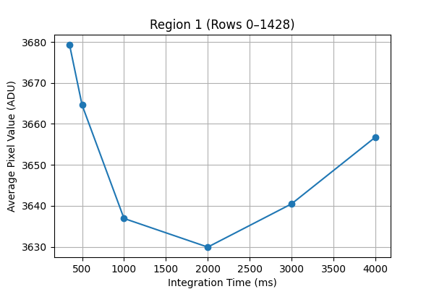
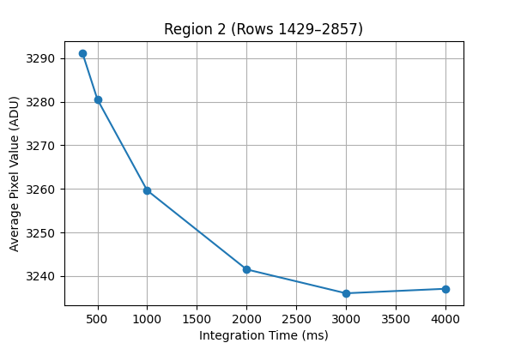
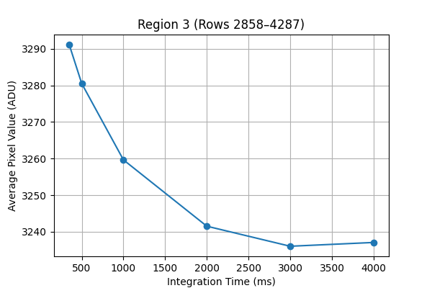
4.2 — Create 3 plots (Region-wise average vs Integration Time)
Outcome
Three distinct offset curves obtained.
Confirms spatial variation across detector rows.

Slide 28
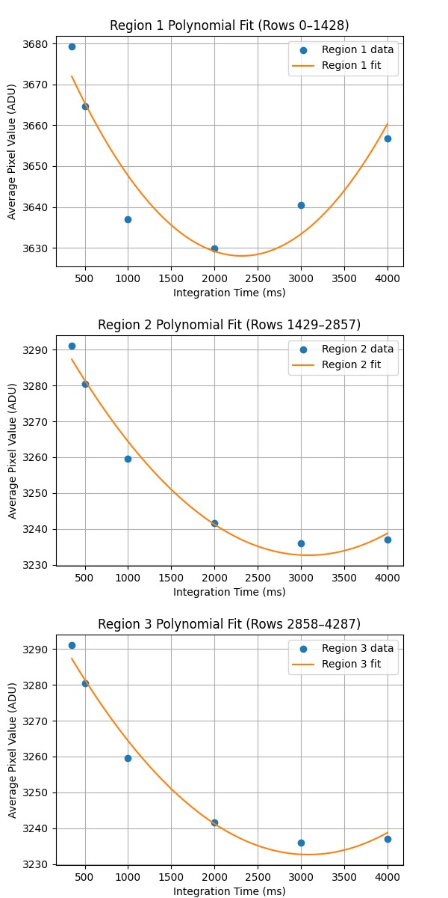
4.3 — Polynomial Modeling for Each Row Region
What is done?
Three separate polynomial fits applied:
One for each row region
Each fit models:
Average pixel value vs integration time
Low-degree polynomial chosen for stability.
Why polynomial fitting?
Offset varies smoothly with integration time.
Polynomial captures this trend efficiently.
Avoids overfitting while preserving accuracy.

Slide 29
4.4 — Region-wise Scaling of Detector Images
What is done?
Detector rows divided into 3 regions.
Each region scaled using its own polynomial fit.
Reference integration time: 500 ms.
Why scaling is needed?
Offset behavior varies across detector rows.
Single global scaling is insufficient.
Region-wise scaling ensures accurate normalization.
Outcome
All images normalized to a common baseline.
Integration-time dependence removed.
Spatial characteristics preserved.

Slide 30
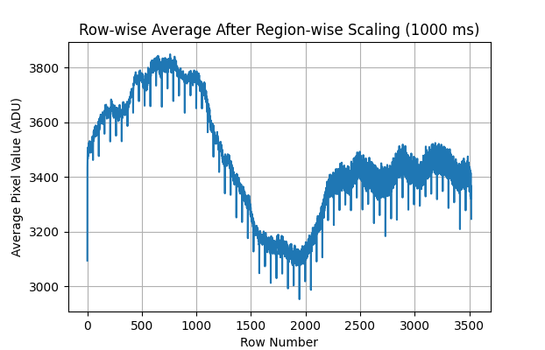
Validation: Row-wise Average After Scaling
What is shown?
Row-wise average pixel value vs row number,
Example shown for 1000 ms image.
Data after region-wise scaling.
What we observe?
Smooth transition across row regions.
No discontinuities at region boundaries.
Overall detector structure preserved.
Conclusion
Region-wise scaling applied correctly.
Offset differences successfully corrected.
Detector response is spatially consistent.

Slide 31
Key learnings
Learned that detector offset varies spatially, not just with integration time.
Understood the need for row-region based analysis instead of a single global average.
Applied multiple polynomial models to capture region-specific offset behavior.
Implemented region-wise scaling to normalize detector response accurately.
Validated correction using row-wise average plots, ensuring spatial consistency.
CODE : Sahithi/Varex_mini_project_tasks/Code & Output_images

Slide 32
Detector Image Processing — Clear Step-by-Step Flow
Raw Detector Output — Binary pixel data directly produced by the detector and FPGA
Task 1 — Understand Raw Image Structure (file format, header, ADU values, 2D image layout)
Task 2 — Validate Pixel Access (confirm correct row–column indexing and pixel values)
Task 3 — Correct Time-Dependent Offset (model and normalize pixel values vs integration time)
Task 4 — Correct Row-Dependent Offset (apply region-wise correction for spatial non-uniformity)
Final Calibrated Image — Offset-corrected, spatially consistent detector image ready for use

