Slide 1
TravelApp - Your Smart Travel Companion
Team Members:
Pesaru, Yamini Reddy
Aenugu, Chathurya Reddy Daka, Sai Sahithi
Mamidiga, Akanksha
Andhe, Leela Krishna.

Slide 2
INTRODUCTION
Challenges: Travelers often face difficulties in finding reliable and up-to-date information about destinations, attractions, restaurants, and accommodations. Traditional travel guides can be outdated, and personal recommendations may not always be accessible.
Solution: Travelapp bridges this gap by offering real-time, user-generated content to make informed travel decisions.

Slide 3
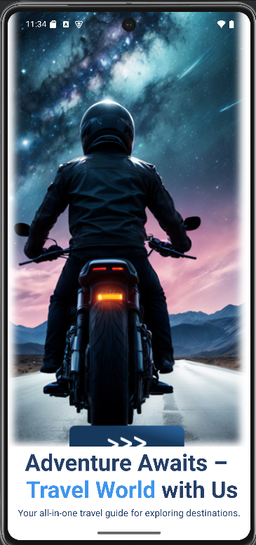
Features of TravelApp
Intro Page:
A welcoming screen that introduces users to the app and its features.

Slide 4
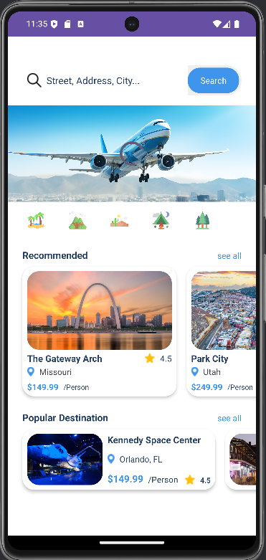
Features of TravelApp
Home Screen:
Search Tab: Quickly search for destination’s, attractions, or activities.
Offers Slide: View current deals on travel and accommodations.
Recommended Items Slider: Personalized recommendations based on user preferences.
Popular Items Section: Trending destinations and attractions.

Slide 5
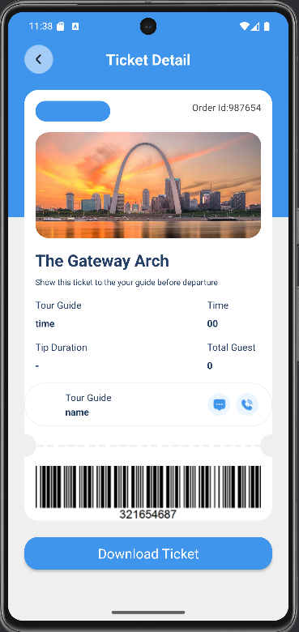
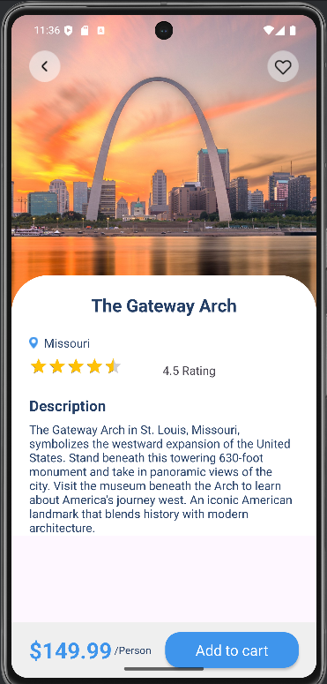
Destination Details Page: Displays detailed information, including distance, ratings, pricing, and an option to add items to the cart.
Ticket Page: Shows ticket details with a QR code for easy access and verification.

Slide 6
Purpose of TravelApp
Addressing Travel Challenges:
TravelApp solves common issues travelers face, like finding reliable and up-to-date travel information.
Key Benefits:
Real-Time, User-Generated Content: Get up-to-date information for better decision-making.
Simplified Trip Planning: Streamlined experience for users to plan their trips easily.
Personalized Recommendations: Tailored suggestions for destinations and activities.
Integration with Firebase: Secure data storage, real-time updates, and authentication.

Slide 7
App Flow/Sequence Information
Intro Page: The app begins with an introductory screen.
Home Screen: Users can explore recommendations, offers, and search for destinations.
Destination Details Page: Displays detailed info, pricing, and ratings.
Cart Management: Users can finalize their travel plans and manage their cart.
Ticket Page: Displays ticket details and QR code for verification.

Slide 8
Future Scope
Firebase Integration: Future plans to integrate Firebase for real-time data storage and user authentication.
Improved Search Criteria: Update search functionality to include more detailed filters and better search accuracy.
Enhanced Ticket QR Codes: Improve ticket QR codes for better accessibility and functionality

Slide 9
Technologies Used
Programming Language: Java/Kotlin.
User Interface: Material Design for a modern, responsive look.
Data Storage: Object-based storage for managing travel data (No Firebase integration at this time).

Slide 10
Conclusion
Simplified Travel Planning: TravelApp helps travelers easily find up-to-date, reliable information for a seamless trip-planning experience.
Personalized Recommendations: Provides tailored travel suggestions for an enhanced user experience.
Secure and Real-Time Updates: With Firebase integration, users can access real-time information and ensure secure authentication and data management.

Slide 11
Github: https://github.com/Sahithi-5690/TravelApp

Slide 12
Thank You

