Slide 1
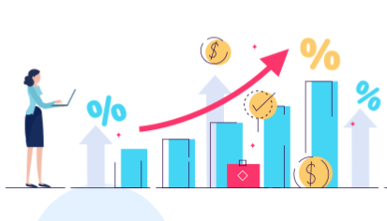
StoreCast: Walmart’s Store Sales Forecasting
By: Aarthi Padmanabhan and Sahithi Sane

Slide 2




Problem Statement & Objective
Higher/Lower Stocks
Price Policy
Not Reaching Projected Targets
Impact: Inaccurate sales predictions lead to overstocking or understocking
Objective: Optimize inventory by aligning stock levels with demand
Impact: Incorrect pricing causes lost customers and profitability
Objective: Optimize pricing strategies to maximize revenue during peak seasons.
Impact: Failing to meet sales targets impacts stock prices and financial stability
Objective: Ensure accurate forecasting to meet sales targets and minimize financial risk

Slide 3
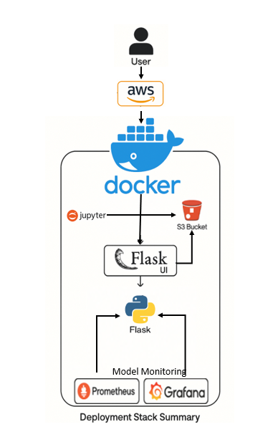
Process Diagram

Slide 4
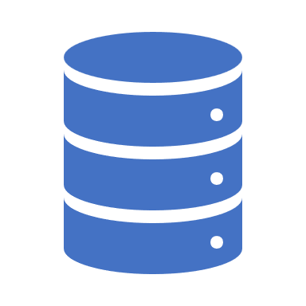

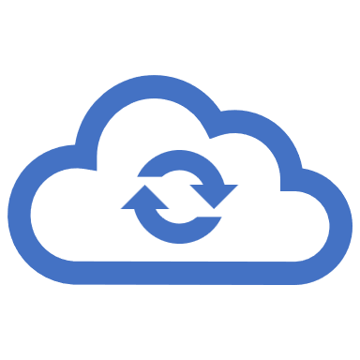

Interactive UI with Flask & AWS S3 Bucket
S3 Model Storage
Model artifacts and cleaned datasets are securely stored and accessed via Amazon S3, supporting flexible cloud-based deployment and centralized version management.
Forecasting Infrastructure Leverages Flask API and joblib-based serialized models for store-specific forecasting, enabling fast, scalable inference served via Dockerized microservices.
Dockerized MLOps Stack Uses Docker Compose to deploy Flask, Prometheus, and Grafana containers. Ensures consistent, reproducible environments for local and cloud execution.
Real-Time Monitoring Prometheus scrapes Flask API metrics, and Grafana dashboards visualize key model and API performance indicators, enabling proactive insights.

Slide 5


Model Monitoring
Prometheus Used to scrape and collect real-time metrics from the Flask API such as request count, response time, and error rates. These metrics are exposed using the prometheus_client library and help monitor API health and performance.
Grafana Visualizes the metrics collected by Prometheus in interactive dashboards. Helps track API uptime, forecast latency, and detect anomalies. You can configure alerts for sudden spikes or drops in performance.

Slide 6
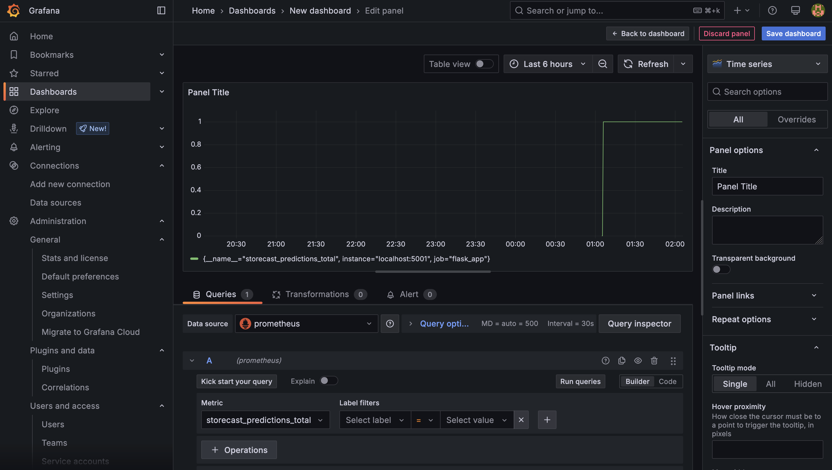
Grafana Dashboard

Slide 7
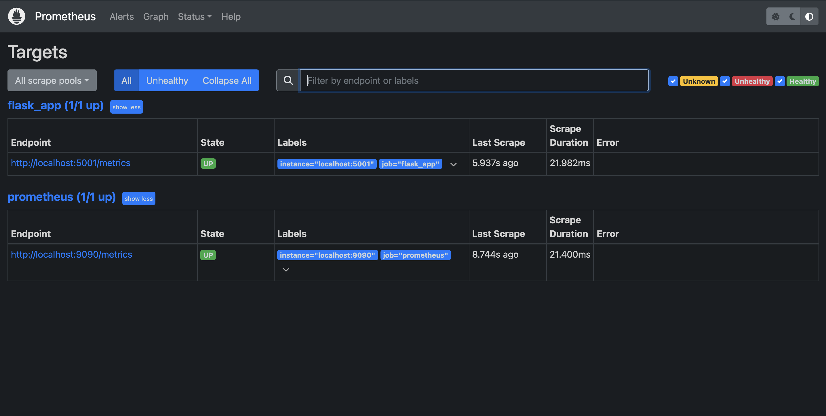
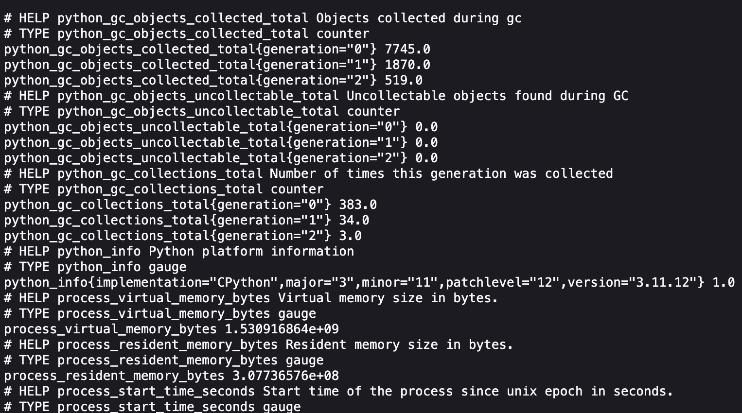
Prometheus Dashboard

Slide 8

Docker Containerization Deployment to AWS EC2
Custom Dockerfiles Dedicated Dockerfiles for Flask App environments ensure reproducible builds and environment consistency..
Docker Hub Deployment Images pushed to Docker Hub for deployment on remote EC2 machines with version control.
EC2 Hosting Flask container deployed on AWS EC2 instances for public web access.
Docker Monitoring & Control Deployment lifecycle managed via Docker CLI; containers tracked, restarted, or stopped via docker ps and docker logs.

Slide 9
Data Pipeline Architecture
Data Ingestion: The data consists of historic weekly sales data for 45 Walmart stores.
Data Preprocessing: Merging Store, weekly sales along with features and is holiday data.
Feature Engineering & EDA: Resampling data by week, stationarity (First-Order Differencing, Lagged Shift, Log Transformation, Exponential smoothening)
Data Storage: Store the data and models in S3 Bucket

Slide 10
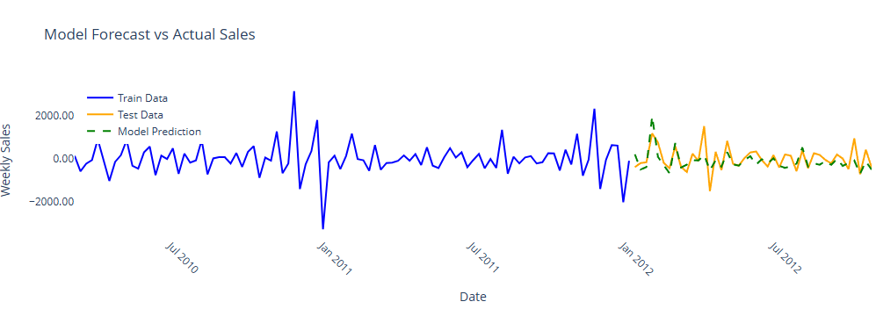
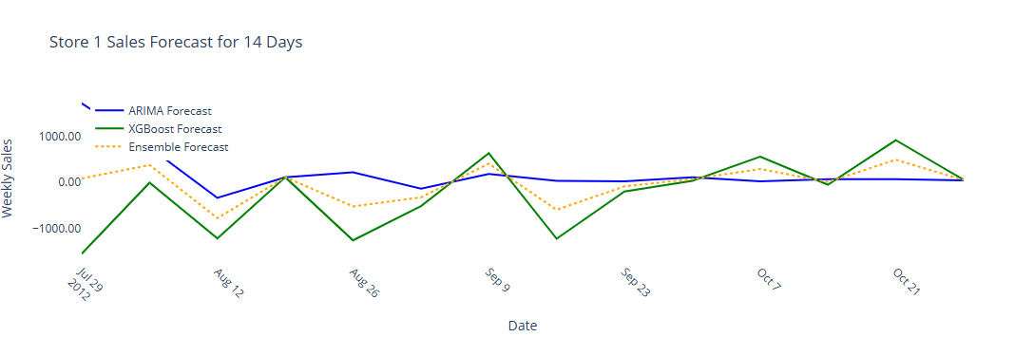
Model Development & Results
Dataset 45 stores timeseries data split into 70/30 train-test for each store.
Performance Metric Use the ensembled model for prediction
MULTIPLE MULTIVARIATE TIME SERIES FORECASTING
ENSEMBLING

Slide 11


Challenges
Loading Models from S3
EC2 Instance Deployment
App performance
There were multiple models for each store to be fetched from S3 bucket
Currently it is taking some time to render the data and predict.

Slide 12



Future Enhancements
MLOps Performance optimization with responsive UI
Optimized Version
Market Basket Analysis
Lower and Upper bound prediction

Slide 13
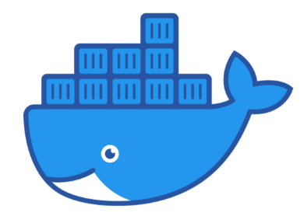

Links & DEMO!
Docker Hub Images: https://hub.docker.com/u/aarthi9929
AWS : https://us-east-1.console.aws.amazon.com/ec2/home?region=us-east-1#InstanceDetails:instanceId=i-01f79e1f63b5789f7

Slide 14

Questions?

