Slide 1



CREDIT CARD FRAUD DETECTION USING DEEP LEARNING
Anuradha Sahithi Padavala (ID: 5488204)
Aishwarya Sri Pati (ID: 5497325)

Slide 2
QUICK RECAP

Slide 3
WHAT IS CREDIT CARD FRAUD DETECTION?
Credit Card Fraud Detection is an important task in the financial industry, which helps to avoid fraudulent activities.

Slide 4
KEYWORDS
TENSOR FLOW : An open-source software library developed by Google for building and training machine learning models. It is one of the most popular and widely used deep learning frameworks, offering a range of tools and resources for building and deploying machine learning models at scale.
KERAS : An API of Tensor flow ; a good interface for machine learning and deep learning problems. Also, provides high iteration velocity.
MAXPOOL : A pooling operations which calculates the largest value in every patch of each feature map.

Slide 5
What are we trying to accomplish?

Slide 6
CHALLENGES:
Unbalanced data
Improving accuracy

Slide 7
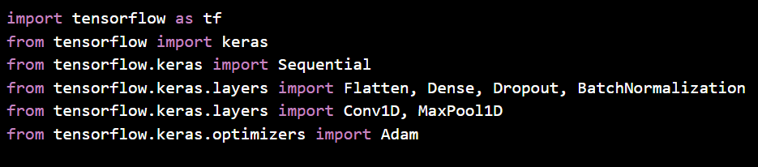
IMPORTING TENSORFLOW AND KERAS

Slide 8
BALANCING DATA
z

Slide 9
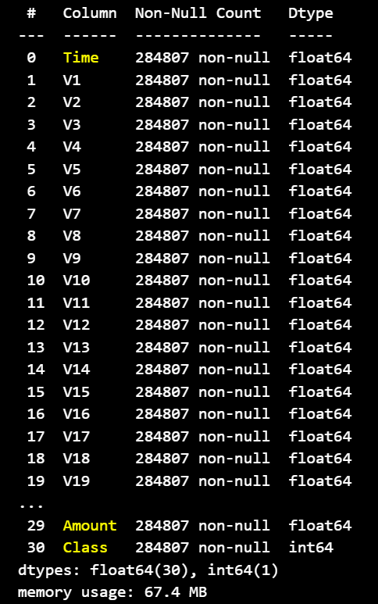
DATASET
This dataset contains transactions made by credit cards in September 2013 by European cardholders. In order to protect the privacy of the card holders the data was changed into principal component variables, except for time, amount and Class.

Slide 10
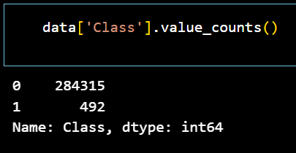
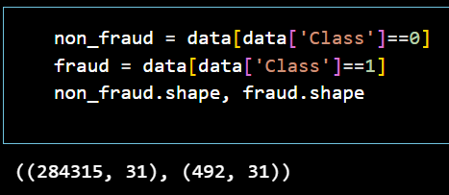
Here, 0 represents non fraudulent data and 1 represents fraudulent data
There are 492 fraudulent cases among 284807 entries, which is 0.172% of all transactions mentioned in this dataset.

Slide 11
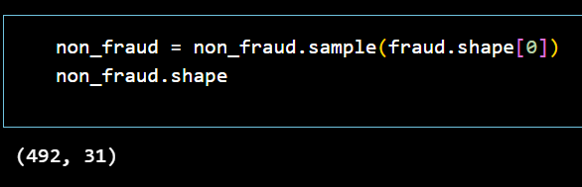
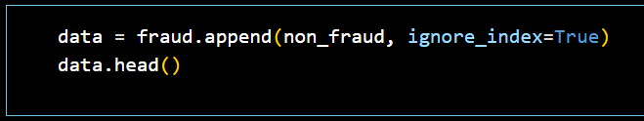
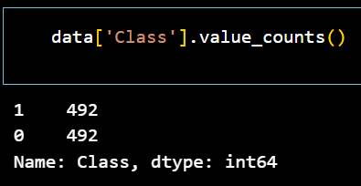
OUR APPROACH TO UNBALANCED DATASET
Optimizing non fraudulent data

Slide 12
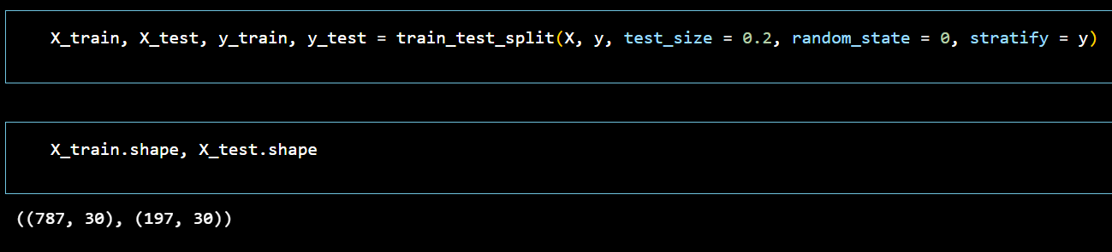
TRAINING THE DATA
z

Slide 13
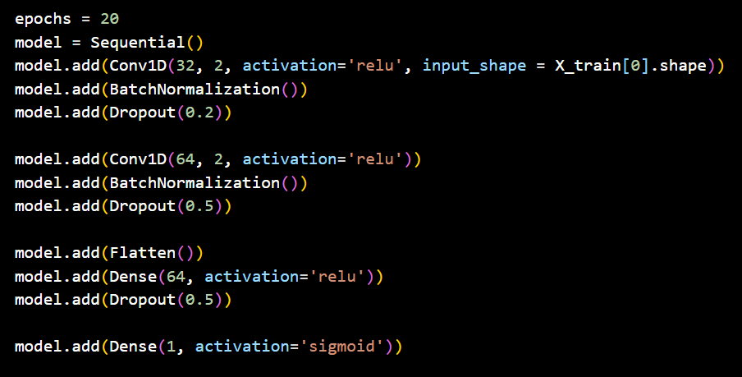
BUILDING NEURAL NETWORK MODEL

Slide 14
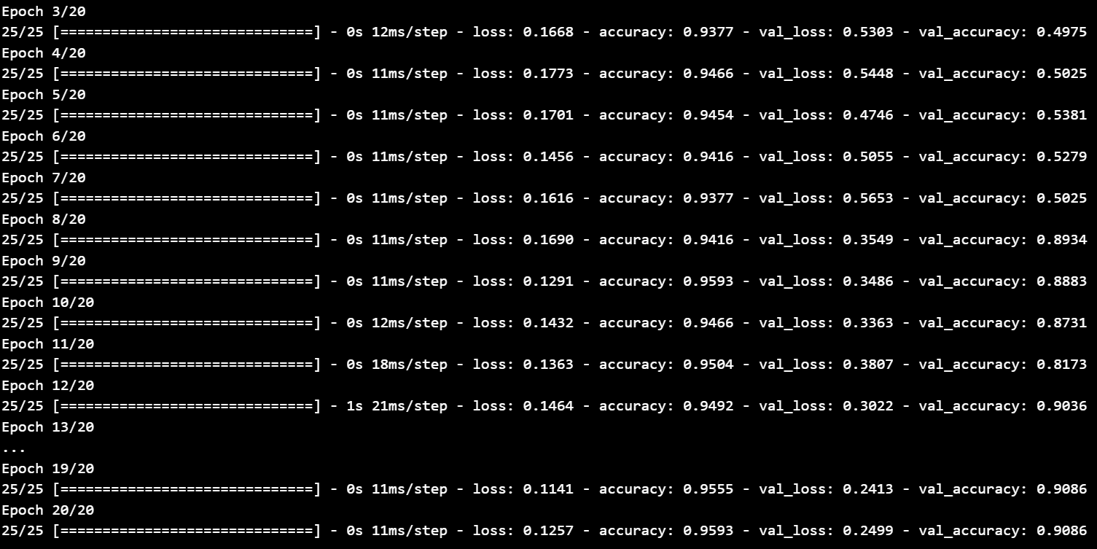

Slide 15
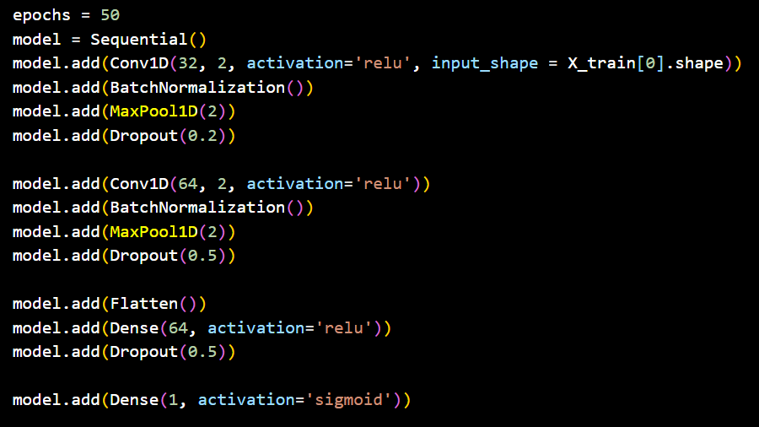
APPLYING MAXPOOL

Slide 16
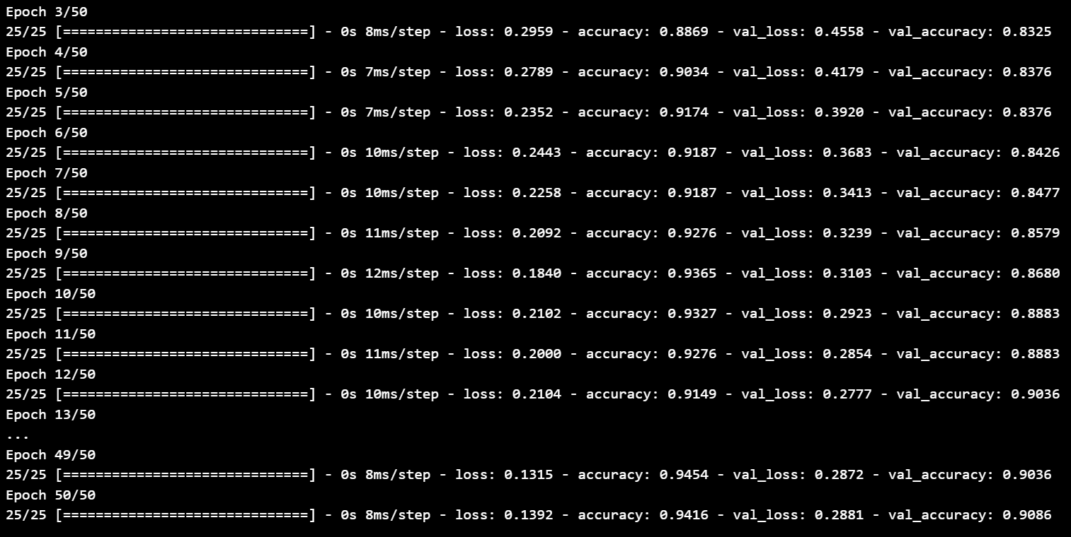

Slide 17
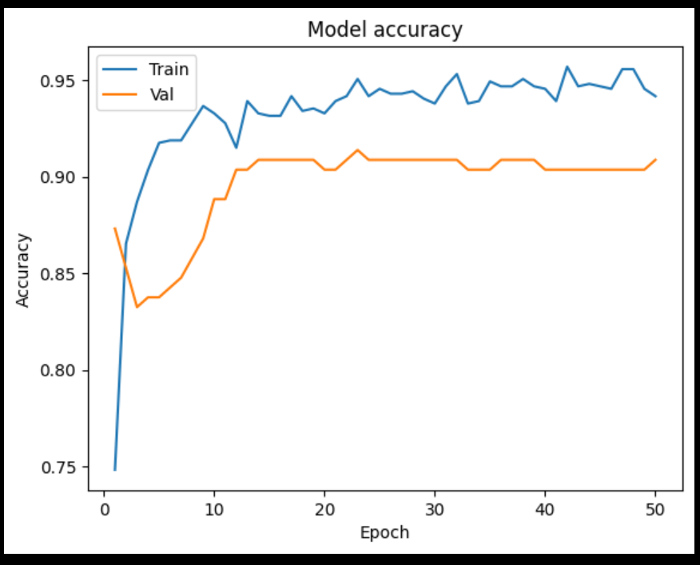
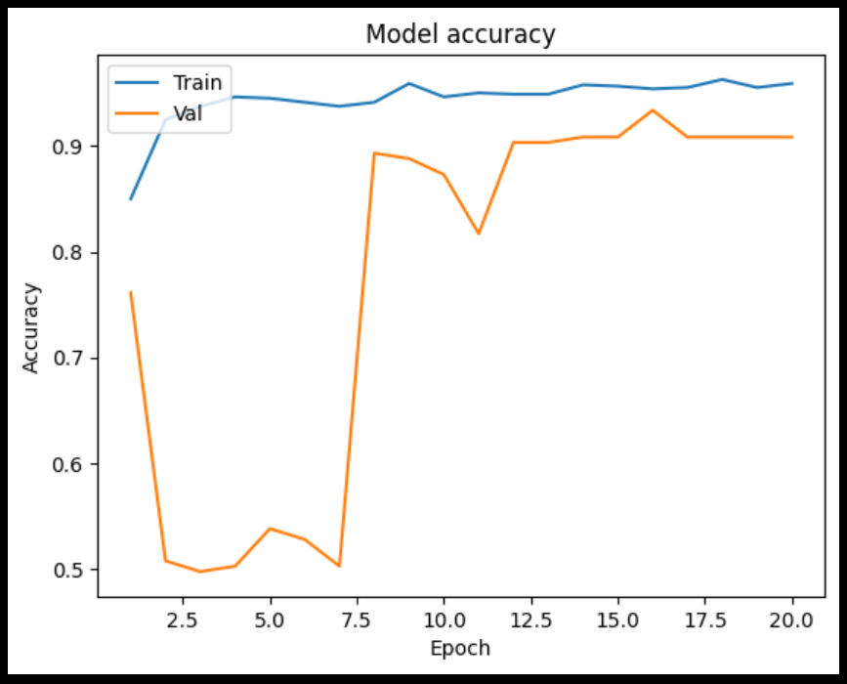
COMPARISION
Before Maxpool
After Maxpool

Slide 18
THANK YOU

