Slide 1
SPEECH EMOTION RECOGNITION
Team no :3
Team members:
S.DIVYA(18JG1A0585)
SAHITHI SARIKA(18JG1A0583)
R .LAVANYA(18JG1A0579)

Slide 2
ABSTRACT :
It is very difficult to predict human emotions quantitatively. Though facial expressions and gestures are the best ways to figure out one’s emotions, it becomes difficult to identify them as the age of a person increases, because people learn to control their expressions with age and experience.
Speech Emotion Recognition (SER) is one of such fields. Using deep learning and machine learning algorithms, we aim to design an automatic emotion recognition system.
Speech Emotion Recognition (SER) main motto is to improve human machine interaction.

Slide 3
We define a SER system as a collection of methodologies that process and classify speech signals to detect emotions embedded in them.
Such a system can find use in a wide variety of application areas like interactive voice based-assistant or caller-agent conversation analysis.
VARIOUS EMOTIONS TO BE CLASSIFIED:
Emotion (01 = neutral, 02 = calm, 03 = happy, 04 = sad, 05 = angry, 06 = fearful, 07 = disgust, 08 = surprised).

Slide 4
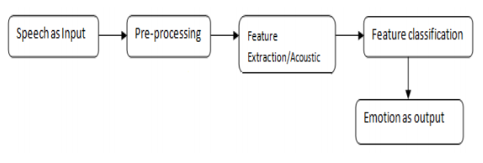
Steps in SER:

Slide 5
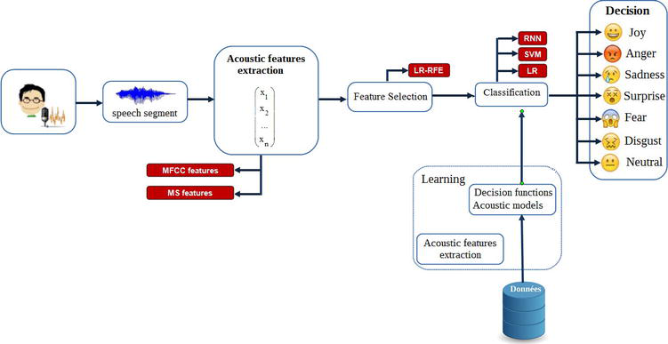

Slide 6
DATASET :
Ryerson Audio-Visual Database of Emotional Speech and Song (RAVDESS) dataset [1][2]
2452 audio files, with 12 male speakers and 12 Female speakers, the lexical features (vocabulary) of the utterances are kept constant by speaking only 2 statements of equal lengths in 8 different emotions by all speakers.

Slide 7
File naming convention
Each of the 1440 files has a unique filename. The filename consists of a 7-part numerical identifier (e.g., 03-01-06-01-02-01-12.wav).
Filename identifiers
Modality (01 = full-AV, 02 = video-only, 03 = audio-only).
Vocal channel (01 = speech, 02 = song).
Emotion (01 = neutral, 02 = calm, 03 = happy, 04 = sad, 05 = angry, 06 = fearful, 07 = disgust, 08 = surprised).
Emotional intensity (01 = normal, 02 = strong).
Statement
Repetition (01 = 1st repetition, 02 = 2nd repetition).
Actor (01 to 24. Odd numbered actors are male, even numbered actors are female).

Slide 8
CLASSES OF FEATURES:
1.the lexical features (the vocabulary used),
2. the visual features (the expressions the speaker makes)
3.the acoustic features (sound properties like pitch, tone, jitter, etc.).
Analysis on the acoustic features can be done in real-time while the conversation is taking place as we’d just need the audio data for accomplishing our task. Hence, we choose to analyse the acoustic features in this work.

Slide 9
FEATURE EXTRACTION:
From the Audio data we have extracted three key features which have been used in this study, namely,
MFCC (Mel Frequency Cepstral Coefficients),
Mel Spectrogram and Chroma.
---The Python implementation of Librosa package was used in their extraction.

Slide 10
Methodology / Model :
The classification model proposed based on
machine learning
deep learning strategy.
Models:
Convolutional neural networks (CNN),
support vector machine (SVM) classifier,
MLP classifier.
Feature :
Mel-frequency cepstral coefficients (MFCC)

Slide 11
MFCC
The most prevalent and dominant method used to extract spectral features is calculating Mel-Frequency Cepstral Coefficients (MFCC)
MFCC coefficients derived from human speech samples play a vital role in the field of speech signal processing. They are used in applications including speaker verification, speaker recognition, emotion detection etc.
MFCC is an audio feature extraction technique which extracts parameters from the speech similar to ones that are used by humans for hearing speech, while at the same time, deemphasizes all other information.
MFCCs use Mel-scale filter bank where the higher frequency filters have greater bandwidth than the lower frequency filters, but their temporal resolutions are the same.
The last step is to calculate Discrete Cosine Transformation (DCT) of the outputs from the filter bank. DCT ranges coefficients according to significance, whereby the 0th coefficient is excluded since it is unreliable.

Slide 12
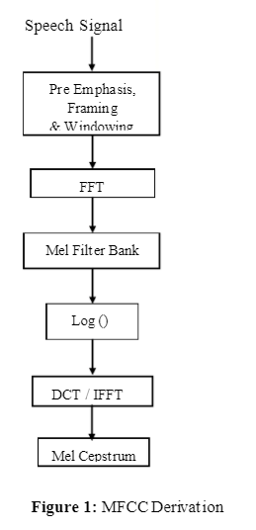
MFCC DERIVATION
For each speech frame, a set of MFCC is computed.
This set of coefficients is called an acoustic vector which represents the phonetically important characteristics of speech and is very useful for further analysis and processing in Speech Recognition.
EXAMPLE : . We can take audio of 2 Second which gives approximate 128 frames each contain 128 samples (window size = 16 ms). We can use first 20 to 40 frames that give good estimation of speech. Total of forty Two MFCC parameters include twelve original, twelve delta (First
order derivative), twelve delta-delta (Second order derivative), three log energy and three 0th parameter.

Slide 13
APPLICATIONS OF EMOTION RECOGNITION :
Emotion Recognition is used in call center for classifying calls according to emotions.
Emotion Recognition serves as the performance parameter for conversational analysis thus identifying the unsatisfied customer, customer satisfaction so on.
SER is used in-car board system based on information of the mental state of the driver can be provided to the system to initiate his/her safety preventing accidents to happen.

Slide 14
THANK YOU

