Slide 1

HOSPITAL MANAGEMENT SYSTEM

Slide 2
Problem Statement
Hospitals often deal with large volumes of information that must be stored accurately, accessed quickly, and analyzed effectively to support patient care and administrative decisions. Without a proper data system, this process becomes time-consuming, error-prone, and inefficient.
This project solves that problem by creating a database system that stores and organizes all this information in one place. This solution helps improve hospital operations, enhances patient experience, and supports informed decision-making through reliable data access.

Slide 3
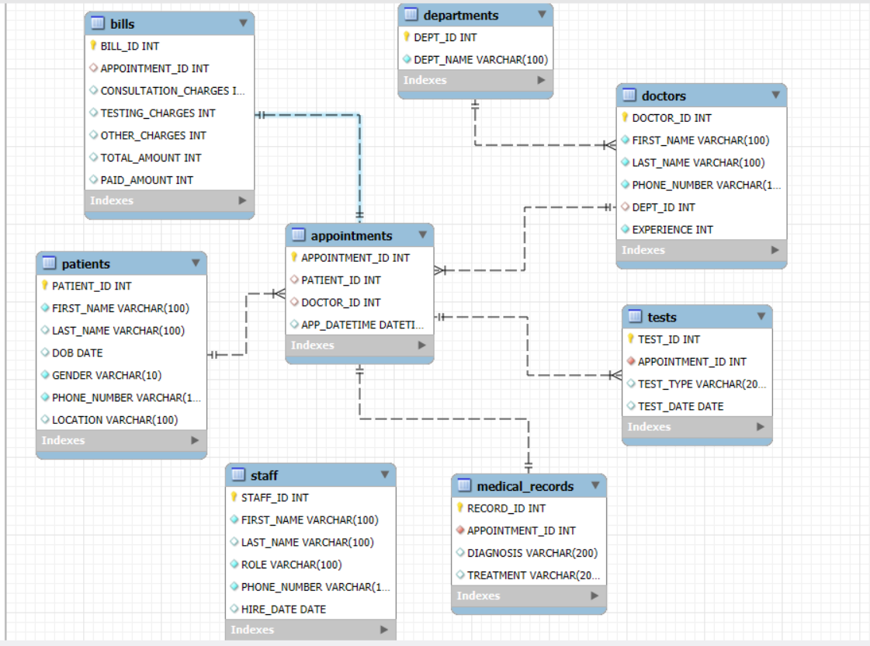
ER Diagram

Slide 4
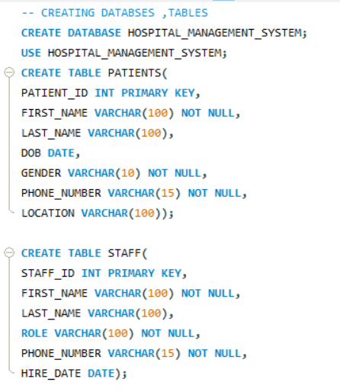
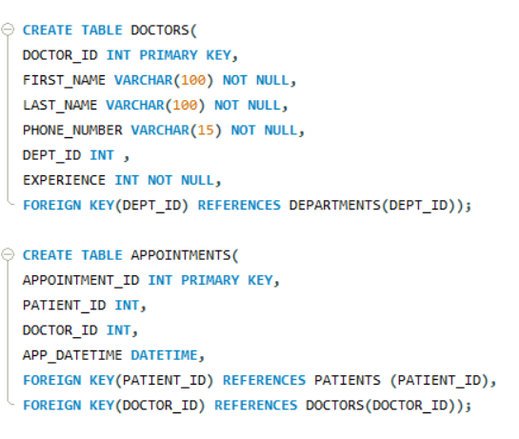
1. Database Design & Table Creation (DDL)

Slide 5
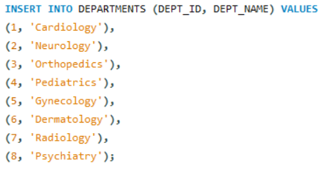
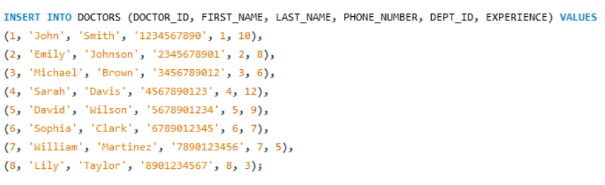
2. Data Insertion

Slide 6

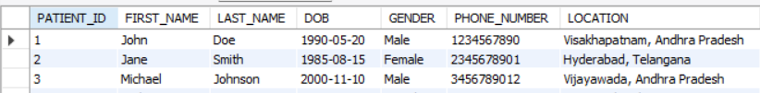
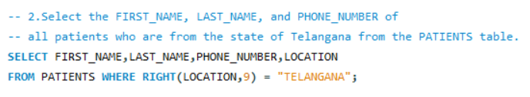
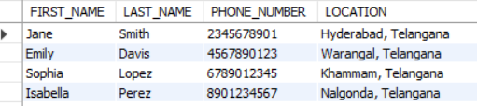
3. SELECT Queries & Filtering

Slide 7
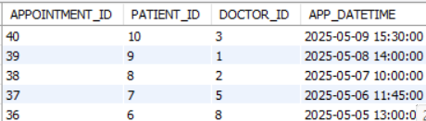
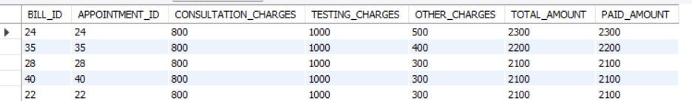
4. Sorting and Pagination

Slide 8
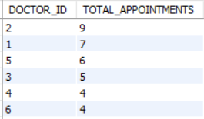



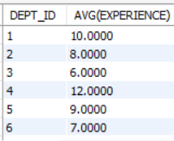
5. Aggregate Functions & Grouping

Slide 9
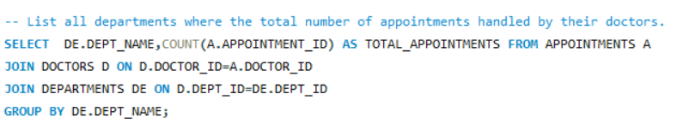
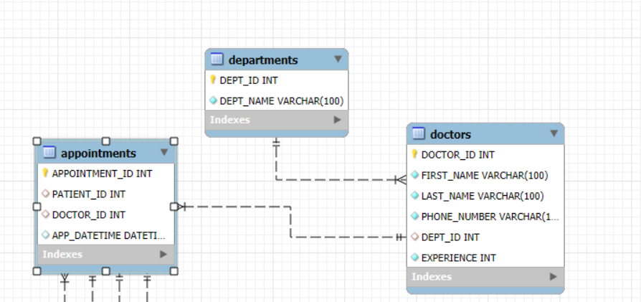
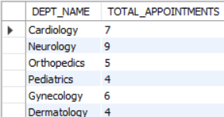
6. Joins

Slide 10
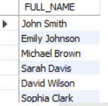


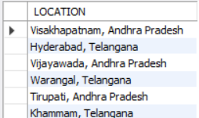

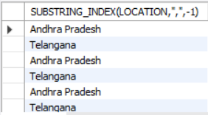
7. String Functions

Slide 11
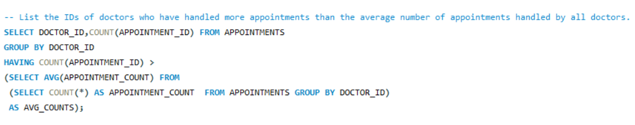
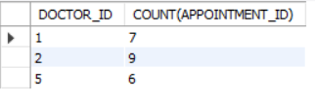
8. Subqueries

Slide 12
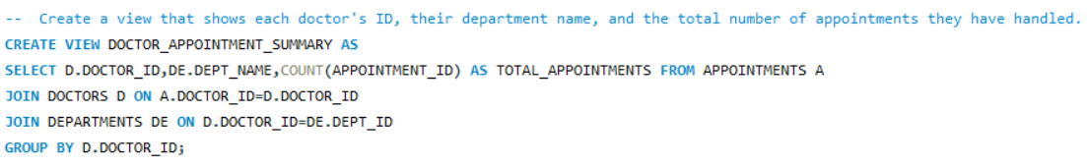

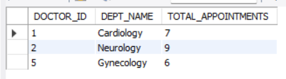
9. Views

Slide 13

THANK YOU

