Slide 1

Childcare Staffing Forecasting Project
Business Forecasting | ECON 8310
By
Sahithi Bikumalla
Vikas Kumar Reddy
Mahmuda Akhter Nishu

Slide 2
Executive Summary
The project aims to optimize staffing for the Child Saving Institute (CSI) by predicting staffing needs using historical check-in/check-out data.
The goal is to reduce labor costs while maintaining safety compliance.
We will use time series forecasting models (ARIMA,XGBoost, and Random Forest regression) to predict staffing needs.

Slide 3
Problem Statement and Data
CSI faces the challenge of predicting staffing needs due to fluctuating child attendance.
The data includes check-in/check-out times, room assignments, and child enrollment status across two childcare centers.
Our task is to forecast staffing requirements based on room-specific age groups and regulatory staff-to-child ratios.

Slide 4
Project Objectives
Clean and standardize check-in/out data
Calculate 30-minute block student counts
Convert student counts to staffing requirements
Generate forecasts (typical and next week)
Compare ARIMA, XGBoost, and Random Forest models
Visualize results clearly for stakeholders

Slide 5
Data Cleaning & Transformation
Parsed raw Excel files into clean format
Filtered active students only
Created 30-minute interval blocks
Mapped rooms to age groups
Applied regulatory staff-child ratios

Slide 6
Feature Engineering
Time-based: hour, weekday, week, day-of-year
No lag features used (to preserve data)
Tagged US holidays using 'holidays' package
One-hot encoded room names

Slide 7
Model Overview
ARIMA: Time-series with trend/seasonality
Random Forest: Captures non-linear effects
XGBoost: Best performance, uses full time features
Preprocessing steps include handling missing values and calculating staffing based on age group ratios.

Slide 8
Methodology overview
Cleaned and structured attendance data into 30-minute intervals
Created time-based features (hour, weekday, etc.) and one-hot encoded rooms
Compared three forecasting models:
- ARIMA (time series baseline)
- Random Forest Regressor
- XGBoost Regressor
Used GridSearchCV for hyperparameter tuning on each model
Gave XGBoost as Best performer.

Slide 9
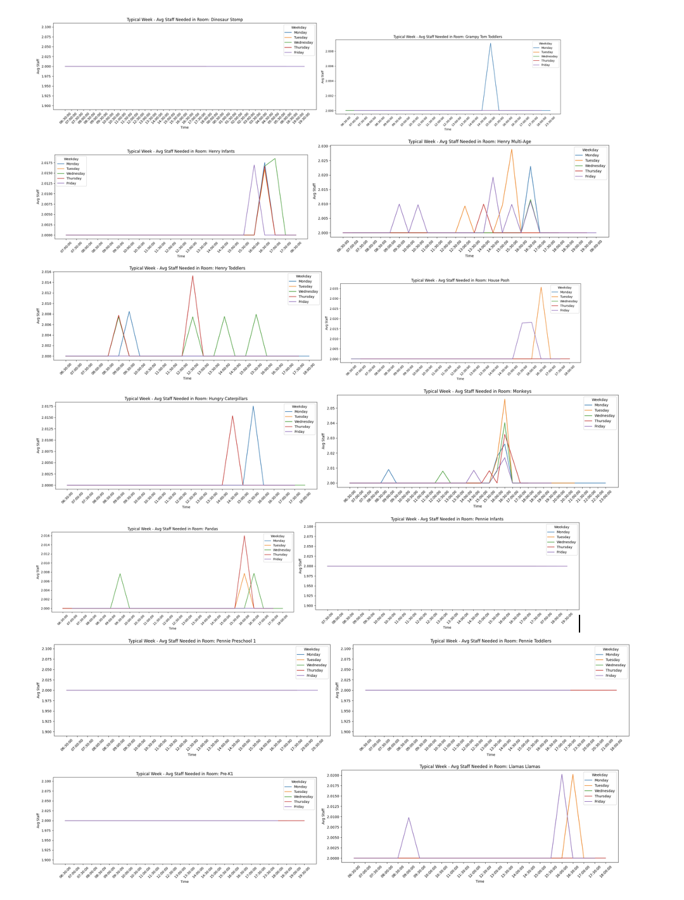
Typical Week Forecast
Averages staffing per 30-min block over history
Identifies regular patterns across weekdays
Many rooms (e.g., Pre-K1, Pre-K2, Pennie Preschool 1) show flat lines at 2 staff members, highlighting that the minimum staffing rule is in effect across most time blocks.
A few rooms like Henry Multi-Age and Hungry Caterpillars display short spikes, mainly around mid-morning, suggesting targeted scheduling needs.
Most rooms follow a similar pattern Monday to Friday, indicating routine attendance trends and predictable scheduling needs.

Slide 10
Next Week Forecast
Uses XGBoost model on all past data
Forecasts 336 blocks (Mon–Fri)
Excludes weekends automatically
Visualized with line plots and heatmaps

Slide 11

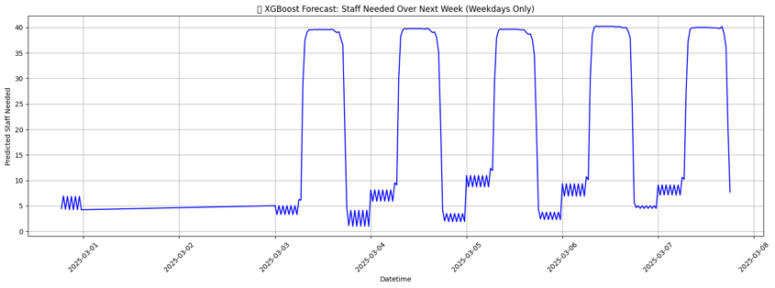
Line plot(Nextweek Forecast)
Mon. – Fri.
The chart shows a consistent spike in staffing from Monday to Friday, indicating that child attendance is significantly higher during weekday daytimes.
Morning
The highest staff needs occur during the mid-morning hours (around 9:00 AM to 12:30 PM), aligning with typical drop-off times.
Weekend
Staffing needs drop sharply outside of the weekday blocks, confirming that Saturday and Sunday are excluded or not operational in the forecast.

Slide 12
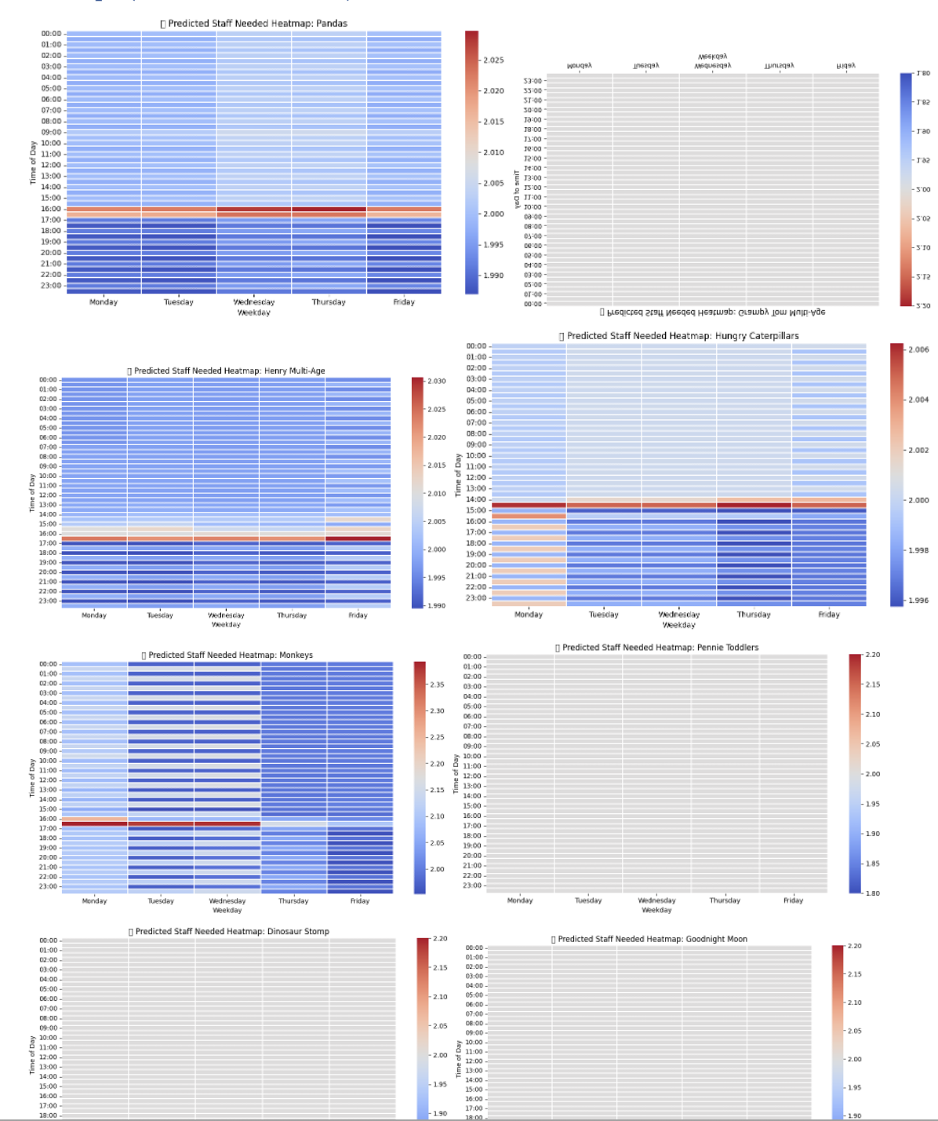
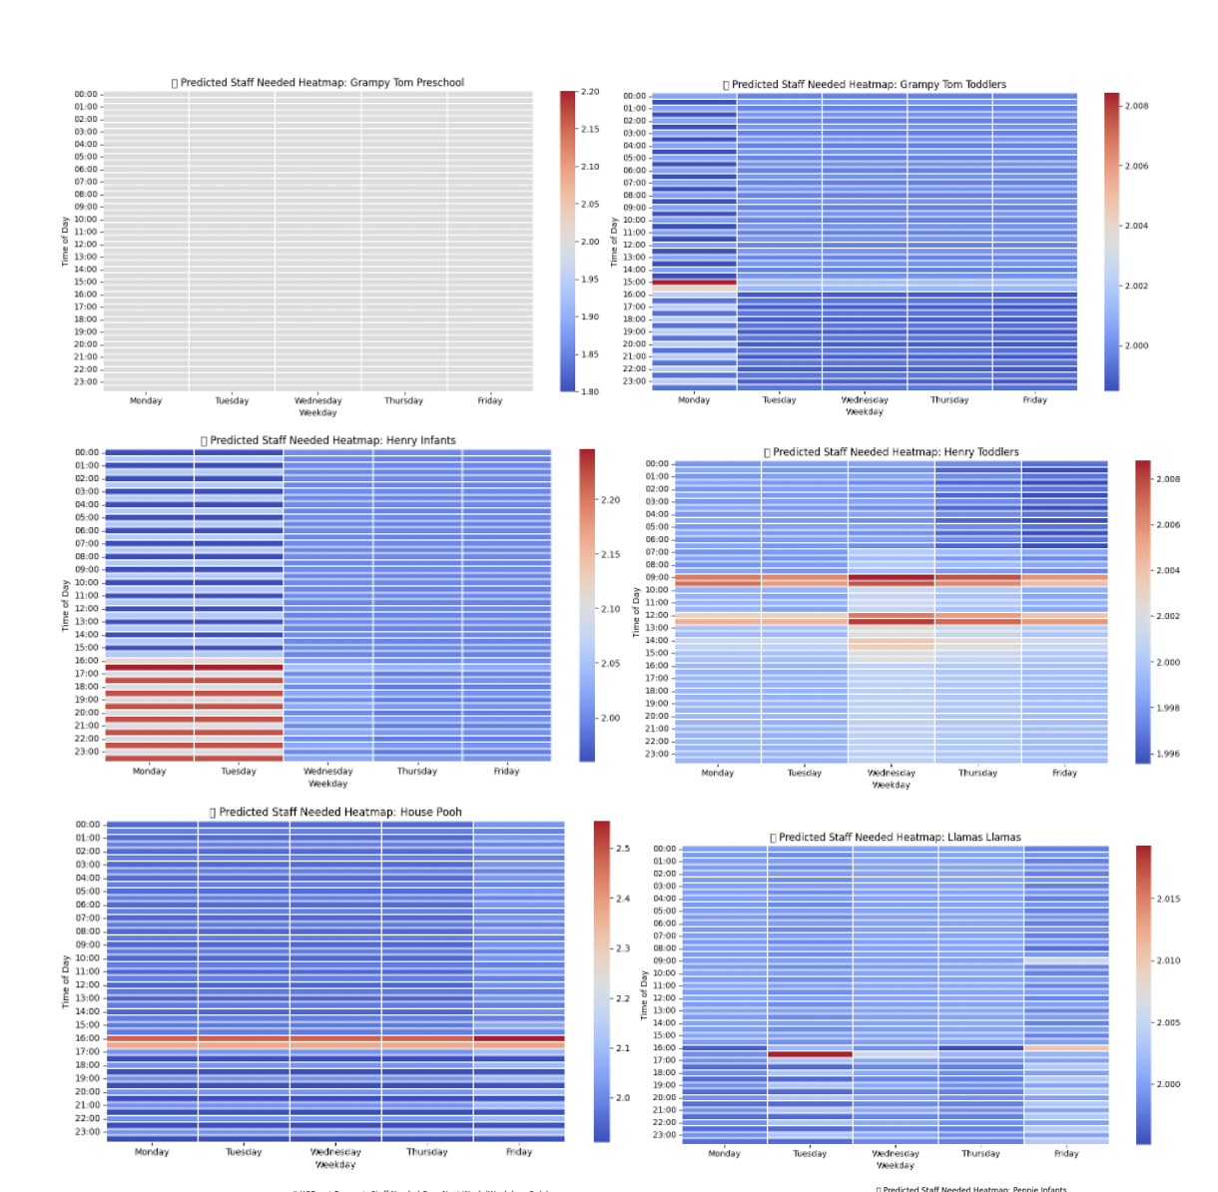
Heatmaps

Slide 13
Each heatmap shows the predicted staff needed for one room across each weekday and 30-minute interval, making it easy to see room-specific demand patterns.
Most rooms show higher staffing needs during morning to early afternoon hours (around 8:30 AM to 1:00 PM), matching busy times when children are most present.
Even when child count is low, staffing never drops below two, reflecting the 2-staff minimum rule.
Some rooms (like Pre-K and Toddlers) show sharp peaks in staffing needs, while others (like Infants) show flatter, more stable requirements.
These visualizations allow CSI administrators to tailor schedules by room, helping reduce overstaffing during quiet periods while maintaining coverage during peak times

Slide 14
Key Visual Insights
Staffing peaks between 8:30 AM – 12:30 PM
Mondays and Fridays show higher variability
All time blocks maintain at least 2staff per room
Higher variation in staffing for rooms like Pre-K1 and Llamas Llamas; steadier demand in Infant rooms.
Lower staff needs observed on Fridays, especially in the afternoon.
Pre-K and Toddler rooms have consistent trends
Weekday forecasts reflect actual staff demands

Slide 15
Insights & Recommendations
Use typical week to draft base schedules
Use next-week forecast for fine-tuning
Focus staffing on peak morning periods

Slide 16
Conclusion
This project will optimize staffing for CSI, reducing labor costs by 10-12% while ensuring safety compliance.
The interactive dashboard and automated reports will allow CSI to efficiently plan staffing needs based on data-driven insights.

Slide 17
Thank You

