Slide 1
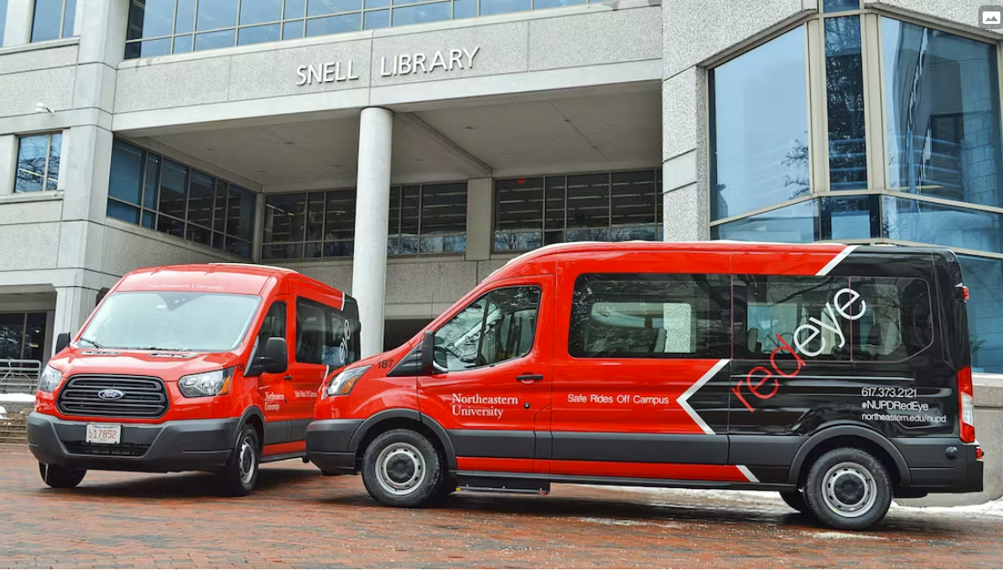
RED EYE MANAGEMENT SYSTEM
“There are no big problems, there are just a lot of little problems”
BY GROUP 08:
Lan Gao - 001568670
Raghav - 002728499
Ruchi Upadhyay – 002934462
Sahithi Reddy – 00276442
Shivani Shekhawat - 002656554

Slide 2
RED EYE MANAGEMENT SYSTEM
OBJECTIVE
The goal is to improve transportation services for students, staff, and visitors, and to streamline operations for the transportation department.
• Streamline Transportation Operations: Automating scheduling, cancelling, and tracking of vehicles, drivers, and the passengers
• Improve Passengers Experience: Up-to-date information on the availability of Redeye transportation services and help them plan their commutes more effectively
• Increase Efficiency: Streamline communication between drivers, passengers, and management staffs, leading to increased efficiency
• Enhanced Analytics: The database system will provide enhanced analytics capabilities, including detailed reports and insights into transportation trends and patterns
BY GROUP 08:
Lan Gao
Raghav
Ruchi Upadhyay – 002934462
Sahithi Reddy –
Shivani Shikhawat -

Slide 3
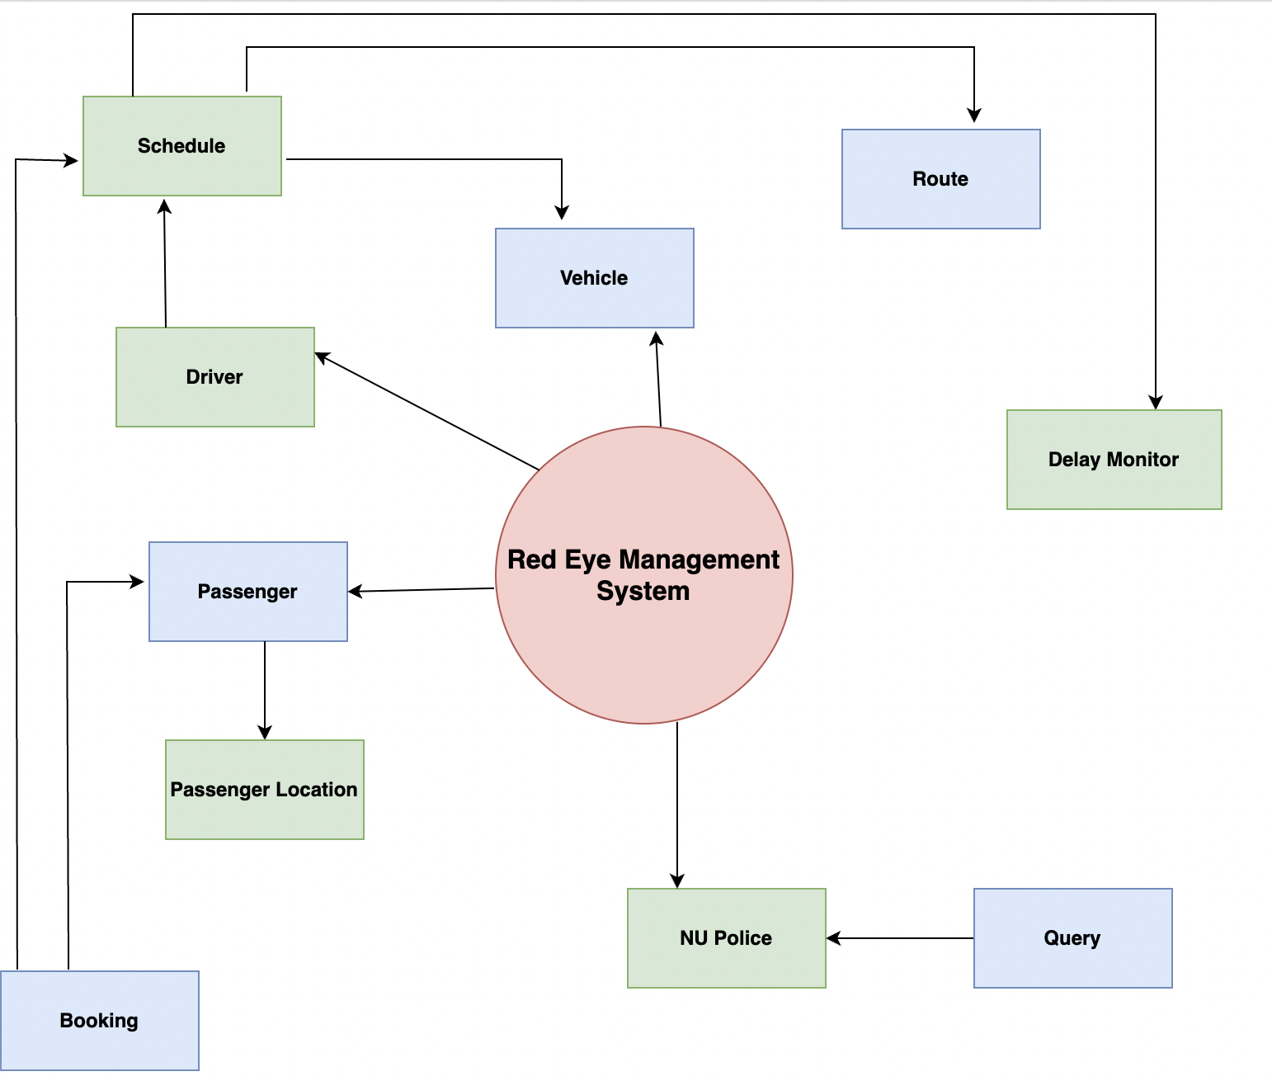
RED EYE MANAGEMENT SYSTEM
HIGH-LEVEL DESIGN
.
BY GROUP 08:
Lan Gao
Raghav
Ruchi Upadhyay – 002934462
Sahithi Reddy –
Shivani Shikhawat -

Slide 4
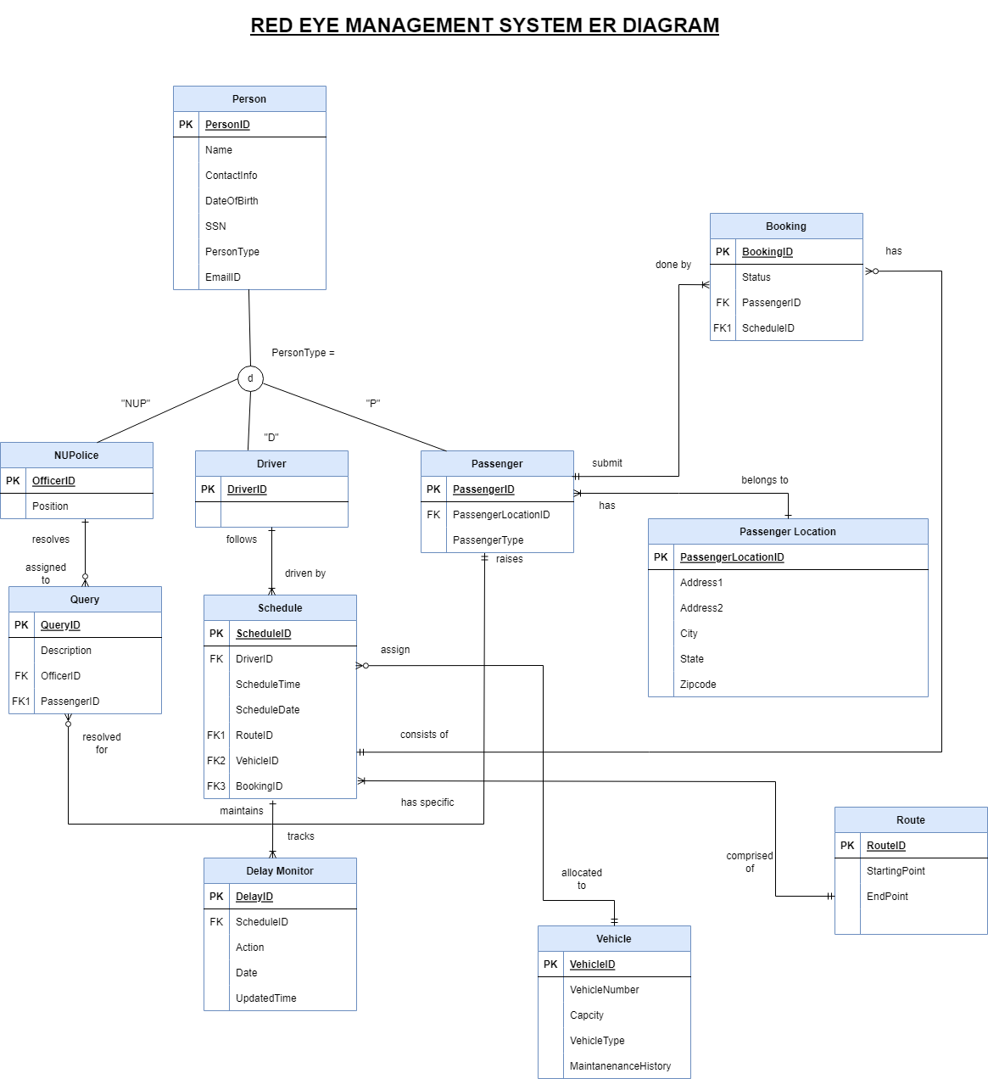
RED EYE MANAGEMENT SYSTEM
The goal is to improve transportation services for students, staff, and visitors, and to streamline operations for the transportation department.
ENTITY RELATIONSHIP DIAGRAM
BY GROUP 08:
Lan Gao
Raghav
Ruchi Upadhyay – 002934462
Sahithi Reddy –
Shivani Shikhawat -
• Streamline Transportation Operations: Automating scheduling, cancelling, and tracking of vehicles, drivers, and the passengers
• Improve Passengers Experience: Up-to-date information on the availability of Redeye transportation services and help them plan their commutes more effectively
• Increase Efficiency: Streamline communication between drivers, passengers, and management staffs, leading to increased efficiency
• Enhanced Analytics: The database system will provide enhanced analytics capabilities, including detailed reports and insights into transportation trends and patterns

Slide 5
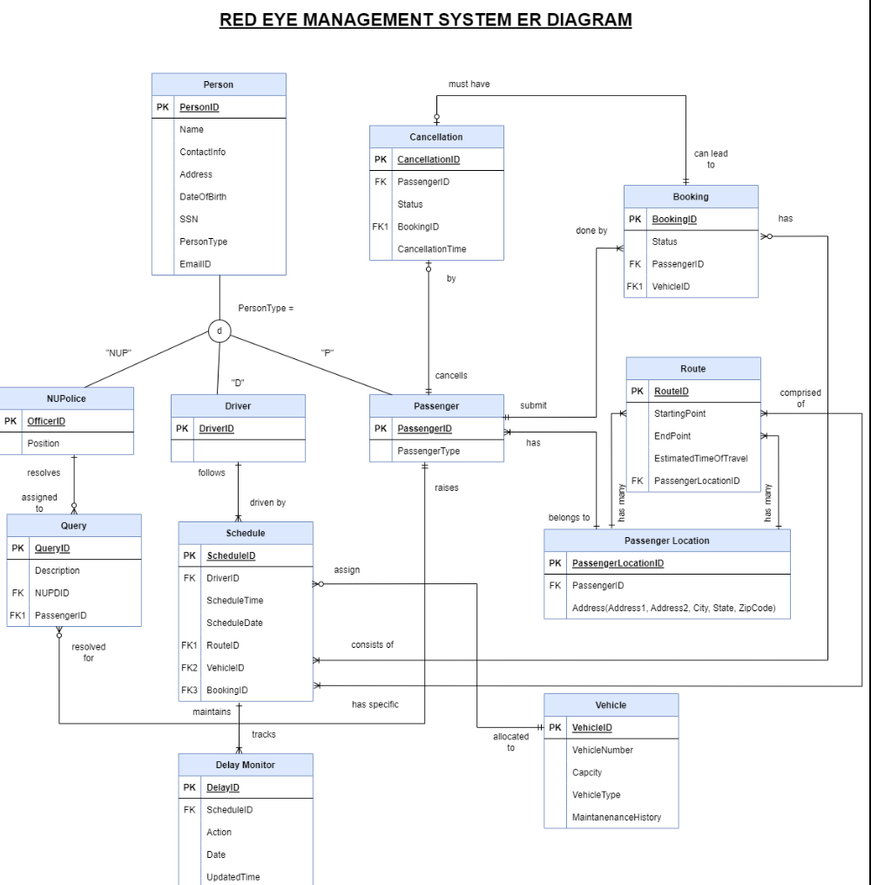
RED EYE MANAGEMENT SYSTEM
The goal is to improve transportation services for students, staff, and visitors, and to streamline operations for the transportation department.
Database Objects
Tables & Constraints
Tables – 11
Encryption & Inserts
Encryption – 1
Indexes & Views
Indexes – 3
Routines
User Defined Functions – 4
Constraints – 3
Inserts - 2
Views - 3
Stored Procedures – 5
Trigger - 2
BY GROUP 08:
Lan Gao
Raghav
Ruchi Upadhyay – 002934462
Sahithi Reddy –
Shivani Shikhawat -
• Streamline Transportation Operations: Automating scheduling, cancelling, and tracking of vehicles, drivers, and the passengers
• Improve Passengers Experience: Up-to-date information on the availability of Redeye transportation services and help them plan their commutes more effectively
• Increase Efficiency: Streamline communication between drivers, passengers, and management staffs, leading to increased efficiency
• Enhanced Analytics: The database system will provide enhanced analytics capabilities, including detailed reports and insights into transportation trends and patterns

Slide 6
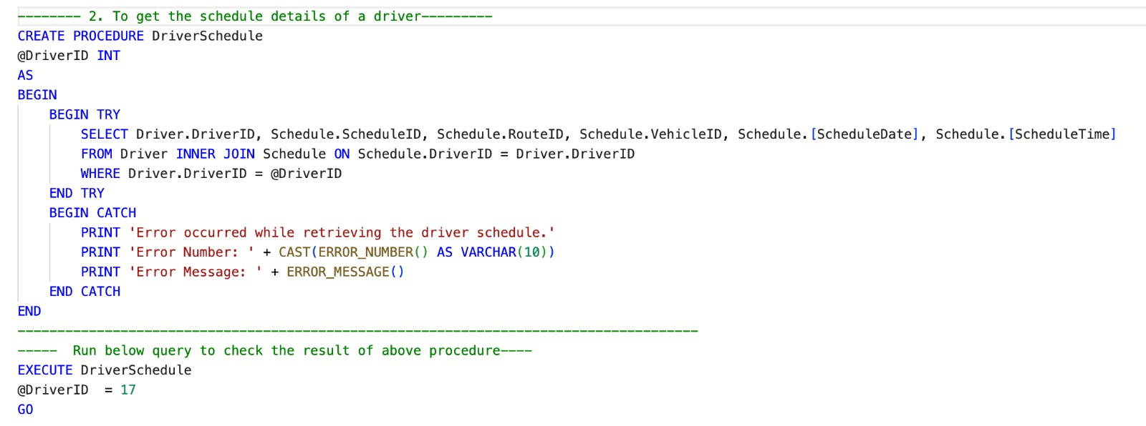
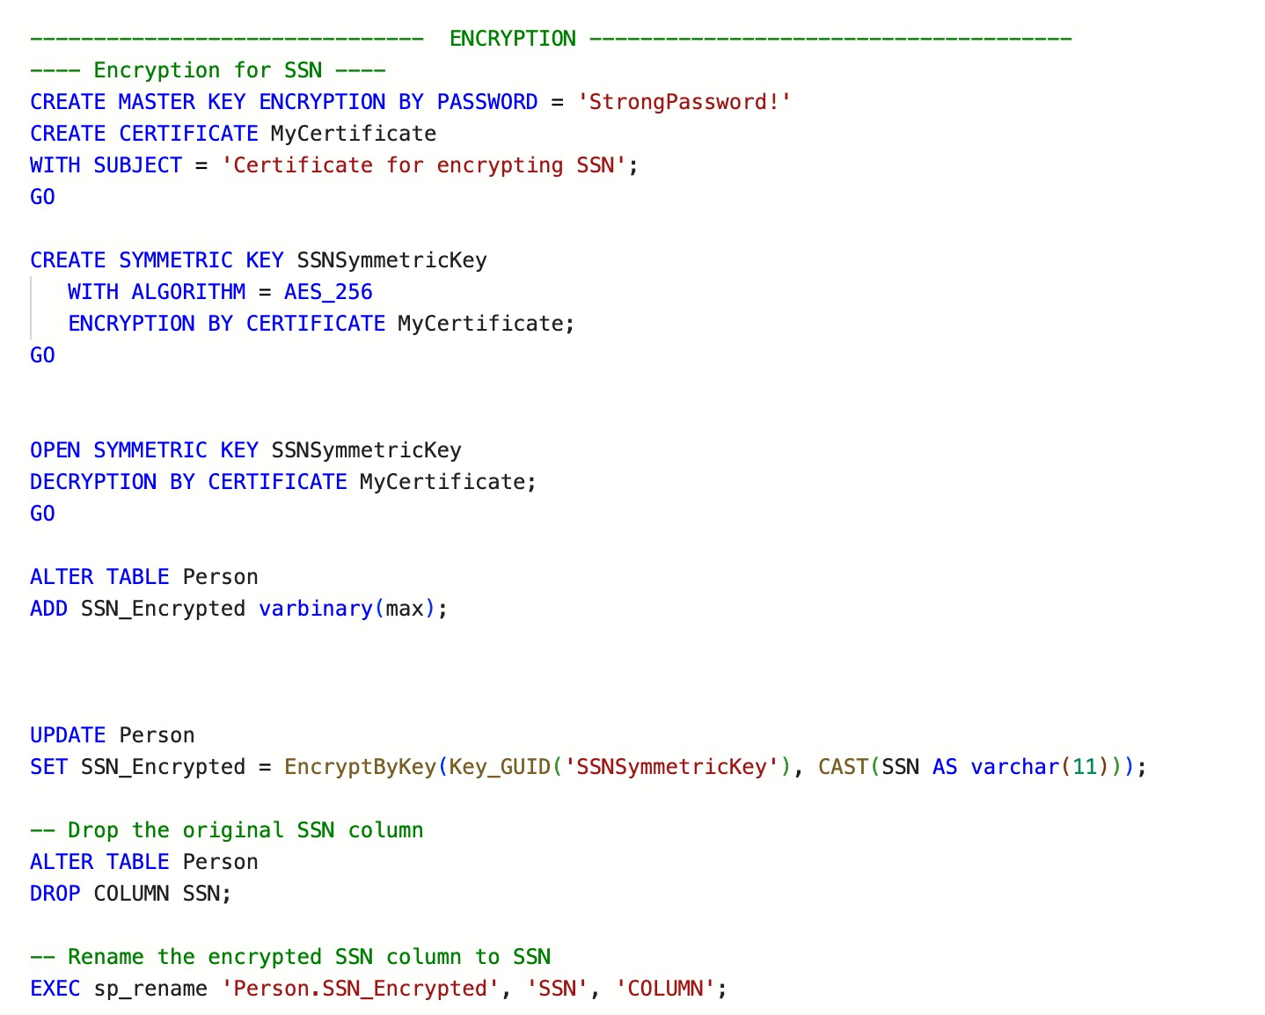
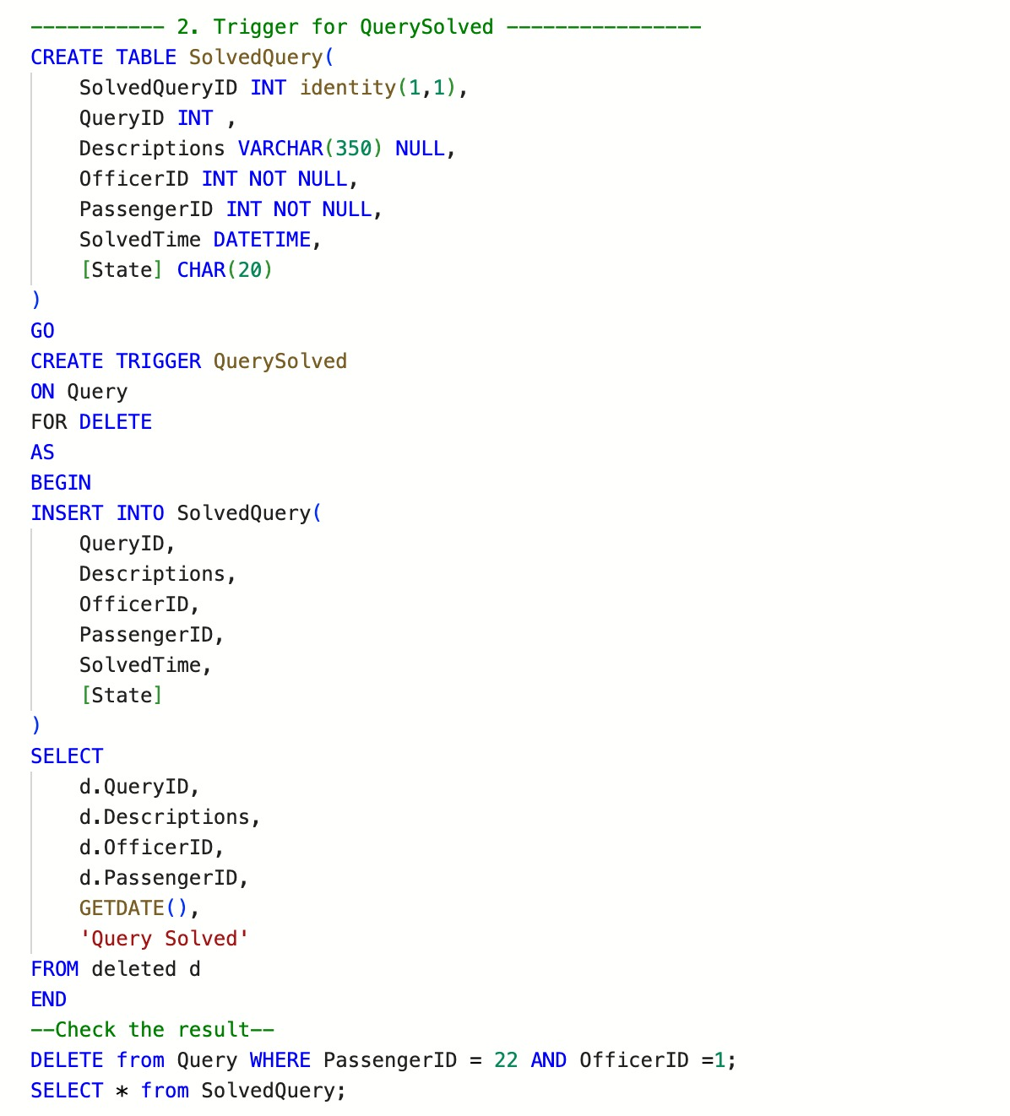
RED EYE MANAGEMENT SYSTEM
The goal is to improve transportation services for students, staff, and visitors, and to streamline operations for the transportation department.
Sample DDL
Procedures
Encryption
Triggers
BY GROUP 08:
Lan Gao
Raghav
Ruchi Upadhyay – 002934462
Sahithi Reddy –
Shivani Shikhawat -
• Streamline Transportation Operations: Automating scheduling, cancelling, and tracking of vehicles, drivers, and the passengers
• Improve Passengers Experience: Up-to-date information on the availability of Redeye transportation services and help them plan their commutes more effectively
• Increase Efficiency: Streamline communication between drivers, passengers, and management staffs, leading to increased efficiency
• Enhanced Analytics: The database system will provide enhanced analytics capabilities, including detailed reports and insights into transportation trends and patterns

Slide 7
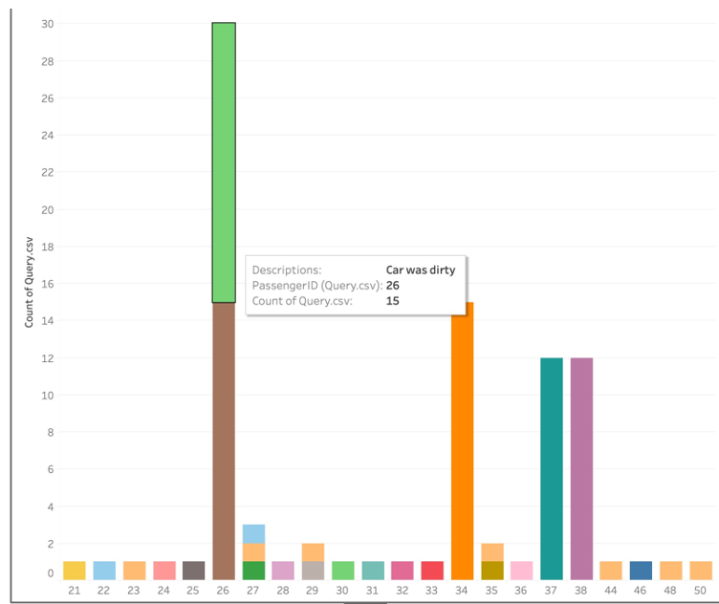
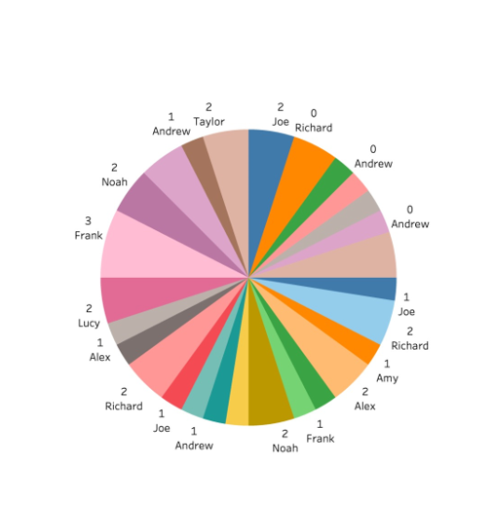
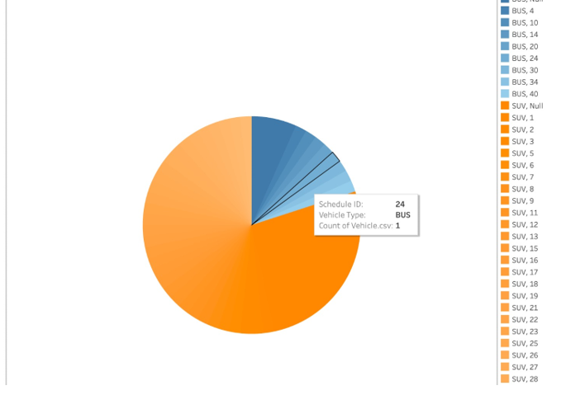
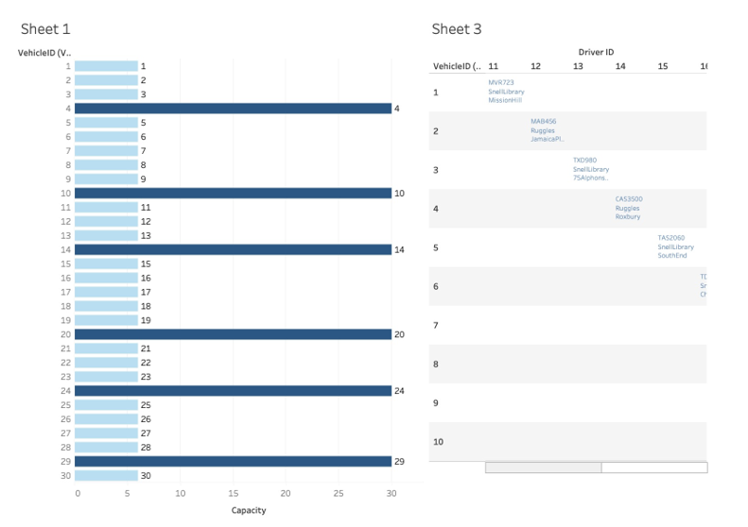
TABLES AND CONSTRAINTS:
Indexes and Views
Routines
Encryption and Try- Catch blocks
Data Visualization

Slide 8

TABLES AND CONSTRAINTS:
Indexes and Views
Routines
Encryption and Try- Catch blocks
HAVE A SAFE RIDE!
The end to Your RED EYE Problems
Data Visualization

