Slide 1

By: Sahithi Vesangi

Slide 2
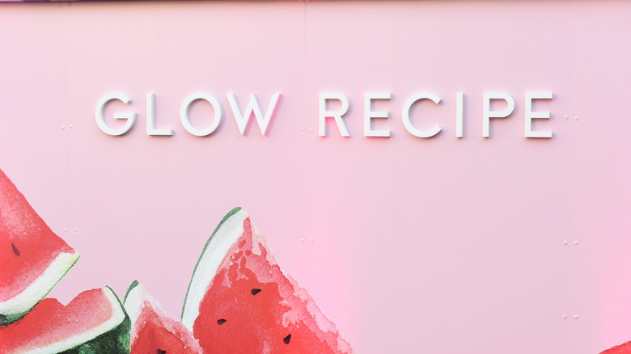


Motivation

Slide 3
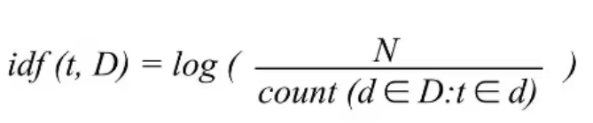
ML Recommendation Engine & Backend
A personalized recommendation system to help users obtain product consultation based on their skin type.
Project runs on TF-IDF (Natural Language Processing) technique.
Uses cosine similarity to find out the similarity index for various skin types.
Flask is used on the backend to render dynamic recommendations to the users

Slide 4
User Interface & Frontend
The user interface helps the users to interact with the website that has a responsive design.
Also, allows users to view the past recommendations using local storage in Javascript
Basic and bright colors are chosen to facilitate accessibility.
Bootstrap is utilized for an interactive design and easy navigation.

Slide 5
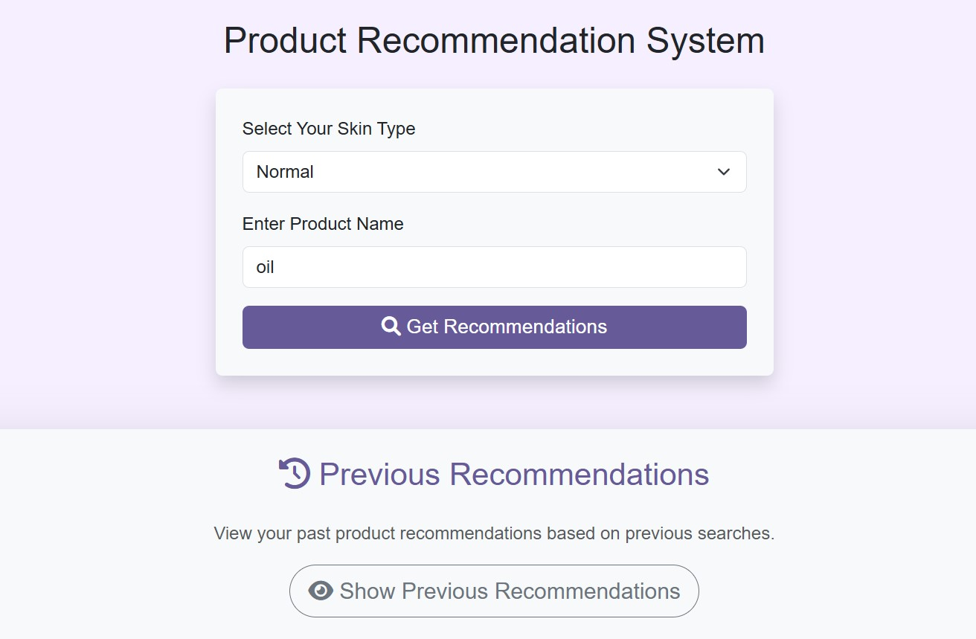
Design and User Interface

Slide 6
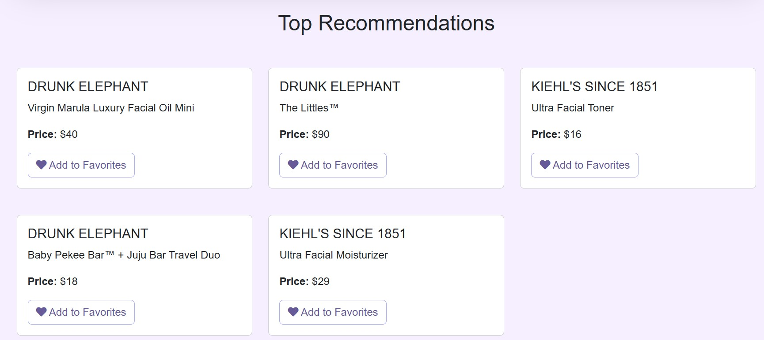
Recommendations

Slide 7
Thankyou!

