Slide 1

CMR INSTITUTE OF TECHNOLOGY
(UGC AUTUNOMOUS)
Approved by AICTE Permanently Affiliated to JNTU, Hyderabad,
Accredited by NBA and NACC with A+ Grade
Kandlakoya(V),Medchal Dist 501401
2024-2025
Detecting Fake Profiles on Social Networks Using Machine Learning and NLP
CSM-C
Presented by
Batch 1:
J.Jashnavi 22R01A6618
A.Sahithya 22R01A6667
R.Likitha 22R01A66J0
Under the Guidance of
Dr. S. Dhanalakshmi
Professor, CSE

Slide 2

ABSTRACT
Social networking platforms have become an essential part of daily life, enabling global interaction. However, they also introduce significant security concerns, particularly the rise of fake profiles, which can lead to identity theft, misinformation, and online abuse. Detecting these fake profiles is critical for ensuring user safety.This project proposes a solution using Machine Learning and Natural Language Processing (NLP) to improve fake profile detection in social networks. By applying algorithms like Support Vector Machine (SVM) and Naïve Bayes, the system analyzes both static and dynamic user profile data to identify anomalies.

Slide 3
INTRODUCTION
Social networking platforms like Facebook and Twitter face rising threats from fake profiles, which enable identity theft, impersonation, and online abuse. Weak privacy settings and lack of user verification make these platforms vulnerable. Fake profiles use static (e.g., demographics) and dynamic (e.g., behavior) data for malicious activities like trolling, phishing, and misinformation. Despite systems like Facebook’s Immune System (FIS), many fake accounts go undetected, highlighting the need for improved detection methods using Machine Learning and Natural Language Processing (NLP)

Slide 4
OBJECTIVE
To develop a system that detects fake profiles in online social networks using machine learning and natural language processing techniques.
To utilize Support Vector Machine (SVM) and Naïve Bayes classifiers for improving the accuracy of fake profile detection.
To analyze both static and dynamic user data, including profile information and behavioral patterns.
To apply natural language processing (NLP) for examining user-generated content to identify suspicious language and posting behavior.
To enhance user safety and privacy by flagging fake accounts that may pose threats such as identity theft or impersonation.

Slide 5
LITERATURE SURVEY
Project titled “Fake Profile Identification in Social Network using Machine Learning and NLP” IEEE Conference on Machine Learning and IOT,Issue Date:12.May.2022
Chai et al. explored the use of natural language dialog systems to improve user interaction in e-commerce, finding that users prefer natural communication methods. Although their work wasn’t directly about fake profile detection, it highlighted how natural language processing (NLP) can help understand user behavior.
Shalinda Adikari and Kaushik Dutta focused on LinkedIn, where limited public data makes fake profile detection more difficult. They identified essential profile attributes that can help in recognizing fake users, and recommended using specific data mining techniques suitable for sparse data environments.

Slide 6
Z. Halim et al. proposed using spatio-temporal mining and latent semantic analysis to identify groups of users involved in malicious activities. Their results showed promise but depended heavily on choosing the right set of features.
Despite these efforts, previous systems lacked robust machine learning implementations and failed to address broader social networking issues such as privacy violations, trolling, and impersonation. Furthermore, classifiers like SVM and Naïve Bayes, which could enhance accuracy, were not widely adopted in earlier models.

Slide 7
EXISTING SYSTEM
Natural language dialog systems have been shown to be more effective and preferred by users, especially beginners, compared to traditional menu-based interfaces in e-commerce platforms. This highlights the critical role of dialog management in enhancing user experience. Key LinkedIn profile attributes have been identified as useful indicators for detecting fake accounts, despite limitations posed by privacy settings. In social networks, spatio-temporal mining methods—particularly those utilizing Latent Semantic Indexing—have demonstrated strong potential for identifying malicious behavior. These methods perform well when supported by a comprehensive set of features, although selecting the most effective features remains a challenge.

Slide 8
DISADVANTAGES
The system has not implemented learning algorithms like SVM and Naive Bayes.
The system has not addressed problems involving social networking, such as privacy, online bullying, misuse, trolling, and many others.
The system lacks scalability and adaptability, limiting its effectiveness in handling large-scale, dynamic social network data.

Slide 9
PROPOSED SYSTEM
This system proposes using machine learning and natural language processing to detect fake profiles on social networks. It incorporates Support Vector Machine (SVM), which finds the optimal hyperplane to separate real and fake profiles, and Naive Bayes, a probabilistic algorithm that assumes feature independence. These algorithms analyze features like post time, date, language, and geo-position to calculate the likelihood of a profile being fake. By combining SVM’s classification strength with Naive Bayes’ probability-based approach, the system enhances detection accuracy and reliability.

Slide 10
ALGORITHMS
Gradient Boosting:
Gradient Boosting builds strong models by combining several weak learners, helping to detect subtle patterns of fake profiles. It reduces errors step-by-step, making detection highly accurate.
Decision Tree Classifiers:
Decision Trees classify user profiles by learning clear decision rules based on profile attributes. They help in identifying suspicious or fake behaviors in social networks.
Random Forest:
Random Forest combines many decision trees to improve classification accuracy. It is robust in detecting fake profiles by analyzing multiple user features.

Slide 11
Logistic Regression Classifiers:
Logistic Regression predicts the likelihood of a profile being fake or genuine. It is widely used for binary classification tasks like fake vs real user detection.
Naive Bayes:
Naive Bayes uses probability and feature independence to quickly classify profiles. It is effective for detecting fake accounts based on textual and profile features.
SVM (Support Vector Machine):
SVM separates fake and genuine profiles by finding the optimal boundary between classes. It is powerful in detecting fake profiles in high-dimensional feature spaces.

Slide 12

MODEL DISCRIPTION
The proposed model aims to detect fake profiles in online social networks using machine learning and natural language processing (NLP). It analyzes both static data (e.g., profile name, age, bio) and dynamic data (e.g., post frequency, language, location). Features are extracted and processed using Support Vector Machine (SVM) and Naïve Bayes classifiers, which help classify profiles as genuine or fake.By combining both classifiers, the model improves detection accuracy, minimizes false positives, and enhances the platform’s ability to prevent identity theft, impersonation, and malicious activities.

Slide 13
ADVANTAGES
In the proposed system, Profile information in online networks will also be static or dynamic. The details which can be supplied with the aid of the person on the time of profile creation is known as static knowledge, the place as the small print that are recounted with the aid of the system within the network is called dynamic knowledge.
In the proposed system, Social Networking offerings have facilitated identity theft and Impersonation attacks for serious as good as naïve attackers.

Slide 14
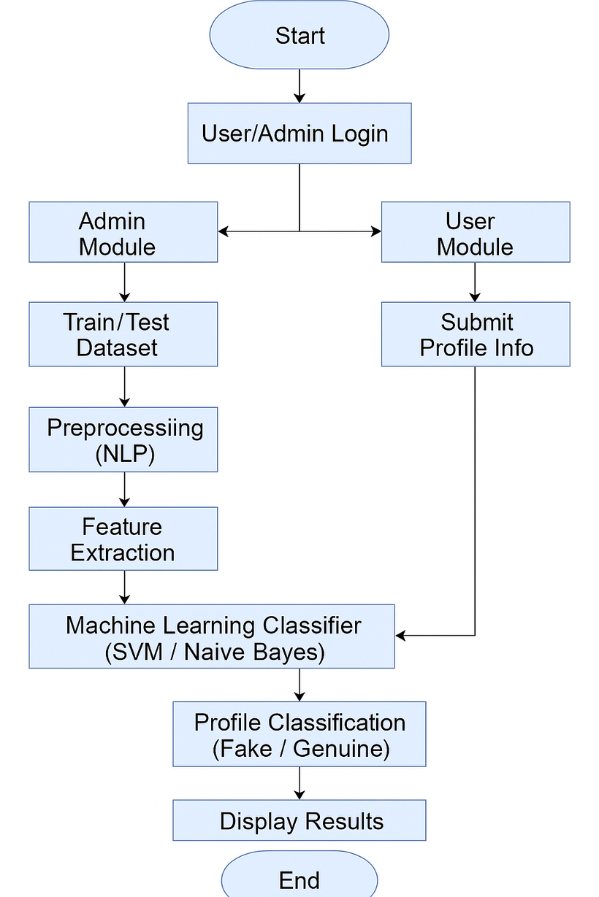
RESULT

Slide 15

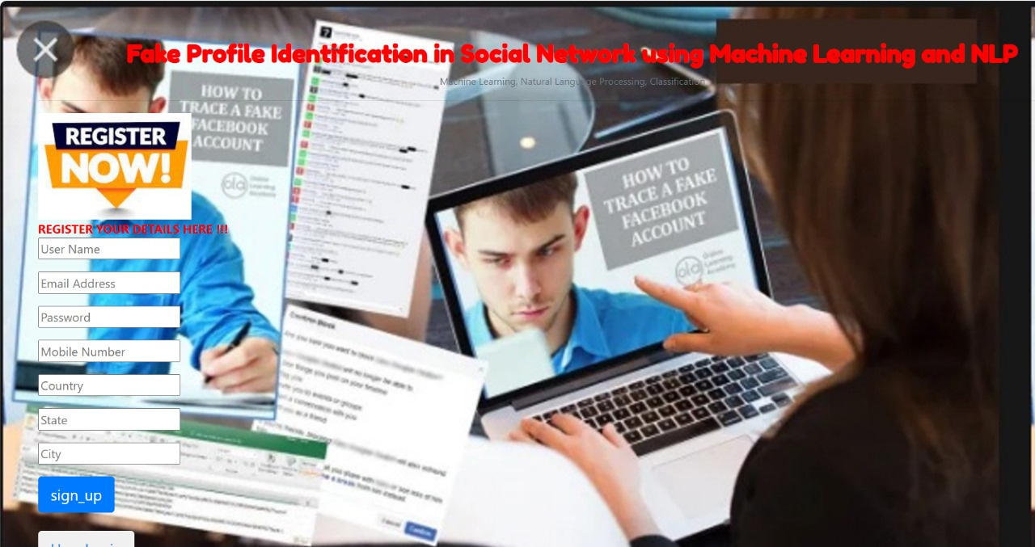
RESULT
Home Page

Slide 16


Register form
Remote Users data

Slide 17

Output form

Slide 18
CONCLUSION
In this paper, we proposed machine learning algorithms along with natural language processing techniques. By using these techniques, we can easily detect the fake profiles from the social network sites. In this paper we took the Face book. Data set to identify the fake profiles. The NLP pre-processing techniques are used to analyze the dataset and machine learning algorithm such as SVM and Naïve Bayes are used to classify the profiles. These learning algorithms are improved the detection accuracy rate in this paper.

Slide 19
Further Enhancements
Deep Learning Integration: Use models like BERT or LSTM to improve text analysis and detection accuracy beyond traditional ML methods.
Real-Time Fake Profile Detection: Deploy the system as a real-time API for dynamic monitoring and immediate flagging of suspicious profiles.
Graph-Based & Multimodal Analysis: Combine user behavior, text, images, and social network connections using Graph Neural Networks for more accurate classification.
User Feedback & Explainability: Integrate a user reporting system and explainable AI to improve model transparency and continuously enhance detection performance.

Slide 20
REFERENCES
[1] Michael Fire et al. (2012). "Strangers intrusion detection-detecting spammers and fake profiles in social networks based on topology anomalies." Human Journal 1(1): 26-39.Günther, F. and S. Fritsch (2010). "neuralnet: Training of neural networks." The R Journal 2(1): 30-38.
[2] Shalinda Adikari and Kaushik Dutta, Identifying Fake Profiles in LinkedIn, PACIS 2014 Proceedings, AISeL.
[3] Z. Halim, M. Gul, N. ul Hassan, R. Baig, S. Rehman, and F. Naz,“Malicious users’ circle detection in social network based on spatiotemporal co-occurrence,” in Computer Networks and Information Technology (ICCNIT),2011 International Conference on, July, pp. 35–390.

Slide 21
THANK YOU!

