Slide 1
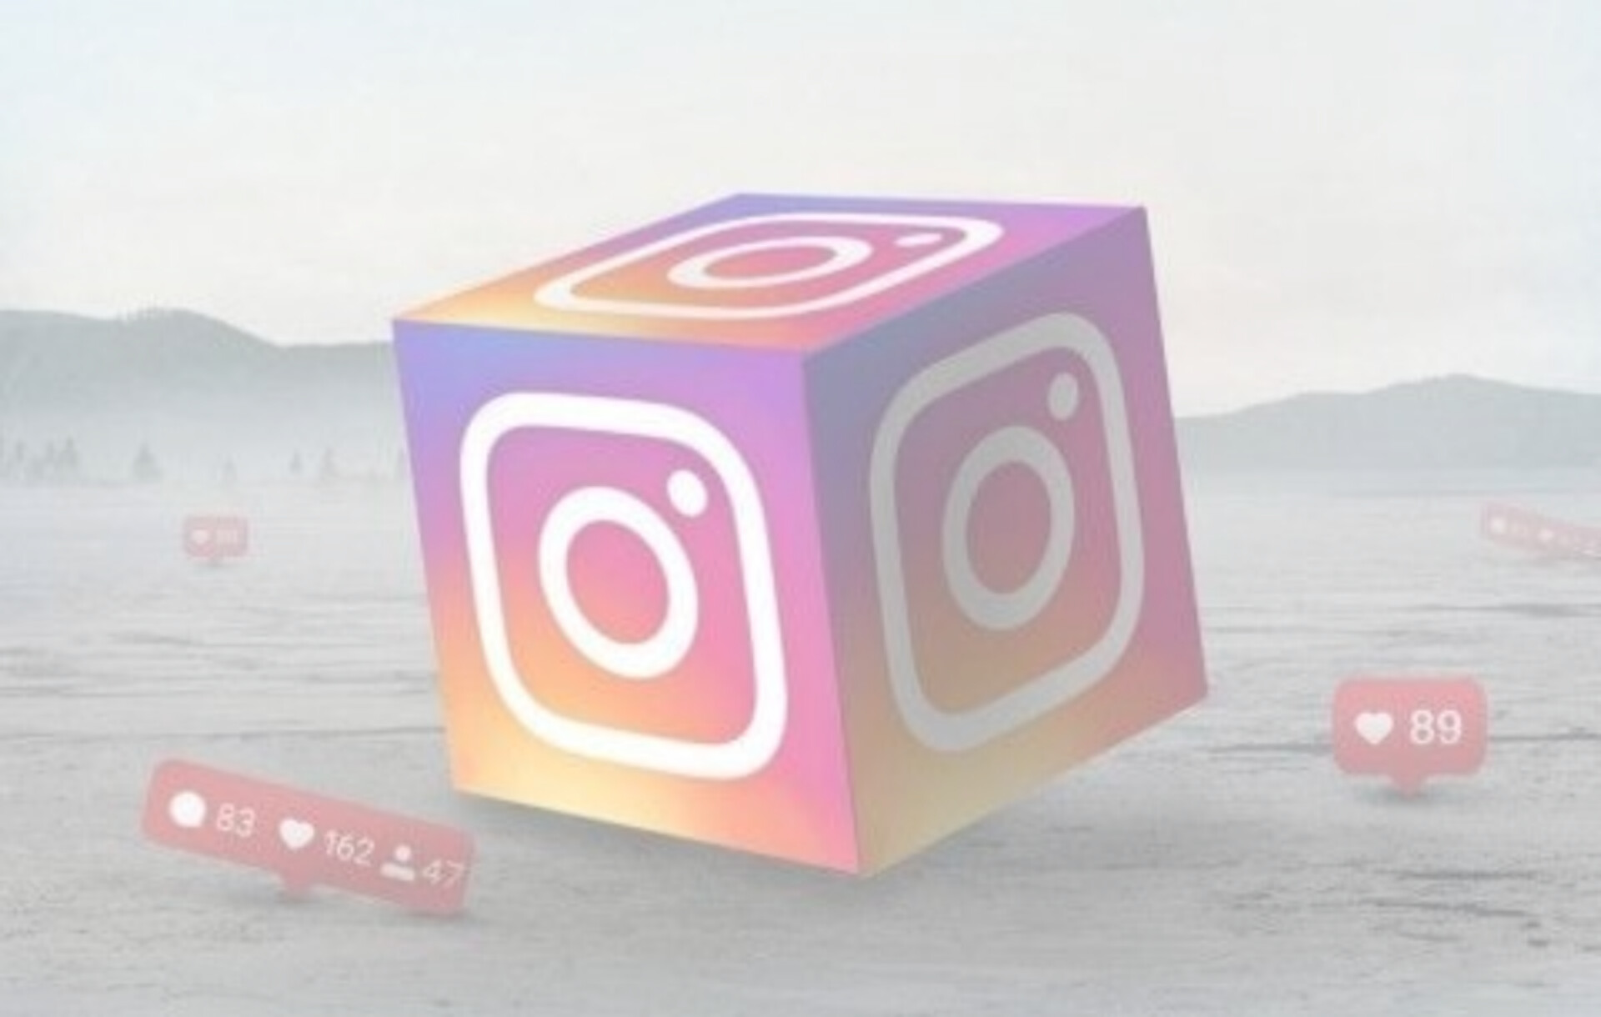
INSTAGRAM REACH ANALYSIS

Slide 2
Under the Guidance: Mr. B. Anil Kumar
Submitted by:
1.A.VAISHNAVI (22R01A6666) 2.A.SAHITHYA (22R01A6667) 3.E.SRUTHI (22R01A6679) 4.K.PRANEETH (22R01A6692)
Team: Dream Team Theme: Social Media

Slide 3

CONTENTS
Abstract
Introduction
Objective
Existing system
Disadvantages
Proposed system
Requirements
Advantages
Algorithms Used
System architecture
Conclusion

Slide 4

ABSTRACT
Instagram is a photo and video sharing social networking services owned by Meta Platform. It allows users to upload media that can be edited with filters, be organized by hashtags, and be associated with a location via geographical, tagging.
The app was launched in 2010 by cofounders Kevin Systrom and Mike Krieger, and it is now owned by Meta Platforms, Inc., the parent company of Facebook.
We use methods like ARIMA and LSTM to create this model, then test it to see which one is the most accurate With these insights, social media managers and content creators can improve their Instagram strategy.

Slide 5

INTRODUCTION
Instagram is a major social media platform with over a billion active users. For businesses, influencers, and content creators, it's a powerful tool to connect with audiences, promote products, and build a brand. However, achieving high visibility on Instagram isn't always straightforward. The "reach" of a post—how many people see it—depends on many factors, from the content's appeal to the timing of its posting. Understanding these factors and knowing how to optimize them is key to a successful Instagram strategy .This study explores the elements that affect Instagram reach. We aim to identify patterns and trends that can help users understand what drives visibility and how they can improve their posts' performance.

Slide 6

OBJECTIVE
Instagram, one of the most popular social media platforms, serves as a vital channel for businesses, influencers, and content creators to connect with audiences and promote their brands. However, achieving high visibility—measured as "reach“ can be challenging due to Instagram's complex algorithms and competitive environment. Reach can vary greatly based on a range of factors, and understanding these dynamics is crucial for maximizing exposure and engagement.
Therefore, the Objective is to address is twofold:
1. Identifying Key Factors Influencing Instagram Reach
2. Analysisng Future Instagram Reach

Slide 7
EXISTING SYSTEM
Instagram insights to learn more about your account’s followers and performance.
You can also view insights on your audience’s engagement with specific posts,
Stories, videos, Reels and Live videos. If applicable, insights and metrics about
your account.
1. Content Quality:
Post high-quality photos and videos.
Keep a consistent look or theme across your posts.
2. Timing and Frequency:
Post at times when your audience is most active.
Keep a consistent posting schedule.
3. Hashtags and Captions:
Use popular and relevant hashtags.
4. Collaborations:
Partner with influencers or other brands to reach more people.

Slide 8
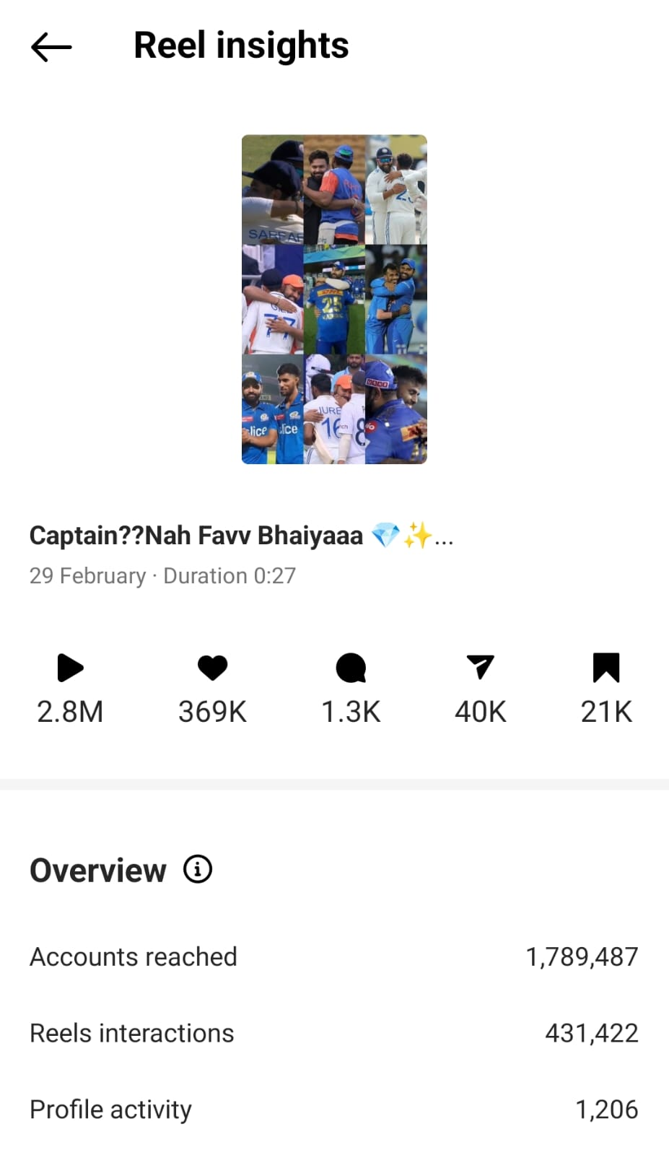

Slide 9
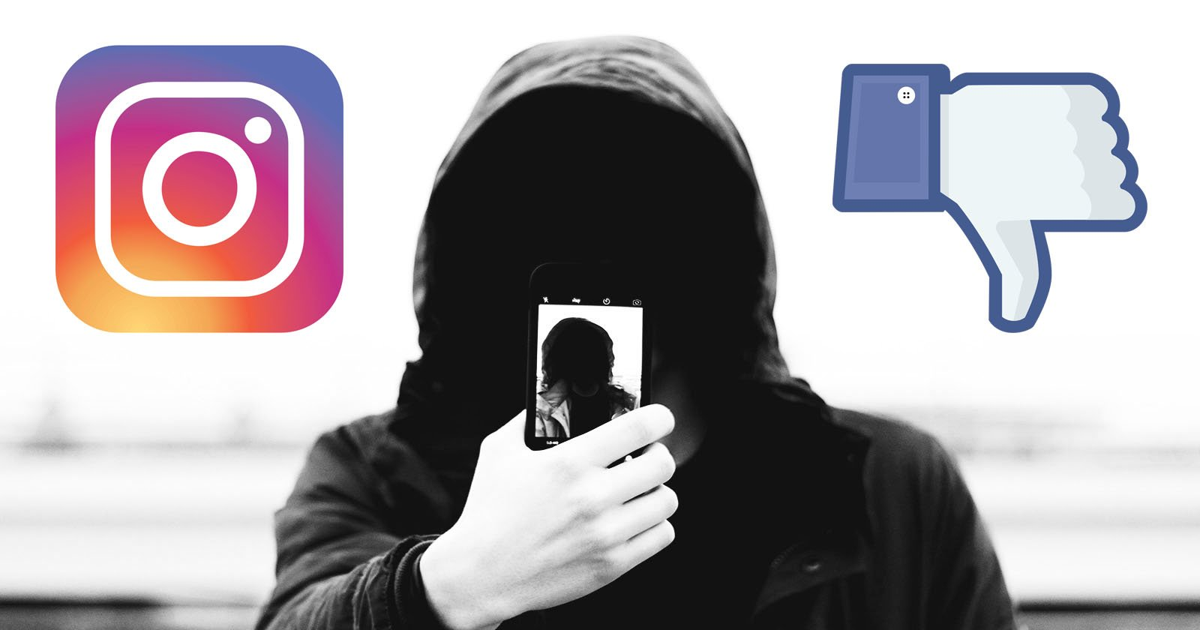
DISADVANTAGES
Cyber Bullying
Features are not available for everyone
Copyright issues
Limited Customizations
Privacy Concerns
Promotion of Unrealistic
Beauty Standards.

Slide 10
PROPOSED SYSTEM
Our proposed system helps users increase their Instagram reach by analyzing data and predicting trends. Here's how it works:
1.Identify Key Factors: -
We identify the most important factors that affect Instagram reach, like post type, timing, and user interactions.
2.Data Analysis:-
We collect and study Instagram data, like posts, engagement (likes, comments, shares), hashtags, and posting times, to find what influences reach.

Slide 11
3. Practical Recommendations:
The system provides suggestions to improve reach, including the best times to post, effective hashtags, and ways to boost engagement.
4. Adaptable and Updated:
The system adapts to changes in Instagram's algorithm, ensuring that users get up-to-date recommendations.

Slide 12
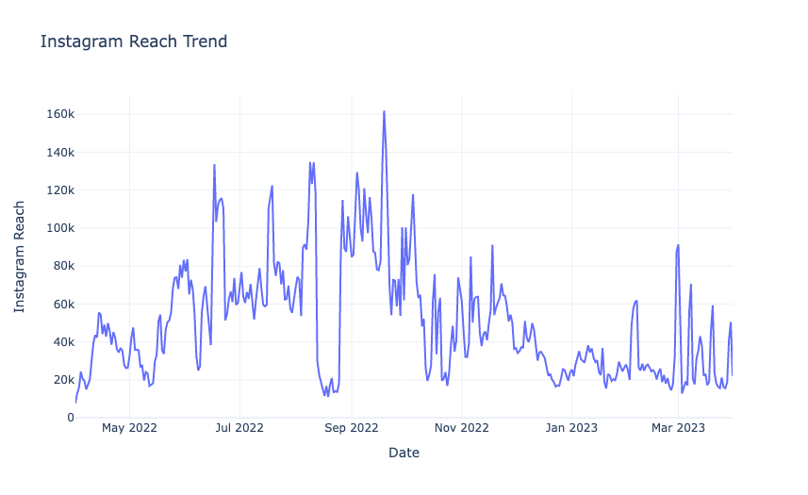

Slide 13
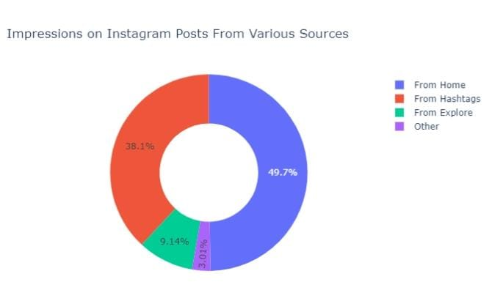

Slide 14

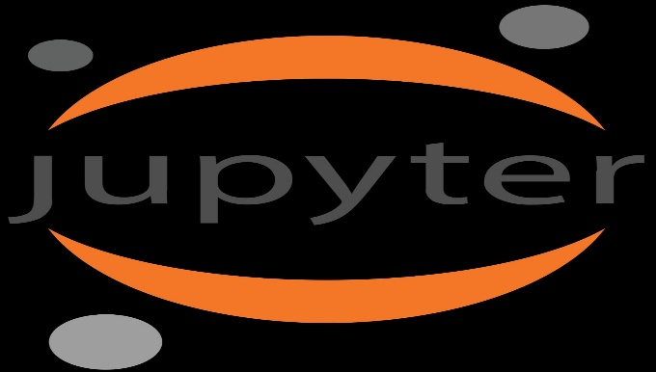
SYSTEM AND SOFTWARE REQUIREMENTS
Python
Jupyter notebook

Slide 15
REQUIREMENTS
1. Processor:
Multi-core (Intel Core i5/AMD Ryzen 5 or better) for fast data processing.
2. Memory (RAM):
At least 8 GB, ideally 16 GB or more for handling large datasets.
3. Storage:
Minimum of 256 GB, with SSD recommended for quicker data access.
4. Graphics Processing Unit (GPU):
Optional, but helpful for advanced machine learning tasks or large-scale
data analysis.
5. Connectivity:
Stable internet connection for data collection and sharing.

Slide 16
ALGORITHMS
Linear Regression: Predicts reach based on linear relationships between independent variables (e.g., time, content features) and reach metrics.
Random Forest: Ensemble learning method that builds multiple decision trees and combines their predictions to improve accuracy in predicting reach.
Gradient Boosting: Another ensemble method that builds decision trees sequentially, each one correcting the errors of the previous one, often resulting in better accuracy.
Long Short-Term Memory (LSTM): A type of recurrent neural network (RNN) well-suited for sequential data, often used for time series forecasting, including reach prediction.

Slide 17
ADVANTAGES
Better Customer Relationships
Followers Growth
Track Your Progress
Evaluate your target audience in more detail
Identifies Trending Topics
Powerful Advertising Platform

Slide 18
LITERATURE SURVEY
I. Instagram Reach Analysis and Prediction Rakesh Kundu 1 , Saraswat Ghosh 1 , Shivam Shreyansh 1 , Yash Yadav 1 , Prof. Bhasker Rao2 1 Student, Department of CSE, Dayananda Sagar Academy of Technology and Management, Bangalore, India
An analysis of Instagram reach and prediction of future reach is an important topic in the field of social
Media platform.
II. RAVI GUSAIN1 , SAKSHAM PATHAK2 1, 2 Department of Information Technology, Maharaja Agrasen Institute of Technology, Delhi, India.
Instagram is photo and video sharing platform having a huge influence on the reach of a person or a brand worldwide.
III.Dr. Daryl D. Green1*, Dr. Richard Martinez1, Amalan Kadja2, Lauran Evenson2 Lisa MacManus2, Stephanie Dirlbeck2
Social media is a great way to foster a personal relationship between a brand and its followers.

Slide 19
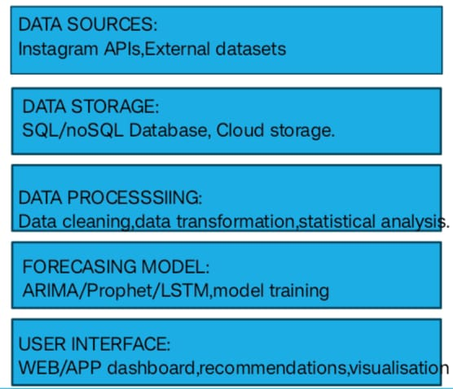
SYSTEM ARCHITECTURE

Slide 20
CONCLUSION
Instagram is one of the most popular social media applications today People using Instagram professionally for promoting their business. So, it’s most important to connect with audiences. So, that we need to know about reach of own account in order to get success. By collecting the dataset of our account which helps us to predict which area has high interaction, so that we can make change accordingly. When we examine hashtag impressions, we realize that not all posts are equally discoverable through hashtags. However, hashtags offer a valuable avenue for reaching new users who share an interest in the content we create.

Slide 21


