Slide 1
Weather Data Analysis Report

Slide 2
This report analyzes and visualizes historical weather data, including basic statistical measures, trends, correlations, and advanced visualizations. The goal is to uncover insights into temperature, humidity, precipitation, and wind speed.

Slide 3
Overview
Section 1: Data Import and Preparation
Section 2: Basic Statistical Analysis
Section 3: Data Visualization
Section 4: Correlation and Regression Analysis
Section 5: 3D Surface Visualization
Section 6: Conclusion

Slide 4
Section 1: Data Import and Preparation

Slide 5
Import weather data from a CSV file and clean it.
% The data contains the following columns:
% - Date
% - Temperature
% - Humidity
% - Precipitation
% - WindSpeed

Slide 6
Section 2: Basic Statistical Analysis

Slide 7
Compute basic statistics such as mean, median, and standard deviation for key weather parameters.
% Example code for statistical calculations
meanTemp = mean(weatherData.Temperature, 'omitnan');
disp(['Mean Temperature: ', num2str(meanTemp), ' °C']);
stdTemp = std(weatherData.Temperature, 'omitnan');
disp(['Standard Deviation of Temperature: ', num2str(stdTemp), ' °C']);
Mean Temperature: 28.4355 °C
Standard Deviation of Temperature: 1.7764 °C

Slide 8
Section 3: Data Visualization

Slide 9
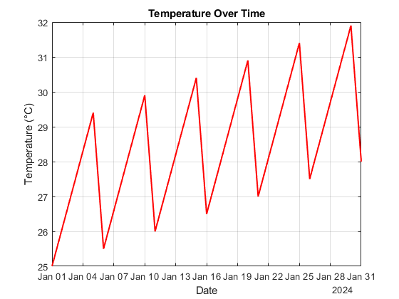
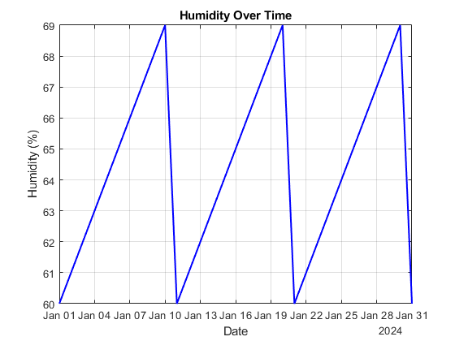
Plot time series and create 3D surface plots to visualize trends.

Slide 10
% Code for a time series plot
figure;
plot(weatherData.Date, weatherData.Temperature, 'r-', 'LineWidth', 1.5);
xlabel('Date');
ylabel('Temperature (°C)');
title('Temperature Over Time');
grid on;
% Code for humidity plot
figure;
plot(weatherData.Date, weatherData.Humidity, 'b-', 'LineWidth', 1.5);
xlabel('Date');
ylabel('Humidity (%)');
title('Humidity Over Time');
grid on;

Slide 11
Section 4: Correlation and Regression Analysis

Slide 12
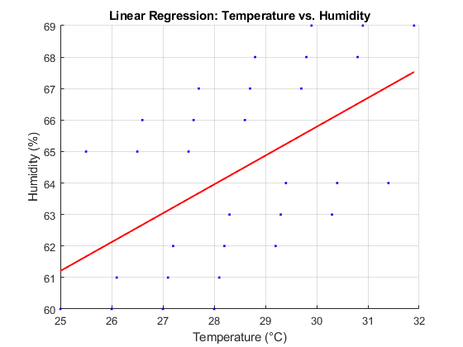
Perform correlation analysis and fit linear regression models.

Slide 13
% Regression plot
figure;
scatter(weatherData.Temperature, weatherData.Humidity, 'b.');
hold on;
p = polyfit(weatherData.Temperature, weatherData.Humidity, 1);
fitted = polyval(p, weatherData.Temperature);
plot(weatherData.Temperature, fitted, 'r-', 'LineWidth', 1.5);
xlabel('Temperature (°C)');
ylabel('Humidity (%)');
title('Linear Regression: Temperature vs. Humidity');
grid on;
hold off;

Slide 14
Section 5: 3D Surface Visualization

Slide 15
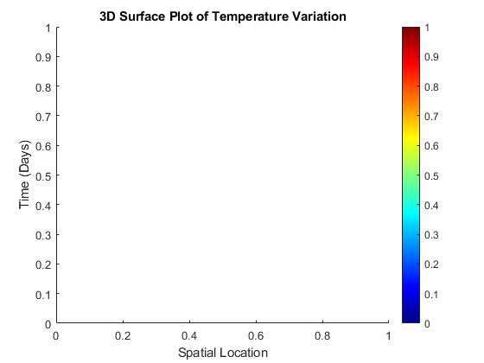
Visualize temperature variation over time and space.

Slide 16
% Convert Date to numeric values for plotting
time = datenum(weatherData.Date); % Convert datetime to serial date numbers
x = 1:length(weatherData.Temperature); % Spatial data (this can be your locations if available)
% Create a 3D surface plot
figure;
xlabel('Spatial Location');
ylabel('Time (Days)');
zlabel('Temperature (°C)');
title('3D Surface Plot of Temperature Variation');
shading interp;
colorbar;
colormap jet;

Slide 17
Section 6: Conclusion

Slide 18
The analysis reveals key trends and insights into the weather data. The linear regression model shows a strong relationship between temperature and humidity. Temperature variations can be observed over time, providing a clear picture of temperature behavior.

