Slide 1

DEPARTMENT OF COMPUTER SCIENCE & ENGINEERING
“LIBRARY INFORMATION TECHNOLOGY” 19CSE48
Presentation by,
NAME:P.SAHITHYA
USN:1NH18CS133
Under the Guidance of ,
Guide: Ms.UMA
Designation: Assistant
Professor

Slide 2
Agenda
Introduction
Abstract
Problem definition
Objectives
Methodology
Concepts implemented
Algorithm
Conclusion

Slide 3
INTRODUCTION
The project title library information technology has changed the function of the library.
Library information Technology is supposed for maintaining info of books, borrower’s information and primarily concerning the issues and returns.
Library is a crucial role for the folks particularly the scholars that helps the scholars in their learning method and understands the ideas in higher manner.

Slide 4
ABSTRACT
The manual maintenance of library daily activities is very difficult.
This plays a vital role for developing the libraries and information centres.
The main goal of Library Information technology is to store, organize, share and retrieve vital information needed to carry out daily operational functions of the library

Slide 5
PROBLEM DEFINITION
Library should offer a decent quality of services, adequate of information, smart activities and employee’s perspective at constant time determination the difficult featured by them.
The aim of the project is to develop a program on Library Information Technology
Library Information Technology which is fast and efficient and consumes less time
10/08/2020

Slide 6
OBJECTIVES
The main objectives of this project are:
To produce up-to-date and authentic info on all subjects;
To produce services freed from value or at nominal rates to every member of the society with none discrimination;
To produce a harmless and elevating use of leisure;
To be answerable for preservation and development of cultural and antiquarian heritage of the community
10/08/2020

Slide 7
METHODOLOGY
In this project, Object Oriented Concepts of java plays a major role in library information technology.
It offers the various choice for the client's
Books information
Borrowers information
Issues and Returns

Slide 8
CONCEPTS IMPLEMENTED
I/O Operations
FileInputStream and FileOutputStream are the classes used to read and write the files in Java.
throws IO exception was implemented to throw the exception.
“close()" method is used to close the file.

Slide 9
EXCEPTIONAL HANDLING
OBJECT
declare a variable of the class type that can refer to an object.
create an object by using the "new" keyword
after the creation of object, we can call a class method by obj_var_name.method_name();
Try and catch are the two exceptional handling implemented
Used to handle run time error.

Slide 10
Algorithm
Step 1: start
Step 2: It displays “NHCE LIBRARY”.
Step3: Choose the option you want to perform Do you want to know the details of library?
Step 4: Enter the number which the library information required for you

Slide 11
Books information
Borrowers information
Issues and Returns
Exit
Step 5: If you want to know the information about books.
It asks to create
It asks to search
It asks to record
It asks to display

Slide 12
Step 6: If you want to display the details about borrowers.
It asks the id no
It asks the name
It asks the address
Step 7: If you select information about issues and returns it will display all the details regarding the borrowers in the library
Step 8: exit

Slide 13
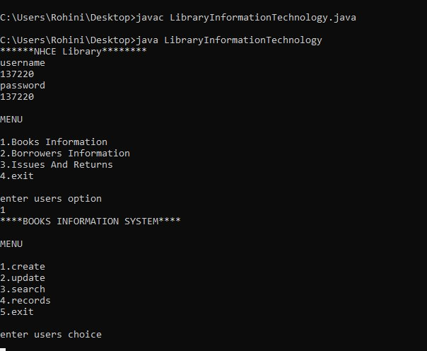
Output 1:

Slide 14
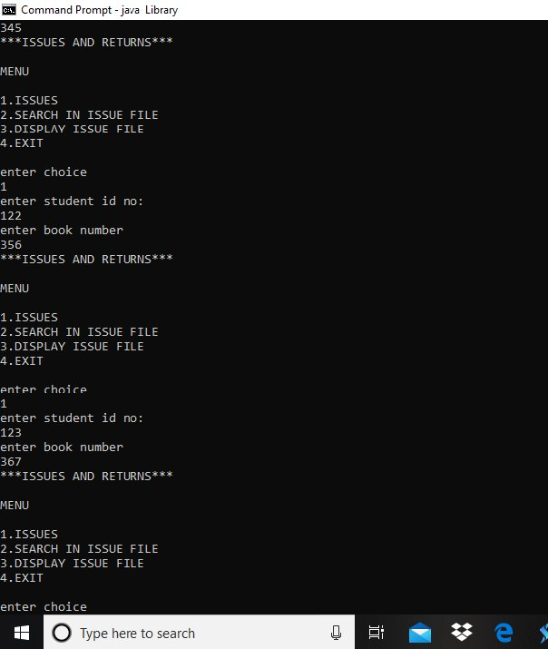
Output 2:
OUTPUT 2

Slide 15
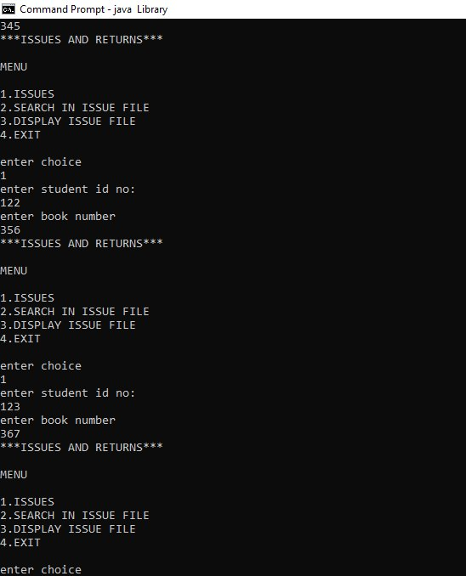
Output 3:
OUTPUT 3

Slide 16
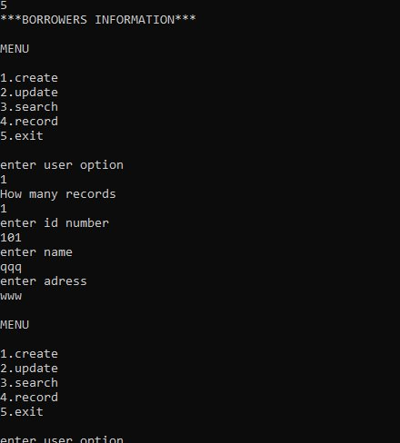
OUTPUT 4

Slide 17
Conclusion
This project mainly deals with the Library information technology which is implemented by the object- oriented concepts in Java.
It has its own merits and demerits.
The main advantage of implementing the library information system is to reach the students satisfaction.
Therefore the project has been designed to provide the user with proper convenient whether the books are issued and returned on time or not.

Slide 18
THANK YOU

