Slide 1
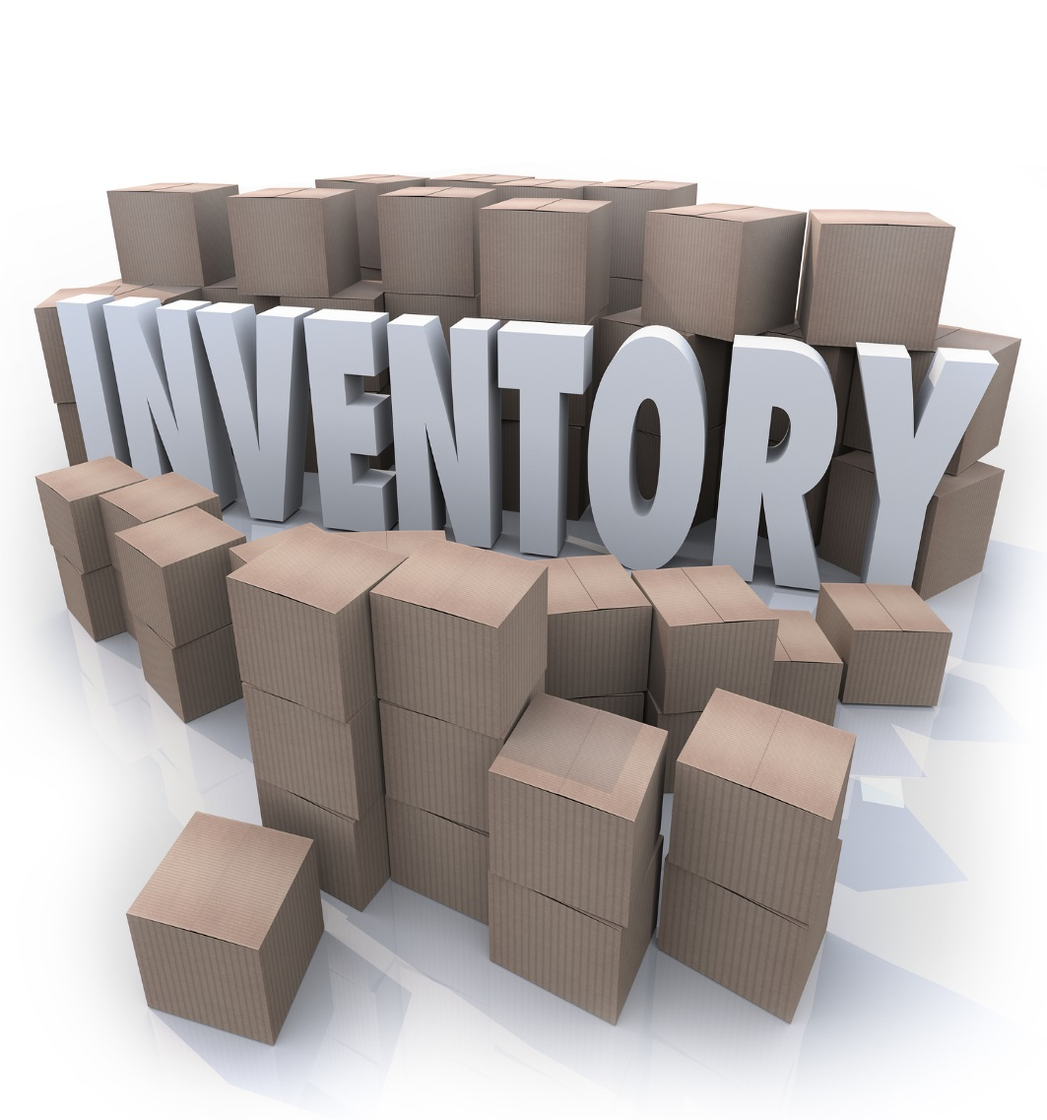


VISION QUEST

Slide 2

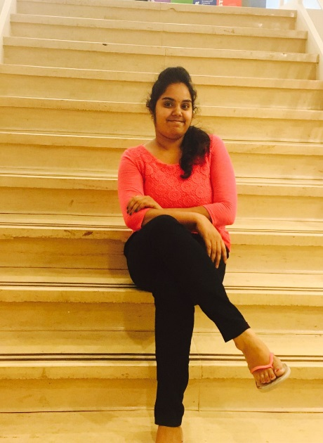



TEAM MEMBERS
Meghana
Suneel
Sahithya
Jeevitha
Manoj

Slide 3
Outline
Introduction
Requirements
Tools Required
Demonstration
Implementation

Slide 4
Introduction
The project Inventory System is developed for an online store. These would take care of all the related products.
This project enables to reduce the manpower and provides a clear view of the stock available.
The main purpose of these inventory system is to increase the production during any season by having products in stock.
Notes:
This project helps a businessman to manage his/her online store. Our project addresses the problem that the physical stores usually face like they have restrictions on the number of products one can buy at most during sale time. The owner hires users based on his requirements and the user get the product for the lowest price and gets a profit.

Slide 5
Requirements
Admin Role
Able to announce how many items he needs at a time
When the product details are verified the payment will be done
Guest approvals are accepted
Guest Role
Asks Permission to continue as a user
Client Role
Records numbers of items bought
User need to upload the shipping receipt to the system

Slide 6
Tools Required
Prototype Design - Just in mind
ER Diagram - Visio
Database Connection - Back4App
Platform - Xcode

Slide 7
Lessons Learned
Teamwork, from working in a team with members having varied skills.
Obtaining a clear and consistent idea of the various stages in development of a UI.
Documentation skills
Swift Programming Language

Slide 8

Implementation

Slide 9
CONCLUSION
Implemented all the functionalities

Slide 10


Slide 11


Slide 12
TEAM MEMBERS
Meghana
Suneel
Sahithya
Jeevitha
Manoj

