Slide 1
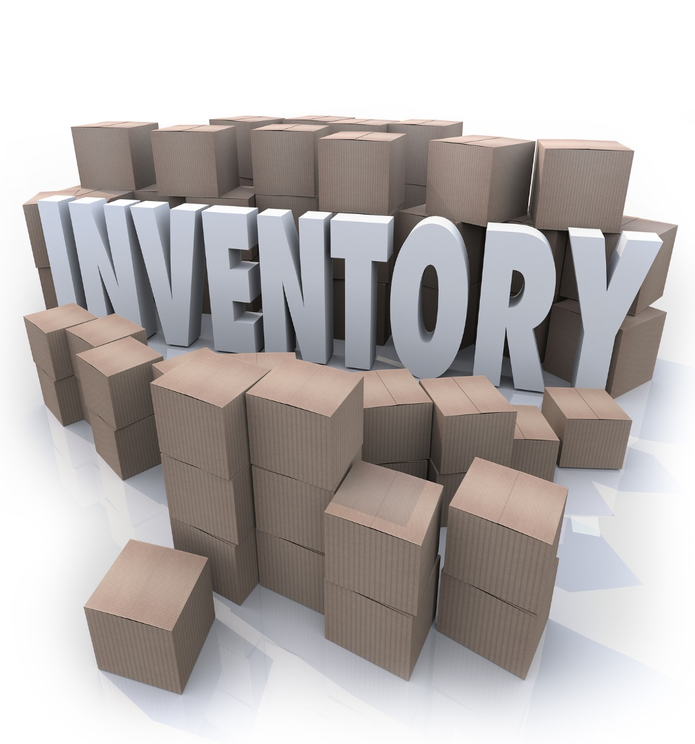


VISION QUEST

Slide 2
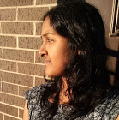

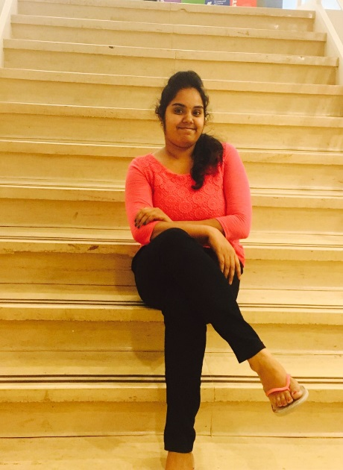
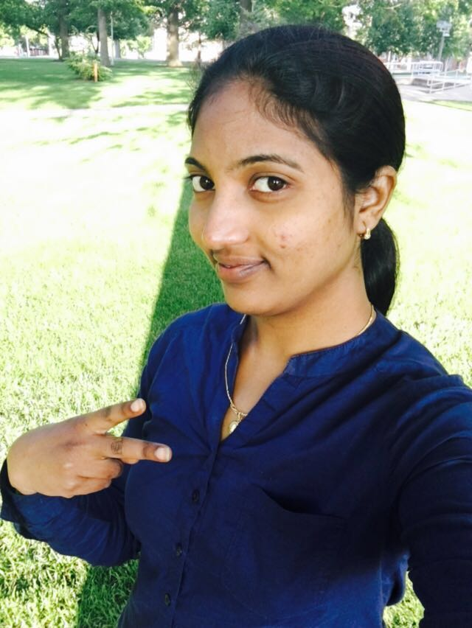

TEAM MEMBERS
Meghana
Suneel
Sahithya
Jeevitha
Manoj

Slide 3
Outline
Introduction
Requirements
ER-Model
Flowchart
Tools Required
Prototype Design
Implementation
Conclusion

Slide 4
Introduction
The project Inventory System is developed for an online store. These would take care of all the related products.
This project enables to reduce the manpower and provides a clear view of the stock available.
The main purpose of these inventory system is to increase the production during any season by having products in stock.
Sahithya Vuppala
Notes:
This project helps a businessman to manage his/her online store. Our project addresses the problem that the physical stores usually face like they have restrictions on the number of products one can buy at most during sale time. The owner hires users based on his requirements and the user get the product for the lowest price and gets a profit.

Slide 5
Requirements
Admin Role
Able to announce how many items he needs at a time
Also fix the price for each product
Request of items should be shown in admin’s dashboard
Need to upload a shipping label to the user
When the product details are verified the payment will be done
Guest approvals are accepted
Sahithya Vuppala

Slide 6
Requirements continued…
Client Role
Records numbers of items bought
Asks admin for the shipping label
User should view the shipping label uploaded by the admin
User can download the shipping package and ship the package
User need to upload the shipping receipt to the system
Sahithya Vuppala

Slide 7
Requirements continued…
Guest Role
Asks Permission to continue as a user
Sahithya Vuppala

Slide 8
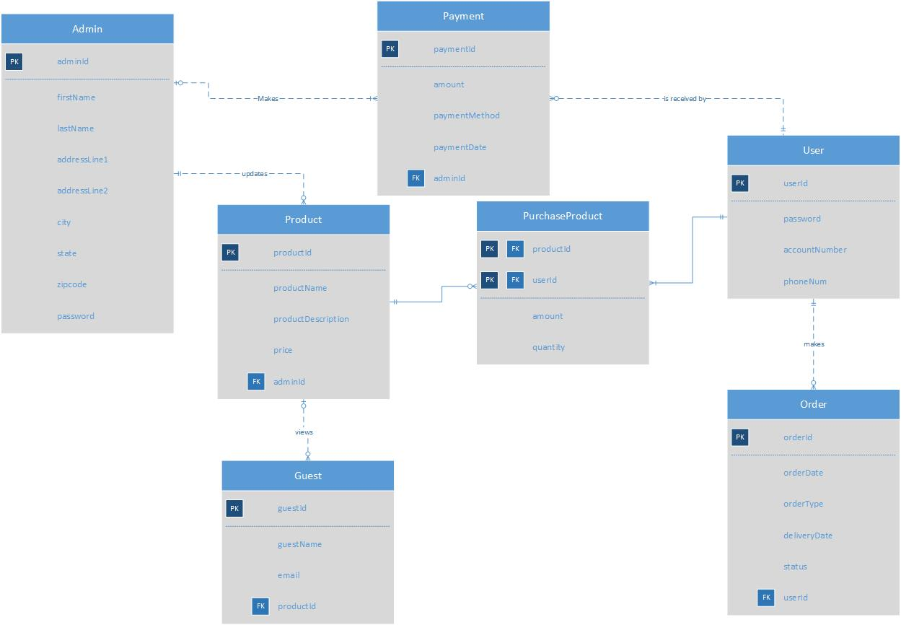
ER-DIAGRAM
Jeevitha Kamatham

Slide 9
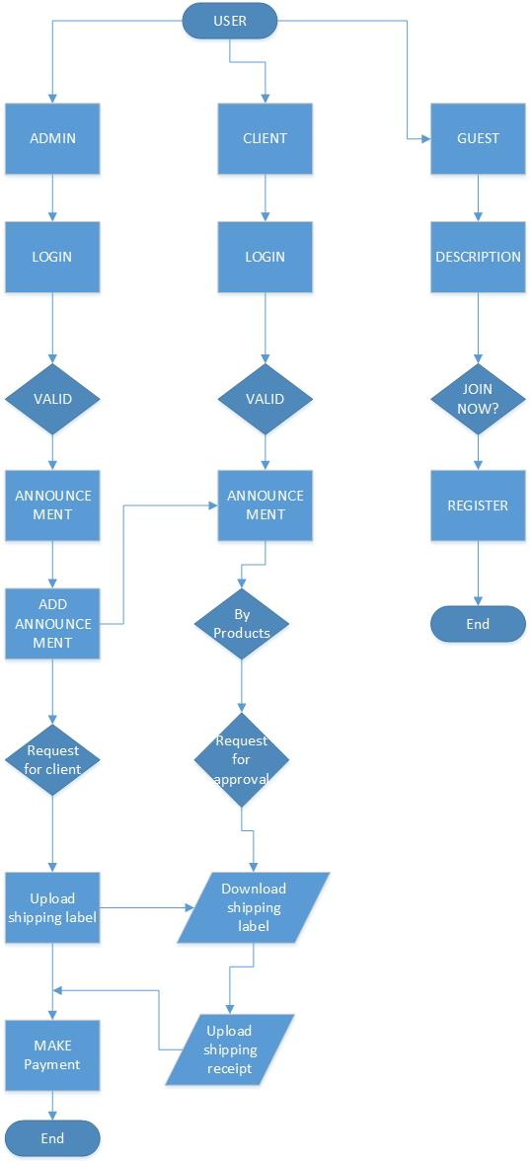
FLOWCHART
Jeevitha Kamatham

Slide 10
Tools Required
Prototype Design - Just in mind
ER Diagram - Visio
Database Connection - Back4App
Platform - Xcode
Jeevitha Kamatham

Slide 11
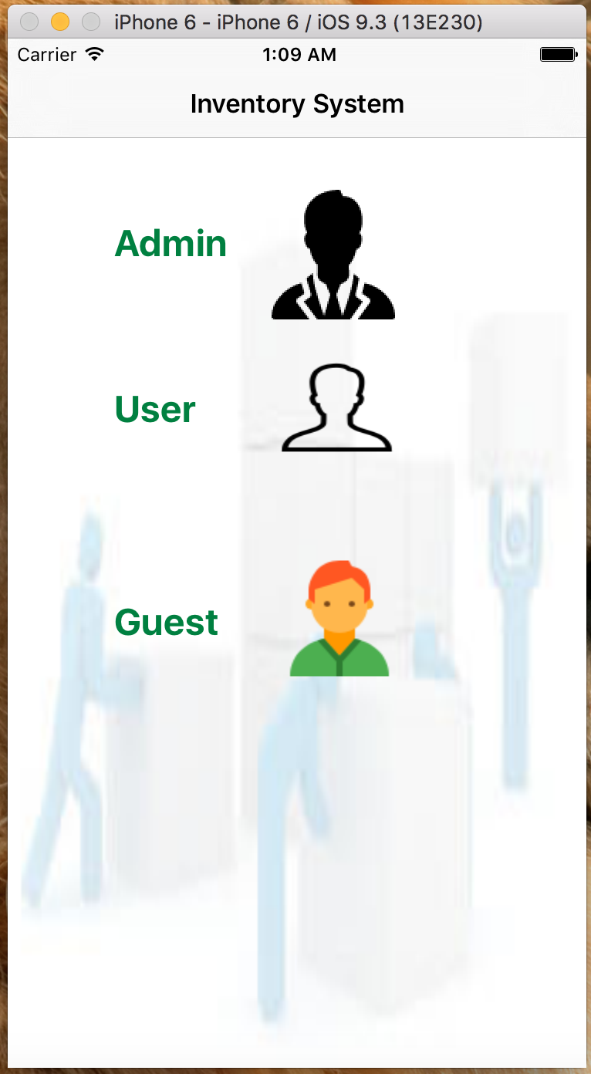
Prototypes
.
Meghana Thakkellapati

Slide 12
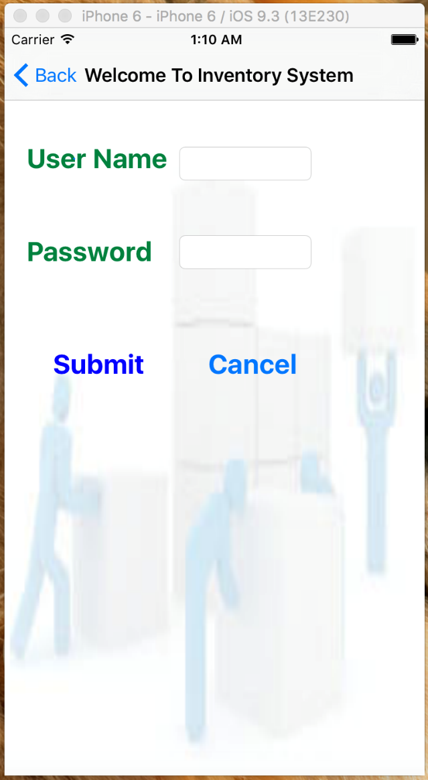
Prototypes continued……
Meghana Thakkellapati

Slide 13
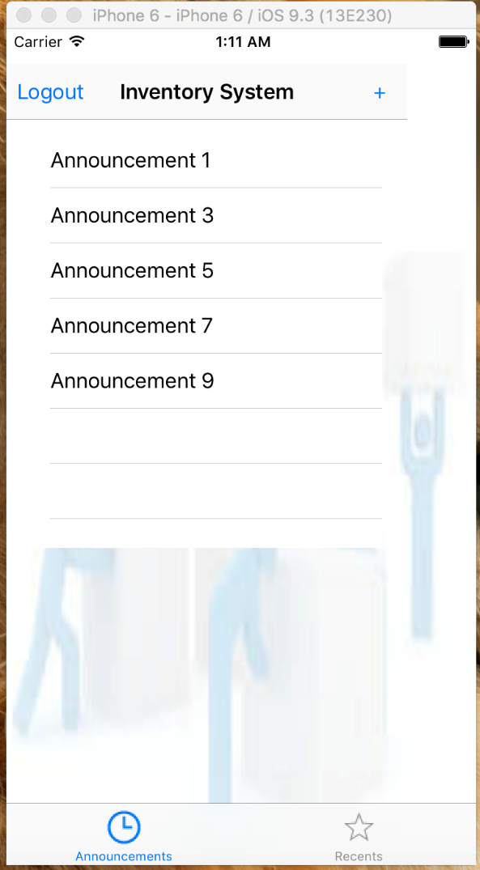
Prototypes continued……
Meghana Thakkellapati

Slide 14
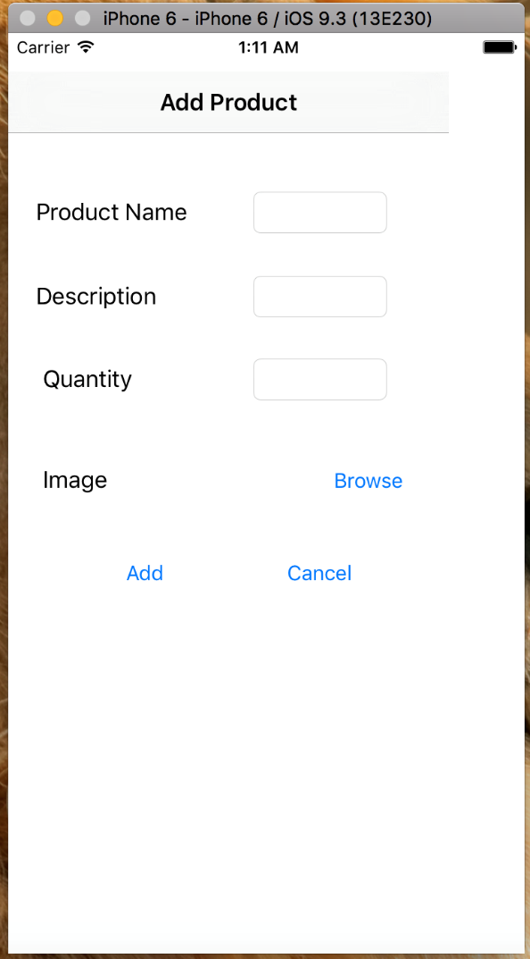
Prototypes continued……
Meghana Thakkellapati

Slide 15
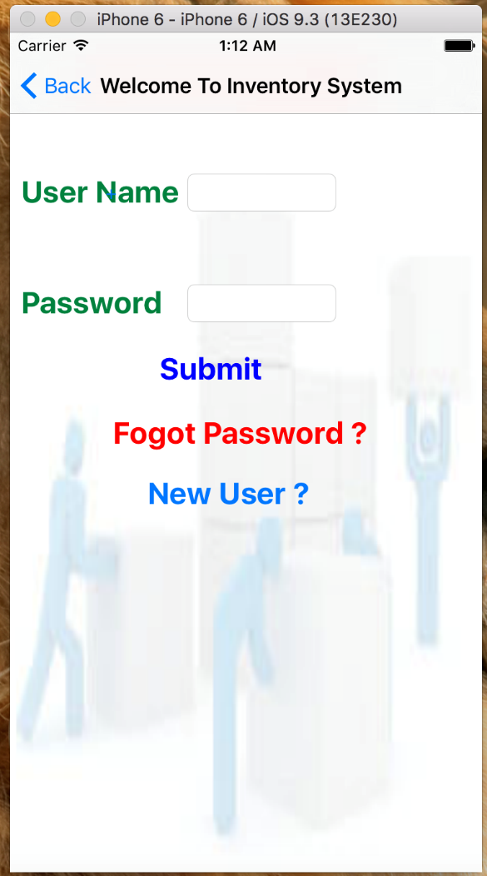
Prototypes continued……
Meghana Thakkellapati

Slide 16
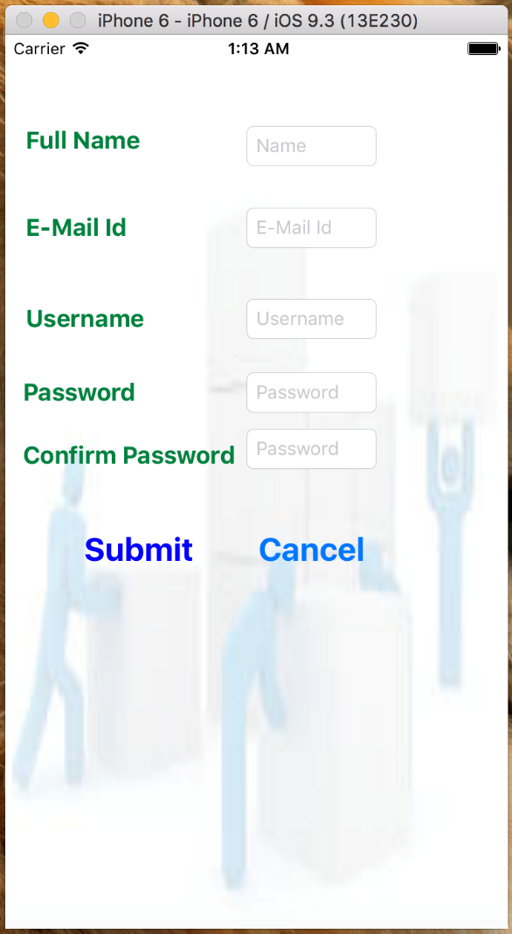
Prototypes continued……
Meghana Thakkellapati

Slide 17
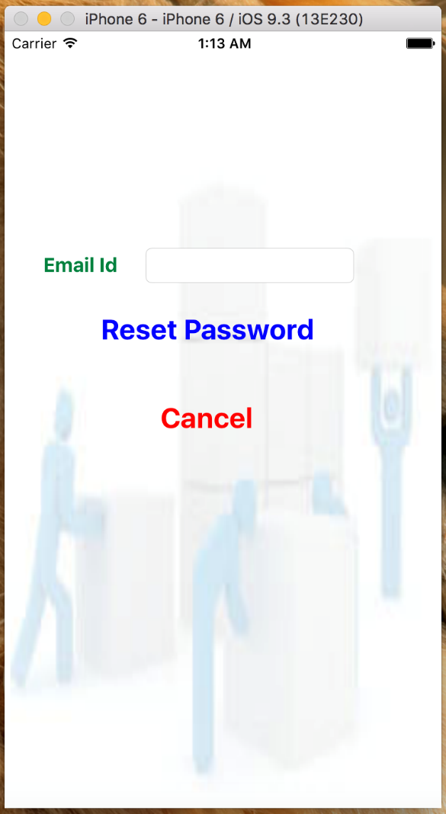
Prototypes continued……
Meghana Thakkellapati

Slide 18
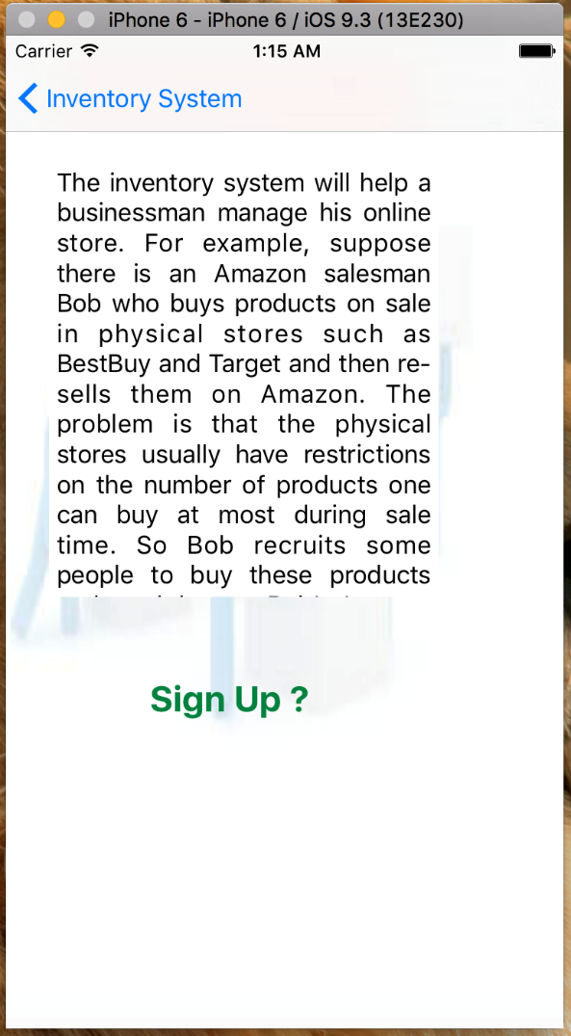
Prototypes continued……
Meghana Thakkellapati

Slide 19

Implementation
Manoj Kumar Kotte

Slide 20
Conclusion: Lessons Learned
Team Management
Time Management
Documentation skills
Swift Programming Language
Sai Suneel Reddy Challa

Slide 21
Conclusion: Tasks accomplished
Designed ER Diagram
Prototype Design of UI Screens
Software Requirements Document
UI Implementation for Admin role
UI Implementation for User role
Register and Login Functionality
Sai Suneel Reddy Challa

Slide 22
Conclusion: ProBlems faced
Connecting to the database
Retrieving from the database
Sai Suneel Reddy Challa

Slide 23
Conclusion: Issues to be addressed
Announcements should be displayed
Shipping label should be created
Able to cope with any future change in requirements
Sai Suneel Reddy Challa

Slide 24


Slide 25


Slide 26
TEAM MEMBERS
Meghana
Suneel
Sahithya
Jeevitha
Manoj

