Slide 1
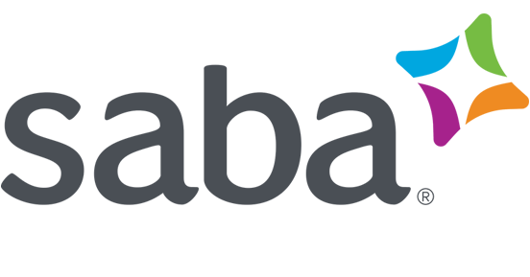

Centra Software
Wildcard Case
Sahiti Sri Upputuri

Slide 2
Centra Software - An Overview
Founded in 1995 by Leon Navickas.
Centra Software, Inc. provided software and services. It's software was used mainly to provided solutions for “e-meetings” and “e-learning”.
They had 3 main products-
The "eMeeting" product let users run virtual meetings for an internal or external audience of up to 100 participants.
The "Conference" delivered interactive seminars and corporate briefings to an audience of up to 1,000 participants.
Their flagship product was called "Symposium" which provided a virtual classroom experience for hands-on training and interactive team collaboration for up to 250 participants.

Slide 3
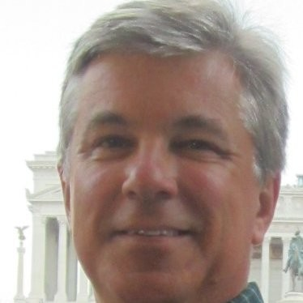
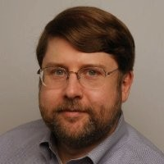
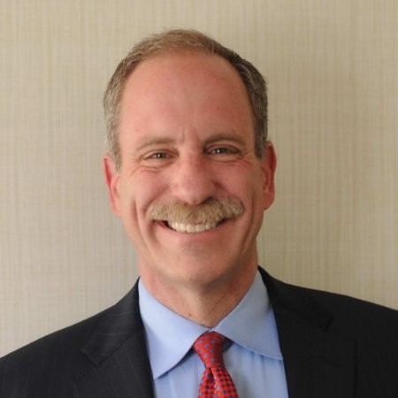
Key People for this case
Leon Navickas
CEO and Founder
Chris Reed
VP, Corporate Strategy
Steve Lesser
VP, Worldwide Sales

Slide 4
The Case
Steve Lesser, the VP Worldwide Sales for Centra faced pressure to increase sales.
One of their competitors- WebEx found success by following a strategy that focused only on Telemarketing and decided to install a telemarketing team at Centra too.
In their first quarter of operations, the telemarketing team contributed 8% of the total revenues. By end of the year, it was projected to be 12%
However, this was viewed by the salesforce negatively and created Conflict.
Leon liked this idea and asked Steve and Chris to resolve this issue by developing a strategy to get the best of both worlds.

Slide 5
The Conflict- Who Said What
Steve Lesser
Chris Reed
To get rid of the friction, he recommended that the telesales be used to sell to customers below $200 Million in sales and the field Sales team be used for Global 2000 companies.
Reed disagreed with Lesser and said that The firm aims to be the standard in Global 200 companies and therefore should focus only on them. He suggested that the telesales team be used to make an entry sale in a Global 2000 firm and the field sales team be used to sell other products.
“Penetrate then Disseminate”

Slide 6
We know what Centra is selling, but what exactly have its customers been buying?
Faster flow of information from sales force to decision makers,
Helping client to attain competitive advantage
Savings on Synchronized Training cost for the company
Convenient and time saving for the employees of the company

Slide 7
What benefits have they derived from its three products?
eMeeting: Markups, Pollings, Text chats, Raise hand buttons
Conference: Interactive seminars and corporate briefings
Symposium: Flagship product 1. Trainings, High end features, Instant responses and feedback, Live recording presentations
Product | Number of clients
Symposium | 398
Conference | 48
eMeeting | 28

Slide 8
How should Centra segment its market?
Sales
Profits
Assets
Market value
Global 2000​​ | Mid-size firms​​ | Firms with revenue <200 million USD​​

Slide 9
Does Centra need a strategy to tell it which customers to select, or should it fish where the fish are biting?
Yes Centra need a strategy
Limited resources- & they should be knowing where to use the resources whether to go into first time sales or dig into existing ones.
Dissemination rate- It will help them improve the dissemination rate because the existing sales force is closest to the opportunity.
Enterprise Solutions

Slide 10
Should all three channels sell all three products to all customers, or should Centra target some products and channels to some segments?
Products: eMeeting, Conference, Symposium
Channels: Telesales, Field Sales, Alliance Partners
Customer Segmentation
 | Global 2000 corporations | Mid-sized firms​ | Firms with revenue <200 million USD​
Penetration | Telesales pass to Field Sales | Telesales | Telesales
Dissemination | Field Sales | ​Telesales | Telesales ​
Strategy

Slide 11

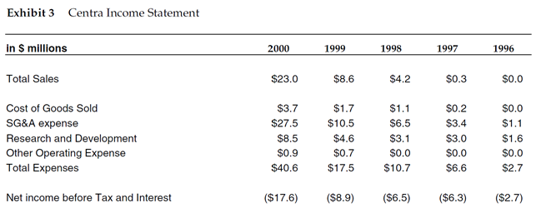
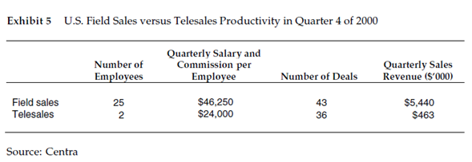
How would you resolve the dispute between Reed and Lesser on how to deploy the telephone-based sales team?
Would you expand Telesales?
Survey existing customers (Marketing and Sales Closed Loop System)
Create a core integrated team (employees and leaders from engineering, marketing, and sales)
Analyze the data
1. Sources of revenue
2. Sources of expenses
Start using Telesales for <$200 million and mid-sized accounts
1. More cost effective 2. More profitable​

Slide 12


Recommendation
Marketing and Sales Closed Loop System
Create Strong Core Team to Make Decisions
Standardize a Sales Methodology and Process
Formalize Lead Generation Programs (Penetration)
Feed Sales Funnel
Create Champions (Dissemination)
Gather Feedback and Adapt Plan
Formalize Lead Generation Programs (Penetration)
Prospecting-by Segment (Telesales)
Demo (Telesales)
Needs Analysis (Telesales)
Conversation Evaluation (Telesales OR Sales Team)
Conversation Evaluation Delivered (Telesales OR Sales Team)
Proposal/Quote Delivered (Telesales OR Sales Team)
Contract Negotiation (Telesales OR Sales Team)
Win
1. Post Sales Tech Support
2. Sales Employee
Telesales for <$200 million and Mid-sized Companies, OR
Sales Team for Global 2000
Create Champions (Dissemination)​

