Slide 1
DIGISIM PS-2 SOLUTION
CHAIN BREAKER
BY
TEAM SSS

Slide 2
AGENDA
SUBCIRCUIT EXPANSION
APPROACH
DATASHEET
SPECIAL FEATURES

Slide 3
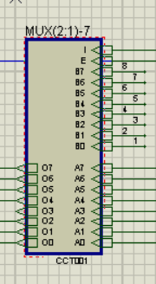
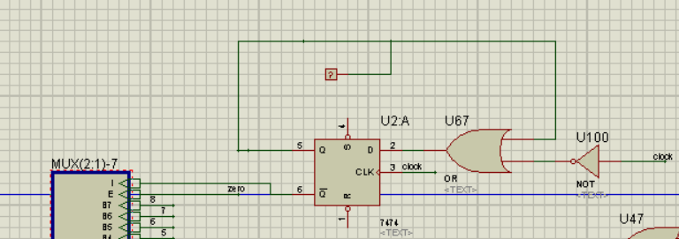
SUBCIRCUIT EXPANSION
8 BIT MULTIPLEXER
This combinational circuit is used twice in the circuit.
It helps in taking the input through logic states and once that input is taken into the cycle it gives an output that makes the mux to break connection with logic states and make connection with cycle.

Slide 4
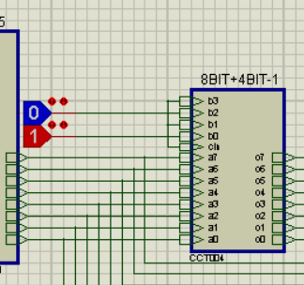
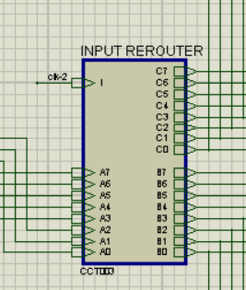
SUBCIRCUIT EXPANSION
8BIT + 4BIT NUMBERS ADDER
REROUTES THE DATA EXTRACTED FROM ROM TO TWO CYCLES ACCORING TO THE CLOCK SIGNAL
BASIC IDEA TO USE THIS WAS TO USE A SINGLE ROM FOR THE CIRCUIT

Slide 5
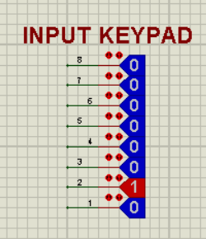
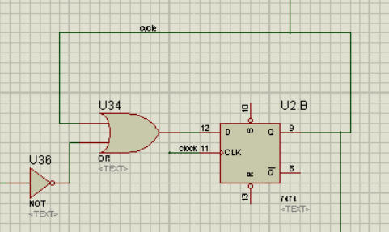
SUBCIRUIT EXPANSION
TAKES ADDRESS OF STARTING POINT FROM THE USER
USED ALONGWITH CYCLE AND TAIL DETECTOR
HELPS IN STORING THE INPUT ONCE A CYCLE OR TAIL OF THE LIST IS DETECTED

Slide 6
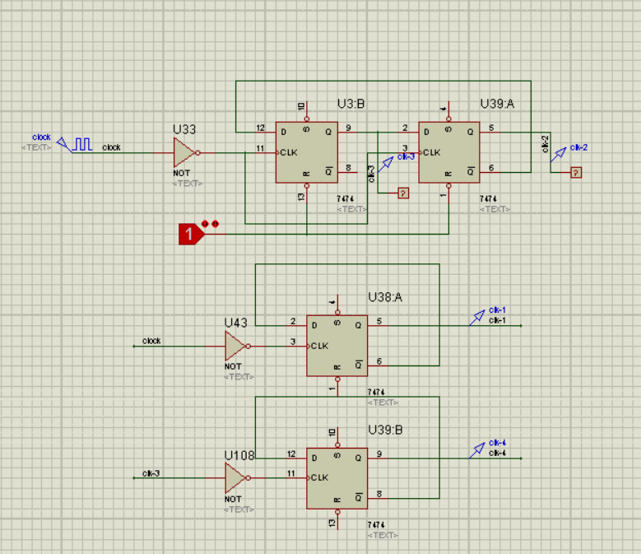
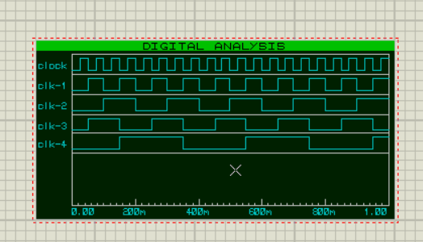
SUBCIRCUIT EXPANSION
5 CLOCKS ARE MADE OUT OF SINGLE IN ABOVE SEQUENTIAL CIRCUIT.
One time period of clk-2 is the total time duration for one cycle of the circuit.
clk-2 also helps in stopping a pointer in advancing while other pointer is advancing for fruitful use of ROM.
clock helps in making the first pointer advance by two positions in half T of clk-2.
clk-1 helps in making the second pointer advance by one position in second half T of clk-2.
clk-4 helps in updating the state of 74273 of second pointer from 0 to initial input and putting it into the cycle.
clk-3 is used in order to make clk-4.

Slide 7
APPROACH
INPUT
ADDRESS OF THE STARTING POINT IS TAKEN FROM USER THROUGH LOGIC-STATES AND THEN SIMULATION IS STARTED
CLOCK AND CLK-1 ARE USED ACCORDINGLY IN THE CIRCUIT TO UPDATE THE INITIAL STATE OF 74273 TO THAT OF INPUT ENTERED BY USER
WHEN INPUT IS BEING LOADED INTO THE CIRCUIT THE CYCLE IS TEMPORARILY DETACHED.
ONCE THE INPUT IS COMPLETELY LOADED, THE SEQUENTIAL CKT ATTACHED TO MUX GIVES A FINAL CONSTANT OUTPUT WHICH FIXES THE CYCLE PERMANENTLY FOR REST OF SIMULATION.

Slide 8
APPROACH
PROCESS
IN THE CYCLE IT IS FIRST CHECKED WHETHER THE NUMBER IS 255
THE CYCLE STARTS WITH THE POINTER THAT MOVES BY TWO POSITIONS AT ONCE
THEN 1 IS ADDED TO THE ADDRESS AND LOADED INTO ROM FOR EXTRACTING DATA AT CORRESPONDING ADDRESS, UPDATES 74273 AND CYCLE CONTINUES.
THE ABOVE HAPPENS TWICE AND THEN THE CYCLE ATTACHED TO THE ROM IS REROUTED TO THE OTHER POINTER WITH HELP OF MUX AND CLK-2 SIGNAL.
THIS WAS HOW A SINGLE ROM WAS USED FOR BOTH THE CYCLES.

Slide 9
APPROACH
OUTPUT
WHEN THE DATA EXTRACTED AT ANY POINT BY THE TWO POINTERS MATCHES THEN THE CYCLE DETECTOR BECOMES 1
ONCE THE CYCLE DETECTOR BECOMES 1 THE MUX JUST AFTER THE ADDER CHANGES THE INPUT TO BE TAKEN.
IT NOW TAKES THE ADDRESS WITHOUT ADDING 1 IN ORDER TO EXTRACT THE DATA AT THE ADDRESS WHERE THE LOOP POINTS BACK.
IF 255 IS DETECTED ,I.E., THE TAIL OF THE LIST THEN THE TAIL DETECTOR BECOMES 1.

Slide 10
DATASHEET
COMPONENT | COUNT | COST
ROM | 1 | 75
74273 | 2 | 8
3 INPUT LOGIC GATES | 3 | 0.6
7485 | 2 | 4
1/2 INPUT LOGIC GATES | 17 | 1.7
7474 | 4 | 4
74283 | 2 | 4
CLOCK | 1 | 40
MULTIPLEXER | 12 | 24
TOTAL |  | 161.3

Slide 11
SPECIAL FEATURES
SINGLE CLOCK
SINGLE ROM
TAKES DIRECT INPUT THROUGH LOGIC STATES
USE OF 7 SEG DIAPLAYS TO REPRESENT TAIL OF LIST/LOOPBACK OF LIST.

Slide 12
-ANIRUDH & SAHIT
THANK
YOU
@TEAM SSS

