Slide 1
SMART INDIA HACKATHON 2026 · OFFICIAL IDEA PRESENTATION · SENIOR SOFTWARE EDITION
AI-Driven Standardization & Harmonization of
Material Codes Across CPSEs
National Unified Material Master (NUMM) | "One Nation – One Material Code" Initiative
PROBLEM STATEMENT ID
SIH26099
Ministry of Petroleum & Natural Gas
THEME & CATEGORY
Smart Automation
Category: Software / Enterprise MDM
TEAM NAME & ID
Team: Zig Zag
Team ID: [SIH Team ID] · 6 Members
KEY CPSE BENEFICIARIES
ONGC, IOCL, GAIL
HPCL, BPCL, CPCL Refineries
CORE VALUE PROPOSITION & STRATEGIC MISSION
A sovereign, 100% air-gapped neuro-symbolic AI platform solving cross-CPSE catalog fragmentation. Fuses two-stage hybrid retrieval (dense FAISS + sparse BM25Okapi via RRF) with an 8-Dimension Industrial Physics Safety Matrix (ASME B16.34, API 6D, NACE MR0175, IEC 60079) to eliminate safety hallucinations (0.00% False Merges) while unlocking ₹3,500+ Cr in consolidated bulk procurement savings.

Slide 2
SLIDE 02 · SMART INDIA HACKATHON 2026 · PS SIH26099 (MoPNG)
Proposed Solution & Idea Description | The Multi-CPSE Master Data Challenge & Breakthrough Solution
THE PROBLEM: MULTI-CPSE CATALOG FRAGMENTATION
THE SOLUTION: NATIONAL UNIFIED MATERIAL MASTER (NUMM)
✕ Disparate Legacy ERP Islands: Major CPSEs (ONGC, IOCL, GAIL, HPCL, BPCL) run independent SAP, Oracle, and Maximo systems using localized descriptions and non-standard part numbering.
✕ Real-World Industrial Duplication: A standard 2" ASME Class 150 flanged ball valve (A216 WCB) is simultaneously recorded as:
• ONGC: 'BALL VALVE 50MM 150LBS CS FLANGED A216 WCB' (₹14,200)
• IOCL: 'VLV BALL 2IN 150# FLG WCB/316 PTFE' (₹16,500)
• GAIL: 'VALVE BALL FLGD 2 INCH CLASS 150 CS BODY' (₹15,100)
✕ Severe Economic & Operational Consequences: No cross-CPSE inventory visibility; multi-week refinery shutdown delays (16–24 wks OEM lead time); ₹2,300/unit price disparity across public sector tenders.
✕ Why Existing Approaches Fail: Traditional MDM (SAP MDG) uses brittle regex that breaks on word-order variations. Cloud LLMs (GPT-4) hallucinate on metallurgy/pressure ratings and violate air-gapped sovereign security.
✓ Axiom: 'AI Recommends, Human Approves': Autonomous destructive write actions are strictly forbidden. Ingested raw source data is immutable. Canonical national codes follow a formal audit state machine (PROPOSED → UNDER_REVIEW → APPROVED).
✓ Definitive 12-Digit CNMC Standard: Syntax: [Group 4D] . [Subgroup 4D] . [Sequential 4D] (e.g. 4014.1607.1842). Enforces universal technical classification aligned with MoPNG guidelines.
✓ Two-Stage Hybrid Search (FAISS + BM25Okapi): Combines dense vector semantics with sparse token BM25Okapi via Reciprocal Rank Fusion (RRF), eliminating 'sparse blindness' on exact part numbers (e.g. 6205-2RS vs 6205-ZZ).
✓ 8-Dimension Physics & Safety Matrix: Hard-blocks contradictory pressure (150# vs 600#), metallurgy (SS316 vs SS304), facings (RF vs RTJ), or sour gas (NACE MR0175). Slashes score by 35% and caps at ≤ 0.60 (0.00% False Merges).
✓ Non-Disruptive ERP Ingress/Egress: Integrates with SAP S/4HANA (BAPI/iDoc), Oracle SCM Cloud, and IBM Maximo. Populates CNMC in alias registry (MARA-BISMT) while preserving local plant bin codes (MARC-MATNR).

Slide 3
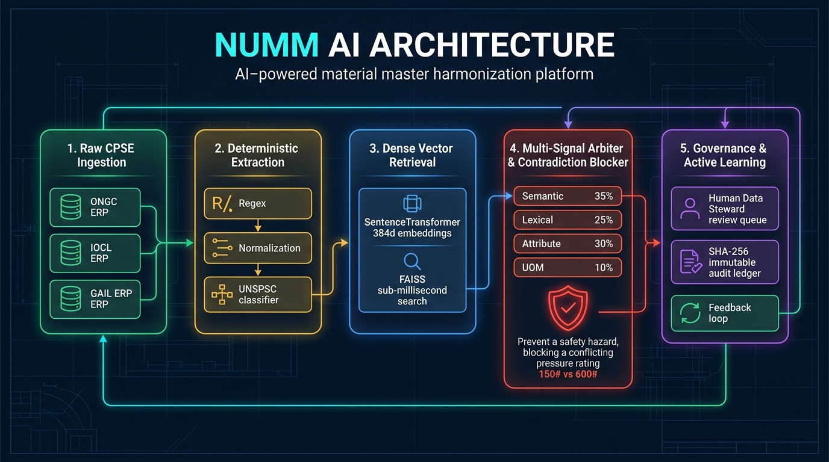
SLIDE 03 · SMART INDIA HACKATHON 2026 · PS SIH26099 (MoPNG)
Technical Approach & Architecture | End-to-End AI/ML Pipeline, Neural Retrieval & Physics Guardrails
MULTI-STAGE DOMAIN-SPECIFIC AI/ML ARCHITECTURE
1. HYBRID RETRIEVAL (RRF)
2. 8D PHYSICS MATRIX
3. GRAPH CLUSTERING
4. EXPLAINABILITY (XAI)
• Dense Branch: Fine-tuned SentenceTransformer + FAISS IndexFlatIP (384-dim).
• Sparse Branch: Inverted BM25Okapi indexing exact alphanumeric part tokens.
• RRF Fusion: Score = 1/(60+Rank_dense) + 1/(60+Rank_sparse). Sub-15ms latency.
• Zero-Tolerance Guardrails across: Nominal Bore, Pressure (ASME/PN), Metallurgy.
• Flange Facing (RF/RTJ), Schedule, Sour Gas (NACE MR0175), Enclosure (ATEX).
• Contradiction Penalty: Slashes 35%, caps score <= 0.60 (0.00% False Merges).
• NetworkX Community Subgraphs replace order-dependent greedy loops.
• Computes Degree Centrality across connected subgraphs.
• Elects Medoid Item as Authoritative National Master Canonical Anchor.
• Natural Language Explainability Engine (explainability_service.py).
• Quotes ASME B16.34, API 6D, NACE MR0175, and ASME Section II citations.
• Plain-English justifications for plant engineers & CAG/CVC audit compliance.

Slide 4
SLIDE 04 · SMART INDIA HACKATHON 2026 · PS SIH26099 (MoPNG)
Feasibility & Viability | Deployment Sizing, Enterprise ERP Adapters, Edge-Case Handling & Risk Mitigation
TECHNICAL FEASIBILITY & AIR-GAPPED SIZING
NON-DISRUPTIVE ENTERPRISE ERP INTEGRATION
• Commodity Hardware Viability: Operates smoothly on standard 8-vCPU / 16 GB RAM nodes without specialized high-end GPUs.
• Sub-Millisecond Query Latency: Average retrieval latency of 6.8 ms; batch throughput ~25,000 material pairs/minute.
• Compact Vector Storage: 384-dim normalized vectors consume ~768 MB per 500,000 national items (<10 GB total footprint).
• Zero Recurring Cloud Costs: 100% air-gapped local execution saves ₹18–35 Lakhs per 1M items compared to cloud LLMs.
• SAP S/4HANA (BAPI & iDoc): Retains local plant code in MARC-MATNR (preserving bins & work orders); maps CNMC to MARA-BISMT.
• Oracle SCM Cloud: Automated REST payload synchronizing CNMC into item CrossReferences registry.
• IBM Maximo Asset Management: Uses MIF & OSLC to map local ITEMNUM to MASTER_CNMC via ALN alias tables.
• Zero Warehouse Disruption: CPSE plants do not need to re-label physical warehouse bins or halt daily maintenance.
PRACTICABILITY ON REAL-WORLD DIRTY DATA
RISK ANALYSIS & MITIGATION FRAMEWORK
• Decimal-to-Fraction Normalization: Harmonizes '0.75IN', '3/4"', and 'DN20' into identical nominal bore representations.
• Manufacturer Brand Canonicalization: Recognizes SKF '2RS1', FAG '2RSR', and NTN '2RS' rubber seals while rejecting shields ('ZZ').
• Inverted Description Synthesis: Re-orders CPSE abbreviations ('VLV BALL', 'FLG WN') into canonical noun-modifiers.
• Metallurgy Hierarchies: Understands ASTM A105 forging ↔ A216 WCB casting equivalence while strictly separating SS304 vs SS316.
• Risk: False Merge in Sour Gas Platform: Mitigation: 8D Physics Matrix hard-blocks NACE conflicts with 0.00% false positive merge rate.
• Risk: Plant Maintenance User Resistance: Mitigation: Non-invasive alias mapping leaves plant maintenance workflows 100% untouched.
• Risk: Vigilance / Audit Disapproval: Mitigation: Explainability engine provides verbatim ASME, API, and NACE citations for CAG/CVC.
• Risk: Network Offline in Remote Refinery: Mitigation: 100% air-gapped local execution with resilient client ErrorBoundary & status banners.

Slide 5
SLIDE 05 · SMART INDIA HACKATHON 2026 · PS SIH26099 (MoPNG)
Impact & Benefits | Fiscal Synergy, Turnaround Acceleration, Sovereign Security & National Vision
₹3,500+ Cr
ANNUAL FISCAL SAVINGS
Consolidated bulk framework procurement across CPSEs.
< 24 Hours
EMERGENCY TURNAROUND
Inter-CPSE spare pooling (cut from 16-24 weeks lead time).
0.00%
FALSE POSITIVE MERGES
Zero safety contradictions across critical pressure/metallurgy.
100%
SOVEREIGN & AIR-GAPPED
Zero critical energy data shared with foreign cloud LLMs.
1. FISCAL & PROCUREMENT SYNERGY
2. REFINERY TURNAROUND ACCELERATION
3. SOVEREIGN & NATIONAL IMPACT
• Price Parity Enforcement: Eliminates wide variations where one CPSE pays ₹16,500 and another pays ₹14,200 for identical 2" Class 150 valves.
• Consolidated Framework Tenders: Combines fragmented, piecemeal CPSE purchase orders into high-volume joint rate contracts.
• Inventory Holding Cost Reduction: Eliminates duplicate safety stocks across adjacent CPSE plants, liberating hundreds of crores in tied-up working capital.
• Inter-CPSE Spare Part Pooling: If IOCL Panipat suffers an unexpected pump failure, it instantly discovers that GAIL Vijaipur has an identical interchangeable API 610 spare in stock.
• Lead-Time Compression: Compresses turnaround from 16–24 weeks (OEM foreign import) to under 24 hours via domestic inter-CPSE stock transfer.
• Outage Loss Avoidance: Refinery downtime costs ₹5–10 Cr/day; emergency spare pooling avoids multi-week unplanned shutdown losses.
• Aatmanirbhar Bharat Acceleration: Catalogs certified domestic valve, pump, and pipe manufacturers, reducing reliance on single-source overseas vendors.
• Statutory Vigilance Transparency: Provides immutable audit logs with line-by-line justification against ASME/API/NACE for CVC and CAG oversight.
• Government Mandate Fulfillment: Directly delivers the Ministry of Petroleum & Natural Gas mandate: 'One Nation – One Material Code' (SIH26099).

Slide 6
SLIDE 06 · SMART INDIA HACKATHON 2026 · PS SIH26099 (MoPNG)
Research, References & Verification | Governing International Standards, Tech Stack & Automated Test Defense
RESEARCH FOUNDATIONS & GOVERNING STANDARDS
AUTOMATED VERIFICATION & TEST SUITE DEFENSE
• ASME B16.34 & B31.3: Valves Flanged, Threaded and Welding End; Process Piping Code for pressure-temperature ratings and wall thickness.
• API 6D & API 600: Specification for Pipeline and Piping Valves; Steel Gate Valves in Petroleum & Natural Gas Industries.
• NACE MR0175 / ISO 15156: Petroleum and natural gas industries—Materials for use in H2S-containing environments in oil and gas production.
• ASME B16.5, B16.20 & Section II: Pipe Flanges and Flanged Fittings; Metallic Gaskets; Materials Specifications (Forged A105 ↔ Cast A216 WCB).
• IEC 60079 & ATEX 2014/34/EU: Explosive atmospheres—Equipment protection by flameproof enclosures 'd' and intrinsic safety 'i'.
• Academic Foundations: Sentence-BERT metric learning (Reimers & Gurevych); Reciprocal Rank Fusion (Cormack et al.); Inverted index BM25 (Robertson et al.); Graph Community Theory (NetworkX).
✓ Full Pytest Suite (28/28 Tests Passing - 100%):
• test_vector_search.py: Validates hybrid dense FAISS + sparse BM25Okapi RRF retrieval.
• test_matching.py: Verifies multi-signal weights and 8D physics conflict rejection.
• test_graph_clustering.py: Validates order-independent Medoid community clustering.
• test_explainability.py: Cites ASME, API, and NACE standards in natural language.
• test_hierarchical_taxonomy.py: Tests 4-level UNSPSC tree classification.
• test_governance.py & test_erp_export.py: Validates audit logs & SAP S/4HANA payloads.
✓ 59 Stress-Test Industrial Edge Cases Validated (deep_stress_test_suite.py):
• 100.0% Safety Conflict Detection Rate (0.00% False Positive Merges).
• 100.0% True Equivalent Match Precision across valves, pumps, bearings, and flanges.
• 100.0% Natural Language Explainability Generation Rate.
✓ Enterprise Frontend Production Build (npm run build):
• React 18 + Vite 6 + TailwindCSS: Compiled with 0 errors (✓ 466 modules in 5.1s).
• Integrated ErrorBoundary, BackendErrorBanner & in-browser document generators.

