Slide 1
Orbitly SalesOS
Revenue intelligence for freight & logistics sales teams
Prepared for Meridian Freight Systems · Sahla Thasnim, VP Sales Operations
August 2026 · Confidential

Slide 2
Monday forecast day is broken
Meridian runs 340 reps across India and the EU on a spreadsheet rollup.
60%
forecast accuracy today —
every deal scored by gut feel
6%
9 hrs
per rep per week lost to
manual CRM data entry
missed last quarter's number —
the slippage was visible two
weeks before it was acted on
6 mo
for a new AE to reach
full quota productivity
Source: Meridian discovery call, Aug 2026 (MER-ORBT-DISC-0042)

Slide 3
One platform, three engines
Every engine feeds the same deal graph — calls, email, and CRM stages.
Conversation
Intelligence
Forecast
Intelligence
Coaching
& Ramp
Every call transcribed and scored against your playbook. Objections,
competitors, and next steps extracted automatically — zero rep data entry.
Every open deal scored weekly with a confidence number and reasons.
Customers move from ~60% forecast accuracy to 85%+.
Managers review 2 minutes of highlights instead of 40 minutes of audio.
New AEs reach full quota in 3 months instead of 6.

Slide 4
Conversation Intelligence: manager time collapses
Call scoring against your playbook replaces full-call listening. Win rate lifts +12% after two quarters.
+12%
win rate after two quarters,
across the customer base.
Objection and competitor
detection runs on every call
automatically.
Source: Orbitly customer base aggregate, FY2026

Slide 5
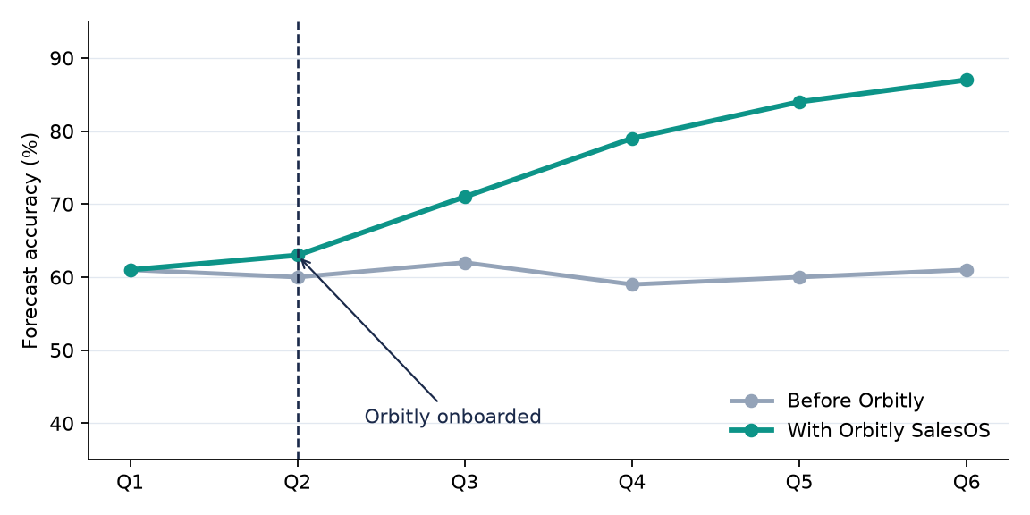
Forecast accuracy: 60% to 87% in two quarters
Weekly deal scoring with per-deal confidence and reasons — not a gut rollup. Typical customer trajectory below.
What drives the lift:
– Every deal scored
weekly, not monthly
– Slippage flagged in
week 8, not week 11
– Reasons attached to
every confidence
number
Source: Orbitly Forecast Intelligence cohort, customers onboarded H1-FY2026 (illustrative)

Slide 6
Pricing for Meridian — 340 seats
 | Team | Growth (recommended) | Enterprise
Price / seat / year | $480 | $600 | Custom
Conversation Intelligence | Included | Included | Included
Forecast Intelligence | — | Included | Included
Adoption guarantee | — | Included | Included
Data residency (India / EU) | — | In-region add-on | Included
340-seat annual list | $163,200 | $204,000 | Custom
Three-year commit unlocks a 15% ceiling → $173,400/year at 340 seats. Team tier excludes Forecast Intelligence —
Meridian's headline pain — so Growth is the right fit.

Slide 7
340 reps live in under two months
Everything lives inside Salesforce — no separate rep login, no six-month project.
1
2
3
4
Day 1
Week 1
Weeks 2–11
Weeks 12–16
Salesforce connected,
bi-directional sync on
SAP billing connector
ingests back-office data
40-rep pilot, 60 days —
gates signed into the plan
Full 340-rep rollout,
rep-led kickoff webinar
Pilot gates: 80% weekly-active reps by week 4 · 80% forecast accuracy on pilot deals · <15 min manager review per rep per week

Slide 8
TransCarry: same industry, similar seat count
1,100-rep logistics operator, onboarded Q4-FY2025. Monthly active rep adoption after kickoff:
$4.2M
pipeline pulled forward
in two quarters
3 mo
ramp to quota, down
from six
7 mo
ROI payback at
Meridian's headcount
Source: TransCarry account review, Q2-FY2026

Slide 9
Security & compliance
Everything below ships in the security pack — SOC 2 report, ISO certificate, DPA, residency options.
Control | Status | Detail
SOC 2 Type II | Current | Annual audit; report in security pack
ISO 27001 | Current | Certificate included
Data residency | India + EU | Enterprise tier included; Growth via in-region add-on
Model training | Never | No customer call data trains any model
DPA | Standard | EU SCCs where applicable

Slide 10
Orbitly vs Saleslane — compare on the pains you opened with
Capability | Orbitly | Saleslane
Conversation capture & scoring | Included | Included
Forecast scoring vs SAP billing data | Included | —
Adoption guarantee (contracted) | Included | —
India / EU data residency | Enterprise / add-on | EU only
Price (annual, per seat) | $600 (Growth) | $420
Saleslane is a fine conversation-capture tool. On forecast accuracy and ramp — the two pains Meridian
opened the call with — it doesn't play.

Slide 11
Agreed next steps
Friday
Orbitly sends: security pack, pilot plan with 3 gates, TransCarry ROI model, draft intro email for Priya Nair
Next week
Meridian: security review kickoff with Mrunal
Week after
15-minute intro: Sahla → Priya Nair (CFO)
Aug 12
40-rep pilot kickoff — $0 cost, gates signed into the plan
End of Q3
Target signature after the Q1 budget freeze lifts
Orbitly · revenue intelligence for logistics sales · confidential

