Slide 1
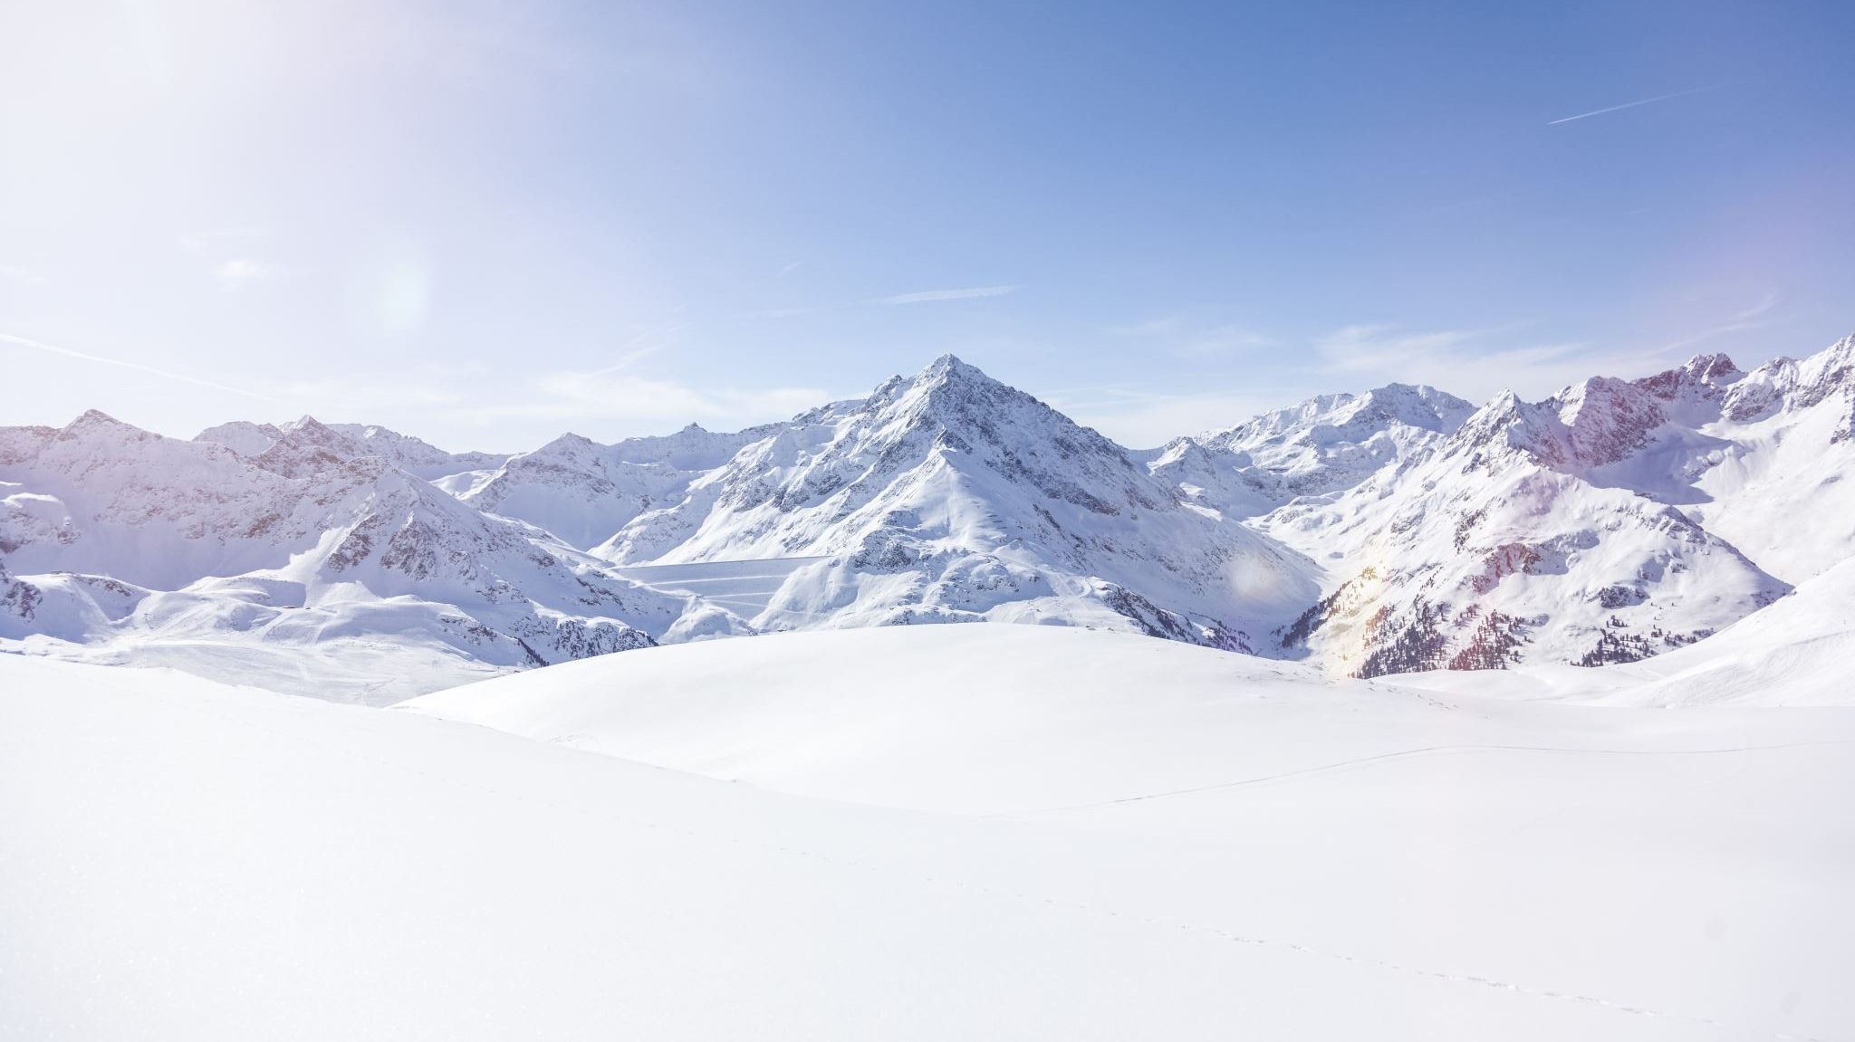
Big Mountain Ski Resort Pricing Model

Slide 2
Problem Statement
Before October 1, 2020 Big Mountain Resort needs to offset $1.6M in operating cost by restructuring their pricing model for tickets to reflect the value of the facilities they provide. This in turn will lead to a more cohesive understanding of what each facility is worth to our customers and better guide our investment strategy.

Slide 3
Analysis
No clear pattern between the state the resort is in and the adult weekend ticket price
Decided to treat all states equally

Slide 4
Linear Regression vs. Random Forest Model
Used cross-validation
Mean absolute error for random forest was $9.60, about $1.00 less than that for linear regression
Less variability in the random forest regression
Use random forest model to predict adult weekend ticket price

Slide 5
Important Features from Random Forest Model
fastQuads, Runs, Snow Making_ac, and vertical_drop

Slide 6
Suggested Solutions
Solution 1:
Closing down up to 10 of the least used runs.
Based on the plot below, we see that closing one run makes no difference but closing 2 and 3 successively reduces support for ticket price and so revenue. Closing down 4 or 5 results in no further loss in ticket price than closing 3. Closing down 6 or more leads to a large drop.

Slide 7
Suggested Solutions
Solution 2:
Increasing vertical drop by 150 ft by adding a run and an additional chair lift. This scenario increased support for ticket price by $1.99, which amounts to about $3.5 million in revenue, well over the additional operating costs of $1.5 million listed in the project overview.

Slide 8
Suggested Solutions
Solution 3:
It was same as Idea 2 but adding 2 acres of snow making cover. The increase in snow making area made no difference. Scenario 4 was increasing the longest run by 0.2 miles and adding 4 acres of snow making cover. This made no difference as well.

Slide 9
Summary
Based on a random forest model, recommend increasing vertical drop by 150 ft by adding a run and additional chairlift
Note: The random forest model relies on the implicit assumption that all other resorts are setting ticket prices based on how much people value certain facilities
Keep in mind that other resort could be mispricing tickets

