Slide 1


Best Time to Trend on YouTube For Aspiring YouTube creators
A data-driven exploration of which videos trend, when they trend and how creators can use this to their advantage across categories, creators, and time.
This story follows a new creator’s journey to trending smarter
Sahreen Rafiq
Pixabay.com

Slide 2

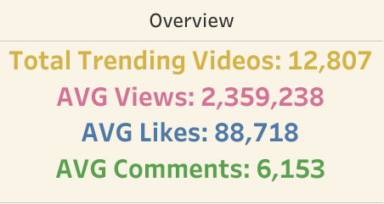
👉 How can creators use data to trend smarter? Why Creators Need Strategy, Not Guesswork
👤 Step 1: Pick the Right Content
⏱️ Step 2: Post at the Right Time
📊Step 3: Plan around the calendar
YouTube has become a crowded space with over 500 hours of content uploaded every minute.
Notes:
“This question is at the heart of our project. Not just ‘what trends,’ but how creators can use evidence to align with what audiences are actually watching.”
“This isn’t just a data dump. It’s a roadmap. Today, I’ll show how aligning content strategy with viewer behavior can help creators trend—not just post.”

Slide 3
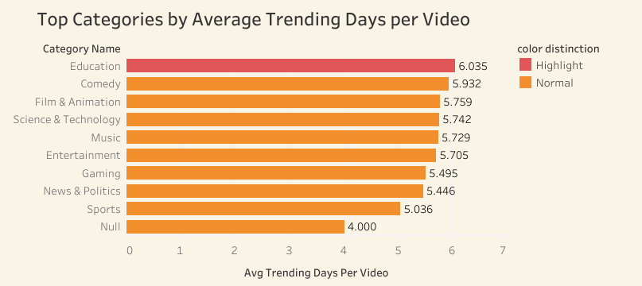
👉 Which Content Lasts the Longest? Some content lasts longer—and that gives you more time to trend.
Surprise: Entertainment, while the most frequently uploaded category, trends for a shorter duration.
Insight: Less saturated categories with high value tend to trend longer.
Notes:
While creators often gravitate toward Entertainment, this data shows that Education and Comedy — though less common — stay trending longer. This tells us it’s not just about what you create, but how unique and valuable it is

Slide 4
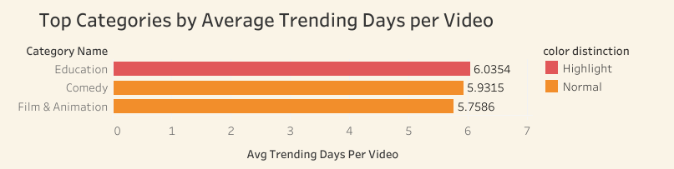
👉 Why Education Is a Smart Starting Point
Let’s look at why Education gives creators an edge over Comedy or Film & Animation:
Education videos are easier to produce and it can trend for over 6 days on average — longer than any other category.
Educational content often evergreen, meaning it continue gaining views well beyond the first week. That gives new creator sustained visibility.
It’s also favored by YouTube’s algorithm for being safe, informative, and highly searchable.
📈
🌱
✅
🧠
New creators should leverage Education to maximize discoverability, build trust, and stay relevant longer.
E.g., Learn How to Edit Stuff or AsapSCIENCE — two Canadian educational creators with evergreen content

Slide 5
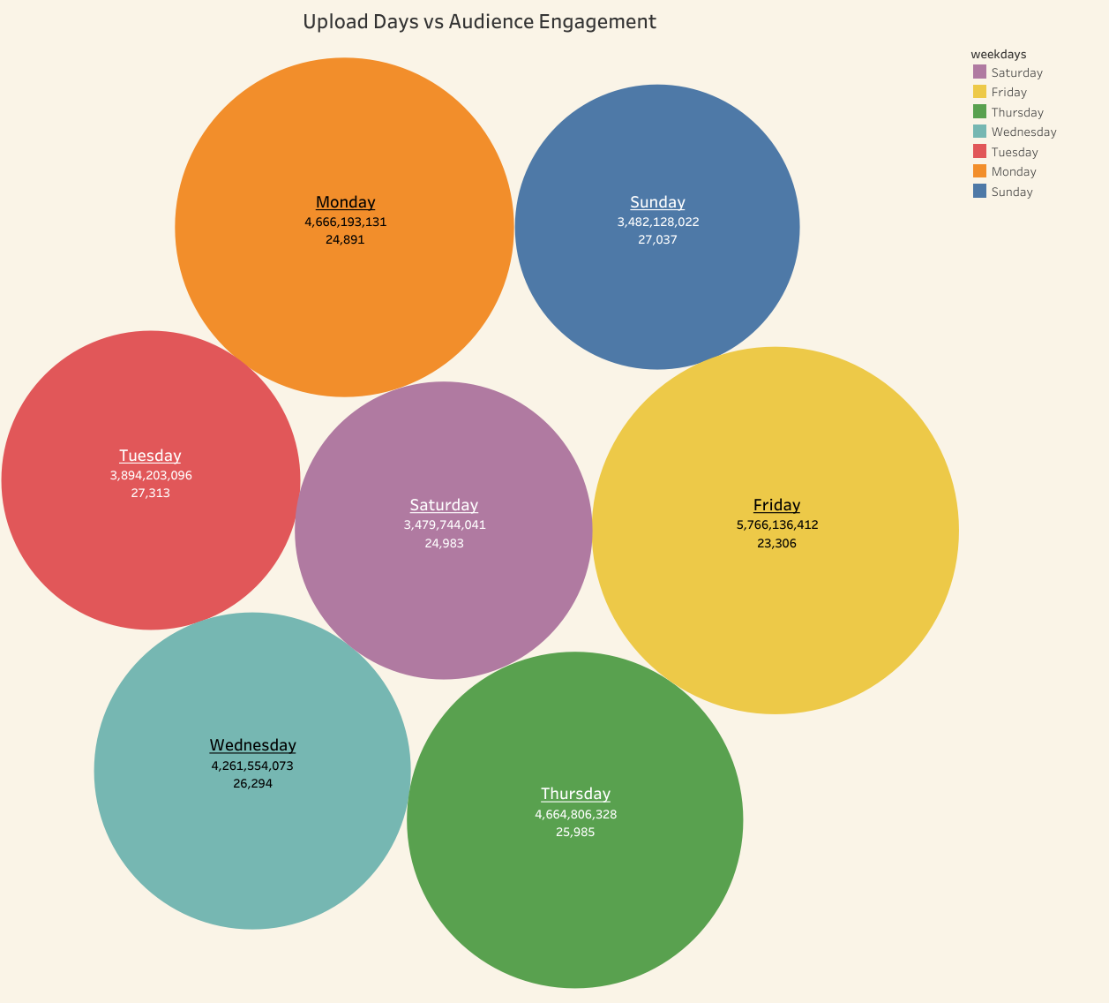
👉 Creators Post vs Viewers watch Viewers are active at different times than creators expect. Here's when to post for max visibility
Most common upload
High Viewer Activity
Notes:
This right here is what most creators miss. They post on Tuesdays because it's familiar — but viewers are most active on Fridays. Aligning upload timing with viewer demand is the strategy behind success.”

Slide 6
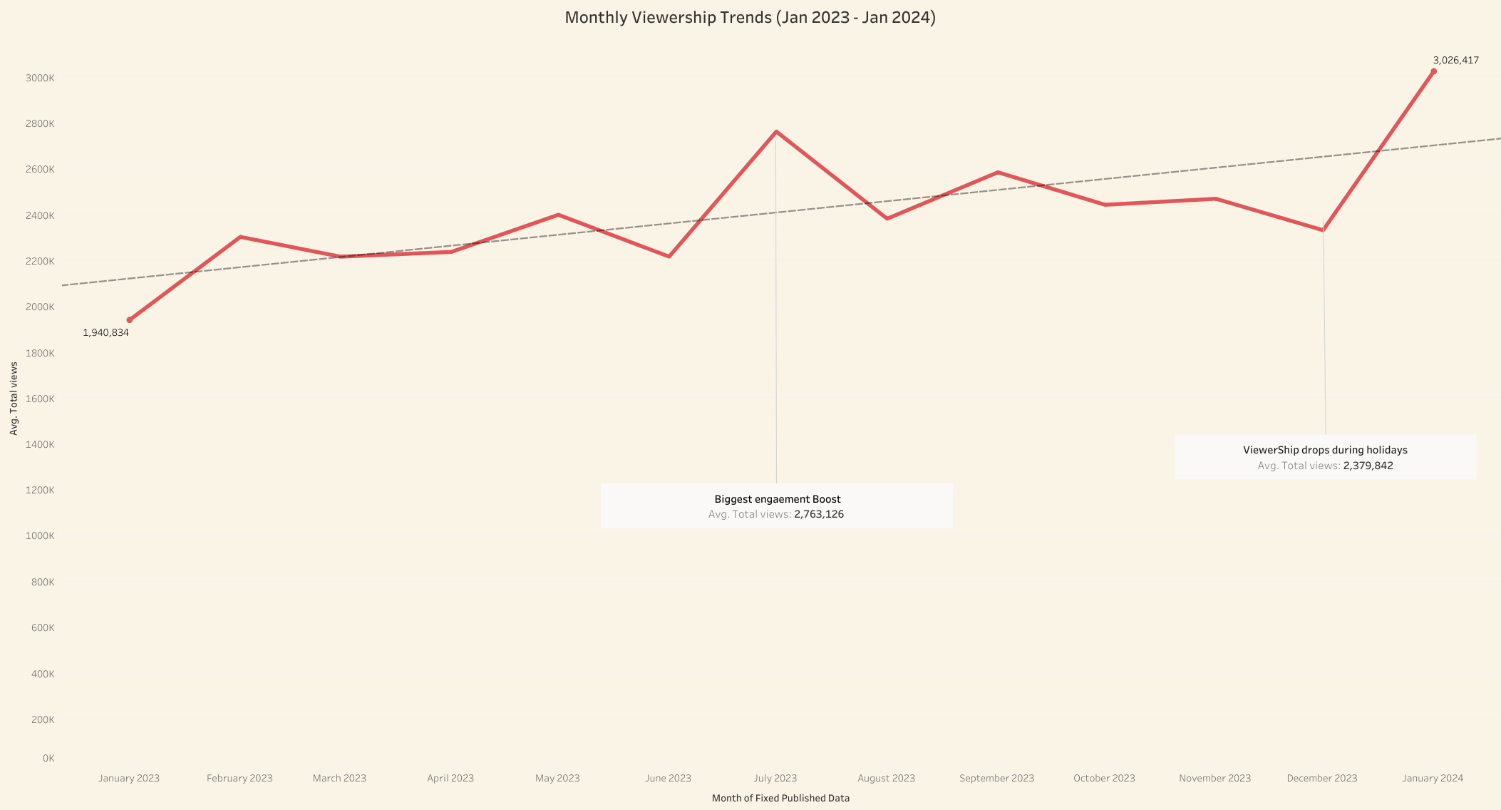
👉 When Should You Launch- Your Best Content Viewer engagement changes by season—post smart, not just often
Key Insight: Viewership spikes in July (2.7M+ views avg) and drops in December.
Strategy: Post your highest-value videos in July, when engagement peaks. Avoid December releases due to audience drop-offs.
This shows how viewer engagement changes throughout the year.
Notes:
That way you are not creating the content you are maximizing its reach

Slide 7
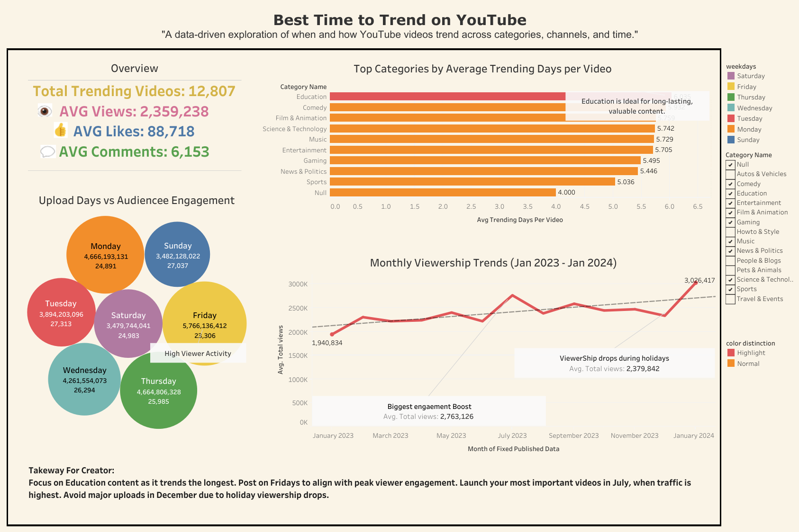
👉 Don’t Just Follow Trends— Create Them
Success on YouTuber isn’t random. It’s strategic.
Creators who use data to guide their strategy will “lead the trend, instead of chasing it.”
Notes:
“This is the mindset shift.
Trending isn’t luck—it’s a result of **understanding your audience, your content, and you’re timing.**
Creators who use data to guide their strategy will **lead the trend**, instead of chasing it.”

Slide 8
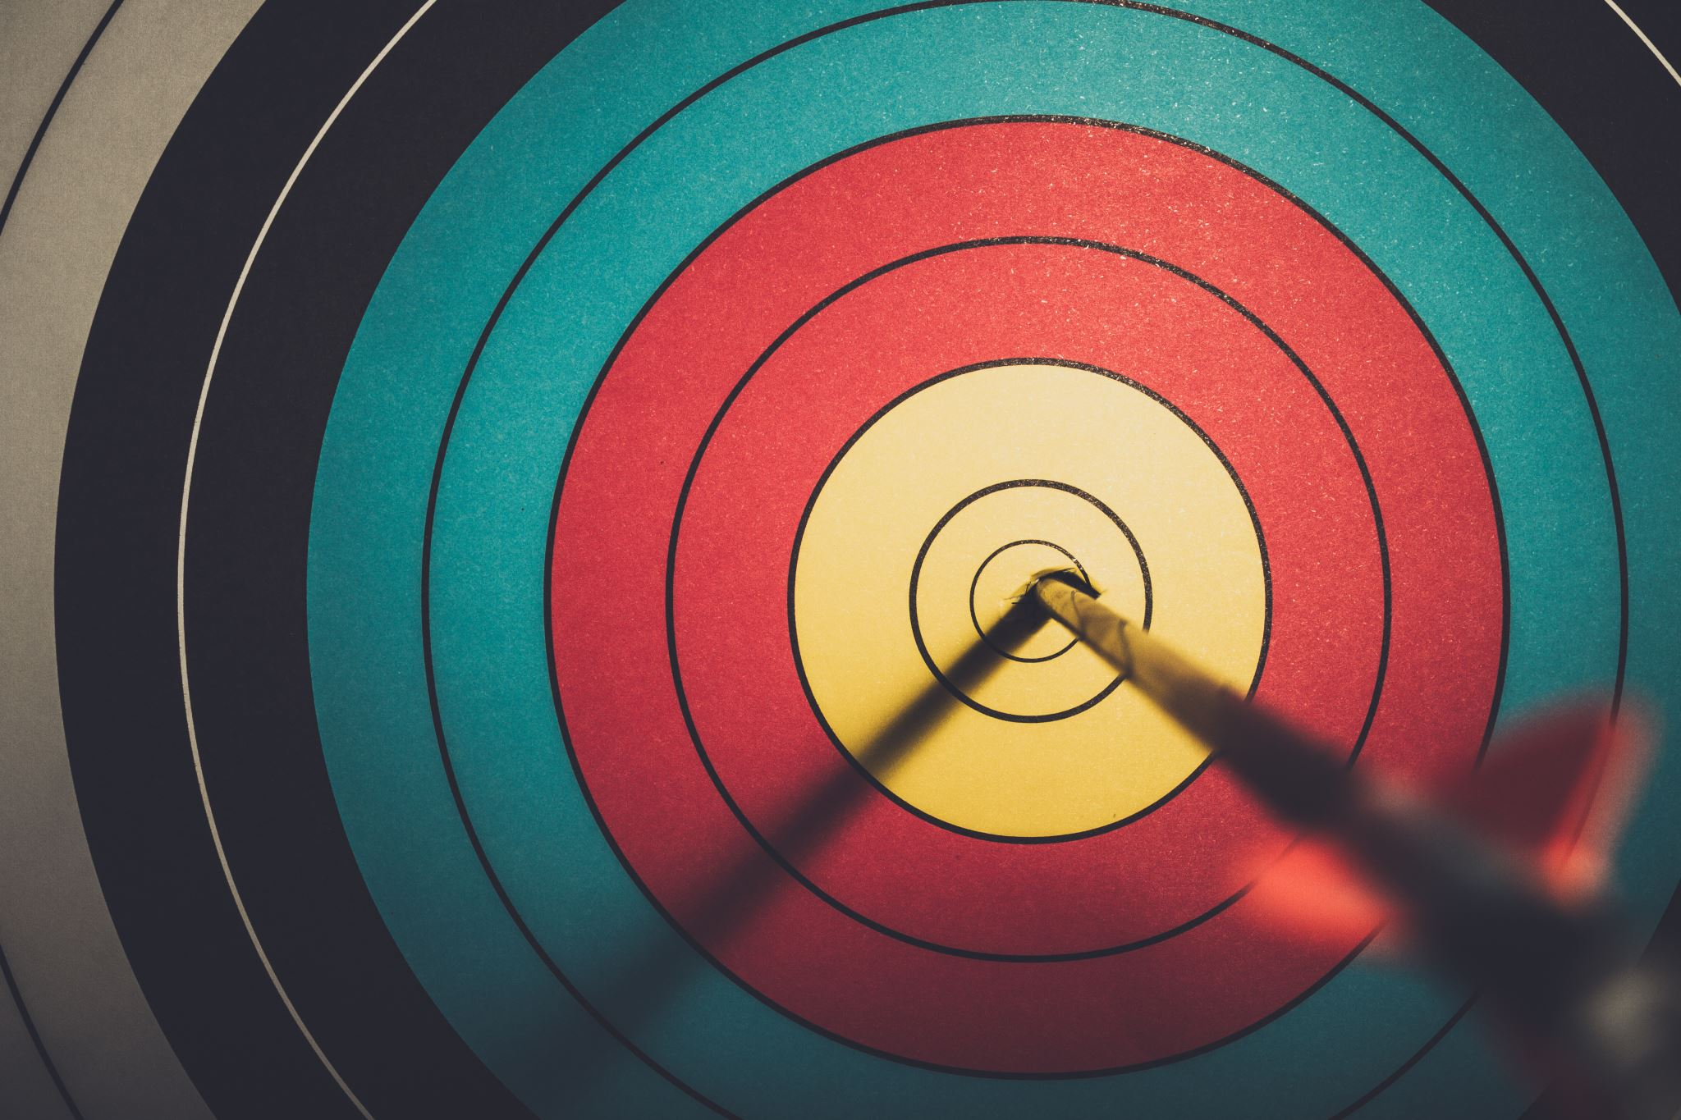
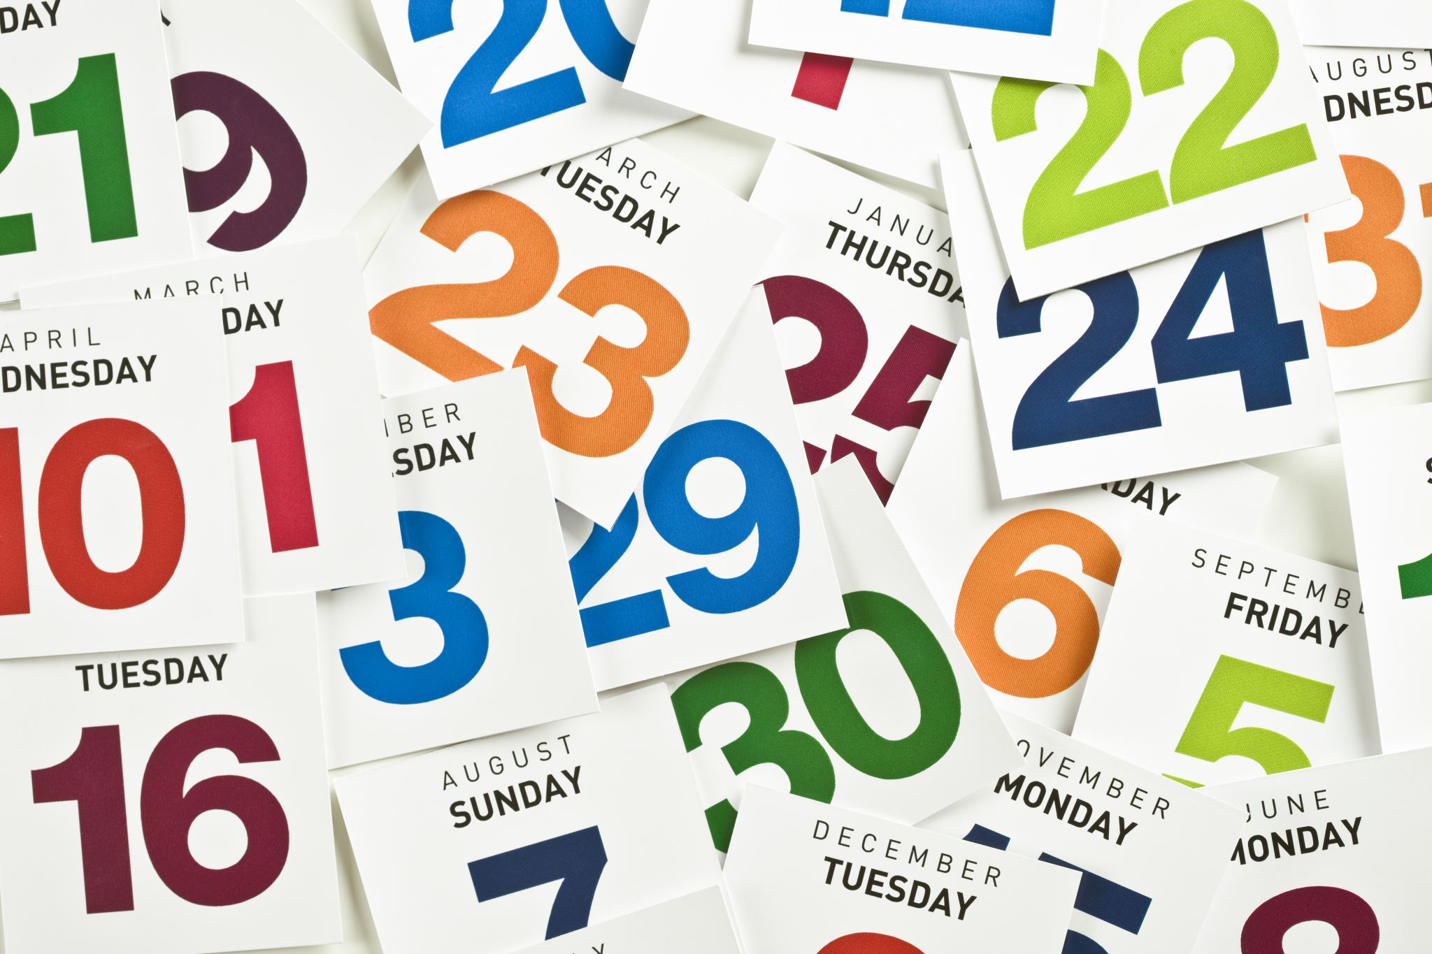
👉 What Should You Do Now? Turn insights into action with a smart, data-backed launch plan
Pick the Right Content
Post at the Right Time
Plan Around the Calendar
Start with Education to trend longer.
Focus on tutorials, How-tos, or explainers- content that’s evergreen and searchable.
Fridays = highest viewer activity
Avoid Tuesdays, where videos get lost.
Launch your best content in July Avoid major drops in December,.
Use seasonality to stay ahead of the trend curve.
THANKYOU..!
Notes:
This is your data-backed roadmap to YouTube success.”

Slide 9

Questions..?
This Photo by Unknown Author is licensed under CC BY-NC

