Slide 1
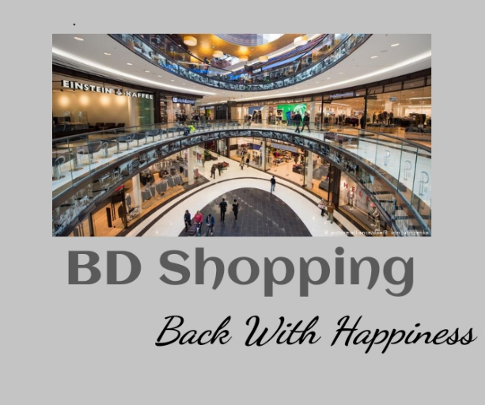
Presentation of Online Shopping App
Group Member:
Md Sayedur Rahman
Id:17182103297
Md Sahrial Alam
Id: 17182103334s
Md Ikbal Hasan
Id: 17182103317
Khairul Anam Mubin
Id:17182103286

Slide 2
Content
Introduction
Motivation
Objective
Technology
Database Table
E-R Diagram
Modules
Future Work
Conclusion

Slide 3
Introduction
Online shopping is a form of electronic commerce which allows consumers to directly buy goods or services from a seller over the Internet using a web browser or application. This project is an android based shopping system for an existing shopping mall

Slide 4
Motivation
Online shopping application has transformed into one of the most popular app, both for consumers and owner. It provides a broad range of benefits such as 24/7 opportunity to purchase, online catalogues, comparative pricing, cost efficiency, less time consuming and a lot more. These are the reasons why we believe that this app is likely to grow in greater popularity in the future. In this aspect we focus on recognizing the motivational factors of online shopping. We believe that in the development of the future characteristics of e-commerce, future patterns of buying behavior would play a significant role.

Slide 5
Objective
To provide an android application for online shopping of products in an existing shop.
To provide user friendly system
To provide error free system
To handle all the products as an admin/owner
Different interface for admin and consumers
Adding product or changing information facility about products for at any time for admin

Slide 6
Technology
There are some technology use in our system.
For Front End we used programming language Java in Android studio
For Back End we used Firebase Real-time Database

Slide 7
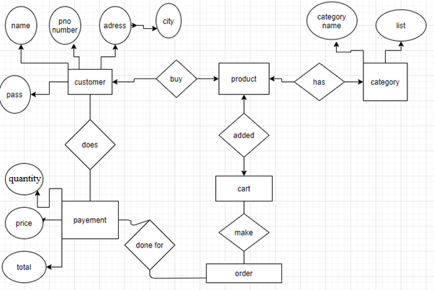
E-R Diagram

Slide 8
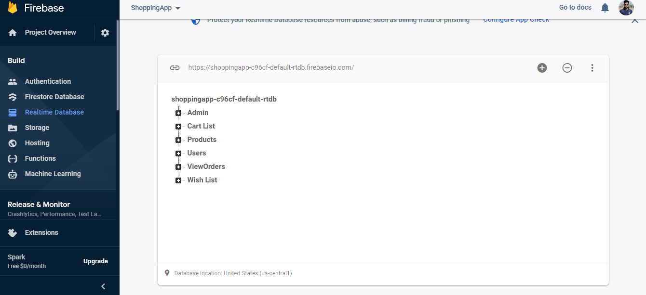
Database tables

Slide 9
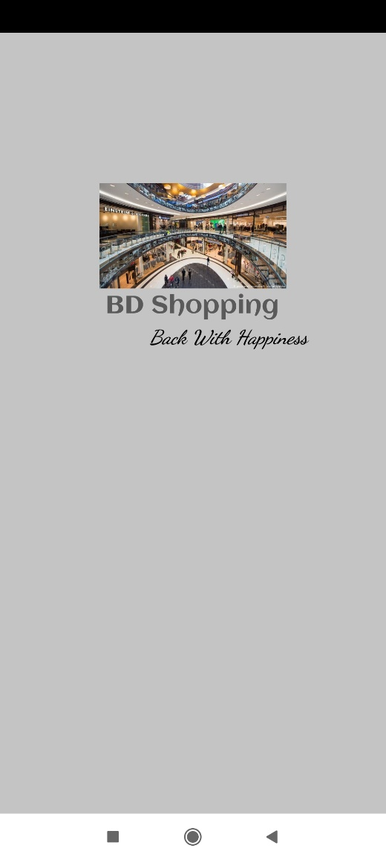
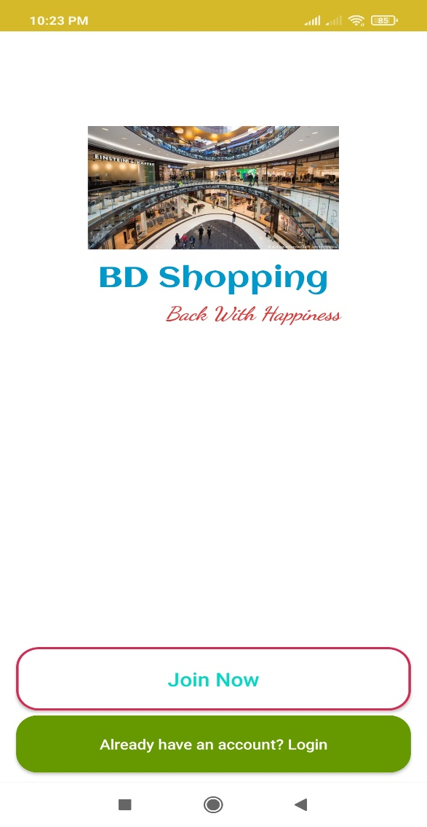
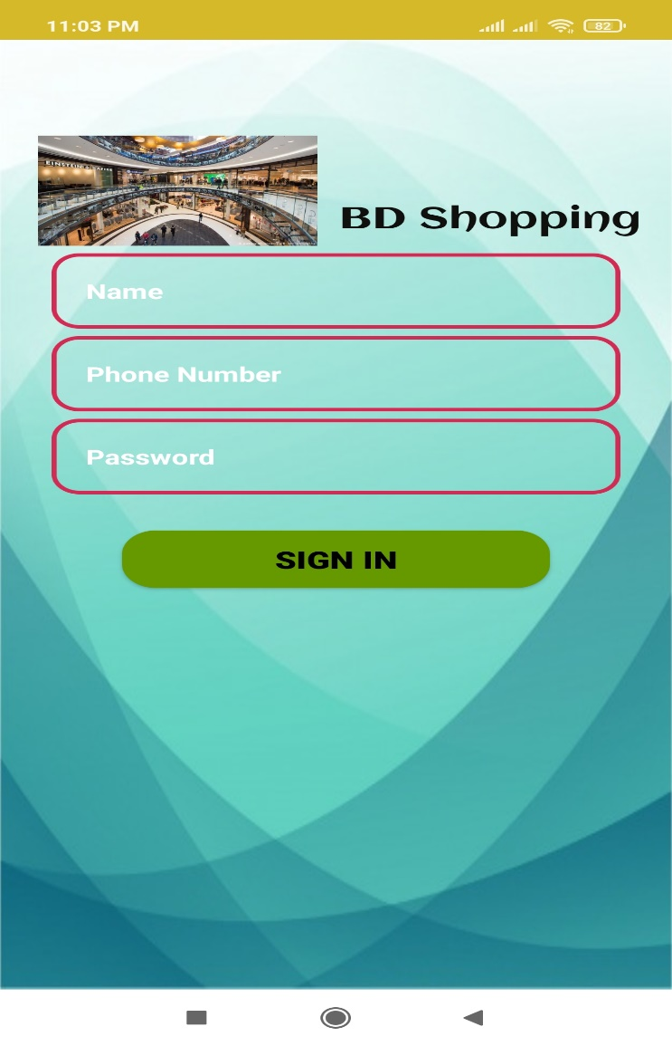
First Page and login page

Slide 10
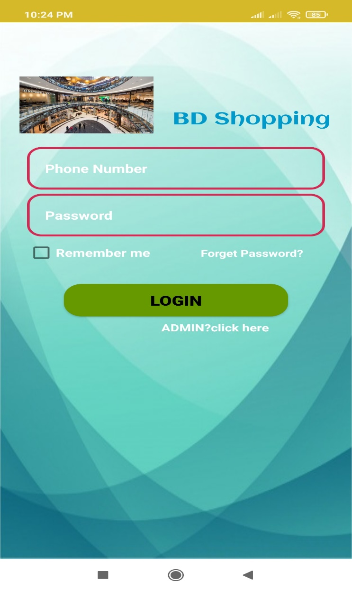
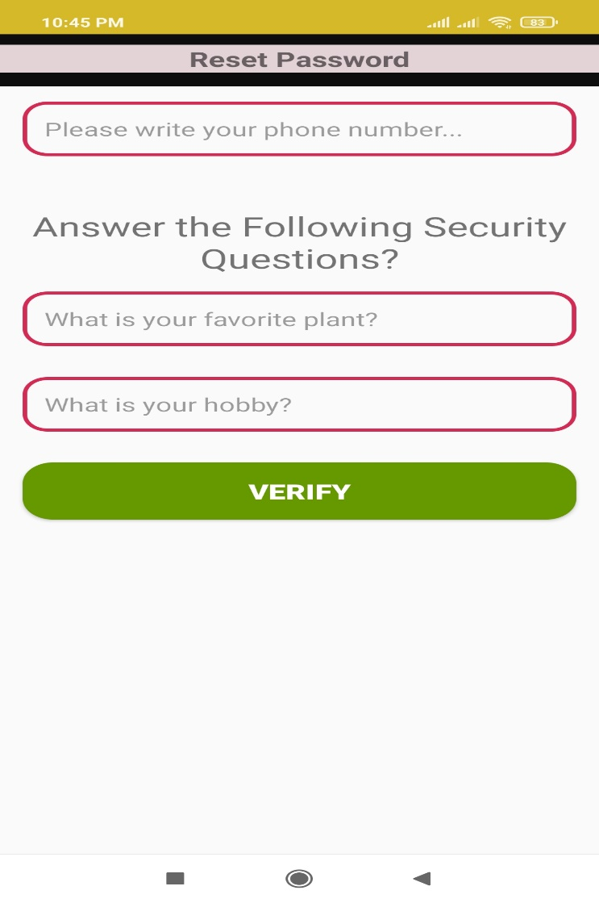

Continue

Slide 11
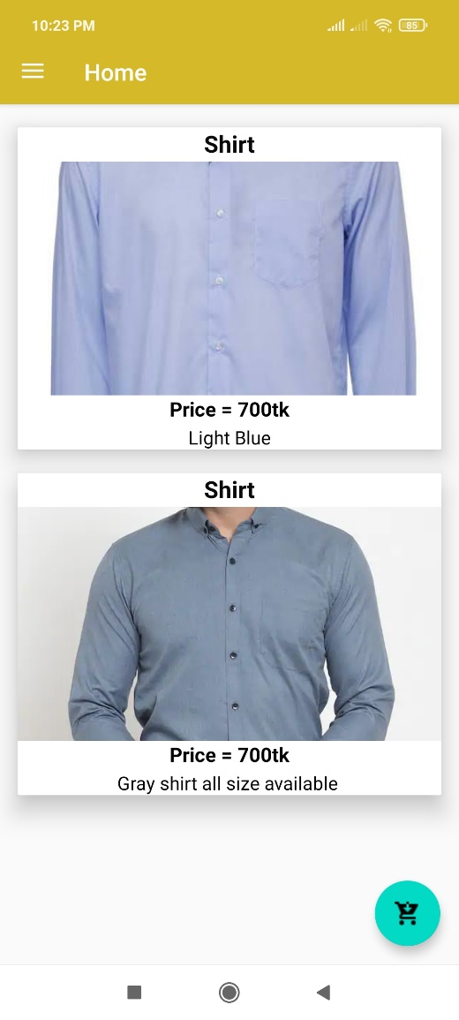
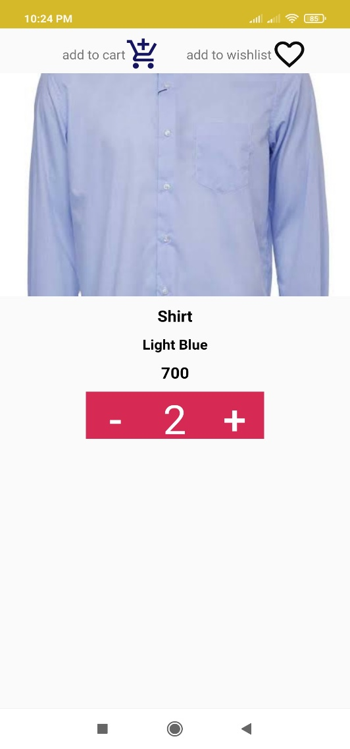
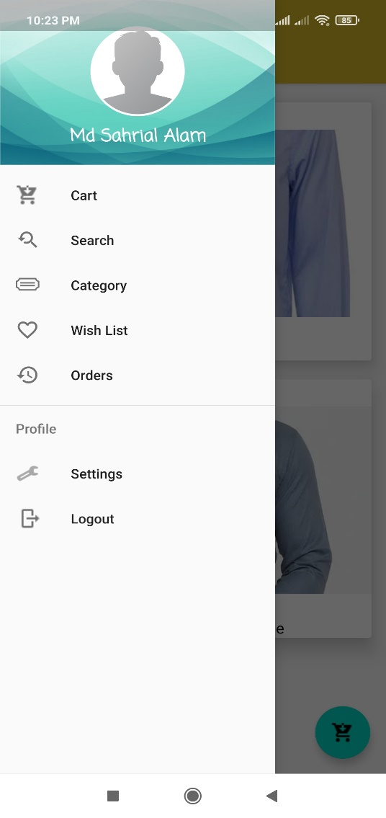
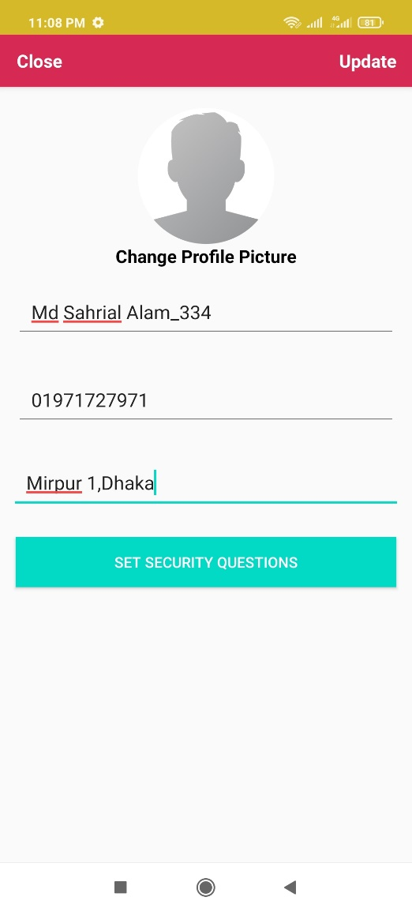
Modules For User

Slide 12
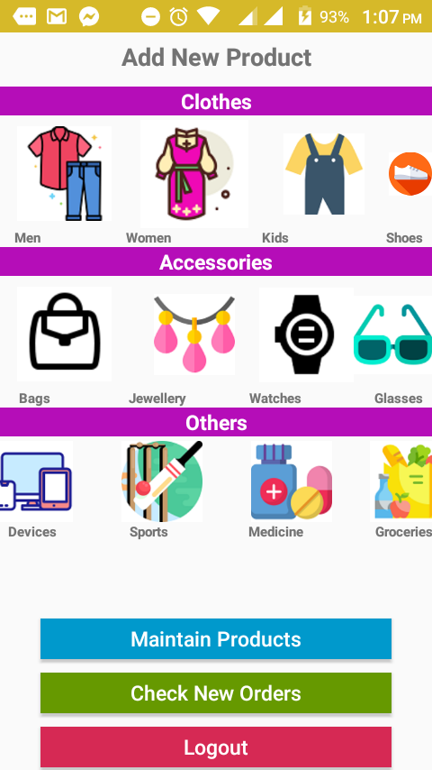
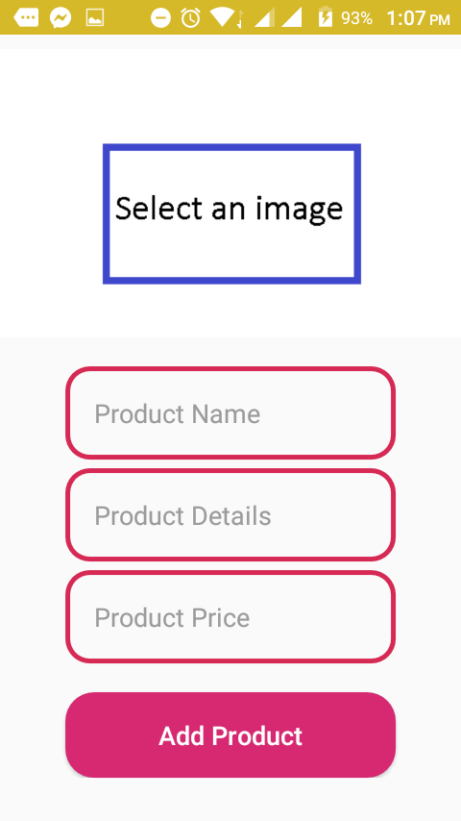
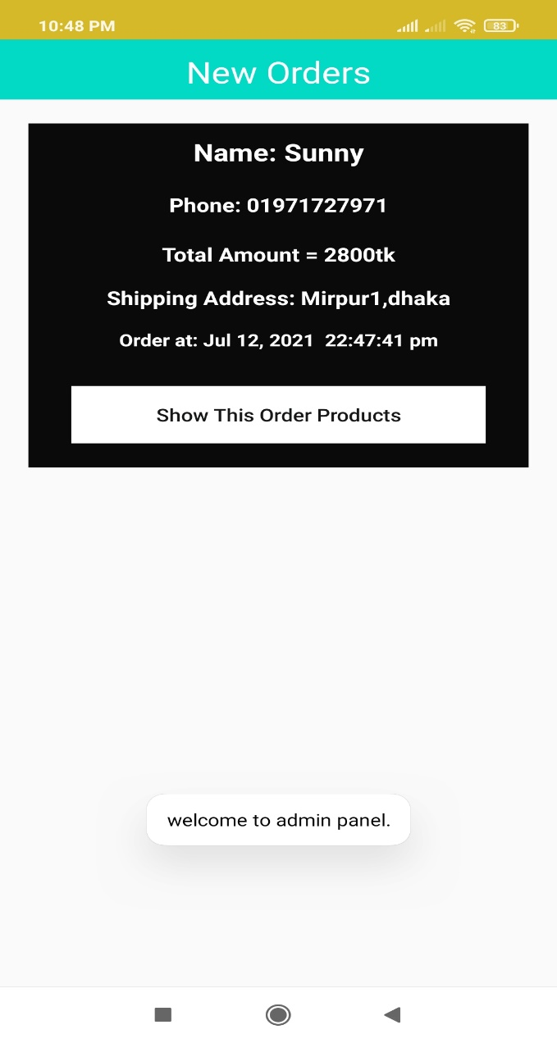
Modules For Admin

Slide 13
Future Work
The security system can be upgraded.
Online payment system can be added.
Customer’s information details auto refilled system can be added.
Search product option will be upgraded.
Product categories will be upgraded.

Slide 14
Conclusion
In this world people want to have an easier lifestyle. Having this thought in our mind, we have tried to make this app to make shopping easier through online. The online shopping is now very popular all over the world. The application has been developed with much care and we have tried to make it free of errors. It is very efficient and less time consuming. It is also very easy to operate. The purpose of this project is to develop an android application for purchasing items from the shop. This project has helped us in gaining valuable information and practical knowledge. This project has given us great satisfaction in having designed an application.

Slide 15
Thank You

