Slide 1
Assignment 5: Node JS microservices + Docker
Created by: Nihar Sahu (NS49108N)

Slide 2
Data Model
For this project a simple JSON file is used as a database.
The Json file contains a customers list.
Customers list consists of individual customer object.
Each Customer is uniquely identified by customer_id.
Each customer has a orders list.
Each order in the order list is also an object.
Each order is uniquely identified by order_id.
For simplicity purpose there are 4 customer and each customer has 3 order objects.

Slide 3
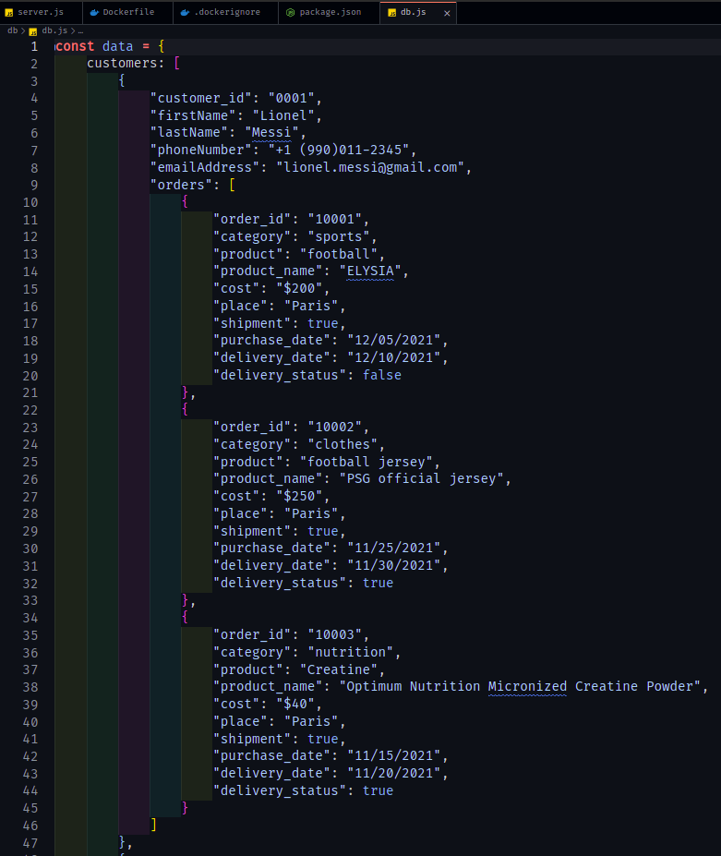
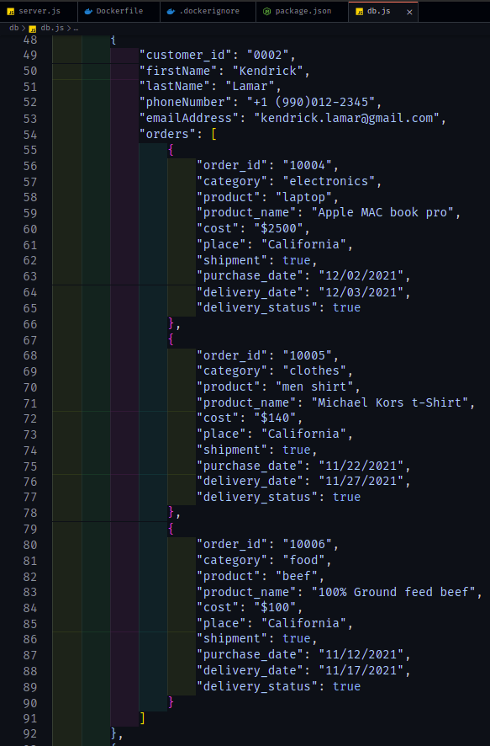
Database (screen shot).

Slide 4
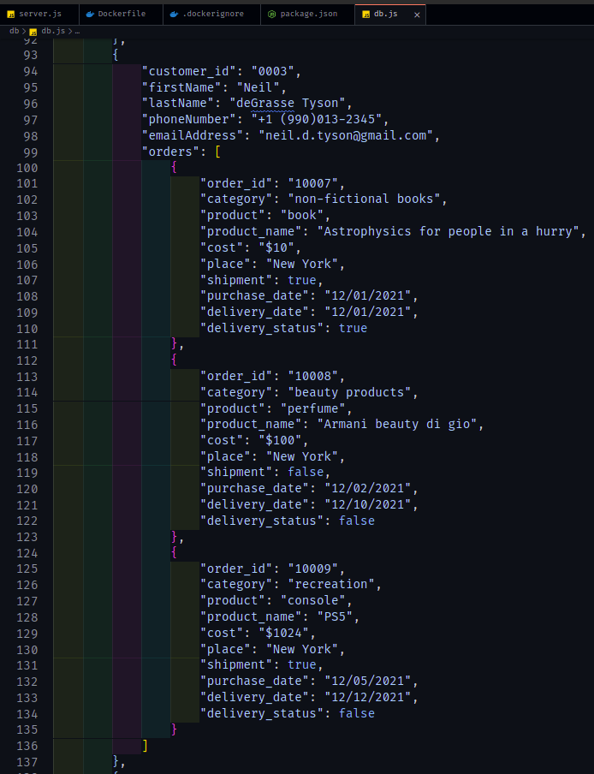
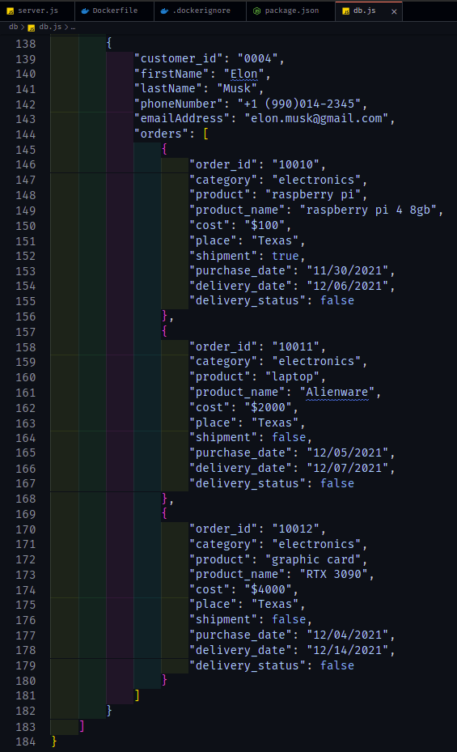
Database (screen shot) continuation

Slide 5
Thank you

