Slide 1
Welcome

Slide 2
Introduction

Slide 3
Introduction
Hi, I'm Nandan Sahu, and I'm here to present my analysis on key metrics and potential expansion opportunities based on the data I've reviewed.
Objective
My goal today is to walk you through the data cleanup process, the insights derived from our analysis, and how these insights align with our expansion goals.

Slide 4
Data Load and Cleanup

Slide 5
Data Load and Cleanup
Initial Data Review: The first step was to ensure that the data we were working with was accurate and reliable. I started by loading the data into our analysis tools and conducting a thorough review for any inconsistencies, missing values, or outliers.
Cleanup Process: This involved standardizing the data formats, correcting any errors, and filling in missing information where appropriate. By doing this, I ensured that our analysis would be based on clean, trustworthy data, providing a solid foundation for decision-making.
Outcome: With the data now clean and organized, we could confidently move forward with our analysis.

Slide 6
Analysis of key Questions

Slide 7
Question 1

Slide 8
Analysis of Key Questions
Question 1: The CEO of the retail store is interested to view the time series of the revenue data for the year 2011 only. He would like to view granular data by looking into revenue for each month. The CEO is interested in viewing the seasonal trends and wants to dig deeper into why these trends occur. This analysis will be helpful for the CEO to forecast for the next year.
Answer: For this analysis, I started by filtering the dataset to display only the monthly revenue for the year 2011. The revenue was calculated by multiplying the quantity of items sold by their unit price. To visualize this data, I used a line graph that illustrates the revenue trend across each month. Additionally, I added data labels to the graph, enabling a clearer view of the revenue figures for each month. This approach helps in identifying trends, such as peak sales periods, and provides insights into the overall performance throughout the year.

Slide 9
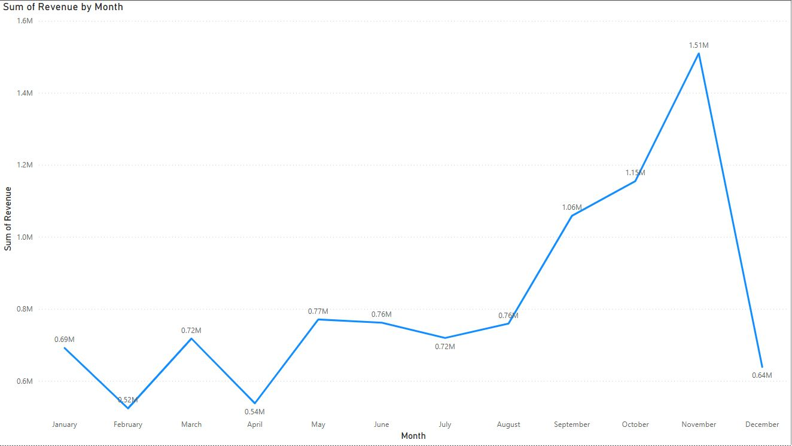
Analysis of Key Questions
Question 1: Output

Slide 10
Question 2

Slide 11
Analysis of Key Questions
Question 2: The CMO is interested in viewing the top 10 countries which are generating the highest revenue. Additionally, the CMO is also interested in viewing the quantity sold along with the revenue generated. The CMO does not want to have the United Kingdom in this visual.
Answer: For this analysis, I filtered the data to focus on the top 10 countries by revenue, specifically identifying which countries are generating the highest revenue. In addition to revenue, I also included the quantity of items sold by each country. To present this information, I used a column graph, which effectively displays both revenue and quantity sold, allowing us to compare which countries are driving the highest revenue. As per the requirements, I excluded the United Kingdom from this analysis to ensure the focus remains on other key markets. This visualization helps in identifying the most profitable international markets and assessing their sales volume.

Slide 12
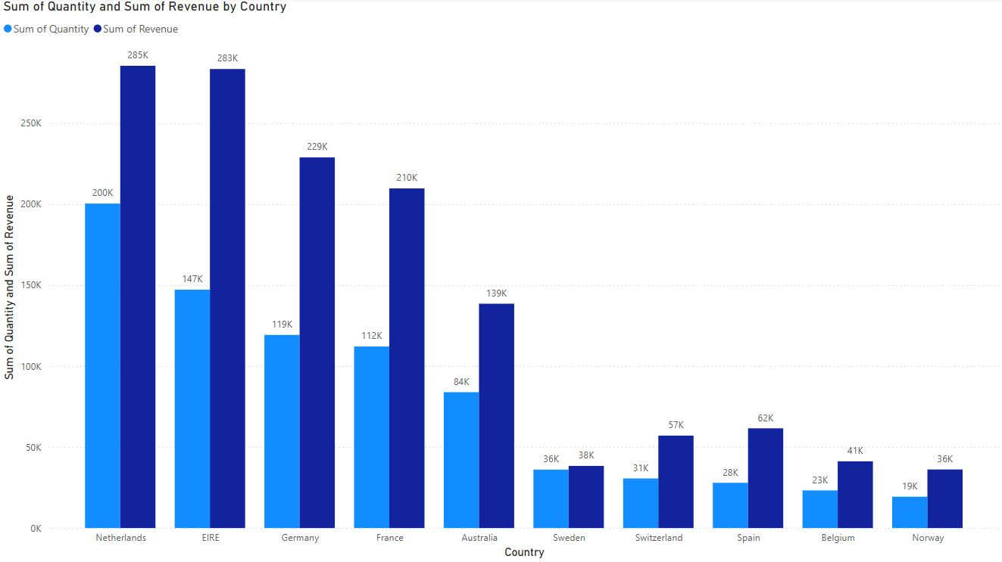
Analysis of Key Questions
Question 2:Output

Slide 13
Question 3

Slide 14
Analysis of Key Questions
Question 3: The CMO of the online retail store wants to view the information on the top 10 customers by revenue. He is interested in a visual that shows the greatest revenue generating customer at the start and gradually declines to the lower revenue generating customers. The CMO wants to target the higher revenue generating customers and ensure that they remain satisfied with their products.
Answer:For this question, I filtered the data to display only the top customers based on revenue. To visualize this, I utilized a column graph, which clearly highlights the revenue contributions of these top customers. This approach helps in identifying the most valuable customers and understanding their impact on overall revenue.

Slide 15
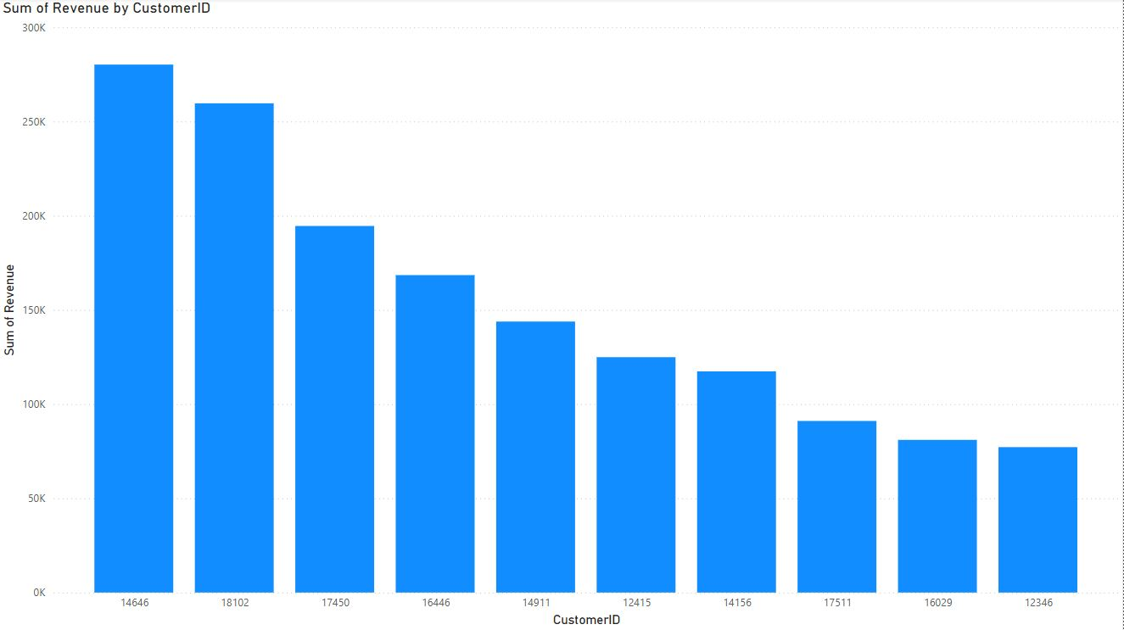
Analysis of Key Questions
Question 3:Output

Slide 16
Question 4

Slide 17
Analysis of Key Questions
Question 4: The CEO is looking to gain insights on the demand for their products. He wants to look at all countries and see which regions have the greatest demand for their products. Once the CEO gets an idea of the regions that have high demand, he will initiate an expansion strategy which will allow the company to target these areas and generate more business from these regions. He wants to view the entire data on a single view without the need to scroll or hover over the data points to identify the demand. There is no need to show data for the United Kingdom as the CEO is more interested in viewing the countries that have expansion opportunities.
Answer:For this, I used a map chart to display the quantity of items sold by country. The map visually represents the sales distribution across different countries, providing a geographic perspective on sales performance. Additionally, I excluded the United Kingdom from the map to focus on other regions. This visualization helps in understanding regional sales trends and identifying areas with higher sales volumes.

Slide 18
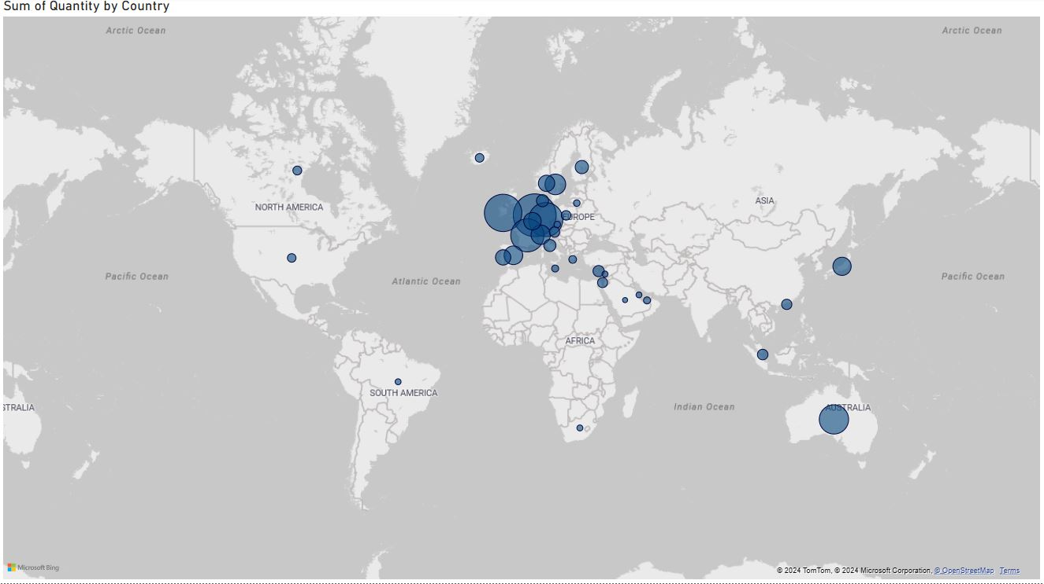
Analysis of Key Questions
Question 4:Output

Slide 19
Thank You

Slide 20
Thank you

