Slide 1
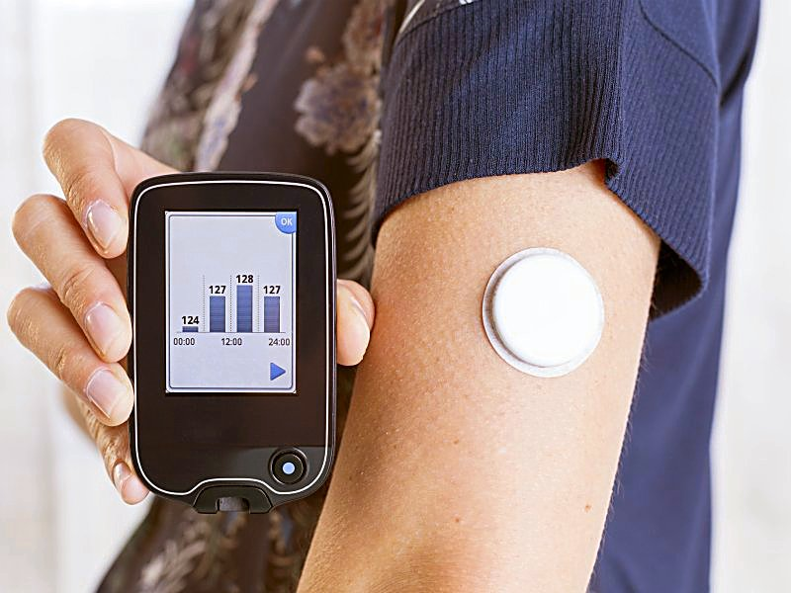

Meal-Tracker
Classification of Meal Macro-nutrient Composition via CGM signal
Megha Yadav
Projna Paromita
Sahul Phaniraj CSCE 633, Machine Learning Project
supervised by Dr. Bobak Mortazavi Assistant Professor.
Department of Computer Science and Engineering
Image credit | https://www.diabetessa.org.za

Slide 2
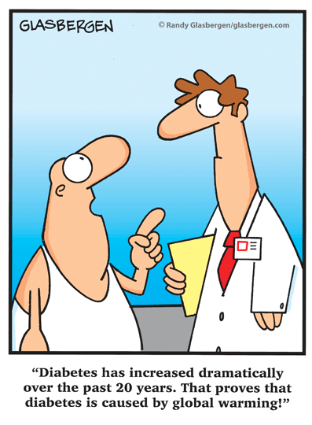
Introduction
DIABETES & PRE-DIABETES
Major Health Issue all over the world
In USA alone:
In 2017, $327 billion is the total estimated cost of diagnosed diabetes.
The economic cost increased 26% over last 5 years
Prevention and control of Diabetes
Healthy diet is one of the cornerstones for prevention and control of Diabetes.
Personalized Diet
Metabolism from person to person varies tremendously.
Personalized diet is important but difficult to achieve.
One way is to maintain food journal: noting down the meals macronutrient compositions.
Difficulty with Food Journal
Difficult to track meals macro nutrient composition for each meal: sometimes it is unknows, sometimes people forget.
Image credit | https://community.diabetes.org

Slide 3

Objective
MEAL-TRACKER
Usage of smart technology: CGM device
Cheap, reliable, easy to use.
Can be used 24/7.
Relatively new in market: giving opportunity to explore unknow domain.
To help making food journal easier
Usage of CGM devices to keep track of food composition on regular basis.
Taking one step at a time
Initial work: finding the level of macro nutrient components of the meal.
Giving the general idea about the level of macro-nutrients of an unknown meal, so that pre-diabetes and diabetes patients could have some idea how a meal affecting their blood glucose level.
Image credit | https://www.firstforwomen.com

Slide 4

Literature Survey
RESEARCHES USING CGM
Prediction of post prandial glucose level
Using pre-prandial CGM signal, prediction of post-prandial CGM value over 30, 60, 90- or 120-minutes time interval.
Usage of different non-linear supervised techniques, different data-assimilation techniques, different genetic programming techniques and deep networks were used for this purpose.
Prediction of hypoglycemic and hyperglycemic events
Finding hypoglycemic and hyperglycemic periods from CGM signal and predicting these events before hand using deep neural network.
Personalized diet chart
Using CGM signal and other parameters, finding how different meals impact on blood glucose level to make suggestions which food to eat and which to avoid to maintain a healthy lifestyle.
Image credit | https://politehnika2025.tvz.hr

Slide 5
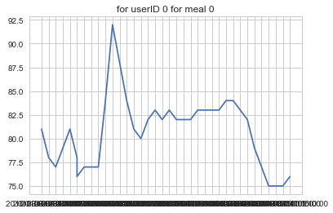
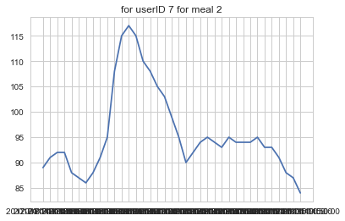
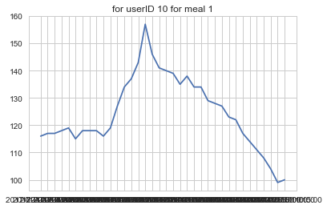
Implementation
PLoS DATA SET
Standardized meal testing with30 participants : 20 males , 10 females
3 meals per subject
Meals vary in proportion of macro nutrients, i.e. some are high carb some are high protein and so on
CGM device tracks subject’s data prior, during and after the meal intake.
Average duration of experiment is 2.5 hours with observable glucose differences in 30 minutes duration.
CGM data is sampled at 5 minutes intervals.

Slide 6
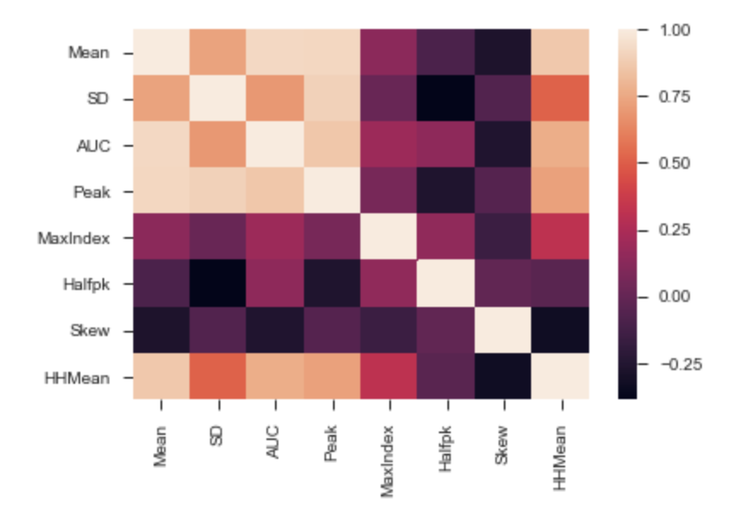
Implementation
Pre-processing
Some meal data was reported to be less than 30 minutes due to various reasons such as sensor displacement, etc.
Pre-processing involved removing such unusable data points and interpolation account for some missing points
We work with only 3 main macro nutrients : Carb, Fat and Protein
Feature Extraction
8 classical features were utilized for conducting classification
Mean, SD, AUC, Peak, MaxIndex, HPBW, Skeweness and HHMean
Features were normalized between range of 0 to 1

Slide 7
Implementation
ML Models
Baseline model
3-layer Neural Network
Parametric models
SVM – Linear, RBF
Logistic – with and without regularization
Decision Tree
Random Forest
Non-parametric models
KNN
Feature Selection
Recursive Feature Elimination
RFE uses a mix of forward and backward selection to reduce features.
Feature selection is done via observing model accuracy

Slide 8
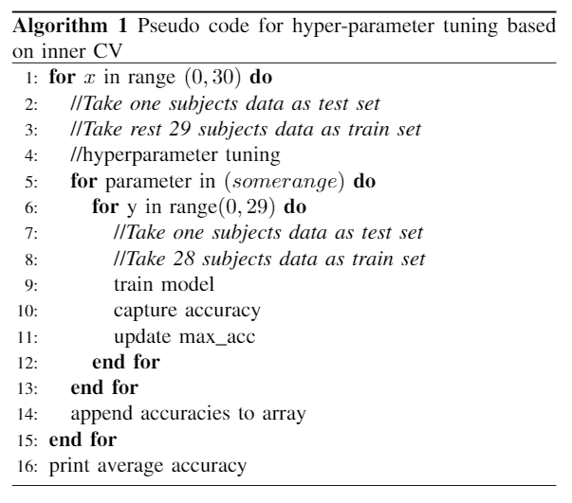
Implementation
LOSO – Leave one Subject Out

Slide 9
RESULTS

Slide 10
RESULTS – NN v/s SVM
MacroNutrient | Classifier | Neural Network | SVM-RBF | SVM-linear | SVM-linear (with RFECV)
Carb | Low-high | 0.4687 | 0.65 | 0.667 | 0.667
 | Medium-high | 0.5661 | 0.783 | 0.775 | 0.742
 | Low-medium | 0.5694 | 0.68 | 0.703 | 0.68
Fat | Low-high | 0.5101 | 0.7833 | 0.775 | 0.733
 | Medium-high | 0.5694 | 0.68 | 0.703 | 0.68
 | Low-medium | 0.5323 | 0.65 | 0.667 | 0.667
Protein | Low-high | 0.5694 | 0.68 | 0.703 | 0.677
 | Medium-high | 0.5101 | 0.783 | 0.775 | 0.733
 | Low-medium | 0.4687 | 0.65 | 0.667 | 0.667

Slide 11
Conclusion
Summary
Implemented classical machine learning techniques for macro-nutrient classification of CGM signals.
Chose features bases on general time-series data.
Trained different classifiers with normalized data set.
Performed feature selection via RFE to improve classifier accuracy.
SVM (linear kernel) provides the best accuracy amongst all macro-nutrients.
Accuracy is approximately 71%.
We observed F1-score similar to accuracy.

Slide 12
Conclusion
Challenges
No feature selection for KNN, SVM(RBF kernel) when using sklearn libraries
Limited data set
There is no baseline.
The signal does not have explicit feature set (eg speech signal or other physiological signal), so we had to resort to classical features. These features may not capture essence of the CGM signals.
Future Works
Tertiary classification.
Work with different feature set.
Implement LSTM-RNN.

Slide 13
THANK YOU!

