Slide 1
COVID-19
DATA
ANALYSIS

Slide 2
Covid-19 Dataset
To analyze the Covid-19 Data associated with the India.
The Given Covid-19 Dataset is in the csv format.
Dataset Contains 9 Columns namely as :
1] Sno
2] Date
3] Time
4] State/Union Territory
5] Confirmed Indian National
6] Confirmed Foreign National
7] Cured
8] Deaths
9] Confirmed

Slide 3
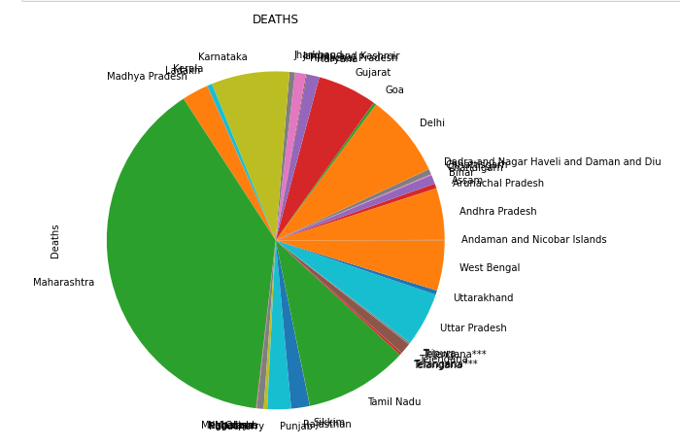
Line Plot Of Maharashtra
The Line Plot Shows The ratio of Deaths related to each other of States of India.

Slide 4
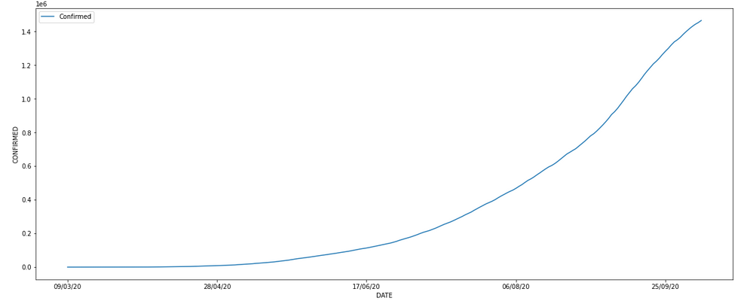
Line Plot of Maharashtra
The above Line Plot shows the line of Date on X axis against the number of Confirmed patients on the Y axis.
The Line plot shows that the exponential line means the patients increased exponentially over the time.

Slide 5
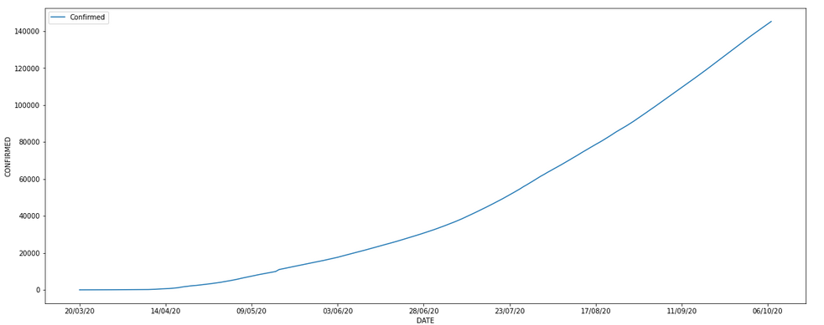
Line Plot of Gujarat
The above Line Plot shows the line of Date on X axis against the number of Confirmed patients on the Y axis.
The Line plot shows that the linear line means the patients increased linearly over the time.

Slide 6
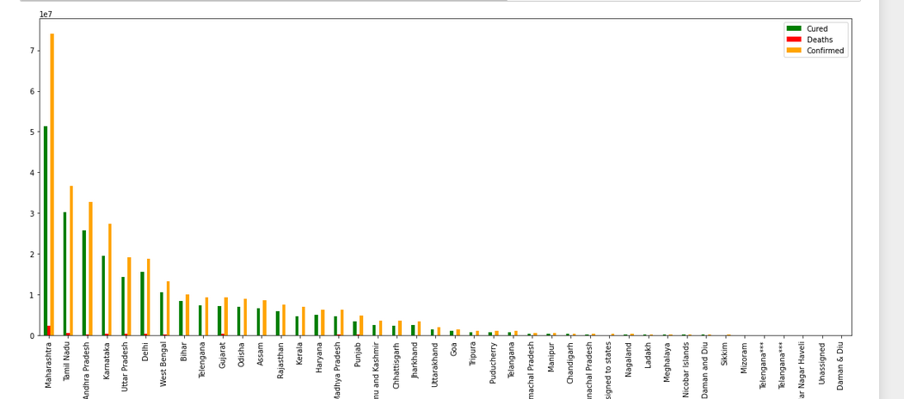
Bar Plot
Bar plot of different states with cured, dead and confirmed number of patients.

Slide 7
Conclusion
The number of increasing patients are more than the number of cured patients.
The number of death persons are less but they are incresing over time.
Maharashtra state has largest number of patients.

