Slide 1
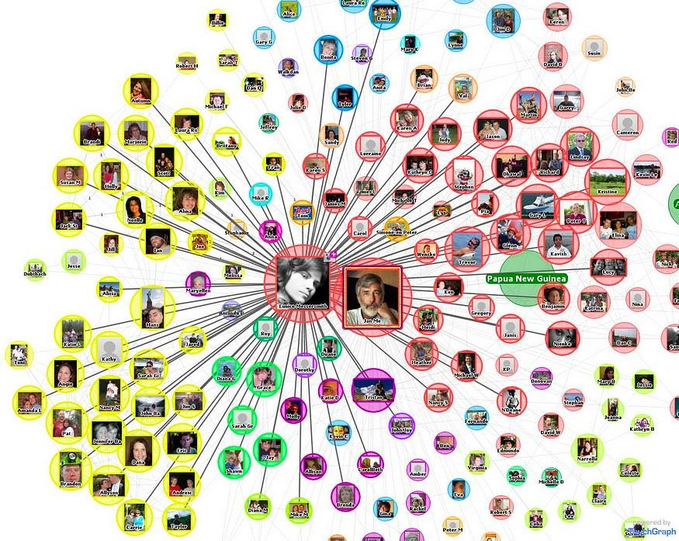
SOCIAL NETWORK ANALYSIS
In this project we will see about the process of generating a social network graph and how we analyze the Facebook social network by using a tool called NetworkX in python.
Social network analysis (SNA) is something that studies the relationships and interactions among individuals, groups, organizations, or any other social entities. It involves the analysis of social networks, which are composed of nodes (representing social entities) and edges (representing relationships or connections between entities). SNA examines how these networks are structured, how information or resources flow through them, and how behaviors, ideas, or influence spread within them.
DATASET
https://snap.stanford.edu/data/ego-Facebook.html
This dataset is collected through a survey by Stanford university. Facebook data was collected from survey participants using this Facebook app. The dataset includes node features (profiles) and edges.
Facebook data has been anonymized by replacing the Facebook-internal ids for each user with a new value. And, the edges will have no direction.
This dataset is not a .csv file and it is a network data and to read this kind of files and to work on them there is a python library “NetworkX” . Let us see about it.

Slide 2
NetworkX
https://networkx.org/
NetworkX is a Python package for the creation, manipulation, and study of the structure, dynamics, and functions of complex networks. NetworkX allows users to create and manipulate networks represented as graphs, which consist of nodes connected by edges. It provides functions for adding, removing, and modifying nodes and edges, as well as for computing various network properties such as degree, centrality, clustering coefficient, and more.
Basic features of dataset
import networkx as nx
import matplotlib.pyplot as plt
GI = nx.read_edgelist("facebook_combined.txt", create_using=nx.Graph(), nodetype=int)
#Basic information about the graph print("Graph Information:")
print("Number of nodes: ", nx.number_of_nodes(GI)) print("Number of edges: ", nx.number_of_edges(GI)) print("Is directed: ", nx.is_directed(GI))
#Basic graph statistics print("\nGraph Statistics:") print("Density: ", nx.density(GI))
print("Average degree: ", sum(dict(GI.degree()).values()) / len(GI)) print("Number of connected components: ", nx.number_connected_component s(GI))
print("Size of the largest connected component: ", len(max(nx.connected
_components(GI), key=len)))
print("Is connected: ", nx.is_connected(GI))
Output:
Graph Information:
Number of nodes: 4039 Number of edges : 88234 Is Directed: False
Graph statistics:
Density : 0.010819963503439287
Average degree: 43.69101262688784

Slide 3
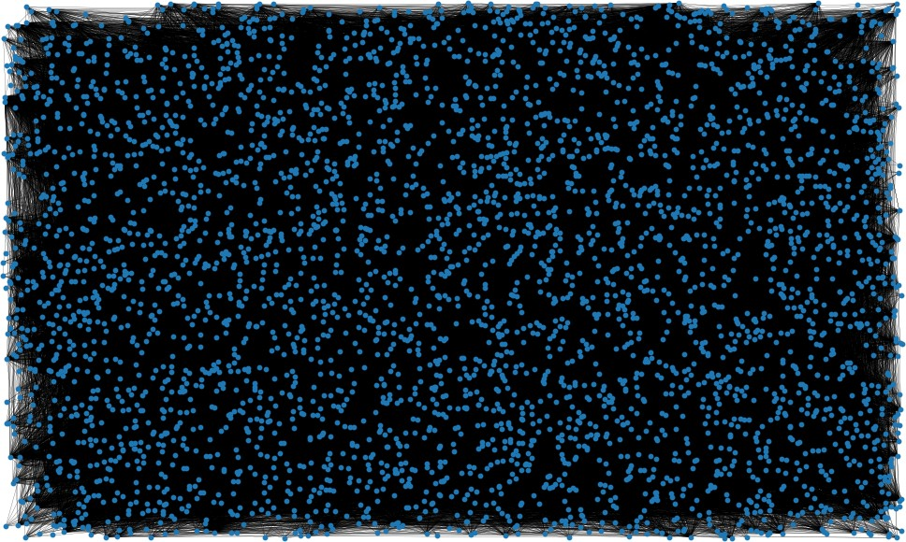
Number of connected components : 1
Is connected: True
NODE: Nodes represent individual entity, in this case in our data it represents individuals. EDGE: Edge is a connection between two nodes.
DIRECTED: For every network the edge might or might not represent a direction, in this network it is undirected.
DENSITY: Ratio of number of edges in the graph to the total number of possible edges in the graph. AVERAGE DEGREE: Total number of edges divided by total number of nodes.
The Network
fig, ax = plt.subplots(figsize=(15, 9))
ax.axis("off")
plot_options = {"node_size": 10, "with_labels": False, "width": 0.15} nx.draw_networkx(GI, pos=nx.random_layout(GI), ax=ax, **plot_options)
output:
This is the resulting image of the network and obviously we know this is not much of a use. Generally, when we use “nx.random_layout”, it randomly places the nodes of a graph in a visual representation which tends to overlapping of the edges and creates such random networks but to get a more accurate network representation we can use “Spring_layout”. This is a force directed graph where nodes that are connected tend to be closer and nodes which are not connected repel each other hence we get more visually appealing representation.

Slide 4
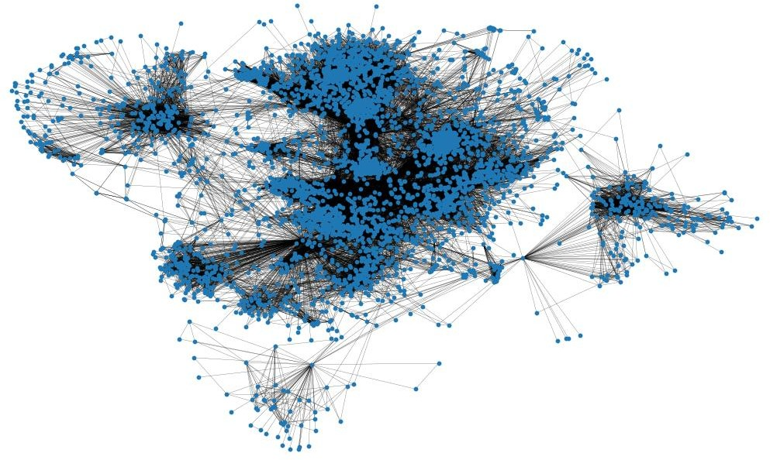
pos = nx.spring_layout(GI, iterations=15, seed=1721)
fig, ax = plt.subplots(figsize=(15, 9)) ax.axis("off")
nx.draw_networkx(GI, pos=pos, ax=ax, **plot_options)
output:
Using “nx.spring_layout” we got clearer network graph.
SHORTEST PATHS
In any social network it is crucial to find out the shortest paths between two nodes or two individuals to make a possible and effective connection between the nodes. For instance, in social networks, finding the shortest path between two individuals can help identify the most efficient path for spreading information, influence, or resources between them.
import numpy as np
mean=np.mean([d for _, d in GI.degree()])
shortest_path_lengths = dict(nx.all_pairs_shortest_path_length(GI)) mean

Slide 5
Output:
Mean = 43.69101262688784
In the code chunk above we have created a dictionary that has the lengths of the shortest paths between all pairs of nodes. And the mean represents the average connectivity of each node to the number of edges, to state this simply on an average a single node is connected to 44 other nodes.
Example:
shortest_path_lengths[50][4000]
output:
6
This means the shortest path length between 50 and 4000 is 6 edges.
The following example is to know what is the actual path between two nodes
import networkx as nx
GI = nx.read_edgelist("facebook_combined.txt", nodetype=int)
source_node = int(input("Enter the source node: ")) target_node = int(input("Enter the target node: "))
shortest_path = nx.shortest_path(GI, source=source_node, target=target_ node)
print(f"Shortest path between {source_node} and {target_node}: {shortes t_path}")
print(f"Length of shortest path: {len(shortest_path) - 1}")
Output:
Enter the source node: 500 Enter the target node: 42
Shortest path between 500 and 42: [500, 348, 34, 0, 42] Length of shortest path: 4
This insight can be very useful where we would know what is the path between two nodes and this could be very helpful in social networks for suggesting friends or suggesting content on social media. In the code we can enter the source node and the target node dynamically at the runtime.
Diameter:
diameter = max(nx.eccentricity(GI, sp=shortest_path_lengths).values())
diameter
Output:
8

Slide 6
This 8 represents to travel between any two nodes in the network we may travel 8 edges or fewer.
CENTRALITY MEASURES
Centrality measures are mathematical metrics used to identify and quantify the importance or significance of individual nodes within a network. Simply we can say Node importance.
Node importance:
"Node importance" also known as node centrality is a measure of how crucial a node can be in forming the network or graph. There are quite a few ways to know the node importance in networks but in this project, we are limiting it to four, they are:
Degree Centrality
Betweenness Centrality
Closeness Centrality
Community Detection
DEGREE CENTRALITY
Degree centrality is defined as the number of edges or connections that a node has in a network. This is often used to identify the most connected or influential nodes in a network. Nodes with high degree centrality are considered more central, as they have more connections and are likely to have more influence over the flow of information, resources etc. they are very crucial for spreading information, controlling the flow of information within the network.
Degree Centrality of a node = No. of edges connected to the node / (Total number of nodes in the network - 1)
import networkx as nx
import matplotlib.pyplot as plt
G = nx.read_edgelist("facebook_combined.txt", nodetype=int) degree_centrality = nx.degree_centrality(G)
pos = nx.spring_layout(G, seed=42) node_color = 'lightgreen'
node_size = [v * 400 for v in degree_centrality.values()] edge_color = 'gray'
edge_width = 0.5
plt.figure(figsize=(12, 8))
nx.draw_networkx(G, pos, node_color=node_color, node_size=node_size, edge_color=edge_color, width=edge_width, alpha=0.7, wi
th_labels=False)
plt.title("Network Graph with Degree Centrality") plt.axis('off')
plt.show()

Slide 7
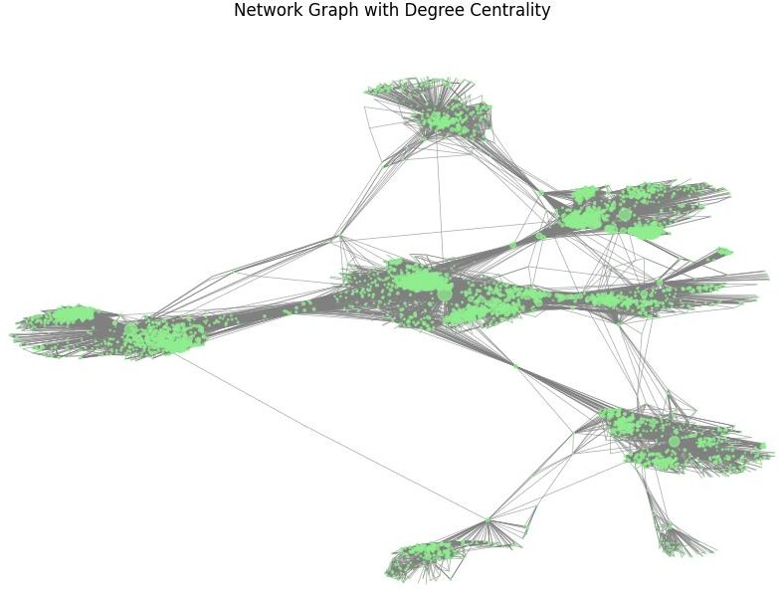
"""
nx.draw_networkx(G, pos, node_color=node_color, node_size=node_size, edge_color=edge_color, width=edge_width, alpha=0.7, wi
th_labels=False)
plt.title("Network Graph with Degree Centrality") plt.axis('off')
plt.show() """
# the above code chunk shows degree centrality for each node but it is
not compatible to show in the output block.
Output:

Slide 8
Now let us observe the top 10 nodes with highest degree centrality values.
degree_centrality = nx.centrality.degree_centrality(GI)
(sorted(degree_centrality.items(), key=lambda item: item[1], reverse=Tr ue))[:10]
Output:
[(107, 0.258791480931154),
(1684, 0.1961367013372957),
(1912, 0.18697374938088163),
(3437, 0.13546310054482416),
(0, 0.08593363051015354),
(2543, 0.07280832095096582),
(2347, 0.07206537890044576),
(1888, 0.0629024269440317),
(1800, 0.06067360079247152),
(1663, 0.058197127290737984)]
This output summarises that node “107” has highest degree centrality value of approximately 0.259 which eventually means that node “107” is connected to 25.9% of the whole network.
The number of neighbours these top 10 nodes contain are:
(sorted(G.degree, key=lambda item: item[1], reverse=True))[:10]
Output:
[(107, 1045),
(1684, 792),
(1912, 755),
(3437, 547),
(0, 347),
(2543, 294),
(2347, 291),
(1888, 254),
(1800, 245),
(1663, 235)]This represents that node “107” has 1045 neighbours or nodes connected to it and vice versa.
Here is the graph of values of degree centrality of each node.
nodes = list(degree_centrality.keys())
degree_values = list(degree_centrality.values()) plt.scatter(nodes, degree_values, alpha=0.5) plt.xlabel("Node Indices")
plt.ylabel("Degree Centrality Values") plt.title("Degree Centrality Distribution") plt.show()

Slide 9
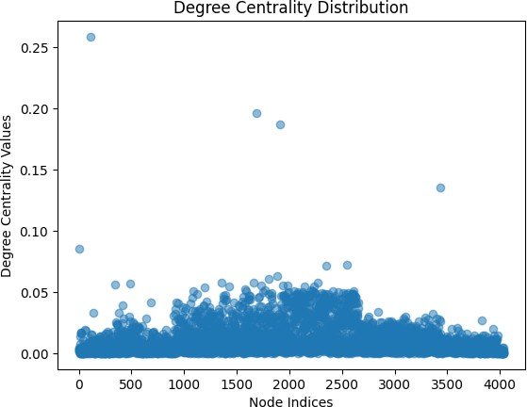
Output:
BETWEENNESS CENTRALITY
Betweenness centrality is a measure of the importance or centrality of a node in a network based on the concept of shortest paths. It quantifies the extent to which a node lies on the shortest paths between pairs of other nodes in the network. It can be used in various applications, such as identifying important individuals in social networks, critical nodes in transportation networks, or key proteins in biological networks.
import networkx as nx
import matplotlib.pyplot as plt
G = nx.read_edgelist("facebook_combined.txt", nodetype=int)
betweenness_centrality = nx.betweenness_centrality(G, normalized=True, endpoints=True)
pos = nx.spring_layout(G, seed=42) node_color = 'lightblue'
node_size = [v * 400 for v in betweenness_centrality.values()] edge_color = 'gray'
edge_width = 0.5
plt.figure(figsize=(12, 8))
nx.draw_networkx(G, pos, node_color=node_color, node_size=node_size,

Slide 10
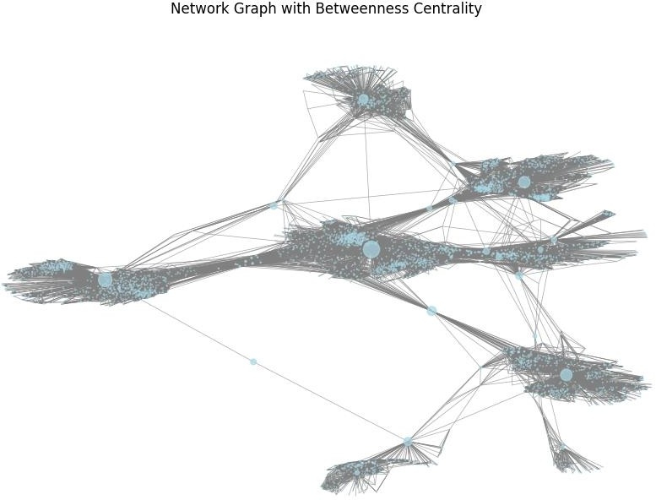
edge_color=edge_color, width=edge_width, alpha=0.7, wi
th_labels=False)
plt.title("Network Graph with Betweenness Centrality") plt.axis('off')
plt.show()
Output:
The top 10 nodes with highest betweenness centrality values are :
(sorted(betweenness_centrality.items(), key=lambda item: item[1], rever
se=True))[:10]
Output:
[(107, 0.48077531149557645),
(1684, 0.33812535393929544),
(3437, 0.23649361170042005),
(1912, 0.22967697101070242),
(1085, 0.14943647607698152),
(0, 0.14672864694039878),
(698, 0.1157685138598761),
(567, 0.0967578131045644),

Slide 11
(58, 0.08481360516228129),
(428, 0.06477239041384117)]
Node “107” has the highest betweenness centrality value of 0.481(apx), indicating that it lies on many shortest paths between pairs of other nodes in the network, potentially serving as a critical connector or information hub.
The highest betweenness does not necessarily depend on the degree because the node which has connections to the most network may not lie in the greatest number of shortest paths, but in our case the node “107” has the greatest number of connections and it lies in the most of the shortest paths and hence has the highest betweenness centrality.
In the following network we can see the top 10 nodes labelled.
sorted_nodes = sorted(betweenness_centrality, key=betweenness_centralit
y.get, reverse=True)
top_nodes = sorted_nodes[:10]
node_size = [
1200 if node in top_nodes else 0 for node in G.nodes()
]
labels = {node: node if node in top_nodes else "" for node in G.nodes()
}
pos = nx.spring_layout(G) plt.figure(figsize=(15, 8))
nx.draw_networkx(G, pos=pos, node_size=node_size, labels=labels, font_s ize=12, font_color='black', width=0.15)
plt.axis("off")
plt.title("Network with Top 10 Nodes based on Betweenness Centrality") plt.show()

Slide 12
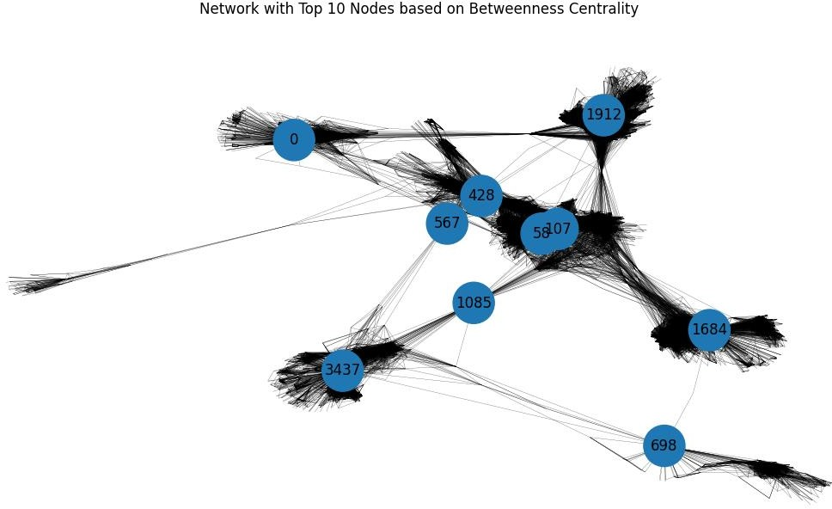
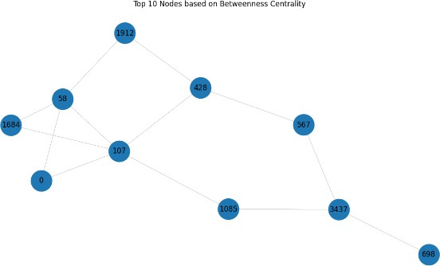
Output:
The above network shows the whole network with only the top 10 nodes labelled and shown. We can predict by observing that they stand in the shortest paths between so many nodes.
Representing only top 10.

Slide 13
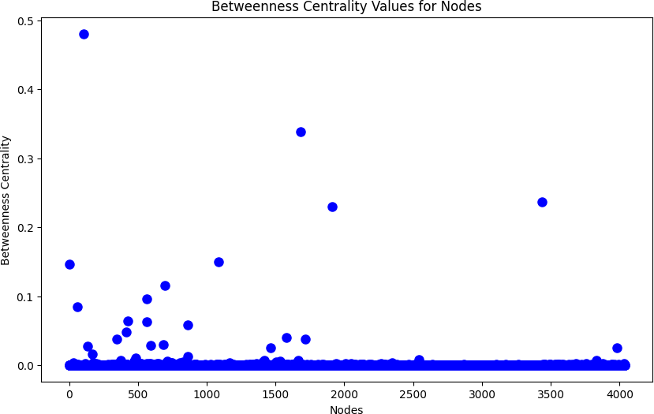
Graphical representation :
nodes = list(betweenness_centrality.keys())
values = list(betweenness_centrality.values())
plt.figure(figsize=(10, 6))
plt.plot(nodes, values, 'bo', markersize=8) plt.xlabel('Nodes') plt.ylabel('Betweenness Centrality')
plt.title('Betweenness Centrality Values for Nodes') plt.show()
Output:
CLOSENESS CENTRALITY
Closeness centrality measures how easily a node can access other nodes in the network. Nodes with higher closeness centrality values are typically located in central or well-connected areas of the network and can quickly transmit information or influence to other nodes. It simply quantifies the average shortest path distance from a node to all the other nodes in the network.
The closeness centrality measure is very important for the monitoring of the spread of false information (e.g., fake news). Let us examine the example of fake news. If the user with the highest closeness centrality measure started spreading some fake news information (sharing or creating a post), the whole network would get misinformed the quickest possible. However, if a user with very low closeness centrality would try the same, the spread of the misinformation to the whole network

Slide 14
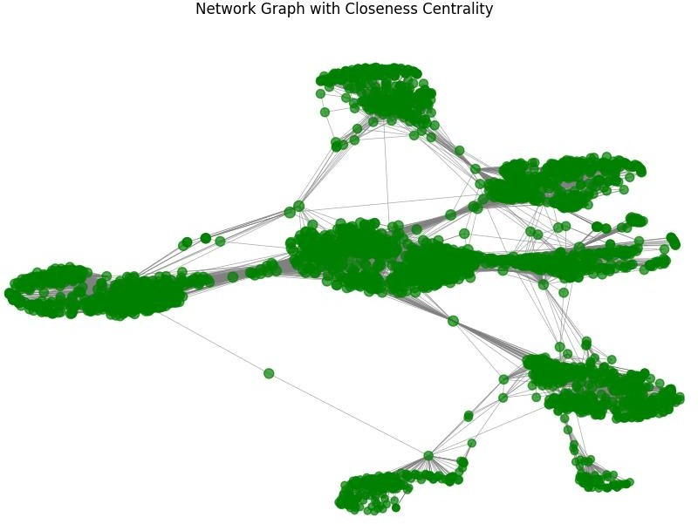
would be much slower. That is because the false information would have to firstly reach a user with high closeness centrality that would spread it to many different parts of the network.
import networkx as nx
import matplotlib.pyplot as plt
G = nx.read_edgelist("facebook_combined.txt", nodetype=int) closeness_centrality = nx.closeness_centrality(G)
pos = nx.spring_layout(G, seed=42) node_color = 'green'
node_size = [v * 200 for v in closeness_centrality.values()] edge_color = 'gray'
edge_width = 0.5
plt.figure(figsize=(12, 8))
nx.draw_networkx(G, pos, node_color=node_color, node_size=node_size, edge_color=edge_color, width=edge_width, alpha=0.7, wi
th_labels=False)
plt.title("Network Graph with Closeness Centrality") plt.axis('off')
plt.show()
Output:

Slide 15
The top 10 nodes with closeness centrality are :
(sorted(closeness_centrality.items(), key=lambda item: item[1], reverse
=True))[:10]
Output:
[(107, 0.45969945355191255),
(58, 0.3974018305284913),
(428, 0.3948371956585509),
(563, 0.3939127889961955),
(1684, 0.39360561458231796),
(171, 0.37049270575282134),
(348, 0.36991572004397216),
(483, 0.3698479575013739),
(414, 0.3695433330282786),
(376, 0.36655773420479304)]
Inspecting the users with the highest closeness centralities, we understand that there is not a huge gap between them in contrast to the previous metrics. Also, the nodes 107,1684,348 are the only spotlight nodes found in the ones with the highest closeness centralities. That means that a node that has many friends is not necessarily close to the centre of the network.
Graph of closeness centrality
plt.figure(figsize=(10, 6))
plt.bar(closeness_centrality.keys(), closeness_centrality.values()) plt.xlabel("Node ID")
plt.ylabel("Closeness Centrality")
plt.title("Closeness Centrality for Nodes") plt.show()

Slide 16
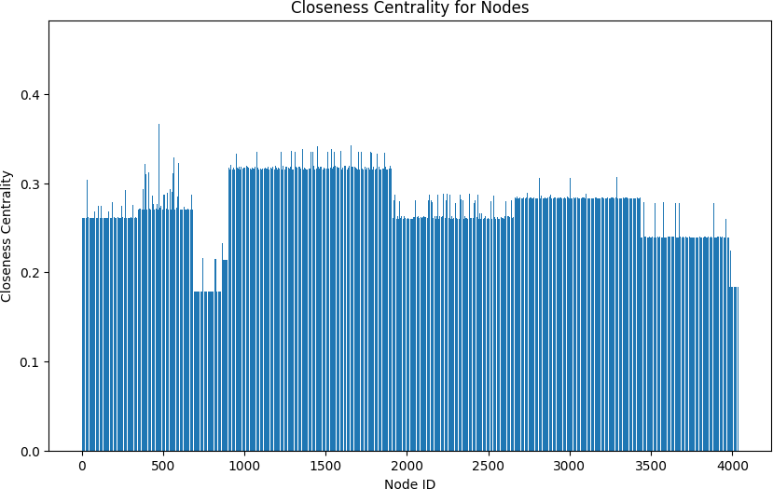
Output:
COMMUNITY DETECTION
Community detection, also known as clustering or partitioning. This is used to identify groups or communities of nodes that are densely connected within themselves but less connected with nodes outside the group. These communities are often considered as "modules" or "clusters" within the network, and their identification can provide insights into the underlying structure and organization of the network.
import networkx as nx
import community
import matplotlib.pyplot as plt
import community.community_louvain as cl
G = nx.read_edgelist("facebook_combined.txt", nodetype=int) partition = cl.best_partition(G)
communities = {}
for node, community_id in partition.items(): if community_id not in communities:
communities[community_id] = [] communities[community_id].append(node)
for community_id, nodes in communities.items(): print(f"Community {community_id}: Nodes {nodes}")

Slide 17
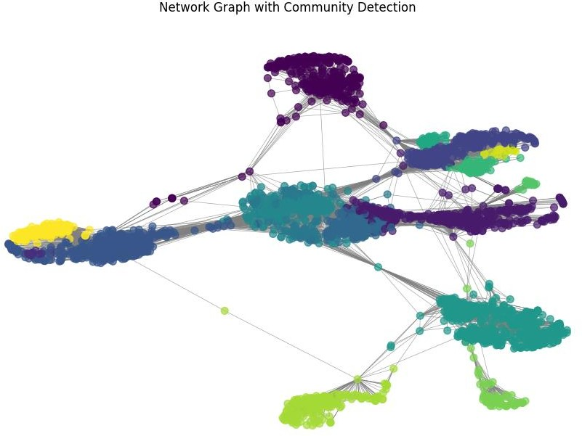
pos = nx.spring_layout(G, seed=42)
node_color = [partition[node] for node in G.nodes()] node_size = 50
edge_color = 'gray'
edge_width = 0.5
plt.figure(figsize=(12, 8))
nx.draw_networkx(G, pos, node_color=node_color, node_size=node_size, edge_color=edge_color, width=edge_width, alpha=0.7, wi
th_labels=False)
plt.title("Network Graph with Community Detection") plt.axis('off')
plt.show()
Output:
In our network we observed the network is divided into 15 communities. The communities are detected by modularity which basically is the measure of structure of graphs, measuring the density of connections within the module or community. Community detection can help identify groups or communities within social networks, such as groups of friends, interest groups, or communities of practice. This can provide insights into the structure and dynamics of social relationships, information diffusion, and social influence processes.

Slide 18
CONCLUSION
In summary, social network analysis (SNA) is a very effective methodology that provides important insights into the composition, dynamics, and behaviours of social networks. SNA can provide a greater knowledge of social systems and human interactions by revealing hidden patterns, relationships, and communities inside social networks through the analysis of network data. Various SNA techniques, including centrality measures, community detection, network visualization, and statistical analysis, can be used in a social network analysis project to illuminate key social network characteristics, including information diffusion, social influence, group formation, and network resilience. The results of a social network analysis can be used in many different sectors, including sociology, marketing, and public health. Researchers, practitioners, and policymakers can get insightful knowledge into the intricate dynamics of social networks and make wise choices for a variety of applications by utilizing the power of SNA.

