Slide 1

Customer Retention: EDA, Segmentation & Churn Modelling
Answering the Retention Brief on the Single Customer View (7,043 customers)
Technical walkthrough · Retention team

Slide 2
The Retention Brief in Five Questions
1
What do churners look like, and what products do they have?
Fibre-heavy with high charges and few add-ons; more often senior and single. Gender is not a factor.
2
Why are they churning?
Mostly competitor offers and poor service - not raw price.
3
What makes customers stay, and what should we incentivise?
Term contracts and add-ons. Allocate the $2.50 employee incentive to Online Security sign-ups.
4
Which 500 customers should get the retention mailer?
A ranked Top-500 at-risk list (mean risk 75%; ~100 retained at the expected 20% uptake).
5
What is the churn risk of our remaining customers?
A 0-100 score & Low/Medium/High band for all 5,174 active customers.

Slide 3
The Data: A Single Customer View of Swan Teleco's Customers
7,043 customers · 31 columns · all in California · one quarter of activity · 26.5% churned
Group | Fields | Type / note
Identifiers & location | CustomerID, City, Zip Code, Lat Long, Latitude, Longitude | PII - kept out of the model
Demographics | Gender, Senior Citizen, Partner, Dependents | Categorical
Services | Phone Service, Multiple Lines, Internet Service, Online Security, Online Backup, Device Protection, Tech Support, Streaming TV, Streaming Movies | Categorical
Account | Tenure Months, Contract, Paperless Billing, Payment Method, Monthly Charges, Total Charges | Numeric + categorical
Target | Churn Value (0/1), Churn Label, Churn Reason | Outcome
Constant (dropped) | Count, Country, State | Single value - no signal

Slide 4
Data Cleaning and Feature Preparation
Cleaning & Data Quality
• Total Charges: 11 blank values (new customers, tenure of 0 months). The blanks were set to 0 and cast to a float.
• Churn Reason: 73% null by design - only churners have one; kept, never imputed
• No duplicate customers found
• Every row validated against a Pydantic schema, so that no invalid data enters the model and affects the analysis.
Feature Engineering & Selection
• Categorical data was one-hot encoded; numerical data was standardised so the model would be less affected by large ranges within the columns.
Removed from the feature set, and why:
- IDs & location (CustomerID, City, Zip, Lat/Long) - identifiable, not predictive
- Churn Reason - only known after a customer churns (leakage)
- Churn Label - a direct copy of the target (leakage)
- Count / Country / State - constant, no signal

Slide 5
Question 1 of 5
What do Churners Look Like: Gender, Family - and What Products do they have?

Slide 6
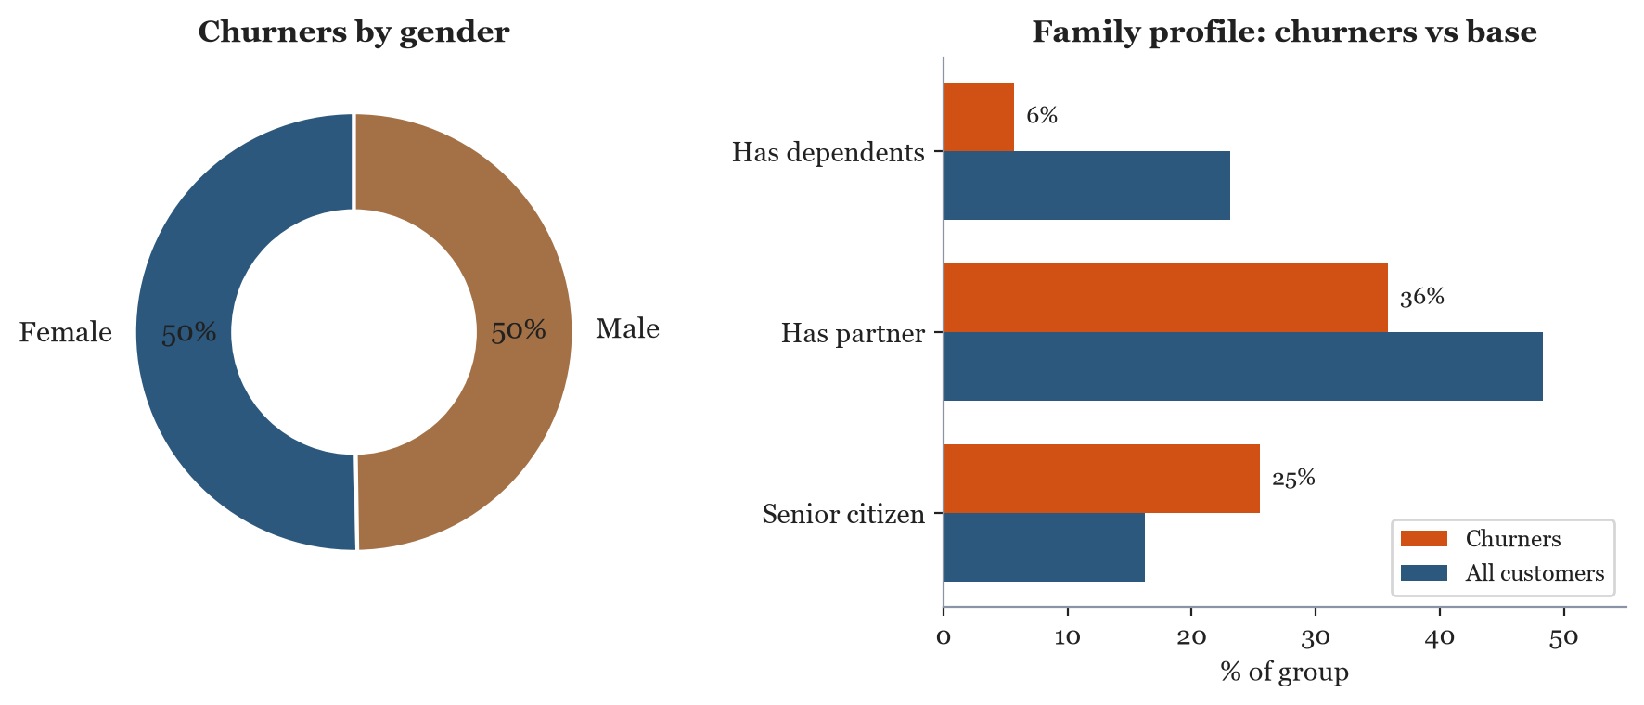
Gender is not a Factor; Churners are typically Senior, Single and Low-commitment
Churners are more often senior (25% vs 16%), and less likely to have a partner (36% vs 48%) or dependents (6% vs 23%).

Slide 7
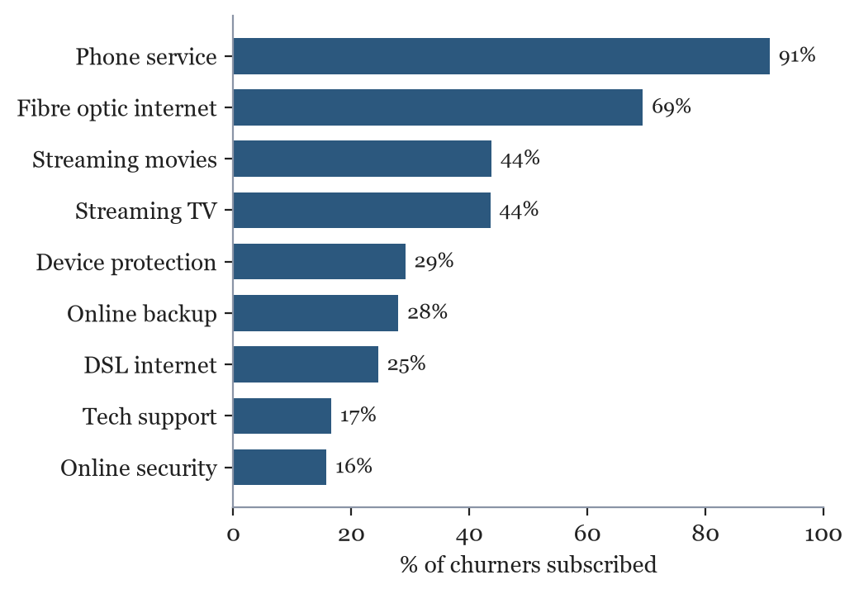
Churners are Fibre-heavy but Rarely Hold Protective Add-ons
Product Profile
• Almost all have phone service (91%)
• Fibre optic internet is common (69%)
• Streaming is popular (~44%)
• But only ~16% hold Online Security and ~17% Tech Support
There is a high correlation between customers lacking certain addons and the risk of a customer churning.

Slide 8
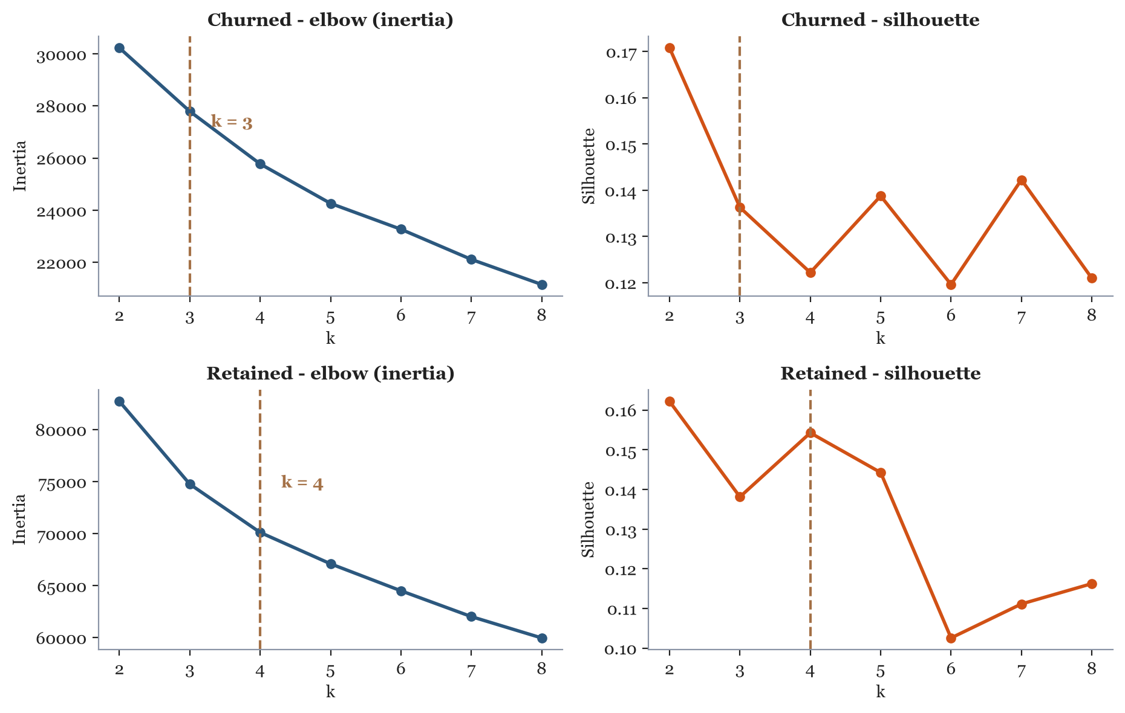
Clustering Analysis with K-means
K-means clustering groups customers who "look alike" across their contract, billing, and service-usage patterns into k distinct segments.
Here, it lets us uncover customer type clusters within the churned and retained populations separately, revealing which combinations of traits (like short tenure, fibre optic, and no add-ons) define the highest-risk profile, and which retained customers most closely resemble that profile today.
Choosing k
k is chosen by picking the point where adding more clusters stops meaningfully reducing inertia, balanced against how interpretable and business-useful the resulting segments are.
k=3 & k=4
• Churned and retained customers were clustered separately
• Categoricals encoded and numerics standard scaled
• Swept k = 2-8, reading the elbow (inertia) and silhouette score
Churned: k = 3 clusters
Retained: k = 4 clusters

Slide 9
Churned Customers: The Three Types
All three are dominated by month-to-month contracts and low add-on take-up.
 | C1 · Budget DSL | C2 · Established fibre | C3 · New fibre (high-risk)
Customers | 487 (26%) | 420 (22%) | 962 (51%)
Avg tenure | 9 months | 48 months | 9 months
Avg monthly charge | $39 | $94 | $84
Month-to-month | 93% | 61% | 98%
Internet type | 77% DSL | 88% fibre | 96% fibre
Electronic check | 39% | 53% | 69%
Has online security | 15% | 29% | 10%
C3 is the priority: half of all churners, brand new, high-value, almost entirely month-to-month with only 10% holding online security.

Slide 10
Retained Customers: Four Types
The loyal segments are defined by term contracts, automatic payment and add-on take-up.
 | C1 · Watchlist | C2 · Low-usage loyal | C3 · Loyal high-value | C4 · New low-spend
Customers | 1,551 (30%) | 805 (16%) | 1,629 (31%) | 1,189 (23%)
Avg tenure | 23 months | 56 months | 61 months | 12 months
Avg monthly charge | $73 | $26 | $91 | $28
Month-to-month | 72% | 8% | 17% | 64%
Internet type | 51% fibre | 80% none | 62% fibre | 65% none
Automatic payment | 40% | 66% | 68% | 27%
Has online security | 34% | 12% | 61% | 9%
Retained C1 looks like a churner cluster (72% month-to-month, mid charges) - it is the watchlist. Retained C3 suggest high-spend fibre customers stay when on a term contract and using add-ons.

Slide 11
Comparison: What Separates a Loyal High-spender from a Churning One?
Churned C2 · Established | Fibre-optic Internet Service
48 months tenure · $94 / month
• 61% still month-to-month
• Only 43% on automatic payment
• Only 29% hold online security add-on
• 53% pay by electronic check - a manual payment method (more friction, more likely to churn)
Retained C3 · Loyal | High-value
61 months tenure · $91 / month
• 83% on a one- or two-year contract
• 68% on automatic payment
• 61% hold online security add-on
• Only 24% pay by electronic check
Similar service/products, similar spends - the difference is contract lock-in, automatic payment and add-ons.

Slide 12
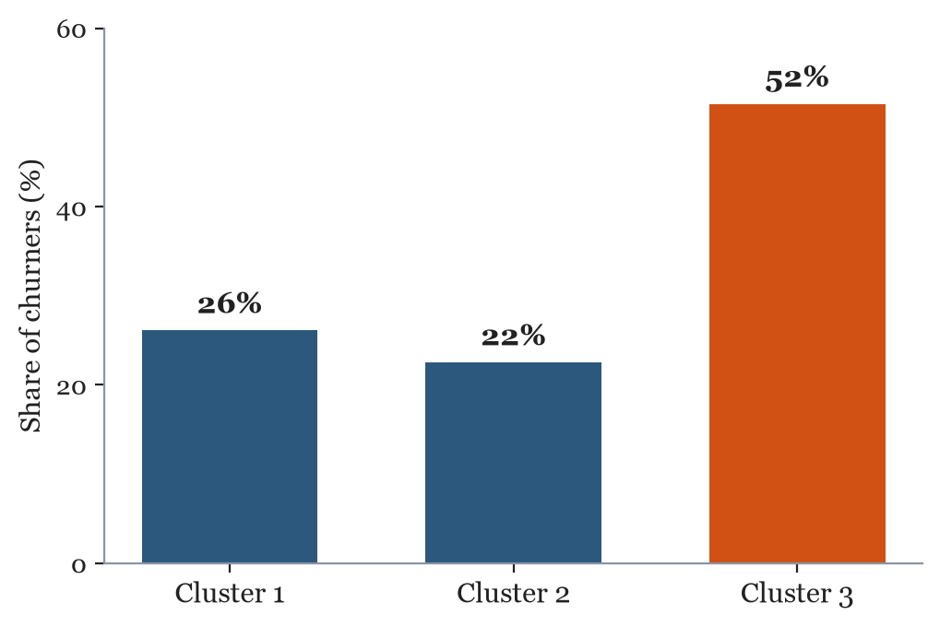
Identified: A High-risk Churner Archetype (51%) and an at-risk Group of Current Customers
Churned Cluster 3 (C3): High-risk (51% of churners)
Short tenure, high charges, ~98% month-to-month, fibre optic, almost no add-ons.
Retained Cluster 1 (C1): The Watchlist
Mid tenure, high charges, 72% month-to-month
(many characteristics mirror churned cluster 3, so it is the clearest target for proactive retention).

Slide 13
Question 2 of 5
Why are Customers Churning?

Slide 14
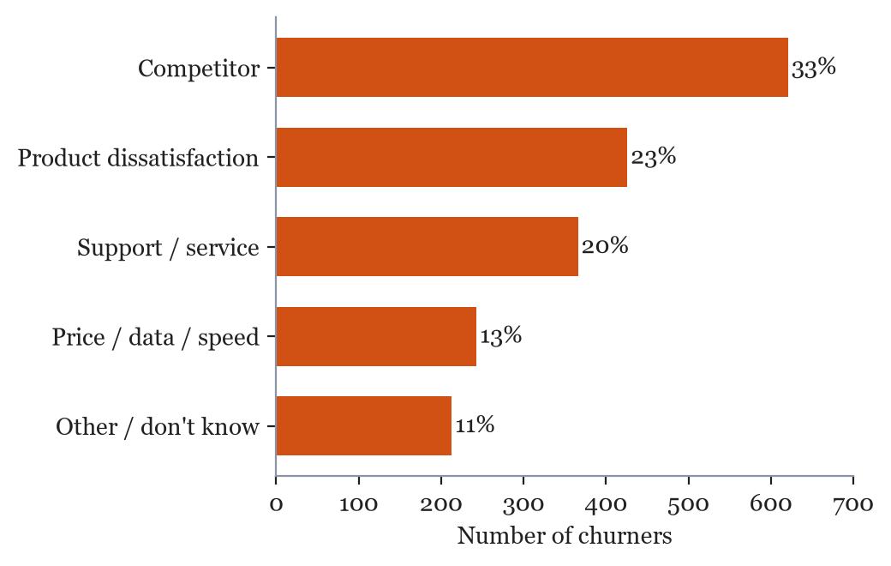
Customers Mostly Leave for Competitors Offers and Poor Service, not Price
Why they Churn
• Competitor offers - speed, data, devices (33%)
• Product dissatisfaction (23%)
• Support attitude & expertise (20%)
• Price / data / speed - only 13%
The top reasons are addressable: a better offer than our competitors and better customer and product support. The data suggests there is little dissatisfaction with the price.

Slide 15
Question 3 of 5
What Makes Customers Stay - and What Sign-up Factor Should we Incentivise?

Slide 16
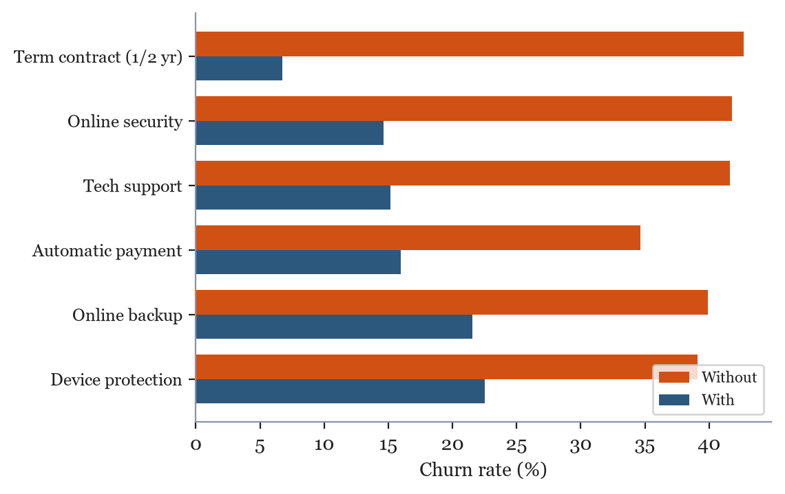
Term contracts and Add-ons Retain Customers: Allocate the $2.50 Incentive to Online Security Sign-ups
The $2.50 Incentive
• Online security cuts churn 42% to 15%
• ~3,500 internet customers lack it, churning at ~42%
• Providing an Incentive to employees for Online Security sign-ups may also improve employee morale (better support service)
Recommend incentivising Online Security sign-ups (Tech support a close second).

Slide 17
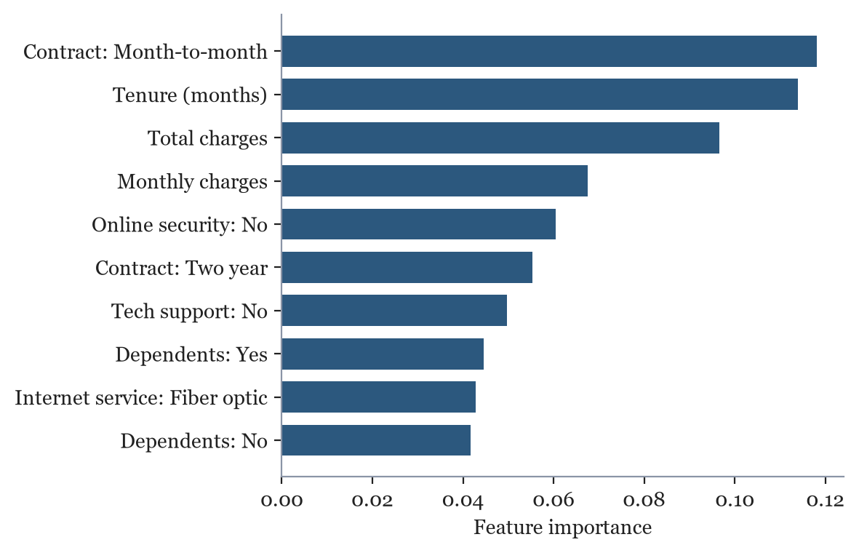
Features that Most Influence Churn: Contract type, Tenure, Charges and Missing Add-ons
Our predictive model feature importances - the strongest churn drivers corroborate our EDA: contract type, tenure, charges, and a lack of online security / tech support.

Slide 18
Question 4 of 5
Which 500 customers should get the retention mailer?

Slide 19
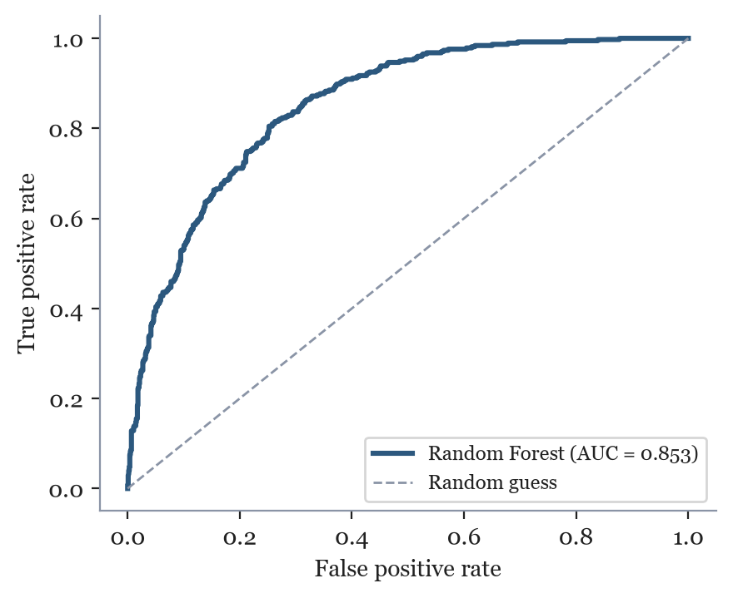
Predictive Modelling: Building a Validated Random Forest (test ROC-AUC 0.85)
How it was Built
• Stratified 80/20 train-test split (seeded, no leakage)
• 5-fold cross-validated model comparison:
- Logistic Regression - CV ROC-AUC 0.859
- Random Forest (tuned) - CV ROC-AUC 0.861
• Preprocessing (one-hot encoding + scaling) to fit inside the Pipeline
• Tuned with GridSearchCV on ROC-AUC
• Held-out test: ROC-AUC 0.853, churn recall 77% (vs 73.5% baseline)

Slide 20
The 500 Highest-risk Active Customers - Ready to Mail
Top of the List
Top-500 Mailer List
for the marketing team
• 500 highest-risk active customers, ranked by churn probability
• Mean churn risk in the list: 75%
• ~100 retained at the expected 20% uptake
• The Top-500 have an average charge of $76.41 per month; over 12 months ✕ 100 customers retained = $91,697 in protected revenue (illustrative - assumes a full year retained).
File: top_500_at_risk.csv
Rank | Customer ID | Risk | Contract
1 | 2545-EBUPK | 96 | Month-to-month
2 | 5542-TBBWB | 96 | Month-to-month
3 | 8161-QYMTT | 95 | Month-to-month
4 | 4927-WWOOZ | 94 | Month-to-month
5 | 1452-VOQCH | 93 | Month-to-month

Slide 21
Question 5 of 5
What is the Churn Risk of our Remaining Customers?

Slide 22
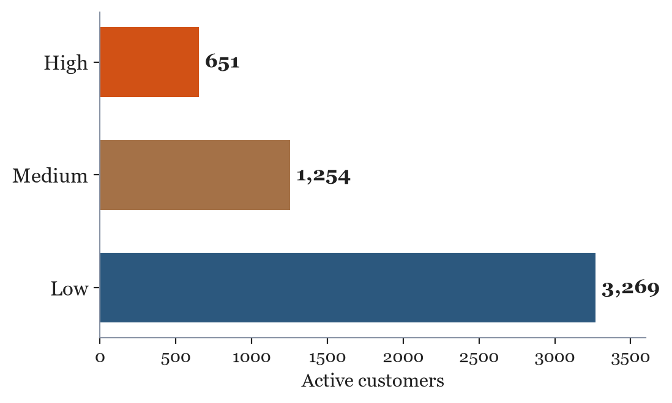
A 0-100 Risk Score and Band for Every Remaining Customer
Churn Risk Scores
for the customer-service team
• All 5,174 active customers scored by the same model
• Each given a 0-100 risk score & Low/Medium/High band
• 651 High | 1,254 Medium | 3,269 Low
• Shown on-screen during live calls to prioritise retention
File: churn_risk_scores.csv

Slide 23
Summary and Recommended Actions
Key Findings
• ~27% churn rate, front-loaded and concentrated in month-to-month fibre customers
• These customers leave for better competitor offers and poor support experience, not raw price
• Term contracts and add-ons are the strongest retention levers
• The model reliably provides a risk score to every customer (test AUC 0.85)
Recommended Actions
1. Allocate the $2.50 incentive to Online Security add-on sign-ups
2. Launch the Top-500 mailer with an Online Security offer
3. Push month-to-month customers onto term contracts
4. Fix the support experience (attitude/expertise) - a top-3 churn reason, with possible extra training.

