Slide 1

Customer retention: EDA, segmentation & churn modelling
Answering the retention brief on the single customer view (7,043 customers)
Technical walkthrough · Retention team · based on eda-and-clustering.ipynb

Slide 2
The retention brief in five questions
1
What do churners look like, and what products do they have?
Fibre-heavy with high charges and few add-ons; more often senior and single. Gender is not a factor.
2
Why are they churning?
Mostly competitor offers and poor service - not raw price.
3
What makes customers stay, and what should we incentivise?
Term contracts and add-ons. Pay the sales team the $2.50 commission on Online Security sign-ups.
4
Which 500 customers should get the retention mailer?
A ranked Top-500 at-risk list (mean risk 75%; ~100 retained at the expected 20% uptake).
5
What is the churn risk of our remaining customers?
A 0-100 score + Low/Medium/High band for all 5,174 active customers.
Swan Teleco · Customer retention analysis
Overview · 2

Slide 3
The data: a single customer view of Swan Teleco's customers
7,043 customers · 31 columns · all in California · one quarter of activity · 26.5% churned
Group | Fields | Type / note
Identifiers & location | CustomerID, City, Zip Code, Lat Long, Latitude, Longitude | PII - kept out of the model
Demographics | Gender, Senior Citizen, Partner, Dependents | Categorical
Services | Phone Service, Multiple Lines, Internet Service, Online Security, Online Backup, Device Protection, Tech Support, Streaming TV, Streaming Movies | Categorical
Account | Tenure Months, Contract, Paperless Billing, Payment Method, Monthly Charges, Total Charges | Numeric + categorical
Target | Churn Value (0/1), Churn Label, Churn Reason | Outcome
Constant (dropped) | Count, Country, State | Single value - no signal
Swan Teleco · Customer retention analysis
Overview · 3

Slide 4
Data cleaning and feature preparation
Cleaning & data quality
• Total Charges: 11 blank values (new customers, tenure 0) -> set to 0, cast to numeric
• Churn Reason: 73% null by design - only churners have one; kept, never imputed
• No duplicate customers found
• Every row validated against a Pydantic schema
Features for the model
• Categoricals one-hot encoded; numerics standardised - inside a leak-free Pipeline
Removed from the feature set, and why:
- IDs & location (CustomerID, City, Zip, Lat/Long) - identifiable, not predictive
- Churn Reason - only known after a customer churns (leakage)
- Churn Label - a direct copy of the target (leakage)
- Count / Country / State - constant, no signal
Swan Teleco · Customer retention analysis
Overview · 4

Slide 5
Question 1 of 5
What do churners look like - gender, family - and what products do they have?
Swan Teleco · Customer retention analysis
Q1 · Who churns · 5

Slide 6
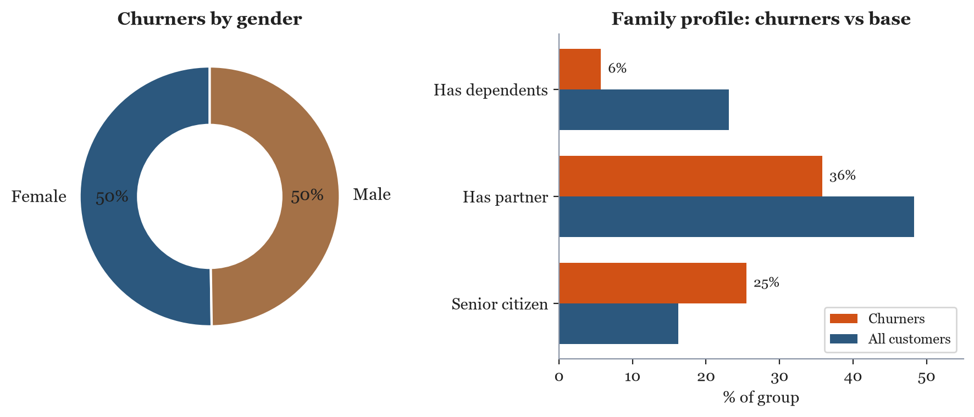
Gender is not a factor; churners skew senior, single and low-commitment
Churners are more often senior (25% vs 16%), and less likely to have a partner (36% vs 48%) or dependents (6% vs 23%). Gender is ~50/50.
Swan Teleco · Customer retention analysis
Q1 · Who churns · 6

Slide 7
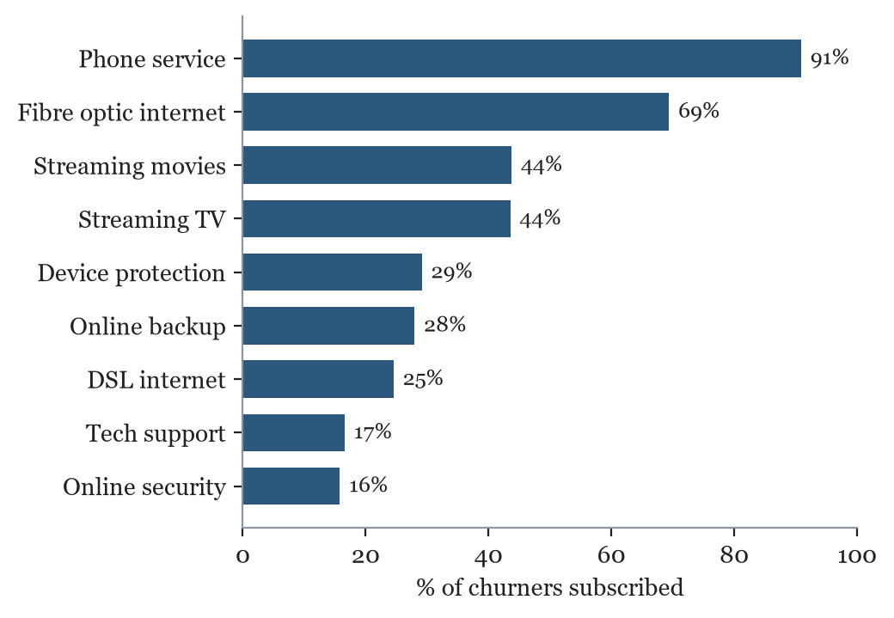
Churners are fibre-heavy but rarely hold protective add-ons
Product profile
• Almost all have phone service (91%)
• Fibre optic internet is common (69%)
• Streaming is popular (~44%)
• But only ~16% hold Online Security and ~17% Tech Support
The protective add-ons that reduce churn are exactly the ones churners lack.
Swan Teleco · Customer retention analysis
Q1 · Who churns · 7

Slide 8
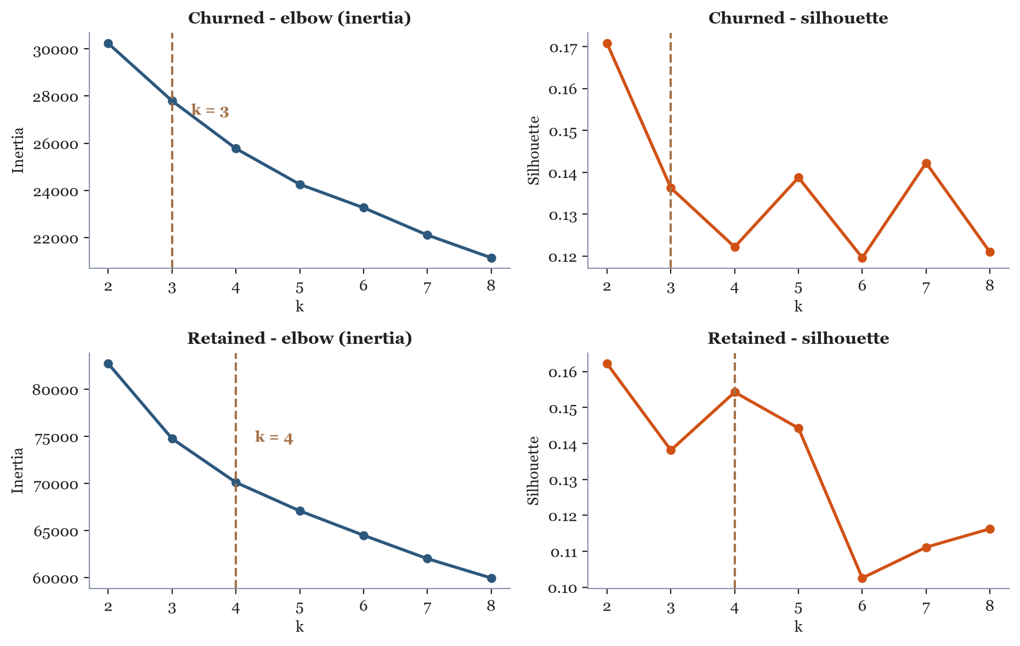
We also grouped customers into archetypes with K-means
Choosing k
• Churned and retained customers clustered separately
• Features label-encoded and standardised
• Swept k = 2-8, reading the elbow (inertia) and silhouette score
Churned -> k = 3
Retained -> k = 4
Swan Teleco · Customer retention analysis
Q1 · Who churns · 8

Slide 9
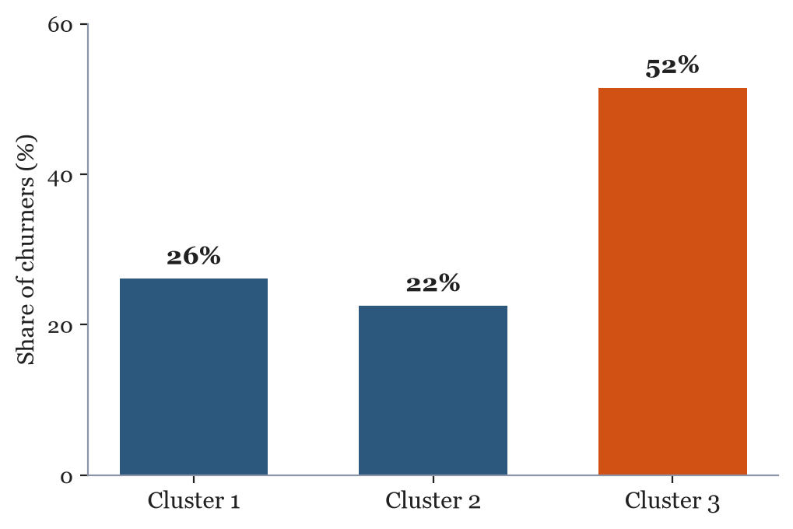
A high-risk churner archetype (51%) and a retained watchlist
Churned Cluster 3 - high-risk (51% of churners)
Short tenure, high charges, ~98% month-to-month, fibre optic, almost no add-ons.
Retained Cluster 1 - the watchlist
Mid tenure, high charges, 72% month-to-month - it mirrors the churners, so it is the clearest target for proactive retention.
Swan Teleco · Customer retention analysis
Q1 · Who churns · 9

Slide 10
Churned customers split into three archetypes
All three are dominated by month-to-month contracts and low add-on take-up.
 | C1 · Budget DSL | C2 · Established fibre | C3 · New fibre (high-risk)
Customers | 487 (26%) | 420 (22%) | 962 (51%)
Avg tenure | 9 months | 48 months | 9 months
Avg monthly charge | $39 | $94 | $84
Month-to-month | 93% | 61% | 98%
Internet type | 77% DSL | 88% fibre | 96% fibre
Electronic check | 39% | 53% | 69%
Has online security | 15% | 29% | 10%
C3 is the priority: half of all churners, brand new, expensive, almost entirely month-to-month with only 10% holding online security.
Swan Teleco · Customer retention analysis
Q1 · Who churns · 10

Slide 11
Retained customers split into four - and one mirrors the churners
The loyal segments are defined by term contracts, automatic payment and add-on take-up.
 | C1 · Watchlist | C2 · Low-usage loyal | C3 · Loyal high-value | C4 · New low-spend
Customers | 1,551 (30%) | 805 (16%) | 1,629 (31%) | 1,189 (23%)
Avg tenure | 23 months | 56 months | 61 months | 12 months
Avg monthly charge | $73 | $26 | $91 | $28
Month-to-month | 72% | 8% | 17% | 64%
Internet type | 51% fibre | 80% none | 62% fibre | 65% none
Automatic payment | 40% | 66% | 68% | 27%
Has online security | 34% | 12% | 61% | 9%
Retained C1 looks like a churner (72% month-to-month, mid charges) - it is the watchlist. Retained C3 proves high-spend fibre customers stay when locked in and using add-ons.
Swan Teleco · Customer retention analysis
Q1 · Who churns · 11

Slide 12
The comparison: what separates a loyal high-spender from a churning one
Churned C2 · Established fibre
48 months tenure · $94 / month
• 61% still month-to-month
• Only 43% on automatic payment
• Only 29% hold online security
• 53% pay by electronic check
Retained C3 · Loyal high-value
61 months tenure · $91 / month
• 83% on a one- or two-year contract
• 68% on automatic payment
• 61% hold online security
• Only 24% pay by electronic check
Same product, same spend - the difference is contract lock-in, automatic payment and add-ons. Those are the levers we can actually pull.
Swan Teleco · Customer retention analysis
Q1 · Who churns · 12

Slide 13
Question 2 of 5
Why are they churning?
Swan Teleco · Customer retention analysis
Q2 · Why they churn · 13

Slide 14
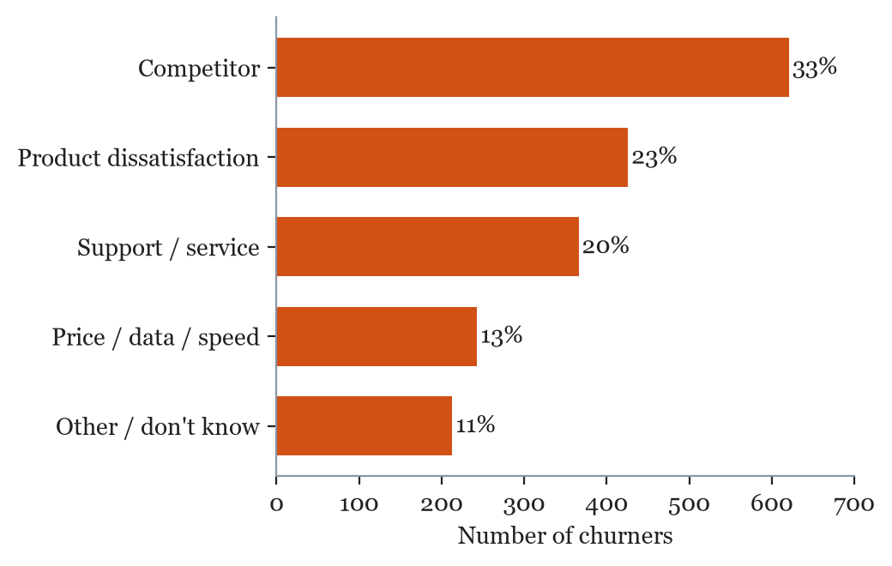
Customers leave for competitors and over service - not raw price
Why they churn
• Competitor offers - speed, data, devices (33%)
• Product dissatisfaction (23%)
• Support attitude & expertise (20%)
• Price / data / speed - only 13%
The top reasons are addressable: a better offer and better support, not a price war.
Swan Teleco · Customer retention analysis
Q2 · Why they churn · 14

Slide 15
Question 3 of 5
What makes customers stay - and what should we incentivise?
Swan Teleco · Customer retention analysis
Q3 · What keeps them · 15

Slide 16
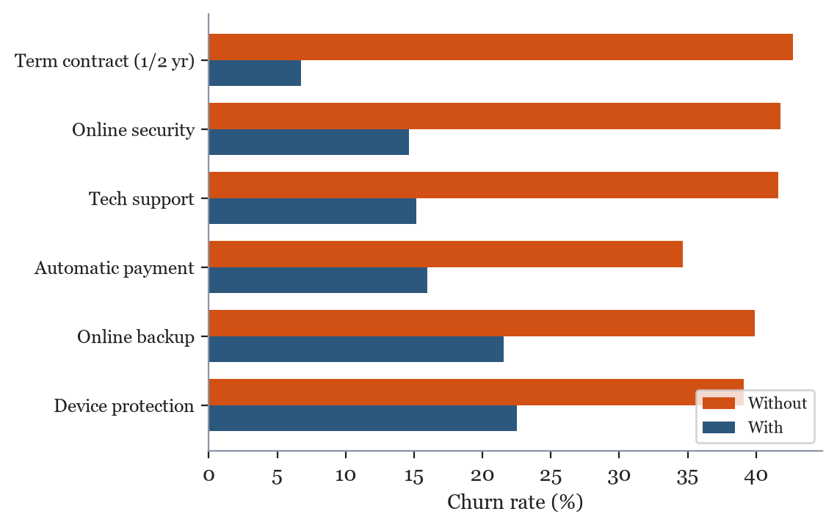
A term contract and add-ons keep customers - put the $2.50 commission on Online Security
The $2.50 incentive
A commission paid to the sales team per sign-up - on one metric only
• Online security cuts churn 42% -> 15% (a 27pp drop)
• ~3,500 internet customers lack it, churning at ~42%
• One retained customer (~$777/yr) funds ~300 commissions
Pay the team $2.50 for every customer they sign up to Online Security.
Swan Teleco · Customer retention analysis
Q3 · What keeps them · 16

Slide 17
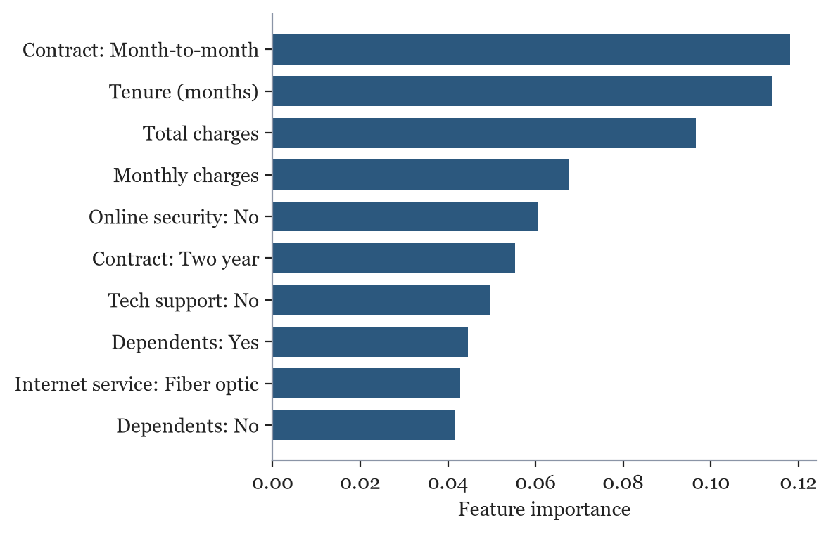
What most influences churn: contract type, tenure, charges and missing add-ons
Model feature importances - the strongest churn drivers echo the EDA: contract type, tenure, charges, and a lack of online security / tech support.
Swan Teleco · Customer retention analysis
Q3 · What keeps them · 17

Slide 18
Question 4 of 5
Which 500 customers should get the retention mailer?
Swan Teleco · Customer retention analysis
Q4 · The mailer list · 18

Slide 19
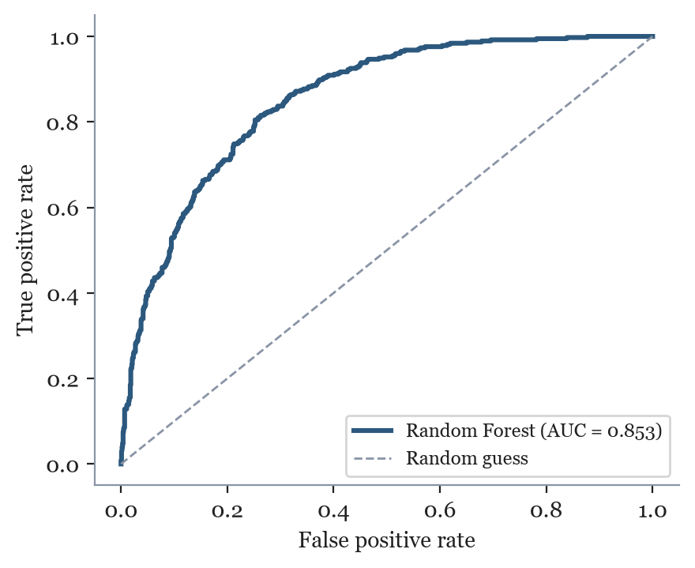
How we rank risk: a validated Random Forest (test ROC-AUC 0.85)
How it was built
• Stratified 80/20 train-test split (seeded, no leakage)
• 5-fold cross-validated model comparison:
- Logistic Regression - CV ROC-AUC 0.859
- Random Forest (tuned) - CV ROC-AUC 0.861
• Preprocessing (one-hot + scaling) fit inside the Pipeline
• Tuned with GridSearchCV on ROC-AUC
• Held-out test: ROC-AUC 0.853, churn recall 77% (vs 73.5% baseline)
Swan Teleco · Customer retention analysis
Q4 · The mailer list · 19

Slide 20
The 500 highest-risk active customers - ready to mail
Top of the list
Top-500 mailer list
for the marketing team
• 500 highest-risk active customers, ranked by churn probability
• Mean churn risk in the list: 75%
• ~100 retained at the expected 20% uptake
• ~$78k / year revenue protected (illustrative)
File: top_500_at_risk.csv
Rank | Customer ID | Risk | Contract
1 | 2545-EBUPK | 96 | Month-to-month
2 | 5542-TBBWB | 96 | Month-to-month
3 | 8161-QYMTT | 95 | Month-to-month
4 | 4927-WWOOZ | 94 | Month-to-month
5 | 1452-VOQCH | 93 | Month-to-month
Swan Teleco · Customer retention analysis
Q4 · The mailer list · 20

Slide 21
Question 5 of 5
What is the churn risk of our remaining customers?
Swan Teleco · Customer retention analysis
Q5 · Risk scores · 21

Slide 22
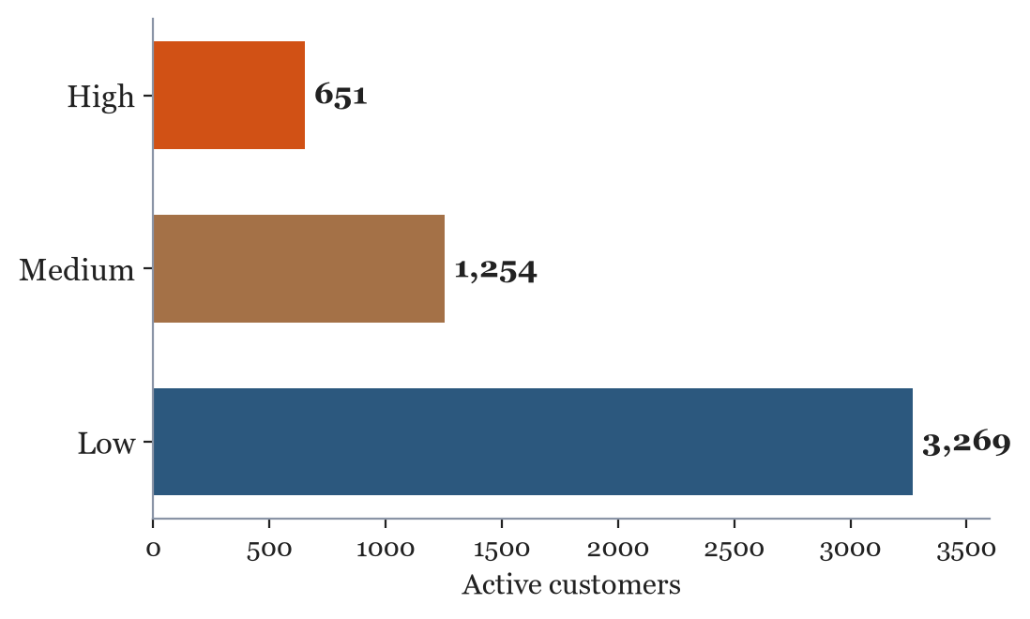
A 0-100 risk score and band for every remaining customer
Churn risk scores
for the customer-service team
• All 5,174 active customers scored by the same model
• 0-100 risk score + Low / Medium / High band
• 651 High · 1,254 Medium · 3,269 Low
• Shown on-screen during live calls to prioritise retention
File: churn_risk_scores.csv
Swan Teleco · Customer retention analysis
Q5 · Risk scores · 22

Slide 23
Summary and recommended actions
Key findings
• ~27% churn, front-loaded and concentrated in month-to-month fibre customers
• They leave for competitors and poor support, not price
• Term contracts and add-ons are the strongest retention levers
• The model reliably scores every customer (test AUC 0.85)
Recommended actions
1. Launch the Top-500 mailer with an Online Security offer
2. Move month-to-month customers onto term contracts
3. Fix the support experience - a top-3 churn reason
4. Give the service team the risk scores for live calls
Swan Teleco · Customer retention analysis
Summary · 23

