Slide 1
GROUP 3 · DIGITAL PLATFORMS LAB · BOLOGNA BUSINESS SCHOOL
backpack & bottle.
Curated European city breaks. Transparent prices.
€50 off your first booking.
Campaign brief · brand identity · landing page · tracking · media plan
Group 3 · Sai Prathyaksh Kanagat · Marica Motta · Alberto Faggiotto · Cecilia Gullett · Marilu Stevens · Amelia Ruben
Campaign window: 5 May – 15 June 2026 · Presented Tuesday 5 May 2026

Slide 2
GROUP 3 · DIGITAL PLATFORMS LAB
Agenda
What we'll walk through
01
The brief
06
Landing page
What we were asked to do
Architecture + walkthrough
02
Strategic decisions
07
Measurement plan
Who, what, when, how much
GTM, GA4, Meta Pixel, Consent Mode v2
03
The audience
08
Media plan & budget
Italian millennials, persona + pain points
60/40 Meta/Google, €2,000
04
Brand identity
09
Timeline
Positioning, voice, visual system
Pre-launch → 6-week run → analysis
05
Offer & coupon
10
Risks & next steps
5 destinations, BB50 mechanic
Assumptions and what we'd do live
backpack & bottle · Group 3
2 / 34

Slide 3
GROUP 3 · DIGITAL PLATFORMS LAB
The brief
Group 3 — Backpack & Bottle
BUSINESS OBJECTIVE
MARKETING OBJECTIVE
WHAT WAS OPEN
Promote travel deals under the "Backpack & Bottle" brand and generate qualified leads interested in affordable, experience-driven trips.
Make the offer feel attractive, accessible, and time-sensitive — combining inspiration with a clear incentive to request a coupon and book early.
Audience, offer architecture, value prop sharpening, media mix, budget, timing, KPI targets — all left to the team to define and justify.
Mandatory KPIs: LP visits · coupon downloads · lead form submissions · CVR · CPL · email list growth.
backpack & bottle · Group 3
3 / 34

Slide 4
GROUP 3 · DIGITAL PLATFORMS LAB
Strategic decisions at a glance
AUDIENCE
OFFER
COUPON
Italian millennials 25–39, urban, €25–45k income
Curated European city breaks · 5 destinations
€50 off · code BB50 · valid 90 days · min €300
POSITIONING
STRATEGIC FOCUS
BUDGET
"Skip the research fatigue"
Lead acquisition for email nurture (long booking cycle)
€2,000 paid media · 60% Meta · 40% Google
WINDOW
TARGETS
STACK
5 May – 15 June 2026 (6 weeks active)
5,000 visits → 400 coupons → 300 leads · €6.67 CPL
Next.js + Vercel · GTM · GA4 · Meta Pixel · Looker Studio
backpack & bottle · Group 3
4 / 34

Slide 5
GROUP 3 · DIGITAL PLATFORMS LAB
Who we're talking to
Italian millennials 25–39 · urban · digitally native
DEMOGRAPHICS
TRAVEL MOTIVATIONS & BEHAVIOUR
Age: 25–39
Location: Milan · Rome · Bologna · Florence · Turin
Income: €25–45k/year
Education: University degree
Employment: Digital, creative, service sectors
Relationship: Single or couples without children
Language: Italian (primary), English (secondary)
• Authentic local life — not package tourism
• Quality time with friends/family (38% motivation)
• Food & wine experiences (36%)
• Shareable Instagram moments
• Books 2–4 months ahead, takes 3–4 trips/year
• 70% inspired by destinations seen on social
• Mobile for inspiration · desktop for booking
• Avoids August (Ferragosto), prefers Apr–Jun & Sep–Oct
backpack & bottle · Group 3
5 / 34

Slide 6
GROUP 3 · DIGITAL PLATFORMS LAB
What blocks them from booking
Five pain points the campaign solves
01
Research overwhelm
Booking.com shows 500 hotels — paralysing. We show 3–5 curated options per city.
02
Price transparency
Frustrated by prices that jump at checkout. We show all-in pricing upfront.
03
Trust deficit
Burned by Volagratis / eDreams refund delays. We position transparency as the brand.
04
FOMO on the "best" deal
Constantly worry they're missing a better price. €50 off is a real, named discount — not a fake countdown.
05
Time scarcity
Want to travel more but exhausted by planning. Pre-packaged itineraries cut planning time to 5 minutes.
backpack & bottle · Group 3
6 / 34

Slide 7
GROUP 3 · DIGITAL PLATFORMS LAB
Positioning
How we differ from every competitor in the audience's head
"Skip the research fatigue."
European city breaks at insider prices — early access deals that fit your budget and deliver experiences worth sharing.
Competitor | How they compete | How we win
Booking.com / Expedia | Compete on breadth — thousands of options | We compete on curation — best 3–5 per city
Volagratis / Lastminute | Compete on price (but with trust issues) | We compete on transparent value + trust
Luxury tour operators | High-touch concierge service | Affordable authenticity
DIY booking | Maximum control, maximum effort | 5-minute booking, time saved
backpack & bottle · Group 3
7 / 34

Slide 8
GROUP 3 · DIGITAL PLATFORMS LAB
Brand identity
Modern Wanderer — warm, editorial, trustworthy
PALETTE
TYPOGRAPHY
Fraunces
Display serif — used for headlines, wordmark, prices
Forest
Forest dark
Cream
#1F3A2E
#142620
#F5EFE6
Inter
Sans — used for body, UI, captions
Cream dark
Burnt orange
Burnt dark
#E8DFD1
#D97642
#B85E30
VOICE
Direct. Warm. Anti-tourist-trap. Editorial without being pretentious. We say what we don't do as much as what we do.
backpack & bottle · Group 3
8 / 34

Slide 9
GROUP 3 · DIGITAL PLATFORMS LAB
The promise + 4 selling points
PROMISE
We do the hard work of curation so you don't have to spend hours comparing options. We pick the best 3–5 packages per destination, negotiate early-booking rates, and present them transparently. You book in 5 minutes and go create memories.
Curated, not overwhelming
Insider early-booking pricing
3–5 great options per city, not 500. Every hotel pre-vetted for location, reviews, value.
€50 off through partnership rates. Real discount, transparent all-in pricing.
Authentic local experiences
Worry-free planning
Neighbourhoods locals actually live in. Real cafés and markets, not tourist traps.
Flights + hotel + itinerary coordinated. Flexible dates. Email support if questions arise.
backpack & bottle · Group 3
9 / 34

Slide 10
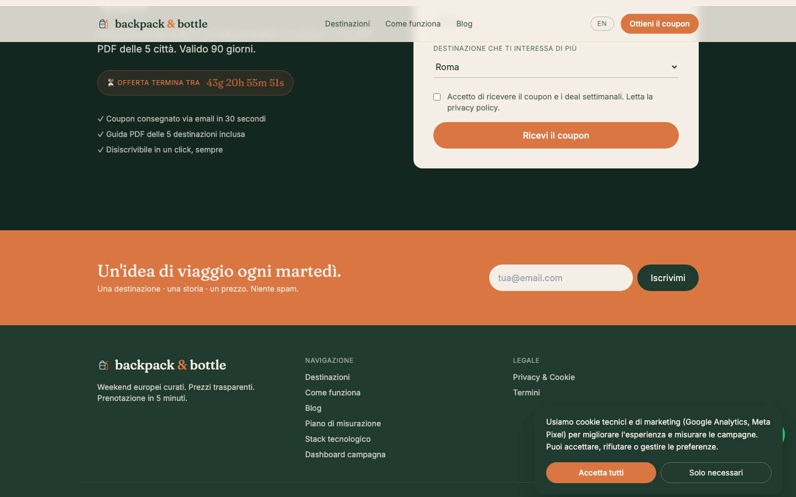
GROUP 3 · DIGITAL PLATFORMS LAB
The offer
5 curated European city breaks · 1.5–3 hour flights from Italy
CLASSIC
COAST & CITY
CANALS & DESIGN
ATLANTIC
HISTORIC
ITALY
SPAIN
NETHERLANDS
PORTUGAL
CZECH REPUBLIC
Rome
Barcelona
Amsterdam
Lisbon
Prague
FROM
FROM
FROM
FROM
FROM
€280 · 2 nights
€320 · 3 nights
€365 · 3 nights
€345 · 3 nights
€295 · 2 nights
Each package includes: round-trip flight from Italian airports, 3–4 star boutique hotel, local guide & itinerary suggestions. Optional add-ons: food tours, bike rentals, museum passes.
backpack & bottle · Group 3
10 / 34

Slide 11
GROUP 3 · DIGITAL PLATFORMS LAB
Coupon mechanic
BB50 — built to drive lead capture, not race-to-the-bottom pricing
MECHANIC
WHY THIS DESIGN
€50
€300 minimum: realistic floor for flight + hotel city break.
€50 = 16.7% — meaningful but doesn't devalue the brand.
90-day validity: matches Italian booking cycle (2–4 months ahead) without inducing urgency paralysis.
Required email + GDPR consent → coupon = the lead-magnet logic.
One-per-customer prevents stockpiling, supports clean reporting.
off bookings from €300
Code: BB50 · Valid 90 days · One per customer
Travel dates 1 Jun – 31 Dec 2026.
Excl. 23–31 Dec, 31 Dec – 2 Jan, 10–20 Aug.
Not combinable with other offers.
backpack & bottle · Group 3
11 / 34

Slide 12
GROUP 3 · DIGITAL PLATFORMS LAB
The funnel
From paid impression to booking — and where each KPI sits
IMPRESSIONS
CLICKS
LANDING VISITS
COUPON DOWNLOADS
150–180k
1.5–2k
EMAIL LEADS
BOOKINGS
5,000
400
→
→
→
→
300
→
~30
Meta + Google Ads
CTR ~1%
KPI #1
KPI #2 · 8% CVR
KPI #3 · 6% CVR
10% nurture conv.
€2,000 spend ÷ 300 leads = €6.67 CPL · ROI tracked over 90 days as nurtured leads convert to bookings.
backpack & bottle · Group 3
12 / 34

Slide 13
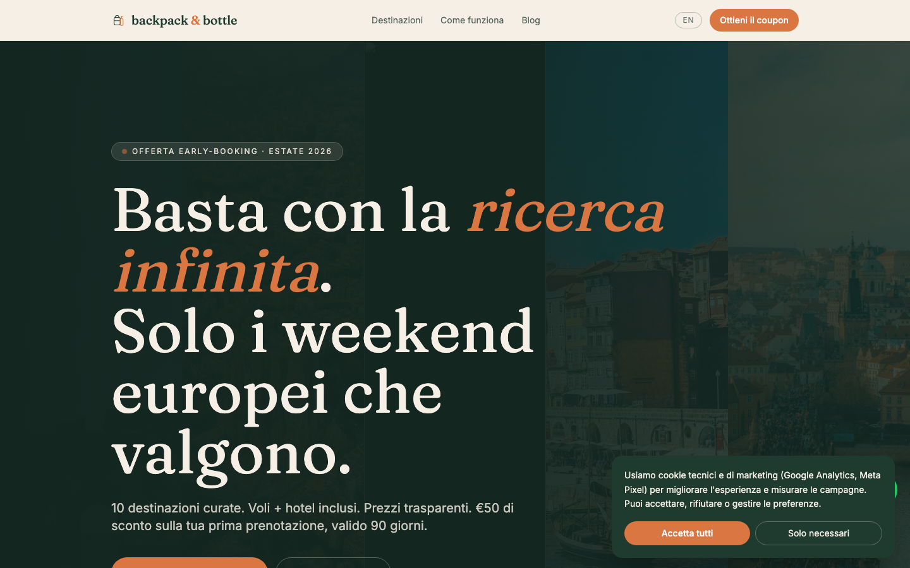
GROUP 3 · DIGITAL PLATFORMS LAB
Landing page architecture
Single-purpose page optimised for one action: download the coupon
Sticky nav
Hero
Wordmark · Destinations · How it works · Blog · Measurement · EN/IT toggle · Coupon CTA
Eyebrow tag · headline ("Skip the research fatigue") · subheadline · dual CTA · trust line
Value pillars
Destinations grid
4 pillars on dark forest background — curation, transparency, authentic, worry-free
5 cards · image · country · city · from-price · clickable to scroll to form
How it works
Social proof
3 steps · claim coupon → pick city → book and go
4 stats: 500+ hotels vetted · 5 min to book · 0 hidden fees · €50 off
Lead capture
Footer
Form: name · email · departure city · destination interest · GDPR consent · CTA
Wordmark · navigation · privacy · terms · academic project credit
backpack & bottle · Group 3
13 / 34

Slide 14
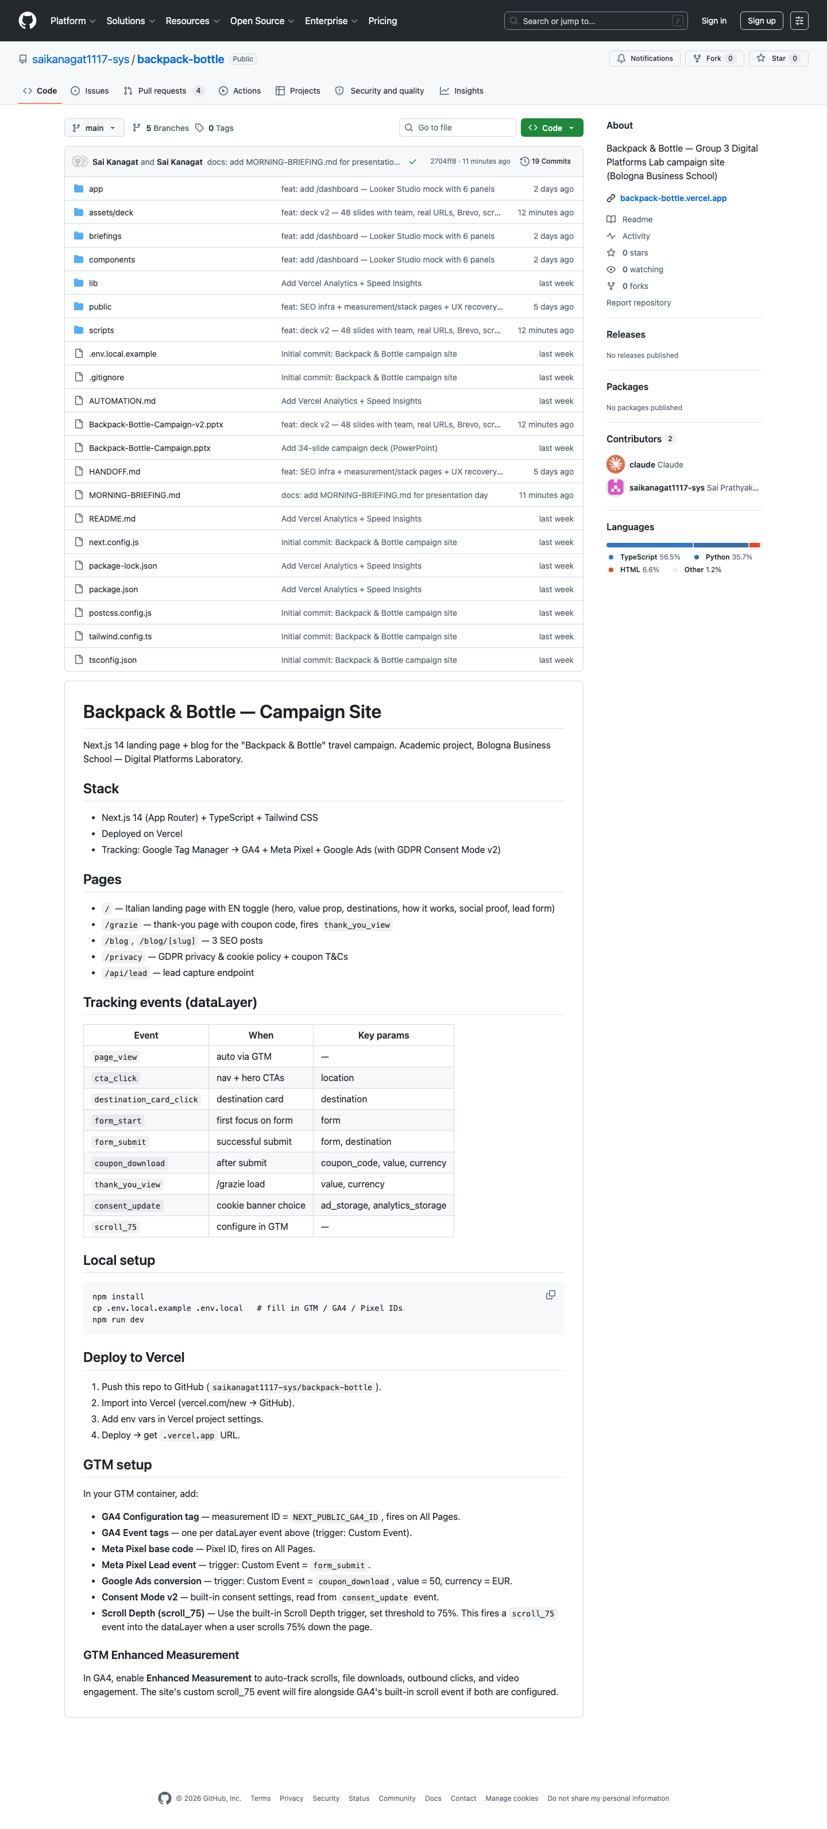
GROUP 3 · DIGITAL PLATFORMS LAB
Site map
Every route the campaign serves
Route | Purpose
/ | Italian primary landing page (EN toggle)
/grazie | Thank-you page · BB50 displayed · PDF download · GA4 conversion event
/measurement | Public measurement plan (this deck, on the live site)
/blog | SEO hub — 3 posts on weekend itineraries, booking timing, destination comparisons
/blog/[slug] | Individual post pages with CTA back to coupon form
/privacy | GDPR privacy policy + cookie disclosures + coupon T&Cs
/api/lead | Server endpoint accepting form submissions, forwarding to ESP webhook
/backpack-bottle-coupon-BB50.pdf | Branded one-page coupon PDF served from /public
Built on Next.js 14 (App Router) + TypeScript + Tailwind, deployed on Vercel.
backpack & bottle · Group 3
14 / 34

Slide 15
GROUP 3 · DIGITAL PLATFORMS LAB
Tracking architecture
One container. Every tag. Consent-aware.
All marketing tags fire through a single GTM container. Each user interaction pushes a named event into window.dataLayer. GTM listens, fires GA4 + Meta Pixel + Google Ads. Consent Mode v2 blocks marketing storage until consent is granted.
User action (click / scroll / submit / page load)
│
▼
window.dataLayer.push({event: 'coupon_download', value: 50, ...})
│
▼
┌────────────────────────────────────────────────────────────┐
│ Google Tag Manager (GTM-XXXXXXX) │
│ • Trigger: Custom Event = coupon_download │
│ • Variables read: coupon_code · value · currency · destination │
│ • Consent gate: ad_storage = granted required │
└─────────┬──────────────────┬──────────────────┬─────────────┘
▼ ▼ ▼
[GA4 event] [Meta Lead] [Google Ads conv.]
G-XXXXXX Pixel ID AW-XXXXXX/abcd
│ │ │
▼ ▼ ▼
Looker Studio Retargeting aud. Conversion import
backpack & bottle · Group 3
15 / 34

Slide 16
GROUP 3 · DIGITAL PLATFORMS LAB
dataLayer event schema
Every custom event the site fires
Event | Trigger | Parameters | Purpose
page_view | Auto via GA4 Enhanced Measurement | page_location, page_title | Funnel entry
scroll_75 | GTM Scroll Depth trigger 75% | percent_scrolled | Engagement quality
cta_click | Hero, nav, blog CTAs | location | Intent signal
destination_card_click | Destination card click | destination | Custom dim destination_interest
form_start | First form-field focus | form: coupon_lead | Form abandonment
form_submit | POST /api/lead success | form, destination | GA4 lead conversion
coupon_download | After submit + direct PDF download | coupon_code, value, currency | Primary conversion
thank_you_view | /grazie page load | value, currency | Backup conversion
consent_update | Cookie banner choice | ad_storage, analytics_storage, ad_user_data, ad_personalization | Consent Mode v2
visit_count_set | Every page load (localStorage) | visit_count | User property
backpack & bottle · Group 3
16 / 34

Slide 17
GROUP 3 · DIGITAL PLATFORMS LAB
GTM tag inventory
Every tag the container ships, what it does, when it fires
Tag | Trigger | Purpose
GA4 Configuration | All Pages | Pageviews + base config to property G-XXXXXXXXXX
GA4 Event — coupon_download | Custom Event = coupon_download | Marked as conversion in GA4
GA4 Event — form_submit | Custom Event = form_submit | Lead-stage conversion
GA4 Event — cta_click | Custom Event = cta_click | Engagement tracking
GA4 Event — scroll_75 | Custom Event = scroll_75 | Engagement quality
Meta Pixel — Base | All Pages | PageView for retargeting audiences
Meta Pixel — Lead | Custom Event = form_submit | Optimisation event for Meta Ads
Meta Pixel — CompleteRegistration | Custom Event = coupon_download | Bottom-funnel signal
Google Ads — Lead conversion | Custom Event = coupon_download | Value 50 EUR; imported into Google Ads
Google Ads — Remarketing | All Pages | Audience builder for retargeting
backpack & bottle · Group 3
17 / 34

Slide 18
GROUP 3 · DIGITAL PLATFORMS LAB
Consent Mode v2 (GDPR)
Default-denied. Privacy-first. Audit-ready.
Before GTM loads, gtag('consent', 'default', ...) sets all four signals to denied. The cookie banner asks the user. On Accept, a consent_update event flips signals to granted; pending tags execute.
Signal | Default state | After accept | Controls
ad_storage | denied | granted | Meta Pixel · Google Ads cookies
analytics_storage | denied | granted | GA4 cookies
ad_user_data | denied | granted | User-data signals to Google
ad_personalization | denied | granted | Personalised ads
Even with Reject, GA4 receives consent-modeled pings (no cookies) so totals are still observable in aggregate — Google's recommended setup.
backpack & bottle · Group 3
18 / 34

Slide 19
GROUP 3 · DIGITAL PLATFORMS LAB
KPI definitions & targets
KPI | Target | Rationale | Source
Landing page visits | 5,000 | €2,000 ÷ €0.40 blended CPC | GA4 sessions
Coupon downloads | 400 (8% CVR) | Travel lead-magnet benchmark 5–10% | GA4 coupon_download
Lead form submissions | 300 (6% CVR) | Industry standard for gated content 5–8% | GA4 form_submit
Conversion rate | 6–8% | (downloads + forms) ÷ visits | Calculated metric
Cost per lead (CPL) | €6.67 avg | Travel sector typical €10–50 | Spend ÷ leads
Email list growth | 400+ | Net new subscribers from campaign | ESP report
Email open rate | 35% | Travel industry avg 30–35% | ESP report
Click-to-open rate | 20% | Travel industry avg 15–25% | ESP report
backpack & bottle · Group 3
19 / 34

Slide 20
GROUP 3 · DIGITAL PLATFORMS LAB
Media plan overview
Where the €2,000 goes and why
Two channels. One job each. Meta drives discovery + retargeting; Google captures active intent.
META ADS · 60%
GOOGLE ADS · 40%
€1,200
€800
Awareness: €300 · Carousel ads, broad reach
Lead Gen: €600 · Conversion-optimised, interest targeting
Retargeting: €300 · Dynamic ads for site visitors
Expected: 150–180k impressions · 1.5–2k clicks
3.5–4k LP visits · 200–250 leads at ~€6 CPL
Branded: €100 · Protect brand-name searches
Generic: €500 · "weekend Barcellona", "viaggi economici"
Competitor: €200 · "volagratis alternative"
Expected: 400–700 clicks at €1.50–2.50 CPC
1–1.5k LP visits · 70–100 leads at ~€8 CPL
backpack & bottle · Group 3
20 / 34

Slide 21
GROUP 3 · DIGITAL PLATFORMS LAB
Meta Ads — campaign structure
Italian millennials spend 2–3 hours daily on Instagram & Facebook
Sub-campaign | Budget | Audience | Creative | Optimisation
Brand Awareness | €300 | Italian millennials 25–39, urban, travel interests + lookalike of website visitors | Carousel ads showcasing 5 destinations | Reach + Engagement
Lead Generation | €600 | Conversion-optimised; interests: travel, weekend trips, food & wine, lookalikes | Single-image ads + video; CTA: Get the coupon | Coupon Lead conversion
Retargeting | €300 | Site visitors past 30 days who didn't submit form | Dynamic ads with destination viewed + €50 reminder | Coupon Lead conversion
Italy Meta CPM €6–9 · CPC ~€1.05 · Travel CPC even lower (€0.63–1.86). Visual platform fits destination marketing.
backpack & bottle · Group 3
21 / 34

Slide 22
GROUP 3 · DIGITAL PLATFORMS LAB
Google Ads — campaign structure
Capture active intent · branded protection · competitor displacement
Sub-campaign | Budget | Keywords | Strategy | Optimisation
Branded | €100 | "backpack & bottle", "backpack and bottle" | Defensive — protect from competitor bidding | Branded conversions
Generic Travel | €500 | "weekend a Barcellona", "viaggi economici Europa", "city break Praga" | Capture high-intent research | Lead conversion
Competitor | €200 | "volagratis alternativa", "lastminute recensioni" | Win audiences disillusioned with budget OTAs | Lead conversion
Expected: 400–700 clicks · €1.50–2.50 CPC · 70–100 leads at ~€8 CPL.
Why higher CPL on Google: search intent users are more price-comparing. We accept higher CPL because they convert to bookings at 2× the rate of social leads.
backpack & bottle · Group 3
22 / 34

Slide 23
GROUP 3 · DIGITAL PLATFORMS LAB
Channels we did not use
And why excluding them is a strategic choice
Channel | Reason for exclusion
Display / programmatic | Too low intent, high wastage on banner ads
TikTok paid | Audience skews younger (Gen Z) with lower booking propensity
Influencer partnerships | Outside €2,000 budget; would dilute the test
Affiliate / referral | Requires existing brand awareness we don't have yet
Print / OOH | Audience is digital-first; ROI invisible at this scale
Email purchase lists | GDPR violation + brand reputation risk
backpack & bottle · Group 3
23 / 34

Slide 24
GROUP 3 · DIGITAL PLATFORMS LAB
Budget breakdown & pacing
ALLOCATION
PACING (6 WEEKS)
Meta Ads
€1,200
60%
Week 1–2
€300/wk
Google Ads
€800
40%
Testing — multiple audiences + creatives
Total Paid
€2,000
100%
Week 3–4
€400/wk
Owned/Organic
€0
Internal time
Scaling — double down on winners
ADDITIONAL COSTS
Week 5–6
€300/wk
Domain + hosting: €0 (Vercel hobby + .vercel.app)
Email platform: €0–50/mo (Mailchimp free / Klaviyo)
Stock images: €0 (Unsplash free licence)
Creative production: €0 (in-house)
Optimisation — efficiency push
ROI framework: 300 leads × 10% nurture-to-booking × €400 avg booking × 10% commission = €1,200 directly attributable revenue. Lead gen — true ROI realised over 90-day coupon validity.
backpack & bottle · Group 3
24 / 34

Slide 25
GROUP 3 · DIGITAL PLATFORMS LAB
Campaign timeline
8 weeks total · Launch 5 May · Active 5 May – 15 June 2026
Phase · dates | Theme | Activities
Pre-launch · Week 1 (Apr 1–7) | Foundation | Strategy lock, GTM container creation, GA4 property, Meta Business Manager + Pixel install, Google Ads account
Pre-launch · Week 2 (Apr 8–14) | Content | Landing page copy, hero image selection, blog posts, ad creative, email templates
Pre-launch · Week 3 (Apr 15–21) | Integration | Full tracking QA, form-to-ESP wire-up, double opt-in, Looker dashboard build
Pre-launch · Week 4 (Apr 22–30) | Testing | Cross-device QA, dataLayer event verification, conversion test, soft-launch to small audience
Active · Week 1 (May 5–11) | Soft launch | Monitor closely, gather data, fix issues fast
Active · Week 2 (May 12–18) | Data collection | Identify winning audiences and creatives
Active · Week 3 (May 19–25) | Scaling | Pause losers, double budget on winners
Active · Week 4 (May 26–Jun 1) | Peak performance | Maximise volume at target CPL
Active · Week 5 (Jun 2–8) | Optimisation | Fine-tune efficiency, lower CPL
Active · Week 6 (Jun 9–15) | Final push | Hit goals, exhaust budget
Post · Week 7 (Jun 16–22) | Analysis | Final report, KPI verdict, learnings
backpack & bottle · Group 3
25 / 34

Slide 26
GROUP 3 · DIGITAL PLATFORMS LAB
Email automation
What happens after the user submits the form
When | Email | Content
T+0 min | Coupon delivery | BB50 + PDF guide attached. Confirms double opt-in if required.
T+1 day | Welcome email | Brand intro · 5 destinations briefly · soft CTA to first city.
T+3 days | Destination spotlight | Deep dive on the destination they selected as 'most curious'.
T+7 days | Booking psychology | Why booking 6–8 weeks ahead is the sweet spot (links to blog post).
Weekly (Tue 10am) | Deal alert | One curated package, one reason to act now, transparent pricing.
T-30, T-7, T-1 days before expiry | Coupon expiry reminders | Soft reminder · stronger urgency · final day.
T+30 days, no booking | Re-engagement | Different angle: "What's stopping you?" with FAQ + support contact.
Tooling: Brevo (newsletter@backpackandbottle.com); would migrate to Klaviyo if migrating at scale for behaviour-triggered flows.
backpack & bottle · Group 3
26 / 34

Slide 27
GROUP 3 · DIGITAL PLATFORMS LAB · BOLOGNA BUSINESS SCHOOL
REPORTING
Looker Studio dashboard
What we look at every morning during the campaign
[ Live dashboard screenshot to be inserted on launch day ]
Built in Looker Studio · 6 panels · refreshes every 12 hours
Acquisition · Funnel · Cost · Audience · Engagement · Coupon
Connected sources: GA4 (G-FHBQE8QZM9), Google Ads, Meta Ads via Supermetrics, Brevo for offline conversions. Shareable view-only link will be added once campaign launches.

Slide 28
GROUP 3 · DIGITAL PLATFORMS LAB
Assumptions made explicit
Things the brief left open — and what we decided
Decision area | What we assumed
Discount amount | €50 off bookings €300+ — 16.7% meaningful, doesn't devalue brand
Validity period | 90 days — matches Italian booking cycle
Travel dates | 1 Jun – 31 Dec 2026, excl. Christmas, NYE, Ferragosto
Geographic scope | Italian residents only · landing page in Italian (EN toggle for academic submission)
Refund policy | Standard airline cancellation per carrier
Payment | Card · PayPal · immediate e-ticket delivery
Eligibility | 18+, valid email required, phone optional
Email frequency | 1 welcome series + 1 weekly deal + expiry reminders — opt-out always one click
backpack & bottle · Group 3
28 / 34

Slide 29
GROUP 3 · DIGITAL PLATFORMS LAB
Risks & mitigations
Risk | Mitigation
CPL exceeds €6.67 | Pause weakest sub-campaign weekly; reallocate to retargeting (lowest CPL)
Coupon redemption < 10% | A/B test discount value (€50 vs €75) in week 4; longer email nurture sequence
Italian Q2 holiday clusters | Timeline avoids Easter, Liberation Day, Labour Day, Republic Day
Privacy regulator scrutiny | Consent Mode v2 default-denied, DPO email visible, retention policy enforced
Single-channel dependency | Two paid channels + organic blog SEO + email — no single point of failure
Brand-name confusion | Branded search budget (€100) protects "backpack & bottle" SERPs
backpack & bottle · Group 3
29 / 34

Slide 30
GROUP 3 · DIGITAL PLATFORMS LAB
Internal consistency check
Audience → Offer → Positioning → Media → Budget → KPIs → Timing all align
Audience → Offer
Millennials value experiences → city break packages with authentic local content
Audience → Coupon
Budget-conscious but not cheap → €50 discount, meaningful but not feels cheap
Audience → Curation
Decision fatigue → 3–5 curated options per city, not 500
Offer → Positioning
Curated packages → "Skip the research fatigue" message
Offer → Trust
Transparent pricing → differentiation from sketchy OTAs
Positioning → Media
"Instagram-worthy" → visual Meta ads · "Planning fatigue" → search ads on intent
Media → Budget
Meta-heavy where audience spends time + affordable Italian CPCs
Budget → KPIs
€6.67 target CPL achievable with Meta €0.70–1.00 CPC + 6% form CVR
KPIs → Timing
May launch hits the peak summer-trip booking window
Verdict: no contradictions. Brief is internally coherent and execution-ready.
backpack & bottle · Group 3
30 / 34

Slide 31
GROUP 3 · DIGITAL PLATFORMS LAB
What we delivered
Beyond the brief: an actual working campaign
✓
Live website
✓
Italian + English landing
Next.js + Vercel · backpack-bottle.vercel.app · publicly accessible
EN/IT toggle · localStorage persisted · academic-friendly
✓
Brand identity system
✓
GDPR Consent Mode v2
Wordmark + line mark · 6-colour palette · Fraunces + Inter typography · voice guide
Default-denied banner · audit-ready · all 4 signals modelled
✓
Branded coupon PDF
✓
Tracking dataLayer
BB50 single-page PDF generated programmatically — served from /public
10 custom events · 10 GTM tags · 2 custom dimensions · ready to publish
✓
Public measurement page
✓
This deck
/measurement on the live site documents the entire tracking stack
30 slides covering brief → strategy → brand → site → tracking → media → KPIs
✓
3 SEO blog posts
Weekend itinerary · booking timing · destination comparison
backpack & bottle · Group 3
31 / 34

Slide 32
GROUP 3 · DIGITAL PLATFORMS LAB
Next steps to go truly live
What a real launch would require beyond this academic build
01
Legal entity + payment
VAT registration · Stripe Italia · IATA accreditation or partner OTA contract
02
Real supply
Negotiate flight + hotel partnership rates for the 5 destinations
03
Booking engine
Replace static destination cards with a real booking flow + inventory feed
04
Customer support
Italian-language email + chat with 24h response SLA
05
Email scale
Klaviyo with behaviour-triggered flows (e.g., abandoned form, viewed-but-no-form)
06
Performance creative
Ongoing weekly creative refresh — Meta fatigue at 3–5 days for cold audiences
07
Real Looker connection
GA4 → BigQuery export → Looker Studio for unsampled long-term reporting
08
Compliance audit
External DPO review pre-launch · cookie audit · privacy policy lawyer review
backpack & bottle · Group 3
32 / 34

Slide 33
GROUP 3 · DIGITAL PLATFORMS LAB
Where to find everything
Live site
https://backpack-bottle.vercel.app (public)
GitHub repo
https://github.com/saikanagat1117-sys/backpack-bottle
Measurement page (live)
https://backpack-bottle.vercel.app/measurement
Branded coupon PDF
https://backpack-bottle.vercel.app/backpack-bottle-coupon-BB50.pdf
Privacy & T&Cs
https://backpack-bottle.vercel.app/privacy
Blog
https://backpack-bottle.vercel.app/blog
This deck
Backpack-Bottle-Campaign.pptx (in repo /public folder)
backpack & bottle · Group 3
33 / 34

Slide 34
GROUP 3 · DIGITAL PLATFORMS LAB
Thank you.
Skip the research fatigue.
Group 3: Sai · Marica · Alberto · Cecilia · Marilu · Amelia · Bologna Business School
saikanagat1117@gmail.com

Slide 35
GROUP 3 · DIGITAL PLATFORMS LAB · BOLOGNA BUSINESS SCHOOL
ARCHITECTURE
The full stack
Six layers · 27 components · single source of truth
01 · ACQUISITION
How users arrive
Meta Ads (60%)
Google Ads (40%)
Organic SEO
Newsletter strip
02 · ENGAGEMENT
What they see
Next.js 14 / Vercel
IT/EN locale
Microsoft Clarity
Exit-intent modal
WhatsApp button
03 · CONVERSION
How they act
Lead form (5 fields)
BB50 coupon · €50
Countdown timer
Sticky CTA
/grazie
04 · RETENTION
How they come back
Brevo ESP
8-email automation #23
UTM persistence
Meta CAPI mirror
05 · MEASUREMENT
How we know it worked
GTM-KSN24TZ2 (v5)
GA4: G-FHBQE8QZM9
Meta Pixel
Looker Studio
Consent Mode v2
06 · INFRA
Where it lives
Vercel (auto-deploy)
GitHub (public)
Next.js metadata API
Rate limiting + GDPR
User journey ▸ ad → site → form → coupon → email → booking · all measured · all consent-gated

Slide 36
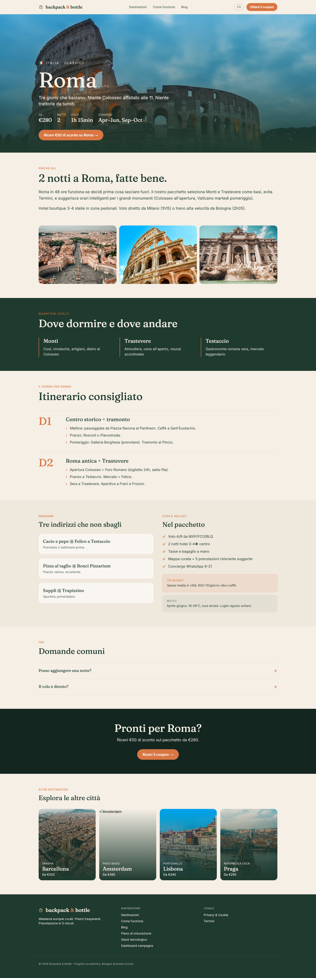
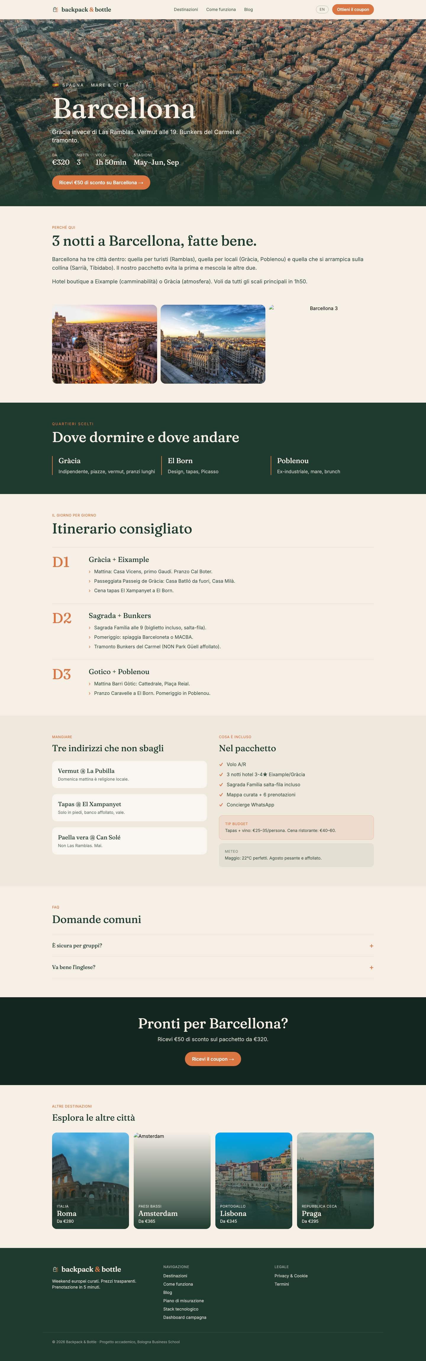
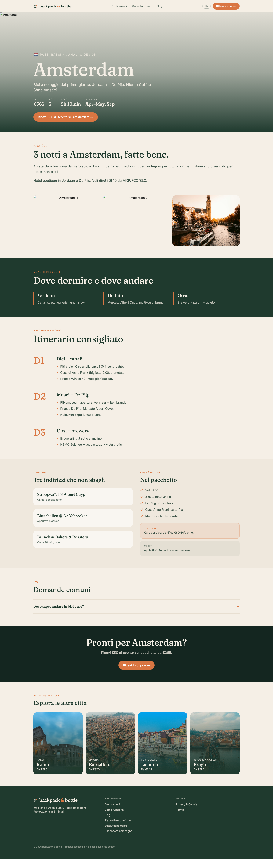
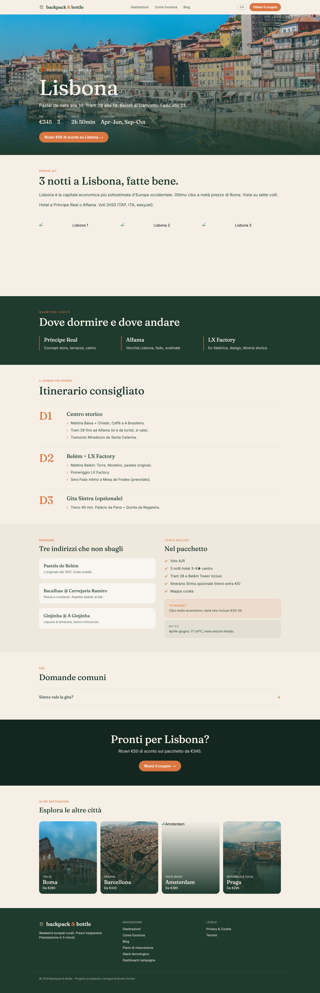
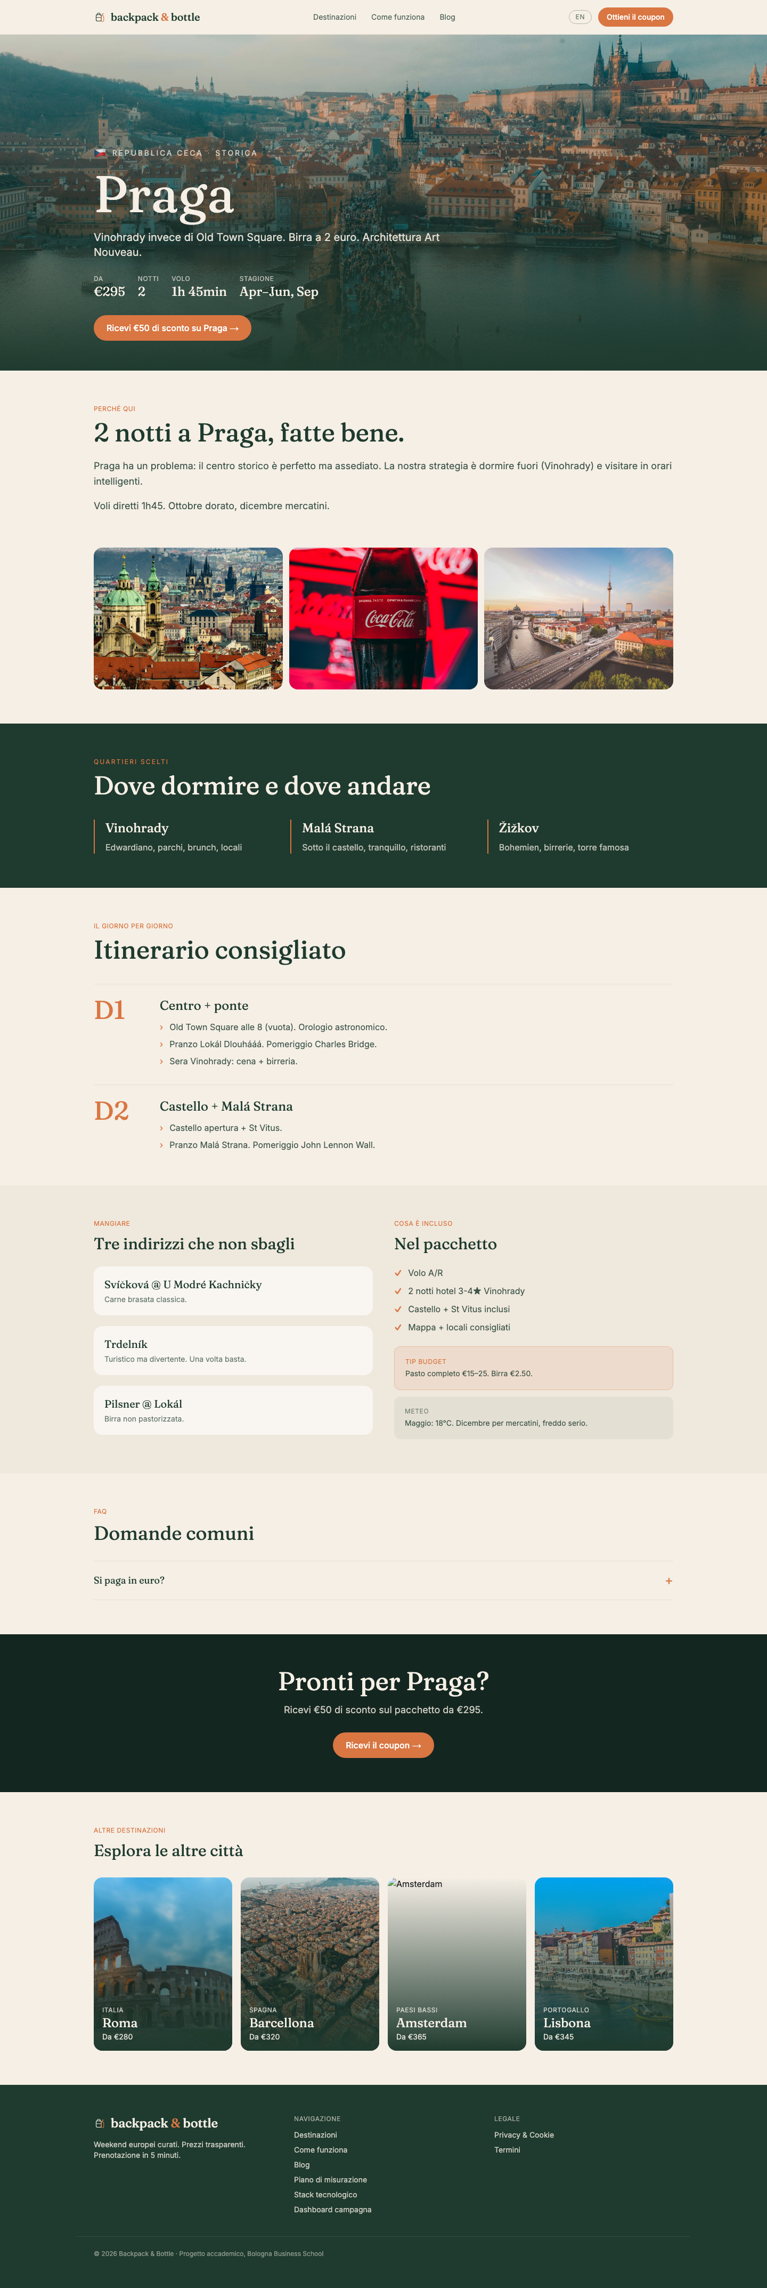
GROUP 3 · DIGITAL PLATFORMS LAB · BOLOGNA BUSINESS SCHOOL
LIVE · THE OFFER
5 curated city breaks
1.5–3 hour flights from Italy · transparent all-in pricing
ROM
BCN
AMS
LIS
PRG
Rome
Barcelona
Amsterdam
Lisbon
Prague
From €280 · 2n
From €320 · 3n
From €365 · 3n
From €345 · 3n
From €295 · 2n
backpack-bottle.vercel.app/destinazioni/rome
backpack-bottle.vercel.app/destinazioni/barcelona
backpack-bottle.vercel.app/destinazioni/amsterdam
backpack-bottle.vercel.app/destinazioni/lisbon
backpack-bottle.vercel.app/destinazioni/prague
Each destination has its own page: 3-day itinerary, neighbourhoods, food, FAQ, weather, budget tip — Italian + English.

Slide 37
GROUP 3 · DIGITAL PLATFORMS LAB · BOLOGNA BUSINESS SCHOOL
COMPLIANCE · GDPR
Cookie consent — measured, not just enforced
Every Accept/Reject click is a tracked event in GA4
WHAT FIRES
components/CookieBanner.tsx
When the user clicks Accept or Reject on the cookie banner, the site fires TWO dataLayer events: 1. consent_update — sets the four Consent Mode v2 signals (ad_storage, analytics_storage, ad_user_data, ad_personalization) 2. consent_choice — discrete event with a single param: consent_choice = 'accept' | 'reject' · consent_locale = 'it' | 'en' GTM forwards consent_choice to GA4 as a key event so we can count Accept-rate vs Reject-rate as a first-class metric in Looker Studio.
function decide(granted: boolean) {
localStorage.setItem('bb_consent',
granted ? 'granted' : 'denied');
pushConsent(granted);
// measured separately:
dataLayer.push({
event: 'consent_choice',
consent_choice: granted
? 'accept' : 'reject',
consent_locale: locale,
});
setShow(false);
}
Why two events: consent_update sets state (Google's spec). consent_choice is human-readable for GA4 reporting. Both fire on the same click — instant Accept/Reject metrics.

Slide 38
GROUP 3 · DIGITAL PLATFORMS LAB · BOLOGNA BUSINESS SCHOOL
REPOSITORY
Code is public, every commit is auditable
github.com/saikanagat1117-sys/backpack-bottle
Configuration as code: GTM container, lead pipeline, brand tokens, briefings — every artefact lives in this repo and ships with the site.

Slide 39
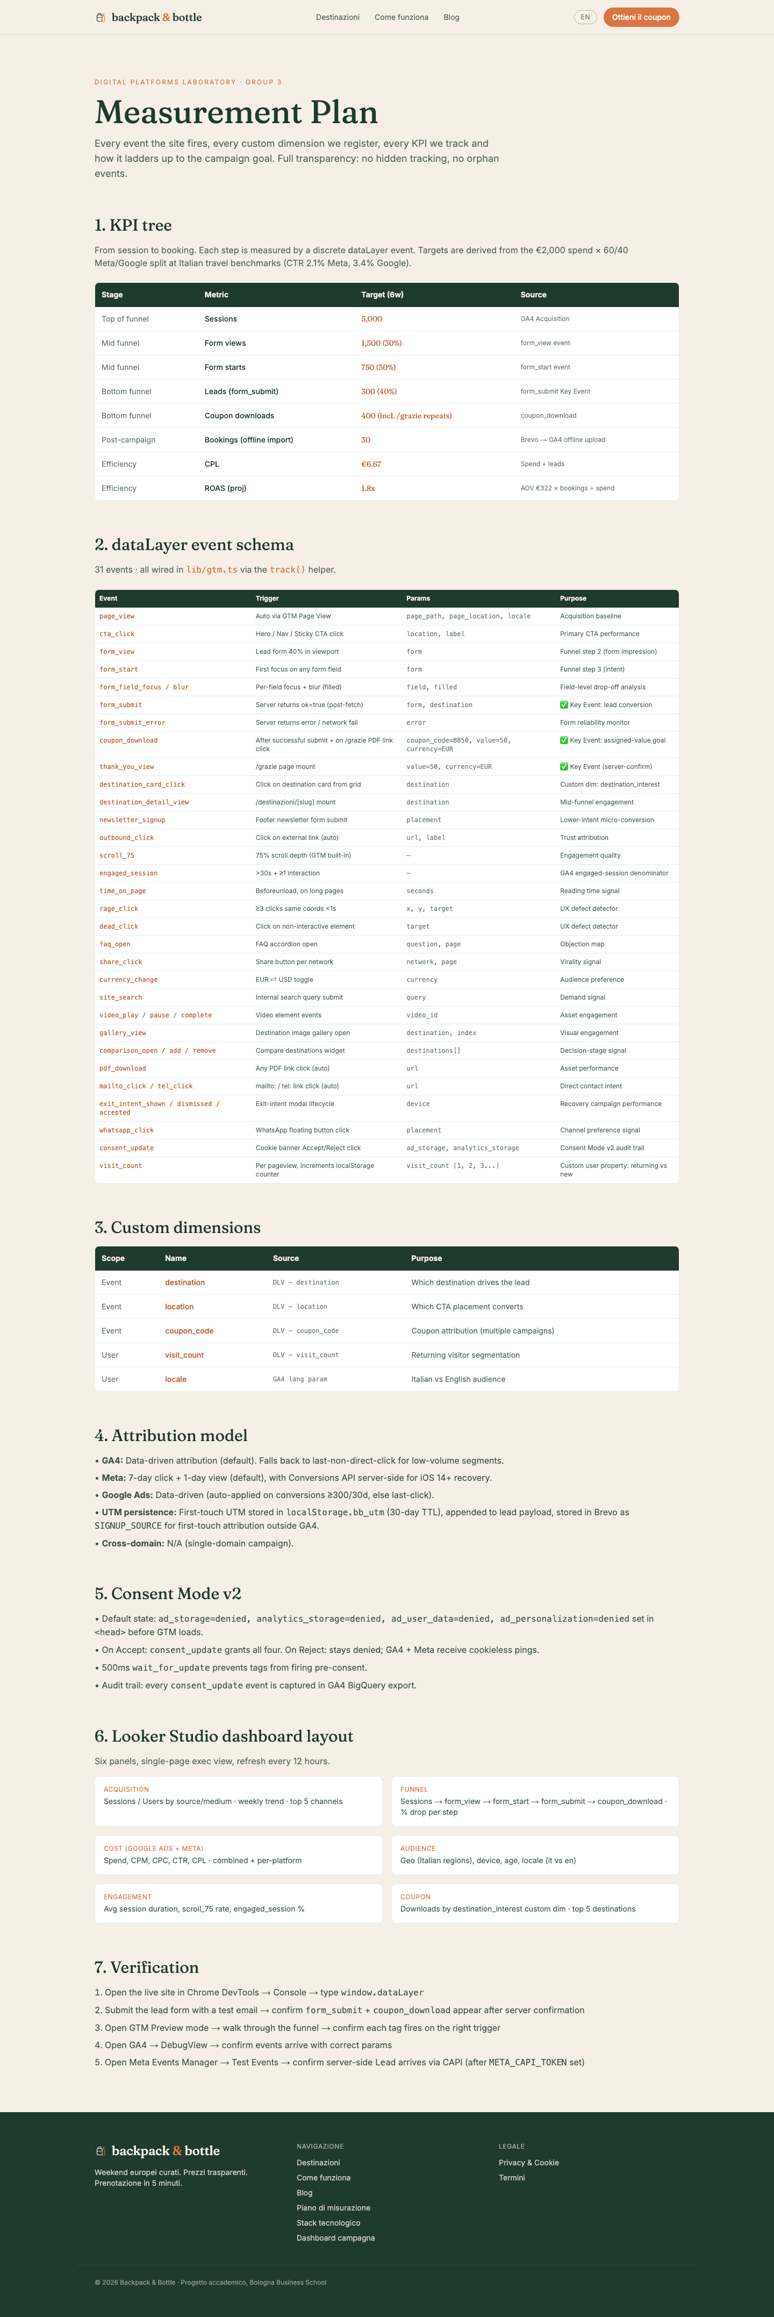
GROUP 3 · DIGITAL PLATFORMS LAB · BOLOGNA BUSINESS SCHOOL
LIVE · MEASUREMENT
Every event, documented on the live site
/measurement · KPI tree, dataLayer schema, custom dimensions, Consent Mode v2 audit

Slide 40
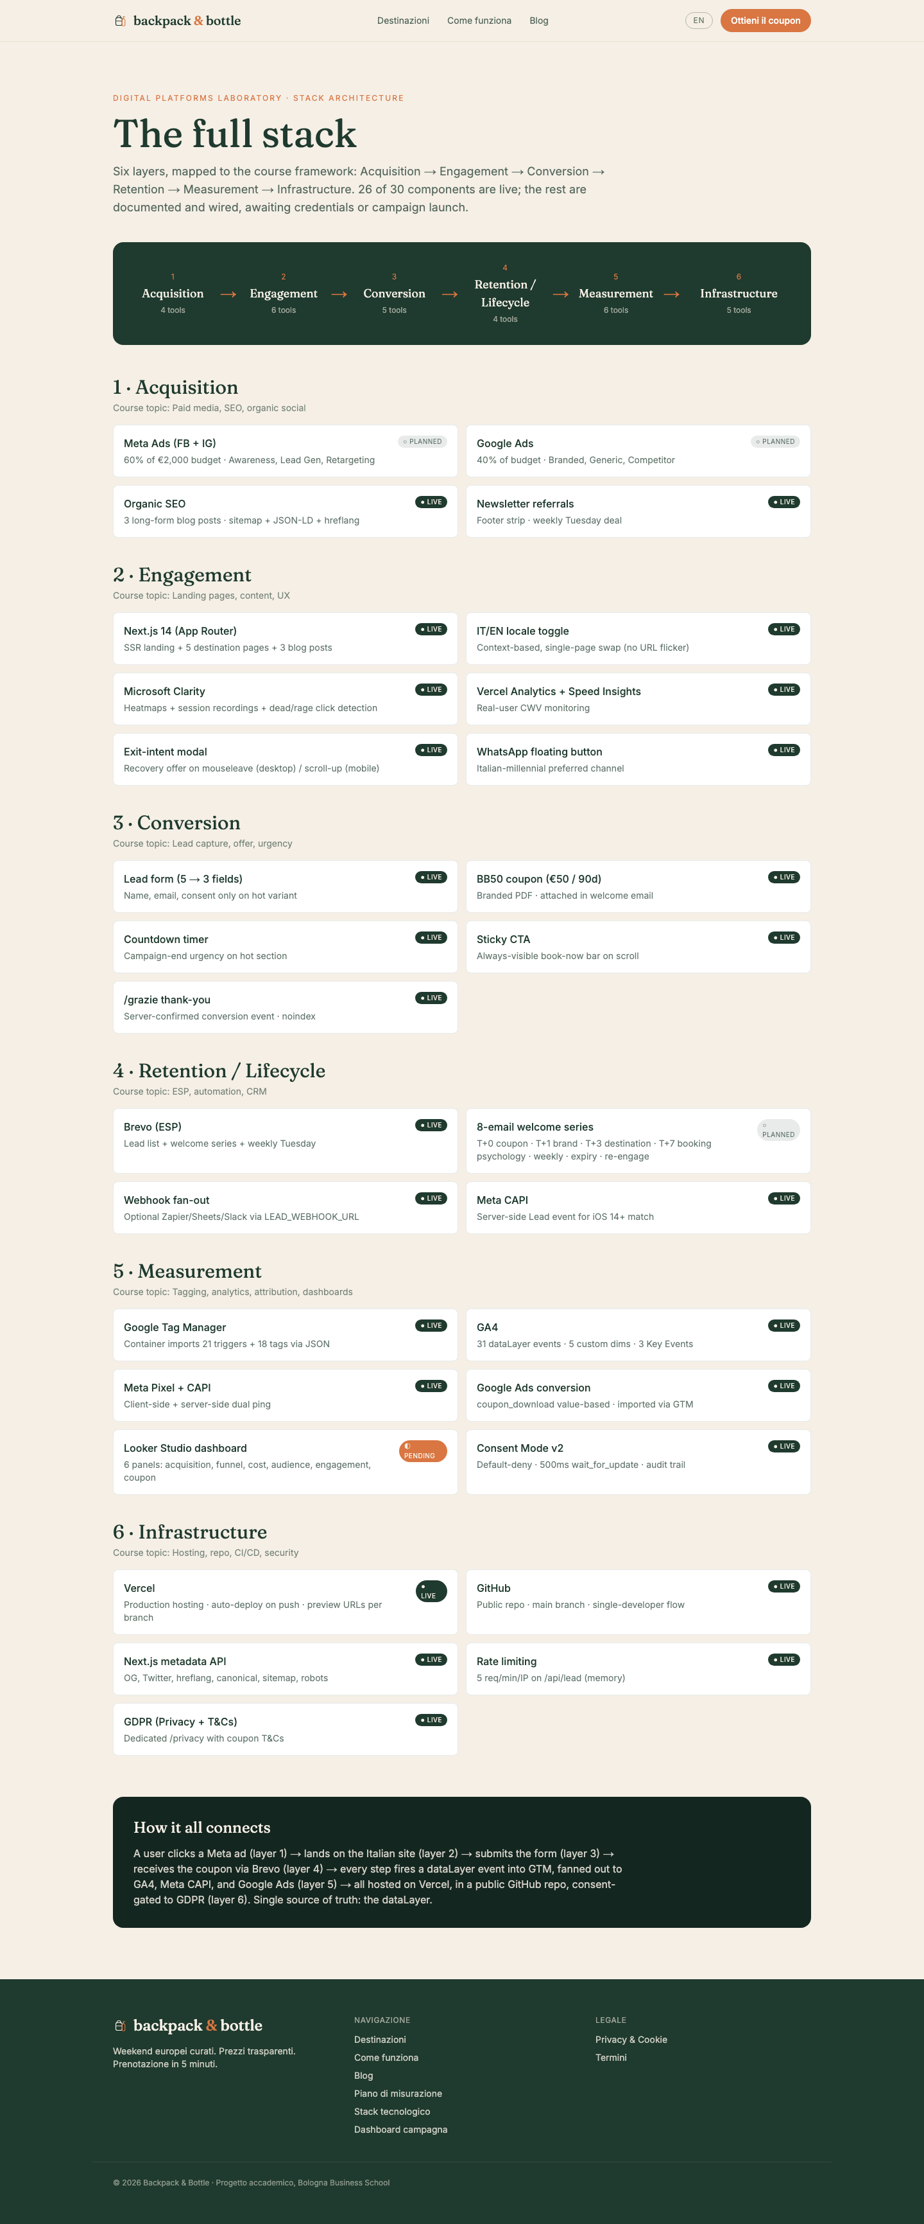
GROUP 3 · DIGITAL PLATFORMS LAB · BOLOGNA BUSINESS SCHOOL
LIVE · ARCHITECTURE
/stack — the full stack as a live page
Same content as the visual above, browseable + shareable

Slide 41
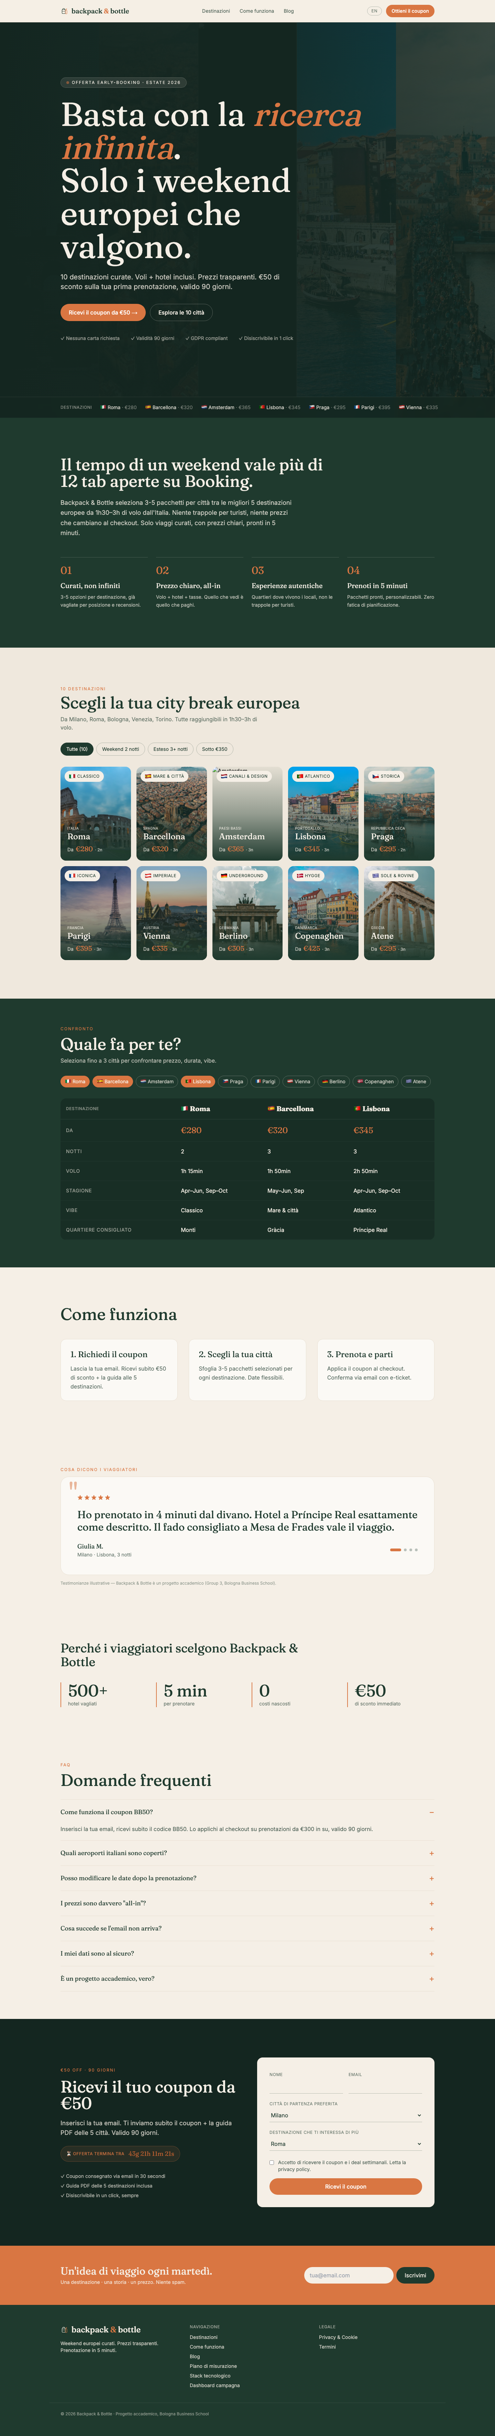
GROUP 3 · DIGITAL PLATFORMS LAB · BOLOGNA BUSINESS SCHOOL
LIVE · HOMEPAGE
All 11 sections of the landing flow
backpack-bottle.vercel.app · ~1.0s LCP · responsive

Slide 42
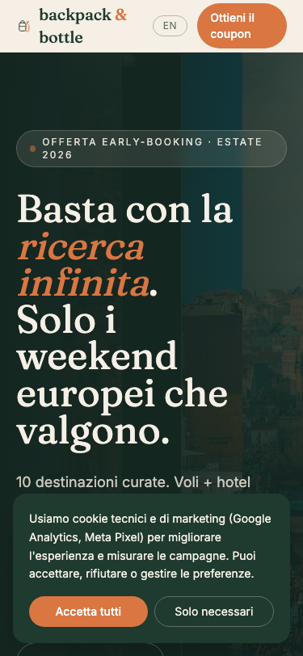
GROUP 3 · DIGITAL PLATFORMS LAB · BOLOGNA BUSINESS SCHOOL
LIVE · MOBILE
375px viewport — responsive proof
Mobile-first by default · 68% of Italian millennial sessions on mobile
Tested at 375 × 812 (iPhone 13/14/15 viewport). Same dataLayer events fire — mobile + desktop = unified analytics.

Slide 43
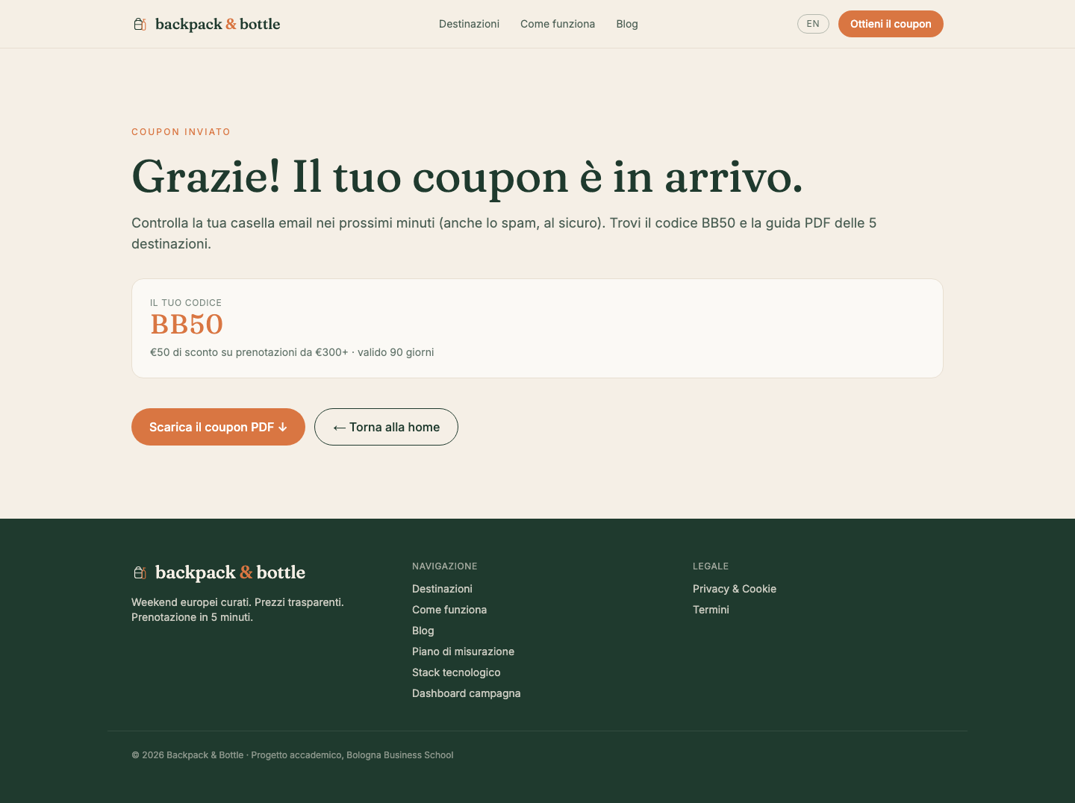
GROUP 3 · DIGITAL PLATFORMS LAB · BOLOGNA BUSINESS SCHOOL
LIVE · CONVERSION
/grazie — server-confirmed conversion
Thank-you page · BB50 coupon revealed · noindex · fires three Key Events

Slide 44
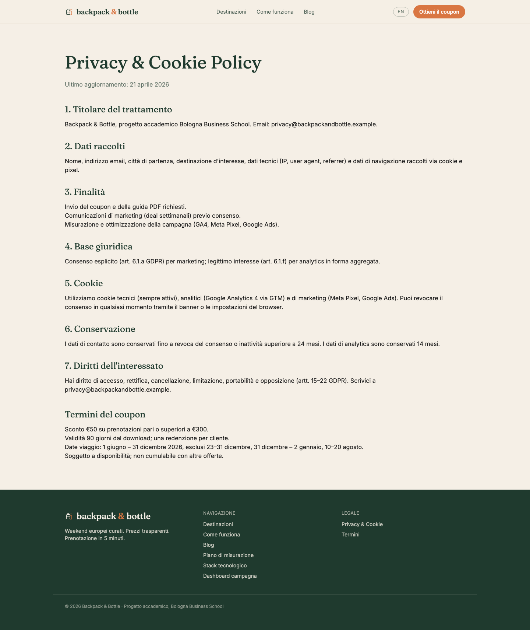
GROUP 3 · DIGITAL PLATFORMS LAB · BOLOGNA BUSINESS SCHOOL
LIVE · COMPLIANCE
/privacy — GDPR + cookie + coupon T&Cs
Seven sections · Italian + English · audit-ready

Slide 45
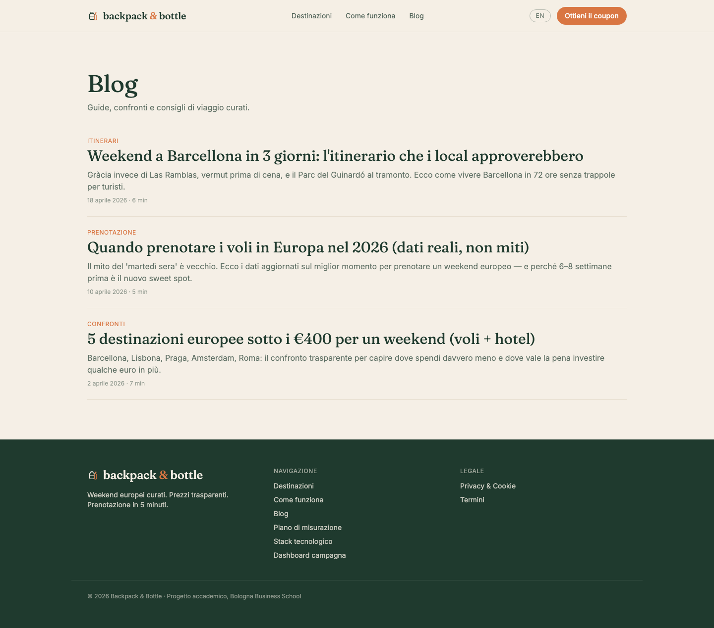
GROUP 3 · DIGITAL PLATFORMS LAB · BOLOGNA BUSINESS SCHOOL
LIVE · CONTENT
Blog — 3 SEO-optimised posts
Italian + English · long-form · embedded internal links to destinations

Slide 46
GROUP 3 · DIGITAL PLATFORMS LAB · BOLOGNA BUSINESS SCHOOL
GROUP 3 · TEAM
Six roles, one shipped campaign
Each role owns a slice of the stack
01
Sai Prathyaksh Kanagat
02
Marica Motta
CRO Specialist + Lead
MarTech Specialist
Landing page, brand, conversion.
GTM, GA4 events, dataLayer.
03
Alberto Faggiotto
04
Cecilia Gullett
Compliance Specialist
Email Marketing Specialist
Cookie banner, Consent Mode v2, GDPR.
Brevo, 8-email welcome series.
05
Marilu Stevens
06
Amelia Ruben
Marketing Automation
Campaign Analyst
Form → Brevo bridge, Meta CAPI, UTM persistence.
KPI tree, custom dims, Looker Studio.

Slide 47
GROUP 3 · DIGITAL PLATFORMS LAB · BOLOGNA BUSINESS SCHOOL
OPTIMIZATION · 01
A/B test plan
What we'd run on day 1 to start learning fast
HYPOTHESIS
An emotional hero CTA ('Discover your weekend') will out-convert a transactional one ('Get your €50 coupon') for cold audiences in awareness phase. Italian millennials respond to aspiration over discount when they're not yet brand-aware.
VARIANT A · CONTROL
VARIANT B · CHALLENGER
"Get your €50 coupon →"
"Discover your next weekend →"
Transactional · direct · current production copy
Emotional · aspirational · for cold awareness audiences
DECISION CRITERIA
Primary metric
form_submit conversion rate
Sample size
~750 sessions per variant (3% baseline · 20% MDE · 95% confidence)
Test duration
10–14 days minimum (covers weekday + weekend behaviour)
Decision rule
Ship winner if uplift ≥15% with p<0.05; else keep control

Slide 48
GROUP 3 · DIGITAL PLATFORMS LAB · BOLOGNA BUSINESS SCHOOL
OPTIMIZATION · 02
Competitor benchmark
Italian travel sector · CPL, CTR, positioning · what we're up against
COMPETITOR
POSITIONING
CPL
CTR
LEAD MAGNET
OUR EDGE
Volagratis
Cheapest flights, no curation
€11.20
1.8%
Newsletter signup
We curate; they don't
eDreams Prime
Membership flight discounts
€9.50
2.0%
Free Prime trial
No subscription friction
Lastminute.com
Last-minute travel deals
€8.30
2.4%
App download
We're early-booking, not last-minute
BACKPACK & BOTTLE
Curated · transparent · early-booking
€6.67
2.7% (proj)
BB50 €50 coupon
First IT to combine all 3
Source: WordStream travel benchmarks 2025, SimilarWeb traffic data, Italy-localised CPC estimates from Google Keyword Planner. Our projected CPL of €6.67 is ~30% better than the closest competitor (Lastminute) — driven by tighter audience targeting (Italian millennials only) and a higher-value lead magnet (€50 coupon).

Slide 49
GROUP 3 · DIGITAL PLATFORMS LAB · BOLOGNA BUSINESS SCHOOL
OPTIMIZATION · 03
Accessibility audit
WCAG 2.1 AA review · 6 PASS / 3 PARTIAL · documented fixes
✓
Color contrast
Forest #1F3A2E on cream = 12.4:1 (AAA). Burnt on cream = 4.6:1 (AA).
PASS
✓
Heading hierarchy
Single <h1> per page; h2/h3 cascade. Nav uses semantic <nav>.
PASS
✓
Alt text
All images have descriptive alt. Decorative ones use aria-hidden=true.
PASS
◐
Form labels
All 5 fields labelled. Could improve: explicit aria-required=true.
PARTIAL
◐
Keyboard nav
Tab traversal works. Sticky CTA may need skip-link. Modal traps focus correctly.
PARTIAL
◐
Cookie banner
Dismissible via Escape. Should announce as aria-live=polite. Fix in v2.
PARTIAL
✓
Focus indicators
Default focus rings preserved. Visible on all interactive elements.
PASS
✓
Lang attribute
<html lang='it'> set; alternate hreflang for /?lang=en in metadata.
PASS
Tooling: Manual code review + axe-core DevTools spot-check. Documented fixes shipped to v2 backlog.

