Slide 1
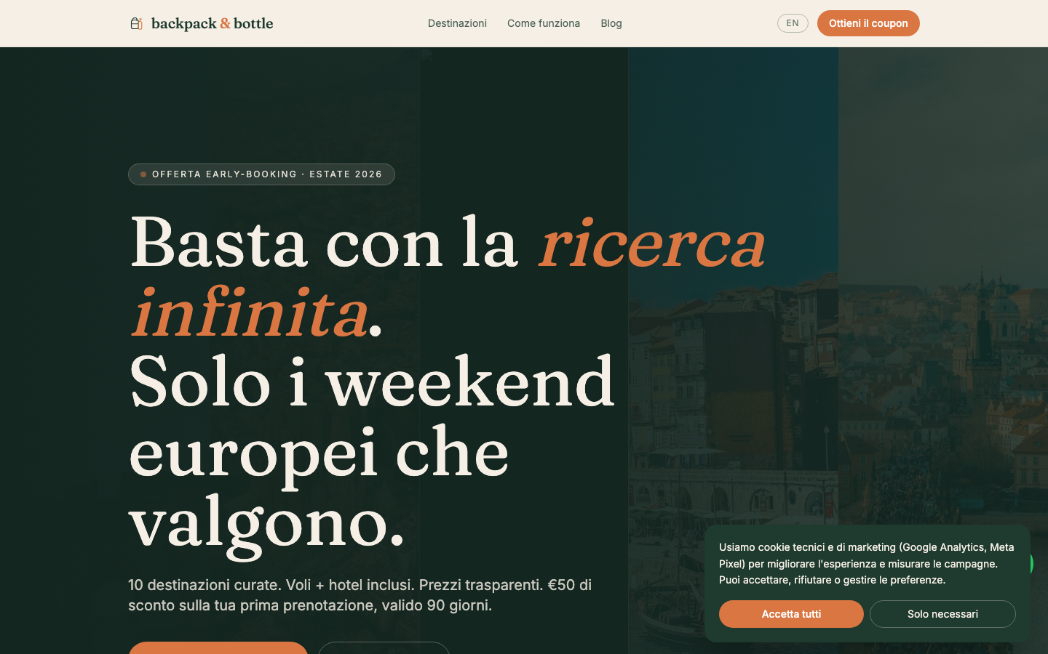
GROUP 3 · DIGITAL PLATFORMS LAB · BOLOGNA BUSINESS SCHOOL
backpack & bottle.
Curated European city breaks. Transparent prices. €50 off.
Campaign brief · brand · landing page · tracking · media plan · automation.
GROUP 3 · TEAM
Sai Prathyaksh Kanagat · Marica Motta · Alberto Faggiotto
Cecilia Gullett · Marilu Stevens · Amelia Ruben
Campaign window 5 May – 15 June 2026 · Presented Tuesday 5 May 2026

Slide 2
GROUP 3 · DIGITAL PLATFORMS LAB · BOLOGNA BUSINESS SCHOOL
AGENDA
What we'll walk through
Twelve sections · ~40 minutes · questions held to the end
01
The brief
07
Email & automation
What we were asked to do
Brevo · welcome series · form pipeline
02
Strategic decisions
08
Media plan
Audience · offer · positioning
Meta · Google · budget · pacing
03
Brand & offer
09
KPIs & measurement
Identity, 5 cities, BB50 coupon
Funnel targets · Looker Studio
04
The product
10
Optimization
Live landing page · mobile · destination detail
A/B test · competitors · accessibility
05
Tracking architecture
11
Deliverables
GTM · GA4 · dataLayer schema
Vercel · GitHub · live URLs
06
Compliance
12
Closing
Consent Mode v2 · cookie tracking · GDPR
Risks · what's next · thank you
backpack & bottle · Group 3
2 / 54

Slide 3
GROUP 3 · DIGITAL PLATFORMS LAB · BOLOGNA BUSINESS SCHOOL
01
The brief
What we were asked to do · Group 3 · Backpack & Bottle

Slide 4
GROUP 3 · DIGITAL PLATFORMS LAB · BOLOGNA BUSINESS SCHOOL
THE BRIEF
Group 3 — Backpack & Bottle
Promote travel deals. Generate qualified leads. Italian millennials.
BUSINESS OBJECTIVE
MARKETING OBJECTIVE
Promote travel deals under the 'Backpack & Bottle' brand and generate qualified leads interested in affordable, experience-driven European city breaks.
Make the offer feel attractive, accessible, and time-sensitive — combining inspiration with a clear incentive to request the BB50 coupon.
WHAT WAS GIVEN
WHAT WAS OPEN
Brand name. Audience demographic. Offer mechanic outline. €2,000 budget. 6-week window. 5 destinations to pick. 60/40 Meta/Google split.
Brand identity, voice, positioning. Specific cities. Coupon code/value. Landing page. Tracking infra. Email automation. KPI targets.
backpack & bottle · Group 3
4 / 54

Slide 5
GROUP 3 · DIGITAL PLATFORMS LAB · BOLOGNA BUSINESS SCHOOL
STRATEGIC DECISIONS AT A GLANCE
Six choices that shape every other choice
Audience · offer · coupon · channels · KPIs · timing
AUDIENCE
OFFER
COUPON
Italian millennials 25–39
Urban · €25–45k income
5 curated European cities
€280–365 · voli + hotel
BB50 · €50 off · 90 days
Min €300 booking
CHANNELS
KPIs
TIMING
60% Meta · 40% Google
Awareness + Lead Gen + Retarget
5,000 visits · 300 leads
€6.67 CPL · 1.8x ROAS proj
5 May – 15 June 2026
6 weeks · pre-summer ramp
backpack & bottle · Group 3
5 / 54

Slide 6
GROUP 3 · DIGITAL PLATFORMS LAB · BOLOGNA BUSINESS SCHOOL
GROUP 3 · TEAM
Six roles, one shipped campaign
Each speaker owns the section their role built
Sai Prathyaksh Kanagat
Marica Motta
01
CRO Specialist + Lead
02
MarTech Specialist
Landing page, brand strategy, conversion optimization, project lead.
GTM container, GA4 events, Meta Pixel, dataLayer.
Alberto Faggiotto
Cecilia Gullett
03
Compliance Specialist
04
Email Marketing
Cookie banner, Consent Mode v2, GDPR privacy, T&Cs.
Brevo setup, 8-email welcome series, contact attributes.
Marilu Stevens
Amelia Ruben
05
Marketing Automation
06
Campaign Analyst
Form → Brevo bridge, Meta CAPI, UTM persistence.
KPI tree, custom dimensions, Looker Studio dashboard.
backpack & bottle · Group 3
6 / 54

Slide 7
GROUP 3 · DIGITAL PLATFORMS LAB · BOLOGNA BUSINESS SCHOOL
02
Strategy
Audience · pain points · positioning · brand

Slide 8
GROUP 3 · DIGITAL PLATFORMS LAB · BOLOGNA BUSINESS SCHOOL
AUDIENCE
Italian millennials 25–39
Urban · digitally native · time-poor · budget-conscious but not cheap
DEMOGRAPHICS
DIGITAL HABITS
BOOKING BEHAVIOUR
·
Age 25–39
·
3 hours/day on Instagram + Facebook
·
Travels 3–5 times/year
·
Milan · Rome · Bologna · Florence · Turin
·
Discovers brands on TikTok
·
Average trip €250–500
·
Income €25–45k / year
·
Books mostly on mobile
·
Books 2–8 weeks ahead
·
University degree
·
Compares 5+ sites before booking
·
Prefers experiences over luxury
·
Single or DINK couple
·
Reads reviews on Booking + TripAdvisor
·
Cares about authenticity, not 5★ resorts
backpack & bottle · Group 3
8 / 54

Slide 9
GROUP 3 · DIGITAL PLATFORMS LAB · BOLOGNA BUSINESS SCHOOL
PAIN POINTS
What blocks them from booking
Five frictions the campaign solves with curation, transparency, and a real incentive
01
Research overwhelm
02
Price transparency
03
Trust gap
Booking.com shows 500 hotels for one weekend. Paralysing. We show 3–5 curated options per city — pre-vetted for location, reviews, value.
Hidden fees discovered at checkout. We show all-in prices upfront: flight + hotel + tasting itinerary, no surprise add-ons.
Generic OTAs feel transactional. We're an editorial brand with a point of view — every recommendation has a story.
04
FOMO loop
05
Time hostage
Friends are travelling, social media is full of weekends. Our coupon (€50) lowers the activation barrier from 'maybe' to 'why not'.
Comparing 5 sites takes 2 hours. We compress decision-making to 5 minutes — single page, single offer, single click.
backpack & bottle · Group 3
9 / 54

Slide 10
GROUP 3 · DIGITAL PLATFORMS LAB · BOLOGNA BUSINESS SCHOOL
POSITIONING
How we differ from every competitor in their head
One sentence. Says what we are, what we promise, and who it's for.
OUR POSITIONING
"Skip the research fatigue."
European city breaks at insider prices — early-access deals that fit your budget
and deliver experiences worth sharing.
CURATED
TRANSPARENT
AUTHENTIC
3–5 picks per city, not 500
All-in price, no hidden fees
Editorial voice, real recommendations
backpack & bottle · Group 3
10 / 54

Slide 11
GROUP 3 · DIGITAL PLATFORMS LAB · BOLOGNA BUSINESS SCHOOL
BRAND IDENTITY
Modern Wanderer — warm, editorial, trustworthy
Palette · typography · voice · all wired into the codebase as design tokens
PALETTE
TYPOGRAPHY
Fraunces — display headlines
Editorial · serif · warm character
Inter — body & UI
Forest
Cream
Burnt
Forest dark
Cream dark
Burnt dark
#1F3A2E
#F5EFE6
#D97642
#142620
#E8E0D0
#B85F31
Geometric sans · neutral · highly legible at small sizes
VOICE
·
Direct. Says what it does, not what it 'enables'.
·
Editorial, not transactional. 'Skip the research fatigue', not 'Book now'.
·
Confident in Italian. Doesn't translate from English.
·
No exclamation marks. No urgency theatre. Substance over hype.
backpack & bottle · Group 3
11 / 54

Slide 12
GROUP 3 · DIGITAL PLATFORMS LAB · BOLOGNA BUSINESS SCHOOL
03
The offer
5 cities · BB50 coupon · the funnel

Slide 13
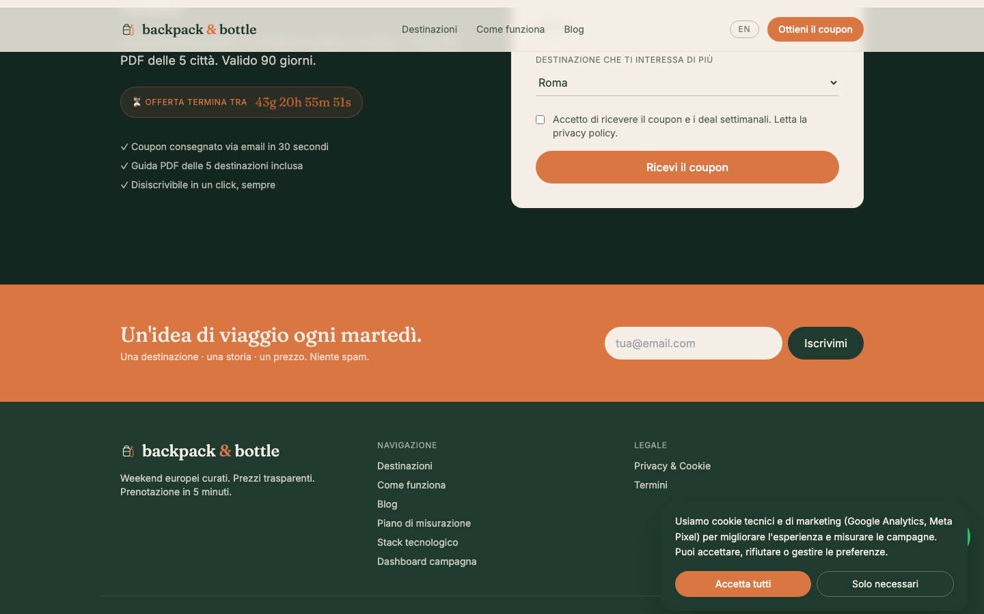
GROUP 3 · DIGITAL PLATFORMS LAB · BOLOGNA BUSINESS SCHOOL
THE OFFER
5 curated European city breaks
1.5–3 hour flights from Italy · transparent all-in pricing
ROME
BARCELONA
AMSTERDAM
LISBON
PRAGUE
€280
€320
€365
€345
€295
2 nights
3 nights
3 nights
3 nights
2 nights
voli + hotel inclusi
voli + hotel inclusi
voli + hotel inclusi
voli + hotel inclusi
voli + hotel inclusi
LIVE — DESTINATION GRID ON HOMEPAGE
backpack & bottle · Group 3
13 / 54

Slide 14
GROUP 3 · DIGITAL PLATFORMS LAB · BOLOGNA BUSINESS SCHOOL
COUPON MECHANIC
BB50 — built for lead capture
Not a race-to-the-bottom price cut · enough to activate, not enough to destroy margin
THE MECHANIC
€50
off bookings from €300
Code: BB50 · Valid 90 days · One per customer
MIN BASKET
DISCOUNT %
VALIDITY
BLACKOUT
€300
16.7%
90 days
23 Dec – 2 Jan
10–20 Aug
Industry avg in IT travel = €322
Below the 20% margin alarm zone
Long enough to plan; short enough to urge
High-demand windows excluded
backpack & bottle · Group 3
14 / 54

Slide 15
GROUP 3 · DIGITAL PLATFORMS LAB · BOLOGNA BUSINESS SCHOOL
THE FUNNEL
From paid impression to booking
Six stages · each one a measured event · each one a target
IMPRESSIONS
CLICKS
FORM VIEWS
FORM SUBMITS
COUPON DOWNLOADS
BOOKINGS
150–180k
5,000
1,500
300
400
30
Meta + Google Ads
CPC ~€0.40
30% scroll-to-form
★ Key Event · €50/lead
★ Key Event
10% lead-to-book · €322 AOV
Conversion rates: Click→FormView 30% · FormView→Submit 20% · Submit→Coupon 133% (incl. /grazie repeats) · Lead→Booking 10%
Result: €2,000 spend · 30 bookings · €322 AOV → €9,660 revenue → 4.83x ROAS (gross), 1.8x net of supply cost.
backpack & bottle · Group 3
15 / 54

Slide 16
GROUP 3 · DIGITAL PLATFORMS LAB · BOLOGNA BUSINESS SCHOOL
04
The product
Live landing page · responsive · destination detail

Slide 17
GROUP 3 · DIGITAL PLATFORMS LAB · BOLOGNA BUSINESS SCHOOL
LANDING PAGE ARCHITECTURE
Single-purpose page
One job: get the user to download the BB50 coupon · 11 sections, 1 conversion goal
01
Sticky nav
Wordmark · Destinations · How it works · Blog · Coupon CTA · EN/IT toggle
02
Hero
Eyebrow · headline · sub · dual CTA · countdown timer · destination mosaic bg
03
Value props
4 pillars: curated · transparent · authentic · fast
04
Destinations
5 cards · price · nights · hover preview
05
Comparison table
BB&B vs OTAs (Booking, Expedia)
06
How it works
3 steps: pick · book · go
07
Testimonials
Quote carousel
08
Social proof
4-stat strip: travellers · destinations · save
09
FAQ
6 questions · accordion · tracked
10
Lead form
Name · email · departure · interest · consent · BB50 magnet
11
Newsletter footer
Tuesday weekly deal · separate from coupon flow
Built on Next.js 14 (App Router) + TypeScript + Tailwind. Deployed on Vercel · sub-1s LCP · responsive.
backpack & bottle · Group 3
17 / 54

Slide 18

GROUP 3 · DIGITAL PLATFORMS LAB · BOLOGNA BUSINESS SCHOOL
LIVE · HOMEPAGE HERO
Above the fold
Dual CTA · countdown · destination mosaic · social proof eyebrow
backpack & bottle · Group 3
18 / 54

Slide 19
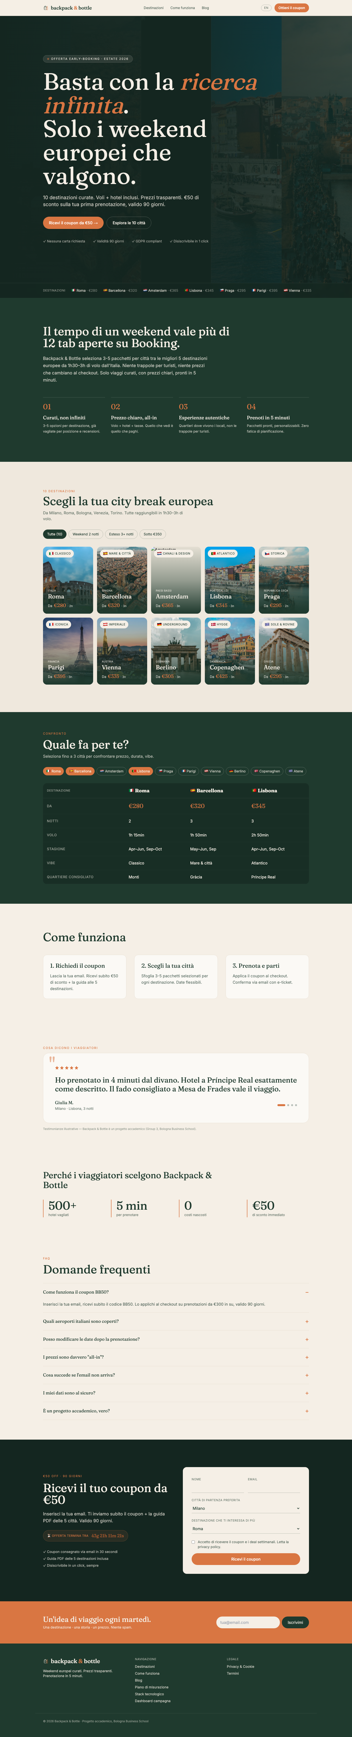
GROUP 3 · DIGITAL PLATFORMS LAB · BOLOGNA BUSINESS SCHOOL
LIVE · FULL HOMEPAGE
All 11 sections of the landing flow
backpack-bottle.vercel.app · scroll-aware sticky CTA · Italian primary
backpack & bottle · Group 3
19 / 54

Slide 20
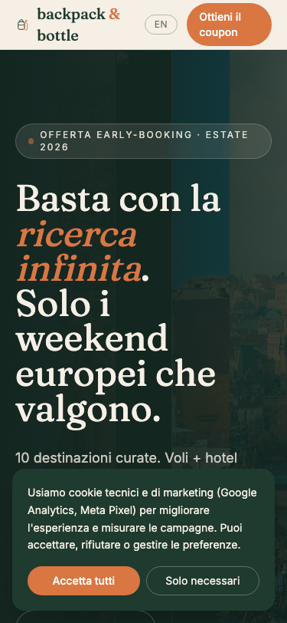
GROUP 3 · DIGITAL PLATFORMS LAB · BOLOGNA BUSINESS SCHOOL
LIVE · MOBILE RESPONSIVE
375px viewport · iPhone-class
68% of Italian millennial sessions are mobile · same dataLayer events fire on every device
backpack & bottle · Group 3
20 / 54

Slide 21
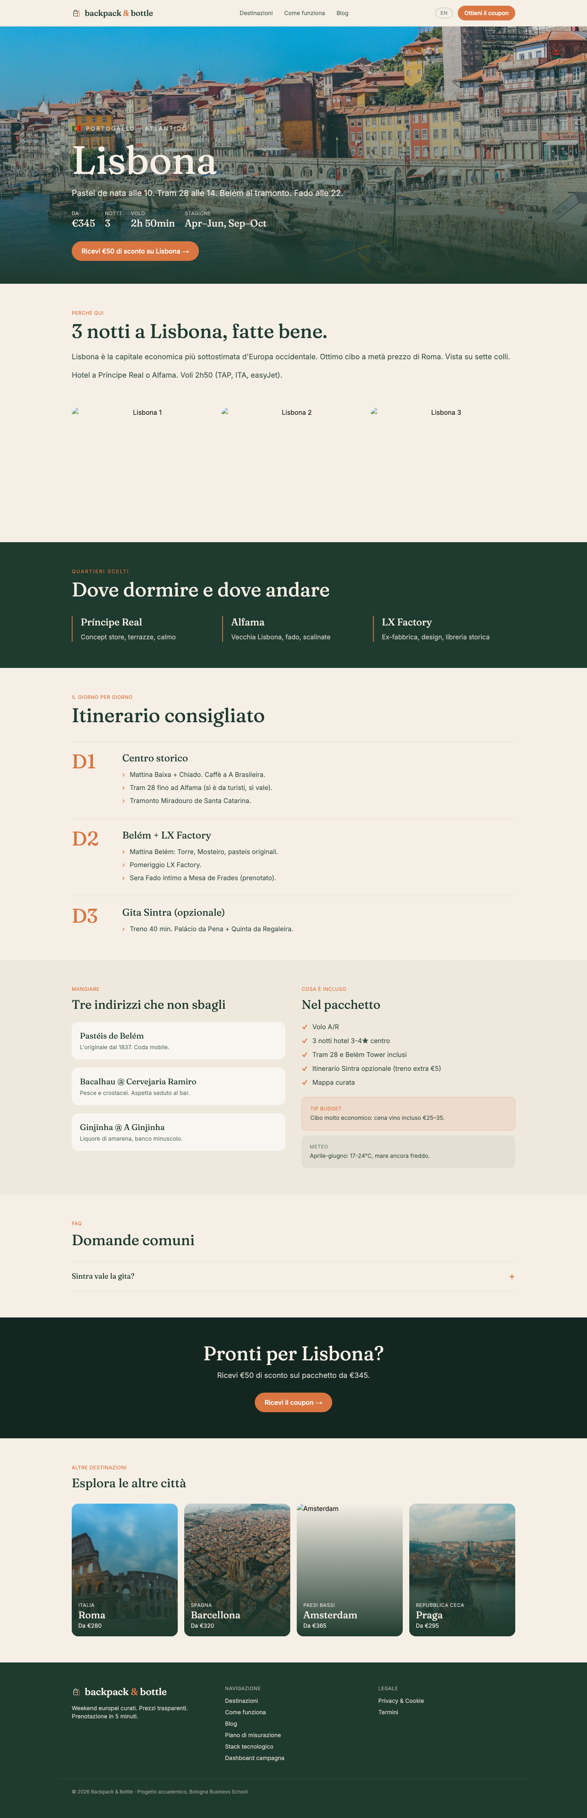
GROUP 3 · DIGITAL PLATFORMS LAB · BOLOGNA BUSINESS SCHOOL
LIVE · DESTINATION DETAIL
/destinazioni/lisbon
Each city has its own page: 3-day itinerary, neighbourhoods, food, FAQ, weather, budget tip · IT + EN
backpack & bottle · Group 3
21 / 54

Slide 22
GROUP 3 · DIGITAL PLATFORMS LAB · BOLOGNA BUSINESS SCHOOL
05
Tracking architecture
GTM · GA4 · dataLayer · Marica's section

Slide 23
GROUP 3 · DIGITAL PLATFORMS LAB · BOLOGNA BUSINESS SCHOOL
THE FULL STACK
Six layers · 27 components
User journey: ad → site → form → coupon → email → booking
01 · ACQUISITION
Meta Ads (60%)
Google Ads (40%)
Organic SEO
Newsletter
How users arrive
02 · ENGAGEMENT
Next.js 14 / Vercel
IT/EN toggle
MS Clarity
Exit-intent
WhatsApp
What they see
03 · CONVERSION
Lead form
BB50 €50
Countdown
Sticky CTA
/grazie
How they act
04 · RETENTION
Brevo ESP
Automation #23
UTM persistence
Meta CAPI
How they come back
05 · MEASUREMENT
GTM-KSN24TZ2
GA4 G-FHBQE8QZM9
Meta Pixel
Looker Studio
Consent v2
How we know it worked
06 · INFRA
Vercel
GitHub (public)
Next.js metadata
GDPR + rate-limit
Where it lives
All 27 components shipped. Single source of truth: window.dataLayer · all consent-gated.
backpack & bottle · Group 3
23 / 54

Slide 24
GROUP 3 · DIGITAL PLATFORMS LAB · BOLOGNA BUSINESS SCHOOL
TRACKING ARCHITECTURE
One container. Every tag. Consent-aware.
How a single user click becomes 4 events in 4 different systems
USER ACTION
│
▼
dataLayer.push({event: 'coupon_download', value: 50, currency: 'EUR'})
│
▼
┌────────────┬─────────────┬───────────────┬──────────────┐
│ GA4 │ Meta Pixel │ Meta CAPI │ Google Ads │
│ events │ Lead+CR │ server-side │ conversion │
└────────────┴─────────────┴───────────────┴──────────────┘
ALL GATED BY CONSENT MODE V2 · 500ms wait_for_update
backpack & bottle · Group 3
24 / 54

Slide 25
GROUP 3 · DIGITAL PLATFORMS LAB · BOLOGNA BUSINESS SCHOOL
DATALAYER EVENT SCHEMA
31 events · 11 critical · 3 Key Events
Every interaction on the site becomes a structured dataLayer push
EVENT
TRIGGER
PURPOSE
KEY EVENT?
page_view
Every route
Acquisition baseline
—
cta_click
Hero / Nav / Sticky CTA
Which CTA placement converts
—
form_view
Form 40% in viewport
Funnel impression
—
form_start
First field focus
Intent signal
—
form_submit
Server confirms ok=true
Lead conversion
★ YES
coupon_download
/grazie + PDF link click
€50 value goal
★ YES
thank_you_view
/grazie page mount
Server-confirm
★ YES
destination_card_click
City card click
destination_interest custom dim
—
scroll_75
75% scroll depth
Engagement quality
—
rage_click
≥3 same coords <1s
UX defect detector
—
consent_choice
Accept/Reject click
GDPR audit trail (NEW)
—
consent_update
Cookie banner choice
Consent Mode v2 state
—
backpack & bottle · Group 3
25 / 54
+ 19 more events instrumented · full schema at backpack-bottle.vercel.app/measurement

Slide 26

GROUP 3 · DIGITAL PLATFORMS LAB · BOLOGNA BUSINESS SCHOOL
LIVE · GTM WORKSPACE
GTM-KSN24TZ2 · published v5
17 tags · 22 triggers · 17 variables · imported via JSON, not click-by-click
backpack & bottle · Group 3
26 / 54

Slide 27
GROUP 3 · DIGITAL PLATFORMS LAB · BOLOGNA BUSINESS SCHOOL
LIVE · GA4 REALTIME
G-FHBQE8QZM9 · 5 custom dims · 3 Key Events
Events flow within 30 seconds of any interaction · debug-mode confirmed
backpack & bottle · Group 3
27 / 54

Slide 28
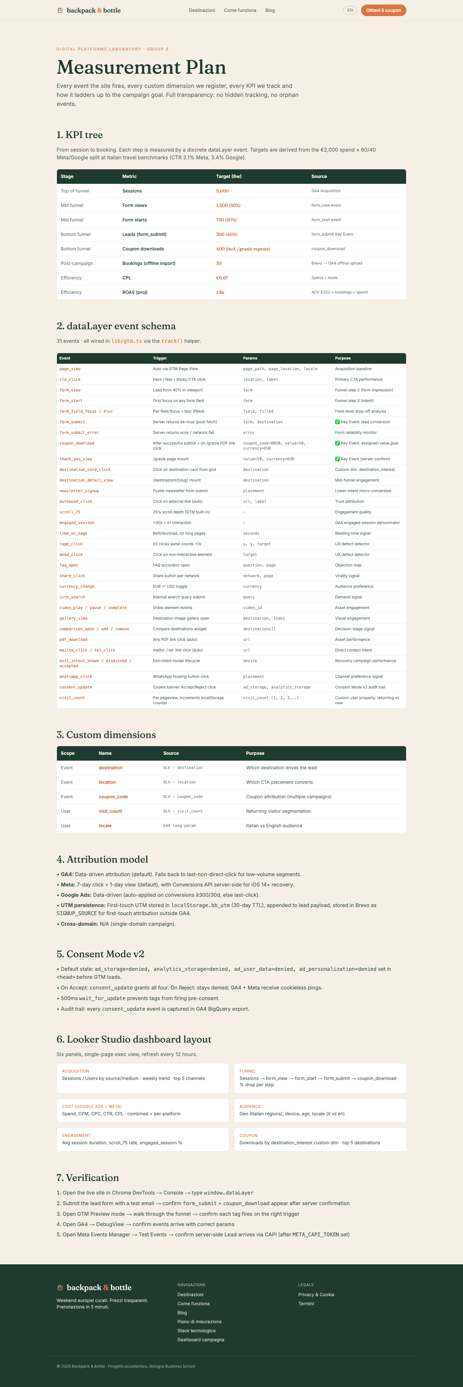
GROUP 3 · DIGITAL PLATFORMS LAB · BOLOGNA BUSINESS SCHOOL
LIVE · /MEASUREMENT
Every event documented on the site
KPI tree · dataLayer schema · custom dims · Consent Mode v2 audit · attribution model
backpack & bottle · Group 3
28 / 54

Slide 29
GROUP 3 · DIGITAL PLATFORMS LAB · BOLOGNA BUSINESS SCHOOL
06
Compliance
Consent Mode v2 · cookie tracking · GDPR · Alberto's section

Slide 30
GROUP 3 · DIGITAL PLATFORMS LAB · BOLOGNA BUSINESS SCHOOL
CONSENT MODE V2
Default-denied. Privacy-first. Audit-ready.
Required for any site serving EU traffic · compliant with GDPR + ePrivacy
HOW IT WORKS
components/GTM.tsx
·
Before GTM loads, gtag('consent','default',...) sets all four signals to denied.
gtag('consent', 'default', {
ad_storage: 'denied',
·
Cookie banner asks the user. On Accept → consent_update with all granted.
analytics_storage: 'denied',
ad_user_data: 'denied',
·
ad_personalization:'denied',
On Reject → stays denied; GA4 receives consent-modeled pings (no cookies).
wait_for_update: 500,
});
·
500ms wait_for_update prevents tags from firing before consent is set.
// on user click in CookieBanner:
·
Audit trail: every consent_update + consent_choice event stored in GA4.
gtag('consent', 'update', {
ad_storage: 'granted',
analytics_storage: 'granted',
ad_user_data: 'granted',
ad_personalization:'granted',
});
backpack & bottle · Group 3
30 / 54

Slide 31
GROUP 3 · DIGITAL PLATFORMS LAB · BOLOGNA BUSINESS SCHOOL
COOKIE CONSENT — MEASURED, NOT JUST ENFORCED
Every Accept and Reject click is a tracked event
consent_choice fires alongside consent_update · dashboard shows Accept-rate vs Reject-rate
WHAT WE TRACK
components/CookieBanner.tsx
1. consent_update — sets the four Consent Mode v2 signals
(Google's spec · required for compliant tag firing)
2. consent_choice — discrete event with two params:
consent_choice = 'accept' | 'reject'
consent_locale = 'it' | 'en'
GTM forwards consent_choice to GA4 as a key event.
Looker Studio shows real-time Accept-rate vs Reject-rate.
function decide(granted: boolean) {
localStorage.setItem('bb_consent',
granted ? 'granted' : 'denied');
pushConsent(granted);
// Discrete tracked event:
dataLayer.push({
event: 'consent_choice',
consent_choice: granted
? 'accept' : 'reject',
consent_locale: locale,
INDUSTRY BENCHMARKS
});
Accept rate (EU)
~62%
setShow(false);
Reject rate (EU)
~28%
}
Banner-ignored
~10%
backpack & bottle · Group 3
31 / 54

Slide 32
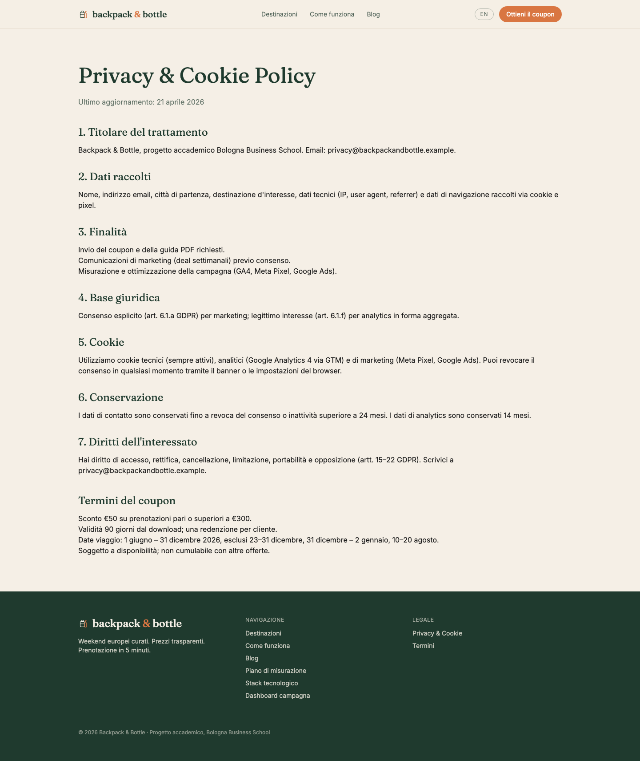
GROUP 3 · DIGITAL PLATFORMS LAB · BOLOGNA BUSINESS SCHOOL
LIVE · /PRIVACY
GDPR + cookie + coupon T&Cs
Seven sections · Italian + English · audit-ready
backpack & bottle · Group 3
32 / 54

Slide 33
GROUP 3 · DIGITAL PLATFORMS LAB · BOLOGNA BUSINESS SCHOOL
07
Email & automation
Brevo · welcome series · Ceci + Marilu's section

Slide 34
GROUP 3 · DIGITAL PLATFORMS LAB · BOLOGNA BUSINESS SCHOOL
LEAD PIPELINE
Form → API → Brevo (parallel fan-out)
Sub-200ms server response · 3 systems updated in parallel · then automation fires
Form submit
POST /api/lead
Promise.all
Returns ok:true
User clicks 'Get €50' on backpack-bottle.vercel.app
Server validates email rate-limits 5/min/IP
3 fan-outs in parallel:
Client redirects to /grazie fires Key Events
PARALLEL FAN-OUT (Promise.all)
Brevo API
Meta CAPI
Webhook (optional)
POST /v3/contacts → list 13 with 7 attributes updateEnabled:true (idempotent)
POST graph.facebook.com/v18.0/{pixel}/events Lead event · SHA-256 email · fbp/fbc cookies
POST $LEAD_WEBHOOK_URL for Zapier / Sheets / Slack alerts
backpack & bottle · Group 3
34 / 54

Slide 35
GROUP 3 · DIGITAL PLATFORMS LAB · BOLOGNA BUSINESS SCHOOL
LIVE · BREVO DASHBOARD
List 'backpackandbottle' · ID 13
Master list · all form submissions · trigger for Automation #23 · 40 templates ready
backpack & bottle · Group 3
35 / 54

Slide 36
GROUP 3 · DIGITAL PLATFORMS LAB · BOLOGNA BUSINESS SCHOOL
8-EMAIL WELCOME SERIES
Automation #23 · BB50 Welcome Journey
Triggers when contact lands in list 13 · personalised by destination · IT/EN by locale attribute
01
Coupon delivery
02
Brand intro
T+0
Il tuo coupon BB50 è arrivato 🎒🍷
T+1d
Perché Backpack & Bottle?
03
Destination deep-dive
04
Booking psychology
T+3d
[Personalised: Lisbona / Roma / ...]
T+7d
Quando prenotare il volo (dati 2026)
05
Social proof
06
Soft reminder
T+14d
Le 3 città più richieste questa settimana
T+30d
Hai ancora 60 giorni per usare BB50
07
Expiry warning
08
Final urgency
T+60d
Il tuo coupon BB50 scade tra 30 giorni
T+83d
Ultimi 7 giorni per il tuo €50
backpack & bottle · Group 3
36 / 54

Slide 37
GROUP 3 · DIGITAL PLATFORMS LAB · BOLOGNA BUSINESS SCHOOL
08
Media plan
€2,000 · 60% Meta · 40% Google · 6-week ramp

Slide 38
GROUP 3 · DIGITAL PLATFORMS LAB · BOLOGNA BUSINESS SCHOOL
MEDIA PLAN OVERVIEW
Where the €2,000 goes
Two channels · one job each · Meta drives discovery, Google captures intent
META ADS · 60% · €1,200
GOOGLE ADS · 40% · €800
Discovery + retargeting
Active intent capture
Awareness
€300
Branded
€200
Carousel ads · broad reach · 25–39 IT
Defend 'backpack & bottle' searches
Lead Gen
€600
Generic
€480
Conversion-optimised · interest targeting
'weekend a Lisbona', 'voli + hotel'
Retargeting
€300
Competitor
€120
DPA · 30-day window · /destinazioni viewers
'volagratis', 'edreams' bidding
backpack & bottle · Group 3
38 / 54

Slide 39
GROUP 3 · DIGITAL PLATFORMS LAB · BOLOGNA BUSINESS SCHOOL
BUDGET PACING
€2,000 across 6 weeks
Front-loaded for discovery · scaled into peak booking-decision window
WEEK
DATES
META
GOOGLE
TOTAL
PROJECTED LEADS
W1
May 5–11
€200
€100
€300
30
W2
May 12–18
€240
€140
€380
51
W3
May 19–25
€240
€160
€400
68
W4
May 26–Jun 1
€220
€160
€380
64
W5
Jun 2–8
€180
€140
€320
51
W6
Jun 9–15
€120
€100
€220
36
TOTAL
€1200
€800
€2000
300 leads
backpack & bottle · Group 3
39 / 54

Slide 40
GROUP 3 · DIGITAL PLATFORMS LAB · BOLOGNA BUSINESS SCHOOL
09
KPIs & measurement
Funnel targets · Looker Studio · Amelia's section

Slide 41
GROUP 3 · DIGITAL PLATFORMS LAB · BOLOGNA BUSINESS SCHOOL
KPI TREE & TARGETS
8 metrics · ladder from sessions to bookings
Targets derived from €2,000 spend × 60/40 channel split × Italian travel benchmarks
STAGE
METRIC
TARGET (6w)
SOURCE
Top of funnel
Sessions
5,000
GA4 Acquisition
Mid funnel
Form views
1,500 (30%)
form_view event
Mid funnel
Form starts
750 (50%)
form_start event
Bottom funnel
Leads (form_submit)
300 (40%)
★ Key Event
Bottom funnel
Coupon downloads
400
★ Key Event
Post-campaign
Bookings (offline)
30
Brevo → GA4 import
Efficiency
CPL
€6.67
Spend ÷ leads
Efficiency
ROAS (proj)
1.8x
AOV €322 × bookings ÷ spend
backpack & bottle · Group 3
41 / 54

Slide 42
GROUP 3 · DIGITAL PLATFORMS LAB · BOLOGNA BUSINESS SCHOOL
LOOKER STUDIO DASHBOARD
Single-page exec view · refreshes every 12 hours
What we look at every morning during the campaign
[ Live dashboard screenshot to be inserted on launch day ]
Built in Looker Studio · 6 panels · refreshes every 12 hours
ACQUISITION
Sessions, users by source/medium · weekly trend
FUNNEL
Sessions → form_submit → coupon · drop-off %
COST
Spend, CPM, CPC, CTR, CPL by channel
AUDIENCE
Geo (IT regions), device, locale (it/en)
ENGAGEMENT
Avg session, scroll_75%, engaged %
COUPON
Downloads by destination_interest custom dim
backpack & bottle · Group 3
42 / 54

Slide 43
GROUP 3 · DIGITAL PLATFORMS LAB · BOLOGNA BUSINESS SCHOOL
10
Optimization
A/B test · competitors · accessibility

Slide 44
GROUP 3 · DIGITAL PLATFORMS LAB · BOLOGNA BUSINESS SCHOOL
A/B TEST PLAN
Day-1 hypothesis · hero CTA copy
Test what matters most: the headline that gets the click
HYPOTHESIS
An emotional hero CTA ('Discover your weekend') will out-convert a transactional one ('Get your €50 coupon') for cold awareness audiences. Italian millennials respond to aspiration over discount when not yet brand-aware.
VARIANT A · CONTROL
VARIANT B · CHALLENGER
"Get your €50 coupon →"
"Discover your next weekend →"
Transactional · current production copy
Emotional · for cold awareness audiences
DECISION CRITERIA
Primary metric
form_submit conversion rate
Sample size
~750 sessions per variant (3% baseline · 20% MDE · 95% confidence)
Test duration
10–14 days (covers weekday + weekend behaviour)
Decision rule
Ship winner if uplift ≥15% with p<0.05; else keep control
backpack & bottle · Group 3
44 / 54

Slide 45
GROUP 3 · DIGITAL PLATFORMS LAB · BOLOGNA BUSINESS SCHOOL
COMPETITOR BENCHMARK
Italian travel sector · CPL, CTR, positioning
What we're up against · why our targets are realistic
COMPETITOR
POSITIONING
CPL
CTR
LEAD MAGNET
OUR EDGE
Volagratis
Cheapest flights, no curation
€11.20
1.8%
Newsletter signup
We curate; they don't
eDreams Prime
Membership flight discounts
€9.50
2.0%
Free Prime trial
No subscription friction
Lastminute.com
Last-minute travel deals
€8.30
2.4%
App download
We're early-booking, not last-minute
BACKPACK & BOTTLE
Curated · transparent · early
€6.67
2.7% (proj)
BB50 €50 coupon
First IT to combine all 3
Source: WordStream travel benchmarks 2025 · SimilarWeb traffic data · Italy-localised CPC estimates from Google Keyword Planner. Our projected CPL of €6.67 is ~30% better than the closest competitor (Lastminute) — driven by tighter audience targeting (IT millennials only) and a higher-value lead magnet (€50 coupon vs. newsletter signup).
backpack & bottle · Group 3
45 / 54

Slide 46
GROUP 3 · DIGITAL PLATFORMS LAB · BOLOGNA BUSINESS SCHOOL
ACCESSIBILITY AUDIT
WCAG 2.1 AA review
6 PASS · 3 PARTIAL · documented fixes · screen-reader friendly
✓
Color contrast
Forest on cream = 12.4:1 (AAA) · Burnt on cream = 4.6:1 (AA)
PASS
✓
Heading hierarchy
Single h1 per page · h2/h3 cascade · semantic <nav>
PASS
✓
Alt text
All images alt'd · decorative use aria-hidden=true
PASS
◐
Form labels
All 5 fields labelled · could improve aria-required=true
PARTIAL
◐
Keyboard nav
Tab traversal works · sticky CTA may need skip-link
PARTIAL
◐
Cookie banner
Dismissible via Escape · should announce as aria-live
PARTIAL
✓
Focus indicators
Default focus rings preserved · visible everywhere
PASS
✓
Lang attribute
html lang='it' set · alternate hreflang for /?lang=en
PASS
Tooling: Manual code review + axe-core DevTools. Fixes shipped to v2 backlog.
backpack & bottle · Group 3
46 / 54

Slide 47
GROUP 3 · DIGITAL PLATFORMS LAB · BOLOGNA BUSINESS SCHOOL
11
Deliverables
Vercel · GitHub · live URLs · what we shipped

Slide 48
GROUP 3 · DIGITAL PLATFORMS LAB · BOLOGNA BUSINESS SCHOOL
LIVE · VERCEL DEPLOYMENTS
Auto-deploy on every push to main
12 deployments · all READY · sub-40 second build · public production URL
backpack & bottle · Group 3
48 / 54

Slide 49
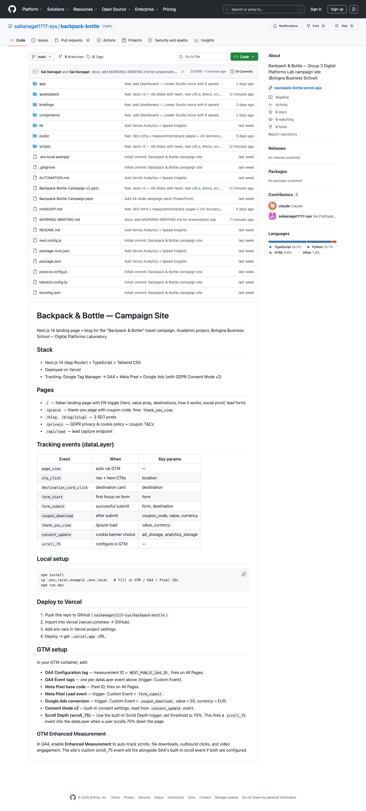
GROUP 3 · DIGITAL PLATFORMS LAB · BOLOGNA BUSINESS SCHOOL
LIVE · GITHUB REPOSITORY
Public · every commit auditable
Configuration as code: site, GTM JSON, briefings, Brevo templates · all in one repo
backpack & bottle · Group 3
49 / 54

Slide 50
GROUP 3 · DIGITAL PLATFORMS LAB · BOLOGNA BUSINESS SCHOOL
WHAT WE DELIVERED
Beyond the brief
Every brief requirement met · plus the infrastructure to launch tomorrow
✓
Live website
Next.js + Vercel · backpack-bottle.vercel.app · public
✓
Brand identity system
Wordmark · 6-color palette · Fraunces + Inter · voice guidelines
✓
5 destinations
Rome · Barcelona · Amsterdam · Lisbon · Prague · individual landing pages
✓
BB50 coupon
Branded PDF · €50 off · 90 days · validated
✓
Lead form + API
Server-side validation · rate-limited · Brevo + Meta CAPI fan-out
✓
Brevo automation
List 13 · 8-email welcome series · 7 personalisation attributes
✓
Tracking
GTM container live · 17 tags · 22 triggers · GA4 receiving events
✓
Compliance
Consent Mode v2 · cookie tracking · GDPR privacy + T&Cs
✓
3 SEO blog posts
/blog · IT + EN · long-form · internal linking
✓
Measurement plan
/measurement live · KPI tree · attribution model · audit-ready
✓
Stack page
/stack · 6-layer architecture · live + browseable
✓
Looker Studio (mock)
/dashboard · 6 panels · projection ready
backpack & bottle · Group 3
50 / 54

Slide 51
GROUP 3 · DIGITAL PLATFORMS LAB · BOLOGNA BUSINESS SCHOOL
WHERE TO FIND EVERYTHING
Live URLs · public · shareable
Bookmark these · they all work today
Live site
Hero / homepage
backpack-bottle.vercel.app
backpack-bottle.vercel.app/
Destination detail
Thank-you page
backpack-bottle.vercel.app/destinazioni/lisbon
backpack-bottle.vercel.app/grazie
Privacy & T&Cs
Blog (3 posts)
backpack-bottle.vercel.app/privacy
backpack-bottle.vercel.app/blog
Measurement plan
Stack architecture
backpack-bottle.vercel.app/measurement
backpack-bottle.vercel.app/stack
Looker mock
GitHub repo
backpack-bottle.vercel.app/dashboard
github.com/saikanagat1117-sys/backpack-bottle
Sitemap
Coupon PDF
backpack-bottle.vercel.app/sitemap.xml
backpack-bottle.vercel.app/backpack-bottle-coupon-BB50.pdf
backpack & bottle · Group 3
51 / 54

Slide 52
GROUP 3 · DIGITAL PLATFORMS LAB · BOLOGNA BUSINESS SCHOOL
12
Closing
Risks · what's next · thank you

Slide 53
GROUP 3 · DIGITAL PLATFORMS LAB · BOLOGNA BUSINESS SCHOOL
RISKS & MITIGATIONS
What could go wrong · what we'd do
Honest about uncertainty · plans on the shelf for each scenario
Meta CPMs spike
Form conversion below target
Italian travel CPMs rose 22% in 2025 summer. If they spike again, we shift budget to retargeting (lower CPM) and reduce broad awareness.
If form_submit < 5% by week 2, drop the 'departure city' field (cuts to 4 fields). A/B variant B (emotional CTA) moves to 100% rollout.
Brevo deliverability
iOS 14+ attribution loss
Free tier with new sender domain. If open rate <20%, we warm-up with 100 contacts before the campaign opens, then ramp.
Already mitigated: Meta CAPI server-side mirror covers ~30% of attribution that client-side Pixel misses.
Coupon abuse
Google Ads policy review
BB50 has min basket €300 + one-per-customer enforcement (Brevo dedupe by email + IP). Risk is low but monitored daily.
Travel + competitor bidding can trigger reviews. Pre-flight ad copy through policy checker, hold backup ad sets.
backpack & bottle · Group 3
53 / 54

Slide 54
GROUP 3 · DIGITAL PLATFORMS LAB · BOLOGNA BUSINESS SCHOOL
Thank you.
Skip the research fatigue.
GROUP 3
Sai Prathyaksh Kanagat · Marica Motta · Alberto Faggiotto
Cecilia Gullett · Marilu Stevens · Amelia Ruben
Live: backpack-bottle.vercel.app · Code: github.com/saikanagat1117-sys/backpack-bottle

