Slide 1
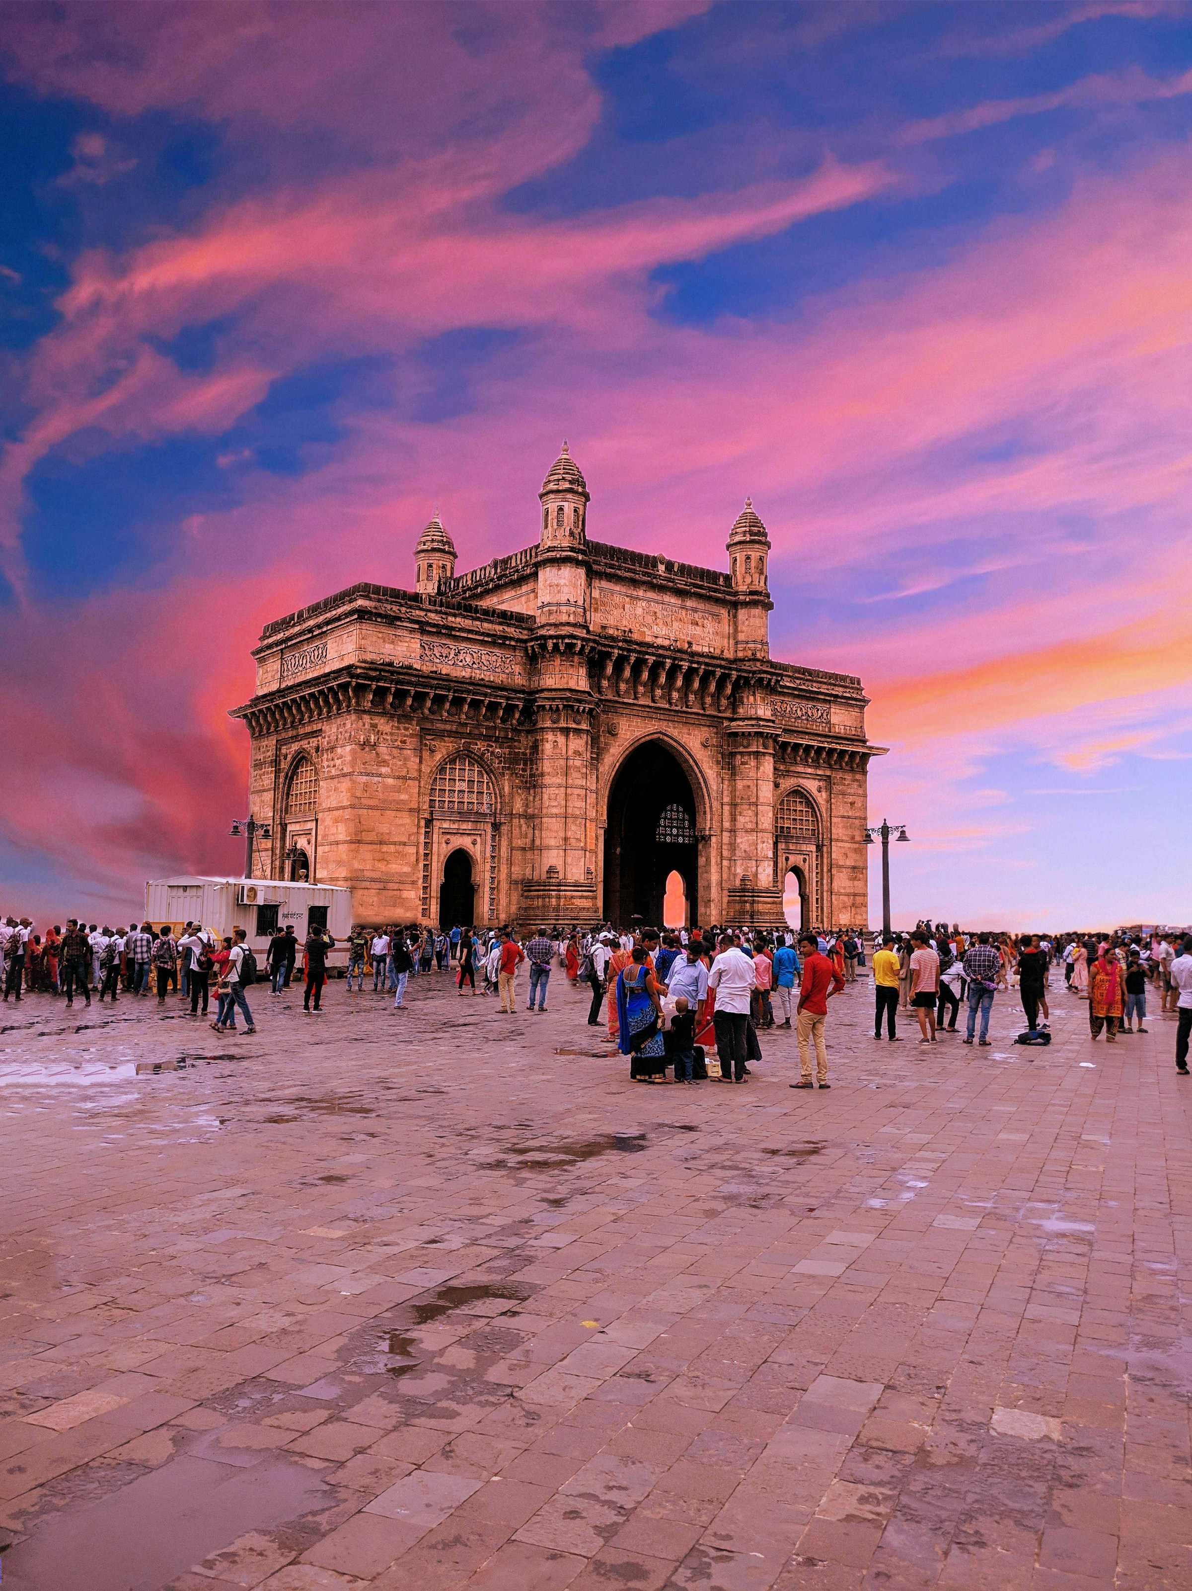
THE GOLDEN HOUR
A speculative launch for Aperol in India.
Strategy & creative direction
Sai Kanagat · Bologna, May 2026

Slide 2
A 90-second read.
This is a speculative campaign for Aperol's entry into India.
It does not sell a drink.
It names an hour.
Speculative · Sai Kanagat · 2026

Slide 3
India is the largest aperitivo opportunity in the world
that nobody is fighting for.
Aperitif market CAGR 2024–33
Asia-Pacific ████████████████████ 6.2% ← fastest
Latin America ████████████████ 5.1%
Europe ███████████ 3.8%
North America █████████ 3.2%
India's share of APAC aperitif growth today: <8%
India's share of APAC spirits market by volume: 67%
The asymmetry is the opportunity.
Speculative · Sai Kanagat · 2026

Slide 4
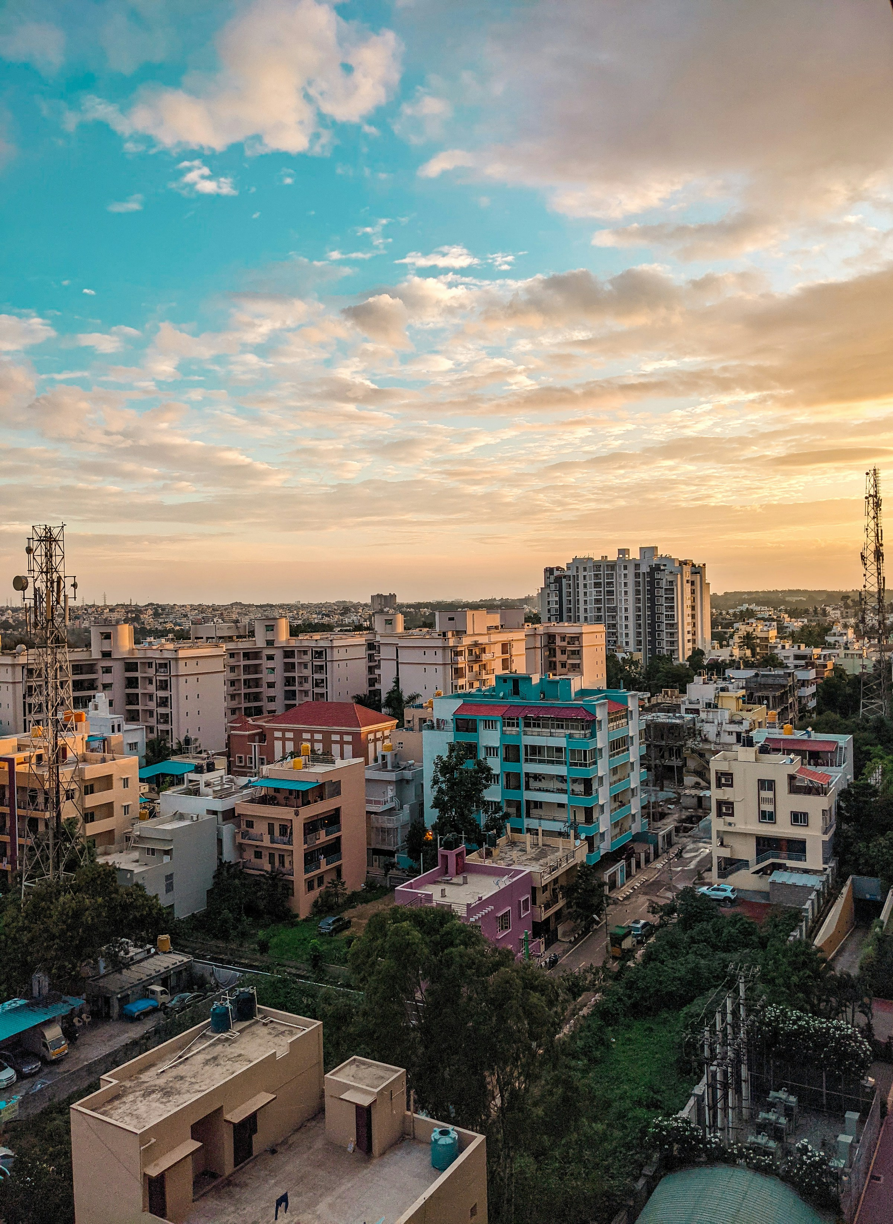
India has chai. India has dinner.
Between the two, there is a window
we have never named.
Speculative · Sai Kanagat · 2026

Slide 5
Don't Indianize the brand.
Let India inherit the ritual.
Most brand entries into India translate themselves
into "masala" versions of who they are.
Saffron palette over the logo. Suresh in the ad called Sunny.
The Reframer cohort smells this from a mile away and rejects it.
Aperol's move is the opposite:
Stay Italian.
Become Indian by being adopted, not adapted.
Speculative · Sai Kanagat · 2026

Slide 6
APEROL.
THE GOLDEN HOUR.
Speculative · Sai Kanagat · 2026

Slide 7
Between the day and the night,
there is an hour with no name.
The light turns gold.
The work is done.
Dinner is still coming.
Italy has worshipped this hour
for a hundred years.
India, the hour is yours now.
Pour. Sit. Look out.
Aperol. The Golden Hour.
Speculative · Sai Kanagat · 2026

Slide 8
The Urban Indian Reframer.
Age 25–34. Mumbai. Bangalore. Delhi NCR. Goa.
Individual income: €17K+ · Household: €33K+
Travels to Europe once a year.
Posts food and architecture, not selfies.
Drinks selectively — wants to be seen well, not drunk.
Female-skewed (55/45). Deliberate.
Their feed feeds the next 50 million Indians.
Speculative · Sai Kanagat · 2026

Slide 9
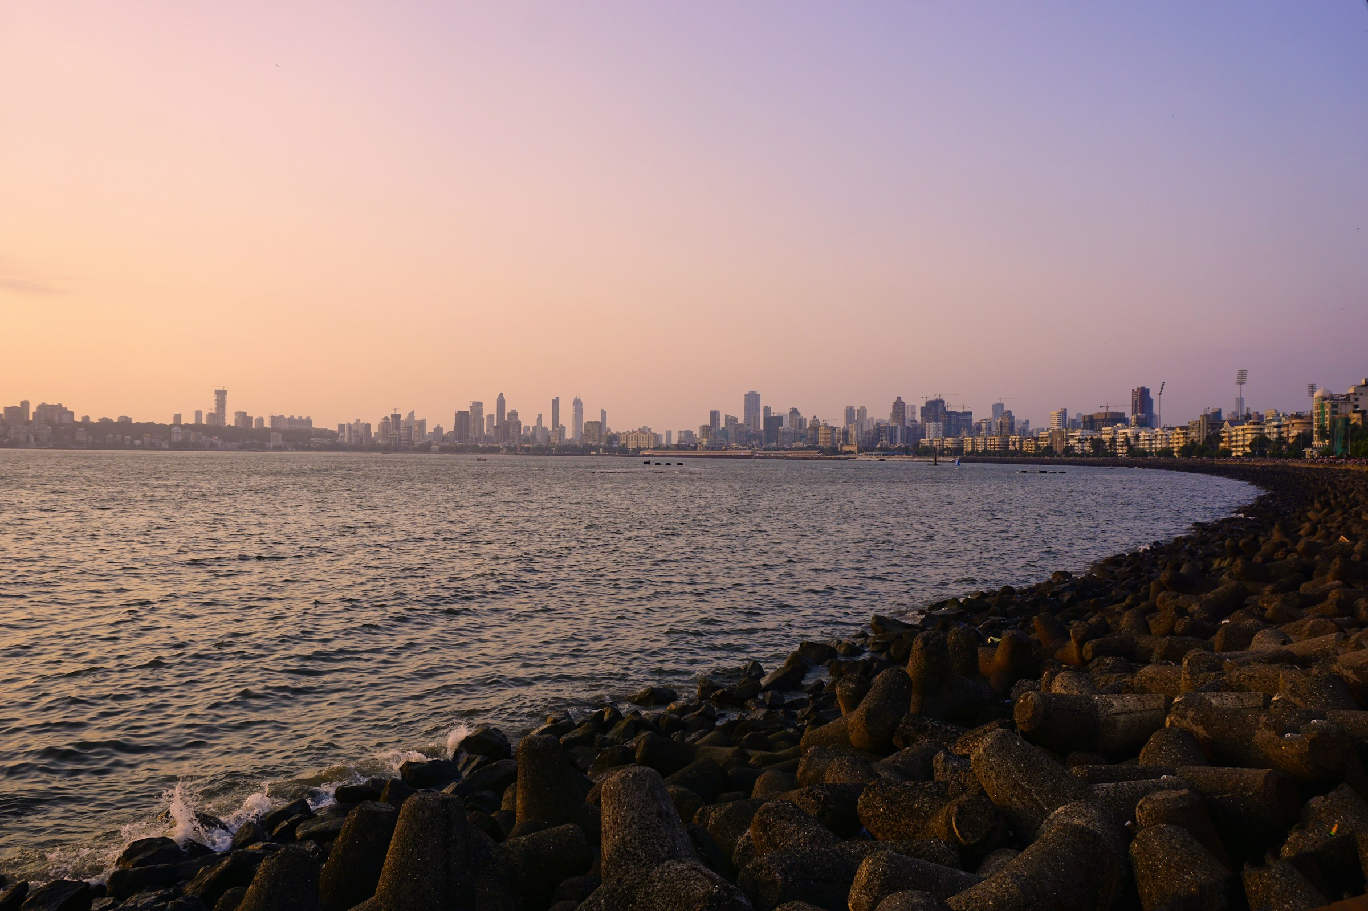
THE HOUR WITH NO NAME
▶
60-second hero film
60 seconds. Four cities. One color.
Speculative · Sai Kanagat · 2026

Slide 10
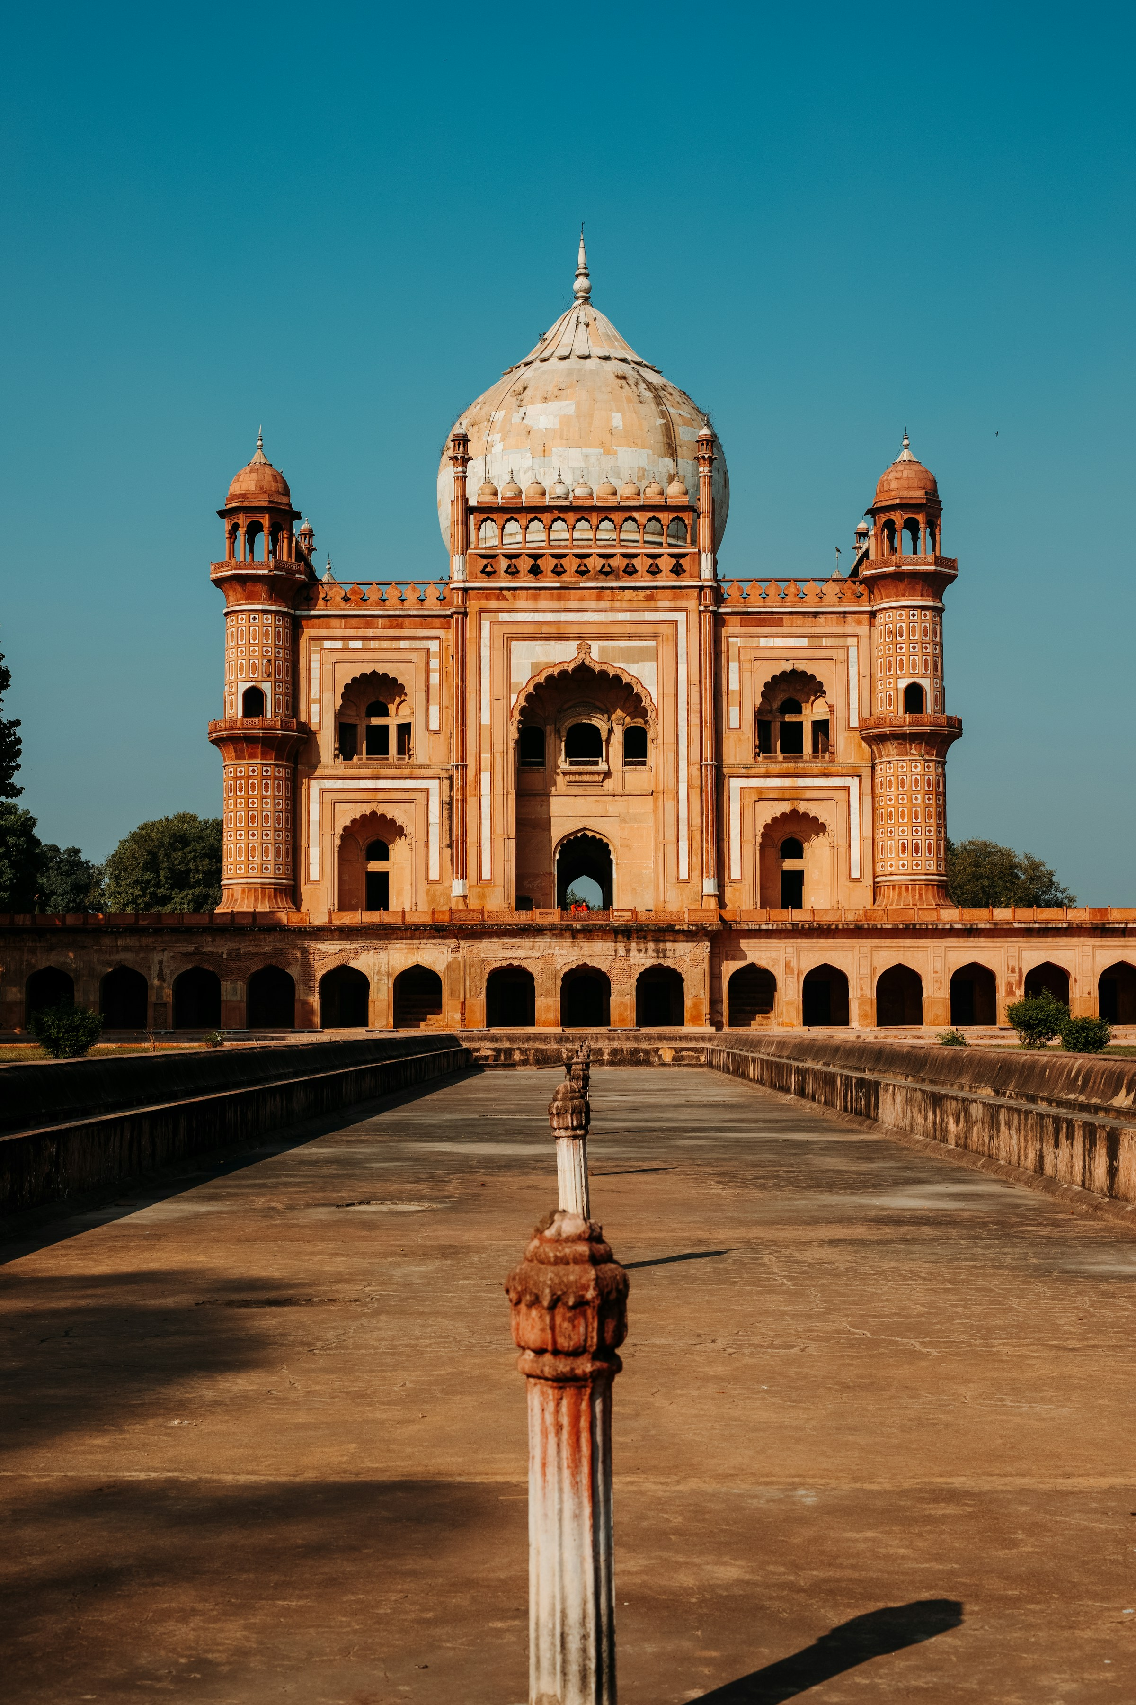
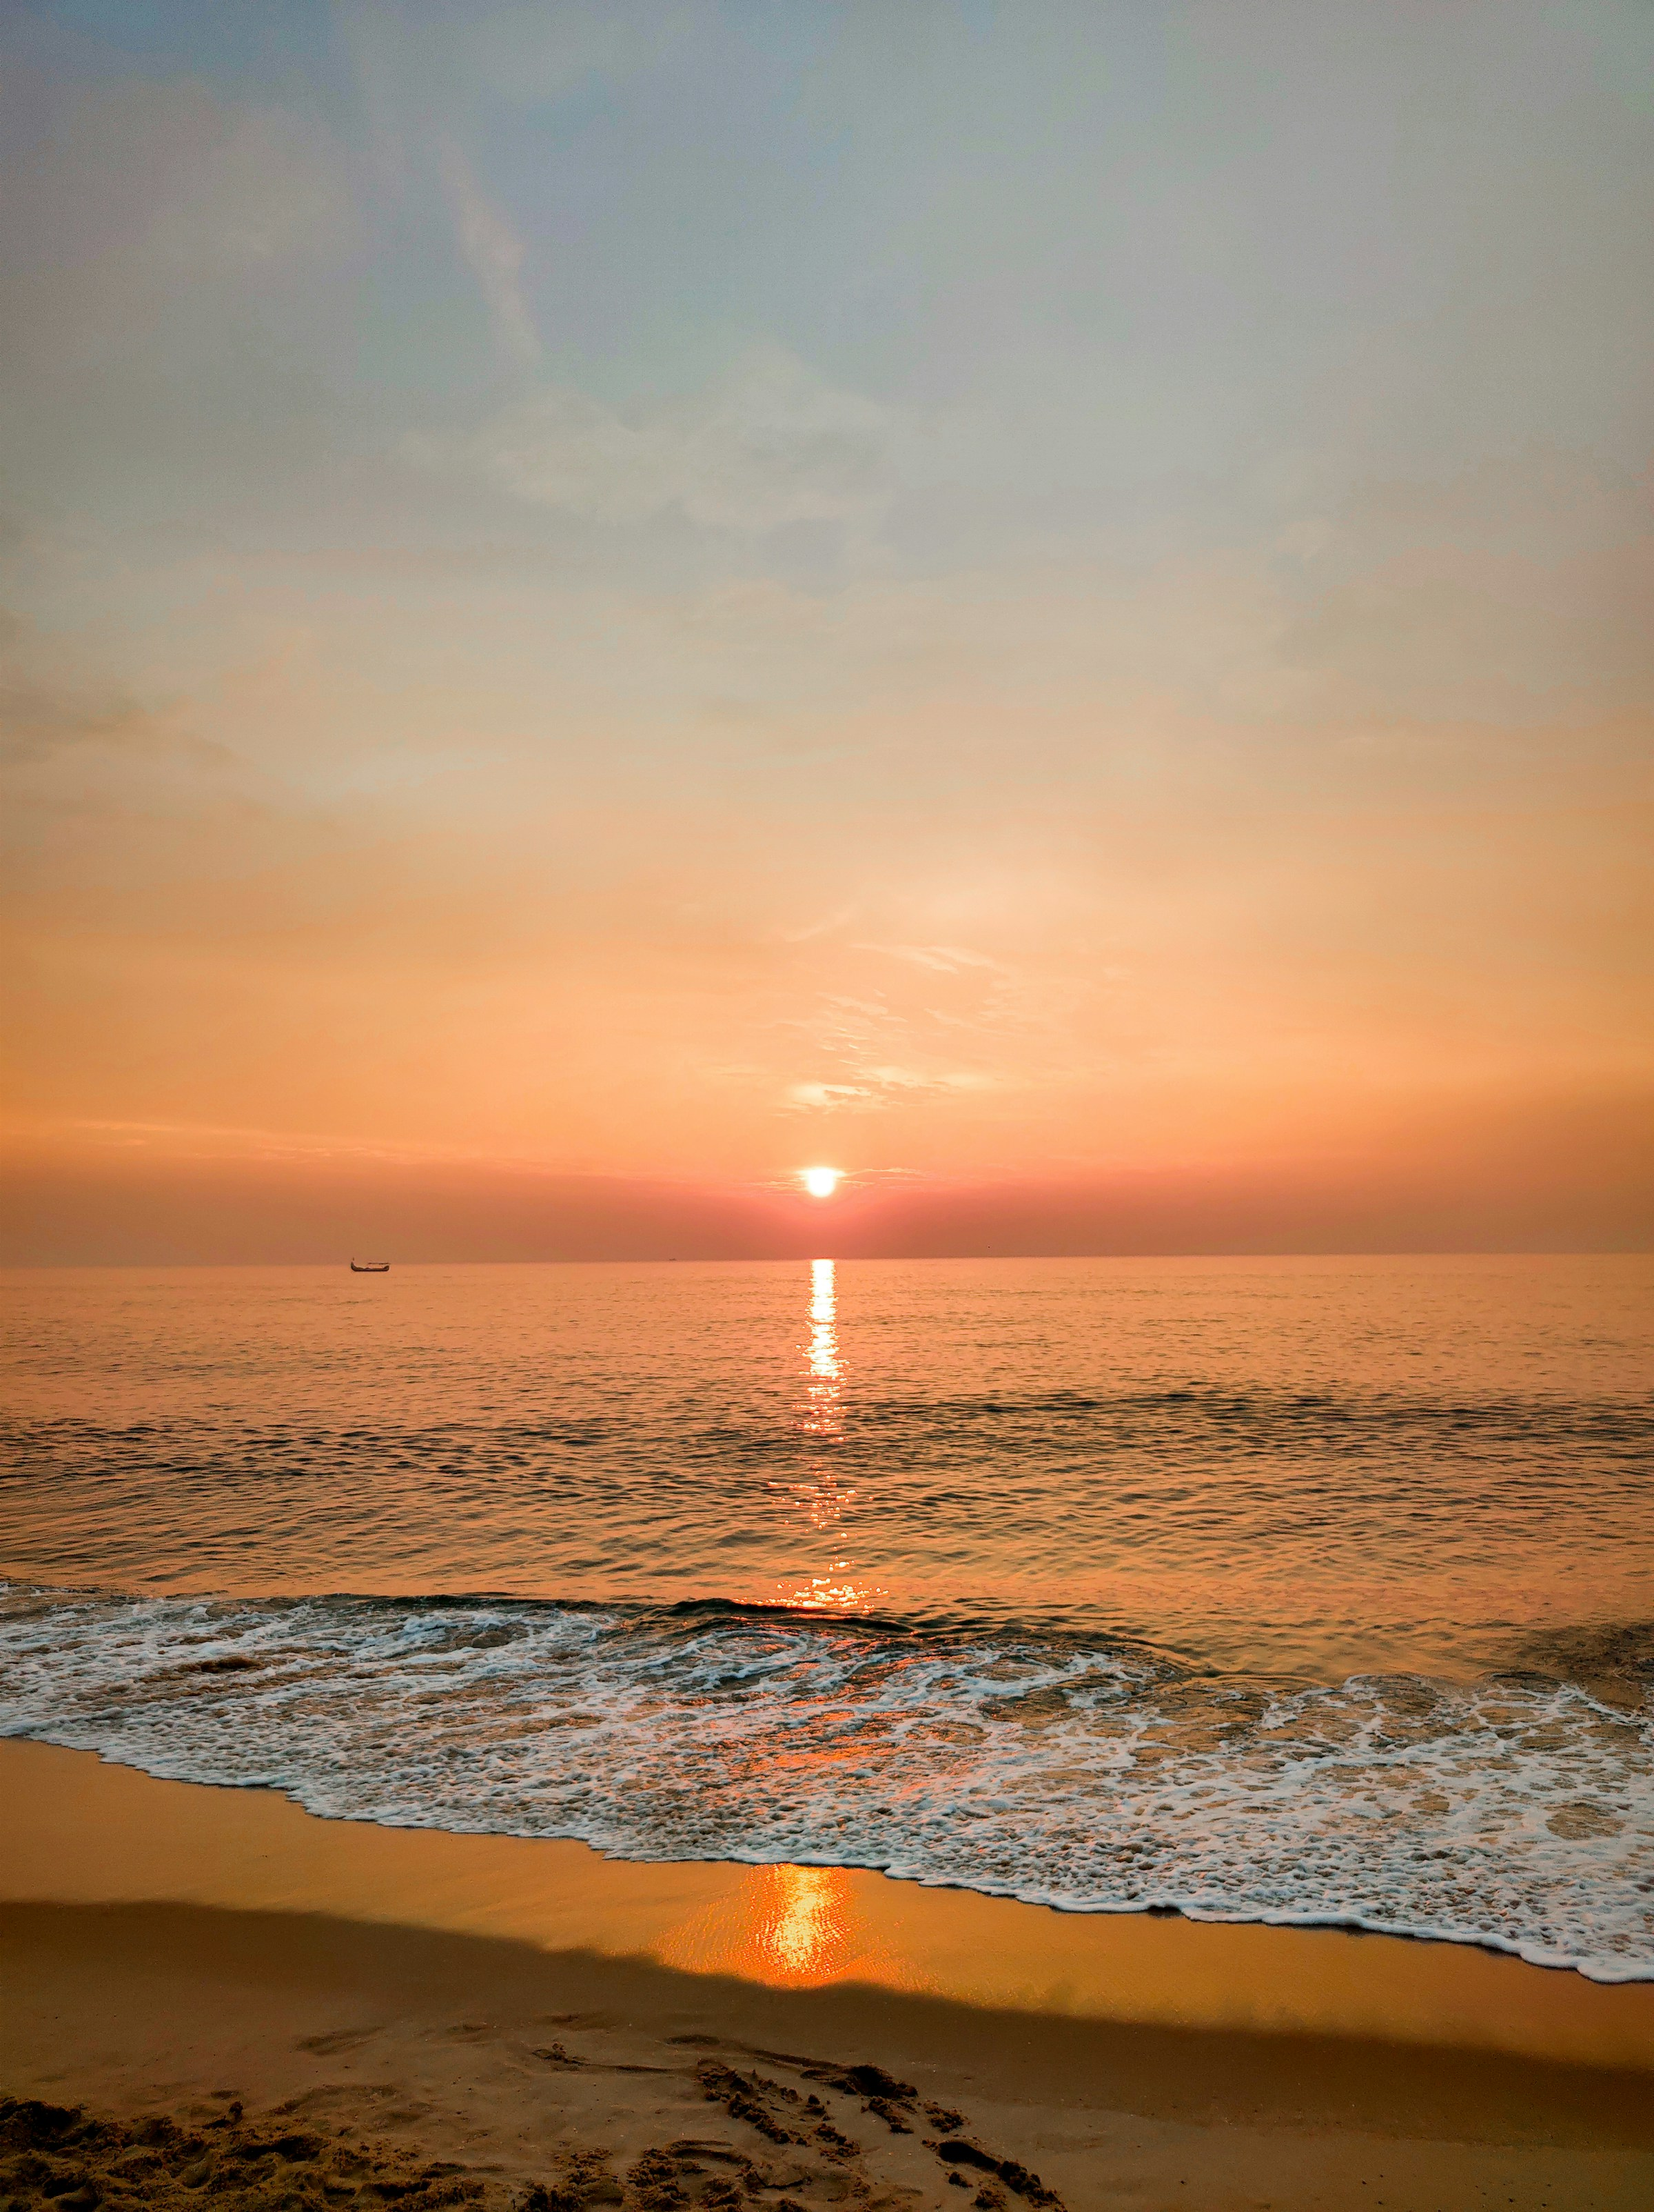
THE HOUR, IN FOUR CITIES.
Mumbai · 6:47 PM
Bangalore · 6:32 PM
Delhi · 6:51 PM
Goa · 6:41 PM
Speculative · Sai Kanagat · 2026

Slide 11
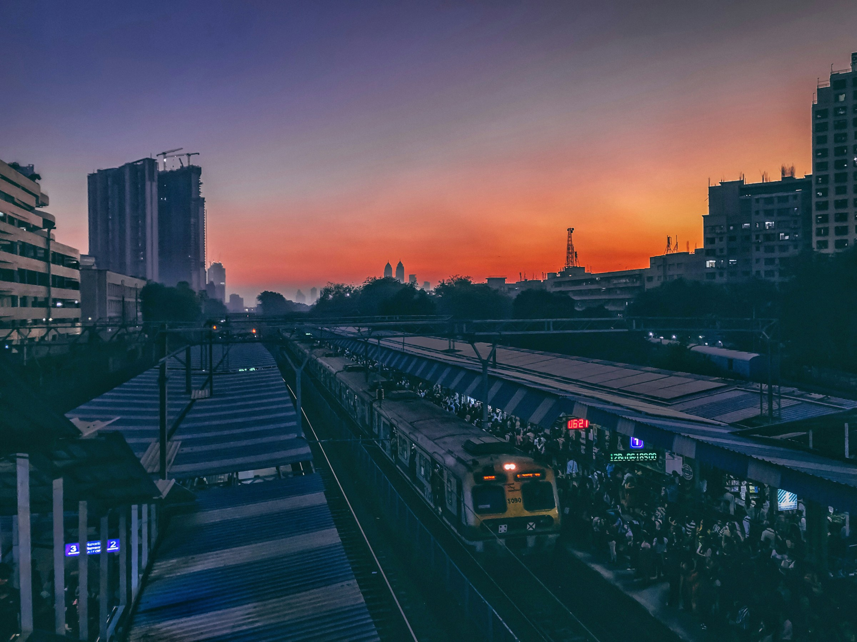
Billboards that ignite at the exact local sunset.
8 sites. 4 cities. Each billboard programmed
to shift to Aperol orange at the precise sunset minute,
every day, for 12 weeks.
Each ignition produces unprompted social capture.
The campaign earns its own OOH.
Speculative · Sai Kanagat · 2026

Slide 12
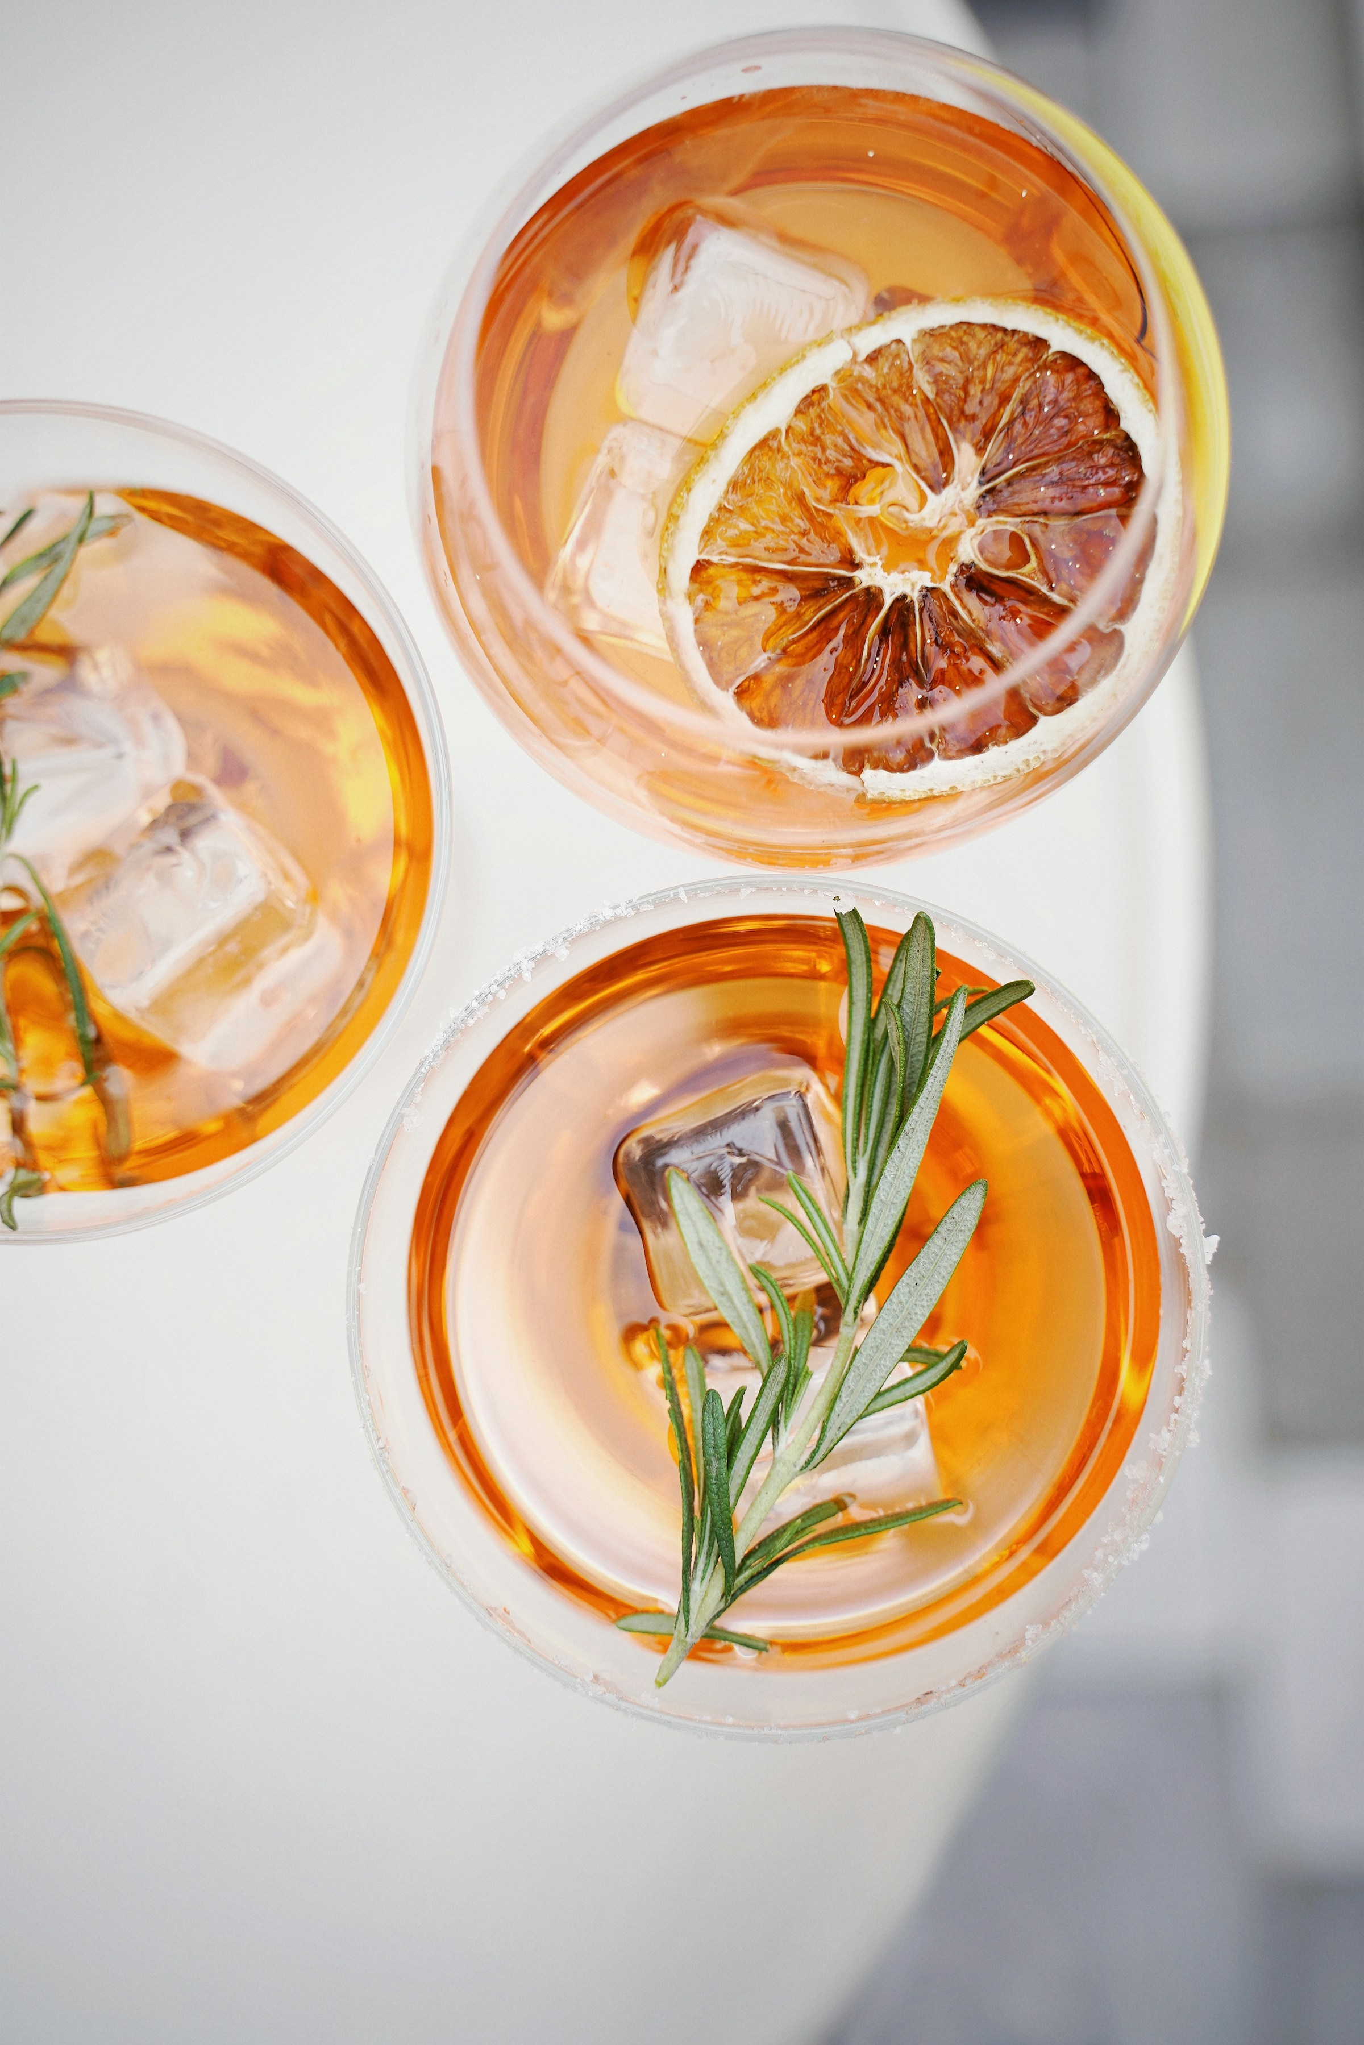
A daily-habit content layer.
Every day, at the exact local sunset minute,
four Instagram Stories go live — one per city — naming the time.
1,460 unique posts per year. Auto-generated.
365 daily reasons to open the account
that have nothing to do with selling.
Speculative · Sai Kanagat · 2026

Slide 13
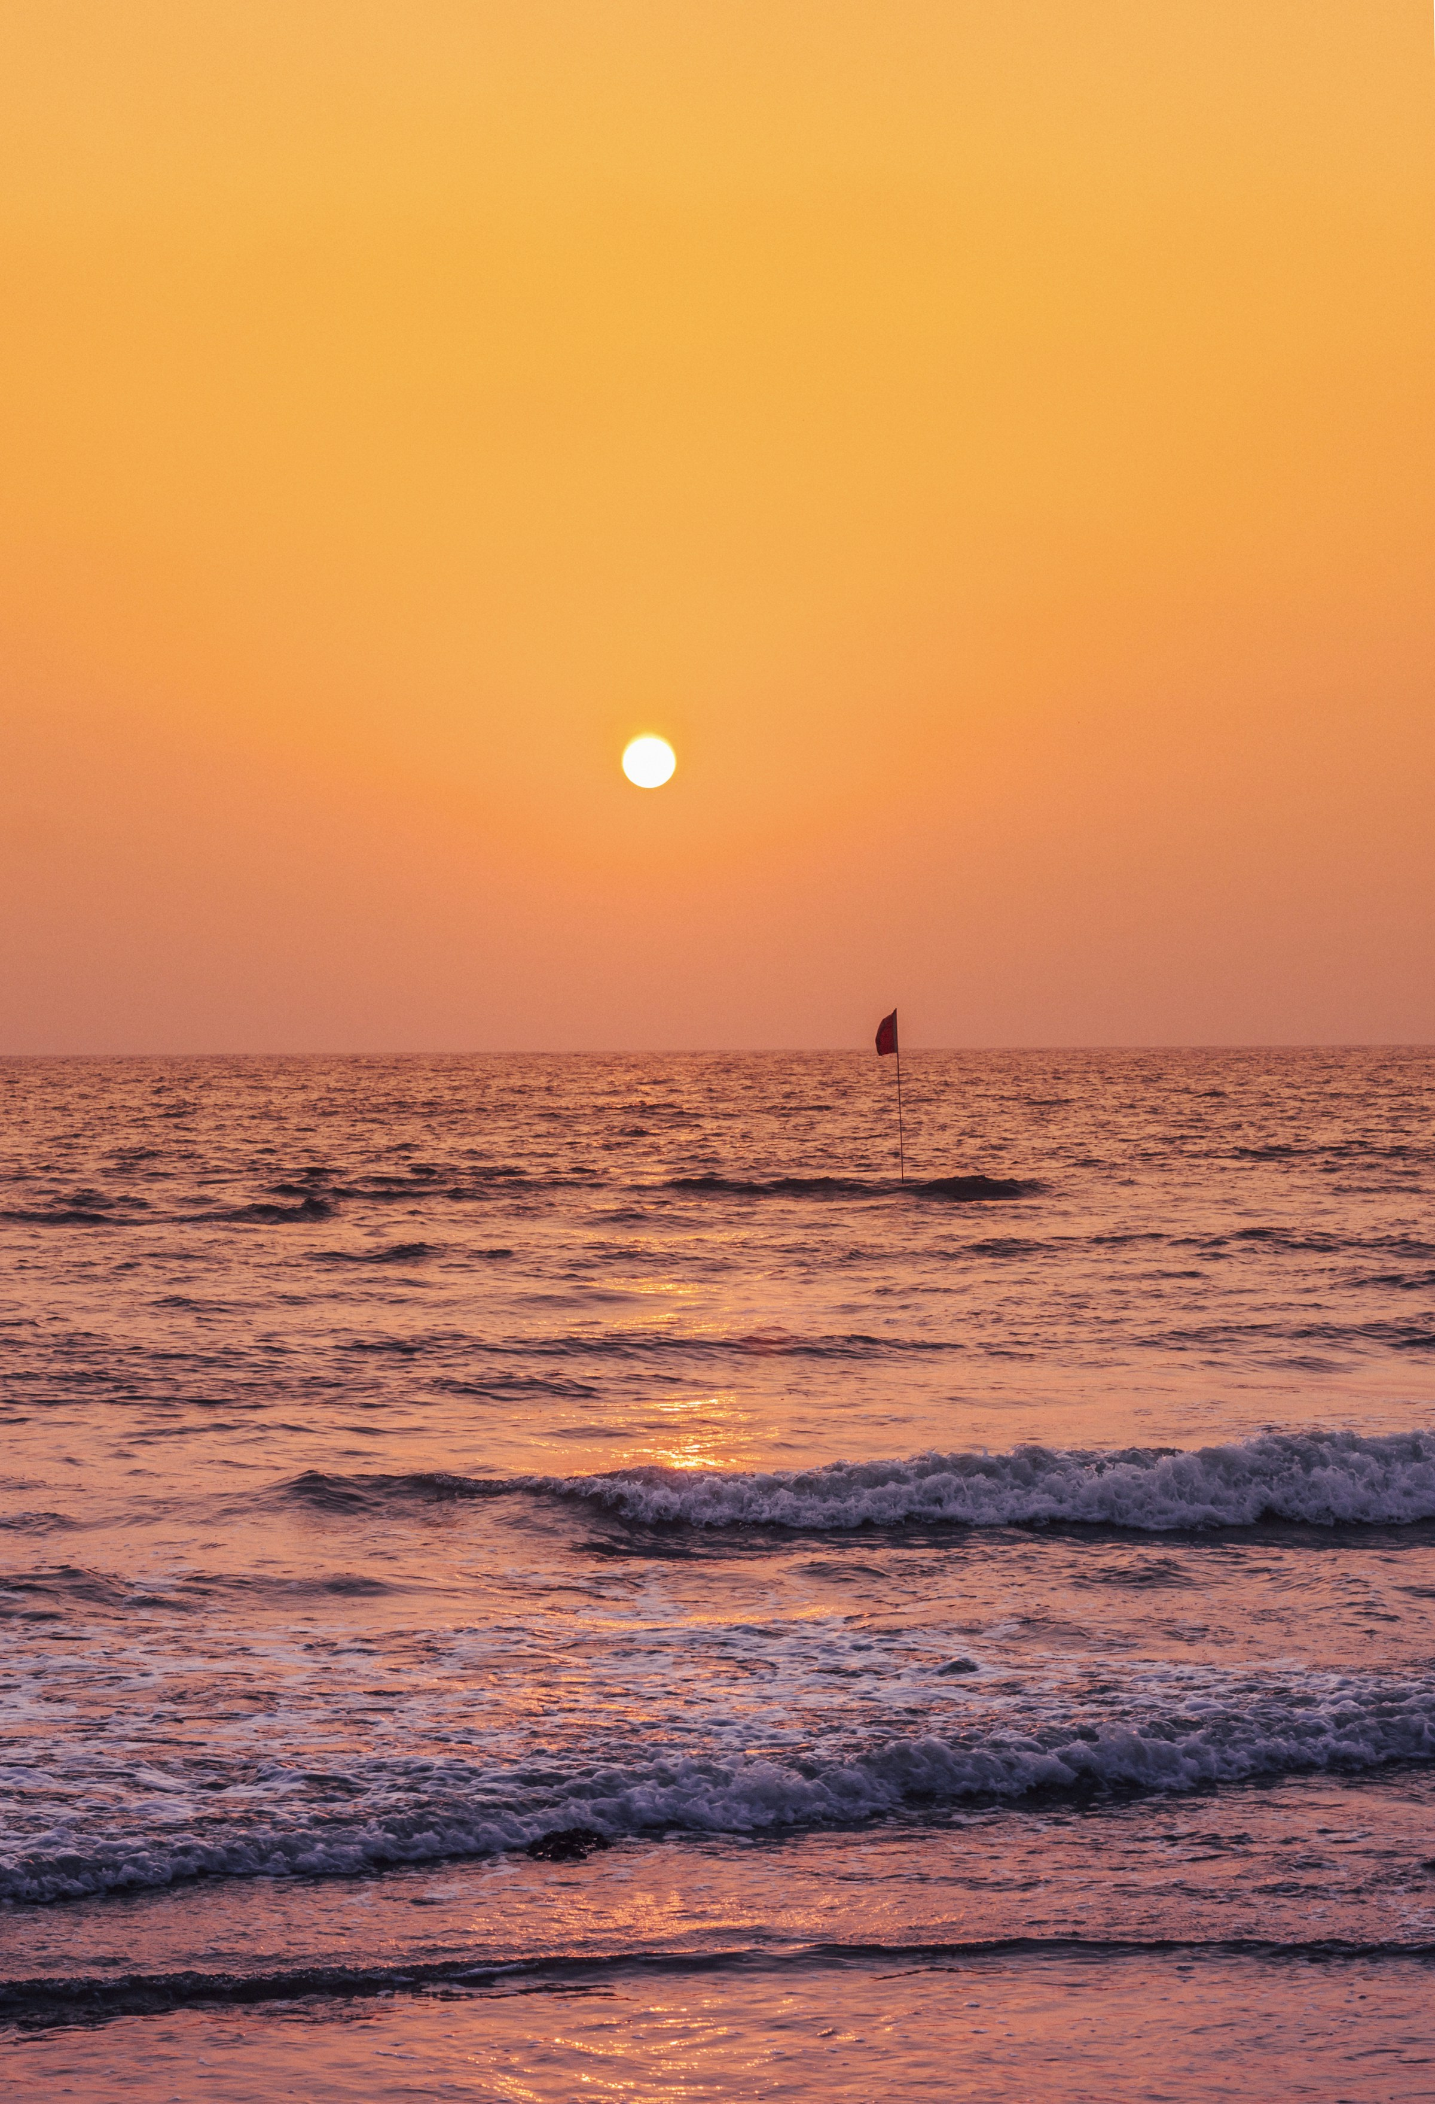
Four rooftops. Four cities. Open only between 6 and 9.
THE GOLDEN HOUR TERRACES
Mumbai · BKC rooftop · Hussain Shahzad × Diego Rossi · 220/night
Delhi · Lutyens bungalow · Manish Mehrotra × Stefano Cavallini · 180/night
Bangalore · UB City lounge · Manu Chandra × Riccardo Camanini · 250/night
Goa · Vagator cliff · Thomas Zacharias × Davide Caranchini · 150/night
8 weeks per city. Reservations open daily at sunset. €30 per cover.
60 nights of content. 4,000+ tagged Instagram posts. 25+ tier-1 features.
The activation pays for itself.
Speculative · Sai Kanagat · 2026

Slide 14
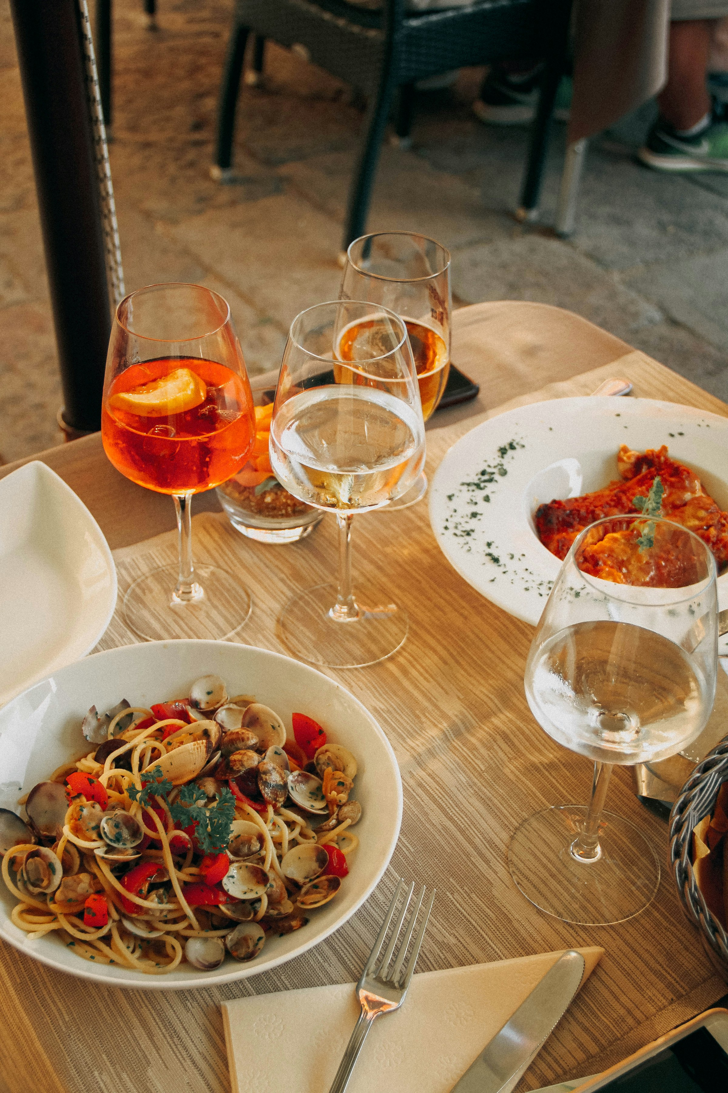
Not Italian. Not Indian.
Two chefs in one kitchen.
Sample menu — Mumbai (Hussain Shahzad × Diego Rossi)
Italian side Indian side
Bone marrow on khari biscuit Parmigiano-stuffed pakora
Veal tongue, Konkan plum Pepper-fry pork on brioche puri
Kashmir saffron fennel risotto Goan choriz cacciatora, polenta
Six cocktails. All Aperol-based.
€30 cover. Two drinks included.
Speculative · Sai Kanagat · 2026

Slide 15
Designed by what we removed.
No bar seating. Everyone is at a table, looking out.
No overhead bulbs. The Terrace dims with the sun.
No DJ in Goa. Acoustic only — we make it a salon again.
No walk-ins, no late seating, no exceptions.
A 6:00 PM bell opens the night.
A 8:45 PM bell closes it.
Every guest leaves with a printed card —
tomorrow's sunset time, no QR code, no URL.
Half throw it. Half become evangelists.
Speculative · Sai Kanagat · 2026

Slide 16
We follow them. We don't brief them.
10 hand-picked creators. Multi-deliverable, multi-month deals.
One brief, one rule: capture YOUR Golden Hour.
We don't art-direct. We don't post-review. We don't ask for the bottle.
The architecture photographer. The indie chef.
The poet. The textile designer. The Goa surfer.
The film photographer doing 35mm street work.
The middle tier — 50K to 300K followers.
The hand-picked who have taste and reach, not fame.
Speculative · Sai Kanagat · 2026

Slide 17
€4.4M. Year 1.
Channel % Spend
Paid social 30% €1.32M
OOH (4-city sunset) 22% €970K
Experiential 20% €880K ← pays for itself
Creators 12% €530K
Editorial & PR 8% €350K
Trade 5% €220K
Production 3% €130K
100% €4.4M
Speculative · Sai Kanagat · 2026

Slide 18
Seed. Anchor. Habit.
Phase 1 — SEED (M1–3) · €500K
Creator drops. Editorial seeds. On-trade activation.
Zero paid media. Phrase enters the world via Indian voices first.
Phase 2 — ANCHOR (M4–9) · €2.65M
Hero film. Terraces open. OOH ignites. Mass-market the phrase.
Phase 3 — HABIT (M10–18) · €1.25M
Sunset Report becomes daily ritual. Retail SKU launched.
The campaign becomes culture.
Speculative · Sai Kanagat · 2026

Slide 19
We measure culture before we measure cases.
Year 1 targets
Cultural
Unaided "Golden Hour" mentions / month 1,000 → 25,000 by Y2
Earned editorial features 12 → 30 by Y2
Behavioral
% target cohort drinking 6–9 PM, 2x/mo baseline → +8pp
Geo-tagged Aperol IG posts from India 5,000 → 50,000 by Y2
Commercial
Aperol India volume vs. baseline +60% → +200% by Y2
Premium on-trade penetration (top 200) 35% → 75%
Bottle price held above €28
Volume follows ritual. Always.
Speculative · Sai Kanagat · 2026

Slide 20
This campaign was built by one person in six weeks.
Strategy, creative, all 17 hero KVs, the 60s hero film,
3 cutdowns, OOH mockups, microsite, this deck —
all produced by Sai Kanagat
between May 22 and June 30, 2026.
Tools:
Claude · Google AI Studio · Kling AI · Plain HTML
Total tooling cost: €0 / month.
The same campaign through traditional production:
€130K in content costs alone.
AI-native production reshapes the marketing P&L.
This case study is the proof.
Speculative · Sai Kanagat · 2026

Slide 21
The honest section.
"Golden Hour" feels imported / colonial
→ Phase 1 Indian voices own the phrase before any brand activation.
Regulatory pushback on OOH
→ Surrogate-free, no product shot. Orange color does the work.
Terraces under-attended in Year 1
→ 150–250 seat caps create scarcity, not risk.
Aperol's bitterness vs. Indian palate
→ On-trade sampling lets bartenders titrate.
Competitive entry from Diageo or Pernod
→ First-mover ownership of the phrase. Language is the moat.
Speculative · Sai Kanagat · 2026

Slide 22
Four weeks to launch-ready.
Week 1 Qualitative validation — 30 Reframer interviews across 4 cities
Week 2 Creator scouting + chef partnership negotiations
Week 3 Director shortlist + film treatment + venue contracts
Week 4 Phase 1 trade & editorial activation begins
Month 4 Hero launch.
Speculative · Sai Kanagat · 2026

Slide 23
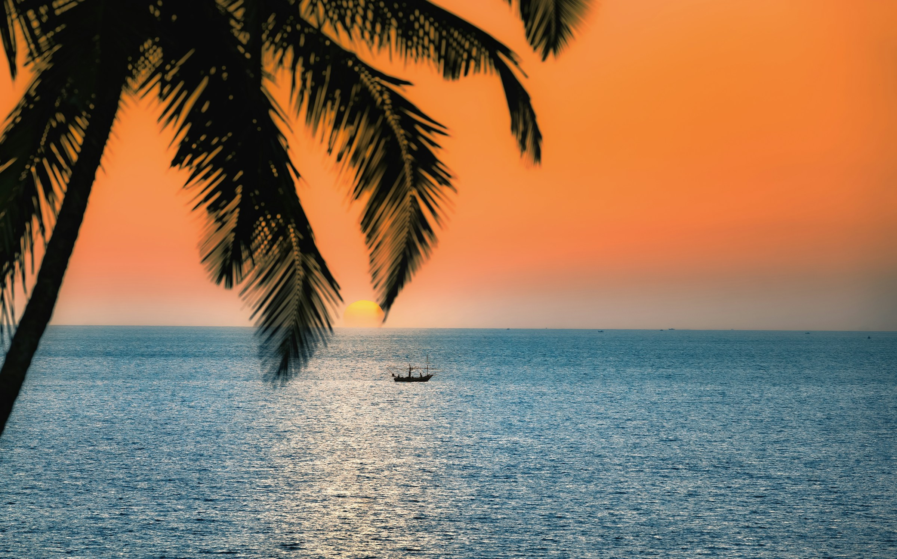
APEROL.
THE GOLDEN HOUR.
Speculative · Sai Kanagat · 2026

Slide 24
THE GOLDEN HOUR
A speculative campaign by Sai Kanagat
May–June 2026 · Bologna, Italy
Strategy, creative direction, prompting, edit:
Sai Kanagat
Visuals: Stock photography (Unsplash) + AI-generated (Google AI Studio)
Film: AI-generated (Kling AI), directed by hand
Microsite: Hand-coded HTML
This work is speculative.
It is not affiliated with, endorsed by,
or commissioned by Campari Group or Aperol.
All trademarks belong to their respective owners.
© Sai Kanagat, 2026.
saikanagat1117@gmail.com

Slide 25
6:47 PM, Mumbai.
The hour is yours.
Speculative · Sai Kanagat · 2026

