Slide 1
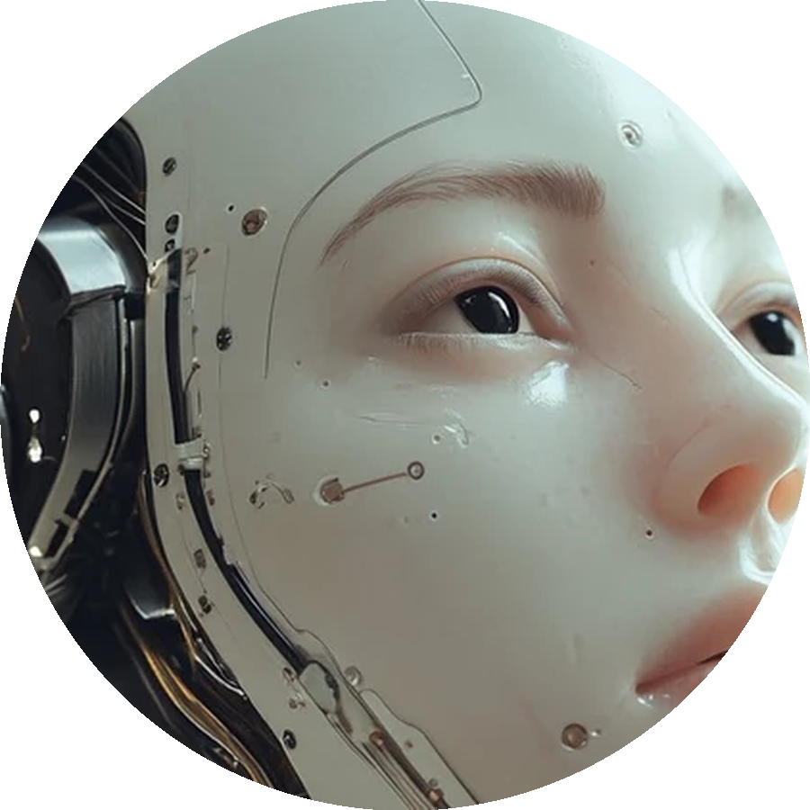
AI CONFESSOR
BY:
SAI KOUSHIK VIMMADisetty

Slide 2
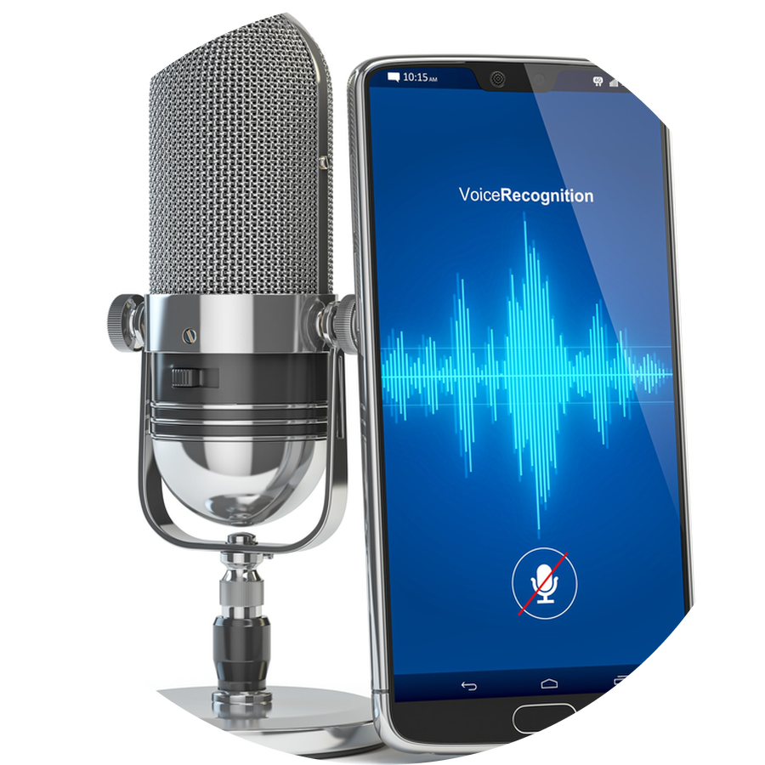
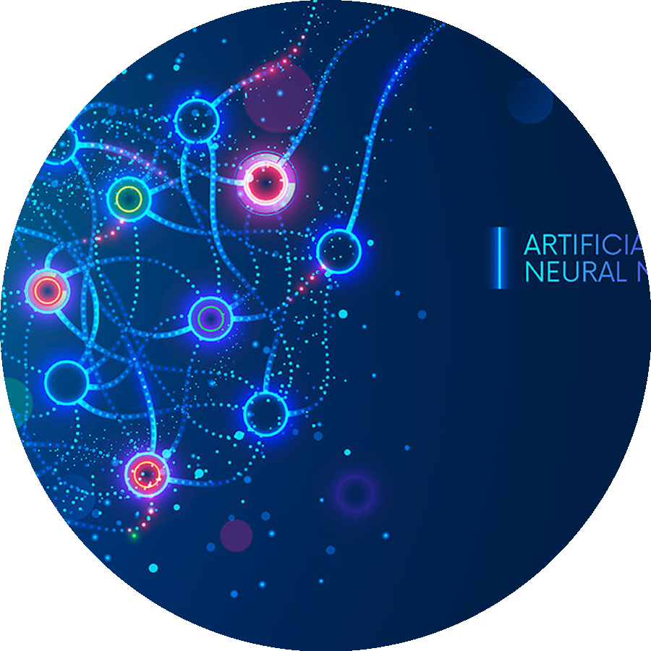
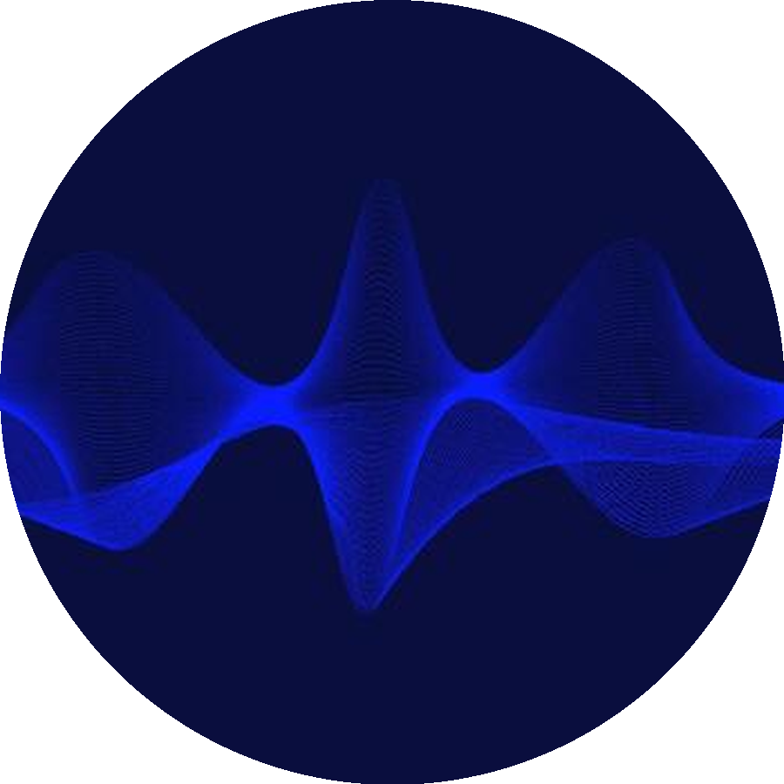
AGENDA
• Introduction
• Proposed method
• Techniques used
• Results
• Summary
• References
2

Slide 3
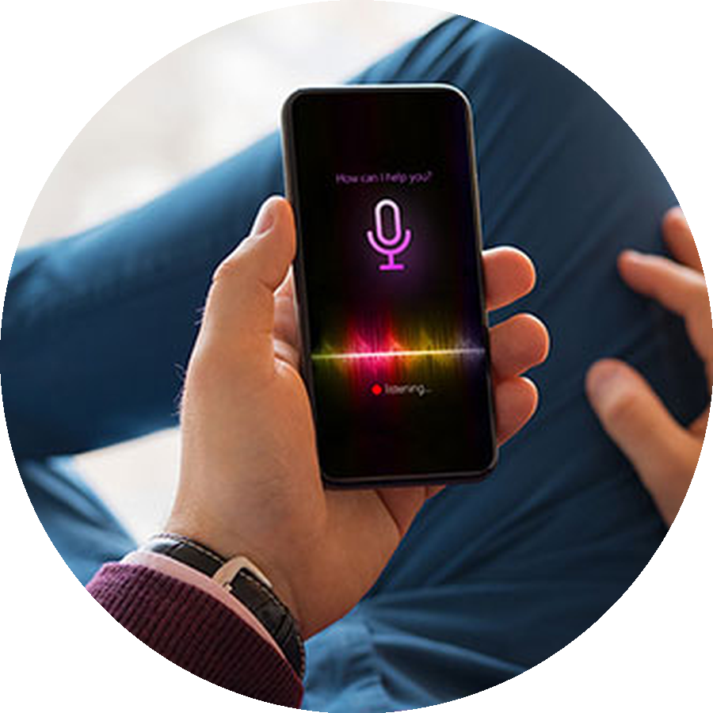
INTRODUCTION
○ Real-time conversational AI: a system you talk to, and it talks back
○ The problem: text-only chatbots feel slow, rigid, and unnatural
○ Voice is the most natural interface — no typing, no waiting
○ Goal: an always-on voice companion that listens, thinks, and speaks
3

Slide 4
WHAT IT IS
○ AI Confessor: a voice-first conversational AI web app
○ FastAPI backend (Python 3.12) + React + TypeScript + Vite frontend
○ Docker Compose: backend + frontend behind nginx
○ Live on AWS with Anthropic Claude (claude-sonnet-4-6) as the brain
4

Slide 5

PROPOSED METHOD: ARCHITECTURE
Mic → WebSocket → FastAPI → Vosk → LLM → Edge TTS → Speaker
○ Audio is captured in the browser and sent over a WebSocket
○ FastAPI transcribes the speech locally with Vosk
○ The text goes to the LLM; tokens stream back to the user live
○ Edge TTS converts the reply to speech for the speaker
5

Slide 6
WEBSOCKET PROTOCOL
○ One persistent WebSocket connection per conversation session
○ Session handshake on connect; ping/pong keeps the socket alive
○ Server pushes token deltas as the LLM generates them
○ Audio chunks in, text plus audio out — on the same socket
6

Slide 7
SESSION ISOLATION
○ Every session keeps its own conversation history
○ Sliding window trims old turns — the system prompt is always preserved
○ Concurrent users never see each other's history
○ Isolation verified with multiple simultaneous sessions
7

Slide 8
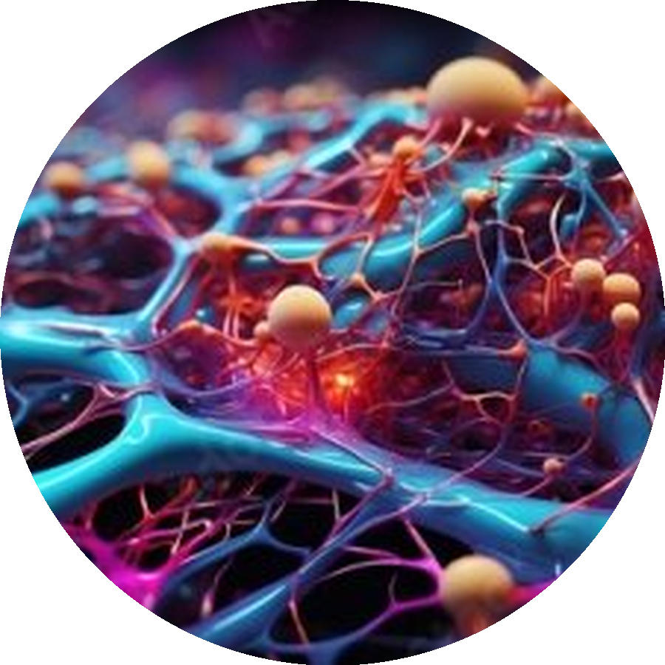
TECHNIQUES USED: LLM PROVIDERS
○ Pluggable providers, selected by the LLM_PROVIDER setting
○ anthropic — live deployment runs claude-sonnet-4-6
○ openai — supported with an OpenAI key
○ mock — offline provider for tests and QA
8

Slide 9

TECHNIQUES USED: VOSK + EDGE TTS
○ Vosk: speech recognition that runs fully locally — no cloud, no key
○ Model vosk-model-small-en-us-0.15 auto-downloads on first run
○ Edge TTS synthesizes voice replies server-side as mp3
○ Audio streams back over the WebSocket; the browser plays it through an audio queue
○ Voice toggle in the UI controls spoken replies
9

Slide 10

TECHNIQUES USED: AWS DEPLOYMENT
○ EC2 t3.medium in us-east-1 running Ubuntu 24.04
○ App runs in Docker Compose: backend + frontend behind nginx
○ Free public HTTPS via a Cloudflare quick tunnel pointed at the frontend (HTTPS is required for phone microphone access)
○ The Claude API key lives server-side only in the backend .env (chmod 600) — never in frontend code or Git
○ Deployment automated with EC2 user-data, which publishes the tunnel URL through the frontend container
○ Code pushed to GitHub (AI-Confessor repo)
10

Slide 11

RESULTS: QUALITY ASSURANCE
○ 12/12 mock WebSocket checks passed
○ 8/8 pytest suite passed
○ Concurrent-user sessions stay isolated
○ Vosk transcribed a 3.4 s clip exactly: “the quick brown fox jumps over the lazy dog”
○ Frontend production build: clean
○ Secrets scan clean — no keys in code
11

Slide 12
RESULTS: LIVE AWS TESTS
○ Page loads over HTTPS with no interstitial
○ Header shows claude-sonnet-4-6 connected (not mock)
○ Live chat test: the AI replied “PONG” exactly to a one-word instruction — proving live Claude, not canned replies
○ Microphone capture and speech-to-text confirmed working from an iPhone
○ Live URL: https://passed-tampa-single-efforts.trycloudflare.com (quick-tunnel URLs change on redeploy)
12

Slide 13
HONEST LIMITATIONS
○ The Cloudflare quick-tunnel URL is ephemeral — it changes on every redeploy (fine for a demo; a custom domain plus a named tunnel for production)
○ Edge TTS is a network service, so voice replies depend on connectivity
○ Single EC2 instance — no high availability yet
13

Slide 14

SUMMARY
○ Built: a voice-first conversational AI — FastAPI + WebSockets + React
○ Deployed: live on AWS (EC2 + Docker + Cloudflare HTTPS tunnel) with Claude claude-sonnet-4-6
○ Verified: QA suite green, live PONG test proves real Claude, iPhone mic/STT works
○ Secure by design: API keys live server-side only, never in frontend code or Git
14

Slide 15
REFERENCES
○ FastAPI — https://fastapi.tiangolo.com/
○ Vosk — https://alphacephei.com/vosk/
○ edge-tts — https://github.com/rany2/edge-tts
○ Anthropic Claude — https://docs.anthropic.com/
○ React — https://react.dev/
○ Docker — https://www.docker.com/
○ AWS EC2 — https://aws.amazon.com/ec2/
○ Cloudflare Tunnel — https://www.cloudflare.com/products/tunnel/
15

Slide 16
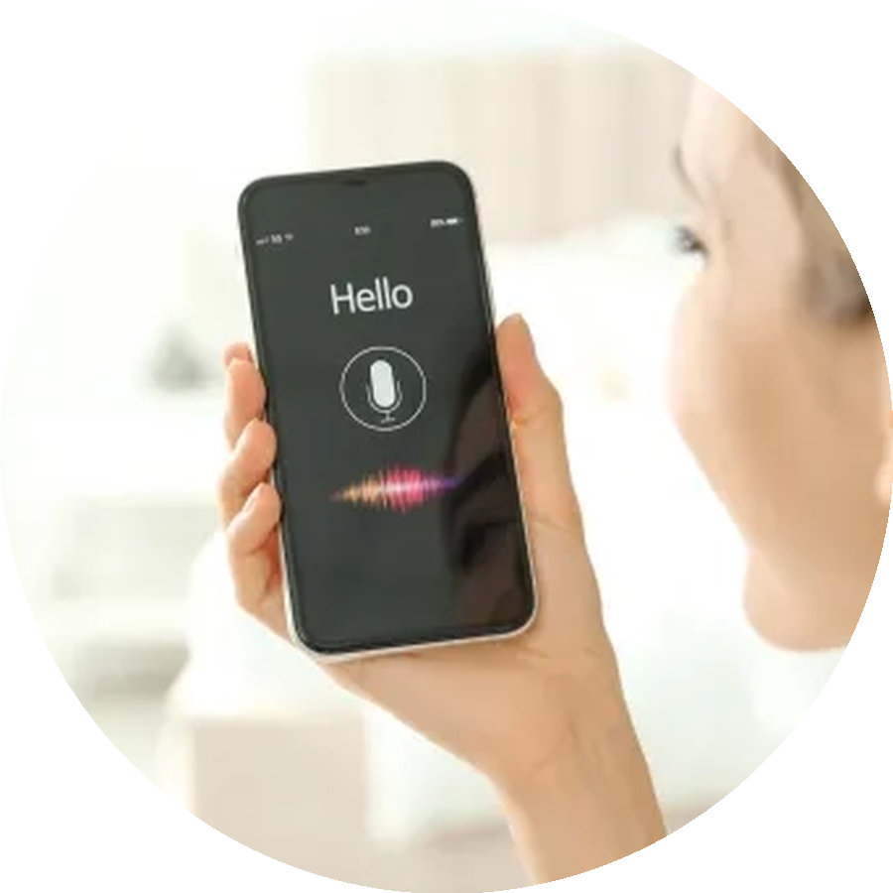
THANK YOU
AI CONFESSOR — SAI KOUSHIK VIMMADisetty

