Slide 1
Lending Club Case Study
Presented By:
Sai Krishna Somisetty
Mrityunjaya Shukla

Slide 2
Brief overview of available dataset
39717 data records with 111 parameters
Some parameters are all null
All loan application types are INDIVIDUAL
Certain columns like interest rate, employee experience etc are having suffixes in all values
2 loan statuses are unique across the dataset - 'Fully Paid', 'Charged Off'

Slide 3
Data Cleaning
Considered the loan status, which are Fully paid and Charged Off.
Deleted all the columns which contains empty values or NA.
Removed the rows which contains empty cells.
For the better analysis grouped the emp_length 10+ Years to 10 & <1 Year to 1
Created two new columns ‘Year’, ‘Month’ from ‘issue_d’ date column.
Columns 'emp_length', 'int_rate’ habing data type as Object, type casted to numeric.
Used Sort function to sort the column ‘Grade’ for the better view.

Slide 4
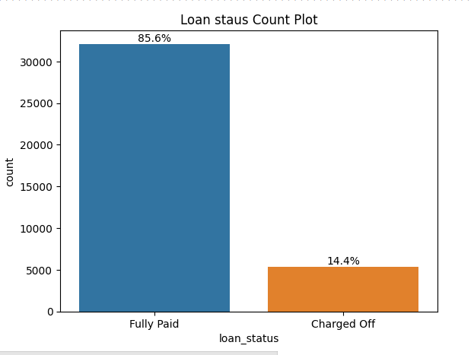
Majority of employees are able to fully pay loan

Slide 5
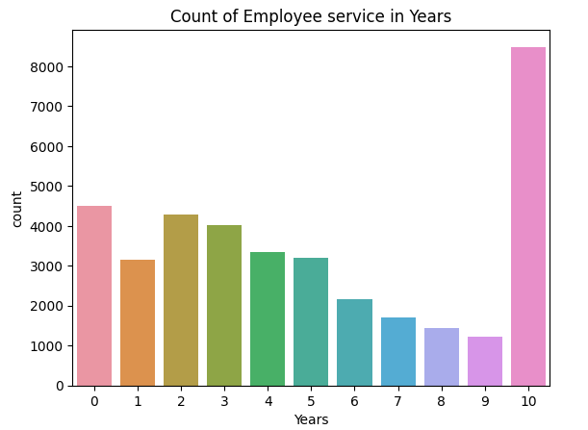
Employees (prospective lendees) profiles
Top 2 lendees are > 10 years and < 1 year experience
Loan taking appetite mostly is reducing with experience

Slide 6
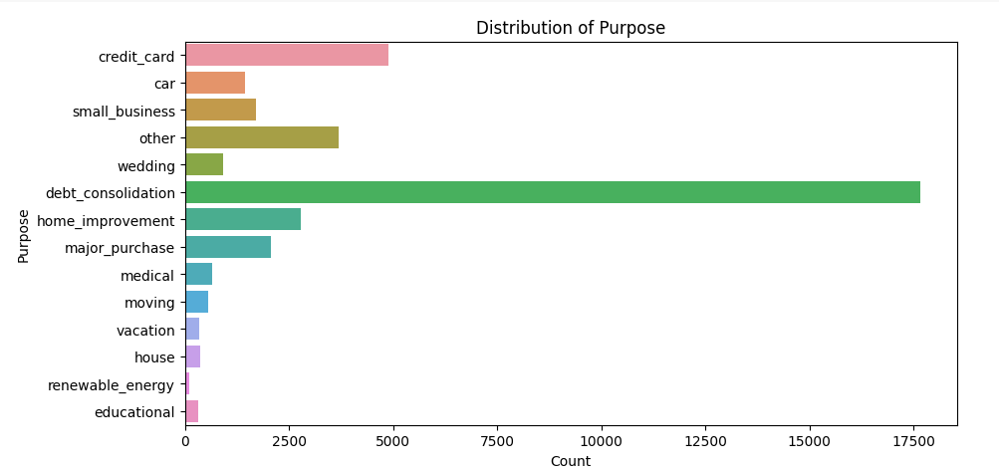
Loans category wise distribution
Debt consolidation is 3.5 times more than second highest share category (credit card)
Those who take loans take more loans to cover the previous loans

Slide 7
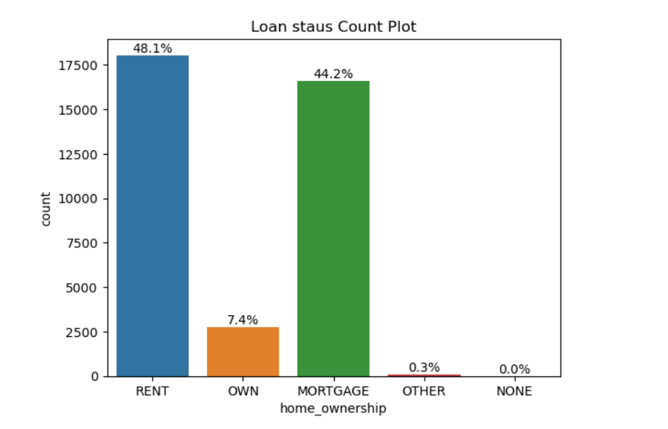
House Ownership
Most of the customers are either in Rented house or Mortgaged their house.
People who owns the house are less likely to apply for a loan.

Slide 8
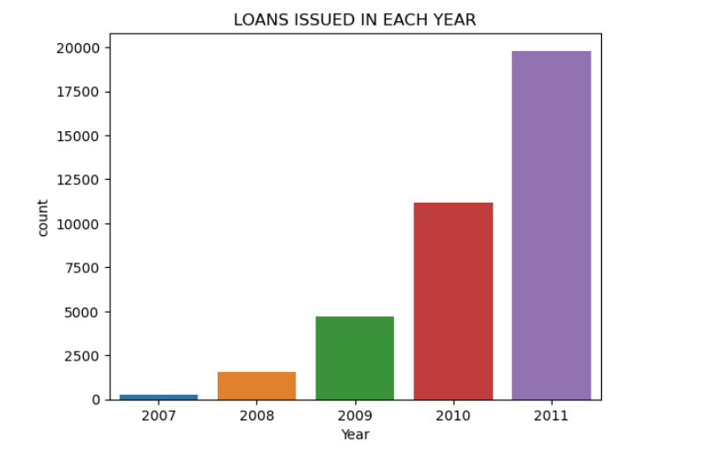
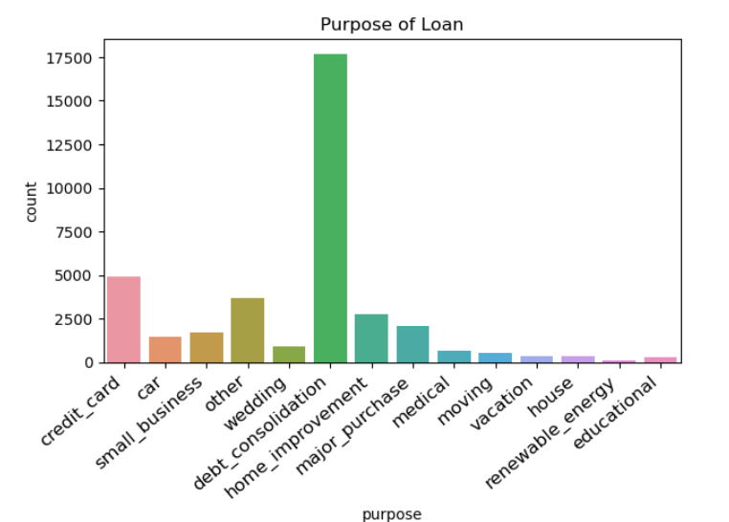
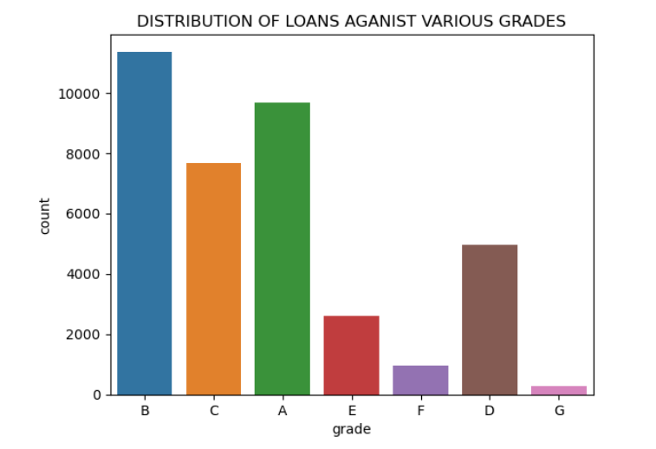
Most of the Loans are Issued in the Year 2011.
Majority of people applied for loan to accumulate their debt_Consolidation
High number of loans are applied by customers of Grade of B.

Slide 9
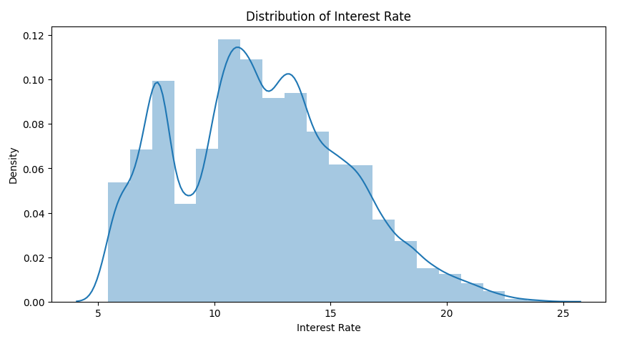
Loans interest rates wise distribution
11-15% interest rate most spread

Slide 10
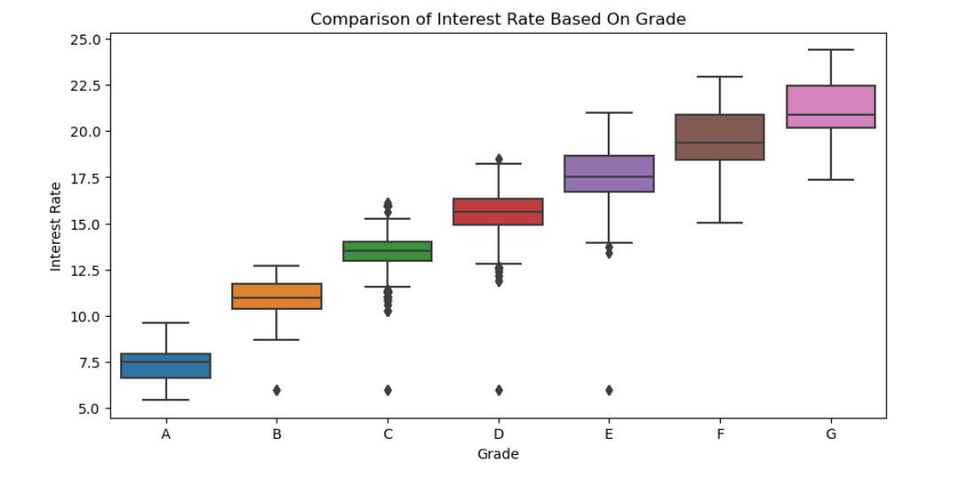
Box Plot for Interest rates on each grade

Slide 11
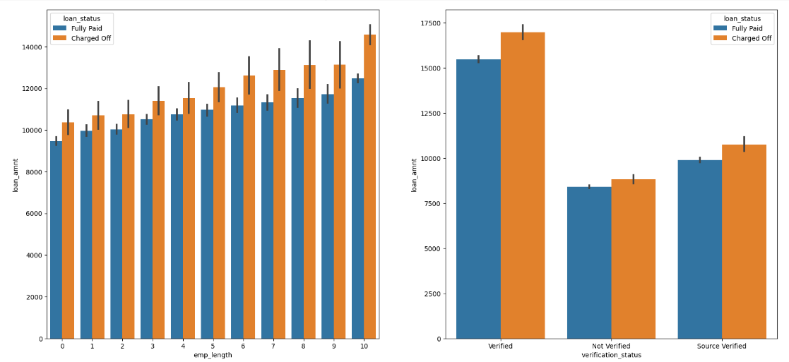
Employee attributes vs defaulting correlation

Slide 12
Employee attributes vs defaulting correlation (contd)
Charged off loan amounts are more than fully paid loans
The difference percentage increases with employee experience
Keeping track of the percentage difference over time for every year of experience will give a rough idea of threshold for fully paid loan amount

Slide 13
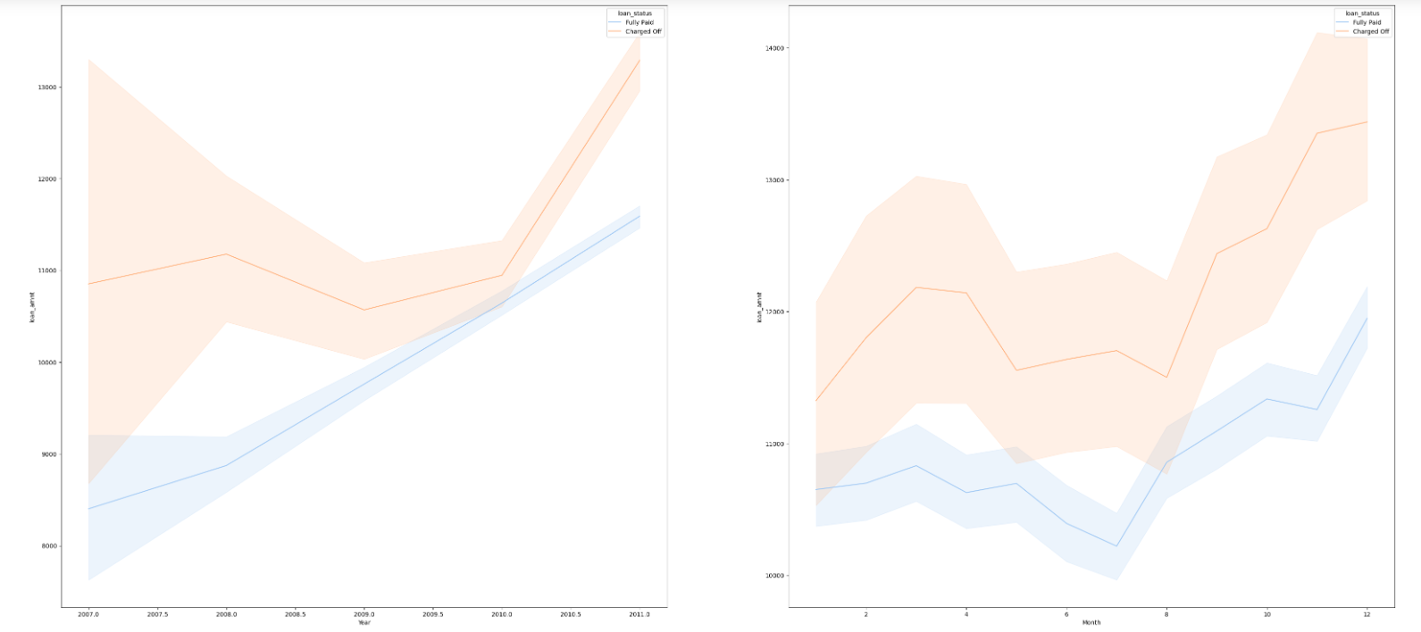
Line graph: Which shows loans issued in each month and a Year

Slide 14
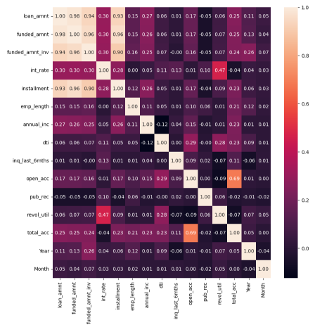
Insights from correlation map - 1
Installment amounts increase almost at par with loan amount, so the loan payment duration will mostly be the same across loan cycles
So the bigger the loan, the larger EMI discipline to be maintained. One miss and default probability increases. Hence smaller loans (to calculate as described in previous slide) should be aimed

Slide 15
Insights from correlation map - 2
Loan amount and interest rate have a feeble but not ignorable correlation(0.3), the more the loan amount it, interest rates are likely follow.
With annual increment, the debt to income ratio decreases, resulting in lesser risk of defaulting. Hence more experience results in dissolution of default risk.
However taking loan at any stage is susceptible to risk afresh at that experience level

Slide 16
Conclusion
Greater caution should be exercised while giving loans to <1 years and >10 years experienced employees
Grade G loans are of highest interest rates. High interest loans are susceptible to greater defaults. Hence amounts of grade G loans should be kept small.
The loan amount should be decided by reviewing the trend of loan disbursement (for fully repaid loan amount) in previous years and the corresponding loan amount increment rate

