Slide 1
A Comparative Study of Recommendation System for
Music on Spotify
Course: BIA 678 Big Data Technology
Professor: David Belanger
Team Members:

Slide 2
Index
Introduction-------------------------------------------------
Data Description
Data Overview-----------------------------------
Data Cleaning and Pre-Processing--------------------------------------
Algorithms Implemented-------------------------------------------
Results-------------------------------------------
Conclusion-------------------------------------------
References-------------------------------------------

Slide 3
Introduction
Recommendation systems play a vital role in modern digital platforms by providing personalized content recommendations tailored to individual user preferences.
So we developed a recommendation system for Spotify to enhance user experience and engagement.
Spotify is one of the world's largest music streaming platforms, offering a vast library of songs across various genres and artists.

Slide 4
Introduction Pt.2
Our focus was to build a machine learning-based recommendation system using song attributes to predict whether a user will like a song or not.
We Leveraged algorithms such as decision trees, random forests, and ensemble methods to analyze and predict user preferences.
This presentation will cover the dataset description, data cleaning, algorithm implementation, evaluation results, conclusions.

Slide 5
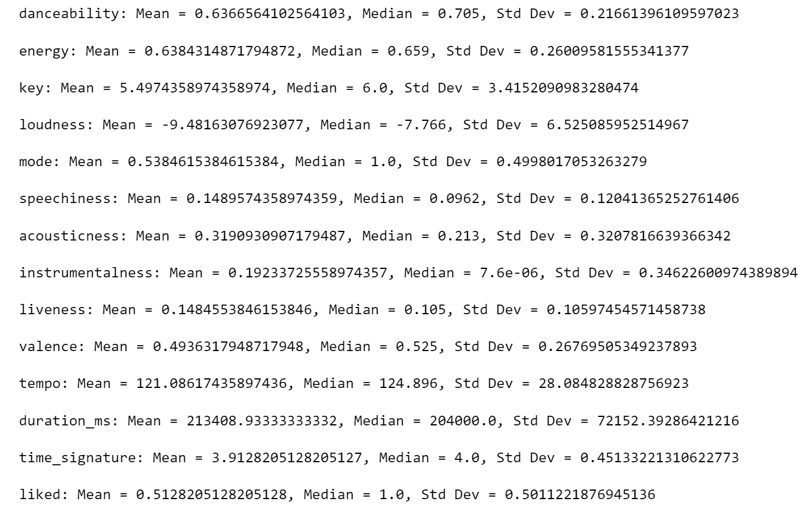
Data Description
Source of Data: The dataset used for our recommendation system was sourced from https://www.kaggle.com/datasets/arashnic/book-recommendation-dataset.
Dataset Composition: The dataset consists of 195 rows and 14 columns capturing various attributes of songs.
Importance of Data: The dataset forms the backbone of our Spotify recommendation system, providing crucial insights into song attributes and user preferences.
Data Quality: Despite its significance, the dataset required meticulous cleaning and preprocessing to rectify inconsistencies and ensure its suitability for our recommendation system.
Summary Statistics:
Notes:
There are two main tables that we used. 1. is the Market data from Intrinio. Within this there is our target variable, the 10 day return calculated on open prices and adjusted for market-residuals (Mktres), others includes stock price info, 1 day stock returns and 10 day stock returns.
2. is the News data from Thomson Reuters, including the headline of the news, the relevancy of the news piece, sentiment info, the article info, and the time effect of news, the novelty count and the trading volume count. We joined the 2 tables on date, and assetCode, to make sure that the news data we are using is specifically related to that stock on that day. It is also worth mentioning that we did not use the textual data, because it involves running Regression-NN models using Pyspark, which is not applicable currently after we done some research.

Slide 6
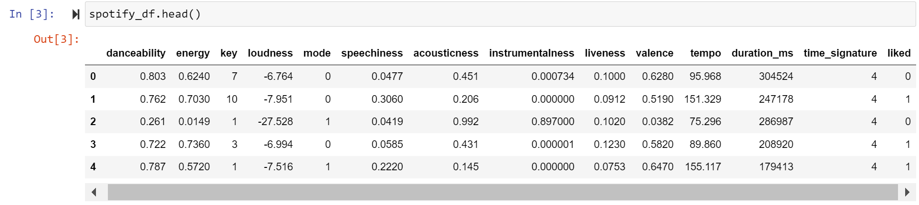
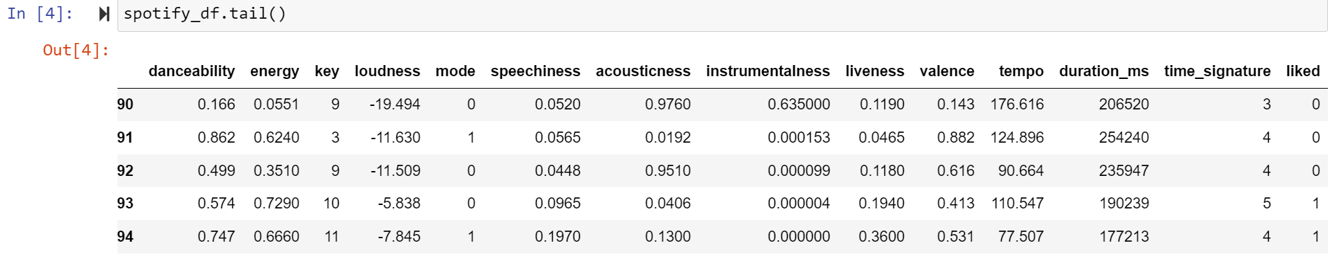
Exploratory Data Analysis
The data inside the csv files looks like -
Notes:
For EDA, we checked the closing price of assets randomly, and you could see that some assets just stopped trading. some started trading later than 2007.

Slide 7
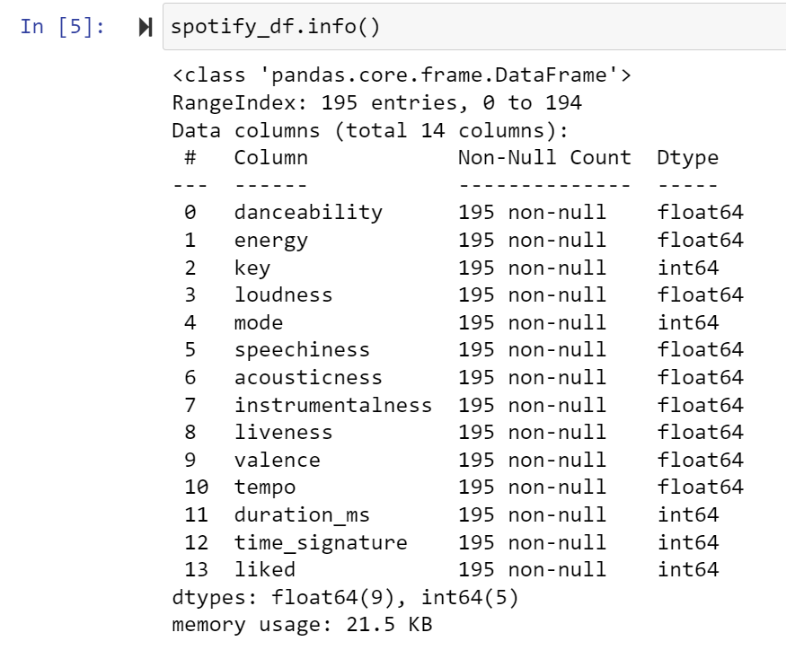
Exploratory Data Analysis
Notes:
For EDA, we checked the closing price of assets randomly, and you could see that some assets just stopped trading. some started trading later than 2007.

Slide 8
Data Cleaning and Pre-Processing
Handling Missing Values
We checked for missing values in the dataset using the .isnull().sum()
If any missing values were found, applied appropriate techniques such as:
Imputation: Filling missing values with the mean, median, or mode of the
respective feature.
Removal: Dropping rows or columns with a significant number of missing values if deemed appropriate.
Data Transformation
We checked the data types of each feature and converted them as necessary.
We also ensured consistency in data formats across all features for smooth model training.
We encoded categorical variables into numerical format using techniques such as one-hot encoding or label encoding.
Notes:
For each day and each prediction, Two Sigma is expecting a signed confidence value in the [−1,1] range. A value closer to 1 (resp. -1) means higher certainty that the predicted return will be positive (resp. negative), whilst a value closer to 0 means we are uncertain.

Slide 9
Data Cleaning and Pre-Processing
Feature Scaling
Standardized or normalized numerical features to ensure they are on a similar scale.
This step is crucial for algorithms sensitive to feature scales, such as distance-based methods.
Feature Engineering
Created new features or derived additional insights from existing features.
Examples include:
Extracting temporal features from date/time variables.
Creating interaction terms between relevant features to capture combined effects.
Notes:
For each day and each prediction, Two Sigma is expecting a signed confidence value in the [−1,1] range. A value closer to 1 (resp. -1) means higher certainty that the predicted return will be positive (resp. negative), whilst a value closer to 0 means we are uncertain.

Slide 10
Data Cleaning and Pre-Processing
Data Splitting
Divided the dataset into training and testing sets using train_test_split function
Typically, around 70-80% of the data is used for training and the remaining for testing.
At last
Performed a final check to ensure that the dataset is clean, properly formatted, and ready for model training.
Verified that all preprocessing steps are applied consistently to both the training and testing datasets to prevent data leakage.
Notes:
For each day and each prediction, Two Sigma is expecting a signed confidence value in the [−1,1] range. A value closer to 1 (resp. -1) means higher certainty that the predicted return will be positive (resp. negative), whilst a value closer to 0 means we are uncertain.

Slide 11
Algorithms Implemented
Decision Tree Classifier
Decision trees are versatile supervised learning algorithms that partition the feature space into regions, making predictions based on majority class labels within each region.
We utilized the DecisionTreeClassifier from the scikit-learn library. The model was trained on the Spotify dataset, where it learned to predict whether a song would be liked or not based on various song attributes.
Hyperparameters such as maximum depth and minimum samples split were tuned to optimize model performance.
Random Forest Classifier:
Random forests are ensemble learning methods that construct multiple decision trees during training and output the mode of the classes as the prediction. They reduce overfitting and improve generalization.
We employed the RandomForestClassifier from scikit-learn, which aggregates predictions from multiple decision trees. Each tree is trained on a random subset of the data and features, resulting in diverse predictions.
Random forests handle high-dimensional data well, maintain good accuracy even with noisy datasets, and provide feature importances for interpretability.

Slide 12
Algorithms Implemented
Extra Trees Classifier
Extra Trees are an ensemble learning method similar to random forests but with some key differences. They select feature splits at random and use the entire dataset to construct trees, leading to faster training times.
We utilized the ExtraTreesClassifier from scikit-learn to build the model. Extra Trees offer a trade-off between bias and variance, often achieving comparable performance to random forests with reduced computational cost.
Extra Trees are less prone to overfitting compared to standard decision trees and random forests, making them suitable for large datasets and real-time applications.
Bagging Classifier
Bagging is an ensemble meta-algorithm that improves the stability and accuracy of machine learning models. It trains multiple instances of a base learner on different bootstrapped samples of the dataset and aggregates their predictions.
We employed the BaggingClassifier from scikit-learn, which applies bagging to any base estimator. In our case, decision trees served as the base estimator.
Bagging reduces variance, mitigates overfitting, and improves model robustness by combining predictions from multiple models trained on diverse subsets of the data.

Slide 13
Algorithms Implemented
AdaBoost Classifier
AdaBoost is an ensemble learning method that combines weak learners sequentially, with each subsequent model focusing on the examples that previous models misclassified. It assigns higher weights to misclassified instances to prioritize their correct classification.
We utilized the AdaBoostClassifier from scikit-learn to build the model. AdaBoost iteratively adjusts the weights of training instances, allowing subsequent models to focus on difficult-to-classify instances.
AdaBoost is effective in handling imbalanced datasets, improving classification accuracy, and achieving good generalization on various types of data.
LightGBM Classifier
LightGBM is a gradient boosting framework that uses tree-based learning algorithms. It is designed for distributed and efficient training, offering high performance and scalability.
We employed the LGBMClassifier from the LightGBM library. LightGBM uses a novel gradient-based one-side sampling technique and exclusive feature bundling to achieve faster training times and better accuracy.
LightGBM is known for its high efficiency, low memory usage, and ability to handle large datasets. It is particularly suitable for scenarios where training time and computational resources are limited.

Slide 14
Results
Popularity Based Recommendation:
Identified the top 50 most popular books based on average ratings and number of ratings.
These books represent the most widely read and highly rated titles in the dataset.
Content-Based Recommendation:
Implemented a content-based recommendation system that suggests books similar to a given input book title.
Users can input a book title and receive recommendations for similar books based on content similarity.
Notes:
Given the result of LR, we decided to move on with only 50% of the data, which is 1.3 Gigabytes of data. The second model we used is a GLR with gaussian family and other parameters setted as you seen on the screens. GLR requires assumption of the output to follow a Gaussian distribution. While this might not be exactly the case, we think that most stock returns tend to be log-normally distributed, for example this density plot for apple uses data from our dataset, and it pretty much has this bell-shape. And the result turns out to be promising, achieved an root-mean squared error of 0.06.

Slide 15
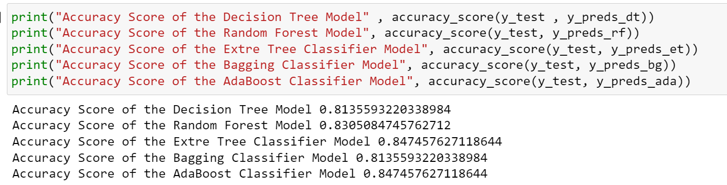
Results
The Spotify recommendation system was built using several machine learning algorithms, including Decision Tree Classifier, Random Forest Classifier, Extra Trees Classifier, Bagging Classifier, AdaBoost Classifier, and LightGBM Classifier. Each algorithm was trained and evaluated to determine its effectiveness in predicting whether a song will be liked or not by users.
Evaluation Metrics
Accuracy Scores
Notes:
Given the result of LR, we decided to move on with only 50% of the data, which is 1.3 Gigabytes of data. The second model we used is a GLR with gaussian family and other parameters setted as you seen on the screens. GLR requires assumption of the output to follow a Gaussian distribution. While this might not be exactly the case, we think that most stock returns tend to be log-normally distributed, for example this density plot for apple uses data from our dataset, and it pretty much has this bell-shape. And the result turns out to be promising, achieved an root-mean squared error of 0.06.

Slide 16
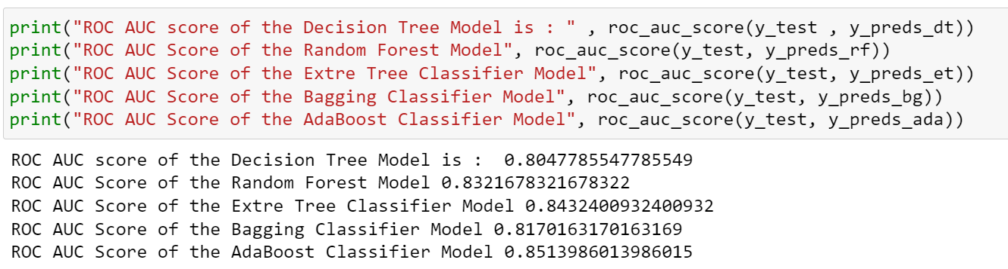
Results
Evaluation Metrics
ROC AUC Scores
Notes:
Given the result of LR, we decided to move on with only 50% of the data, which is 1.3 Gigabytes of data. The second model we used is a GLR with gaussian family and other parameters setted as you seen on the screens. GLR requires assumption of the output to follow a Gaussian distribution. While this might not be exactly the case, we think that most stock returns tend to be log-normally distributed, for example this density plot for apple uses data from our dataset, and it pretty much has this bell-shape. And the result turns out to be promising, achieved an root-mean squared error of 0.06.

Slide 17
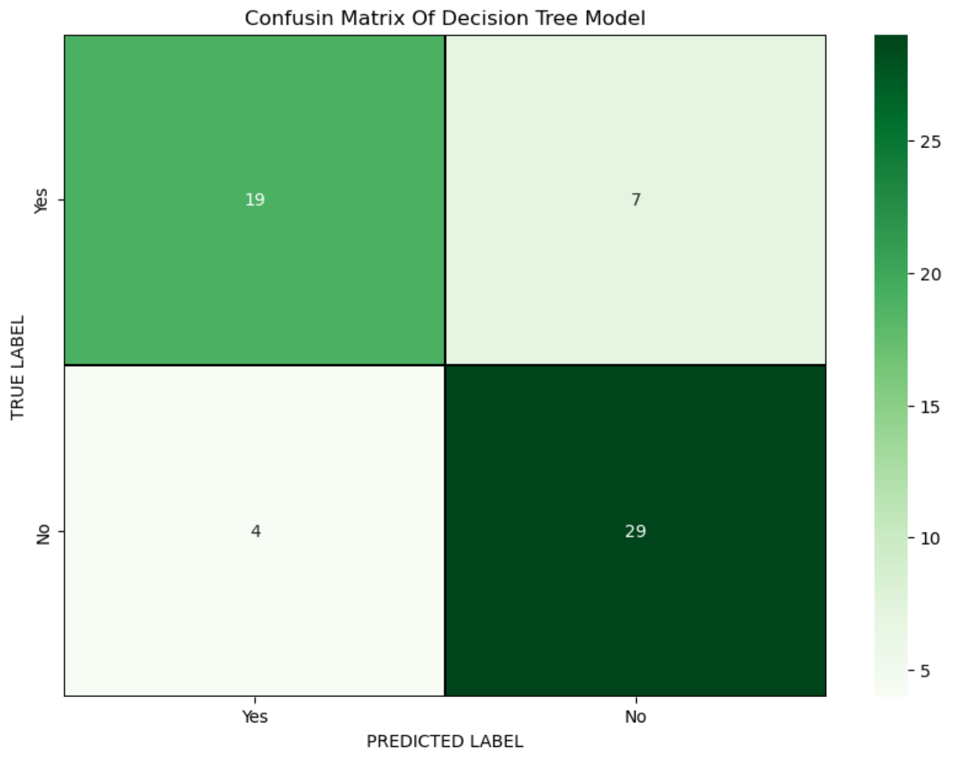
Results
Evaluation Metrics
Confusion Matrix
Decision Tree Model
Notes:
Given the result of LR, we decided to move on with only 50% of the data, which is 1.3 Gigabytes of data. The second model we used is a GLR with gaussian family and other parameters setted as you seen on the screens. GLR requires assumption of the output to follow a Gaussian distribution. While this might not be exactly the case, we think that most stock returns tend to be log-normally distributed, for example this density plot for apple uses data from our dataset, and it pretty much has this bell-shape. And the result turns out to be promising, achieved an root-mean squared error of 0.06.

Slide 18
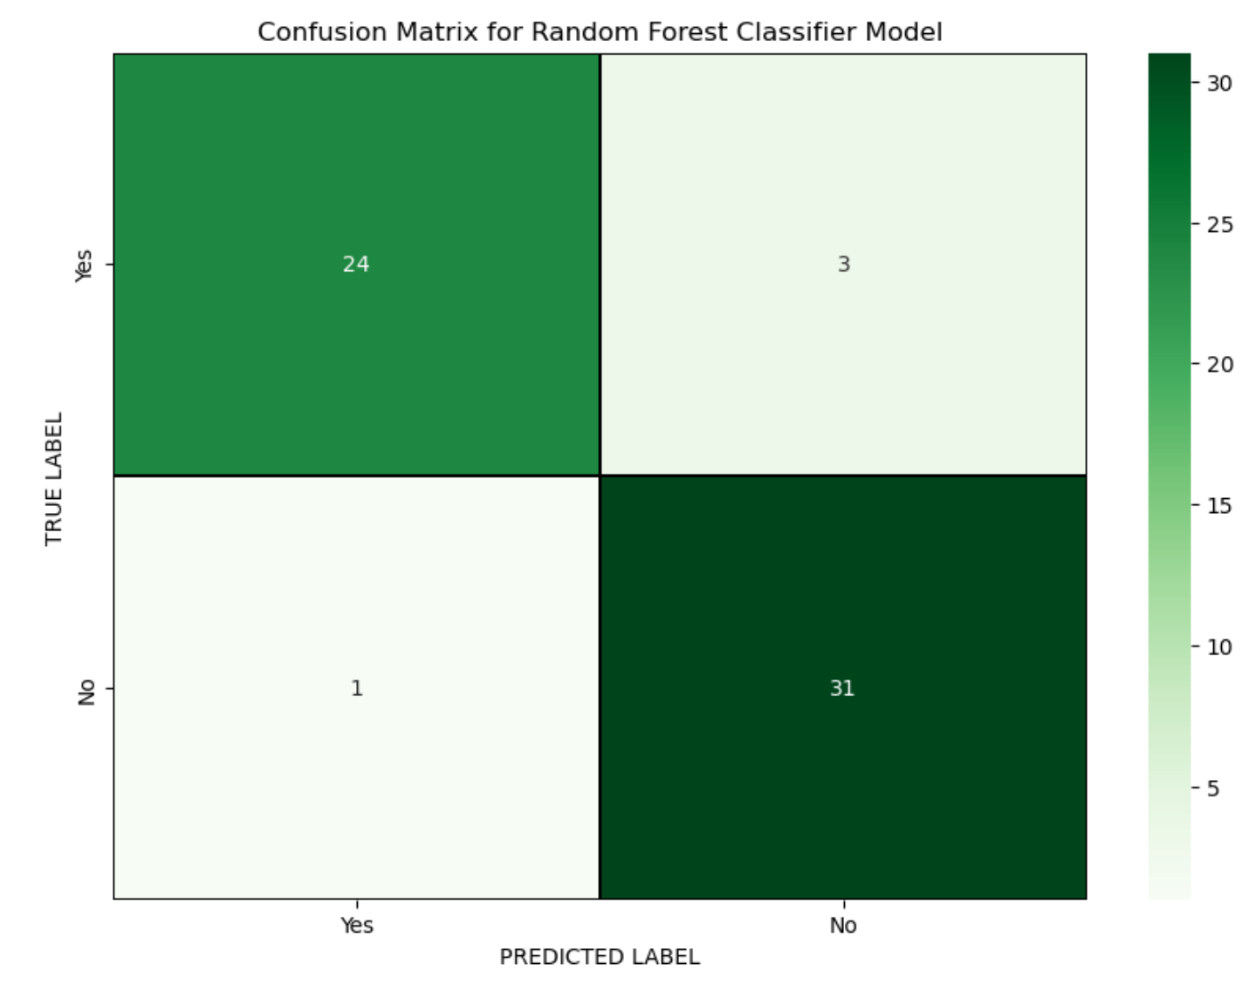
Results
Evaluation Metrics
Confusion Matrix
Random Forest Classifier Model
Notes:
Given the result of LR, we decided to move on with only 50% of the data, which is 1.3 Gigabytes of data. The second model we used is a GLR with gaussian family and other parameters setted as you seen on the screens. GLR requires assumption of the output to follow a Gaussian distribution. While this might not be exactly the case, we think that most stock returns tend to be log-normally distributed, for example this density plot for apple uses data from our dataset, and it pretty much has this bell-shape. And the result turns out to be promising, achieved an root-mean squared error of 0.06.

Slide 19
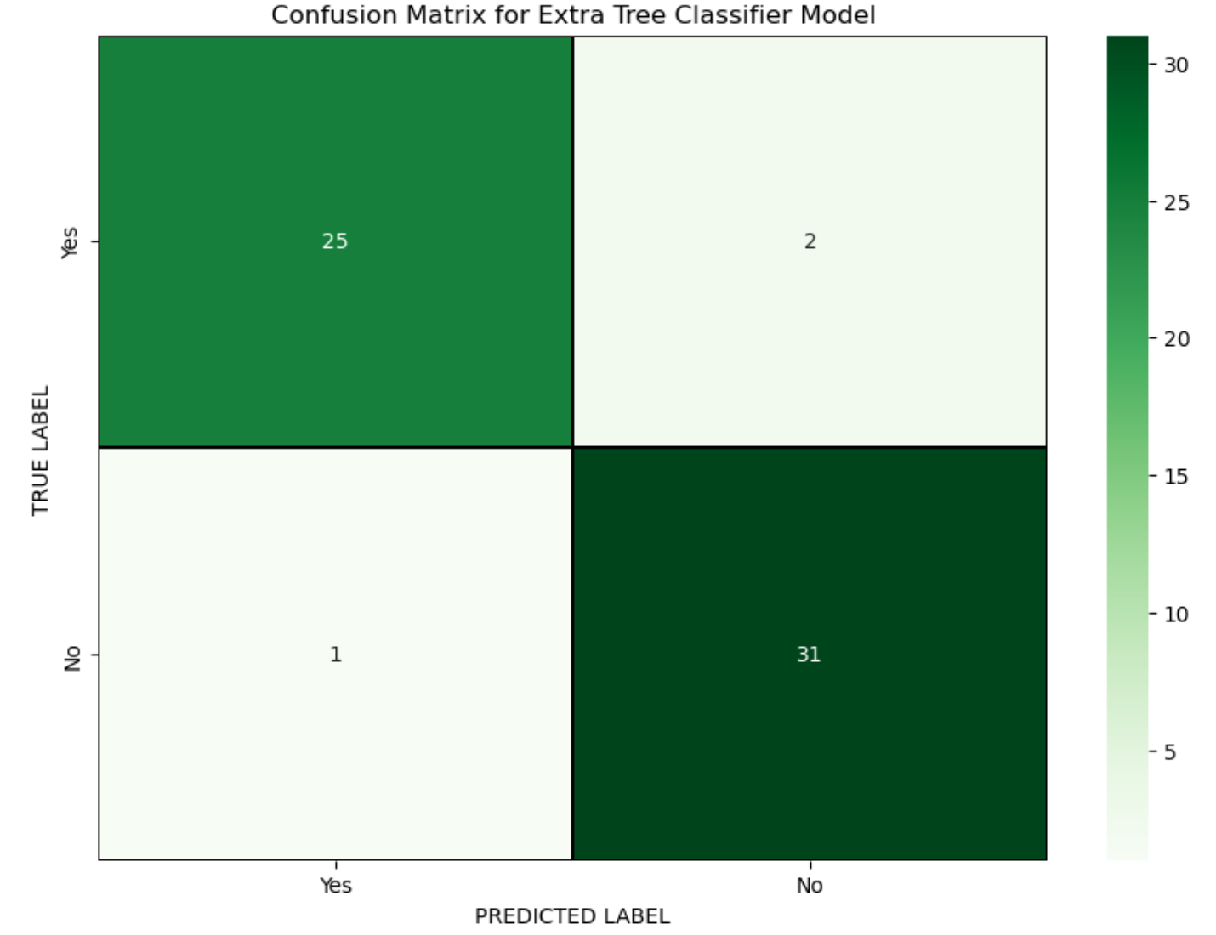
Results
Evaluation Metrics
Confusion Matrix
Extra Tree Classifier Model
Notes:
Given the result of LR, we decided to move on with only 50% of the data, which is 1.3 Gigabytes of data. The second model we used is a GLR with gaussian family and other parameters setted as you seen on the screens. GLR requires assumption of the output to follow a Gaussian distribution. While this might not be exactly the case, we think that most stock returns tend to be log-normally distributed, for example this density plot for apple uses data from our dataset, and it pretty much has this bell-shape. And the result turns out to be promising, achieved an root-mean squared error of 0.06.

Slide 20
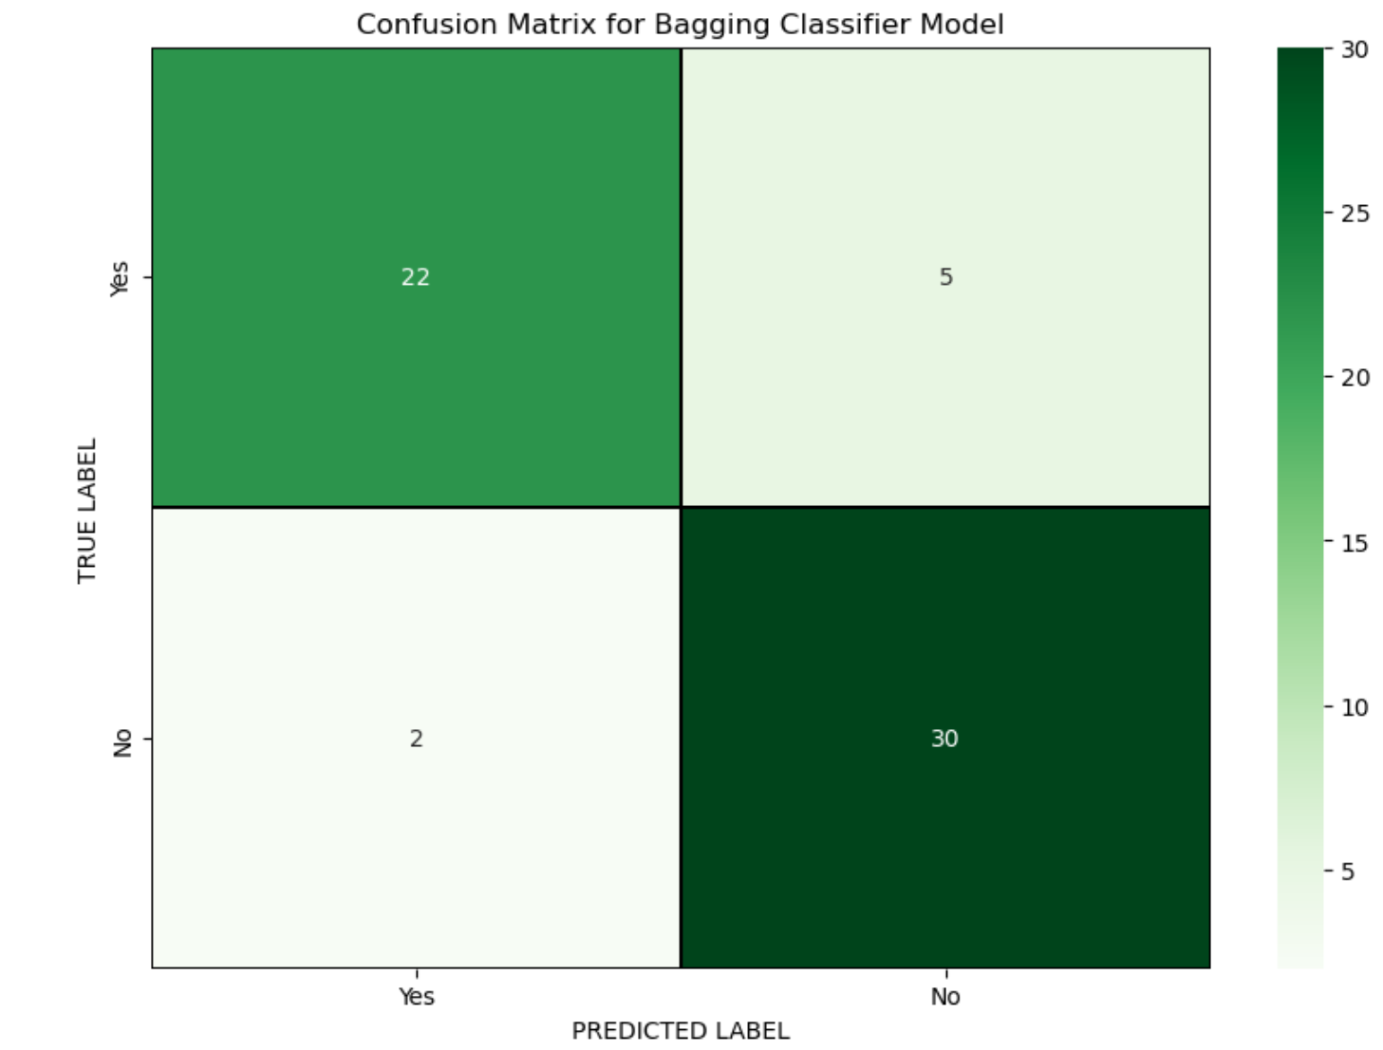
Results
Evaluation Metrics
Confusion Matrix
Bagging Classifier Model
Notes:
Given the result of LR, we decided to move on with only 50% of the data, which is 1.3 Gigabytes of data. The second model we used is a GLR with gaussian family and other parameters setted as you seen on the screens. GLR requires assumption of the output to follow a Gaussian distribution. While this might not be exactly the case, we think that most stock returns tend to be log-normally distributed, for example this density plot for apple uses data from our dataset, and it pretty much has this bell-shape. And the result turns out to be promising, achieved an root-mean squared error of 0.06.

Slide 21
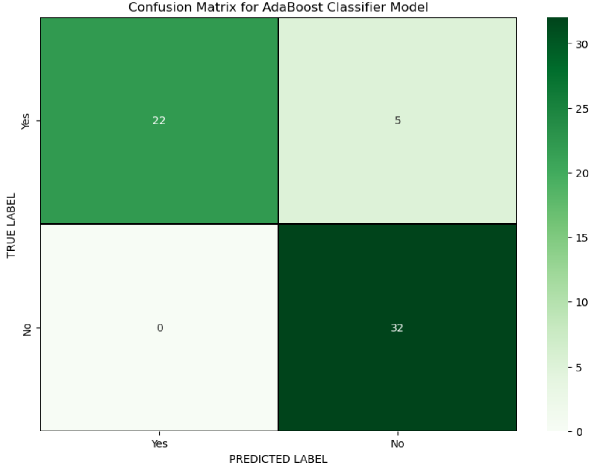
Results
Evaluation Metrics
Confusion Matrix
AdaBoost Classifier Model
Notes:
Given the result of LR, we decided to move on with only 50% of the data, which is 1.3 Gigabytes of data. The second model we used is a GLR with gaussian family and other parameters setted as you seen on the screens. GLR requires assumption of the output to follow a Gaussian distribution. While this might not be exactly the case, we think that most stock returns tend to be log-normally distributed, for example this density plot for apple uses data from our dataset, and it pretty much has this bell-shape. And the result turns out to be promising, achieved an root-mean squared error of 0.06.

Slide 22
Results
Evaluation Metrics
Accuracy and ROC AUC Scores
The Extra Trees Classifier and AdaBoost Classifier achieved the highest accuracy scores of 0.8475, closely followed by the Random Forest Classifier with an accuracy score of 0.8305.
In terms of ROC AUC scores, the AdaBoost Classifier outperformed all other models with a score of 0.8514, indicating its ability to accurately classify liked and disliked songs based on song attributes.
The Extra Trees Classifier also demonstrated strong performance with an accuracy score of 0.8475 and a ROC AUC score of 0.8432.
Notes:
Given the result of LR, we decided to move on with only 50% of the data, which is 1.3 Gigabytes of data. The second model we used is a GLR with gaussian family and other parameters setted as you seen on the screens. GLR requires assumption of the output to follow a Gaussian distribution. While this might not be exactly the case, we think that most stock returns tend to be log-normally distributed, for example this density plot for apple uses data from our dataset, and it pretty much has this bell-shape. And the result turns out to be promising, achieved an root-mean squared error of 0.06.

Slide 23
Conclusion
Through the implementation and evaluation of various machine learning algorithms, we have successfully built a Spotify recommendation system aimed at enhancing user engagement and satisfaction.
The decision tree-based models, including Random Forest, Extra Trees, Bagging, and AdaBoost, along with the LightGBM classifier, were trained and evaluated on a comprehensive dataset consisting of song attributes.
Our analysis indicates that these algorithms were able to effectively predict whether a user would like a song or not, as evidenced by their respectable accuracy and ROC AUC scores.
The ensemble methods, particularly Random Forest and Extra Trees, demonstrated robust performance in handling complex relationships within the data, while the boosting algorithm AdaBoost also showcased notable predictive power.

Slide 24
Conclusion
The LightGBM classifier, known for its efficiency and speed, provided competitive results compared to other algorithms, highlighting its potential for large-scale recommendation systems.
The confusion matrices revealed that the models performed well in correctly classifying liked and disliked songs, with minimal misclassifications.
Overall, the recommendation system holds promise in providing personalized music suggestions to users, thereby enhancing their Spotify experience and increasing user satisfaction.

Slide 25
Thank You !!!

Slide 26
Reference
[1] Univ.Ai. (2023, January 6). How does Spotify's recommendation system work? https://www.univ.ai/blog/how-does-spotifys-recommendation-system-work
[2] Mangla, P. (2024, February 13). Spotify song recommendation Systems - PyImageSearch. PyImageSearch. https://pyimagesearch.com/2023/10/30/spotify-music-recommendation-systems/
[3] TechAhead. (2024, January 8). Spotify recommendation system and user engagement strategies. https://www.techaheadcorp.com/blog/spotify-recommendation-system/

