Slide 1

A conversational RAG application for Information Retrieval(IR) from custom data (Disaster Specific)
K. Sai Kumar
M Tech Student
Under the guidance of
Prof. Sudip Roy
Centre of Excellence in Disaster Mitigation and Management

Slide 2
The Problem
Knowledge cut off.
Access to entire web including unauthorized sources and websites.
LLMs try to guess and hallucinate (the major problem in LLMs).

Slide 3
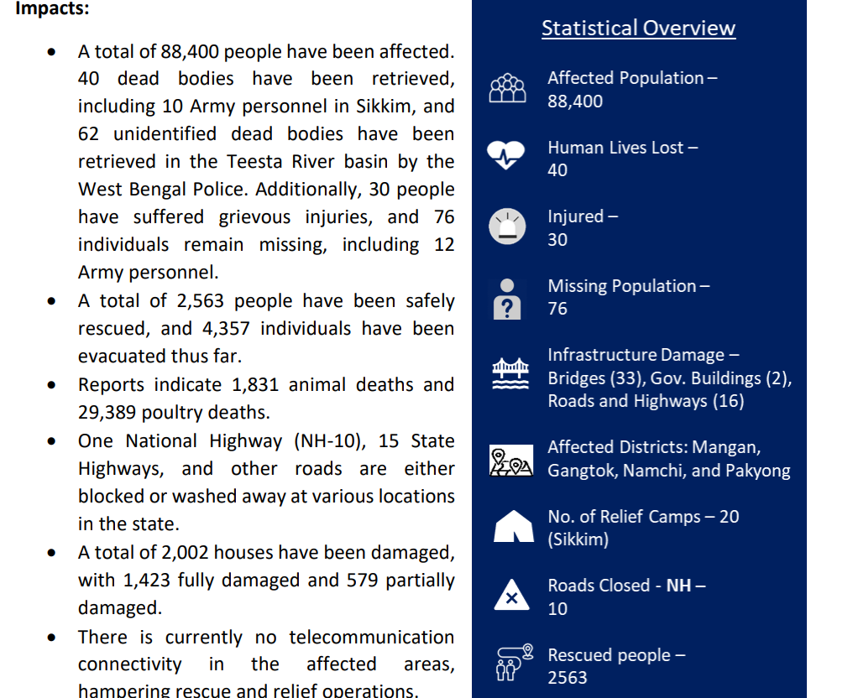
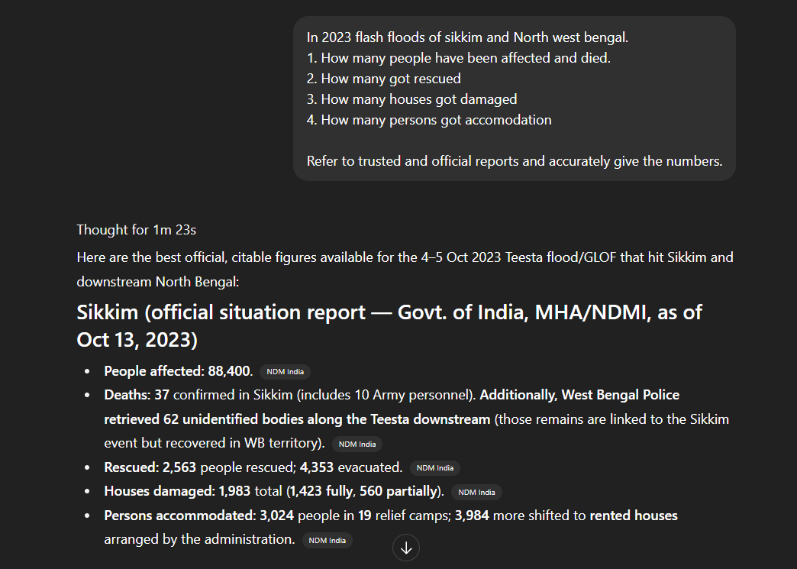
The GAP
Response from LLM
Post disaster assessment report by NDMA

Slide 4
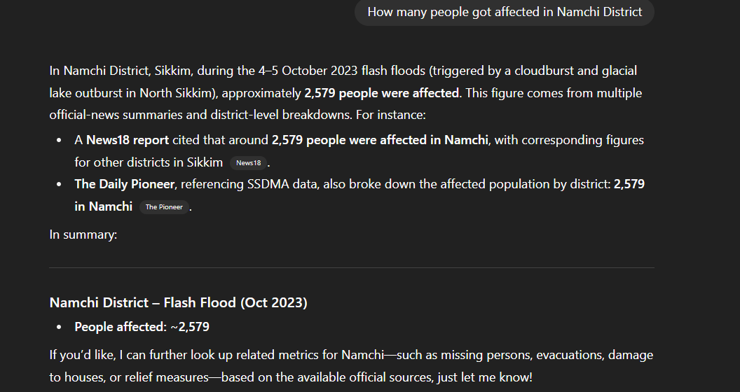
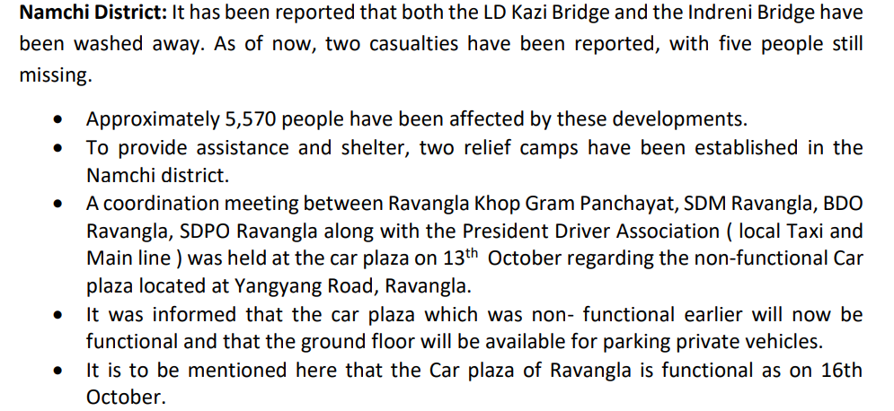
Response from LLM
Post disaster assessment report by NDMA

Slide 5
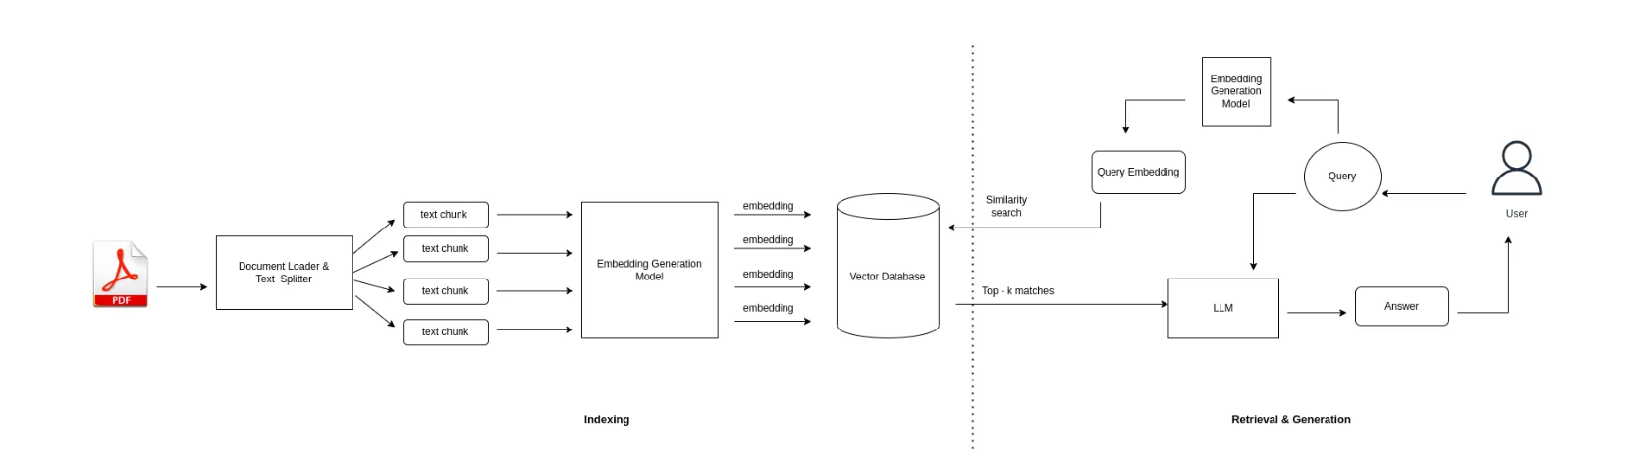
The Solution – Retrieval Augmented Generation
The working flow of RAG

Slide 6
Features
Scalable
Multi modal capability
Cost effective
No hallucination
Contextual Continuity

Slide 7
THANK YOU

