Slide 1

E-Commerce Sales Trends Analysis
Using Microsoft Excel · 34,500 orders · Sep 2023 – Sep 2025

Slide 2

Project at a Glance
Objective
Transform raw sales data into actionable business insights
34,500
Orders analyzed
17
Data columns
24
Months covered

Slide 3
Data Cleaning & KPIs
No significant data quality issues found.
₹58.65L
34.5K
₹170
Total Revenue
Total Orders
Avg Order Value
28%
5.52%
Avg Profit Margin
Return Rate

Slide 4
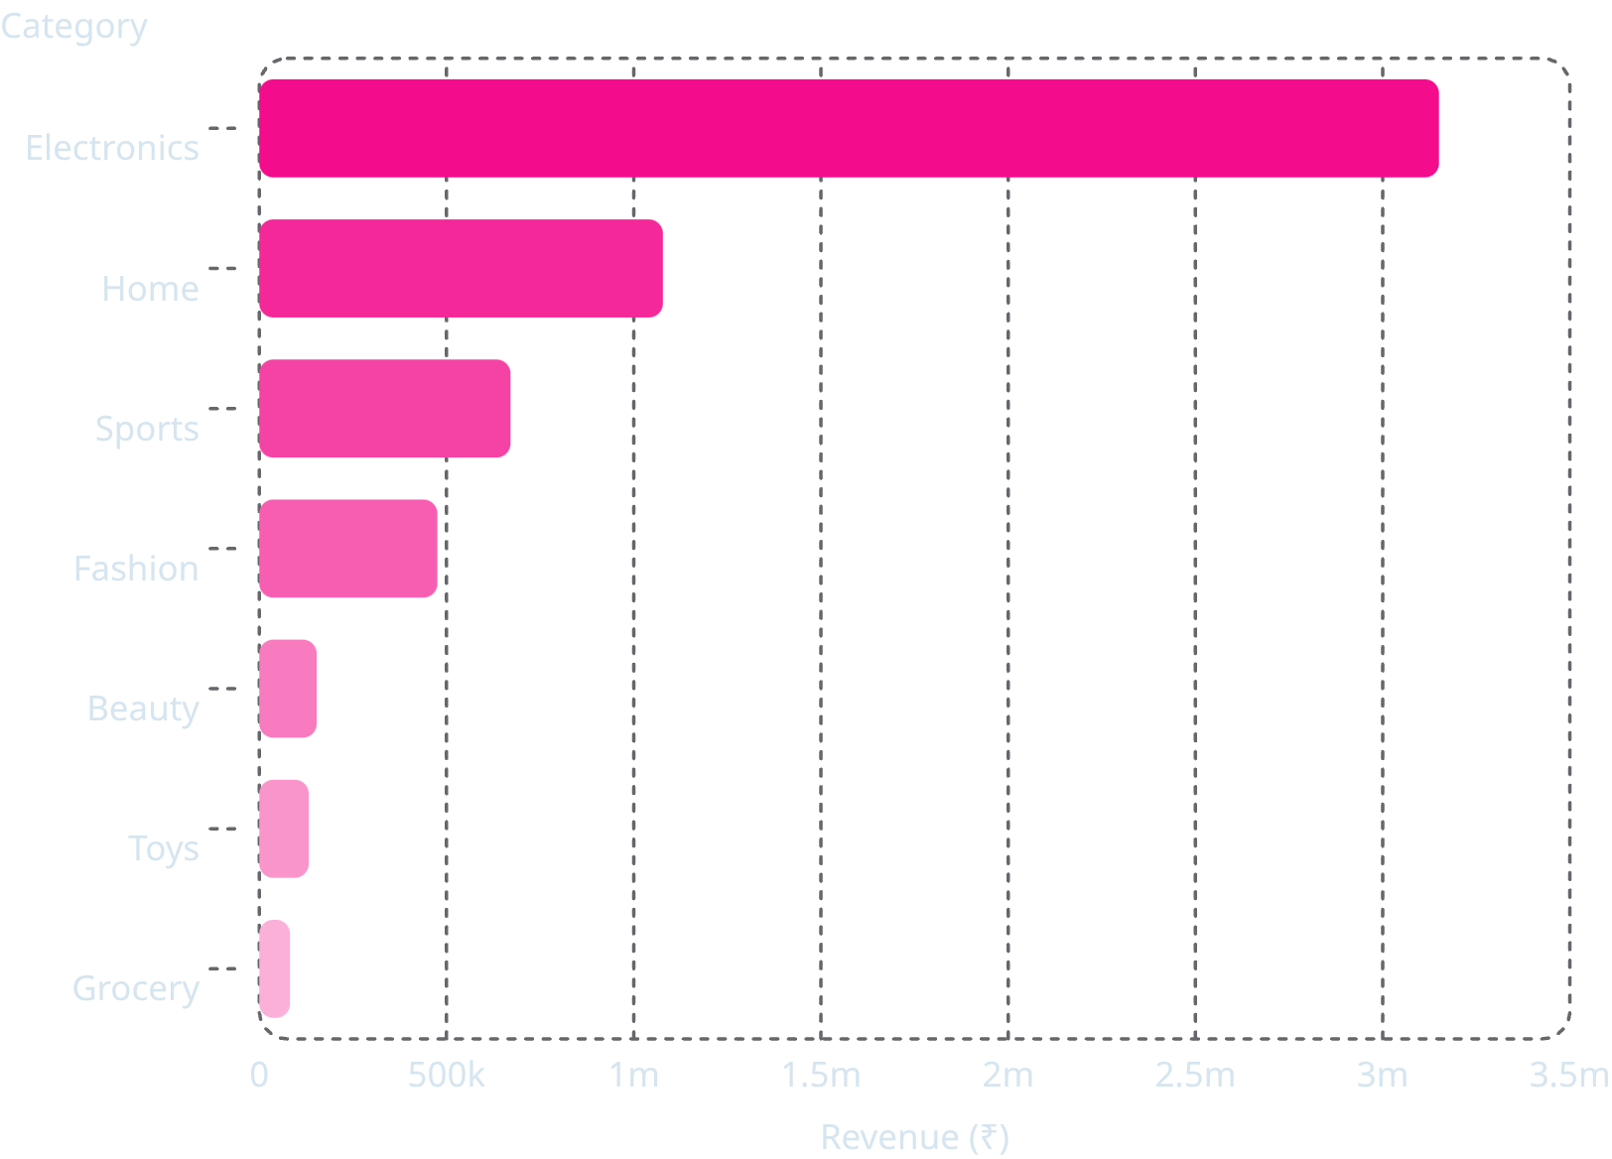

Revenue by Product Category
Electronics Dominates
Electronics generated ₹33.19 lakh — 56.59% of total sales, making it the most critical revenue driver.
Fashion recorded the highest number of returns — a quality improvement opportunity.

Slide 5
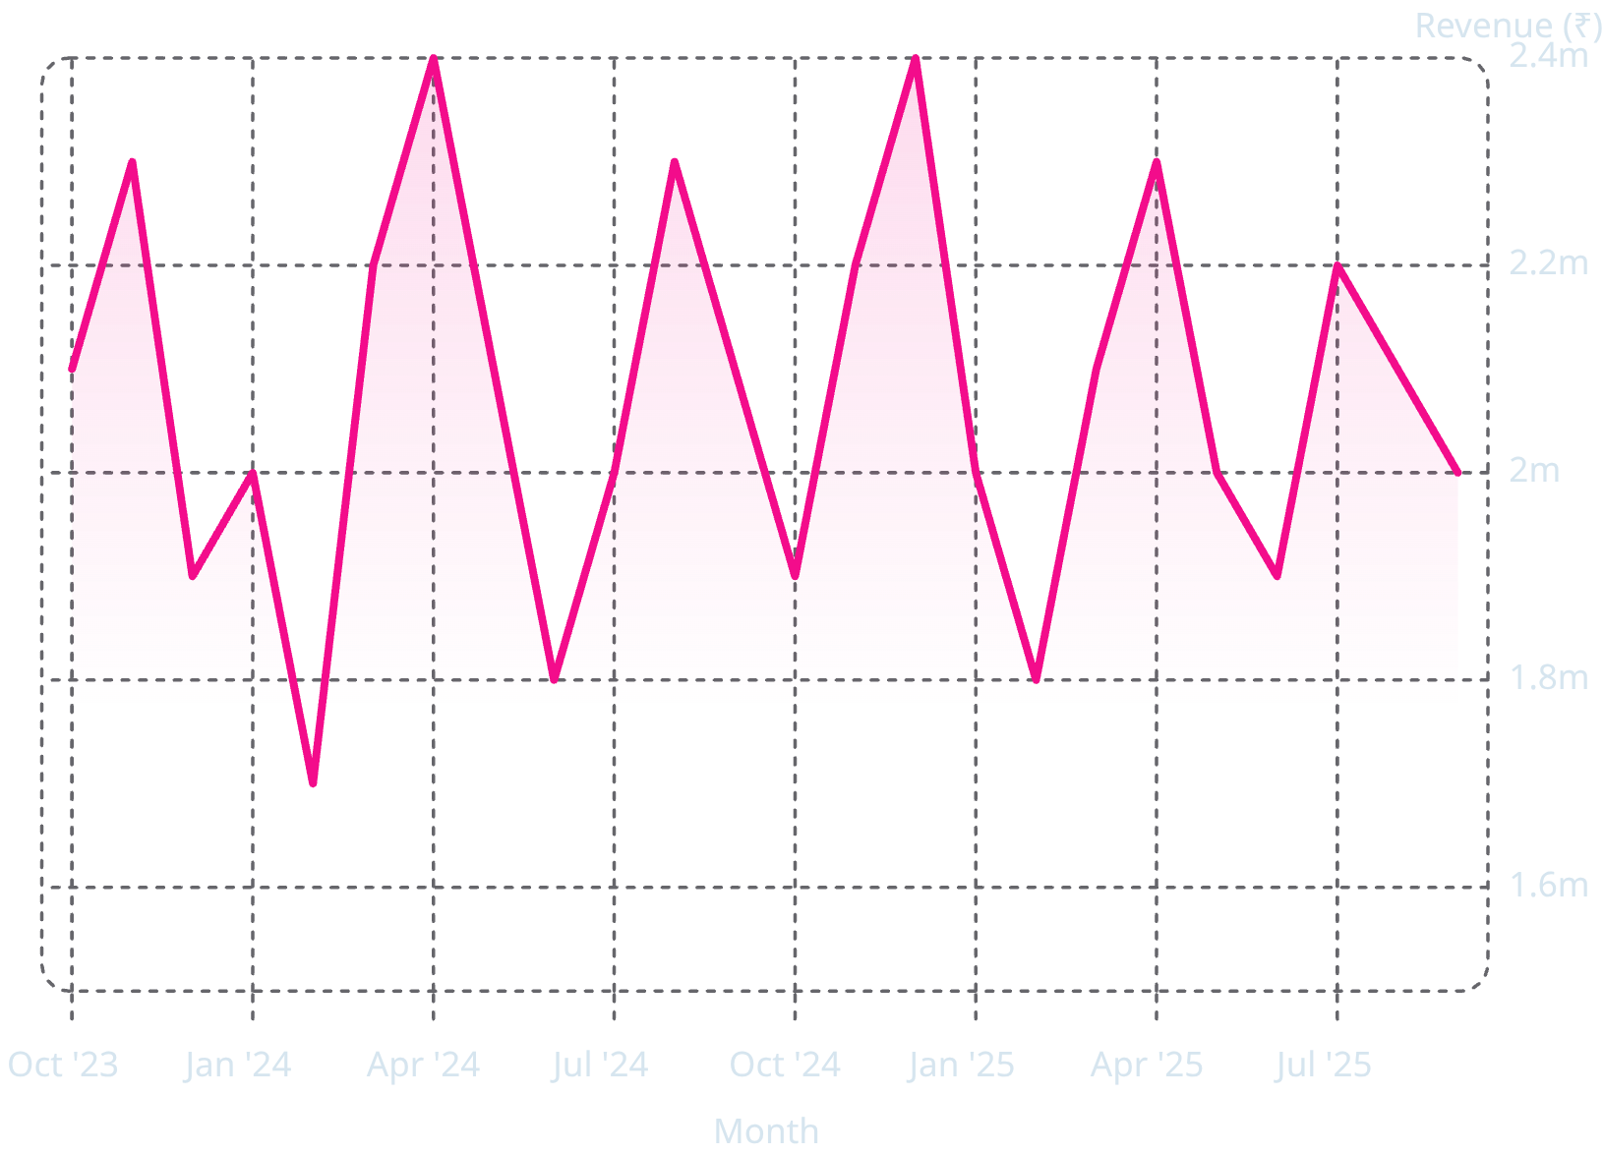
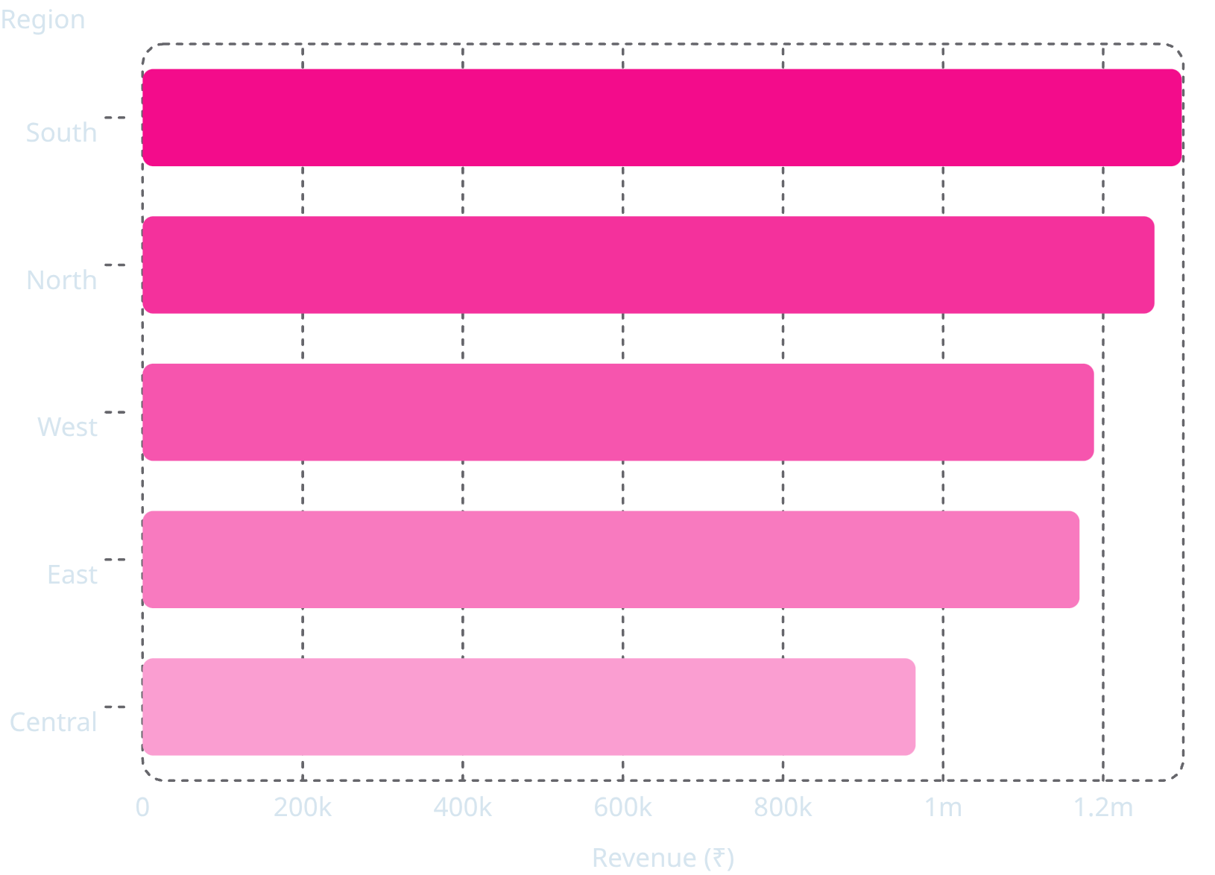
Monthly Revenue & Regional Performance
Monthly Revenue Trend
Revenue by Region
South region leads at 22.13% of total sales. Revenue remained stable across the period, fluctuating between ~₹15L–₹25L monthly.

Slide 6
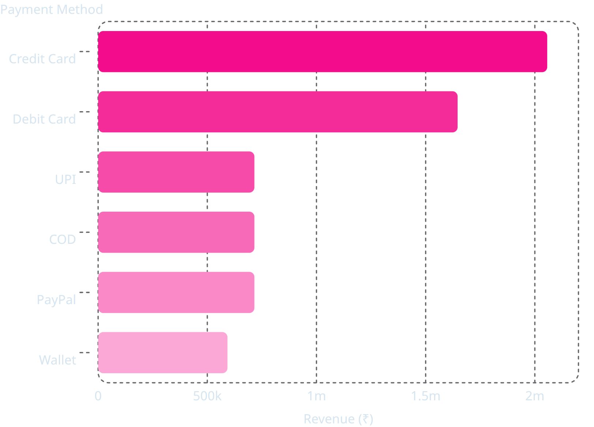
Payment Methods & Customer Demographics
Revenue by Payment Method
Customer Insights
Top Payment
Prime Age Group
Credit Card — highest revenue & order volume
28–37 contributed the highest revenue share
Gender Balance
Male & female revenue contribution nearly equal

Slide 7

Key Insights
Electronics = 56.59%
South Region Leads
Top revenue category at ₹33.19L
22.13% of total sales
Credit Card Preferred
Low Return Rate
Highest revenue & order volume
5.52% — strong satisfaction
Fashion Returns
Age 28–37
Highest returns — quality opportunity
Highest revenue share
Gender Balance
Stable Sales
Near-equal male & female revenue
Consistent monthly revenue

Slide 8



Recommendations & Conclusion
Invest in Electronics
Primary revenue driver
Fix Fashion Returns
Quality & expectation management
Expand South Region
Strongest market
Promote Digital Payments
Targeted incentives
Target Age 28–37
Highest revenue segment
Grow Underperformers
Boost lower categories
Dashboard & findings support strategic, data-driven decisions for operational growth.

