Slide 1



Bangalore Real Estate Price Prediction

Slide 2
Group Members: -Sai -Harsh -Anushka -Suhani

Slide 3
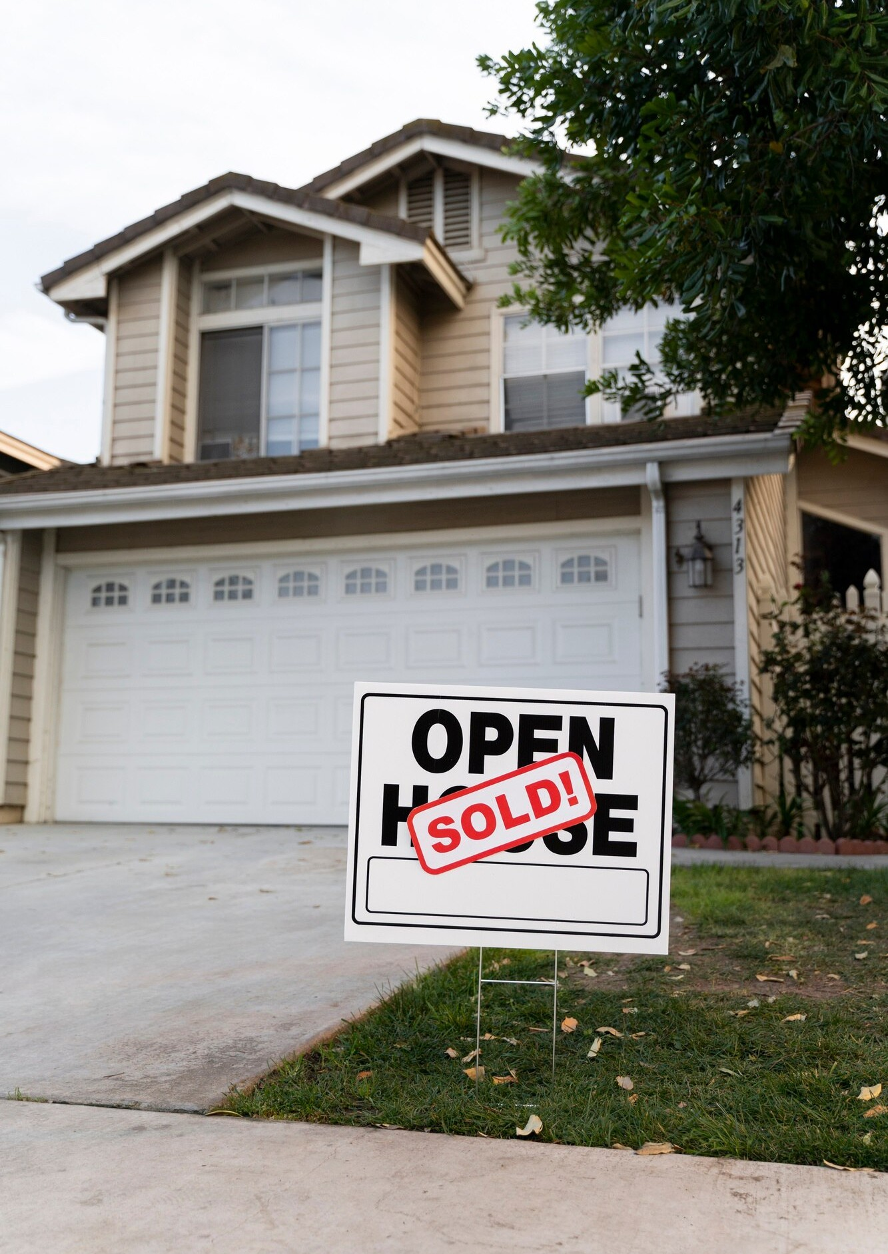
Introduction
In today's session, we will delve into the intricacies of predicting Estate prices and how we utilized R programming along with the Shiny library to develop an efficient predictive model. Predicting Estate prices is crucial in the real estate market as it helps buyers, sellers, and investors make informed decisions. Our project aims to provide a reliable tool for forecasting house prices accurately, focusing specifically on the dynamic real estate market of Bangalore.

Slide 4





Importance of Bangalore's Real Estate Market
Bangalore, often dubbed as the Silicon Valley of India, has witnessed exponential growth in its real estate market. With a booming IT sector, influx of migrants, and limited land availability, the demand for housing in Bangalore has surged significantly. As a result, house prices in Bangalore have soared to unprecedented levels, making accurate price prediction indispensable for buyers, sellers, and investors alike.

Slide 5
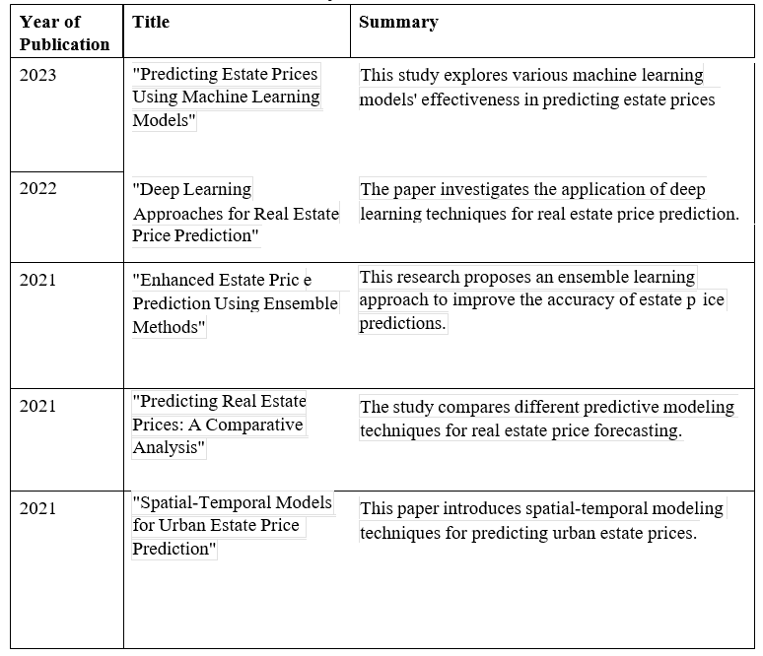
Literature Review

Slide 6

Project Architecture
Our project architecture encompasses several key components, including data collection, preprocessing, model training, and deployment. We collected extensive housing data specific to Bangalore from various sources, including real estate listings, government databases, and online platforms. After preprocessing the data to clean and normalize it, we utilized R programming along with the Shiny library to develop an interactive web application for house price prediction.

Slide 7
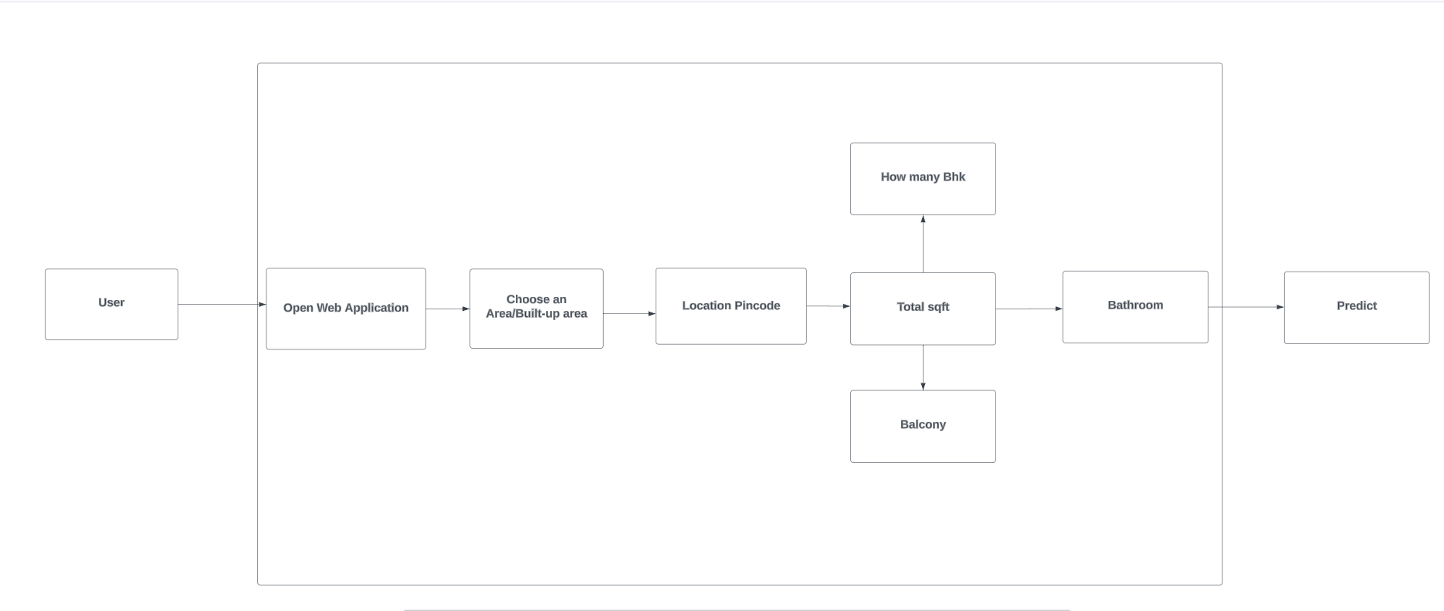
Project Architecture

Slide 8

Implementation Details
In this section, we'll delve into the implementation details of our predictive model. We used R for its robust statistical and data analysis capabilities, coupled with the Shiny library for building interactive web applications. Our predictive model employs a machine learning algorithm trained on historical Estate data to predict future house prices. We incorporated various features such as location, size,ID ,Pincode , and market trends to enhance the model's accuracy. Through rigorous testing and validation, we optimized our model to achieve reliable predictions.

Slide 9
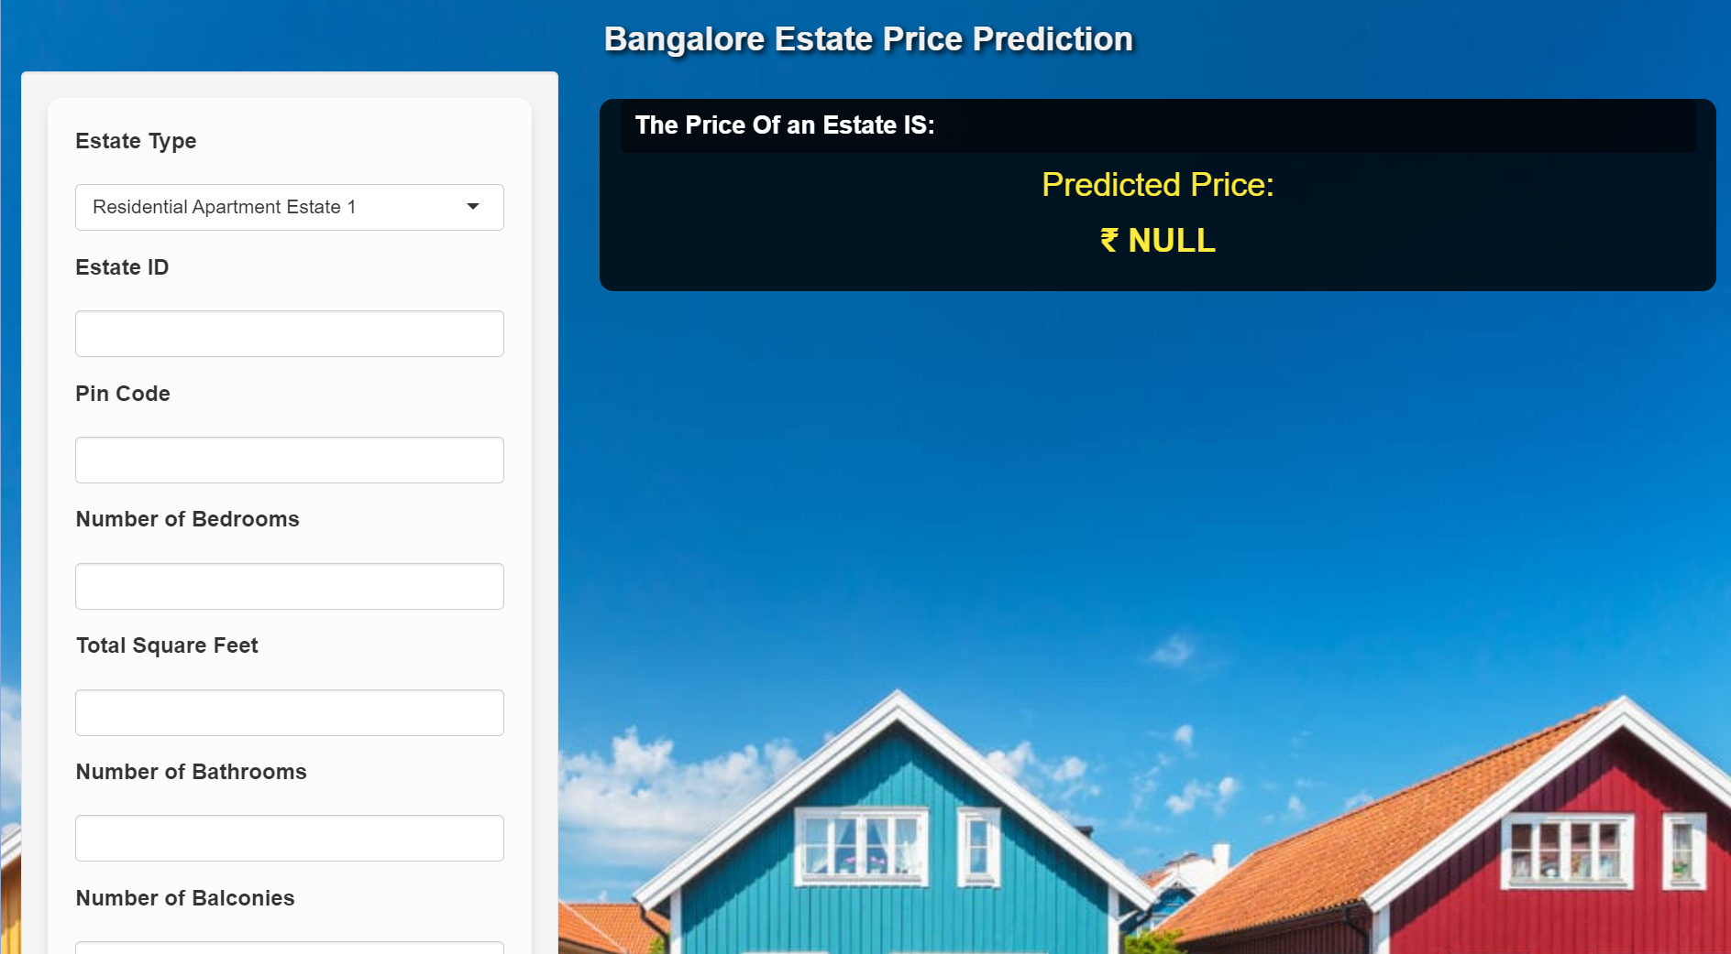
UI/ User Interface

Slide 10


Conclusion
In conclusion, our project provides a valuable contribution to the field of house price prediction, particularly in the context of Bangalore's dynamic real estate market. By leveraging R programming and the Shiny library, we developed an efficient predictive model that accurately forecasts house prices in Bangalore. Our findings have significant implications for buyers, sellers, and investors, enabling them to make informed decisions in the rapidly evolving real estate landscape of Bangalore.

Slide 11
Future Scope
Looking ahead, there are several avenues for future research and enhancement. We plan to further refine our predictive model by incorporating additional datasets and features specific to Bangalore's real estate market. Additionally, exploring advanced machine learning techniques and conducting longitudinal studies could further improve the accuracy and reliability of our predictions. Furthermore, we aim to extend the application of our model to other cities and regions, contributing to a deeper understanding of housing dynamics across India.

Slide 12
References
Finally, we acknowledge the contributions of existing research and resources that have informed our project. Here is a list of references, including research papers, articles, and online resources:
YouTube,
Google,
Publications,
Blogs.
Mostly referenced by the Documentations.

Slide 13


Thanks!

