Slide 1

AI-Driven Explainable MOF Recommendation with RAG and Multi-Objective Optimization
22AIE452 – Dara Driven Material Modeling and Simulation
Team_09
Amrutha.T-24255
Charan Tej Reddy.Y-24259
Poojitha.D-24263
Enku Sai Mohith – 24316
Ramu Jahna Bindu - 24249

Slide 2
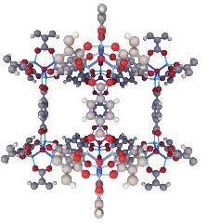
Introduction
Metal–Organic Frameworks (MOFs) are advanced porous materials widely used in carbon capture, hydrogen storage, gas separation, and energy applications. However, selecting the right MOF from thousands of available materials is difficult because it requires analyzing large scientific databases using programming and database query languages. MOF Chat addresses this challenge by providing a conversational AI assistant that enables users to search and compare MOFs using natural language.
Instead of writing SQL or Python code, users can simply ask questions such as "Which MOF has the highest surface area?" or
"Suggest a MOF for CO₂ capture," and the system retrieves and explains the most suitable materials from the database.
They are crystalline materials made by linking metal ions with organic molecules, creating microscopic cages.

Slide 3
Base Paper
“Chat MOF: An artificial intelligence system for predicting and generating metal-organic frameworks using large language models”
https://www.nature.com/articles/s41467-024-48998-4#data-availability
What Base paper did??
The base paper (ChatMOF) is not simply a chatbot. It is an AI agent that combines a Large Language Model (GPT-4) with materials databases, machine learning models, and genetic algorithms to perform three major tasks:

Slide 4
Drawbacks in Base paper:
Limitation 1 (No Intrinsic Knowledge): The LLM lacks native material science understanding and acts purely as a tool planner rather than a scientific calculator.
Limitation 2 (Token Context Limits): Strict context window constraints trigger execution failures when searching large tables or comparing numerous materials.
Limitation 3 (Reasoning & Logic Errors): Frequent reasoning missteps lead to incorrect tool selection, faulty code generation, and query misunderstandings.
Limitation 4 (Restricted Search Space): Token bottlenecks limit candidate structural generation from millions down to fewer than 200 frameworks.
Limitation 5 (Narrow Topology Coverage): Structural exploration is strictly confined to only nine predefined MOF topologies, limiting material diversity.
Limitation 6 (Pretrained Model Dependency): The system cannot predict properties that lack a dedicated, fine-tuned ML model.
Limitation 7 (Un-fine-tuned Models): Relying on general, non-fine-tuned LLMs restricts the system's specialized reticular chemistry capabilities.
Limitation 8 (High Compute Overhead): Integrating genetic algorithms, geometry optimizations, and molecular simulations creates significant computational cost.
Limitation 9 (Invalidated Output Quality): Generated candidates require expensive downstream simulations (GCMC/MD) before they can be considered viable for experimental synthesis.

Slide 5
Optimize and preprocess MOF data.
Develop a custom FT-Transformer for MOF representation learning.
Generate 384-D MOF embeddings using self-supervised learning.
Implement FAISS-based similarity retrieval.
Evaluate the learned representations using standard ML metrics.
Extend the framework toward natural-language, RAG-based, optimized and explainable MOF recommendation.
Problem Statement
Identifying suitable Metal–Organic Frameworks (MOFs) from large and diverse material databases is challenging because of the huge search space, multiple material properties, and the limitations of conventional search and existing AI-based approaches. Therefore, an efficient AI-driven approach is required to learn meaningful MOF representations and retrieve relevant candidate materials for application-specific recommendation
Objectives

Slide 6
Our Novelty – How we improve on it
Base Paper Limitation | Your Novelty
LLM has no material knowledge | RAG (Retrieval-Augmented Generation) using MOF papers + database
Token limit | Hybrid Retrieval Engine (Vector Search + SQL) instead of loading large tables
Logic errors | Planner + Validator Agent that verifies generated SQL/Python before execution
Small search space | Multi-stage Candidate Retrieval instead of fixed 100-parent selection
Only 9 topologies | Generalized Material Recommendation across the full hMOF dataset
Depends on pretrained models | Train your own Transformer/XGBoost for new properties
General GPT-4 | Domain-specific MOF Knowledge Base + Prompt Templates
High computation | Surrogate ML models instead of expensive simulations
No explainability | Explainable AI (SHAP/LIME/Attention Visualization)

Slide 7
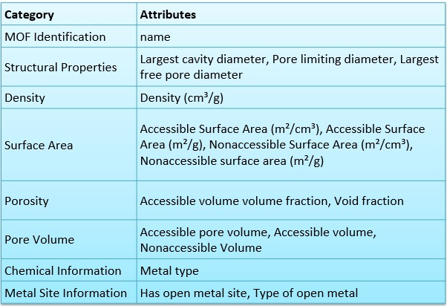
Dataset
Datasets Used in Chat MOF (Core MOF dataset)
Our project uses the CoRE-MOF (Computation-Ready Experimental Metal-Organic Framework) dataset. The dataset contains 12,020 MOF records and 17 attributes. It provides structural, physical, and chemical information about different Metal-Organic Frameworks.

Slide 8
Literature for each Improvement:
S.NO | Paper Name | Author Name | Year | Methodology of Paper | Contribution | Limitation | Research Gap
1 | ChatMOF: An Autonomous AI System for Predicting and Generating Metal-Organic Frameworks | A. S. Rosen et al. | 2024 | Integrates GPT models with materials databases using LLM tool-calling and autonomous agents. | First fully autonomous agent for querying and generating MOF properties via conversational interfaces. | Struggles with handling complex, unformatted tabular databases without explicit schema alignment. | Needs integration with native tabular embeddings to handle raw numerical datasets effectively.
2 | TableRAG: Million-Token Scale Table Understanding with Large Language Models | H. Li et al. | 2024 | Proposes a hierarchical RAG architecture designed to index and retrieve rows/columns from massive tabular datasets. | Solves the context-window limitation for large tables, enabling QA over million-token spreadsheets. | Primarily focuses on generic text/numerical data, lacking domain-specific mathematical constraints. | Application of TableRAG to specialized scientific data where exact numerical matching is critical.
3 | Chain-of-Table: Evolving Tables in the Reasoning Chain for LLMs | Z. Wang et al. | 2024 | Iterative LLM prompting technique that dynamically adds, removes, and aggregates table columns during reasoning. | Dramatically improves logical reasoning and multi-step deduction on tabular datasets. | Relies entirely on the LLM's internal math capabilities, leading to occasional hallucination in exact calculations. | Combining Chain-of-Table with external deterministic deep learning models (like FT-Transformer).
4 | Tabular Embedding Model (TEM): Fine-Tuning Encoders for Structured Data | S. Khanna & R. Subedi | 2024 | Fine-tunes BERT-based encoders using contrastive learning specifically on row-level tabular data. | Demonstrates that small domain-specific embedding models outperform general LLMs in tabular retrieval tasks. | Embeddings capture semantic similarity but struggle with continuous non-linear numerical relationships. | Architectural enhancements (like Feature Tokenizers) are needed to better represent complex numerical distributions.
5 | Benchmarking Deep Learning Models for MOF Adsorption Prediction | L. Kim et al. | 2024 | Compares XGBoost, MLPs, and FT-Transformers on predicting MOF gas adsorption capacities. | Concludes that FT-Transformers offer the best feature interaction modeling for MOF tabular datasets. | Models act as black boxes, providing little chemical intuition for the final predictions. | Integrating LLMs to explain and interpret the feature interactions generated by FT-Transformers.
6 | TARGET: Benchmarking Tabular Retrieval for Generative AI | J. Ji et al. | 2024 | Proposes a comprehensive benchmark evaluating the “semantic-answerability gap” in tabular retrieval. | Exposes the failure modes of standard dense text retrievers when applied directly to numerical tables. | The benchmark is mostly generic (finance, wiki) and lacks complex scientific/materials datasets. | Establishing benchmarks for deep tabular retrieval specifically in materials science and chemistry.
7 | L²MOF: Multimodal Learning for Crystal Structure Prediction | J. Chen et al. | 2025 | Multimodal fusion combining 3D crystal structure representations with text-based LLMs. | Outperforms pure text-based models in predicting spatial coordination and topological geometries of MOFs. | High computational overhead for encoding 3D structures alongside billions of text tokens. | Lacks an efficient retrieval mechanism for structured feature data derived from structures.

Slide 9
8 | MSFT-Transformer: Multistage Fusion for Tabular and Multimodal Data | M. Zhang et al. | 2025 | Extends the FT-Transformer with multistage fusion layers to process tabular data alongside unstructured text. | Achieves state-of-the-art results on multimodal tasks by preserving tabular feature interactions. | The quadratic complexity of the self-attention mechanism makes it slow for extremely large tabular datasets. | Exploring linear-attention mechanisms for FT-Transformers in large-scale retrieval tasks.
9 | MOF-ChemUnity: Automating Literature Mining for Materials Science using LLMs | Y. Wang et al. | 2025 | Uses a Retrieval-Augmented Generation (RAG) stack to extract structural metrics of MOFs from PDFs. | Created the largest auto-curated database of MOF properties from unstructured literature. | The extracted data often contains OCR errors or misaligned tabular structures. | Integrating table-aware RAG models to improve the extraction fidelity of numerical results.
10 | Integrating FT-Transformer with Vector Databases for Fast Tabular Search | T. Nguyen et al. | 2025 | Modifies the FT-Transformer's final hidden state into a dense vector compatible with FAISS indexing. | Enables sub-millisecond similarity search over millions of tabular records based on deep feature interactions. | The embedding space is optimized for classification, not necessarily for open-ended semantic queries. | Developing contrastive learning objectives to align FT-Transformer embeddings with natural language.
11 | Table-R1: Reinforcement Learning for Complex Table Reasoning | D. Liu et al. | 2025 | Uses reinforcement learning with AI feedback (RLAIF) to train LLMs to navigate complex tables. | Achieves state-of-the-art accuracy on multi-hop tabular reasoning datasets. | Extremely high training cost and sensitivity to reward function design. | Applying RL-based tabular reasoning to specialized domains like reticular chemistry and MOF discovery.
12 | FTT+: Enhancing Feature Tokenizer Transformers with Pruned Attention | S. Gupta et al. | 2025 | Applies attention pruning and quantization to the standard FT-Transformer architecture. | Reduces inference time by 40% while maintaining accuracy on tabular classification. | Performance drops when highly correlated continuous features are aggressively pruned. | Optimizing FTT+ for vector database indexing where embedding preservation is critical.
13 | Retrieval-Augmented Generation for Tabular Materials Data | R. Patel et al. | 2026 | Couples a deep learning tabular encoder (FT-Transformer) with a FAISS index and an LLM synthesizer. | Provides a scalable architecture for querying massive materials databases using natural language. | LLM synthesis sometimes hallucinates when the retrieved tabular context is too mathematically dense. | Prompt engineering techniques and constraints to strictly enforce factual compliance in tabular RAG.
14 | TabRAG: Structured Representation for Advanced Question Answering | K. Sharma et al. | 2026 | Introduces a schema-aware retrieval mechanism that converts natural language into SQL before vector matching. | Bridges the gap between semantic search and deterministic database querying for tables. | Requires highly structured schemas; fails on messy or heterogeneous tabular data. | Developing schema-agnostic tabular embeddings that can infer mathematical relationships on the fly.
15 | LLM-Driven Synthesis Planning for Reticular Chemistry | A. Rahman et al. | 2026 | Fine-tunes open-source LLMs (e.g., Llama 3) on MOF synthesis recipes paired with tabular structural parameters. | Suggests synthesis conditions based on desired tabular target properties (e.g., surface area > 4000). | Struggles to guarantee the thermodynamic stability of the suggested novel frameworks. | Connecting the generative LLM with real-time predictive tabular models in a closed continuous loop.

Slide 10

Model and Tools Used:
Model / Tool | Purpose
LLM (Llama 3 / GPT-4) | Understands the user's question and converts it into a form the system can process. It also generates the final conversational answer.
Sentence-BERT (Embedding Model) | Converts the user's query and research papers into numerical vectors so similar information can be found quickly.
FAISS (Vector Database) | Searches and retrieves the most relevant MOF information and research papers based on the user's query.
SQLite | Stores the hMOF dataset and quickly retrieves material properties using SQL queries.
FT-Transformer | Predicts missing material properties (such as gas uptake or surface area) when they are not available in the dataset.
NSGA-II | Selects and ranks the best MOFs by considering multiple properties together (e.g., high CO₂ uptake and low density).
SHAP | Explains why a particular MOF was recommended by showing which features were most important.
LangChain | Connects the LLM with the database, vector search, prediction model, and optimization module. It manages the complete workflow.
Pandas | Cleans, processes, and prepares the hMOF dataset for analysis and prediction.
PyTorch | Used to build and run the FT-Transformer prediction model.
Streamlit | Creates the web interface where users can chat with the system and view recommendations.
Matplotlib / Plotly | Displays graphs, charts, and recommendation results in an easy-to-understand way.
LLM → Understands the user's question.
Sentence-BERT → Converts text into searchable vectors.
FAISS → Finds similar materials and documents.
SQLite → Stores the MOF dataset.

Slide 11
FT-Transformer → Predicts missing properties.
NSGA-II → Chooses the best MOFs based on multiple criteria.
SHAP → Explains why a MOF was selected.
LangChain → Connects all the components.
Pandas → Processes the dataset.
PyTorch → Runs the deep learning model. Streamlit → Provides the user interface.
Matplotlib/Plotly → Visualizes the results.
Overall Pipeline
Explanation of Completed Work
MOF Dataset: Loaded and prepared the MOF material-property dataset for model development.
Data Preprocessing: Cleaned the dataset and handled missing values.
Feature Selection: Selected Surface Area, Density, Pore Volume, and Void Fraction as input features.
Feature Normalization: Applied Z-score normalization to standardize the numerical properties.
Custom FT-Transformer: Developed a Transformer-based architecture to learn relationships between MOF physical properties.
Self-Supervised Training: Trained the model using an autoencoder with MSE reconstruction loss.
384-D Embedding: Generated compact 384-dimensional representations of MOF properties.
FAISS Indexing: Stored the learned MOF embeddings in a FAISS vector index.
Top-100 Retrieval: Performed similarity-based retrieval to obtain the Top-100 candidate MOFs.
Evaluation: Evaluated the learned embeddings using Accuracy, F1-score, Recall, AUC, and ROC analysis.

Slide 12
Explanation of Pending Work
Sentence-BERT: Connect natural-language user queries to 384-dimensional query embeddings for actual text-to-MOF retrieval.
Natural Query Retrieval: Integrate the query embedding with the existing FAISS MOF embedding index.
RAG: Add scientific literature and MOF knowledge retrieval to ground the recommendations.
LLM: Integrate an LLM for query understanding, reasoning, and conversational responses.
Property Prediction: Develop and train models to predict missing MOF properties.
NSGA-II Optimization: Rank candidate MOFs using multiple material objectives simultaneously.
SHAP/XAI: Provide explanations showing why particular MOFs are recommended.
Hybrid SQL + Vector Retrieval: Integrate structured database search with embedding-based retrieval.
Planner/Validator: Add intelligent validation of generated queries and tool actions.
Streamlit Application: Integrate the complete pipeline into an interactive user-facing application.

Slide 13
WORK FLOW
USER QUERY
LLM(OLLEMA)
RAG
CARDINATE RETRIVAL
FT-TRANSFORMER

Slide 14
WORK FLOW
DATA CLEANING
MOF DATASET
DATASET PREPROCESSING
FEATURE NORMALIZATION
FEATURE EXTRACTION
FEATURE TOKENIZATION
SELF-SUPERVISED LEARNING
FT-TRANSFORMER
SELECTED MOF FEATURES
TRANSFORMER ENCODER
384-D MOF EMBEDDING
FAISS RETRIEVAL
TOP-K MOF SEARCH
SENTENCE-BERT + RAG
LLM REASONING
AI-BASED MOF RECOMMENDATION
STREAMLIT APPLICATION
SHAP / XAI
NSGA-II OPTIMIZATION
PROPERTY PREDICTION

Slide 15
Overall Pipeline
The overall pipeline begins with the MOF dataset, where relevant material properties are extracted, cleaned, and normalized. The processed features are given to the custom FT-Transformer, which learns relationships among MOF properties through self-attention. A self-supervised autoencoder trains the model to generate meaningful 384-dimensional MOF embeddings. These embeddings are indexed using FAISS for efficient similarity-based retrieval, enabling the system to identify the Top-100 candidate MOFs. Finally, the learned representations are evaluated using Accuracy, F1-score, Recall, AUC, and ROC analysis.
Results & Discussion – Completed Work
Data Preparation: Successfully cleaned, selected, normalized, and tensorized four MOF physical properties.
Representation Learning: Custom FT-Transformer generated 384-D MOF embeddings using self-supervised reconstruction.
Training: MSE loss was monitored over 50 training epochs.
Retrieval: FAISS successfully indexed the learned embeddings and retrieved Top-100 candidates.
Evaluation: Learned embeddings were evaluated using Accuracy, F1, Recall, AUC, and ROC.
Outcome: Established a deep-learning-based MOF representation and retrieval foundation for the proposed recommendation system

Slide 16
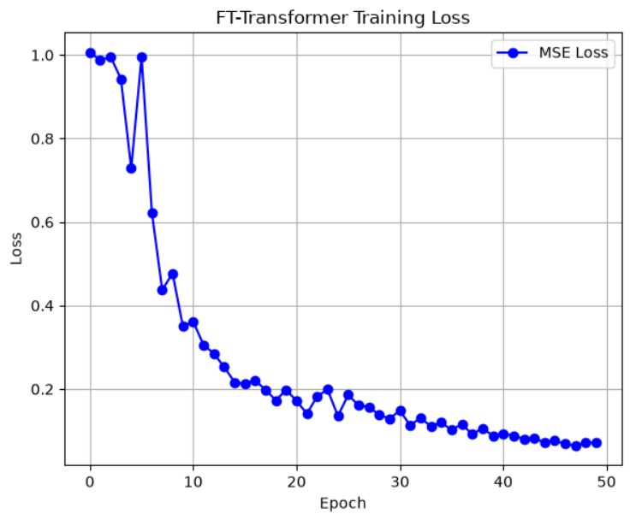
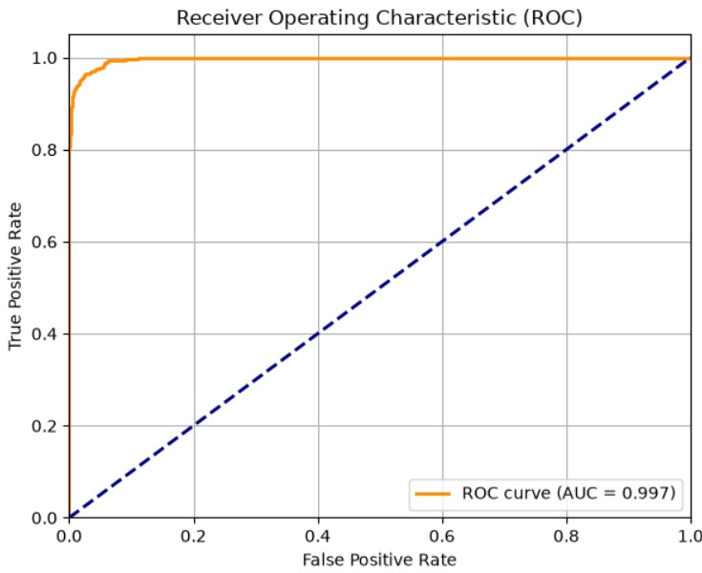
Results

Slide 17
Thank You

