Slide 1

MOFChat: Explainable, Data-Grounded MOF Recommendation with Validated LLM Planning, Multi-Objective Optimisation and Deep-Learning Surrogates
22AIE452 - Data Driven Material Modeling and Simulation | Final Review
Team_14
Amrutha T - 24255
Charan Tej Reddy Y - 24259
Poojitha D - 24263
Enku Sai Mohith - 24316
Ramu Jahna Bindu - 24249

Slide 2
Outline
1
Introduction
MOFs, problem statement, base paper (ChatMOF)
2
Objectives and Novelty
What we set out to do and how we improve on ChatMOF
3
Literature Review
18 papers from 2024 to 2026 and the research gap
4
Dataset and Feature Extraction
CoRE MOF 2019, preprocessing, descriptor and embedding analysis
5
Pipeline and Architecture
Dashboard-to-backend pipeline, models used, FT-Transformer architecture
6
Results
Retrieval benchmark, classification (accuracy, ROC, confusion matrices), regression, learning curves
7
Application, Conclusion and Future Work
Streamlit application, limitations, references

Slide 3
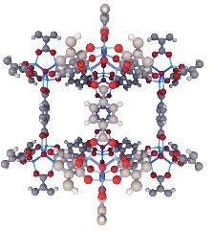
Introduction
Metal-Organic Frameworks (MOFs) are crystalline porous materials made by linking metal ions with organic molecules, creating microscopic cages. Their tunable pores make them candidates for carbon capture, hydrogen and methane storage, gas separation and catalysis.
Selecting the right MOF is difficult: the CoRE-MOF database alone has 12,020 MOFs, and a good choice has to balance several properties (surface area, pore size, density, metal sites) and needs domain knowledge.
Problem statement
Existing LLM agents such as ChatMOF make MOF search conversational, but they generate code that can fail, depend on paid models, run into token limits and return numbers that are never checked against the data.
Aim
MOF framework: metal nodes joined by organic linkers
A conversational assistant that answers MOF questions exactly from the full database, ranks trade-offs between properties, predicts properties with uncertainty and explanations, runs on free or offline models, and verifies its own answers.
Dataset at a glance | Value
MOFs in CoRE MOF 2019 | 12,020
Different metals | 65
MOFs with zero accessible surface area | 27 %
Terms: MOF = metal-organic framework. LLM = large language model (AI that reads and writes text, e.g. GPT-4, Gemini). CoRE MOF = Computation-Ready, Experimental MOF database. Domain knowledge = chemistry facts such as which pore sizes let which gases through.

Slide 4
Base Paper: ChatMOF (Kang and Kim, 2024)
What the base paper did
Drawbacks reported in the base paper
GPT-4 agent that plans tool calls (ReAct)
Search: the LLM writes pandas code over the CoRE-MOF table
Prediction: MOFTransformer (one fine-tuned model per property)
Generation: genetic algorithm with PORMAKE
L1 No intrinsic materials knowledge (the LLM only plans tools)
L2 Token-context limits: 4 % of search tasks failed
L3 Reasoning and logic errors in generated code
Task | Reported accuracy
Search | 96.9 %
Prediction | 95.7 %
Generation | 87.5 %
L4 Restricted search space (about 100 parent structures)
L5 Narrow topology coverage (9 topologies)
L6 One pretrained model needed per property
https://www.nature.com/articles/s41467-024-48998-4
L7 General, non-fine-tuned LLM (GPT-4)
L8 High compute cost (GA and simulations)
L9 Results are not validated against the data
Terms: ReAct = an agent loop where the LLM reasons, calls a tool, reads the result and repeats. pandas = Python library for tables. MOFTransformer = pretrained Transformer that predicts MOF properties from the 3-D structure. GA = genetic algorithm (evolves candidates by mutation and selection). PORMAKE = tool that builds MOF structures from building blocks. Topology = the connection pattern of metal nodes and linkers. Token limit = maximum amount of text an LLM can read at once.

Slide 5
Objectives and Our Novelty
Objectives
Base-paper limitation | MOFChat novelty
No materials knowledge | RAG over curated notes and the ChatMOF paper
Token limits | SQL filters first; the LLM sees at most 10 verified rows
Logic errors in code | The LLM writes a JSON plan; a validator checks and repairs it
Small search space | All 12,020 MOFs searched and ranked (NSGA-II)
Only 9 topologies | Every CoRE-MOF structure, 65 metals
One model per property | Our own XGBoost and FT-Transformer surrogates
Proprietary GPT-4 | 14 free or local LLMs with automatic fallback
High computation | Millisecond surrogate models instead of simulations
No validation | Answer validator, conformal intervals, SHAP and a benchmark
1. Exact answers over all 12,020 MOFs using free or local LLMs
2. Safe LLM planning with validation, self-correction and fallback
3. Multi-objective ranking with NSGA-II
4. Deep-learning and ML surrogate models with uncertainty and SHAP
5. Knowledge grounding by retrieval (RAG)
6. Measured results: benchmark, held-out set, classification and regression metrics
Terms: NSGA-II = Non-dominated Sorting Genetic Algorithm II (ranks options with several goals). SHAP = SHapley Additive exPlanations (how much each input pushed a prediction). RAG = retrieval-augmented generation (look up documents, then answer). SQL = database query language. JSON plan = structured text that says what to search. Surrogate = fast ML model that replaces a slow calculation. Held-out set = test questions never used while building.

Slide 6
Literature Review (2024-2026), part 1 of 3
# | Paper | Authors | Year, venue | Method | Contribution | Limitation | Use in MOFChat
1 | ChatMOF: an AI system for predicting and generating MOFs using LLMs | Kang, Kim | 2024, Nat. Commun. | GPT-4 agent writes pandas code; MOFTransformer; genetic algorithm | 96.9 / 95.7 / 87.5 % on search / prediction / generation | Token limits, code errors, answers not checked | Base paper; we use validated JSON plans and SQL
2 | Augmenting LLMs with chemistry tools (ChemCrow) | Bran et al. | 2024, Nat. Mach. Intell. | GPT-4 with 18 expert tools in a reason-act loop | Planned real syntheses; found a new chromophore | Needs GPT-4; tool outputs not cross-checked | Tool calling; our tools are deterministic and tested
3 | MOFDiff: coarse-grained diffusion for MOF design | Fu, Xie, Rosen et al. | 2024, ICLR | Equivariant diffusion over building blocks | Valid, novel MOFs for CO2 capture | Needs simulation to validate | Generation is future work
4 | TableRAG: million-token table understanding | Chen et al. | 2024, NeurIPS | Schema and cell retrieval before the LLM | Table QA on very large tables | Numeric filters still judged by the LLM | We filter with SQL first
5 | Chain-of-Table: evolving tables in the reasoning chain | Wang et al. | 2024, ICLR | LLM plans table operations step by step | Best results on WikiTQ and TabFact | No domain validation of operations | We validate every planned operation
6 | Detecting hallucinations in LLMs using semantic entropy | Farquhar, Kossen, Kuhn, Gal | 2024, Nature | Entropy over the meanings of sampled answers | Detects confabulations without task data | Misses consistent errors; needs many samples | We check answers against the data instead
Terms: QA = question answering. WikiTQ / TabFact = public table question-answering benchmarks. Confabulation = a confident but made-up LLM answer. Equivariant diffusion = generative model that respects rotations of a structure. CO2 capture = trapping carbon dioxide from gas mixtures.

Slide 7
Literature Review (2024-2026), part 2 of 3
# | Paper | Authors | Year, venue | Method | Contribution | Limitation | Use in MOFChat
7 | Harnessing LLMs to collect and analyze MOF property data (L2M3) | Lee, Kang, Bae, Kim | 2025, JACS | LLM text mining of over 40,000 articles | Experimental MOF database and synthesis recommender | Extraction errors from text | Source of real labels for future uptake models
8 | MOF-ChemUnity: literature-informed LLMs for MOF research | Pruyn et al. | 2025, JACS | Multi-agent LLM links literature names to CSD structures | Literature-grounded answers via a knowledge graph | Large infrastructure | Our RAG grounds answers in notes and papers
9 | Accurate predictions on small data with a tabular foundation model (TabPFN) | Hollmann et al. | 2025, Nature | Transformer pretrained on synthetic tables | Beats tuned GBDT on small tables | About 10k rows / 500 features at most | Possible surrogate for our 8k-row tables
10 | TabM: tabular deep learning with parameter-efficient ensembling | Gorishniy, Kotelnikov, Babenko | 2025, ICLR | MLP with BatchEnsemble | Beats attention-based tabular models | Generic benchmarks only | Matches our finding: DL close to trees
11 | LLaMP: LLM for high-fidelity materials knowledge retrieval | Chiang et al. | 2025, EMNLP | Hierarchical ReAct agents over Materials Project | Grounded answers with a confidence metric | Needs the Materials Project API | Same grounding idea with a local MOF database
12 | System of agentic AI for the discovery of MOFs (MOFGen) | Inizan et al. | 2025, arXiv | LLM proposes compositions; diffusion and quantum-chemistry agents | Synthesizable MOF candidates | Heavy compute; preprint | We verify answers against the database
Terms: JACS = Journal of the American Chemical Society. CSD = Cambridge Structural Database of crystal structures. Knowledge graph = facts stored as linked entities. GBDT = gradient-boosted decision trees (e.g. XGBoost). BatchEnsemble = cheap way to train many networks that share weights. Materials Project = public database of inorganic materials.

Slide 8
Literature Review (2024-2026), part 3 of 3
# | Paper | Authors | Year, venue | Method | Contribution | Limitation | Use in MOFChat
13 | L2M3OF: a large language multimodal model for MOFs | Cui et al. | 2025, arXiv | Crystal encoder projected into an LLM | Better than text-only LLMs on properties | Needs structure files and fine-tuning | Multimodal input is future work
14 | Conversational LLM agent for synthesis of MOF catalysts (MOFsyn Agent) | Lin et al. | 2025, ACS Nano | RAG and ML agent guiding synthesis | Faster Ni@UiO-66(Ce) catalyst optimisation | Single reaction system | RAG and ML combined, as in MOFChat
15 | The rise of generative AI for MOF design and synthesis | Duan et al. | 2025, arXiv (perspective) | Review of VAEs, diffusion models and LLM agents | Roadmap to closed-loop discovery | Feasibility and data gaps | MOFChat sits at the screening stage
16 | LitMOF: LLM multi-agent for literature-validated MOF database correction | Kim, Kim, Kim | 2025, arXiv | Agents check CSD structures against papers | 189,567 structures; 9,227 entries repaired | Preprint | We also audit the data (ETL checks)
17 | Enhancing spatial reasoning in LLMs for MOF structure prediction (MOF-LLM) | Pan et al. | 2026, arXiv | Qwen-3 8B with spatial pretraining, SFT and RL | 35.78 % match rate, 0.04 s per structure | Low match rate | Small open LLMs can be specialised
18 | An LLM agent for end-to-end computational materials discovery (MAESTRO) | Chen et al. | 2026, arXiv | Agent mines papers, builds a database, screens MOFs | Finds wet-flue-gas separation candidates | Preprint | MOFChat is a verified query layer
Terms: Multimodal = uses more than one kind of input (crystal structure and text). VAE = variational autoencoder (generative model). SFT = supervised fine-tuning. RL = reinforcement learning. Preprint = paper not yet peer-reviewed (arXiv). Closed-loop discovery = AI proposes, lab tests, results feed back.

Slide 9
Research Gap from the Literature
Gap | Evidence in 2024-2026 work | What MOFChat does
Answers are rarely verified against data | ChatMOF, ChemCrow and LLaMP trust the LLM's final text; semantic entropy needs many samples. | A deterministic answer validator checks IDs, numbers and comparison claims against the database.
Dependence on proprietary LLMs | Most agents use GPT-4. | 14 free or local models with fallback; works fully offline with Llama 3.
Few benchmarks for query planning | Accuracy is reported on the authors' own question sets. | 64-question development set, 20 held-out questions, model comparison and ablation.
Tabular DL vs trees on MOF descriptors | TabPFN, TabM and Grinsztajn et al. compare on generic data. | FT-Transformer, MLP, XGBoost and GP compared on MOF regression and classification.
Terms: Deterministic = always gives the same output for the same input (normal code, not an LLM). Proprietary = paid, closed model. Ablation = removing one part to measure what it adds. Tabular DL = deep learning on tables. MLP = multilayer perceptron (simple neural network). GP = Gaussian process.

Slide 10
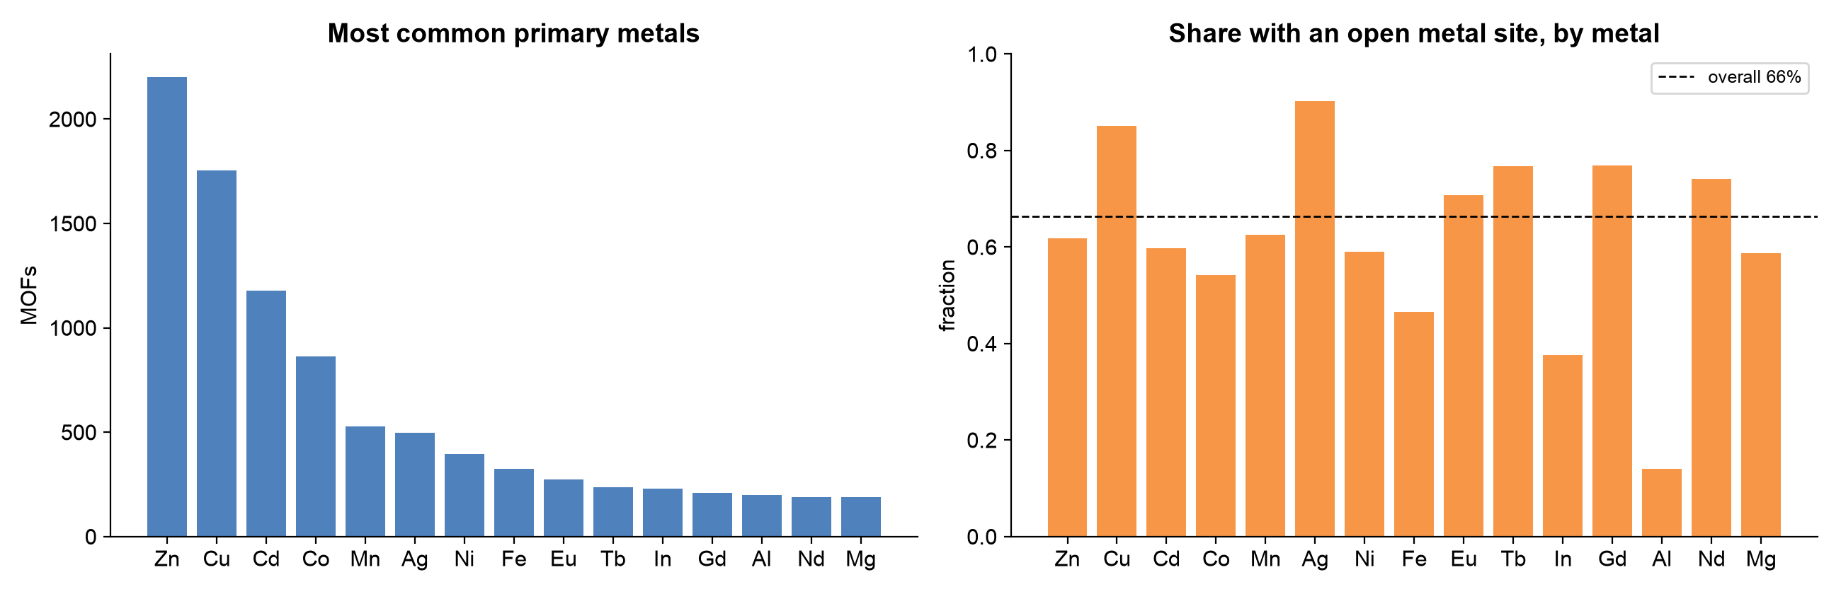
Dataset: CoRE MOF 2019 and Preprocessing
Category | Attributes
Identification | MOF_ID (CSD refcode)
Pore geometry | LCD, PLD, LFPD (Å)
Density | Density (g/cm³)
Surface area | Accessible (m²/g, m²/cm³), non-accessible
Porosity | Void fraction, pore volume, non-accessible volume
Chemistry | Metal type, open metal site, OMS type
Preprocessing (ETL) findings
Check | Finding and action
Missing values, duplicates | None
Two column pairs identical | Duplicates dropped
Pore volume = void fraction / density | Derived column; documented
Zero surface area (3,252 MOFs) | All have PLD < 3.31 Å; physics rule
Density header said cm³/g | Values are g/cm³; label fixed
2,087 multi-metal MOFs | Separate mof_metals table
Feature scaling | log1p and z-score
12,020 experimental MOFs and 17 columns, computed with Zeo++ using a 3.31 Å (N2) probe.
Terms: LCD = largest cavity diameter (biggest sphere that fits in a cage). PLD = pore limiting diameter (narrowest window a molecule must pass). LFPD = largest free pore diameter (biggest sphere that can travel through). OMS = open metal site. CSD refcode = MOF ID in the Cambridge Structural Database. Zeo++ = software that computes pore geometry. ETL = extract, transform, load. log1p = log(1 + x). z-score = (value - mean) / standard deviation.

Slide 11
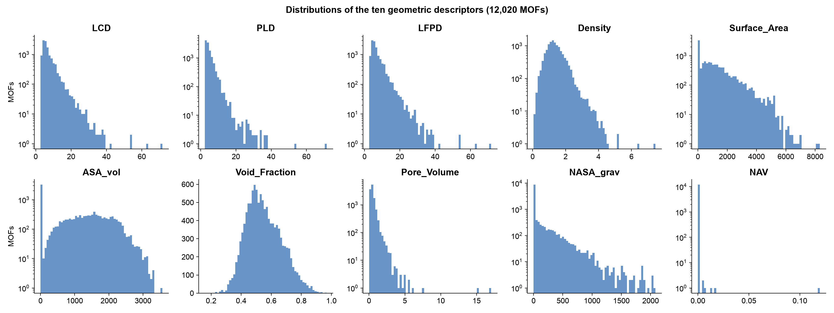
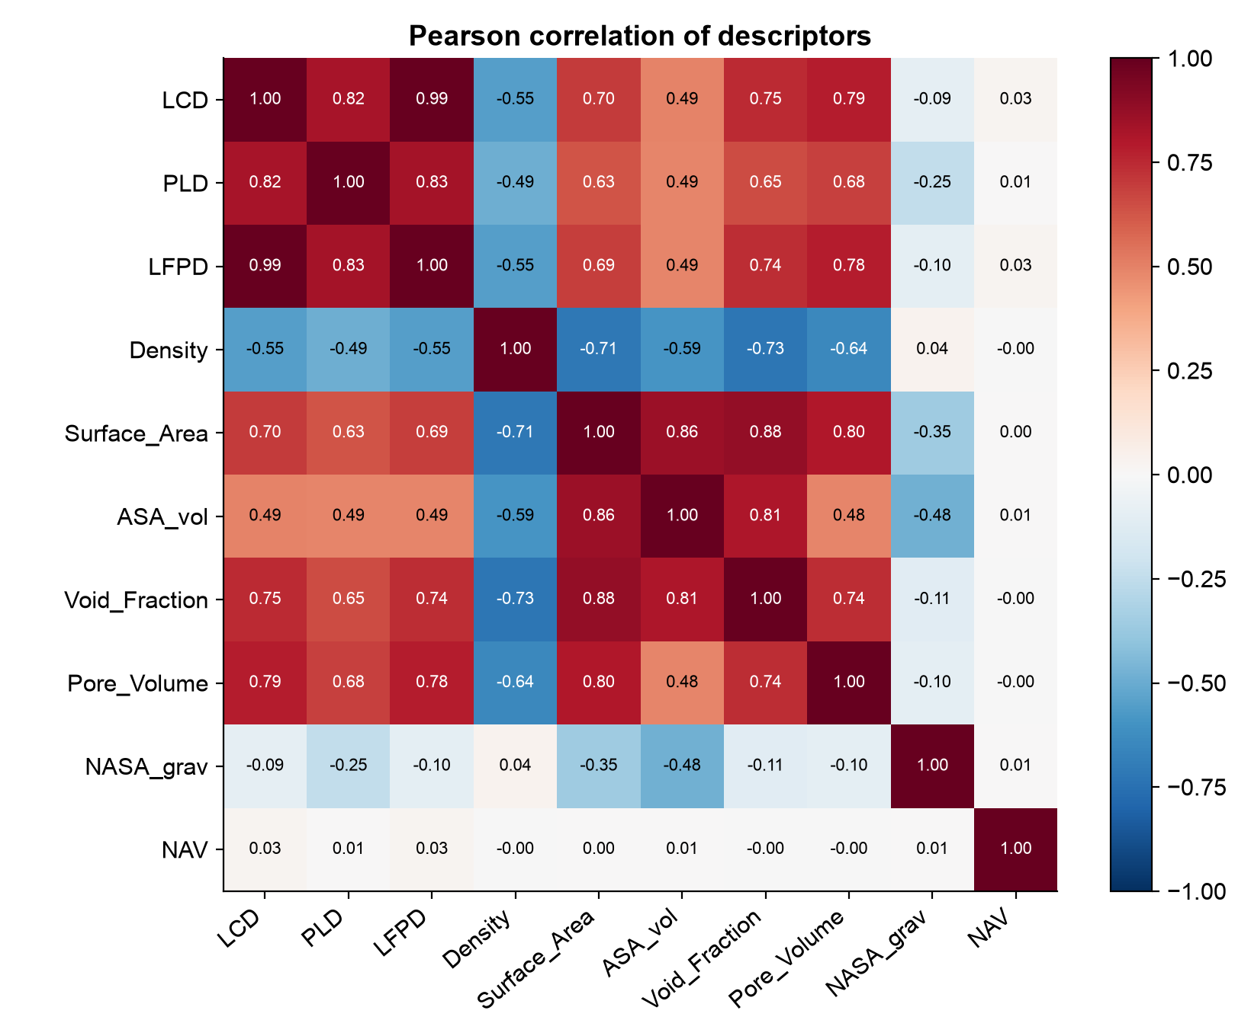
Feature Extraction: Descriptor Distributions and Correlations
Observations
Most descriptors are right-skewed, so they are log-transformed and standardised before the FT-Transformer
27 % of MOFs have exactly zero accessible surface area (the spike at 0)
Strongest correlations: LCD and LFPD (+0.99), Surface_Area and Void_Fraction (+0.88), Surface_Area and ASA_vol (+0.86), PLD and LFPD (+0.83)
Pore volume is derived from void fraction and density, so it is left out when predicting void fraction
Pearson correlation of the ten descriptors
Terms
LCD: largest cavity diameter
PLD: pore limiting diameter (narrowest window)
LFPD: largest free pore diameter along a path
ASA / ASA_vol: accessible surface area per gram / per cm³
Void fraction: share of the volume that is empty
Pore volume: empty volume per gram
NASA / NAV: non-accessible area / volume
Pearson r: -1 to +1, how linearly two values move together

Slide 12
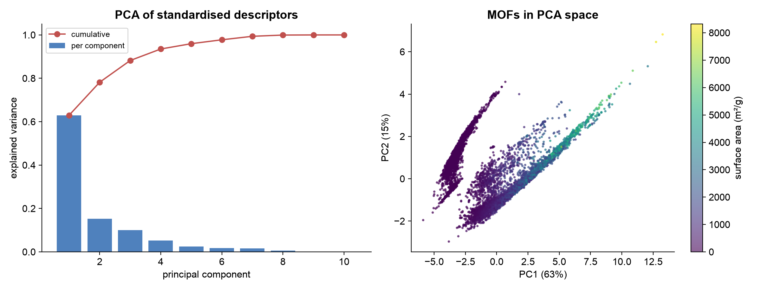
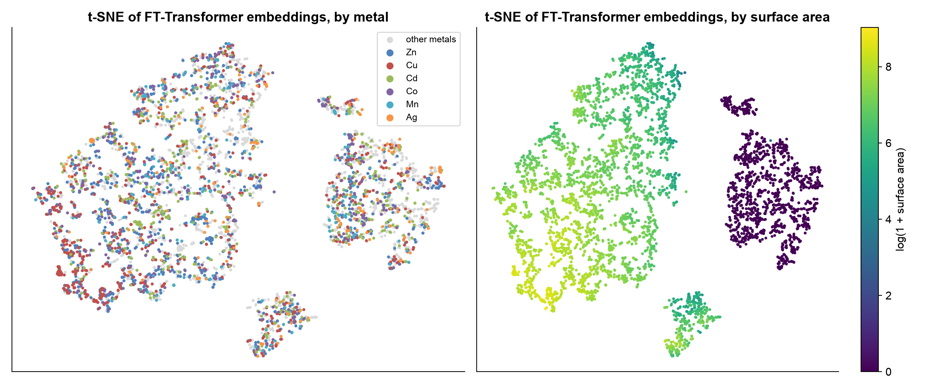
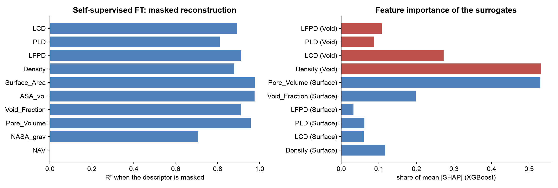
Feature Extraction: PCA, Learned Embeddings and Reconstruction
PCA: the first two components explain 78 % of the variance
t-SNE of the 64-d FT-Transformer embeddings: smooth surface-area gradient; metals form local clusters
Masked reconstruction: R² 0.978 for surface area and 0.913 for void fraction when hidden
SHAP: pore volume and void fraction drive surface area; density drives void fraction
Terms: PCA = principal component analysis (finds the main directions of variation). t-SNE = method that draws high-dimensional data as a 2-D map. Embedding = a vector of numbers that represents a MOF. Masked reconstruction = hide some inputs and let the model rebuild them. R² = share of variance explained (1 = perfect).

Slide 13
Overall Pipeline: Dashboard to Backend
FRONTEND
BACKEND (mofchat/agent.py)
Streamlit dashboard (app.py)
Rule parser
14 LLMs with fallback
retry up to 2 times
User question and model choice
LLM planner (JSON plan)
Plan validator
Intent router
SQL and NSGA-II
FT-Transformer and FAISS
XGBoost, conformal, SHAP
RAG: MiniLM and FAISS
LLM answer writer
Answer validator
Answer, verified table, Pareto and SHAP plots, trace
Red boxes use a language model; the other steps are deterministic code.
Terms: Intent router = picks the tool for the request type. FAISS = fast vector search library. MiniLM = small sentence-embedding model. Conformal = 90 % prediction interval. Fallback = next model used when one fails.

Slide 14
Pipeline Architecture: Offline Training and Online Inference
Offline (run once)
MOF dataset
ETL and checks
Feature scaling
Masked FT-Transformer
Surrogate models
Knowledge index
Evaluation
• Dataset: 12k CoRE-MOFs • ETL: Clean & SQLite • FT-Transformer: 64-d SSL • Surrogates: XGBoost • Index: S-BERT + FAISS RAG
Scripts: setup_db.py, train_ft.py, train_property_models.py, setup_vectorstore.py, evaluate.py, evaluate_dl.py
Online (per question)
User query
Plan (LLM and rules)
Validate plan
Execute tools
Write answer (LLM)
Validate answer
Show answer
Feature extraction inside the FT-Transformer
10 descriptors, metal, OMS
Feature tokenizer
[CLS] and 3 Transformer blocks
64-d MOF embedding
FAISS nearest neighbours
Similar MOFs
In review 1, 384-d MOF embeddings were matched to a Sentence-BERT question vector. The two were never trained together, so this path was replaced by plan, validate and SQL (exact answers rose from 9.4 % to 100 %).
Terms: SSL = self-supervised learning (learns from the data itself, no labels). S-BERT = Sentence-BERT. Regex = text-pattern rules. Levenshtein = number of letter edits between two words. [CLS] = extra summary token. L2-normalised = scaled to length 1. Cosine = similarity of two vectors (1 = same direction).

Slide 15
Models Used (1): Language and Embedding Models
Model | Type | How it works | Role in MOFChat
Gemini 3.1 Flash-Lite | LLM, cloud (free) | Transformer decoder that predicts the next token; we prompt it with the schema, rules and 9 examples at temperature 0 in JSON mode | Default planner and answer writer
GPT-OSS 120B / 20B, Qwen 3.8 27B (Groq) | LLMs, cloud (free) | Same principle; open-weight models served by Groq | Fallback planners and writers
Nemotron 3, Gemma 4 (OpenRouter) | LLMs, cloud (free) | Open models through an OpenAI-compatible API | Further fallbacks
Llama 3 / 3.1 8B, Qwen 2.5 7B (Ollama) | LLMs, local | Small open models running on the laptop CPU | Offline planning and answers
all-MiniLM-L6-v2 (Sentence-BERT) | Embedding model, 384-d | 6-layer Transformer; mean-pooled sentence vectors compared by cosine similarity | Embeds questions and knowledge chunks for RAG
FT-Transformer autoencoder | Embedding model, 64-d | Each descriptor becomes a token; 30 % are masked and the [CLS] state reconstructs all ten | MOF embeddings for similarity search
FAISS | Vector index | Inner product on normalised vectors equals cosine similarity; fast exact search | Nearest-neighbour search for RAG and similarity
Terms: Token = a piece of a word or one input feature. Temperature 0 = always choose the most likely output (repeatable). JSON mode = output forced to structured JSON. Open-weight = model weights are public. 384-d / 64-d = a vector of 384 / 64 numbers. Mean-pooled = average of the word vectors.

Slide 16
Models Used (2): Prediction Models and Algorithms
Model | Type | How it works | Role in MOFChat
XGBoost | Gradient-boosted trees | Hundreds of small decision trees added one after another, each fitting the errors of the previous ones | Main surrogate model; OMS classifier
FT-Transformer regressor / classifier | Deep learning | Same Transformer backbone with a linear head; MSE or cross-entropy loss; early stopping on validation loss | Surface area, void fraction; OMS classification
MLP classifier | Deep learning | Two hidden layers of 128 ReLU units with a metal embedding; cross-entropy loss | Deep-learning baseline for OMS
Gaussian process | Bayesian regression | RBF kernel with one length scale per feature plus noise; gives a mean and an uncertainty | Regression baseline with 95 % intervals
Ridge, logistic regression | Linear models | Linear models with an L2 penalty | Baselines
NSGA-II | Multi-objective algorithm | Sorts candidates into Pareto fronts, then prefers well-spread points (crowding distance) | Ranks MOFs on several objectives
SHAP (TreeSHAP) | Explainability | Shapley values split each prediction into per-feature contributions | Explains every prediction
Split-conformal prediction | Uncertainty | 90th percentile of absolute errors on a calibration split gives a ± interval | 90 % prediction intervals
Terms: MSE = mean squared error. Cross-entropy (BCE) = loss for yes/no classification. ReLU = max(0, x). RBF kernel = similarity that decays with distance. L2 penalty = keeps weights small. Pareto front = set of best trade-offs. Calibration split = data kept aside only to size the interval.

Slide 17
Model Architecture: FT-Transformer (Gorishniy et al., 2021)
Decoder: 10 descriptors (MSE)
Linear: 1 value (MSE)
Linear: logit (BCE)
Configuration
Item | Value
Parameters (embedding) | 114,378
Parameters (classifier) | 104,449
Blocks / heads / d | 3 / 4 / 64
Optimiser | AdamW, lr 0.001
Batch size | 256
Early stopping | validation loss
SSL masking | 30 % of tokens
SSL training | 38 epochs
Regressor (surface area) | 163 epochs
Classifier (OMS) | best epoch 31
LayerNorm, [CLS] (64-d)
3 pre-norm Transformer blocks (d = 64, 4 heads)
LayerNorm
Self-attention
Residual add
LayerNorm
Feed-forward
Residual add
Terms: d = numbers per token. Heads = parallel attention units. Self-attention = each token weighs every other token. LayerNorm = rescales each token. Residual add = adds the input back. FFN = feed-forward layer. AdamW = optimiser. lr = learning rate. Epoch = one pass over the training data.
[CLS]
LCD
PLD
LFPD
Dens.
SA
VF
...
metal
Input tokens: numeric value times a learned vector plus bias, categorical embeddings and a learned [CLS] token

Slide 18
LLM Planning: Plan, Validate, Execute
"Which zinc MOFs have high surface area and low density?"
Validator checks
Column aliases resolved from one registry
Units, operators and percentages normalised
Impossible or invented values rejected
Thresholds not in the question become preferences
MOF IDs not in the question dropped
Superlatives written as constraints repaired
Application presets expanded (H2, CH4, CO2, sieving, catalysis)
Objectives not asked for in an application question dropped
{ "intent": "search",
"metals": ["Zn"],
"objectives": [
{"column": "Surface_Area", "direction": "max"},
{"column": "Density", "direction": "min"} ],
"limit": 5 }
Executor: whitelisted columns, bound parameters, read-only SQL on zinc MOFs, then NSGA-II ranking for the two objectives
If errors remain after two corrections, the rule-parser plan is used. If no LLM is reachable, the rules and a template answer are used.
Intents: search, count, lookup, similar, predict, knowledge, out of scope
Terms: Intent = type of request. Whitelisted columns = only known column names allowed. Bound parameters = numbers passed separately, so the query cannot be changed. Read-only = cannot modify data. Superlative = 'highest', 'lowest'. Preset = ready-made rules for an application. Rule parser = regex-based question reader.

Slide 19
Multi-Objective Ranking with NSGA-II
Domination: A beats B if A is at least as good on every objective and better on one
Non-dominated sorting: front 1 holds the MOFs no other MOF beats; remove them and repeat
Crowding distance: prefers MOFs in sparse regions, giving diverse trade-offs
Two objectives: exact O(n log n) sweep; the worst 25 % are screened out first
Speed: all 12,020 MOFs in 0.02 s (2 objectives) and 2.6 s (3)
Application | Heuristic rule
H2 storage | PLD ≥ 2.89 Å; max surface area and void fraction
CH4 storage | PLD ≥ 3.80 Å; max volumetric area and void fraction
CO2 capture | Open metal site; PLD ≥ 3.30 Å; min LCD
Separation A/B | Kinetic diameter of A ≤ PLD ≤ that of B
Catalysis | Open metal site; PLD ≥ 5 Å
Terms: Pareto front = MOFs not beaten on all objectives at once. Objective = a property to maximise or minimise. O(n log n) = time grows only a little faster than the number of MOFs. Kinetic diameter = effective size of a gas molecule (H2 2.89 Å, CO2 3.3 Å, CH4 3.8 Å).

Slide 20
Results: Retrieval Benchmark
An answer counts as correct only if it returns exactly the MOFs of a hand-written gold plan. Constraint precision@k on the held-out set: review 1 41.8 %, hybrid 100 %.
The rules were tuned on the development set, so the held-out questions (written later, never used for tuning) give the fair estimate.
The validator and hybrid planner add 15 points for the offline model and cost less than 0.01 s; for the cloud model they change nothing.
ChatMOF reports 96.9 % on its own search questions; the question sets differ.
Terms: Gold plan = the correct plan written by hand. Precision@k = share of returned MOFs that really satisfy the question. Development set = 64 questions used while building. Held-out set = 20 later questions never used for tuning. Single shot = LLM alone, no corrections. Two-tower = review-1 method matching question and MOF vectors.

Slide 21
Results: Free LLM Comparison and Answer Validation
Model | Held-out alone | Held-out hybrid | Dev hybrid | Median call | Provider errors
Gemini 3.1 Flash-Lite (default) | 100 % | 100 % | 100 % | 1.5 s | 13 / 84
GPT-OSS 120B (Groq) | 95 % | 95 % | 100 % | 2.4-4.7 s | 0
Qwen 3.8 27B (Groq) | 95 % | 95 % | 100 % | 20 s | 0
Nemotron 3 Super 120B | 95 % | 95 % | - | 2.0 s | 0
Llama 3 8B (local) | 65 % | 80 % | 100 % | 1.5 s | 0
Gemini 3.5 Flash | - | - | - | - | 64 / 84 (quota)
Answer validation (16 full answers per model)
Examples caught by the validator
Model | Drafts with a problem | Rewritten | Still flagged | s per answer
Gemini 3.1 Flash-Lite | 0 of 16 | 0 | 0 | 9.9
Llama 3 8B (local) | 2 of 16 | 1 | 0 | 9.3
GPT-OSS 120B | 2 of 16 | 2 | 1 | 30.2
Qwen 3.8 27B | 0 of 16 | 0 | 0 | 26.4
Llama 3 invented two densities and a "90 %"; the ID OFEUN06 was corrected to OFERUN06
GPT-OSS 120B claimed "Pareto front 1" for MOFs ranked on front 2
Llama 3 named MOFs that do not exist ("MOF-210") in a prediction answer
GPT-OSS cited a prompt header "[WHY]" as a source; it is now removed
Terms: Hybrid = LLM plan plus facts the rule parser is sure of. Median call = typical time for one planning request. Provider error = the free API refused or failed the call. Quota = daily request limit. Draft = the LLM's first answer before checking.

Slide 22
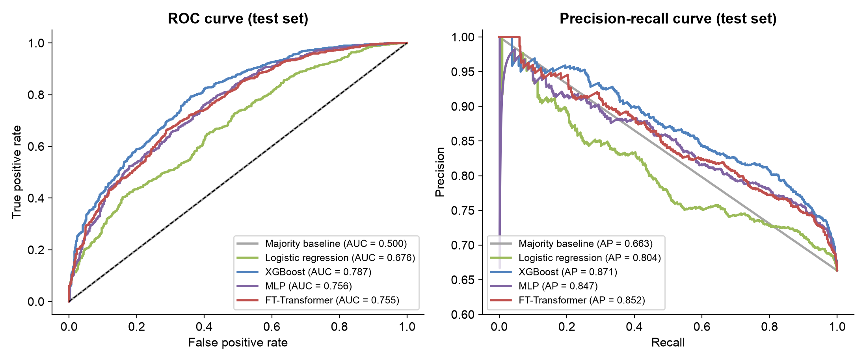
Results: Open-Metal-Site Classification (DL vs ML)
Model | Accuracy | Precision | Recall | F1 | ROC-AUC | PR-AUC
Majority baseline | 0.663 | 0.663 | 1.000 | 0.798 | 0.500 | 0.663
Logistic regression | 0.693 | 0.708 | 0.916 | 0.798 | 0.676 | 0.804
XGBoost | 0.750 | 0.765 | 0.901 | 0.827 | 0.787 | 0.871
MLP | 0.734 | 0.759 | 0.878 | 0.814 | 0.756 | 0.847
FT-Transformer | 0.728 | 0.755 | 0.873 | 0.810 | 0.755 | 0.852
Task: predict whether a MOF has an open metal site from its 10 geometric descriptors and primary metal. 66.4 % of MOFs have one. OMS_Type is not used as an input.
Split: 8414 / 1803 / 1803 MOFs (train / validation / test, stratified = same OMS share in each)
Terms: Accuracy = share of correct predictions. Precision = of MOFs predicted OMS, share that are right. Recall = of real OMS MOFs, share found. F1 = balance of precision and recall. ROC-AUC = chance a real OMS MOF scores higher than a non-OMS one (0.5 = guessing). PR-AUC = area under the precision-recall curve. Majority baseline = always predict the most common class.

Slide 23
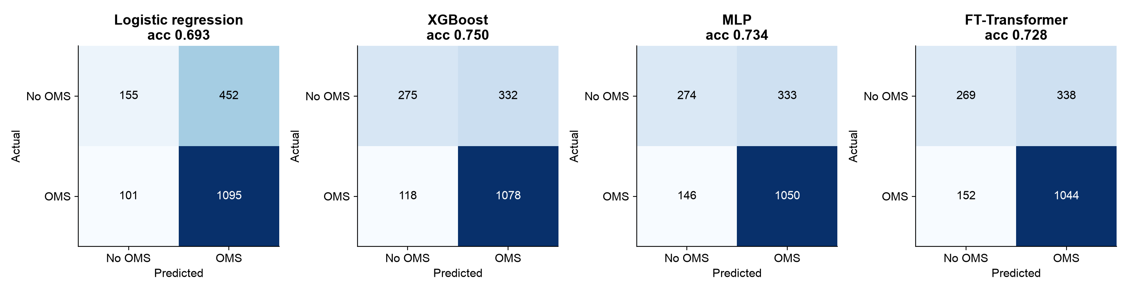
Results: Confusion Matrices of the OMS Classifiers
Model | True negative | False positive | False negative | True positive | Train / val / test accuracy
XGBoost | 275 | 332 | 118 | 1078 | 0.868 / 0.770 / 0.750
MLP | 274 | 333 | 146 | 1050 | 0.782 / 0.755 / 0.734
FT-Transformer | 269 | 338 | 152 | 1044 | 0.781 / 0.735 / 0.728
All trained classifiers beat the majority baseline (66.3 % accuracy, ROC-AUC 0.50). XGBoost is best and the two deep-learning models are close behind.
Whether a metal site is open depends on coordination chemistry that pore geometry and metal type only partly describe, so accuracy levels off near 75 %.
Terms: Confusion matrix = table of actual vs predicted classes. True positive = has OMS, predicted OMS. False positive = predicted OMS but has none. False negative = has OMS, predicted none. True negative = no OMS, predicted none. Overfitting = learning the training data too closely (train accuracy much higher than test).

Slide 24
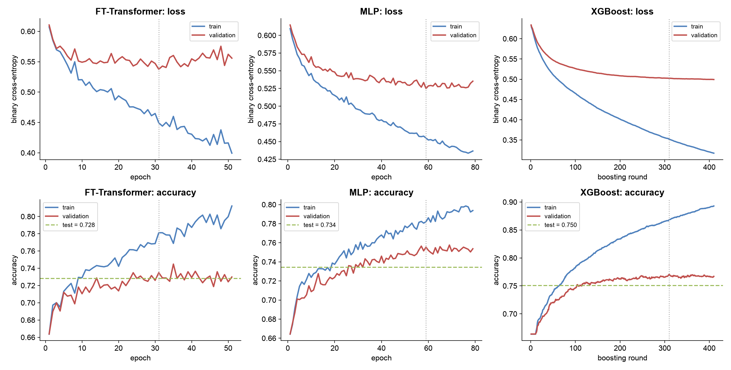
Results: Train, Validation and Test Accuracy and Loss
Blue: train, red: validation, green dashed: test, dotted: best epoch. FT-Transformer best epoch 31 of 51; MLP 59; XGBoost best round 310.
Terms: Loss = how wrong the model is (lower is better). Epoch = one pass over the training data. Boosting round = one tree added in XGBoost. Early stopping = keep the epoch with the lowest validation loss. Validation set = data used to choose that epoch; test set = untouched final check.

Slide 25
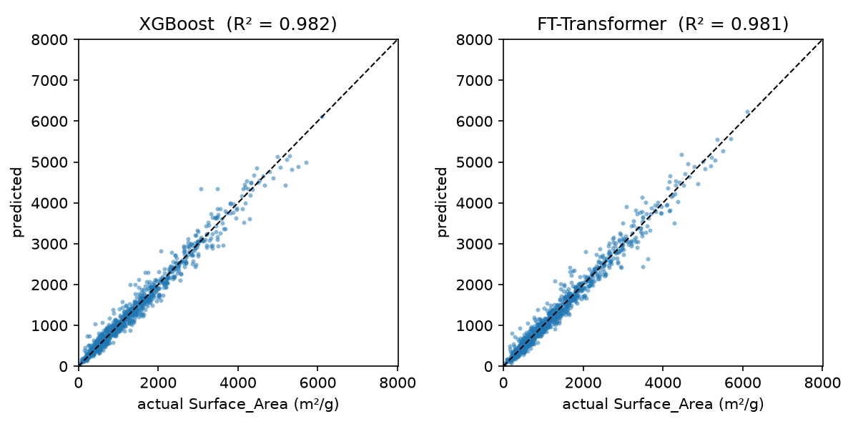
Results: Property Prediction (Regression)
Predicted vs actual surface area on test MOFs
Target | XGBoost MAE | XGBoost R² train / val / test * | FT R² train / val / test * | 90 % interval coverage | GP 95 % coverage
Surface area (m²/g) | 90.0 | 0.987 / 0.959 / 0.972 | 0.975 / 0.969 / 0.972 | 90.5 % | 93.9 %
Void fraction | 0.037 | 0.899 / 0.820 / 0.828 | 0.825 / 0.811 / 0.823 | 88.4 % | 95.1 %
* R² on MOFs with accessible pores; the physics rule handles the zeros exactly (100.0 % on test). XGBoost trains in 0.25 s, the FT-Transformer in 111.58 s.
Terms: Regression = predicting a number. R² = share of variance explained (1 = perfect). MAE = mean absolute error. Parity plot = predicted vs actual (perfect on the diagonal). Interval coverage = share of true values inside the 90 % interval. GP = Gaussian process.

Slide 26
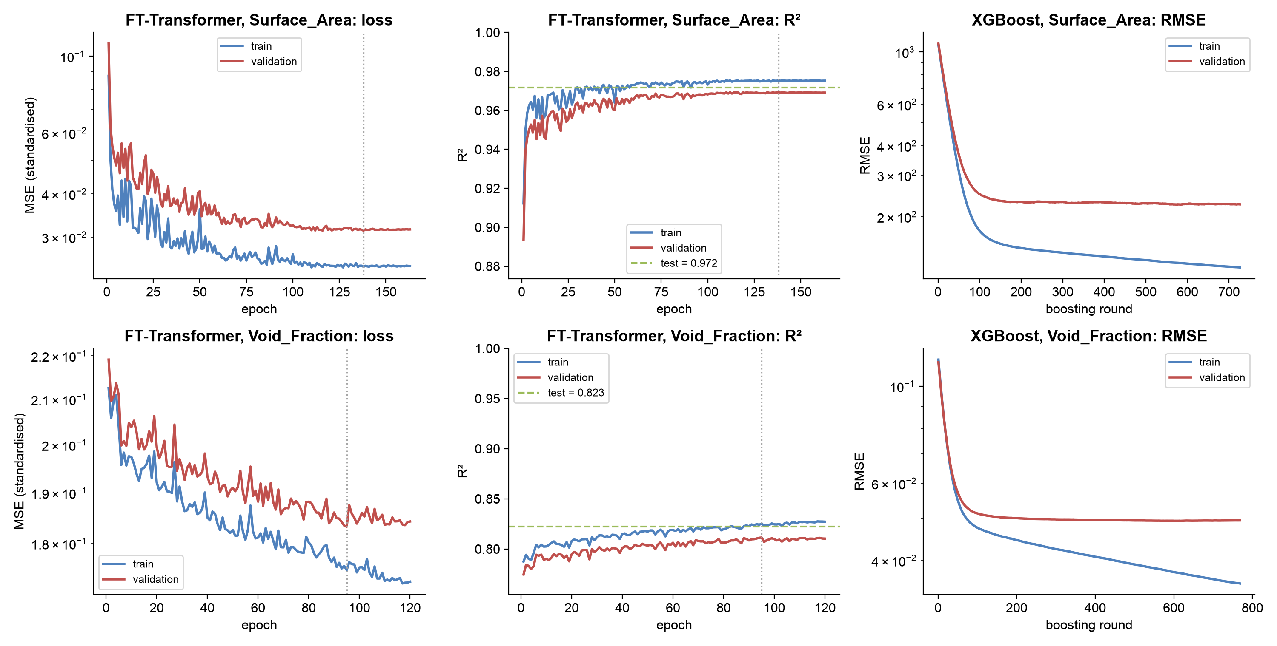
Results: Regression Learning Curves
Blue: train, red: validation, green dashed: test R². FT-Transformer best epoch 138 (surface area) and 95 (void fraction); XGBoost best round 576 and 618.
Terms: MSE (standardised) = squared error after scaling the target. RMSE = root mean squared error, in the target's units. Log scale = each grid step is ten times the last.

Slide 27
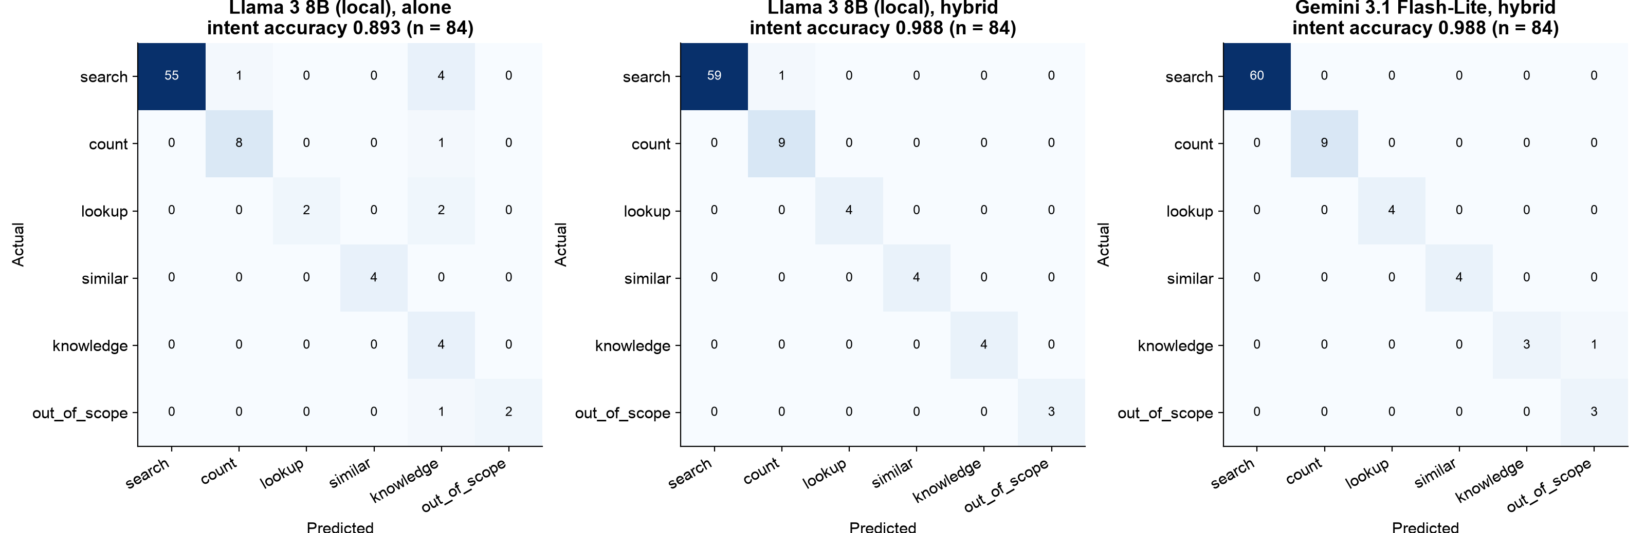
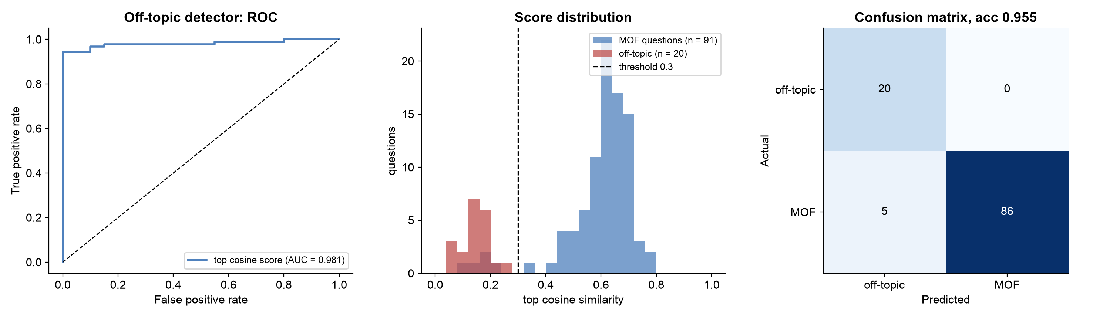
Results: Intent Classification and Off-Topic Detection
Planner | Accuracy | Macro F1
Rules planner | 0.964 | 0.950
Llama 3 8B, alone | 0.893 | 0.802
Llama 3 8B, hybrid | 0.988 | 0.990
Flash-Lite, hybrid | 0.988 | 0.952
Off-topic detector: ROC-AUC 0.981, accuracy 0.955 on 91 MOF questions and 20 off-topic questions (cosine threshold 0.3).
Terms: Intent = request type (search, count, ...). Macro F1 = F1 averaged equally over all intents. Off-topic = not about MOFs. Cosine threshold = minimum text similarity to count as a MOF question.

Slide 28
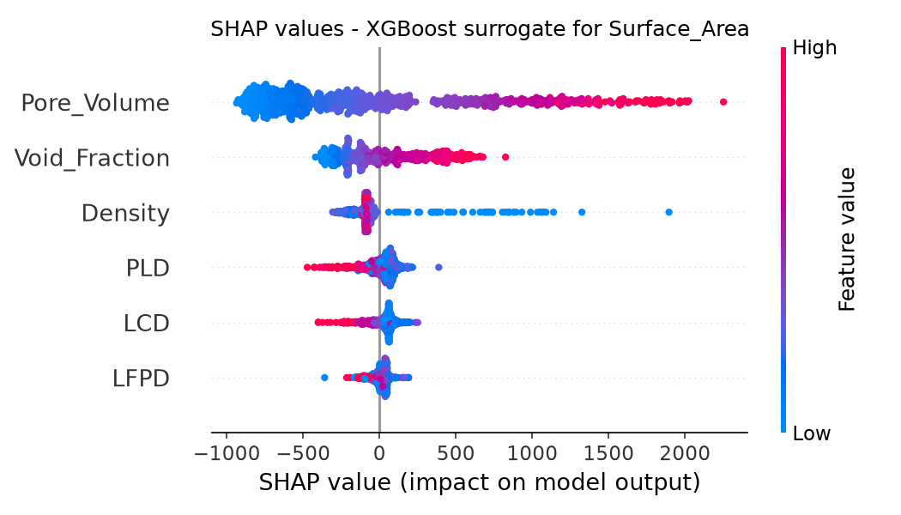
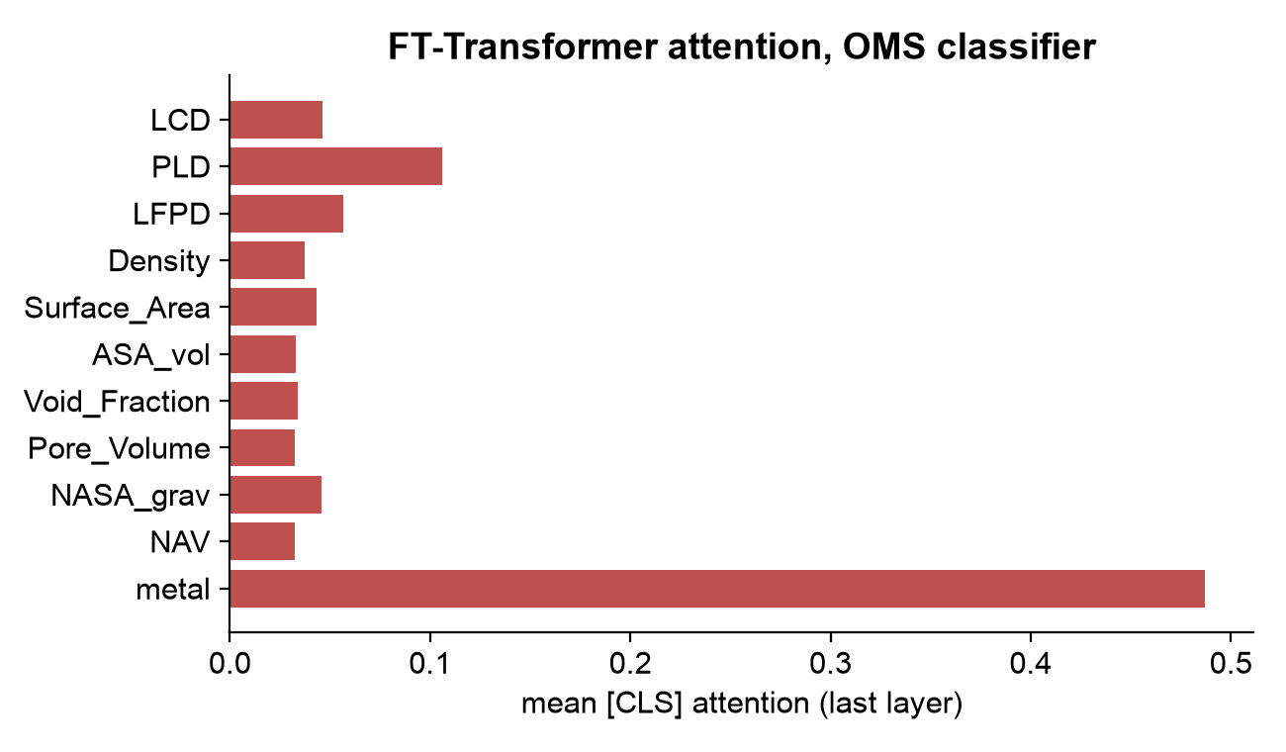
Results: Explainability and Similarity Search
Neighbours from (1,000 queries) | Descriptor gap (σ) | Same metal | Same OMS flag
FT-Transformer embedding | 0.077 | 27.8 % | 70.2 %
k-NN on raw descriptors | 0.068 | 22.8 % | 66.4 %
Random MOFs | 0.952 | 8.0 % | 55.7 %
Pore volume and void fraction dominate surface-area predictions; density dominates void fraction
Knowledge retrieval: hit@1 75 %, hit@3 83 %
Every prediction in the application shows its SHAP contributions and a 90 % interval
Terms: SHAP value = how much a feature pushed one prediction up or down. Attention = how much the model looks at each input. σ = standard deviation. k-NN = k nearest neighbours on the raw numbers. hit@k = correct source among the top k results.

Slide 29
Results: ChatMOF Limitations Addressed
ChatMOF limitation | What MOFChat does | Status
No intrinsic knowledge | RAG over curated notes and the ChatMOF paper | Done
Token-context limits | SQL first; the LLM sees at most 10 rows | Done
Logic errors in LLM code | JSON plan, validator, whitelisted SQL | Done
Restricted search space | All 12,020 MOFs searched and ranked | Done
Narrow topology coverage | All CoRE-MOF structures, 65 metals | Done *
Pretrained model per property | Own surrogate models and OMS classifier trained on the table | Done *
General, non-fine-tuned LLM | Domain prompts, few-shot examples, presets | Partly
High compute cost | Millisecond screening; XGBoost trains in 0.25 s | Done
Unvalidated output | Answer validator, intervals, SHAP, benchmark | Done
* for recommending existing MOFs and for properties in the table; no structure generation and no gas uptake without uptake data
Terms: Few-shot = worked examples placed in the prompt. Fine-tuning = retraining an LLM on our own data. Gas uptake = how much gas a MOF adsorbs.

Slide 30
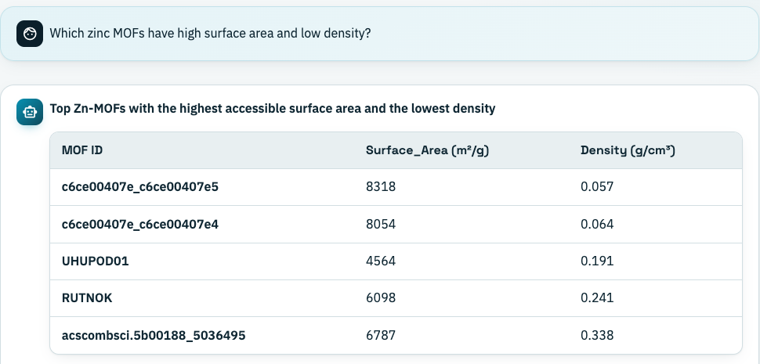
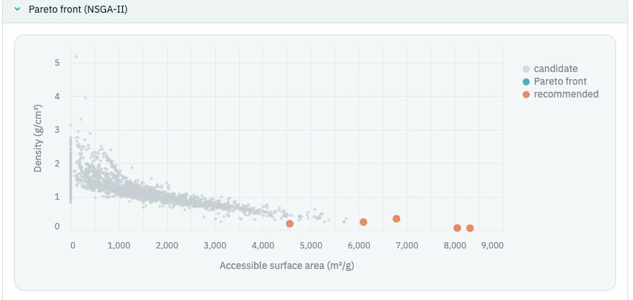
Application: Streamlit Dashboard
Verified result table for a zinc MOF question
NSGA-II Pareto plot for the same question
Page | What it shows
Chat | Answer, verified table, Pareto plot, SHAP, sources, plan, SQL, validator report, model used
Explore and optimise | Filters and two-objective NSGA-II with a Pareto plot
Predict and explain | Prediction, 90 % interval, SHAP bars, FT-Transformer attention
Evaluation | Benchmark, model comparison, parity and SHAP plots
About | Method summary and data sources
Sidebar: choice of language model (or none), planner mode (hybrid, LLM or rules), and the status of every component.
Terms: Streamlit = Python library for web dashboards. Parity plot = predicted vs actual values. Planner mode = how the question is read: hybrid (LLM + rules), LLM only, or rules only.

Slide 31
Conclusion and Future Work
Conclusion
Limitations and future work
Exact answers over all 12,020 MOFs: 5 % (review 1) to 100 % on held-out questions with the default model, 80 % fully offline
Validated LLM planning with 14 free or local models and automatic fallback
NSGA-II multi-objective ranking with application presets
Surface-area surrogate: R² 0.982; the 90 % interval covers 90.5 % of test MOFs
Open-metal-site classification: ROC-AUC 0.787 (XGBoost), 0.755 (FT-Transformer), 0.756 (MLP)
An answer validator checks every MOF ID, number and comparison in the LLM's answer
Limitation | Future work
No gas-uptake labels | Add GCMC uptake data and reuse the surrogate pipeline
No structure generation | Diffusion or GA generator (e.g. MOFDiff)
Offline model at 80 % | LoRA fine-tuning of Llama 3 on plan examples
Free-text reasoning not checked | Sentence-level checks such as semantic entropy
Heuristic presets | Learned rules once uptake data exists
Descriptor-only embeddings | Structure or multimodal encoders (L2M3OF)
Terms: GCMC = grand canonical Monte Carlo (simulation of gas uptake). LoRA = low-rank adaptation (cheap fine-tuning of an LLM). GA = genetic algorithm. Semantic entropy = uncertainty measured over the meanings of several sampled answers. Multimodal encoder = model that reads crystal structures as well as text.

Slide 32
References (1 of 2)
[1] Y. Kang and J. Kim, "ChatMOF: an artificial intelligence system for predicting and generating metal-organic frameworks using large language models," Nat. Commun., vol. 15, 4705, 2024.
[2] Y. G. Chung et al., "Advances, updates, and analytics for the computation-ready, experimental MOF database: CoRE MOF 2019," J. Chem. Eng. Data, vol. 64, pp. 5985-5998, 2019.
[3] Y. Gorishniy, I. Rubachev, V. Khrulkov and A. Babenko, "Revisiting deep learning models for tabular data," NeurIPS, 2021.
[4] L. Grinsztajn, E. Oyallon and G. Varoquaux, "Why do tree-based models still outperform deep learning on typical tabular data?" NeurIPS Datasets and Benchmarks, 2022.
[5] K. Deb, A. Pratap, S. Agarwal and T. Meyarivan, "A fast and elitist multiobjective genetic algorithm: NSGA-II," IEEE Trans. Evol. Comput., vol. 6, pp. 182-197, 2002.
[6] S. M. Lundberg and S.-I. Lee, "A unified approach to interpreting model predictions," NeurIPS, 2017.
[7] A. M. Bran et al., "Augmenting large language models with chemistry tools," Nat. Mach. Intell., vol. 6, 2024.
[8] X. Fu, T. Xie, A. S. Rosen, T. Jaakkola and J. Smith, "MOFDiff: coarse-grained diffusion for metal-organic framework design," ICLR, 2024.
[9] S.-A. Chen et al., "TableRAG: million-token table understanding with language models," NeurIPS, 2024.
[10] Z. Wang et al., "Chain-of-Table: evolving tables in the reasoning chain for table understanding," ICLR, 2024.
[11] S. Farquhar, J. Kossen, L. Kuhn and Y. Gal, "Detecting hallucinations in large language models using semantic entropy," Nature, vol. 630, pp. 625-630, 2024.
[12] W. Lee, Y. Kang, T. Bae and J. Kim, "Harnessing large language models to collect and analyze MOF property data set," J. Am. Chem. Soc., vol. 147, pp. 3943-3958, 2025.

Slide 33
References (2 of 2)
[13] T. M. Pruyn et al., "MOF-ChemUnity: literature-informed large language models for metal-organic framework research," J. Am. Chem. Soc., 2025.
[14] N. Hollmann et al., "Accurate predictions on small data with a tabular foundation model," Nature, vol. 637, pp. 319-326, 2025.
[15] Y. Gorishniy, A. Kotelnikov and A. Babenko, "TabM: advancing tabular deep learning with parameter-efficient ensembling," ICLR, 2025.
[16] Y. Chiang, E. Hsieh, C.-H. Chou and J. Riebesell, "LLaMP: large language model made powerful for high-fidelity materials knowledge retrieval," EMNLP, 2025.
[17] T. J. Inizan et al., "System of agentic AI for the discovery of metal-organic frameworks," arXiv:2504.14110, 2025.
[18] J. Cui et al., "L2M3OF: a large language multimodal model for metal-organic frameworks," arXiv:2510.20976, 2025.
[19] J. Lin et al., "Conversational large-language-model AI agent for accelerated synthesis of MOF catalysts in olefin hydrogenation," ACS Nano, vol. 19, pp. 23840-23858, 2025.
[20] C. Duan et al., "The rise of generative AI for metal-organic framework design and synthesis," arXiv:2508.13197, 2025.
[21] H. Kim, D. Kim and J. Kim, "LitMOF: an LLM multi-agent for literature-validated MOF database correction and expansion," arXiv:2512.01693, 2025.
[22] M. Pan et al., "Enhancing spatial reasoning in large language models for MOF structure prediction," arXiv:2601.09285, 2026.
[23] Y. Chen et al., "An LLM agent for end-to-end computational materials discovery," arXiv:2608.20434, 2026.

Slide 34
Thank You
github.com/Sai-Mohith24/MOFChat-AI-Driven-Material-Recommendation-

Slide 35
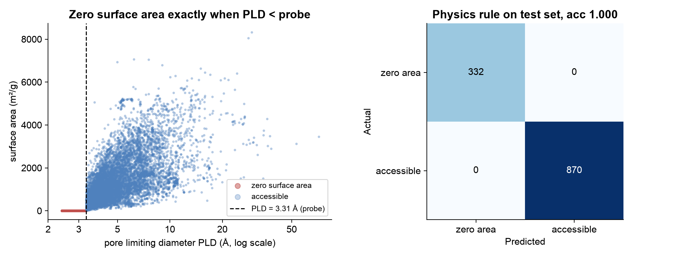
Appendix: Physics Rule as a Classifier
Rule: surface area = 0 if PLD < 3.3107 Å. Test accuracy 100.00 % on 1202 MOFs.
Terms: Probe = the 3.31 Å sphere (size of N2) rolled through the pores to measure them. If the narrowest window (PLD) is smaller than the probe, the probe cannot enter, so the accessible surface area is zero.

Slide 36
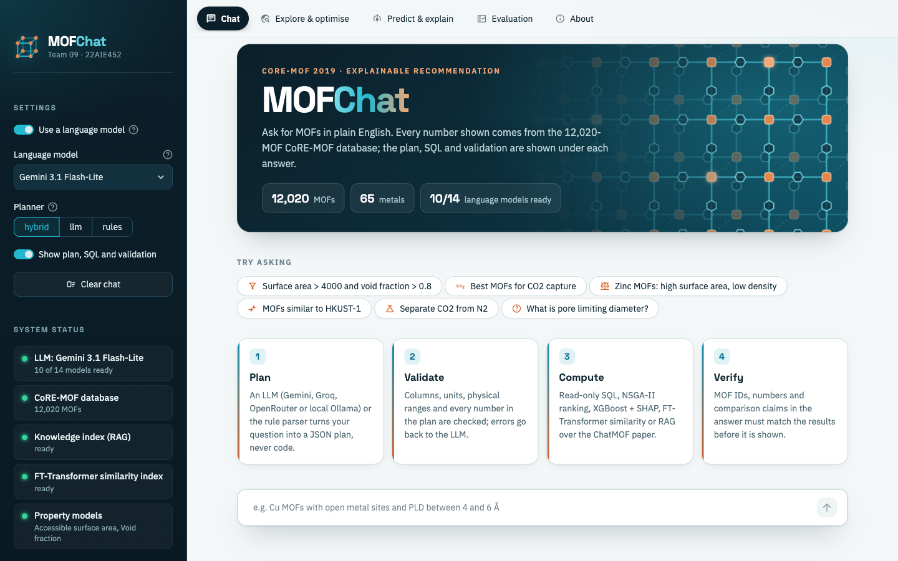
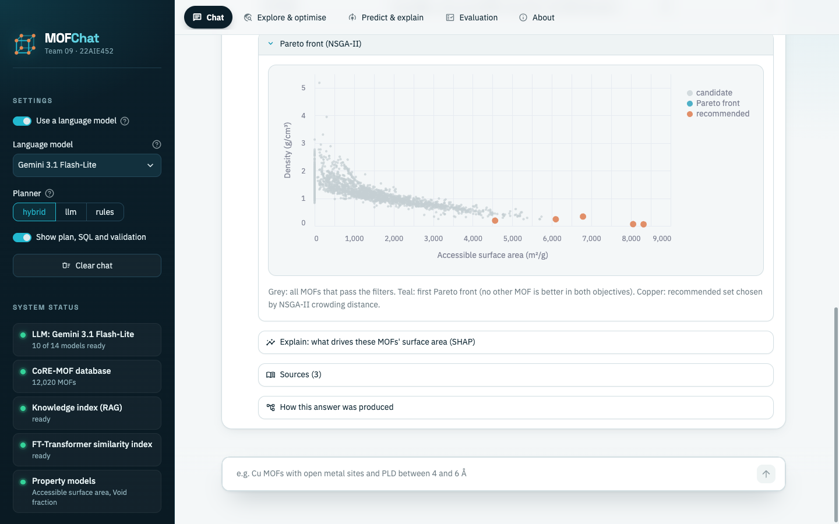
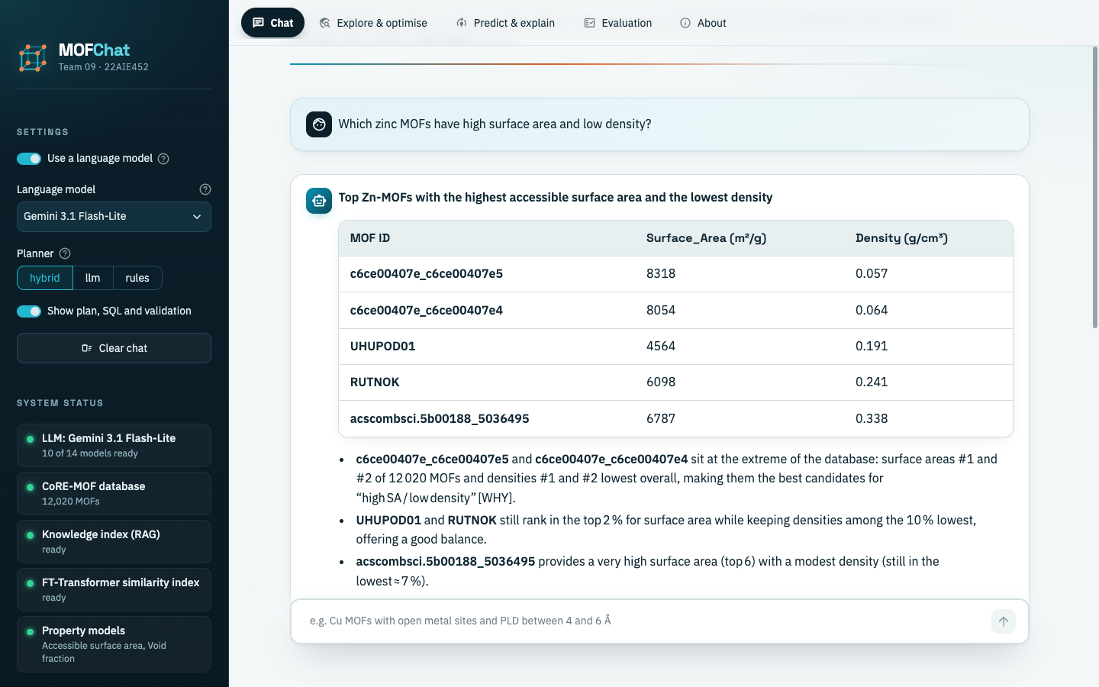
Appendix: Application Screenshots
Chat page with model choice and system status
Pareto plot for the zinc MOF question

