Slide 1

Social Network Ads Prediction

Slide 2
Contents
Problem definition
Data
Features
Modeling

Slide 3
Problem definition
Using various python-based Machine Learning Model to the given parameters to predict if the item shown in the ad is purchased or not.
Methods are:
Logistic regression
Random Forest Classifier
SVM(Support vector Machines)

Slide 4
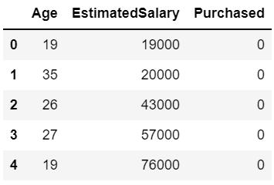
Data
Data set from: https://www.kaggle.com/d4rklucif3r/social-network-ads
The Dataset used in these models talks about whether a person of certain age having certain income purchases a product or not.
We need to predict whether a targeted audience will purchase the product or not.

Slide 5
Features
Input / Features
Age - Age of the Person
EstimatedSalary - Estimated Salary of Person
Output / Label
Purchased Item - Purchased or Not

Slide 6
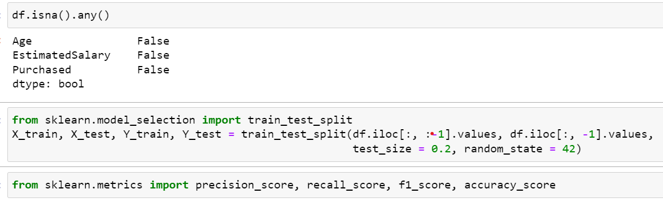
Modeling
We will compare accuracy of each model using the test data
The model with best accuracy will be chosen for prediction of Ads.

Slide 7
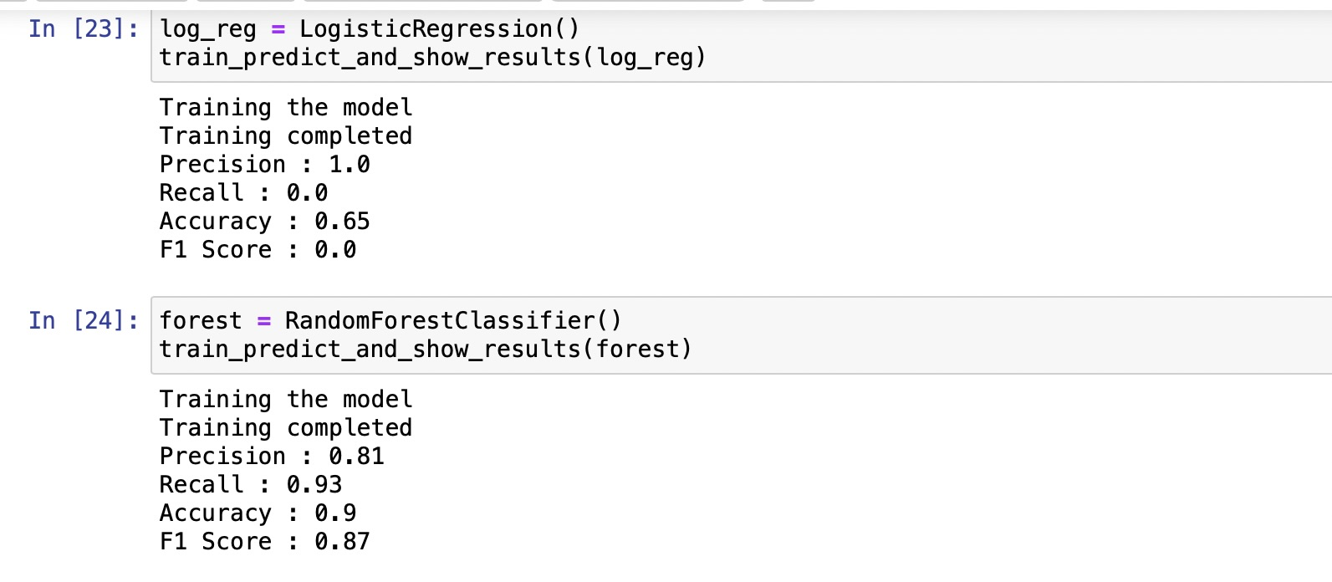

Slide 8
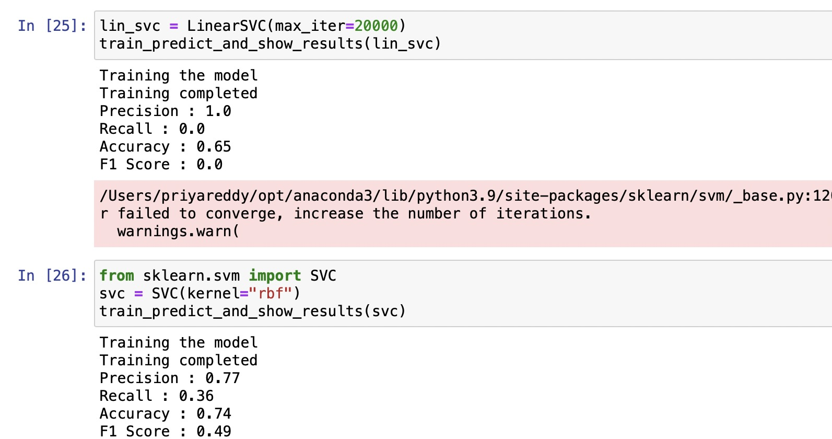

Slide 9
CONCLUSION
Form the above features, Random Forest classifier has best accuracy of all the models better recall score and Precision and F1 score using the below code

Slide 10
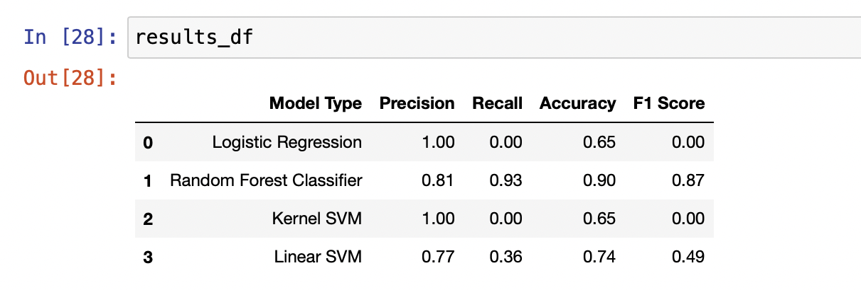
Forming a table using the models and accuracy, f1 scores.

Slide 11

Thank You

