Slide 1
Micro-Credit Defaulter Model
A Microfinance Institution (MFI) is an organization that offers financial services to low income populations.
We are working with one such client that is in Telecom Industry from Indonesia.
Telecom is providing their services and products to low income families and poor customers that can help them in the need of hour.

Slide 2
Aim of the Project
Build a model which can be used to predict in terms of a probability for each loan transaction.
Whether the customer will be paying back the loaned amount within 5 days of issuance of loan.
In this case, Label 1 indicates that the loan has been payed, while Label 0 indicates that the loan has not been payed.

Slide 3
Machine Learning
Importing the required libraries
Data Analysing
Exploratory data analysis(EDA)
Model Building
Grid Search
Saving the model with joblib

Slide 4
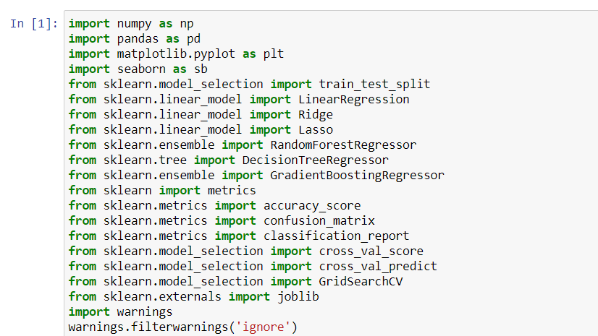
Importing the required libraries

Slide 5
Data Analysing
It consists of the following:-
Importing data
finding data types
Finding null values
Getting data info
Getting nunique values of each column
Getting the basic statistical details

Slide 6
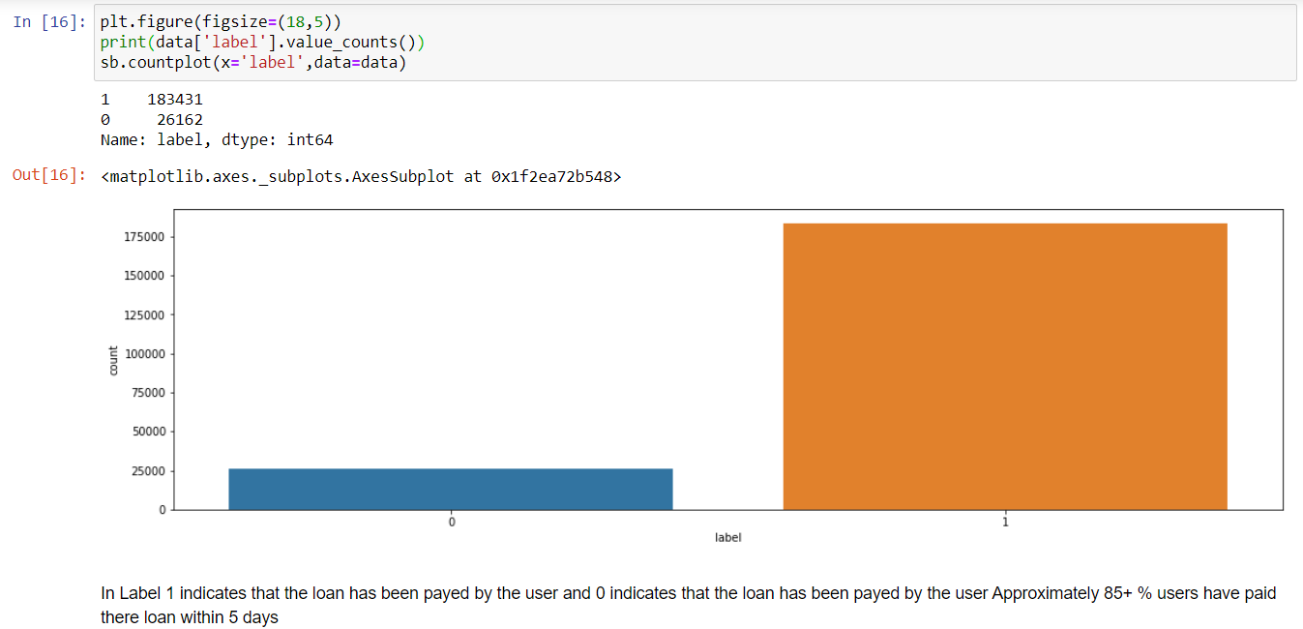
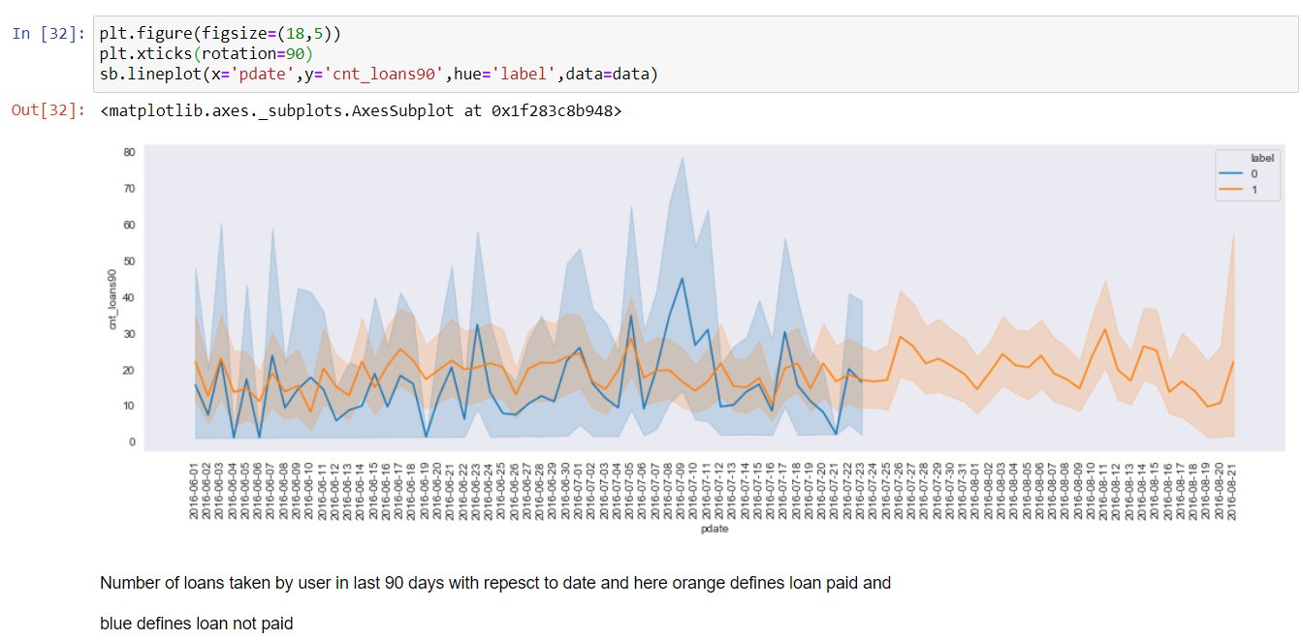
Exploratory data analysis(EDA)
Univariate plot
Bivariate plot

Slide 7
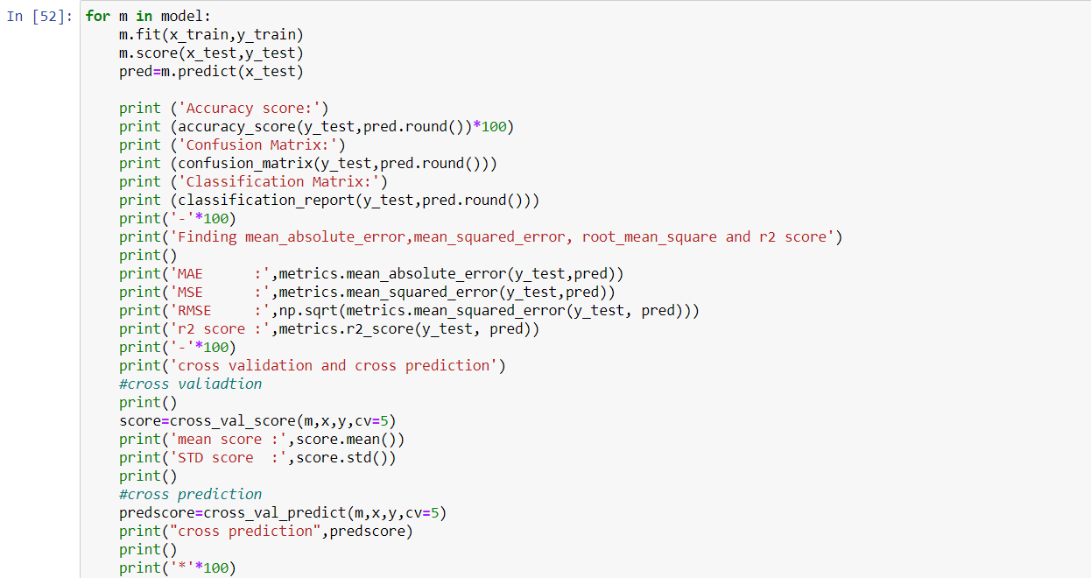
Model Building
Assigning Independent and Dependent Variables, Here x is considered as Independent variable y is Dependent Variables
x=datafin.drop(['label'],axis=1)
y=datafin['label']
x_train,x_test,y_train,y_test=train_test_split(x,y,test_size=.25,random_state=100)

Slide 8
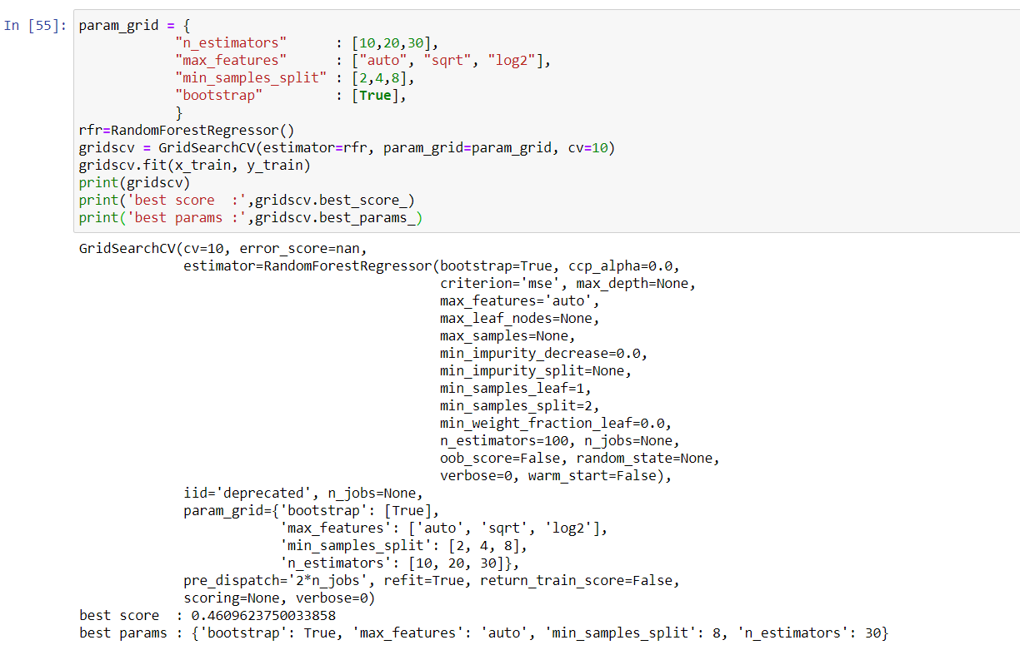
Grid search
GridSearchCV is a library function that is a member of sklearn's model_selection package.
It helps to loop through predefined hyperparameters and fit your estimator (model) on your training set.
So, in the end, you can select the best parameters from the listed hyperparameters.

Slide 9
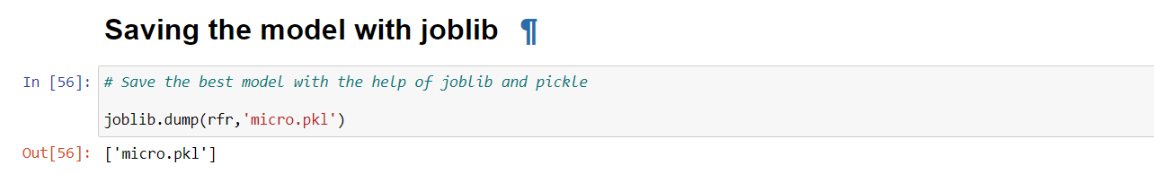
Saving the model with joblib
Save the best model with joblib and pickle
Hence we conclude the project by taking the final step by saving the best model

