Slide 1
IMAGE CLASSIFICATION
Using Web scraping to extract data and Deep learning for modelling

Slide 2

Content
Problem Statement and Goals
Data Collection
Deep learning Model

Slide 3
Problem Statement and Goals
Images are one of the major sources of data in the field of data science and AI. This field is making appropriate use of information that can be gathered through images by examining its features and details.
We are trying to give you an exposure of how an end to end project is developed in this field.
The idea behind this project is to build a deep learning-based Image Classification model on images that will be scraped from e-commerce portal.
This is done to make the model more and more robust.
This task is divided into two phases: Data Collection and Model Building.

Slide 4
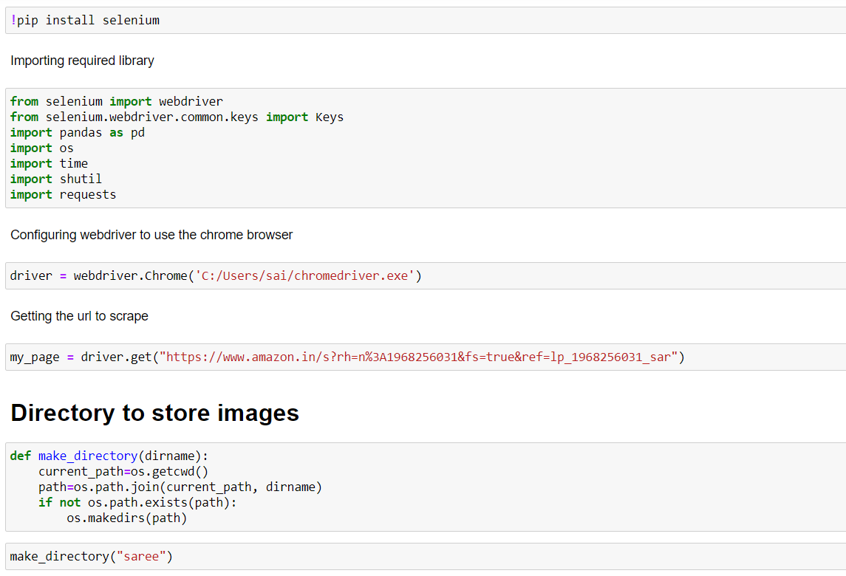
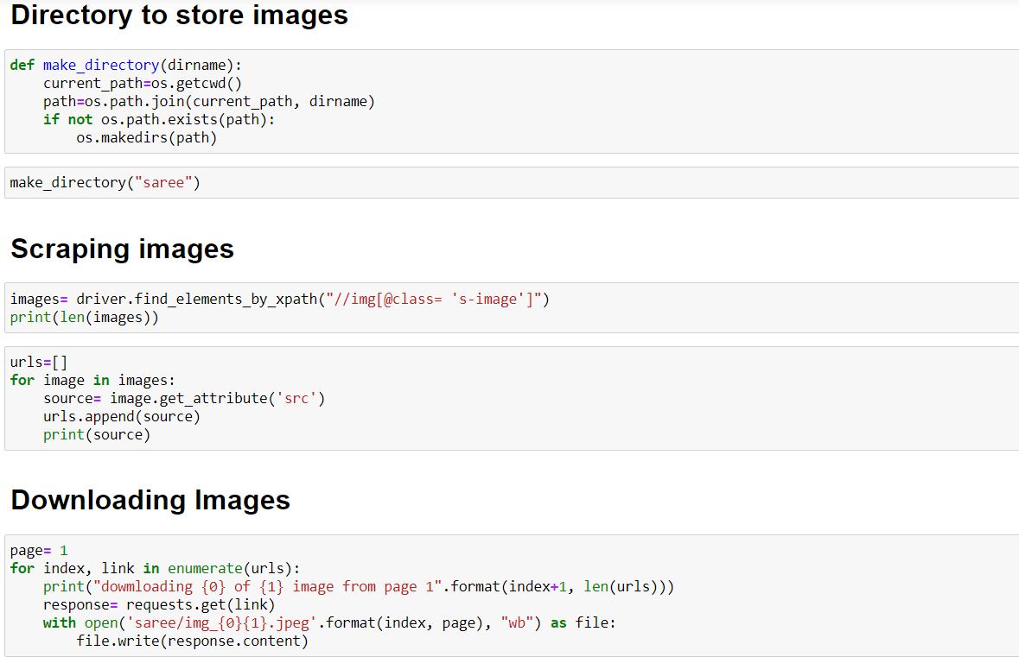
Data Collection
Data collection process includes web scraping
Scrape images from e-commerce portal, Amazon.in.
The clothing categories used for scraping will be: saree(women), trousers (men), jeans(men).

Slide 5
Deep learning Model
Setting up tensorflow GPU
Importing Libraries
Importing data
Training data
Loading data using Pickle
Building Model
Model fitting

Slide 6
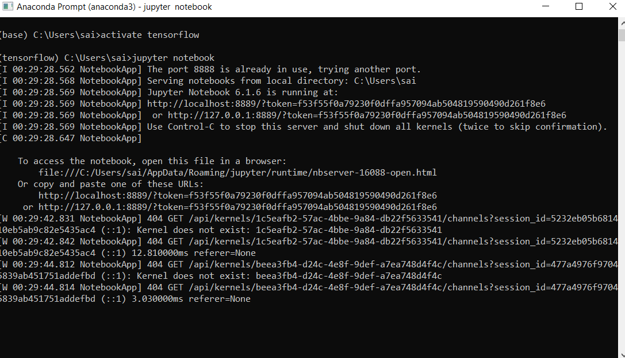
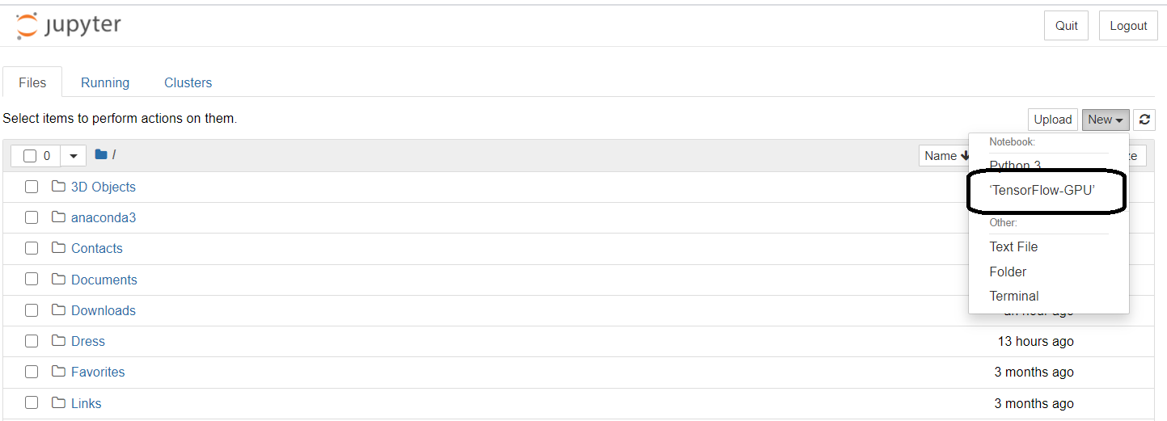
Deep learning Model
Setting up tensorflow GPU
Tensorflow GPU is not ready available in jupyter notebook. It must be set-up through anaconda prompt. After set-up choose tensorflow GPU as shown

Slide 7
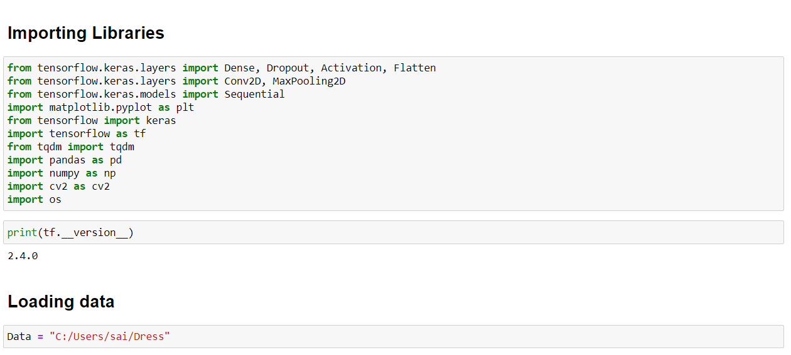
Deep Learning Model
Importing Libraries and Importing data
Importing required libraries and importing data

Slide 8
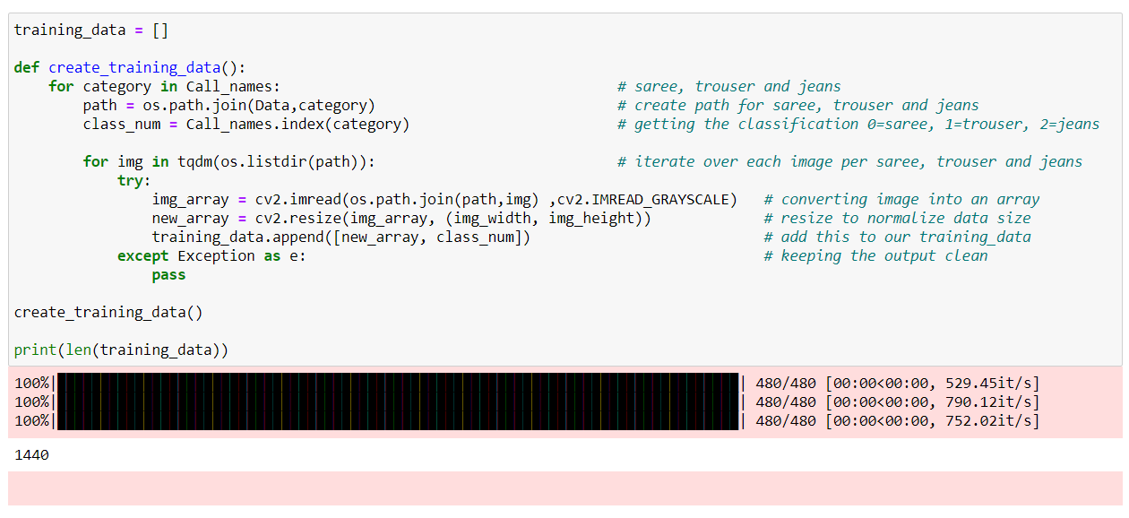
Deep learning model
Training data
Training data includes iterate over each image , converting image into an array , resize to normalize data size, add this to our training_data.

Slide 9
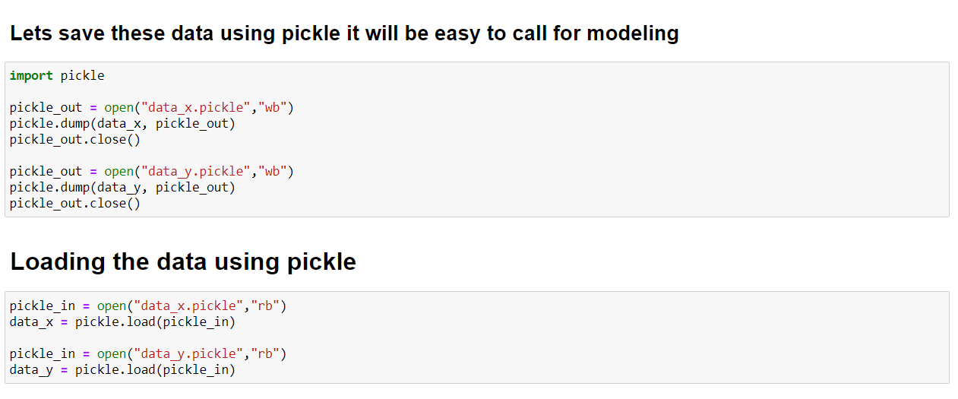
Deep learning model
Loading data using Pickle
After training the data it is saved using pickle, it will be useful while feeding it to the model.

Slide 10
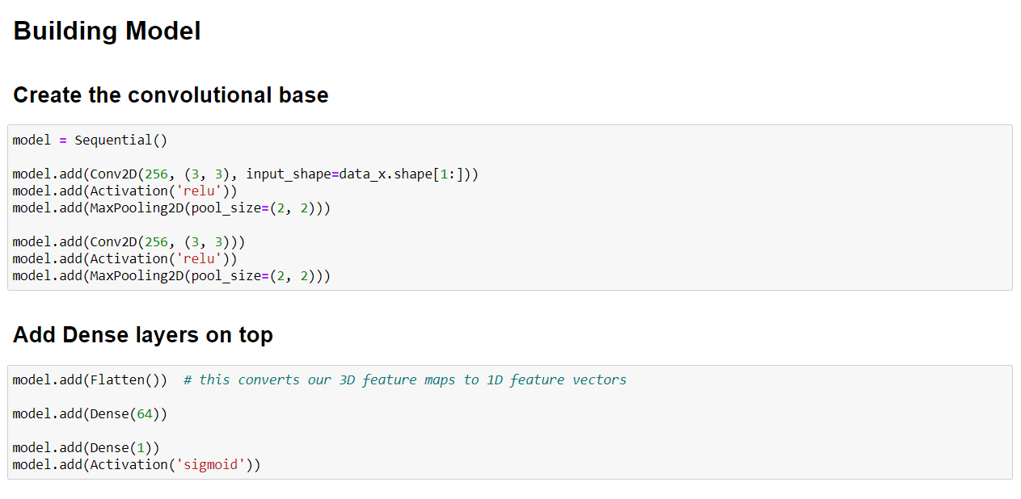
Deep learning Model
Building Model
Building model consists of convolutional base, Adding Dense layers.

Slide 11
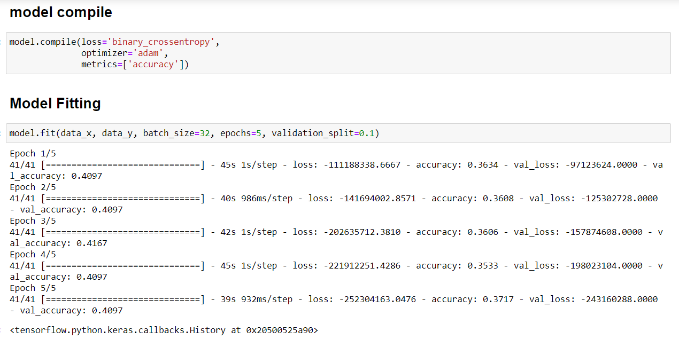
Deep learning Model
Model fitting
Once the training data is ready, it is ready for model fitting.

Slide 12
Conclusion
Collecting data through Web scraping
Storing data
Setting up tensorflow through anaconda prompt
Jupyter notebook
Importing data
Training data
Model building

