Slide 1
FlipFit
Maximise your Fitness Journey

Slide 2
WHERE WE STARTED?
Started as a team with individual experience in small college projects
Limited knowledge on larger scope projects
Initial understanding of Git fundamentals
Basic knowledge of Java syntax and workings

Slide 3
THE ASK
The ask of this project is to expand Flipkart into the fitness industry
enhance user convenience
strengthen gym partnerships
streamline slot management
real-time booking capabilities

Slide 4
FRAMEWORK FOR THE WEEK
DAY 1 | DAY 2 | DAY 3 | DAY 4 | DAY 5 | DAY 6
Introduction to UML Artifacts | Introduction to Git and GitHub | Created project structure and bean classes | Implemented client menu and functionality of business classes. | JDBC, Database and DAO implementation. | Interface implementation,custom exception handling,Java 17 features

Slide 5
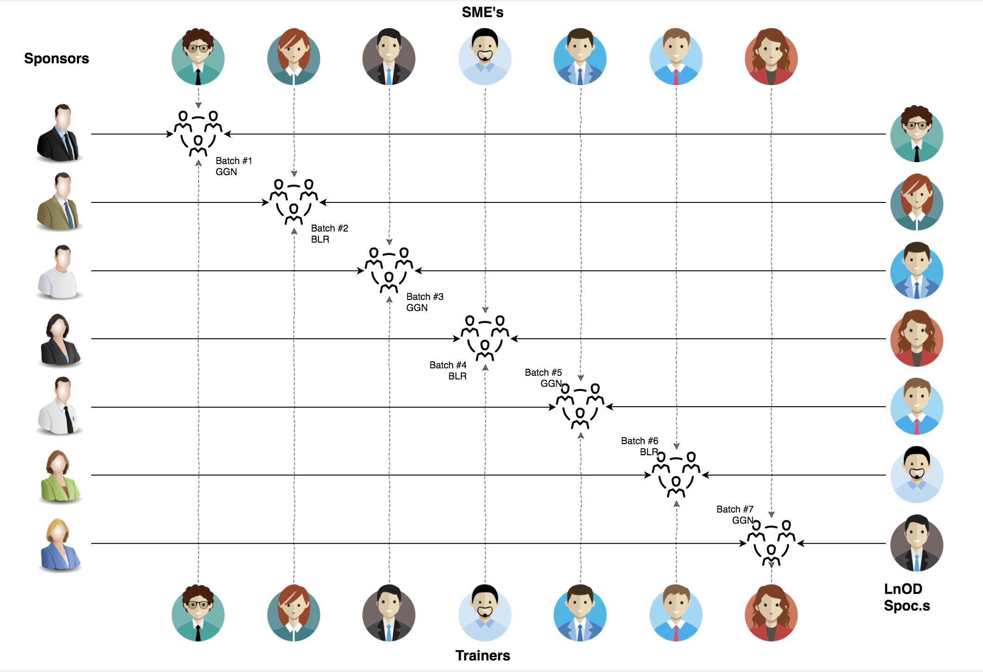
THE STAKEHOLDERS
1. Sponsor
- Flipkart
2. SME’s
- Amit Balyan
3. Co-ordinators
-Anushka khanna

Slide 6
1 WEEK TRAINING + PROJECT DEMO
6 DAYS
144 HOURS
8640 MINUTES
518400 SECONDS
LIMITLESS KNOWLEDGE

Slide 7
TABLE OF CONTENTS
Team Structure
Project Goals
Engineering Practices
Tech Stack
Development
Challenges and Learning
Demo

Slide 8
TEAM STRUCTURE
Laxmi Kurapati (Team Leader)
Pratishtha
Sai Rohan Harshavardhan Vuppala
Sankalp Garg

Slide 9
PROJECT GOALS
Problem Statement:
Design FlipFit: An enterprise app for Flipkart's fitness venture in Bengaluru. The app will feature multiple gym centers, each offering fixed-hour slots managed by the gym owners. Users can register, view center availability, and book slots, ensuring no double bookings and adherence to capacity constraints. A simplified admin interface for slot setup will ensure accurate and efficient booking management.

Slide 10

Our Vision:
The goal is to create and deploy a FlipFit Gym application using Java tools, enabling users to register, check the availability of slots, and book workout sessions at different gym centers across Bangalore.

Slide 11

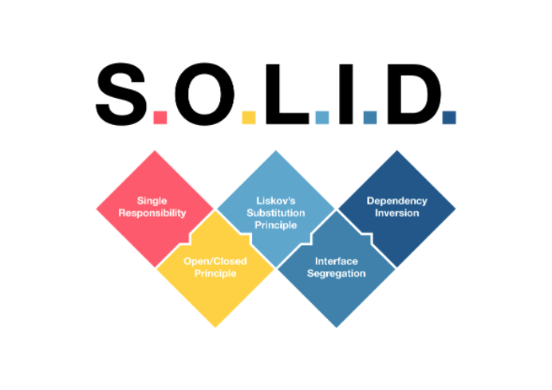
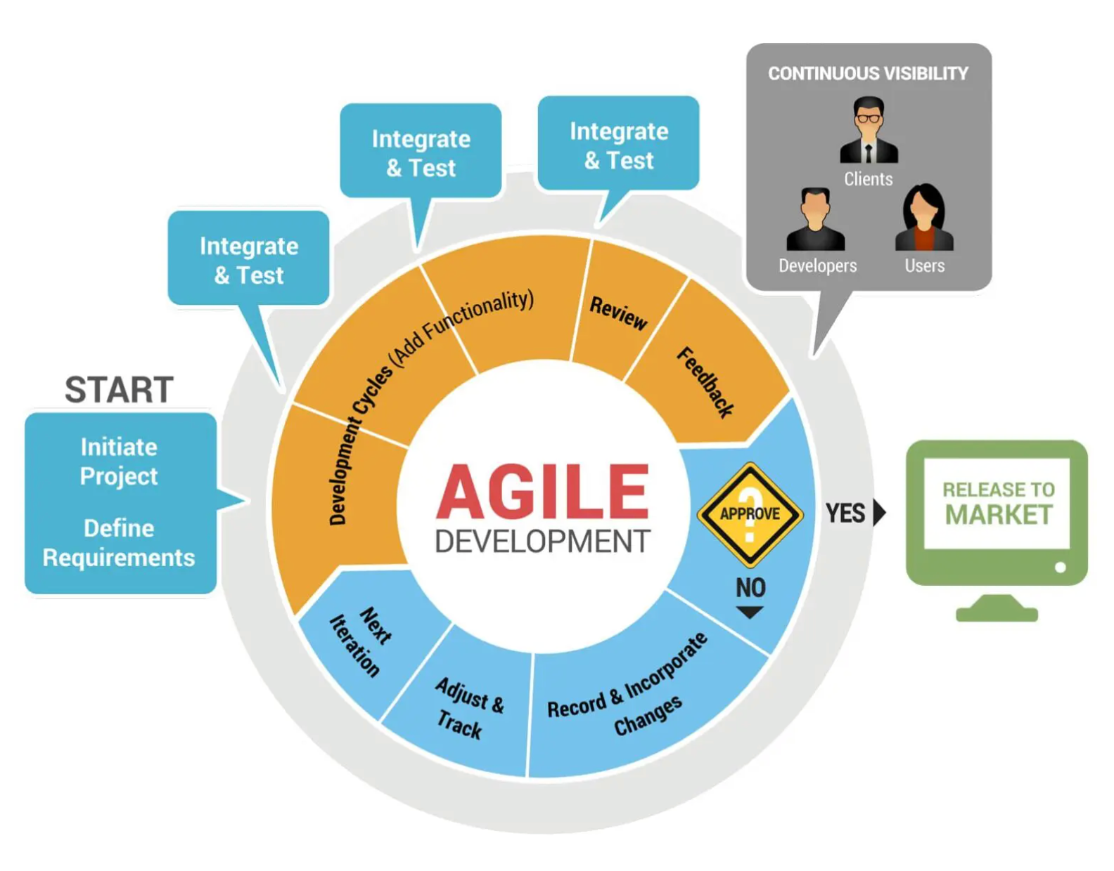
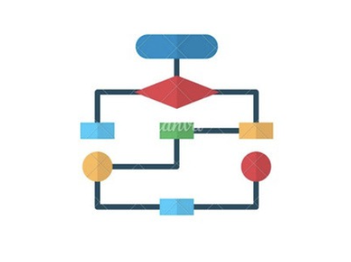
ENGINEERING PRACTICES
Deploy

Slide 12




TECH STACK
BACKEND
SCM
DATABASE
IDE

Slide 13
DEVELOPMENT
Bean
Custom Exceptions
BUSINESS LAYER
(Processes business logic & interacts with DAO Layer)
processes request
DAO LAYER
(Performs database - CRUD operations)
data result
Initiates requests
Returns data
Data operations
Returns data
Prepares and sends results(outcome of the request)
DATABASE
(Stores and retrieves data)
CLIENT LAYER

Slide 14
Challenges & Learnings
Challenges
SQL Workbench Setup: Overcame initial setup challenges and mastered schema design.
DAO & Business Logic: Ensured efficient DAO operations and robust business logic.
Learnings
Tech Stack Proficiency: Mastered Git, Java, MySQL.
Best Practices: Adopted Agile methods and rigorous code reviews.
Troubleshooting: Developed strong debugging and problem-solving

Slide 15

DEMO

Slide 16
THANK YOU

