Slide 1
Database and SQL
By
JanardhanA Bandi

Slide 2
Database Basics

Slide 3
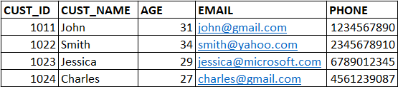
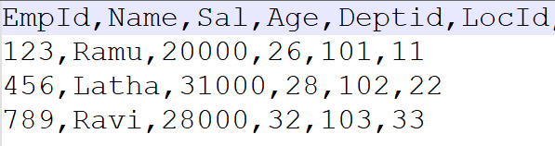
What is Data, Database?
Data is any thing that can be represented as text, numbers, or multimedia(image, sound, video etc.)
Examples: ‘Technology’, 243589, ‘2022-09-20’
Dataset is a structured collection of data that contains information of an entity
Examples:

Slide 4
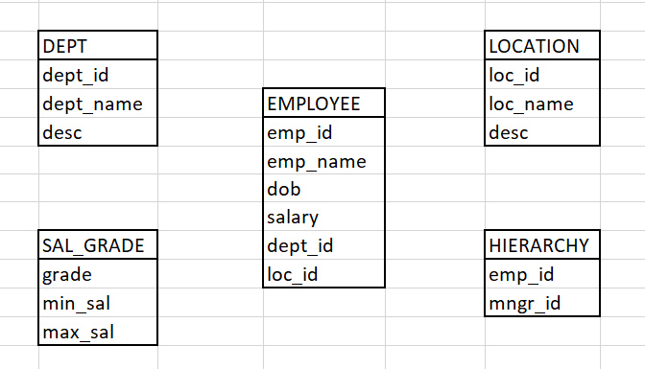
What is Data, Database?
Database is a system that allow users to store, organize and analyze data. It is an organized collection of data stored in multiple related datasets.
Example: Employee Database contains below datasets.

Slide 5
USES of Database?
Can handle huge amounts of data
Easy to combine different datasets
Analyze the data for decision making
Database is backend for many applications
Easy to share the data
Data security

Slide 6
What is RDBMS?
RDBMS – Relational Data Base Management Systems.
A relational Database is database that stores data in a table form, containing columns and rows.
RDBMS is a system used to store, manage, query, and retrieve data stored in a relational databases.
The RDBMS provides an interface between users&applications and the database.

Slide 7
List of RDBMS systems
Oracle
MySQL
Teradata
SQL Server
PsotgreSQL
Vertica
IBM DB2
Snowflake (Cloud Database)

Slide 8
What is Table?
Table is a database object that is a collection of related data entries, where data is organized in rows and columns.
Rows are also know as records
Columns are also known as fields
Example: Customer table
Metadata: Data about data, it gives the info that what data is stored in a table.

Slide 9
How to Load data into Database Tables?
Using manual insert statements
Importing data from files using SQL clients(Dbeaver, Squirrel, Oracle SQL dev, Teradata SQL Assistant, TOAD)
Load using ETL tools or Scripts

Slide 10
How to Access the data from database?
SQL – Structured Query Language
We can access and manipulate the data from relational databases by using SQL.
SQL is a programming language used to communicate with these RDBMS systems like Oracle, Teradata, MySQL, SQL Server etc.
SQL is an ANSI/ISO standard, all databases support ANSI SQL so the syntaxes, keywords and functions or almost similar in all databases.
We can build SQL queries and procedures to operate with the data present in Database.
Queries can be written by using Operators, Keywords, Expressions, Functions..

Slide 11
Thank You
Janardhana Bandi

